Slide 1
Minimum Spanning Trees
CSE 373
Data Structures

Slide 2
Spanning Trees
Given (connected) graph G(V,E),
a spanning tree T(V’,E’):
  Is a subgraph of G; that is, V’ ⊆ V, E’ ⊆ E.
  Spans the graph (V’ = V)
  Forms a tree (no cycle);
  So, E’ has |V| -1 edges

Slide 3
Minimum Spanning Trees
Edges are weighted: find minimum cost spanning tree
Applications
  Find cheapest way to wire your house
  Find minimum cost to send a message on the Internet

Slide 4
Strategy for Minimum Spanning Tree
For any spanning tree T, inserting an edge e_{new} not in T creates a cycle
But
  Removing any edge e_{old} from the cycle gives back a spanning tree
  If e_{new} has a lower cost than e_{old} we have progressed!

Slide 5
Strategy
Strategy for construction:
  Add an edge of minimum cost that does not create a cycle (greedy algorithm)
  Repeat |V| -1 times
  Correct since if we could replace an edge with one of lower cost, the algorithm would have picked it up

Slide 6
Two Algorithms
Prim: (build tree incrementally)
  Pick lower cost edge connected to known (incomplete) spanning tree that does not create a cycle and expand to include it in the tree
Kruskal: (build forest that will finish as a tree)
  Pick lowest cost edge not yet in a tree that does not create a cycle. Then expand the set of included edges to include it. (It will be somewhere in the forest.)

Slide 7
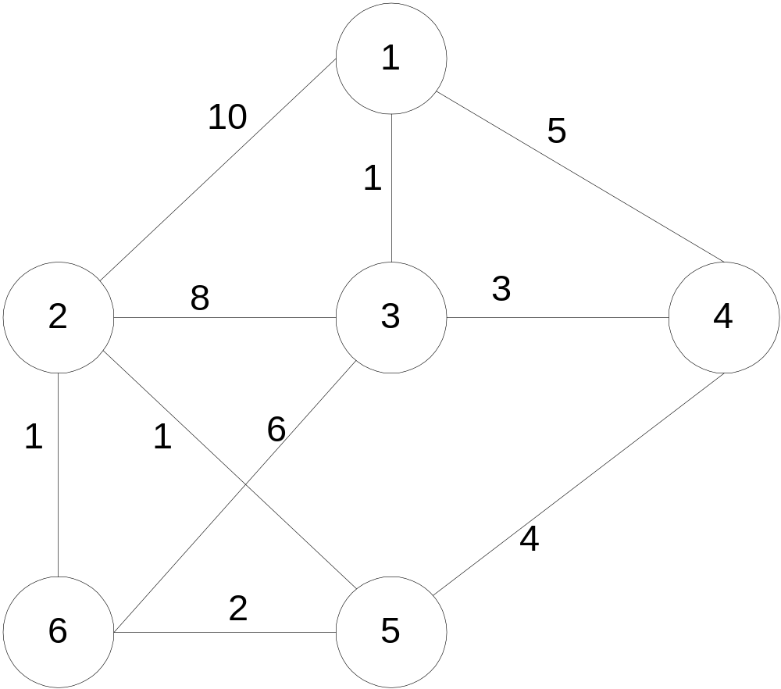
Prim’s algorithm
Starting from empty T, choose a vertex at random and initialize
V = {1), E’ ={}

Slide 8
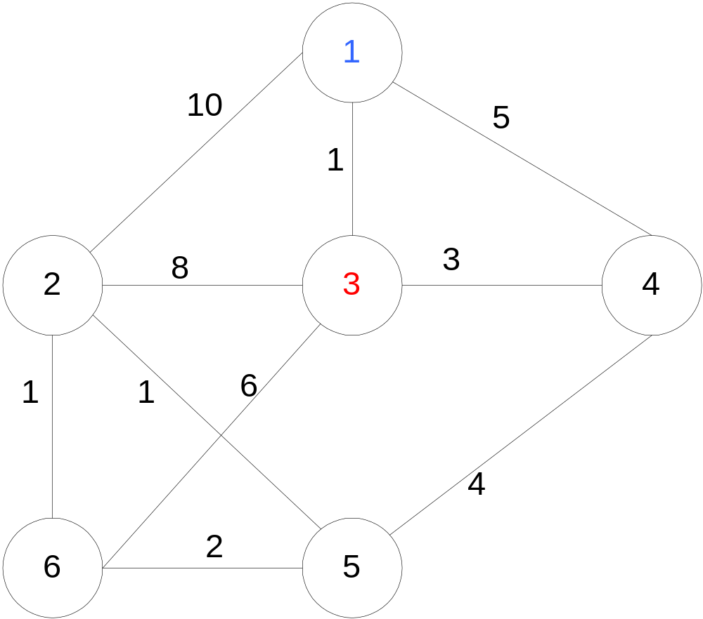
Prim’s algorithm
Choose the vertex u not in V such that edge weight from u to a vertex in V is minimal (greedy!)
V={1,3} E’= {(1,3) }

Slide 9
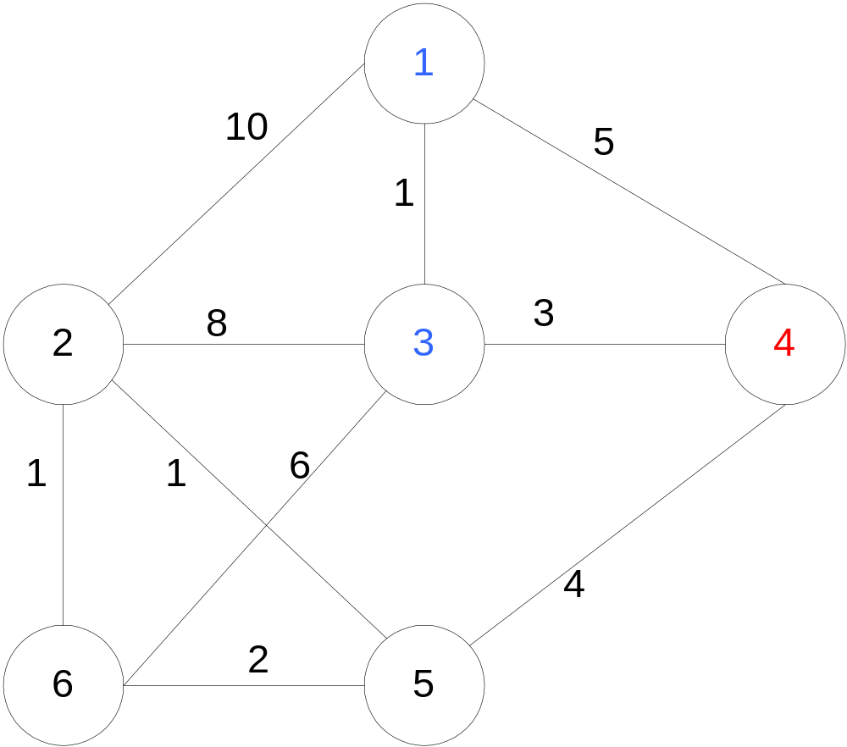
Prim’s algorithm
Repeat until all vertices have been chosen
Choose the vertex u not in V such that edge weight from v to a vertex in V is minimal (greedy!)
V= {1,3,4} E’= {(1,3),(3,4)}
V={1,3,4,5} E’={(1,3),(3,4),(4,5)}
….
V={1,3,4,5,2,6}
E’={(1,3),(3,4),(4,5),(5,2),(2,6)}

Slide 10
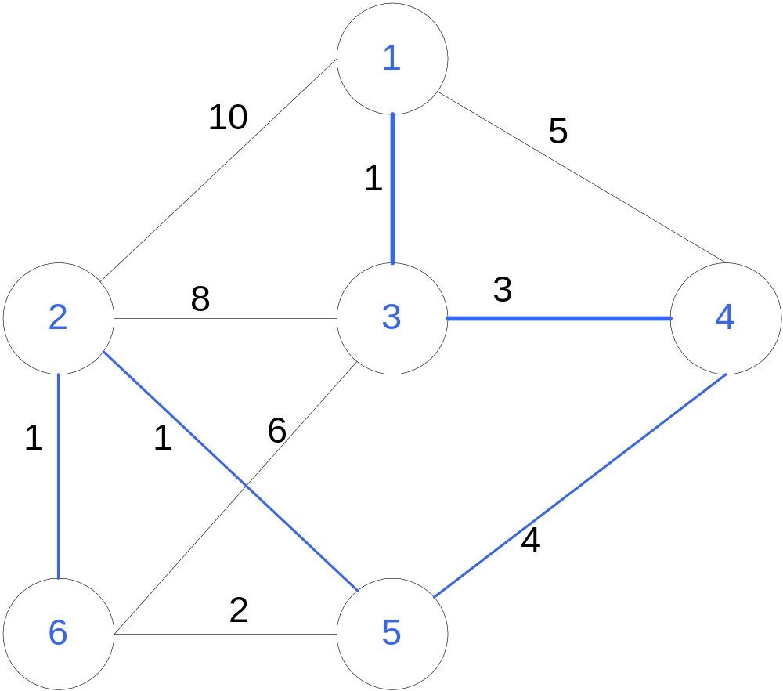
Prim’s algorithm
Repeat until all vertices have been chosen
V={1,3,4,5,2,6}
E’={(1,3),(3,4),(4,5),(5,2),(2,6)}
Final Cost: 1 + 3 + 4 + 1 + 1 = 10

Slide 11
Prim’s Algorithm Implementation
Assume adjacency list representation
Initialize connection cost of each node to “inf” and “unmark” them
Choose one node, say v and set cost[v] = 0 and prev[v] =0
While they are unmarked nodes
Select the unmarked node u with minimum cost; mark it
For each unmarked node w adjacent to u
if cost(u,w) < cost(w) then cost(w) := cost (u,w)
prev[w] = u

Slide 12
Prim’s algorithm Analysis
If the “Select the unmarked node u with minimum cost” is done with binary heap then O((n+m)logn)

Slide 13
Kruskal’s Algorithm
Select edges in order of increasing cost
Accept an edge to expand tree or forest only if it does not cause a cycle
Implementation using adjacency list, priority queues and disjoint sets

Slide 14
Kruskal’s Algorithm
Initialize a forest of trees, each tree being a single node
Build a priority queue of edges with priority being lowest cost
Repeat until |V| -1 edges have been accepted {
Deletemin edge from priority queue
If it forms a cycle then discard it
else accept the edge – It will join 2 existing trees yielding a larger tree and reducing the forest by one tree
}
The accepted edges form the minimum spanning tree

Slide 15
Detecting Cycles
If the edge to be added (u,v) is such that vertices u and v belong to the same tree, then by adding (u,v) you would form a cycle
  Therefore to check, Find(u) and Find(v). If they are the same discard (u,v)
  If they are different Union(Find(u),Find(v))

Slide 16
Properties of trees in K’s algorithm
Vertices in different trees are disjoint
  True at initialization and Union won’t modify the fact for remaining trees
Trees form equivalent classes under the relation “is connected to”
  u connected to u (reflexivity)
  u connected to v implies v connected to u (symmetry)
  u connected to v and v connected to w implies a path from u to w so u connected to w (transitivity)

Slide 17
K’s Algorithm Data Structures
Adjacency list for the graph
  To perform the initialization of the data structures below
Disjoint Set ADT’s for the trees (recall Up tree implementation of Union-Find)
Binary heap for edges

Slide 18
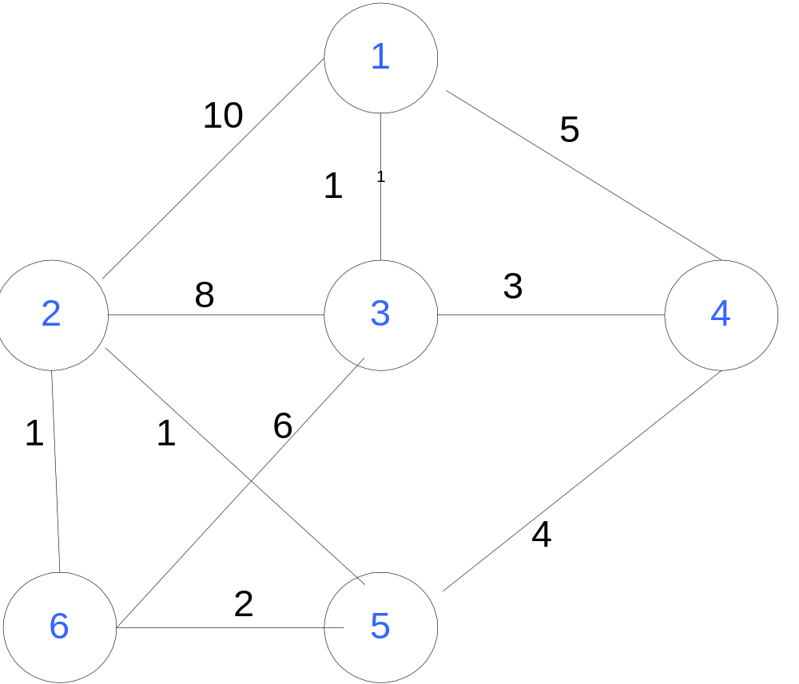
Example

Slide 20
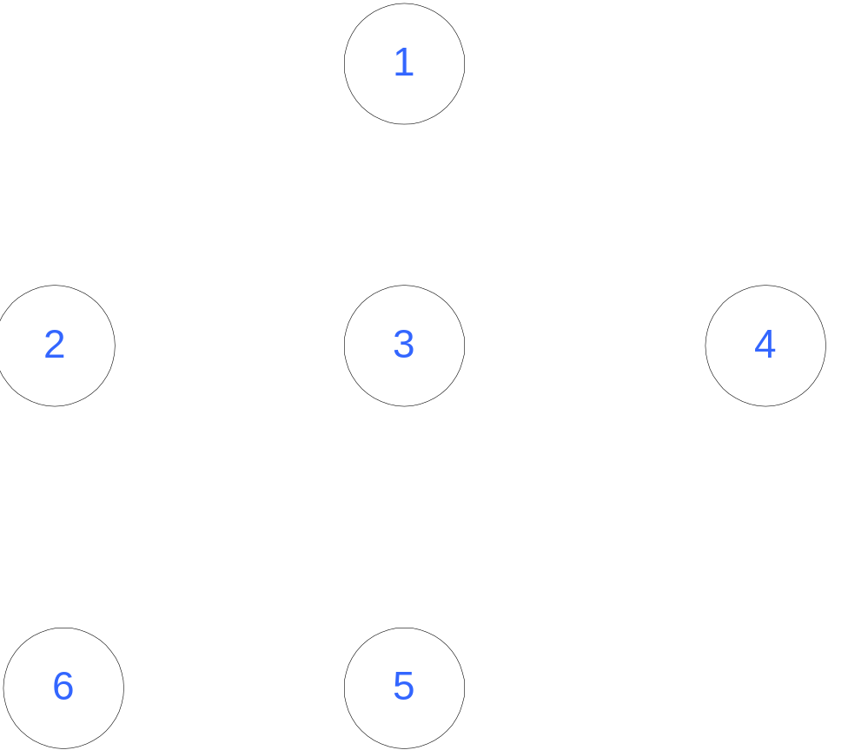
Initialization
Initially, Forest of 6 trees
F= {{1},{2},{3},{4},{5},{6}}
Edges in a heap (not shown)

Slide 21
Step 1
Select edge with lowest cost (2,5)
Find(2) = 2, Find (5) = 5
Union(2,5)
F= {{1},{2,5},{3},{4},{6}}
1 edge accepted
1

Slide 22
Step 2
Select edge with lowest cost (2,6)
Find(2) = 2, Find (6) = 6
Union(2,6)
F= {{1},{2,5,6},{3},{4}}
2 edges accepted
1
1

Slide 23
Step 3
Select edge with lowest cost (1,3)
Find(1) = 1, Find (3) = 3
Union(1,3)
F= {{1,3},{2,5,6},{4}}
3 edges accepted
1
1
1

Slide 24
Step 4
Select edge with lowest cost (5,6)
Find(5) = 2, Find (6) = 2
Do nothing
F= {{1,3},{2,5,6},{4}}
3 edges accepted
1
1
1

Slide 25
Step 5
Select edge with lowest cost (3,4)
Find(3) = 1, Find (4) = 4
Union(1,4)
F= {{1,3,4},{2,5,6}}
4 edges accepted
1
3
1
1

Slide 26
Step 6
Select edge with lowest cost (4,5)
Find(4) = 1, Find (5) = 2
Union(1,2)
F= {{1,3,4,2,5,6}}
5 edges accepted : end
Total cost = 10
Although there is a unique spanning tree in this example, this is not generally the case
1
3
1
4
1

Slide 27
Kruskal’s Algorithm Analysis
Initialize forest O(n)
Initialize heap O(m), m = |E|
Loop performed m times
  In the loop one DeleteMin O(log m)
  Two Find, each O(log n)
  One Union (at most) O(1)
So worst case O(m log m) = O(m log n)

Slide 28
Time Complexity Summary
Recall that m = |E| = O(V²) = O(n² )
Prim’s runs in O((n+m) log n)
Kruskal runs in O(m log m) = O(m log n)
In practice, Kruskal has a tendency to run faster since graphs might not be dense and not all edges need to be looked at in the Deletemin operations

