Slide 1

Chapter 6
Tree (18M)
Visit for more Learning Resources

Slide 2

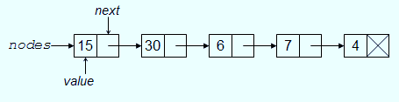
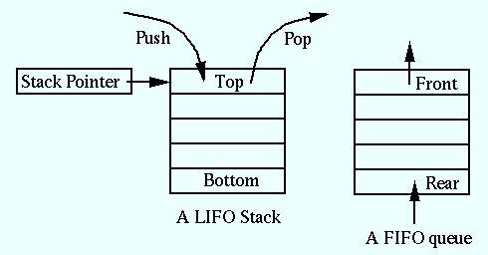
Data structure
Store and organize data in computer.
Linear Data Structure
Arrays
Linked List
Stacks
Queues

Slide 3

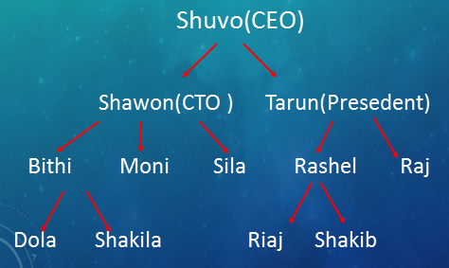
Logic of Tree

Slide 4

Logic of Tree

Slide 5
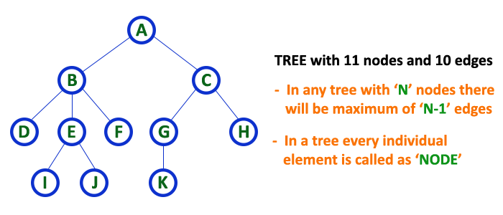
Tree Definition
Tree is a non-linear data structure which organizes data in hierarchical structure and this is a recursive definition.

Slide 6
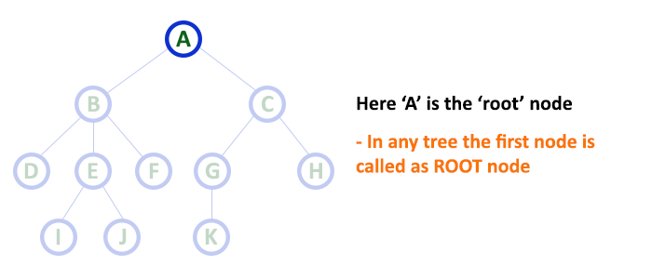
Tree terminology...
1.Root:
  The first node is called as Root Node.
  Every tree must have root node, there must be only one root node.
  Root node doesn't have any parent.

Slide 7
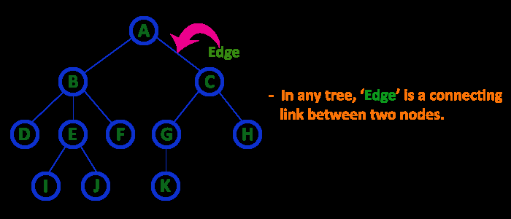
2. Edge
In a tree data structure, the connecting link between any two nodes is called as EDGE. In a tree with 'N' number of nodes there will be a maximum of 'N-1' number of edges.

Slide 8
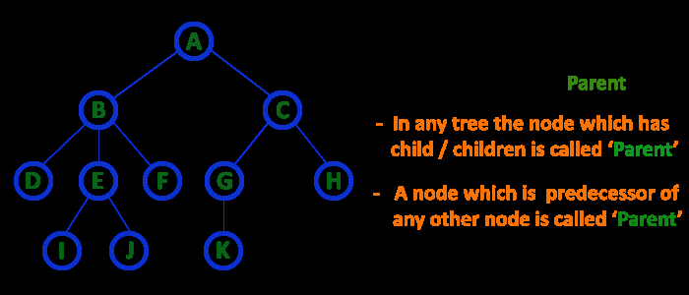
3. Parent
In a tree data structure, the node which is predecessor of any node is called as PARENT NODE. In simple words, the node which has branch from it to any other node is called as parent node. Parent node can also be defined as "The node which has child / children".

Slide 9
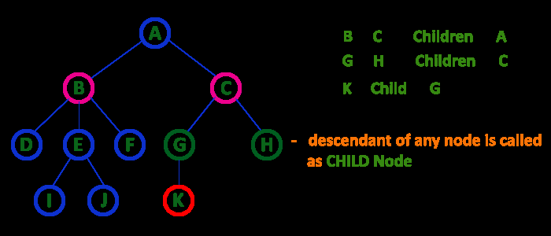
4. Child
The node which has a link from its parent node is called as child node.
In a tree, any parent node can have any number of child nodes.
In a tree, all the nodes except root are child nodes.

Slide 10
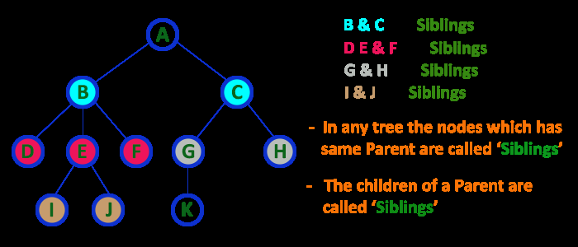
5. Siblings
The nodes with same parent are called as Sibling nodes.

Slide 11
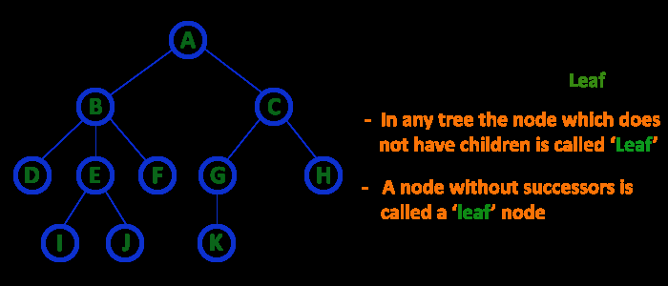
6. Leaf Node
The node which does not have a child is called as LEAF Node.
The leaf nodes are also called as External Nodes or 'Terminal' node.

Slide 12
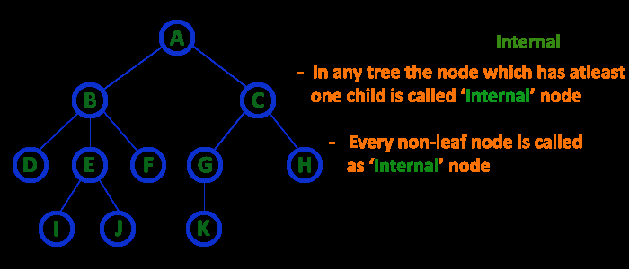
7. Internal Nodes
An internal node is a node with atleast one child.
Nodes other than leaf nodes are called as Internal Nodes.
The root node is also said to be Internal Node if the tree has more than one node. Internal nodes are also called as 'Non-Terminal' nodes.

Slide 13
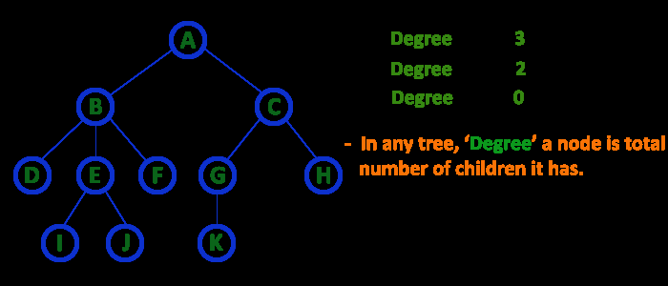
8. Degree
In a tree data structure, the total number of children of a node is called as DEGREE of that Node.

Slide 14
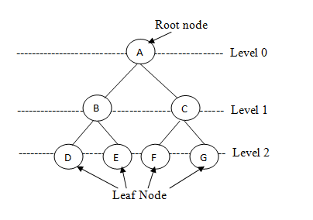
9. Level
In a tree data structure, the root node is said to be at Level 0 and the children of root node are at Level 1 and the children of the nodes which are at Level 1 will be at Level 2 and so on...
In a tree each step from top to bottom is called as a Level and the Level count starts with '0' and incremented by one at each level (Step).

Slide 15
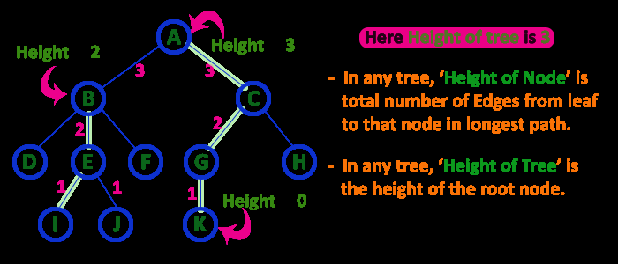
10. Height
the total number of egdes from leaf node to a particular node in the longest path is called as HEIGHT of that Node.
In a tree, height of the root node is said to be height of the tree.

Slide 16
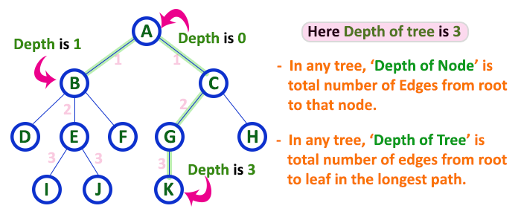
11. Depth
In a tree data structure, the total number of egdes from root node to a particular node is called as DEPTH of that Node.

Slide 17
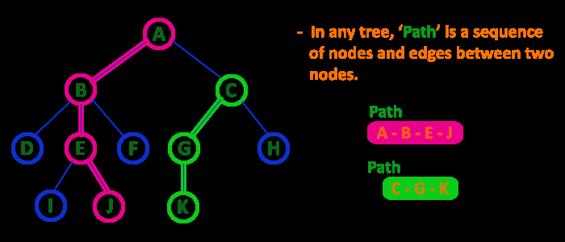
12. Path
In a tree data structure, the sequence of Nodes and Edges from one node to another node is called as PATH between that two Nodes.
Length of a Path is total number of nodes in that path. In below example the path A - B - E - J has length 4.

Slide 18
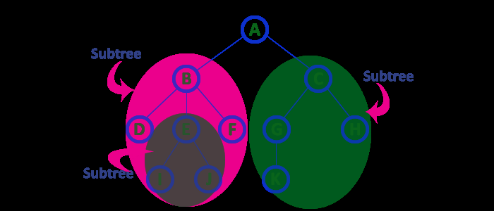
13. Sub Tree
Every child node will form a subtree on its parent node.

Slide 19
Type of Trees
General tree
Binary tree
Binary Search Tree

Slide 20
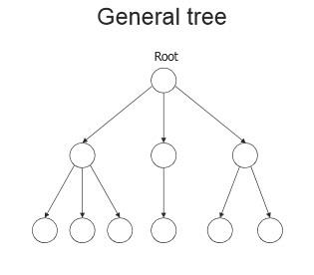
General Tree
A general tree is a data structure in that each node can have infinite number of children .
In general tree, root has in-degree 0 and maximum out-degree n.
Height of a general tree is the length of longest path from root to the leaf of tree. Height(T) = {max(height(child1) , height(child2) , … height(child-n) ) +1}

Slide 21
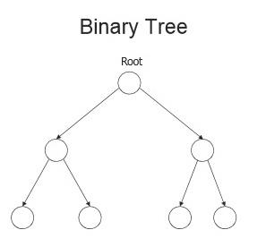
Binary tree
A Binary tree is a data structure in that each node has at most two nodes left and right
In binary tree, root has in-degree 0 and maximum out-degree 2.
In binary tree, each node have in-degree one and maximum out-degree 2.
Height of a binary tree is : Height(T) = { max (Height(Left Child) , Height(Right Child) + 1}

Slide 22
Representation of Binary Tree
Array Representation
Linked List Representation.

Slide 23
Representation of Binary Tree
Struct node { int data; struct node * left,right; };

Slide 24
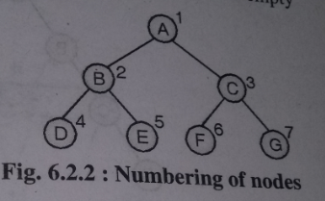

Array Representation
To represent a tree in one dimensional array nodes are marked sequentially from left to right start with root node.
First array location can be used to store no of nodes in a tree.

Slide 25
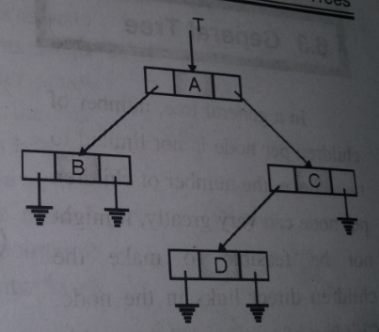
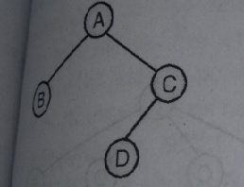
Linked Representation
This type of representation is more efficient as compared to array.
Left and right are pointer type fields left holds address of left child and right holds address of right child.
Struct node
{
int data;
struct node * left,*right;
};

Slide 26
Binary Tree Types
Extended Binary Tree
Complete Binary Tree
Full Binary Tree
Skewed Binary Tree
Strictly Binary Tree
Expression Binary tree

Slide 27
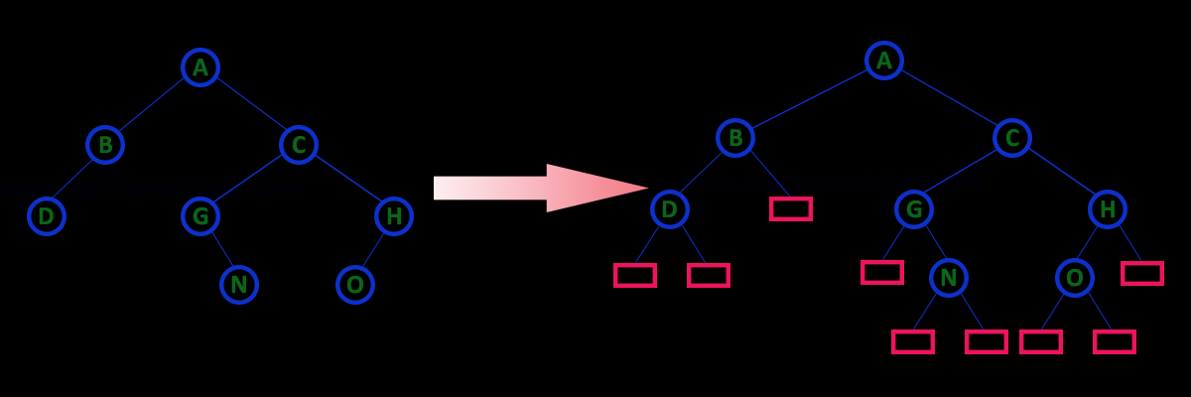
Extended Binary Tree
An extended binary tree is a transformation of any binary tree into a completebinary tree. This transformation consists of replacing every null subtree of the original tree with “special nodes”or “failure nodes” .The nodes from the original tree are then internal nodes, while the “special nodes” are external nodes.

Slide 28
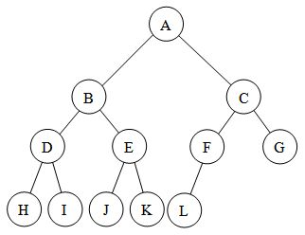
Complete Binary Tree
A complete binary tree is a tree in which
1.All leaf nodes are at n or n-1 level
2.Levels are filled from left to right

Slide 29
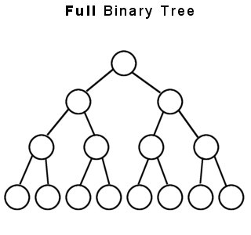
Full Binary Tree
A full binary tree (sometimes proper binary tree or 2-tree) is a tree in which every node other than the leaves has two children or no childeren. Every level is completely filled up.
No of nodes= 2^{h+1} -1

Slide 30
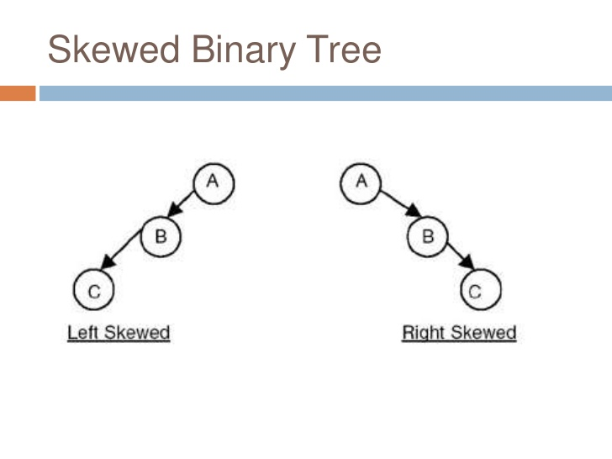
Skewed Binary Tree
A binary tree is said to be Skewed Binary Tree if every node in the tree contains either only left or only right sub tree. If the node contains only left sub tree then it is called left-skewed binary tree and if the tree contains only right sub tree then it is called right-skewed binary tree.

Slide 31
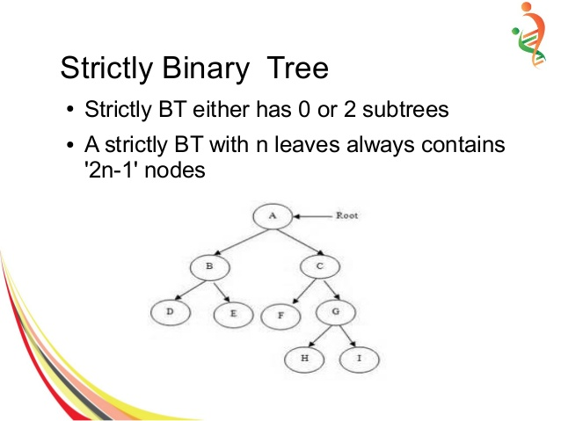
Strictly Binary Tree
A nod will have either two children or no child at all.

Slide 32
Expression Binary tree
Expression trees are a special kind of binary tree used to evaluate certain expressions.
Two common types of expressions that a binary expression tree can represent are algebraic and boolean.
These trees can represent expressions that contain both unary and binary operators.
The leaves of a binary expression tree are operands, such as constants or variable names, and the other nodes contain operators.
Expression tree are used in most compilers.

Slide 33
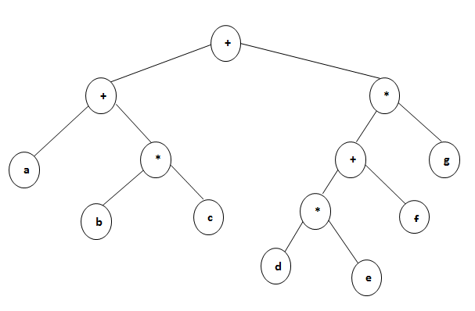

Slide 34
Binary Tree Traversal
1. Preorder traversal:-In this traversal method first process root element, then left sub tree and then right sub tree.
Procedure:-
Step 1: Visit root node
Step 2: Visit left sub tree in preorder
Step 3: Visit right sub tree in preorder

Slide 35
2. Inorder traversal:-
In this traversal method first process left element, then root element and then the right element.
Procedure:-
Step 1: Visit left sub tree in inorder
Step 2: Visit root node
Step 3: Visit right sub tree in inorder

Slide 36
3. Postorder traversal:-
In this traversal first visit / process left sub tree, then right sub tree and then the root element.
Procedure:-
Step 1: Visit left sub tree in postorder
Step 2: Visit right sub tree in postorder
Step 3: Visit root node

Slide 37
Binary Search Tree
A binary search tree (BST) or "ordered binary tree" is a empty or in which each node contains a key that satisfies following conditions:
    All keys are distinct.’
    , all elements in its left subtree are less to the node (<), and all the elements in its right subtree are greater than the node (>).

Slide 38
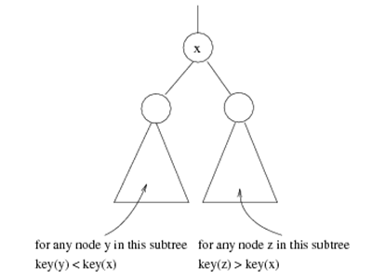
Binary search tree
Binary search tree property
  For every node X
  All the keys in its left
  subtree are smaller than
  the key value in X
  All the keys in its right
  subtree are larger than the
  key value in X

Slide 39
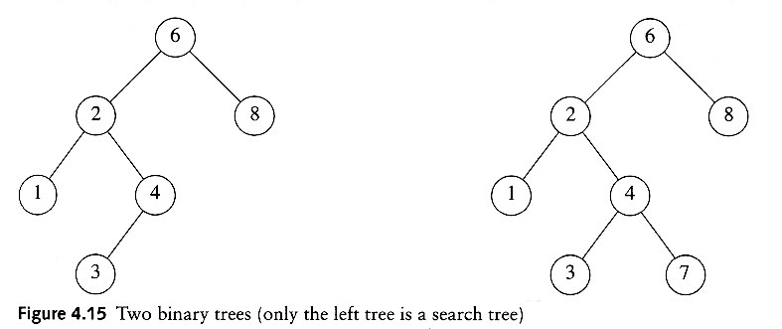
Binary Search Trees
A binary search tree
Not a binary search tree

