Slide 1
AIMMS Training Presentation Slides Guidelines
AIMMS User Support

Slide 2
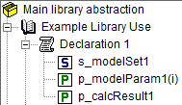

Data flow for Functions

Slide 3
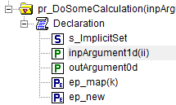

Data flow for procedures

