Slide 1
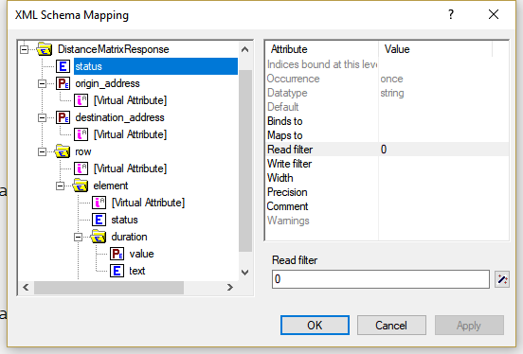
Maps to spOrigin(iOrigin)
Maps to spDestination(iDestination)
Binds to iOrigin
Binds to iDestination
Maps to pDuration(iOrigin, iDestination)

