Slide 1
AIMMS Training Presentation Slides Guidelines
2018 Wide Screen

Slide 2
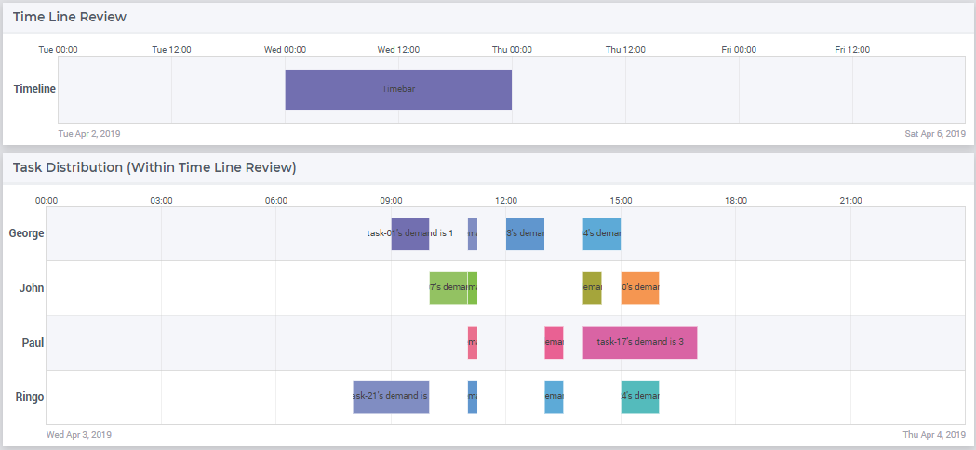
Mechanism

