Slide 1

Bachelor Thesis Project
Techno-Economic Analysis of Sabatier Reaction
Arghadeep Biswas
21CH30049
Under the supervision of
Dr. Koustuv Ray
Department of Chemical Engineering
Indian institute of Technology, Kharagpur

Slide 2


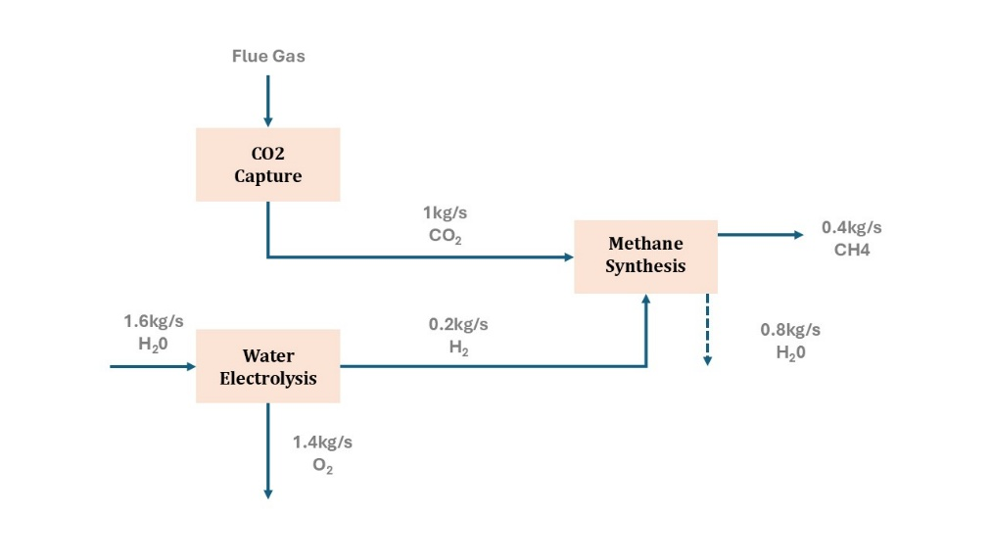

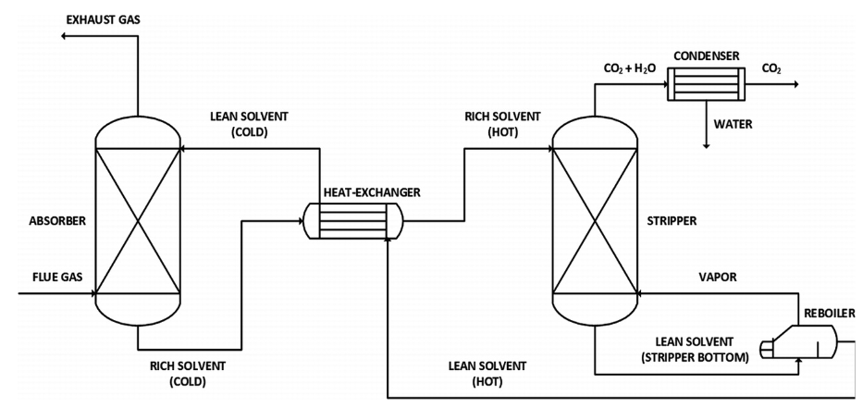
Power-to-Gas
Capture Technology
Three Main Processes
C
Catalytic Methanation
CO₂ + H₂
Direct methanation of CO₂
Oxy-Fuel Combustion System
Pre-Combustion System
Post Combustion System
(CO₂)_{ads}
(HCO₃)_{ads}
(HCOO)_{ads}
CH₄
CO₂ + H₂
CO as intermediate
Madeddu et al.
(HCO₃)_{ads}
Based on Splitting water molecules
(CO₂)_{ads}
Water Electrolysis
H₂
Alkaline Water Electrolysis mostly used
(C)_{ads}

Slide 3




SCOPE
Streamline techno-economic analysis (TEA) of emerging carbon-utilization technologies
Identify cost and environmental impact hotspots rather than highly precise cost estimates for early stage technologies
Useful for technologies converting captured CO₂ and green hydrogen into methane, contributing to India’s commitment to Carbon Neutrality
Helps address uncertainties in cost and environmental impact for technologies in the early stages of development, from idea to pilot trial

Slide 4
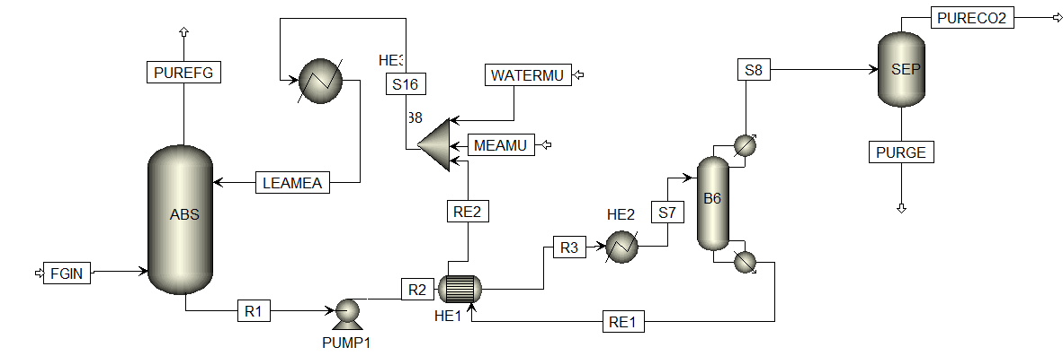

Carbon Capture
Rad-Frac
based Model
Flue gas enters the bottom of the absorber column.
Counter current absorption through MEA solvent
Rich CO₂ heated through HE1 and HE2
Fed to the second stage of the stripper column
Rad-Frac based Model
Vapours from reboiler strips CO₂
Stripped CO₂ goes to a separator to get pure yield
11 mol % CO₂
Key Steps
Stripped MEA recycled back to the absorber
Make up water is also add
Absorption
Stripping
Regeneration
Solvent
Preheating
Inspired from CO₂ Capture by Reactive Absorption-Stripping Modeling, Analysis and Design by Madeddu et al.

Slide 5
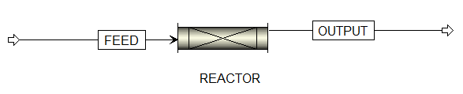
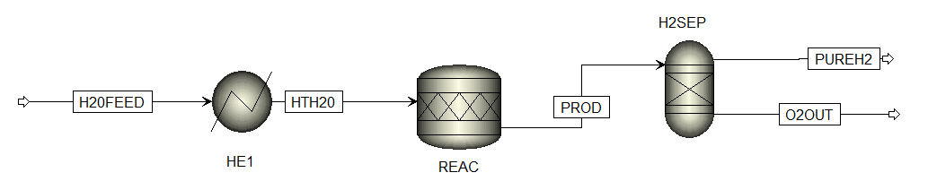


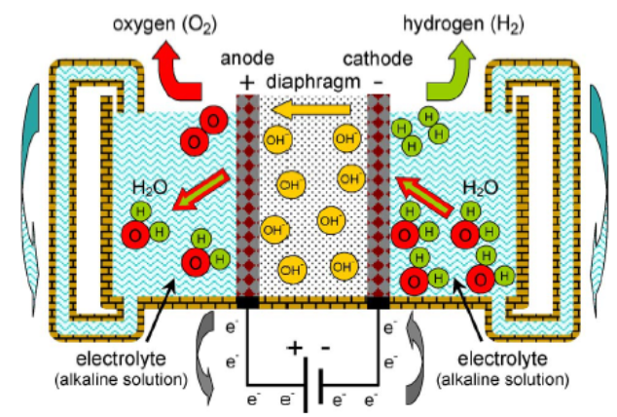
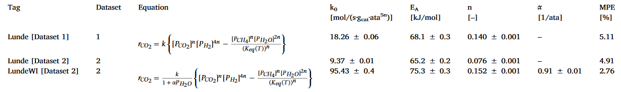


Electrolysis and Methanation Reactor
Sabatier reaction
H20FEED is fed at 25⁰C and 1 bar
Electrolysis reaction takes place inside the ‘RGibbs’ reactor
Kinetics of ruthenium(Ru) based catalyst was used
Soave-Redlich-Kwong equation of state as property method
Isothermal homogeneous plug flow reactor is used
H₂ produced at the cathode
The following equation reported by P.J. Lunde et al. was used for the temperature dependence
O₂ produced at the cathode
Used as a input to the methanation reactor
Estimated kinetic parameters(Adopted from LundeWI dataset 2)

Slide 6
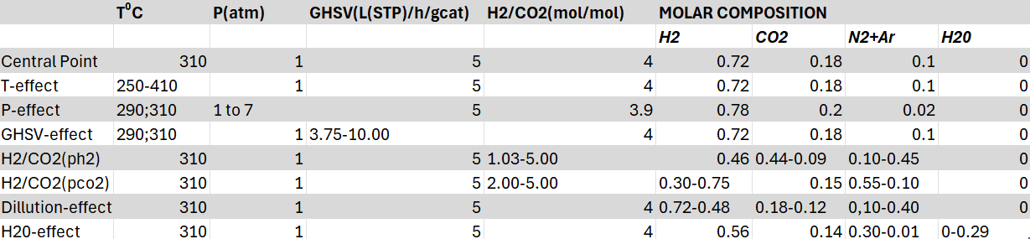
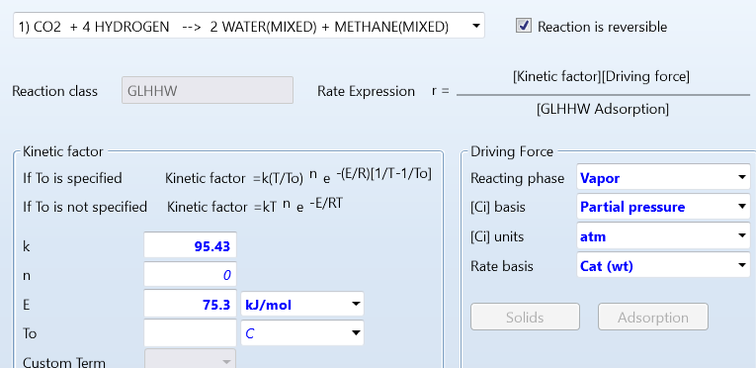
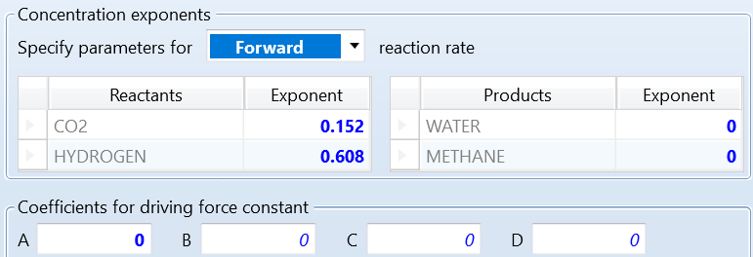
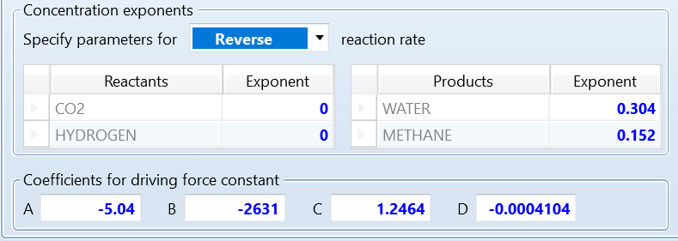
Experimental Plan – Sabatier Reaction
The following process conditions were used to gather kinetically relevant data on CO₂ conversion and CH₄ selectivity: temperature (T) between 250 and 410°C, pressure (P) between 1 and 7 atm, gas hourly space velocity (GHSV) from 3.75 till 10.00 L(STP)/h/g_cat, and a H₂/CO₂ inlet ratio between 1 and 5 mol H₂/mol CO₂ (while maintaining constant CO₂ partial pressure).
. Kinetic input for Sabatier reaction in Aspen plus
GHHLW Adsorption input for reverse reaction
GHHLW Adsorption input for forward reaction

Slide 7
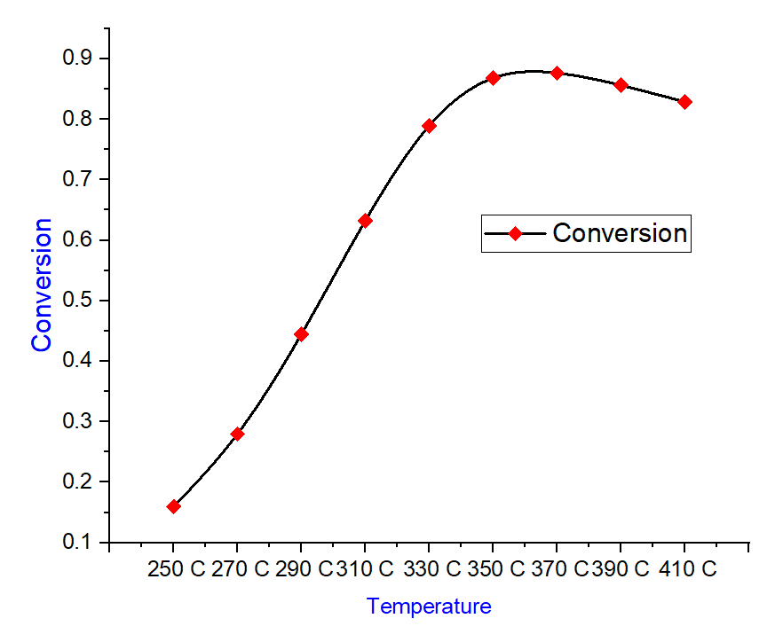
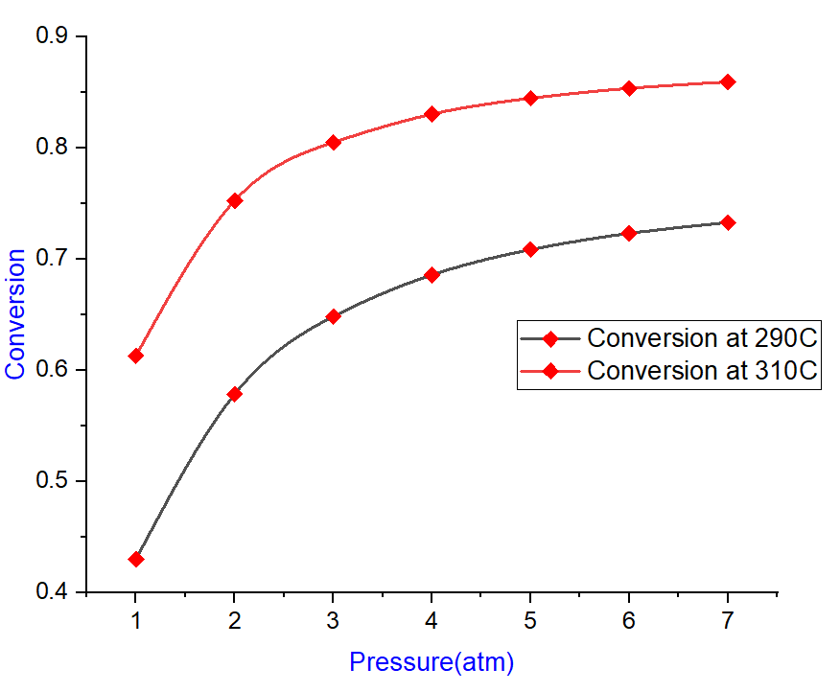
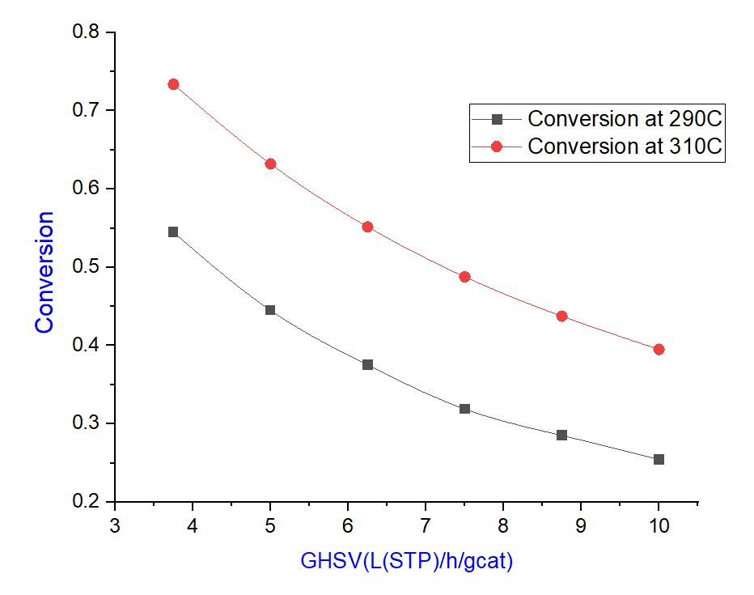
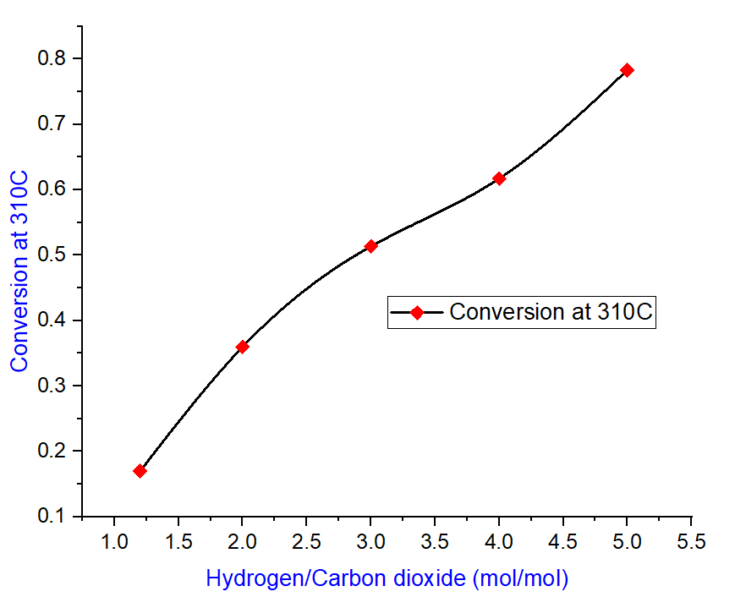
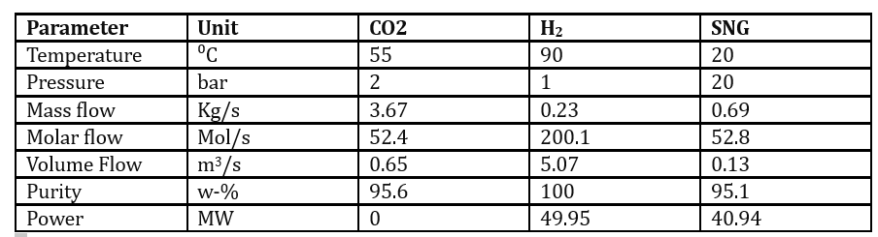
Simulation Results
(a)
(b)
(c)
95% CO₂
100% H₂
Conversion dependence on (a) T, (b) P, (c) GHSV, (d) H₂/CO₂
Results Summary
(d)

Slide 8
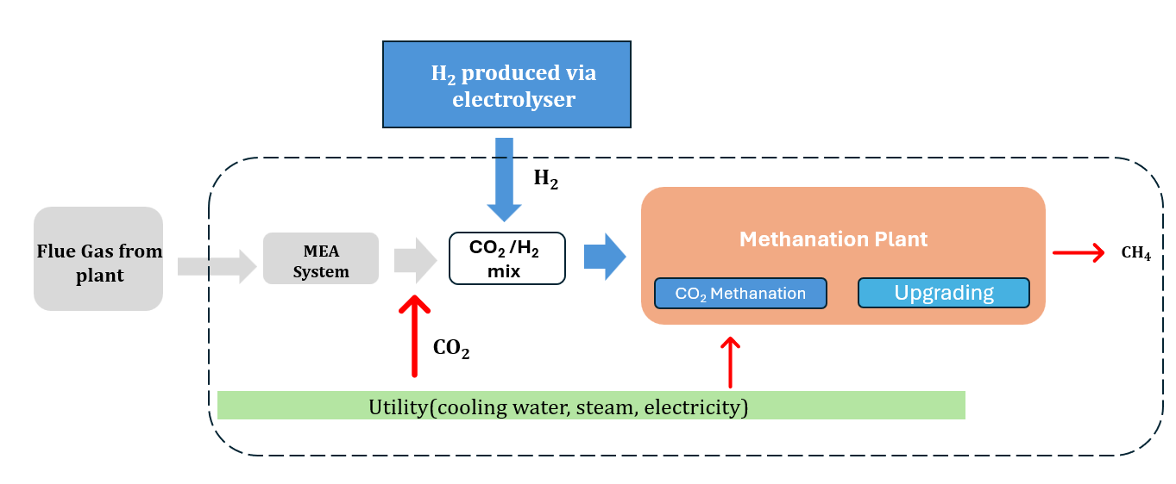

Techno-Economic Analysis
Treats the CO₂ flows after MEA carbon capture as input
The system consists of three main units
1. Carbon capture system employing MEA as the solvent
2. A plug flow reactor based catalytic methanation using Ru as the catalyst
3. Electrolyser system
Scenario Analysis
Base case: In the default scenario, 10,000,000 kg are produced, average electricity prices and impacts are used, Catalyst A is used
TEA guidelines
TEA Template
Order of magnitude
estimations
Study components
Scenario#1: Renewable Electricity: This first scenario models the use of renewable electricity (50% solar and 50% wind)
Low technology
readiness level
assessment guidance
Goal
Scope
Sensitivity and
uncertainty
analysis
Inventory
Indicator
Economic and
hotspot analysis
Scenario#2: Catalyst B is used in place of catalyst A
Example processes
and placeholder data
Interpretation
Overview of inputs, outputs and features
Snapshot of Excel Sheet

Slide 9
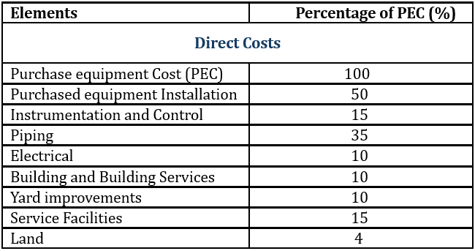

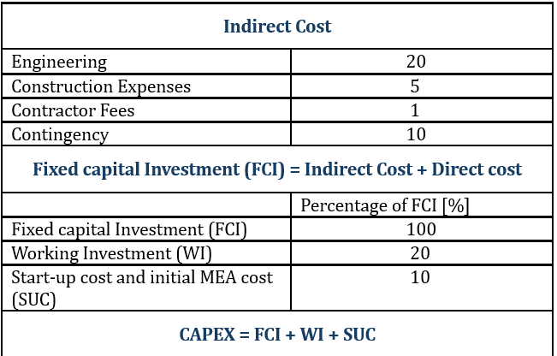
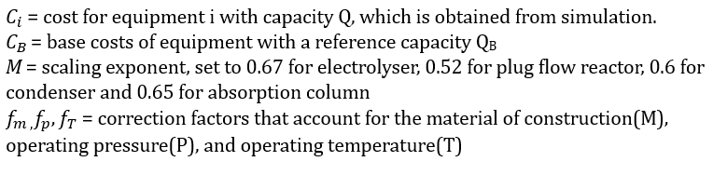
Inventory
Capital Expenditure CAPEX
Inventory Parameters
Scenario Specification
Catalyst parameters and Reaction energy
Cost parameters
Machine parameters
Purchase Equipment Cost
For absorber and stripper, equipment costs are calculated

Slide 10
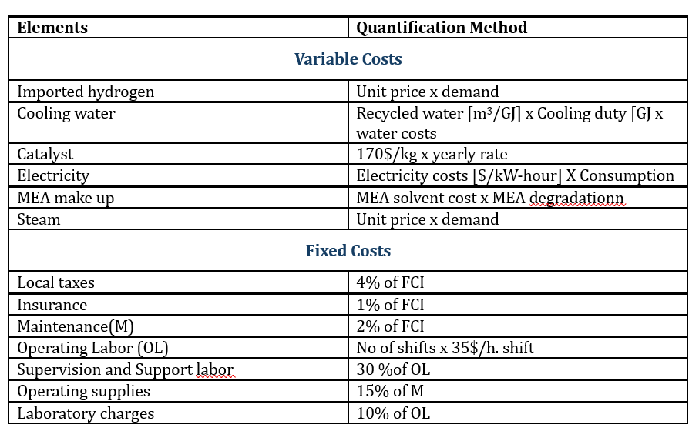
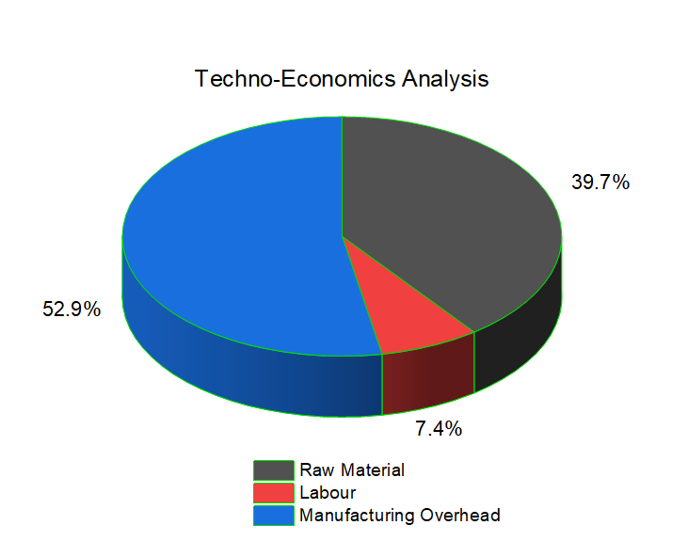
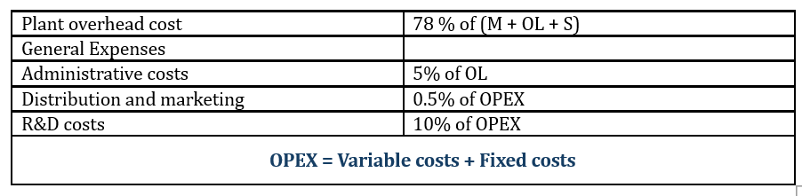
Indicator Calculation
Operating Expenditure OPEX
Assumptions
Process operating for 90% of the year
Scaling factors are used
Emissions for capital equipment are ignored
Pay-check of debt taken for equipment over 20 years
Pay-check of debt taken for factory taken over 30 years
Indicator Summary
The expected purchase equipment cost was
$22 million
CAPEX – 21.3 M$
OPEX – 35.4 M$

Slide 11
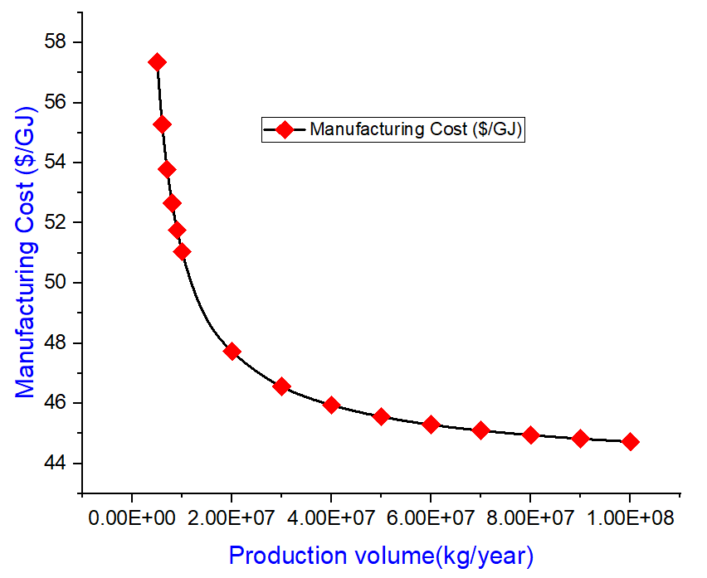
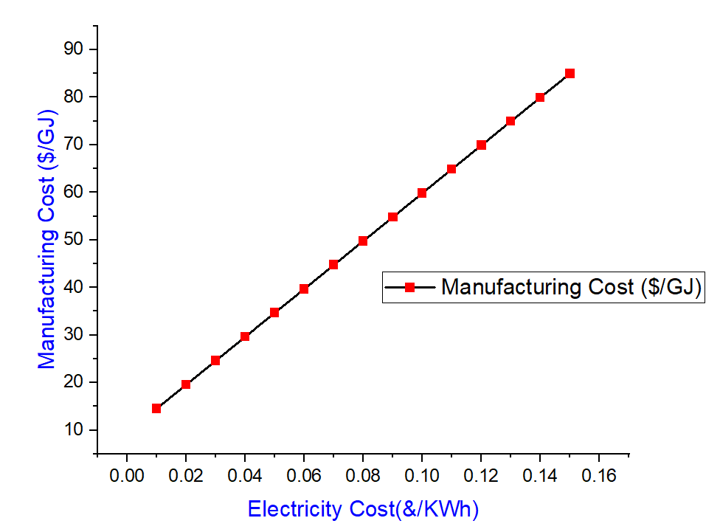
Sensitivity Analysis
Production Volume(t/year): At 100 million kg per year, cost is down from around $57/GJ to $45/GJ
Electricity cost($/kWh):Varying electricity costs from $0.01/kwh to $0.15/kWh increases manufacturing costs from around $15/GJ to around $85/GJ.

Slide 12
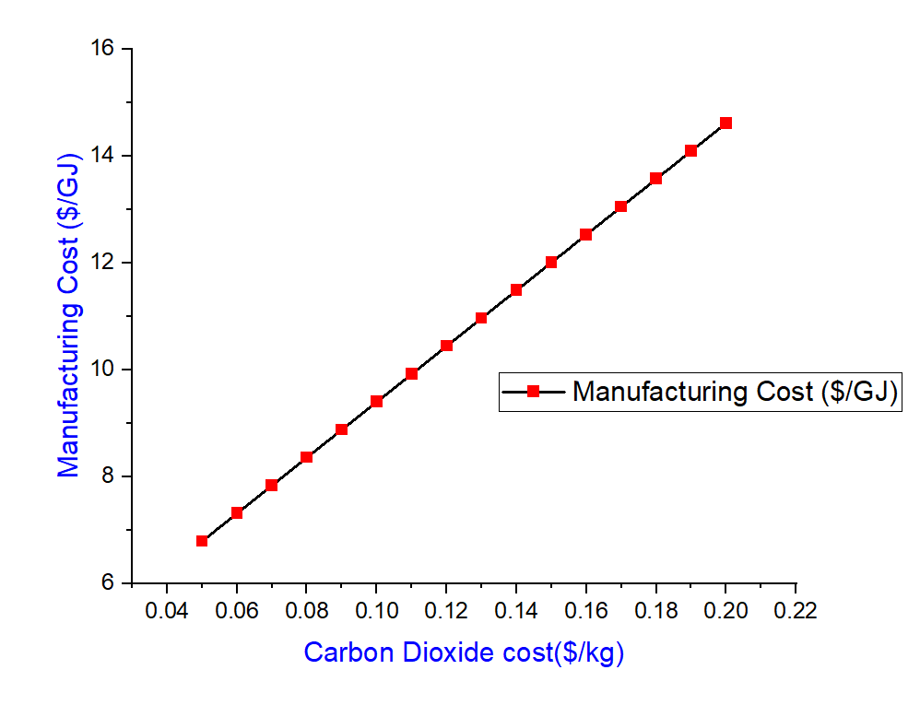
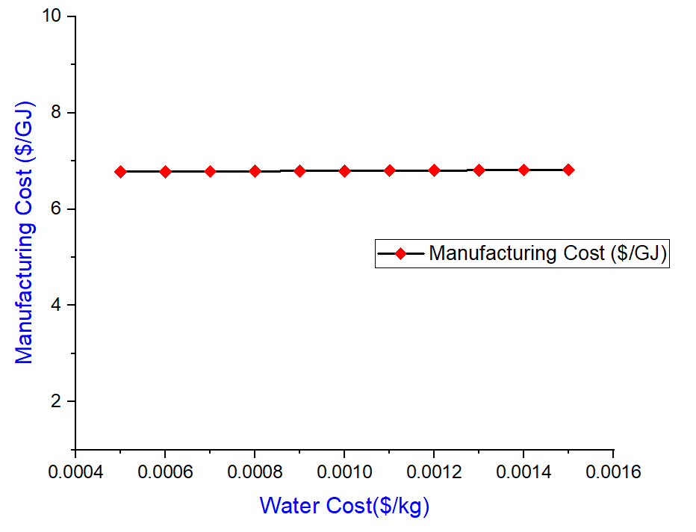
Uncertainty Analysis
Carbon Dioxide Cost($/year): Varying the carbon Dioxide costs captured directly from the air from $0.05/kg to $0.20/Kg increases the manufacturing costs from around $6.8/Kg to $15/Kg
Water Cost($/year): Varying water cost from $0.0005/kg to $0.0015/kg has a negligible impact on manufacturing costs

Slide 13
Economic Insights and Recommendation
Cost of GJ of methane is around $50/GJ
Energy required for process comprises majority (~80%) of the cost
Carbon dioxide is the next largest cost contributor at around 20%
The process is inefficient
Insight 1
Renewable electricity decreases costs to $38/GJ
Use an alternative catalyst has a negligible effect on overall costs
Increasing production volume to 100M kg reduces costs to $45/GJ
Using electricity that costs $0.01/kWh would decrease costs to $15/GJ
Sourcing carbon dioxide at $0.05/kg decrease costs to $45/GJ
Insight 2
Researchers should seek to use the lowest cost possible
Innovating to reduce the costs of hydrogen production help reduce manufacturing cost
Recommendation 1
Recommendation 2
Process becomes more economically viable in areas where methane is more expensive
Place where there is cheap electricity
Place where cheap hydrogen can be sourced

Slide 14
CONCLUSION
Please refer to the Excel sheet: https://t.ly/UFHzR
Carbon Capture
Methanation Reaction
Capture capture model simulated with 30% MEA conc.
Nearly 85% capture efficiency.
30 KW reboiler Load
Combined with H₂ from electrolysis.
Modelled in a plug flow reactor
Conversion varied against temperature, pressure, GHSV, and H₂/CO₂ ratio
Techno-Economic Analysis
Future Work
Use Aspen Plus dynamics rather than a steady state approach
To not use constant cash flows to get a more realistic approach
Sensitivity and Uncertainty analysis were looked upon
CAPEX and OPEX were analysed
Yearly costs were estimated
Sensitivity and Uncertainty analysis were looked upon

