Slide 1



EVONIK Sustainability Challenge
Team Members
Rahul Rajwar Arghadeep Biswas Sanket Bhirud
Department of Chemical Engineering
Indian Institute of Technology Kharagpur

Slide 2
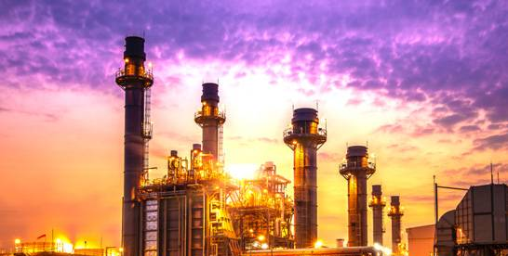
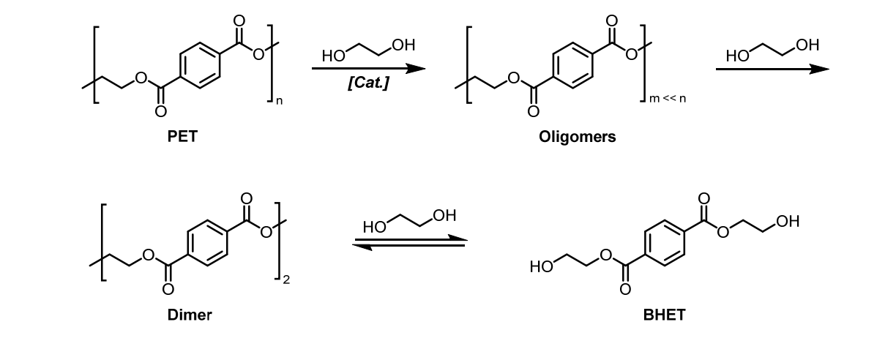
EVONIK Sustainability Challenge
Introduction
Chemical transformation of PET
Types of PET Recycling:
Mechanical Recycling (Recycled PET cannot used in food industry)
Chemical Recycling:
Methanolysis
Aminolysis
Glycolysis (most efficient way of recycling)
Starting Material: PET (Polyethylene Terephthalate)
A long-chain polymer used in water bottles and food containers
Contains aromatic rings and ester linkages
Transformation Process
Uses ethylene glycol as a solvent and catalyst
Gradually breaks down the PET polymer into smaller fragments
Intermediate Products
First, breaks into oligomers (shorter polymer chains)
Then, further breaks down into dimers (two-unit molecules)
Final Product: BHET (Bis(2-hydroxyethyl) terephthalate)
A crucial intermediate in PET recycling
Enables chemical transformation of plastic waste
Glycolysis reaction on PET to produce BHET:
Transesterification Catalyst : Sodium Methoxide

Slide 3
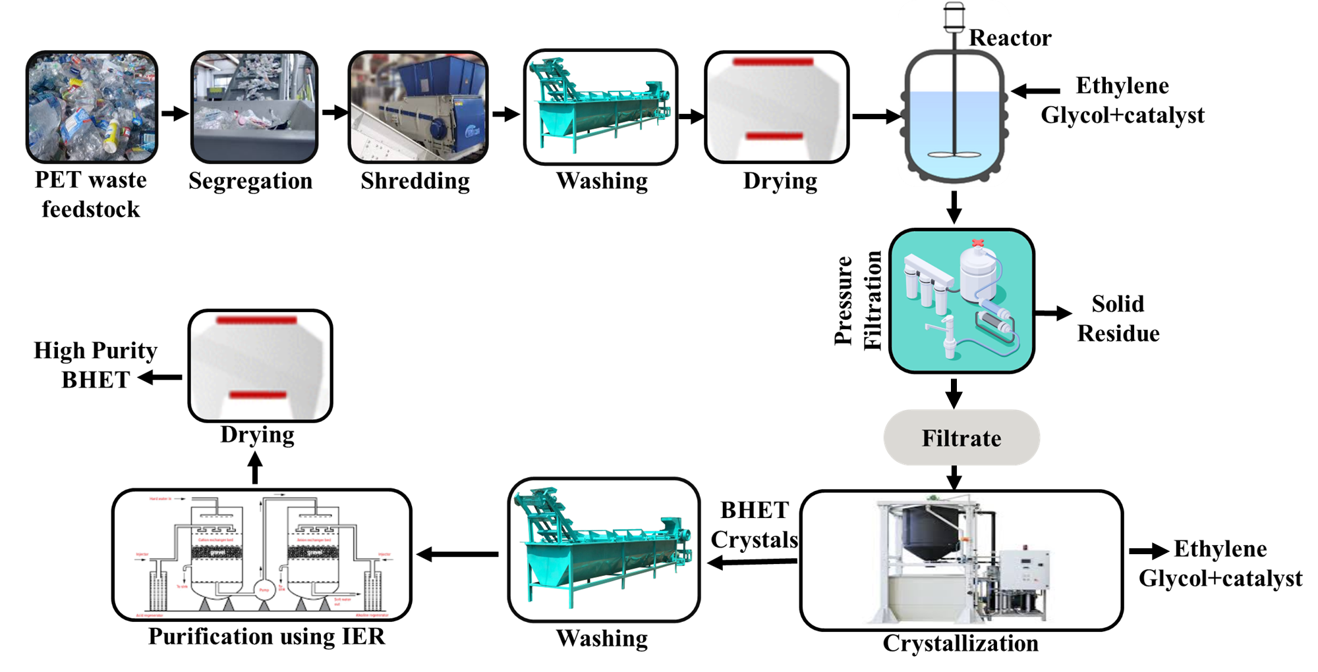
Flow Diagram
Process Description
The recycling process for PET begins with the collection of PET waste feedstock
feedstock, primarily post-consumer bottles. Segregation is conducted to remove non-PET materials such as caps and labels, followed by shredding of the PET into small flakes for efficient processing. Flakes produced by shredding undergo thorough washing to remove dirt, adhesives, and contaminants and then dried to remove moisture, which can hamper chemical reactions.
Recycling Process
The dried PET flakes are fed into a reactor, where depolymerization occurs using ethylene glycol and a catalyst, breaking down PET into Bis(2-hydroxyethyl) terephthalate (BHET). The resulting mixture undergoes pressure filtration to separate solid residues from the BHET-rich filtrate. This filtrate is then crystallized to form BHET crystals, while excess ethylene glycol and catalysts
are recovered for reuse.
Post-crystallization, the BHET crystals are washed to remove residual impurities. Further purification is done using ion exchange resins (IER) to eliminate trace ionic contaminants, ensuring high-purity BHET. The final drying step removes any remaining moisture, producing high-purity BHET suitable for reuse in PET production. This closed-loop process promotes sustainability by efficiently recovering BHET and recycling key reagents, minimizing waste and resource consumption.

Slide 4
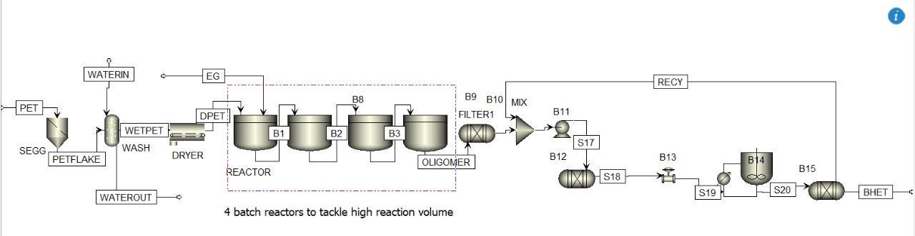
Schematic of Proposed Process
Crystallisation of bis(2-hydroxyethylene) terephthalate as a part of a bottle-to-bottle recycling concept for poly(ethylene terephthalate), Grause et al. (2024)
Optimization and Kinetic Evaluation for Glycolytic Depolymerization of Post-Consumer PET Waste with Sodium Methoxide, Javed et al. (2023)
This simulation model illustrates the chemical recycling of PET into BHET through a glycolysis-based depolymerization process. The process begins with PET flakes, which are washed and dried to remove contaminants before entering batch reactors (B1–B8) in Parallel configuration. Here, ethylene glycol (EG) is added to break down PET into oligomers and BHET. The oligomer mixture then passes through a filtration unit (FILTER1) to remove solid residues before being homogeneously mixed (MIX) and pumped (B11) to the next stage.
The purification and separation process involves separators (S17, S18) and reactors (B12, B13) to refine the BHET further. A crystallizer (B14) plays a crucial role in BHET purification by cooling the solution to promote BHET crystallization. The purified BHET then undergoes final separation (B15), ensuring high-quality recovery. Additionally, settling tanks (S19, S20) remove heavier fractions, and a recycle loop (RECY) reintroduces unreacted material to improve efficiency.
This sustainable approach, integrating batch reactors, filtration, crystallization, and recycling, ensures efficient PET-to-BHET conversion with minimal waste.

Slide 5
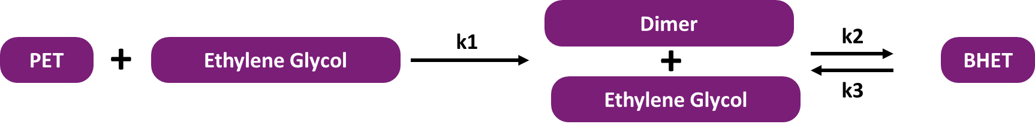
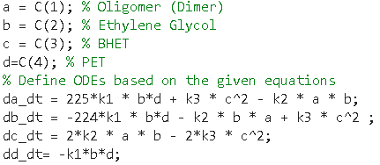
Governing Equations for MATLAB Model
Reaction that we are considering:
Assumptions:
1 PET molecule contains 450 repeating units.
In the first step, 225 Ethylene Glycol moles are required to break down 1 mole of PET into a Dimer. This is an irreversible step.
In the next step, 1 mole of dimer and 1 mole of Ethylene Glycol are required to get 2 moles of BHET. This is a reversible step.
Considering everything in a liquid phase at high temperatures.
Reaction is done in a batch reactor.
Governing Equations:
Calculations:
1. All the rate constants are taken from an experimental research article (https://doi.org/10.1016/j.ces.2025.121463).
The essential calculation has been done and here is the excel sheet link for that:-
https://shorturl.at/CeGvV

Slide 6
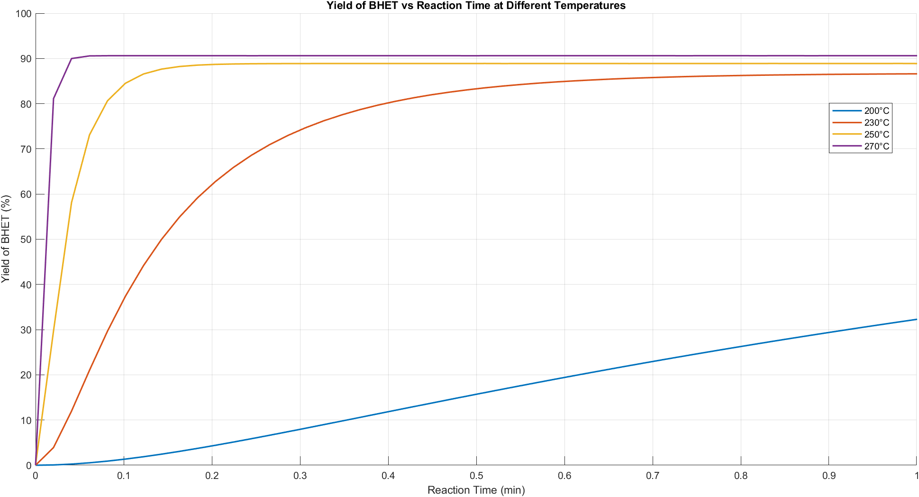
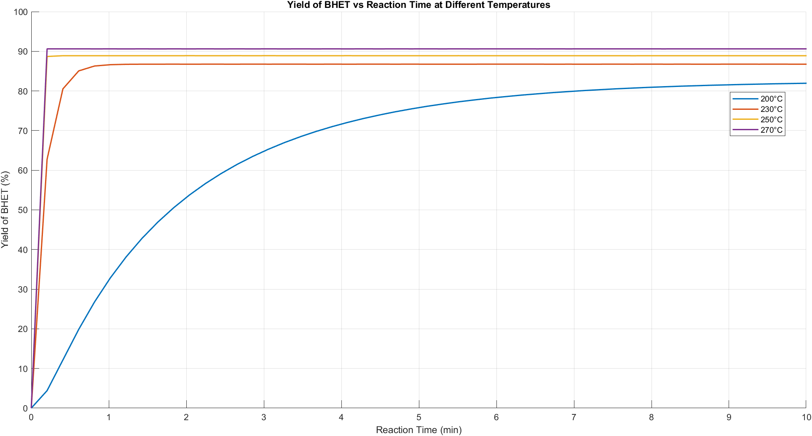
Results from our MATLAB model
This graphs represents the yield of BHET (%) as a function of reaction time (minutes) at different reaction temperatures (200°C, 230°C, 250°C, and 270°C) during the glycolysis of PET.
Key Observations:
Effect of Temperature:
Higher temperatures (250°C and 270°C) result in rapid and high BHET yield, reaching above 90% almost instantly (within a minute).
At 230°C, the yield also rises quickly but plateaus slightly below the highest temperatures.
At 200°C, the reaction is significantly slower, taking about 7–8 minutes to approach 75–80% yield, unlike higher temperatures where the reaction is nearly complete in under a minute.
Reaction Time Dependency:
At higher temperatures (250°C and 270°C), BHET formation is nearly instantaneous due to faster PET depolymerization.
Lower temperatures (200°C) require a much longer time to reach a comparable yield, indicating a strong temperature dependence on reaction kinetics.

Slide 7


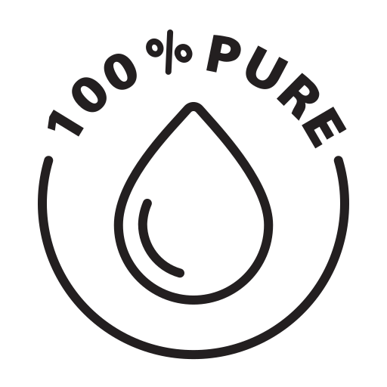
Important factors to Consider…
For reaction temperatures below the melting point of PET, the size of PET flakes will have to be optimized for fast reaction rates.
Reaction temperature and reaction time must be optimized for higher BHET purity and yield.
IER (ion exchange resins) can be used in downstream processing to remove colored impurities.

Slide 8
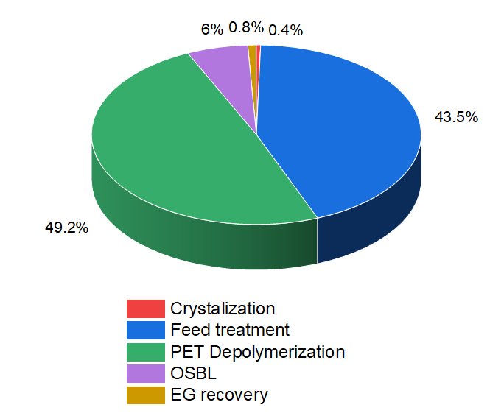
Our Economic aspect
Parameters | Value
Feedstock rate | 62.122 tonnes
Annual Interest rate | 10 %
MACRS depreciation | 10 years
Taxation rate | 26%
Inflation rate | 2%
Project life | 12 years
Construction period | 2 years
Working capital | 10 % of Raw Materials cost
Product | Cost ( Indian rupees)
BHET | 99.07 ₹/kg
Ethylene Glycol | 83.43 ₹/kg
Raw Material | Cost
PET | 47.80 ₹/kg
Utilities | Cost
Process Water | ₹ 23.46 /m³
Cooling Water | ₹ 434.51 /GJ
Electricity | ₹ 6.08 kW-h
Refrigerant | ₹ 562.25 /GJ
Waste pickers sell discarded PET bottles to scrap dealers at ₹14–15/kg, while scrap dealers resell them at ₹15–20/kg. Traders incur ₹4/kg for sorting, cleaning, and baling before selling clear PET bottles to recyclers at ₹30–31/kg, with colored PET fetching lower prices. Recycled PET end products range from ₹50–110/kg. The cost of PET flakes, including shredding and cleaning, is ₹47.78/kg.
The project follows a 10-year MACRS depreciation, with a two-year startup period generating no profit. The facility runs three shifts (8h/day) for 330 days/year, with a 10% return rate and 2% inflation. Colorants in PET, especially reactive dyes, are challenging to remove. Ion-exchange resins offer a promising decoloration method, but further research is needed to develop an efficient technique for BHET purification, advancing a sustainable plastic economy.
Economic and profitability analysis excel sheet link:
https://shorturl.at/caFdI
Fig: Breakdown of Cost

Slide 9
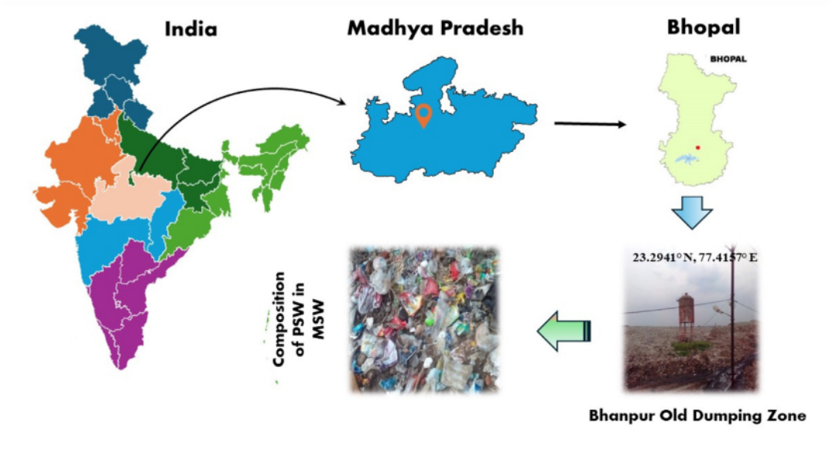
Consideration for selecting recycling plant location in India
The PET recycling plant we are planning to locate in Bhopal, Madhya Pradesh, near the Bhanpur Old Dumping Zone, ensuring proximity to a significant waste accumulation site. This location provides a continuous supply of discarded PET waste, primarily sourced from food packaging, plastic carry bags, bottle caps, and disposable items. The region has a well-developed network of waste pickers and traders who collect and resell PET bottles at ₹14–31/kg, making raw material procurement efficient and cost-effective. The facility processes PET flakes, valued at ₹47.78/kg, through sorting, cleaning, and depolymerization.
The plant operates three shifts (8 hours each) daily for 330 days a year, optimizing production while maintaining a sustainable return on investment. Key utilities such as process water, electricity, and cooling water are efficiently managed to minimize operational costs. The economic framework follows a 10-year MACRS depreciation model with a two-year startup period, ensuring long-term profitability.
Bhopal’s industrial infrastructure and transportation network support streamlined logistics, allowing easy distribution of recycled products. By reducing plastic waste through efficient recycling, the plant plays a crucial role in promoting a circular economy. Its strategic location, supply chain integration, and economic viability make it a key initiative in advancing sustainable plastic waste management in India.

Slide 10






Life Cycle Analysis
Scenario | Total system GHG emissions (kg CO₂-eq/1000 kg PET) | Circularity of the System
Only Chemical Recycling | 3942 | 0.9
Only Mechanical Recycling | 4120 | 0.34
2% waste: 20kg
0.4 kg CO₂-eq
Landfill
Landfill
Basis of PET
Bottles: 1000kg
PC-PET bottles: 1000 kg
Waste: 0 kg
Virgin PET resin: 119kg
329 kg CO₂-eq
Chemical recycling is more environmentally efficient due to its lower GHG emissions (4.32% less) and much higher circularity, making it a more sustainable solution for PET recycling
Incineration
Manufacturing:
1906 kg CO₂-eq
Waste: 0 kg
cr-PET resin: 544 kg
0.6 kg CO₂-eq
MRF:
80 kg CO₂-eq
Landfill
The GHG emission factor for chemical recycling of PET by depolymerization was found to be 2.4-ton CO2-eq/ton of waste. By using catalytic glycolysis, it has about 73% lower carbon footprint than fossil-based PET and produces 1 - 1.3 tonnes of CO₂/dry tonne of plastic waste converted.
3% Waste: 30 kg
0.6 kg CO₂-eq
Landfill
PC-PET bottles: 572 kg
5% Waste: 29 kg
Virgin PET production | 2.77 kg CO₂-eq/PET
Landfilling | 0.02 kg CO₂-eq/PET
Incineration | 1.24 kg CO₂-eq/PET
Material Recovery Facilities (MRF) | 0.08 kg CO₂-eq/PET
Chemical recycling | 1.73 kg CO₂-eq/PET

Slide 11
Conclusion
Recycling Method: The process uses glycolysis, a chemical recycling method, to break down PET into BHET (Bis(2-hydroxyethyl) terephthalate), which can be reused to produce new PET.
Efficient Depolymerization: PET is depolymerized using ethylene glycol and a catalyst, breaking it into smaller fragments like oligomers and dimers before converting it into BHET.
High-Purity BHET: The process includes crystallization and ion exchange to purify BHET, ensuring it meets quality standards for reuse in PET production.
MATLAB Model: The model simulates PET breakdown into dimers and BHET, using experimental rate constants to predict reaction kinetics.
Closed-Loop System: The process recovers and reuses ethylene glycol and catalysts, minimizing waste and resource consumption, promoting a circular economy.
Environmental Benefits: Chemical recycling through glycolysis has a 73% lower carbon footprint compared to fossil-based PET production, with 4.32% lower GHG emissions than mechanical recycling.
Challenges in Recycling: Removing colorants (especially reactive dyes) from PET is difficult, requiring further research for efficient decoloration methods.
Economic Feasibility: The cost of processing PET flakes is ₹47.78/kg, and the recycled BHET can be sold at competitive prices, making the process economically viable.
Scalability: The process is designed for large-scale application, with a strategic location in Bhopal ensuring a steady supply of PET waste and efficient logistics.
Future Potential: With further development in purification techniques, this process can significantly advance sustainable plastic waste management in India.

Slide 12
References
https://drive.google.com/drive/folders/1_cSfibuQkabRXG2yaugRRRGUrsXtdml9?usp=sharing
All the material that we have used are in this google drive!

