Slide 1
Digital Image Processing BCSE403L Digital Assignment-1
Vishal Bhooma Kannan 21BCE1294
Arghya Bhattacharya 21BCE1858

Slide 2
Introduction
Presently, we commonly use 8-bit full color images in various display devices and for representing images (0-255 range).
This implies that we use and need 8 bits of information per channel of an RGB image.
This is often not possible or feasible for storage/transmission due to some very common image and video compression techniques which often trade the information bit depth relying on the more significant bits to capture a lossy image distribution.
Moreover, bit depth expansion (for example, 3 bits to 8 bits) to the desired number of bits (for display) is often needed when the capturing device is less sophisticated but we require a high-fidelity image.

Slide 3
Motivation
Recent advancements in computer vision based deep learning methods have been proven to excel at ill-posed inverse problems, for example: super resolution, deblurring and denoising.
Current problems in video and image transmission, for example in online compressed media demonstrate degradations arising from using a low bit depth such as false contours (for example: some of stremio’s streams).
This research will also demonstrate a strong prospective methodology allowing us to effectively convert current media to future higher fidelity color displays like 16 bit if needed.
On successful results, it will also allow us to design simpler devices with lower bit depth resolution for capturing and simply expand it effectively potentially reducing manufacturing costs.

Slide 4
Problem Statement
We aim to develop a system which is able to effectively expand the bit depth of an image from a low bit representation (lower color levels) to a naturally plausible high bit representation.
This is an example of an ill-posed inverse problem where given an input low bit depth image, there are multiple possible high bit depth outputs.
However, there is also an additional constraint of generating an image which follows the natural image distribution of images i.e. conforms to the distribution of real-world data.
This is exactly a system where recent advancements in computer vision based deep learning methods have been proven to excel, for example: super resolution, deblurring and denoising.
We therefore apply a deep learning architecture effectively incorporating local/global context in spatial dimension and the bit depth in channel dimension to predict an appropriate high bit depth image

Slide 5
Proposed System
We propose to implement the mentioned system for expanding from 3 bit to 8 bit. However, this can easily be generalized if needed.
We would first need a representative dataset modelling indicative distribution of images/videos in full color depth (8 bit in this case).
This indicates images from scenic landscapes and also including various objects, humans and artificial items.
Now we derive the 3-bit equivalent representations of the images with lower color levels from our chosen 8-bit images by extracting the 3 significant bits (degradation).

Slide 6
Proposed System
We now use the generated paired dataset to train a deep learning model which learns to restore from the inverse problem.
Inspired from recent works in deep learning and computer vision, we use a double transformer-based architecture for our model.
We effectively capture local relations and patterns using the shifted window transformer (SWIN) which learns the features of the image on a spatial level.
We also integrate a channel level transformer treating all bit planes (including all the red, blue, green channels) as different channels and treating those features as a sequence to effectively learn the data distributions.

Slide 7
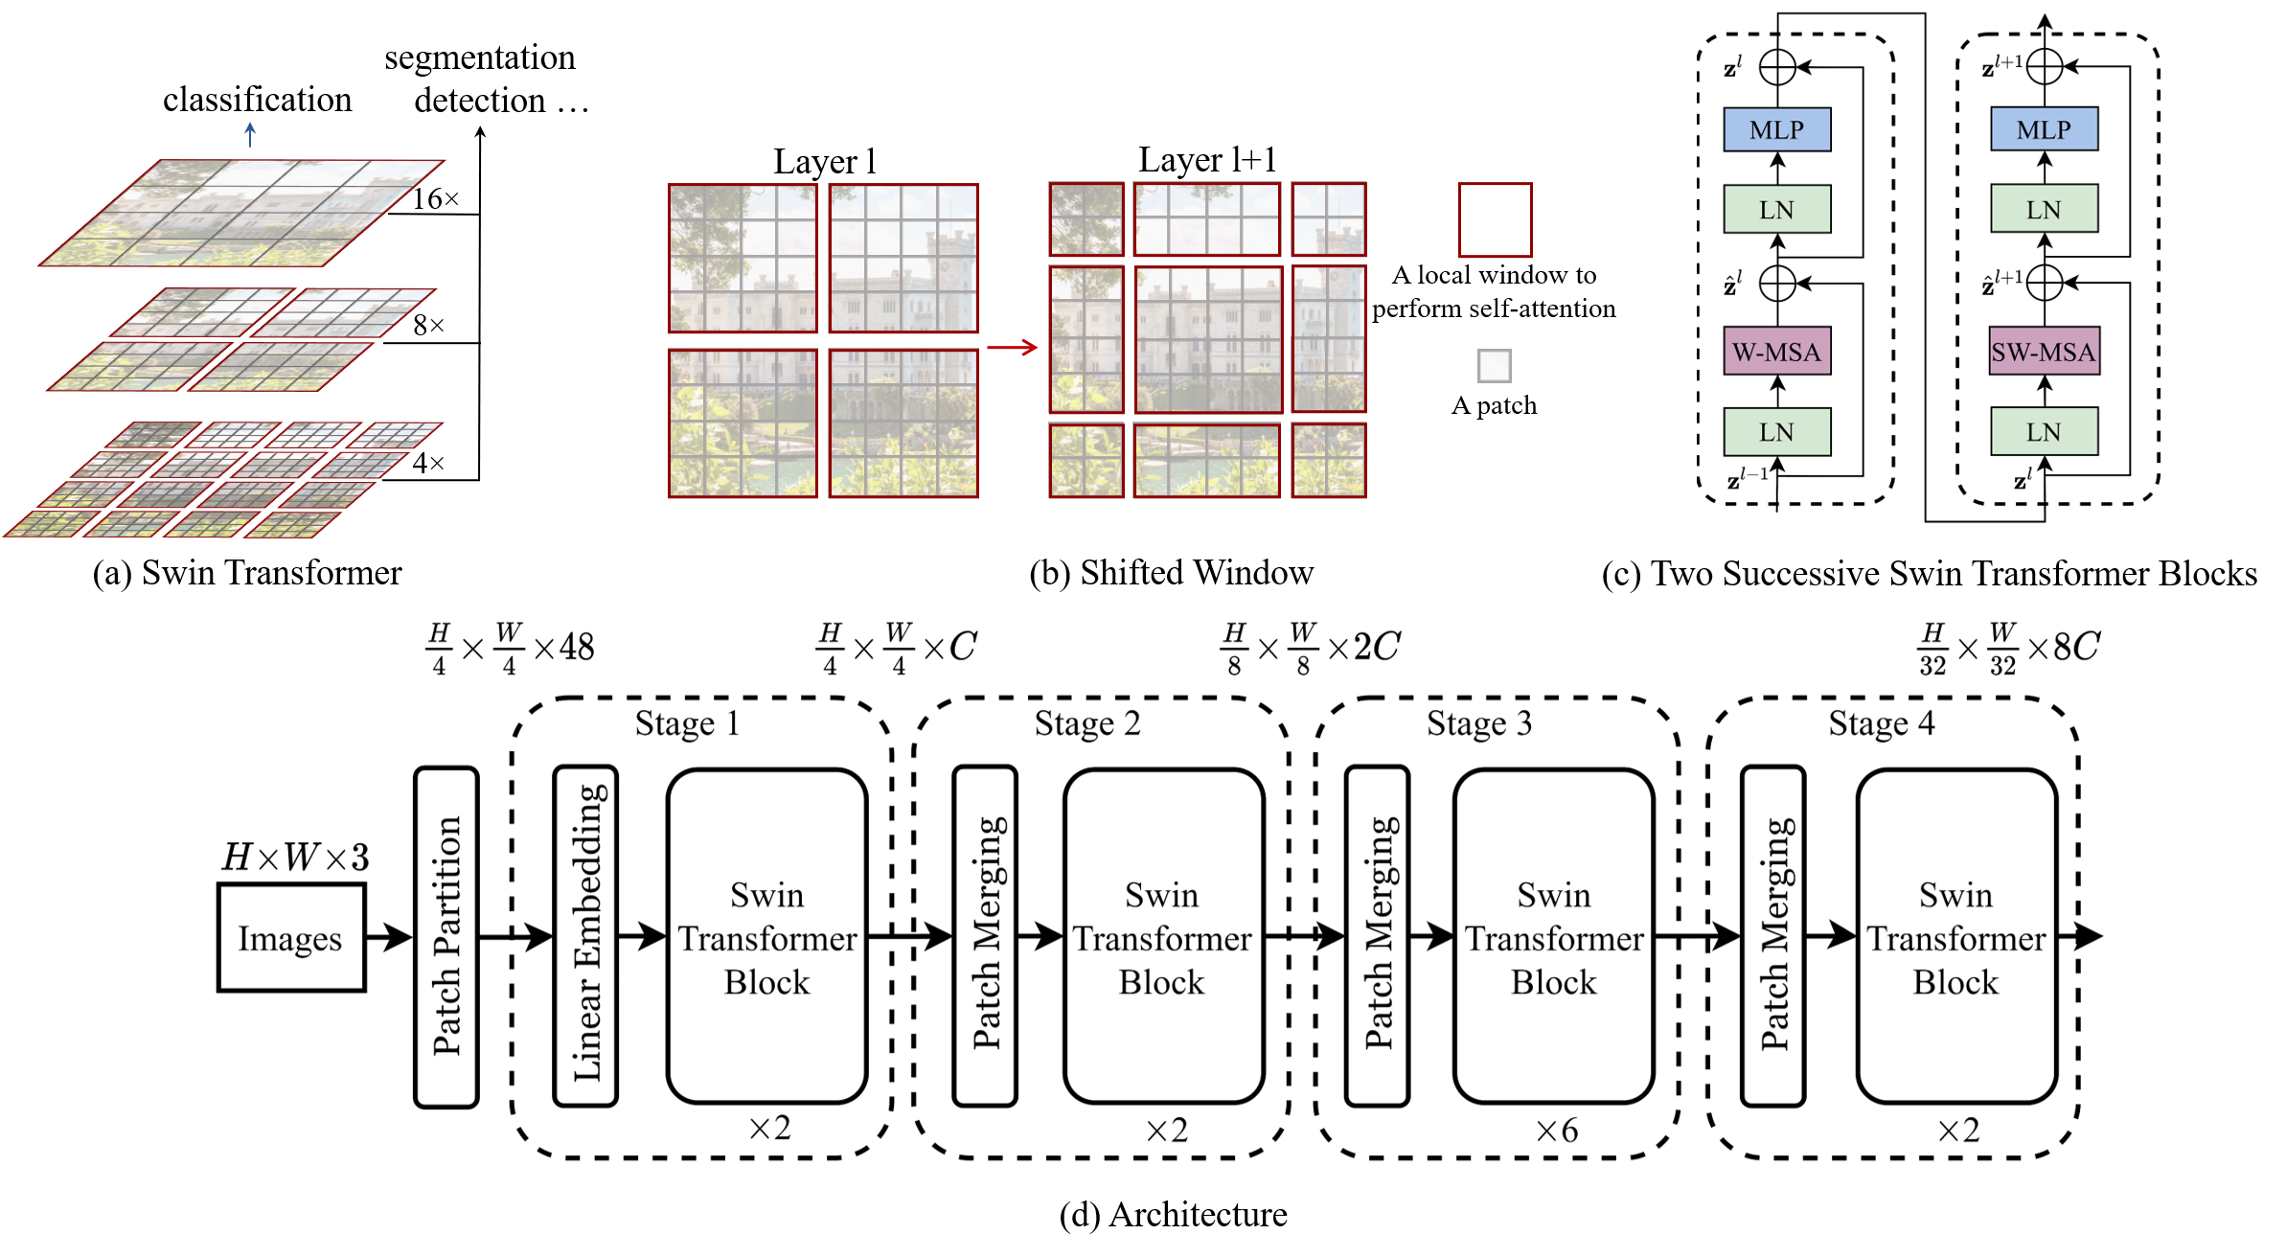
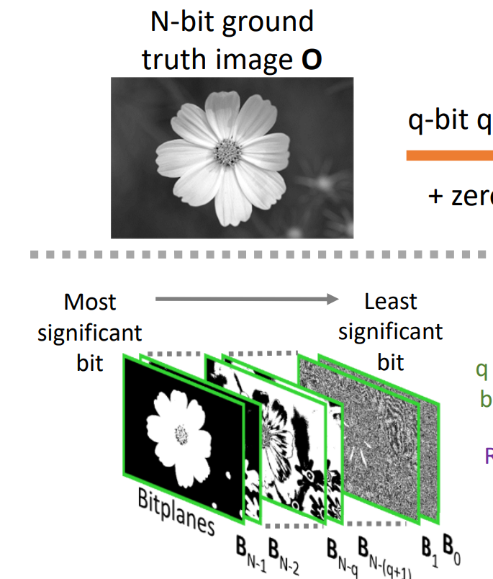
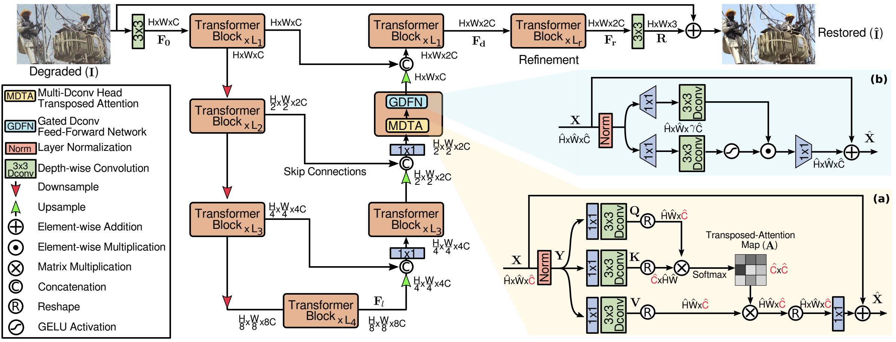
Proposed System Architecture
Spatial Transformer (Shifted window/SWIN)
Channel dimension input for the second transformer architecture on left. Replicated for all 3 channels
Channel dimension Transformer (Restormer)

Slide 8
Results and Evaluation
Effectiveness: Extensive evaluation shows significant improvement in both qualitative and quantitative assessments of our bit-depth enhancement method.
Comparison with Existing Approaches: Outperforms traditional methods and older deep learning models across multiple quality metrics.
Quantitative Results
Metrics Used:
PSNR: indicating high fidelity in pixel reconstruction.
SSIM: maintaining structural integrity and natural transitions..
Key Finding: Our method consistently achieves restoration of both pixel-level accuracy and structural integrity.
We achieve a 28.28dB average validation PSNR which is done on the KODAK dataset completely unrelated to the urban dataset domain for all image pairs available.

Slide 9
Base Papers
Byun, J., Shim, K., & Kim, C. (2019). BitNet: Learning-based bit-depth expansion. In Computer Vision–ACCV 2018: 14th Asian Conference on Computer Vision, Perth, Australia, December 2–6, 2018, Revised Selected Papers, Part II 14 (pp. 67-82). Springer International Publishing.
J. Liang, J. Cao, G. Sun, K. Zhang, L. Van Gool and R. Timofte, "SwinIR: Image Restoration Using Swin Transformer," 2021 IEEE/CVF International Conference on Computer Vision Workshops (ICCVW), Montreal, BC, Canada, 2021, pp. 1833-1844, doi: 10.1109/ICCVW54120.2021.00210.
S. W. Zamir, A. Arora, S. Khan, M. Hayat, F. S. Khan and M. Yang, "Restormer: Efficient Transformer for High-Resolution Image Restoration," 2022 IEEE/CVF Conference on Computer Vision and Pattern Recognition (CVPR), New Orleans, LA, USA, 2022, pp. 5718-5729, doi: 10.1109/CVPR52688.2022.00564.

