Slide 1
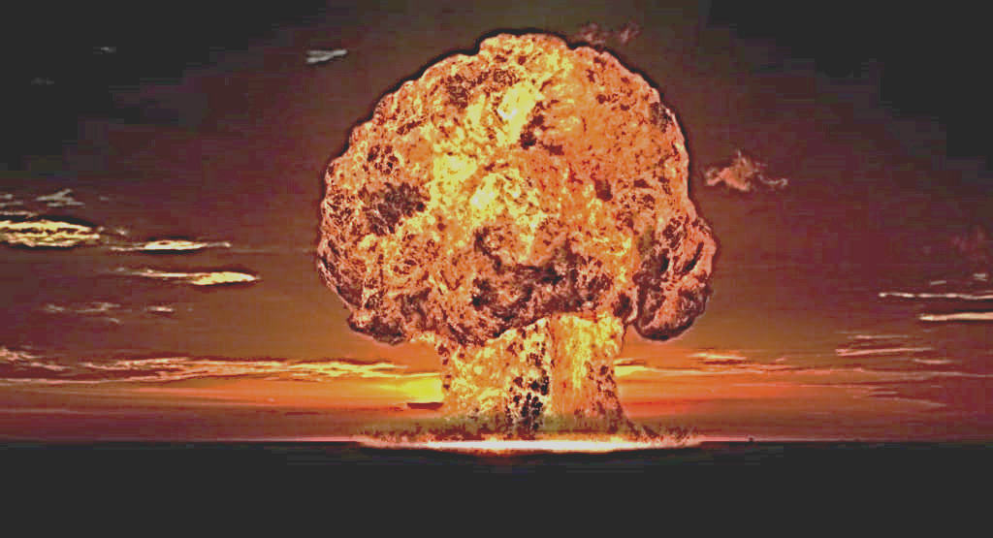
$teganogrαphy Aττack

Slide 2
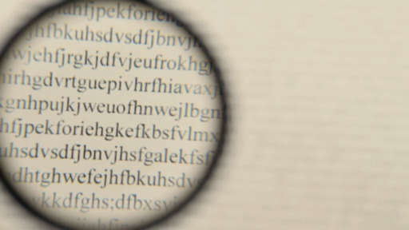
What is Steganography Attack?

Slide 3
Steganography
What is Steganography Attack?

Slide 4
Steganos : Concealed
What is Steganography Attack?
Graphein : Writing

Slide 5
Concealed Communication passed on through Text, Image and Sound
What is Steganography Attack?

Slide 6

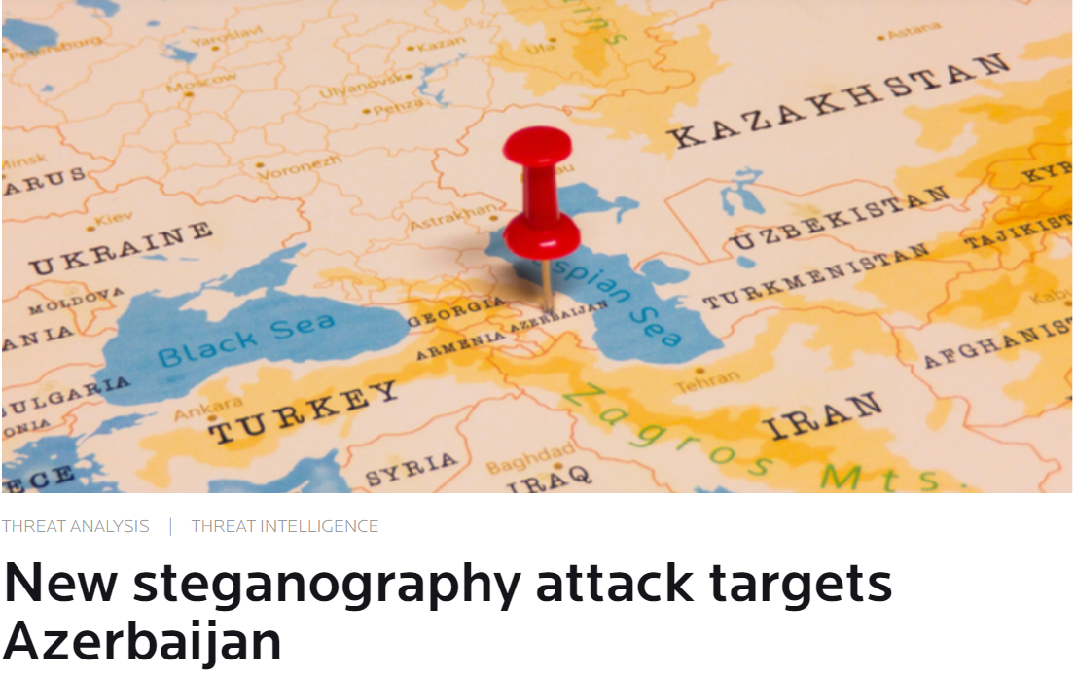
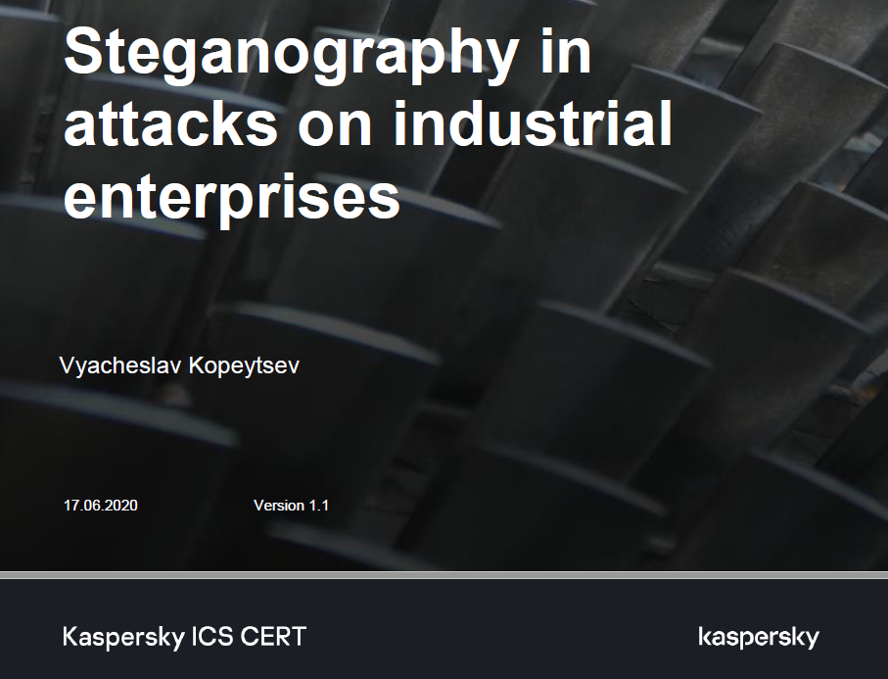
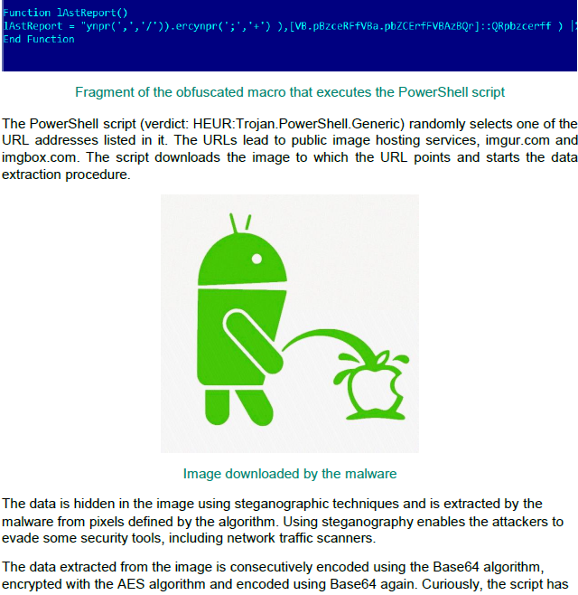
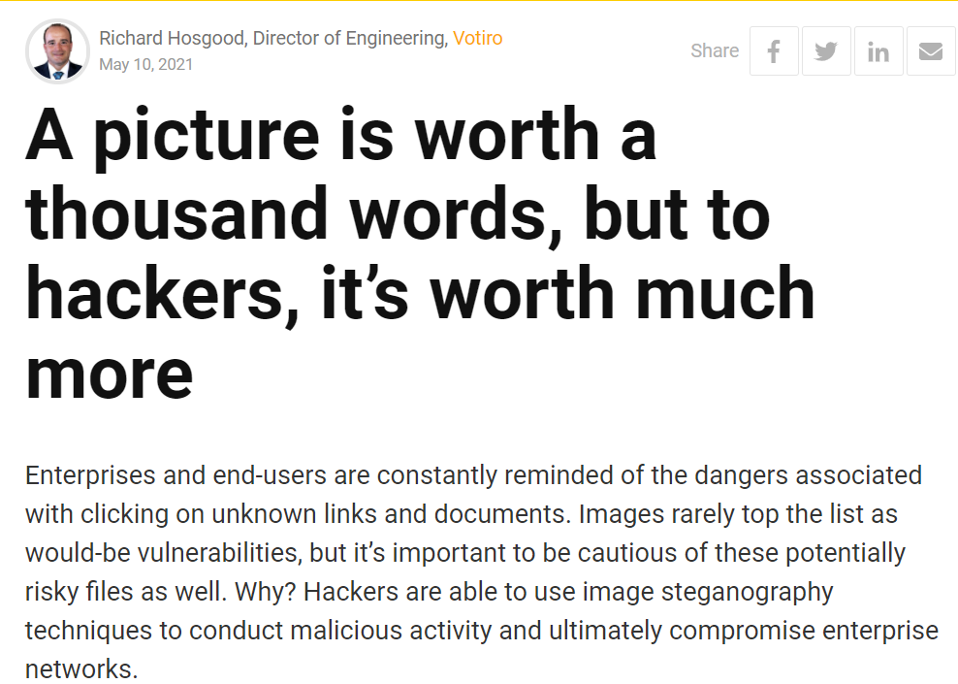
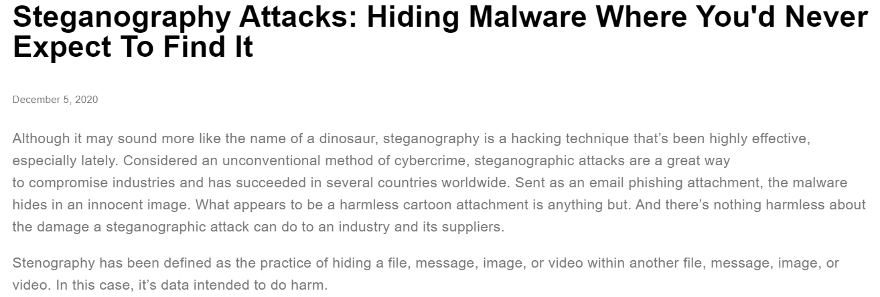

Slide 7
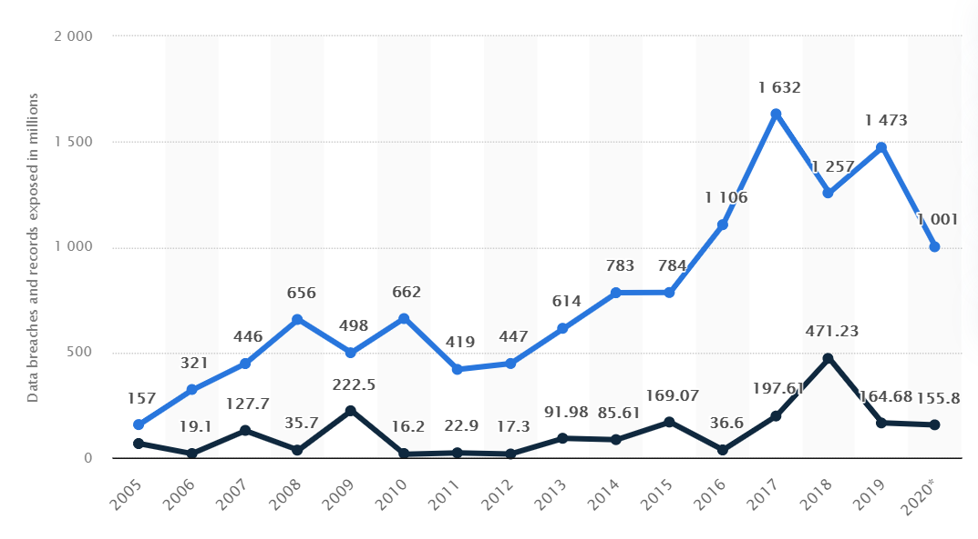
Data Breach

Slide 8
Data Breach
Cyber Attacks

Slide 9
Data Breach
Cyber Attacks

Slide 10
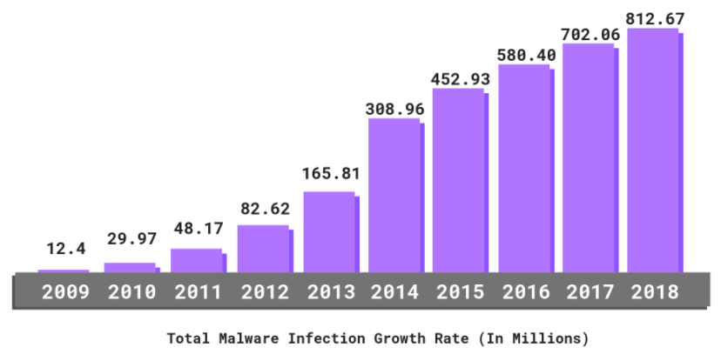
Data Breach
Cyber Attacks

Slide 11
Potential Threat
~ 54million!

Slide 12
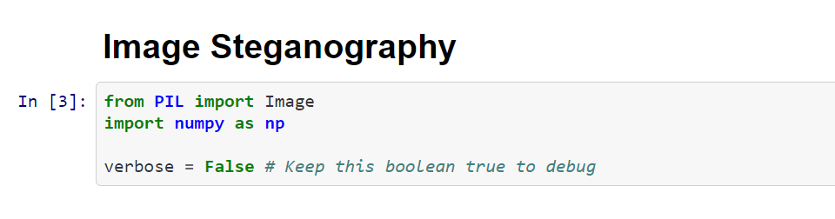
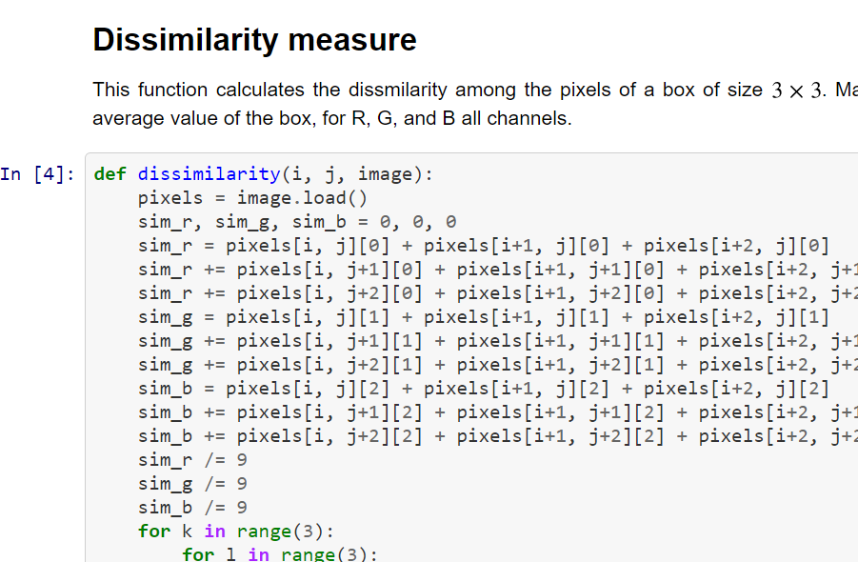
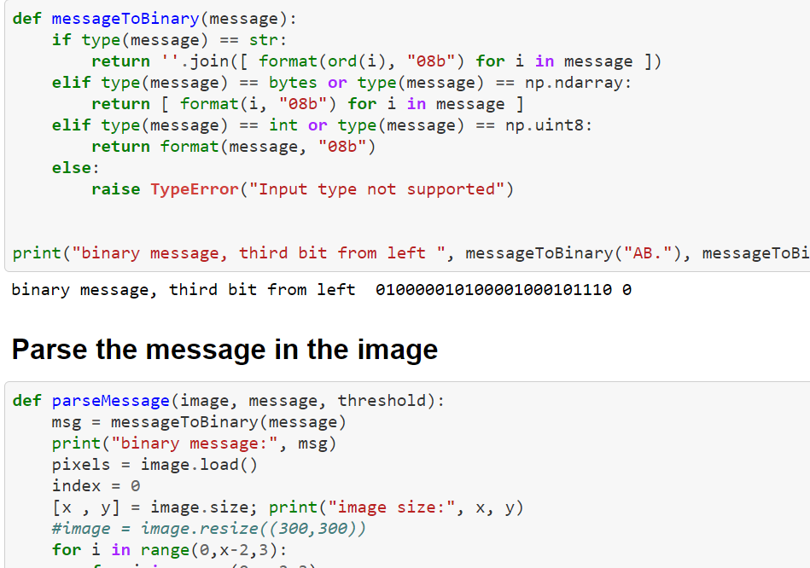
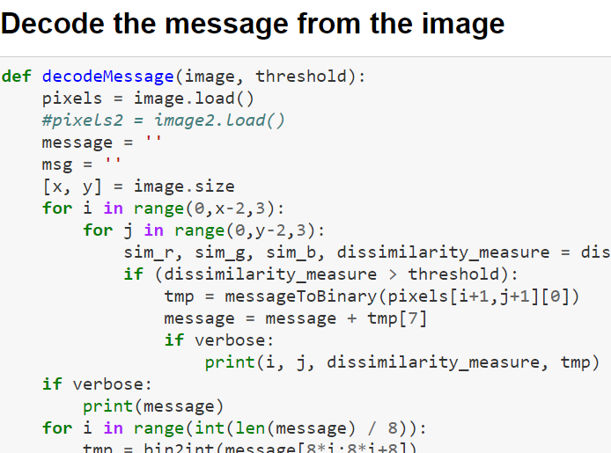

Slide 13
Our Implementation

Slide 14
Hacker’s end
Read the image and identify if it is RGB?
If yes :
Add text delimiter at the end of message
Convert the message in binary
Determine if size of image has enough pixels for encoding text?
If yes :
Slide a window of 3x3 pixels and Identify center and neighbor pixels
If dissimilarity value > threshold
Encode the LSBs of R,G and B channels with the message bit at that index
Proceed to next center pixel
Else
Discard : No encryption performed
Else :
Discard : No encryption performed

Slide 15
Receiver’s end
Read the image and identify if it is RGB?
If yes :
Slide a window of 3x3 pixels and Identify center and neighbor pixels
If dissimilarity value > threshold
If the LSB of R,G and B channels are same
Store the binary value sequentially in array/list
Proceed to next center pixel
After traversing through all pixels : decode the ASCII message from stored binary values
Parse to identify text delimiter
If present :
Display secret information
Else :
Discard : no secret information
Else :
Discard : no secret information

