Slide 1

SCReAM BW test tool 2021-02-17
Ingemar Johansson Ericsson AB
ingemar.s.johansson@ericsson.com

Slide 2
SCReAM BW test tool
The SCReAM BW test tool gives a measure of how high bitrate a reasonably good congestion controlled realtime media application can reach.
Enables testing of real time e2e performance in e.g. wireless access
Generates fake video frames (RTP media)
No media capture/rendering
Possible to generate key frames with a given interval
SCReAM does congestion control
Default settings can be configured
Congestion control can be turned off completely
Test tool is implemented on two Ubuntu PCs
One RTP sender
One Receiver
Media rates up to ~500Mbps can be tested
Modest complexity (~20% CPU on a Intel i7 8-core @ 2.80GHz) at 80Mbs
Application reports:
Bitrate
Loss
Estimated queue delay
RTT

Slide 3
Key component : SCReAM
SCReAM = Self-Clocked Rate Adaptation for Multimedia
Window based congestion control → like TCP but without the retransmissions
Algorithm reacts on packet loss as well as delay
RTP packets can be queued up already in sender
Developed since 2014
Design goal : Good performance for wireless access (LTE, 5G)
IETF RFC8298
Available as open source
https://github.com/EricssonResearch/scream
All RTP streams can be congestion controlled
Video, Audio, Haptics
And… it works with ECN (Explicit Congestion Notification)
ECN makes it even more stable
And… it works with L4S!

Slide 4
SCReAM test tool where ?
Sender PC transmits fake RTP media
Receiver PC generates feedback
Sender PC
Receiver PC
Cong. control
Send. side
Cong. control
Recv. side
Fake video encoder
Network

Slide 5
How to run it?
Receiver side: >./bin/scream-bw-test-rx <sender side IP> <port>
Sender side: >./bin/scream-bw-test-tx <receiver side IP> <port>
Will run test with basic settings, more examples later
Please note 1 The performance data (throughput, queue delay, RTT and packet loss) obtained by this tool reflects what you can roughly expect when you use SCReAM congestion control for real video streams
Please note 2 Some Android based UEs have some odd NAT functionality that can re-map port numbers To avoid this : Start the application on the modem side first

Slide 6
Compile/build
The SCReAM-tester builds on Ubuntu
Sender and receiver built on different PC’s
cd to scream-bw-test folder
cmake .
make
./bin/scream-bw-test-tx is the sender application
./bin/scream-bw-test-rx is the receiver application

Slide 7
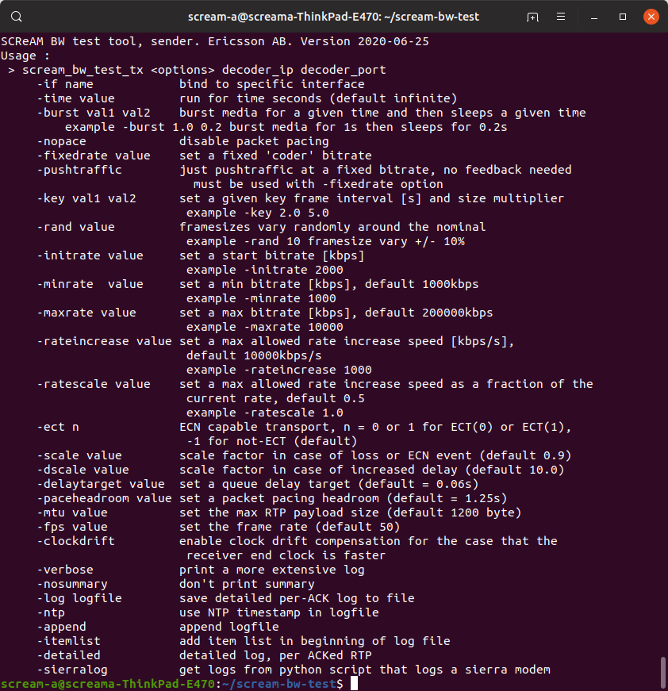
Sender side
By default the tester will run in rate adaptive mode with a RTP media rate that is almost constant (no key frames), the max rate is 200Mbps. In addition a summary report is printed on stdout. Packet pacing is enabled by default
A verbose, more detailed log can be printed on stdout with the –verbose option
Detailed per-ACK log with –log option
-itemlist option adds a line in the beginning that describes the data columns, log file can be read with readtable in matlab.
-clockdrift option compensates for up to 0.05% faster clock on the receiver side
For more truthful modeling of video
-key interval multiplier
Generates key frames every interval s with a size multiplier times larger than the “P-frames”
-rand value
Randomizes frame sizes +/- value %

Slide 8
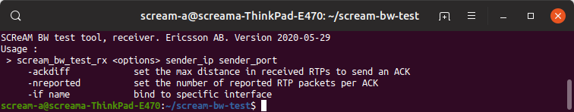
Receiver side
Command line options explained to the right
For very low bitrates (e.g VoLTE):
-ackdiff 1 -nreported 1 reduces size of ACKs and gives info about each received RTP packet

Slide 9
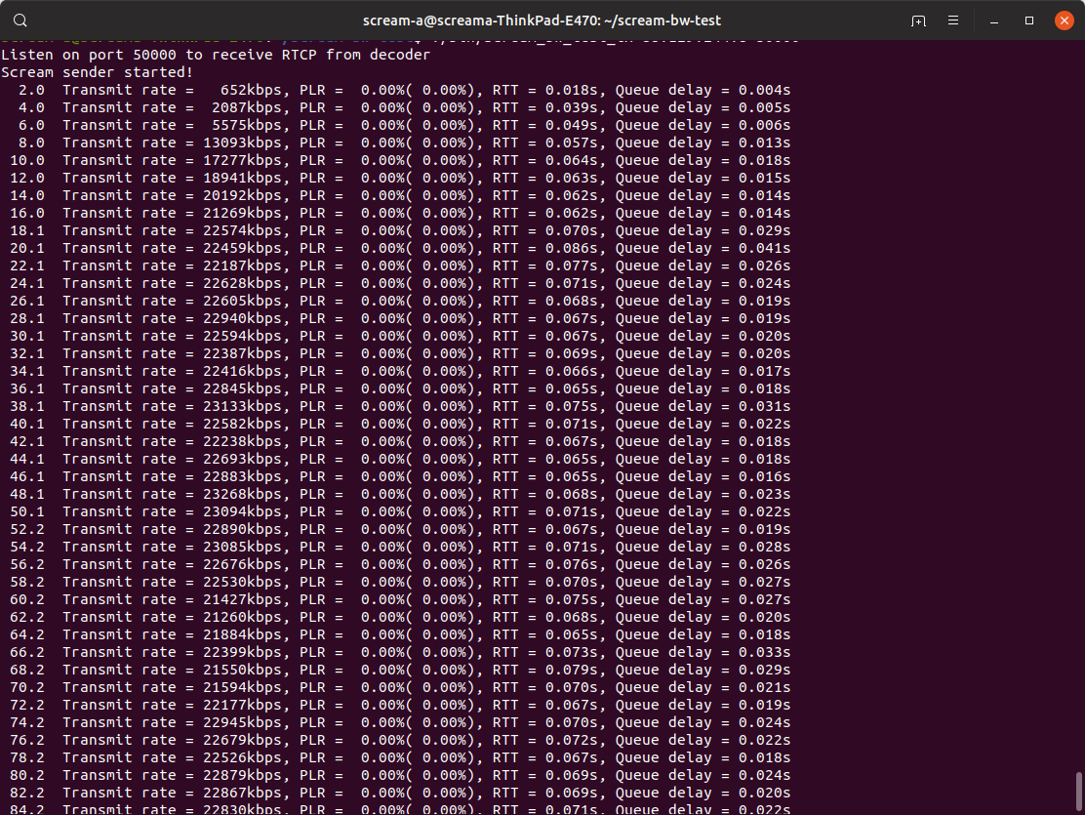
Sender output summary mode (default)
The summary output presents the most important data every 2s
Transmit rate
Packet loss rate (PLR), two values
Average over a 5s window
Long term average (entire test session)
RTT
Queue delay, i.e. the estimated queue delay.

Slide 10
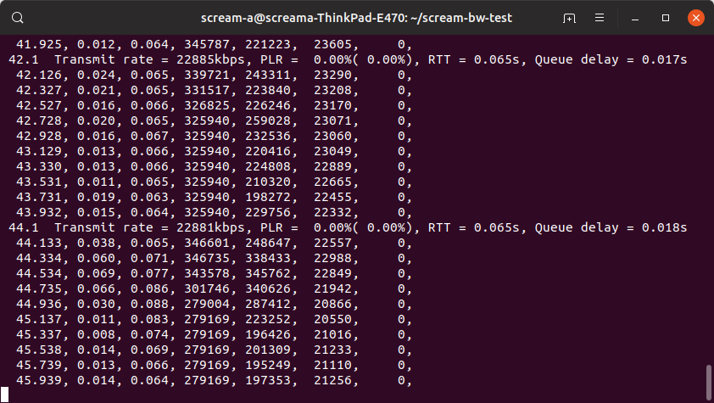
Sender output verbose mode
Detailed information is printed out every 200ms
Enabled with –verbose
-nosummary disables the summary report
8 columns of data
Time [s]
Estimated queue delay [s]
RTT [s] (average)
Congestion window [byte]
Bytes in flight [byte]
Total transmit bitrate [kbps]
Lost bitrate [kbps]
CE marked bitrate [kbps]

Slide 11
Detailed per-ACK log
The detailed per-ACK log generates one log per incoming ACK, stored in a text file
-ntp option enables NTP timestamp
13 columns of data
Time [s]
Estimated queue delay [s]
RTT [s]
Congestion window [byte]
Bytes in flight [byte]
Fast increase mode
Total transmit bitrate [bps]
Stream ID
RTP SN
Bytes newly ACKed
Bytes newly ACKed and CE marked
Media coder bitrate [bps]
Transmitted bitrate [bps]
ACKed bitrate [bps]
Lost bitrate [bps]
CE Marked bitrate [bps]
Marker bit set
1.4666,0.0009,0.1003, 28425,18983,1,1421877,0,212,2518,0,1421877,1421877,1338874,0,0,1
1.4666,0.0004,0.0802, 28425,15253,1,1421877,0,216,3730,0,1421877,1421877,1338874,0,0,1
1.4666,0.0009,0.0602, 28425,11523,1,1421877,0,220,3730,0,1421877,1421877,1338874,0,0,1
1.4666,0.0005,0.0403, 28425,7793,1,1421877,0,224,3730,0,1421877,1421877,1338874,0,0,1
1.4666,0.0000,0.0202, 28425,6581,1,1421877,0,225,1212,0,1421877,1421877,1338874,0,0,0
1.5465,0.0007,0.1001, 28425,20315,1,1462577,0,228,2518,0,1462577,1462577,1303788,0,0,1
1.5465,0.0003,0.0802, 28425,16252,1,1462577,0,232,4063,0,1462577,1462577,1303788,0,0,1
1.5465,0.0008,0.0602, 28425,12189,1,1462577,0,236,4063,0,1462577,1462577,1303788,0,0,1
1.5465,0.0004,0.0402, 28425,8126,1,1462577,0,240,4063,0,1462577,1462577,1303788,0,0,1
1.5465,0.0000,0.0203, 28425,6914,1,1462577,0,241,1212,0,1462577,1462577,1303788,0,0,0
1.6265,0.0008,0.1003, 28425,20315,1,1530568,0,244,2851,0,1530568,1530568,1259669,0,0,1
1.6265,0.0003,0.0802, 28425,16252,1,1530568,0,248,4063,0,1530568,1530568,1259669,0,0,1
.
.
.
14.6419,0.0126,0.0328, 309809,121390,0,43145928,0,35993,14544,0,43145928,43145928,43045184,0,0,0
14.6442,0.0147,0.0349, 309809,108058,0,43145928,0,36004,13332,0,43145928,43145928,43045184,0,0,0
14.6478,0.0153,0.0385, 309809,174623,0,43145928,0,36005,95,0,43145928,43145928,43045184,0,0,1
14.6478,0.0011,0.0214, 309809,164927,0,43145928,0,36013,9696,0,43145928,43145928,43045184,0,0,0
14.6501,0.0030,0.0232, 309809,192898,0,43145928,0,36024,13332,0,43145928,43145928,43045184,0,0,0
14.6523,0.0052,0.0254, 309809,178354,0,43145928,0,36036,14544,0,43145928,43145928,43045184,0,0,0
14.6546,0.0073,0.0275, 309809,165022,0,43145928,0,36047,13332,0,43145928,43145928,43045184,0,0,0
14.6570,0.0095,0.0298, 309809,151690,0,43145928,0,36058,13332,0,43145928,43145928,43045184,0,0,0
14.6594,0.0100,0.0304, 309809,138358,0,43145928,0,36069,13332,0,43145928,43145928,43045184,0,0,0
14.6616,0.0122,0.0324, 309809,123814,0,43145928,0,36081,14544,0,43145928,43145928,43045184,0,0,0
14.6639,0.0144,0.0346, 309809,110482,0,43145928,0,36092,13332,0,43145928,43145928,43045184,0,0,0
14.6673,0.0159,0.0381, 309809,168563,0,43145928,0,36095,2519,0,43145928,43145928,43045184,0,0,1
14.6673,0.0007,0.0209, 309809,161291,0,43145928,0,36101,7272,0,43145928,43145928,43045184,0,0,0
14.6697,0.0027,0.0230, 309809,195322,0,43145928,0,36112,13332,0,43145928,43145928,43045184,0,0,0

Slide 12
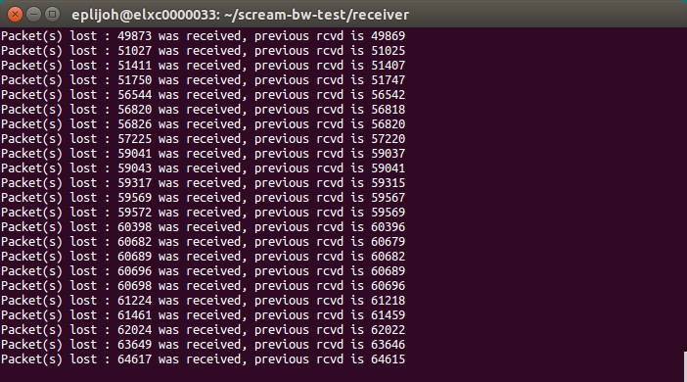
Receiver side log
Indication of lost packets
The number of consecutive lost packets is
SN_{received}-SN_{previous-received} -1

Slide 13
Other
Firewalls may need to be opened up but it is most often not needed
Use e.g firewall-cmd
sudo firewall-cmd --zone=public --add-port=30122/udp
Priority for SCReAM sender and receiver may need to be elevated to avoid that the SCReAM processes are halted by other processes
>sudo nice -n - 10 ./bin/scream-bw-test-rx …..
>sudo nice -n - 10 ./bin/scream-bw-test-rx …..
UDP sockets may need more memory at high bitrates to avoid packet loss
See https://medium.com/@CameronSparr/increase-os-udp-buffers-to-improve-performance-51d167bb1360 for setting of net.core.rmem_max, net.core.rmem_default, net.core.wmem_max and net.core.wmem_default
sudo sysctl -w net.core.wmem_max=26214400
sudo sysctl -w net.core.wmem_default=26214400
sudo sysctl -w net.core.rmem_max=26214400
sudo sysctl -w net.core.rmem_default=26214400

Slide 14
Examples
Below a few examples, the options can be combined
>./bin/scream-bw-test-tx -verbose <receiver side IP> <port>
Print statistics in verbose mode
>./bin/scream-bw-test-tx -log test.txt <receiver side IP> <port>
Save detailed log to test.txt that can be visualized in matlab or octave
>./bin/scream-bw-test-tx -key 2 10 <receiver side IP> <port>
Emulate a key frame (refresh frame) every 2s that is 10 times larger than the normal frame size
>./bin/scream-bw-test-tx -minrate 2000 <receiver side IP> <port>
Set min bitrate to 2Mbps (default 100kbps)
>./bin/scream-bw-test-tx -maxrate 20000 <receiver side IP> <port>
Set max bitrate to 20Mbps (default 100Mbps)
>./bin/scream-bw-test-tx -delaytarget 0.05 <receiver side IP> <port>
Set delay target to 50ms (default 100ms), this makes the congestion controller more sensitive to congestion and gives lower jitter but can result in lower throughput

Slide 15
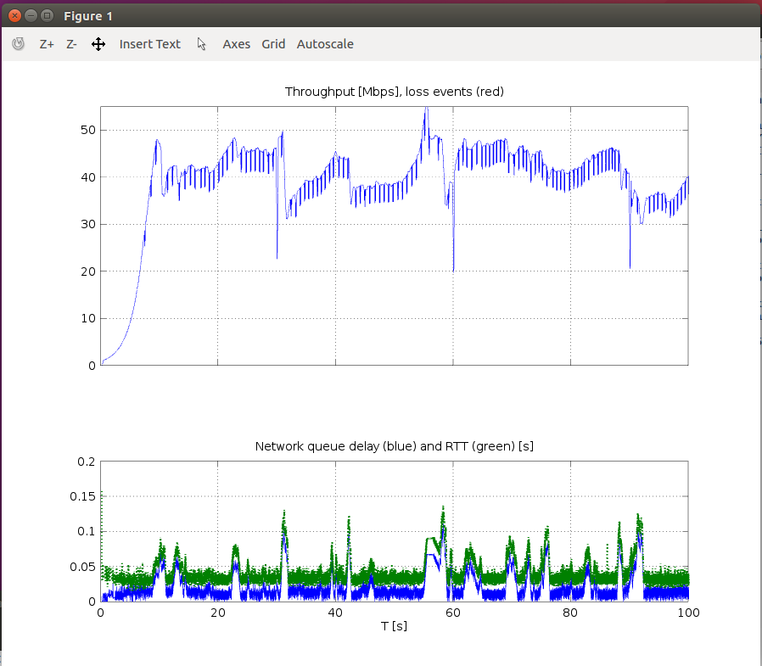
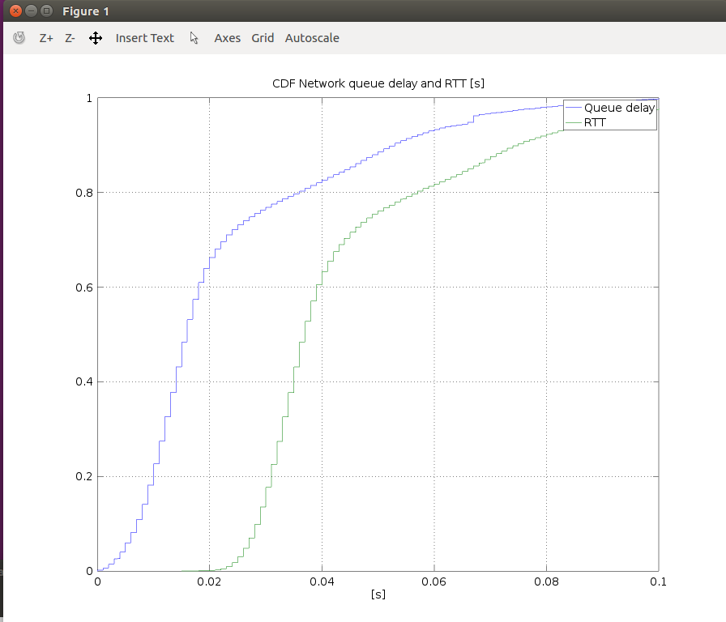
Visualization of data
With octave or matlab installed, it is possible to plot and visualize the performance measurements.
Examples:
Load the data file generated by the -log option
>> a = load(‘test.txt’)
Plot the throughput, queue delay and RTT, note that the drops in throughput every 30s is a SCReAM BW test feature.
>> plot_thp_delay(a,[0 100], 55, 0.2)
Plot a CDF of the RTT and queue delay
>> plot_cdf(a,[0 100]), 0.1)

