Slide 1
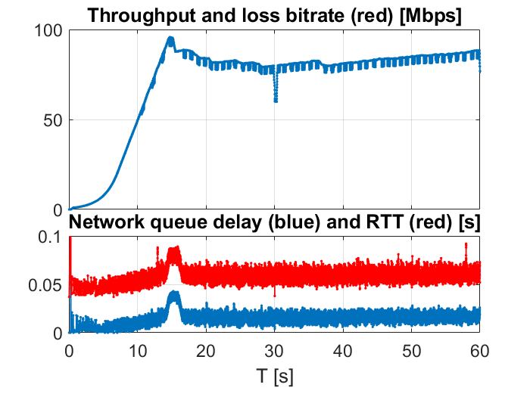
SCReAM BW test tool
A network performance test tool that emulates a video coder
Fixed rate or...
Rate adaptive : Adjusts bitrate to available network bandwith, working range 10kbps-500Mbps
I frames and variable frame sizes can be modeled
Measures : RTT, estimated queue delay, throughput, packet loss
Based on IETF standard
Congestion control (RFC8298)
Algorithm implemented in RC-Car prototype
Sender PC
Receiver PC
Cong. control
Send. side
Cong. control
Recv. side
Fake video encoder
Network

