Slide 1
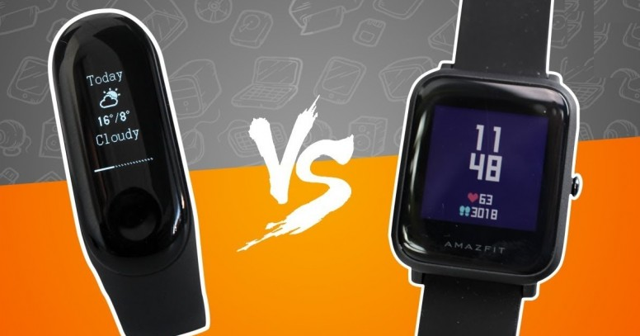
A Research Project by Arghya J Chakraborty.
Fitness Tracker Analysis (Case Study)
Top Ranked Data Science & Analytics Education Provider since 2007

Slide 2
Contents
CASE STUDY
OBJECTIVES
QUESTIONS TO FIND PATTERNS
FINDINGS

Slide 3
Case Study
The Case study has a single dataset.
The dataset consists of different brands that sells Fitness Bands and Smart Watches all over the world.
The dataset gives us the information about different model name, color of the product, selling and original price, etc.

Slide 4
Objectives
Analyze how the fitness industry is evolving and moving forward with latest technologies used in Fitness bands and Smart watches.
Answer all the possible questions that we can raise looking at the dataset.
Analyze which brand is the leading player in the market
Who wins the battle- Fitness Band vs Smart Watch

Slide 5
Questions to find patterns
Fitness Trackers Demand
Number of brands in the market
Brands with average Battery Life more than 14
Smart watches vs Fitness band
Top 5 companies based on no of products
Are fitness trackers with highest ratings more expensive?
Does expensive fitness trackers products have a better battery life?
Common color of fitness trackers over all company's products
Most Common strap material for trackers
Which display is more used in smartwatches and bands?

Slide 6
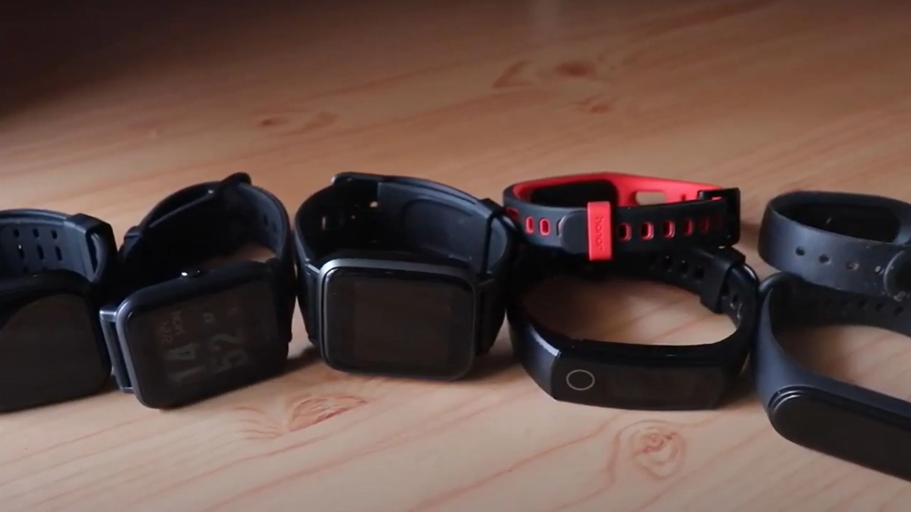
1. Fitness Trackers Demand

Slide 7
2. Number of Brands in the market.
We found that the dataset comprises of total 25 brands that are competing with each other for fitness bands and smart watches.

Slide 8
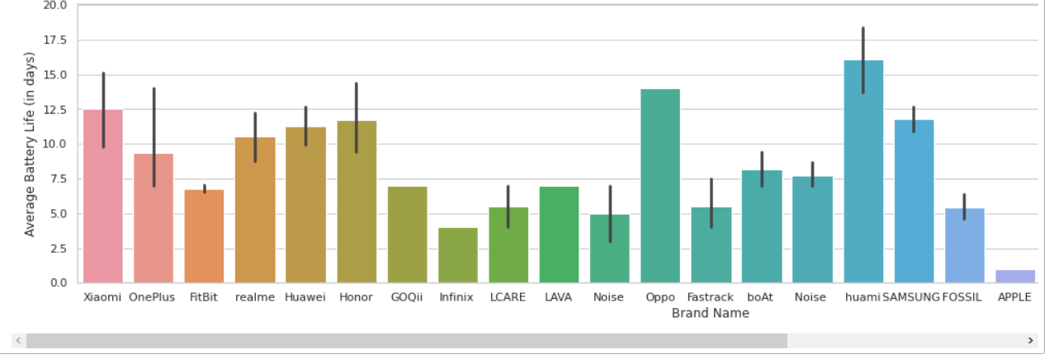
3. Brands with average Battery Life more than 14.

Slide 9
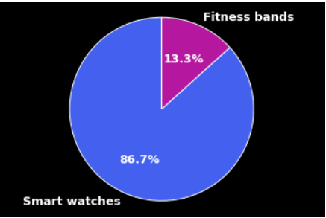
4. Smart watches vs Fitness band.

Slide 10
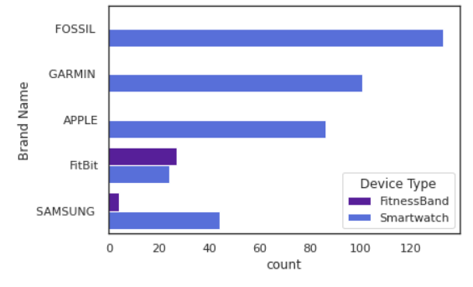
5. Top 5 companies based on no of products.

Slide 11
6. Are fitness trackers with highest ratings more expensive?
No. We cannot say that higher rated products are more expensive.
As there are lot of expensive brands with low ratings as well.

Slide 12
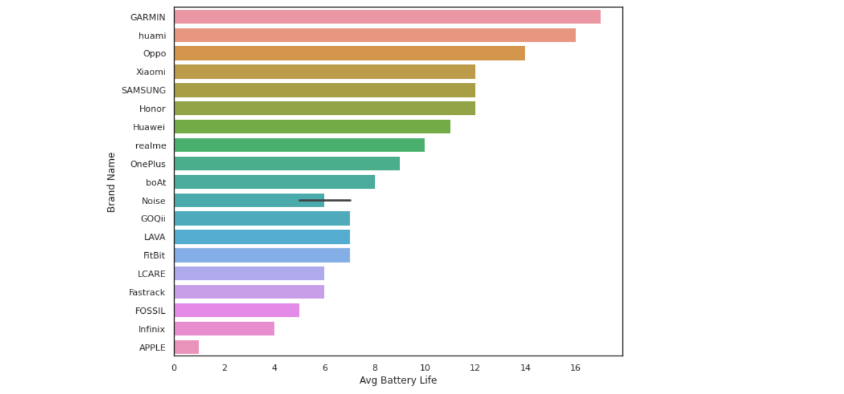
7. Does expensive fitness trackers products have a better battery life?

Slide 13
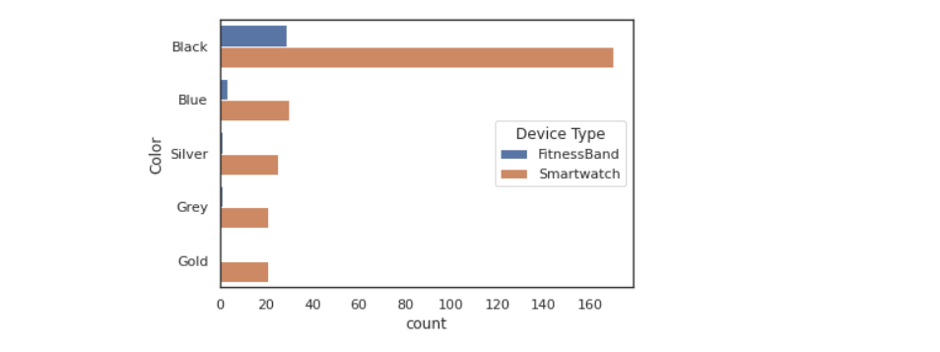
8. Common color of fitness trackers over all company's products

Slide 14
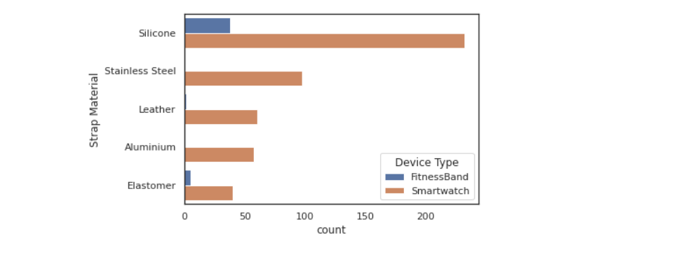
9. Most Common strap material for trackers.

Slide 15
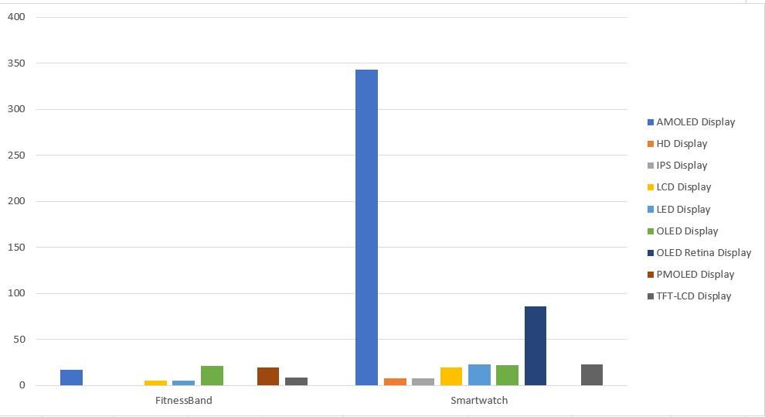
10. Which display is more used in smartwatches and bands?

Slide 16
FINDINGS
WHO WON???
A Big question!
Smartwatches or Fitness Bands?

Slide 17
THANK YOU.

