Slide 1
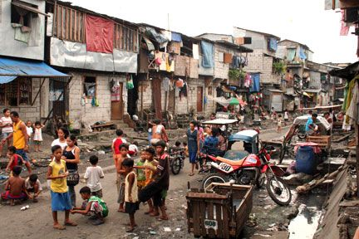
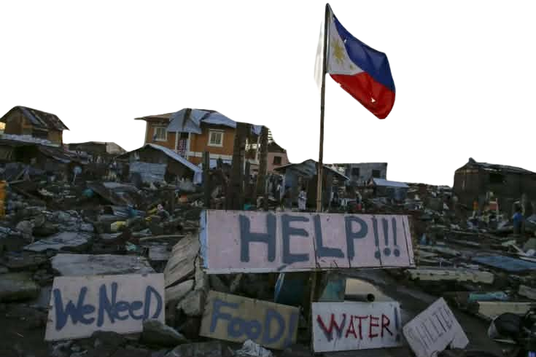
CAPSTONE PROJECT – SOFTWARE DESIGN
PROJECT NEXUS
COMMUNITY AID NETWORK
A Capstone Project presented to the Faculty of the College of Engineering and Digital Technology, ICCT Colleges Foundation Inc., in partial fulfillment of the requirements for the course Software Design.
A Web-Based Platform for Disaster Response and Social Support
Presented by:
Bradecina, Art Lenard B.
Ladrera, Jose Mariano L.
Etac, Argie M.
Bayani, Eunice Gay D.
Montes, Adrian S.
Canatoy, Ara Jean C.
Cu, Lanze Axhel Kenneth D.
Quiban, Shanti T.
Tuvilla, Anjho M.

Slide 2
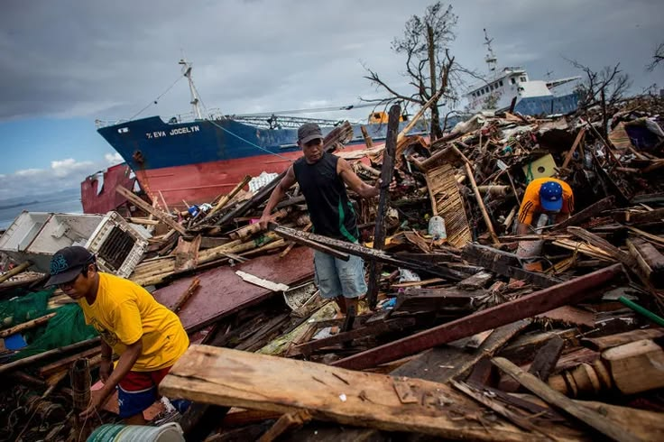
CHAPTER 1 - INTRODUCTION
THE PROBLEM AND ITS BACKGROUND
THE PROBLEM AND ITS BACKGROUND
Communities such as barangays, shelters, and orphanages often face serious challenges when disasters like typhoons, fires, or poverty strike. Based on observations and conversations with local leaders, the current process of asking for help is scattered — requests are shared through social media posts, word of mouth, or informal notices. This leads to delays, confusion, and sometimes duplication of aid, making it harder for essential goods and medicines to reach those who need them most.
Search it – Click it – Helping Hand
Search it – Click it – Helping Hand
C A N
Community Aid Network is a web-based application that serves as a centralized platform for verified community representatives to post their needs and for helpers to find and respond directly. Unlike donation systems focused on money, this project emphasizes essential items and medical supplies, ensuring that tangible resources are prioritized. By streamlining communication and improving transparency, the platform aims to strengthen disaster response, support vulnerable groups, and promote a culture of shared responsibility within the community.

Slide 3
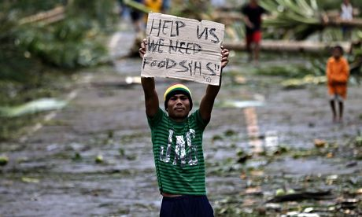
1.2 – STATEMENT OF THE PROBLEM
Aid requests are currently spread across social media, word of mouth, or informal notices, leading to confusion and delays.
A centralized posting system where verified community representatives can submit structured requests for essentials.
UNORGANIZED REQUESTS
A searchable database with filters (location, type of need, urgency) to help helpers quickly find communities to support.
Donors and volunteers cannot easily identify which communities require urgent help.
COMMUNITY SEARCH DIFFICULTY
C A N
Helpers often have no reliable way to coordinate with community leaders, causing miscommunication or duplication of aid.
LACK OF DIRECT COMMUNICATION
A secure messaging system that connects helpers directly with barangay officials or community representatives.
Donors may not know if their contributions reached the intended recipients, reducing trust and willingness to help.
A request tracking and update mechanism where communities can mark fulfilled needs and provide progress updates.
Donors may not know if their contributions reached the intended recipients, reducing trust and willingness to help.
LIMITED TRANSPARENCY
Communities in remote areas with poor internet access may face challenges in using the system.
ACCESIBILITY CONSTRAINTS
A lightweight, mobile-friendly interface designed to work on basic smartphones and low-bandwidth connections.
Community Aid Network is a web-based application that serves as a centralized platform for verified community representatives to post their needs and for helpers to find and respond directly. Unlike donation systems focused on money, this project emphasizes essential items and medical supplies, ensuring that tangible resources are prioritized. By streamlining communication and improving transparency, the platform aims to strengthen disaster response, support vulnerable groups, and promote a culture of shared responsibility within the community.

Slide 4
1.3 – OBJECTIVES OF THE STUDY
SPECIFIC OBJECTIVES
WHAT THIS STUDY AIMS TO ACHIEVE
1
Organized Requests
To establish a centralized posting system where verified barangay officials and community leaders can submit structured requests for essential goods and medicines.
G
E
N
E
R
A
L
O
B
J
E
C
T
I
V
E
2
Finding Communities in Need
To develop a searchable database with filters for location, urgency, and type of need, enabling helpers to quickly identify communities.
The primary objective of this project is to develop a centralized and accessible web-based application that connects communities in need with individuals and organizations willing to provide assistance. By integrating a structured system for posting requests, searching for communities, and facilitating direct communication between helpers and recipients, the project aims to enhance the efficiency, transparency, and timeliness of community aid distribution.
3
Direct Communication
To integrate a secure messaging feature that connects helpers directly with community representatives.
4
Transparency in Aid Distribution
To implement a request tracking and update mechanism where communities can mark fulfilled needs
5
Accessibility Constraints
To design a lightweight, mobile-friendly interface that functions on basic smartphones and low-bandwidth connections, demonstrating usability during pilot testing in three barangays within twelve months.

Slide 5
1.4 – SCOPE & LIMITATIONS
WHAT CAN COVERS AND WHAT IT DOESN’T
LIMITATIONS
Financial
SCOPE
SCOPE
No monetary transactions or financial contributions.
Target Users
Focus of Application
Development of a web-based platform connecting communities in need with helpers.
Barangays, orphanages, animal shelters, and vulnerable groups.
Technical
Requires internet access and devices; limited participation in remote areas.
Data Accuracy
Core Features
Focus Area
Verified representatives post requests for essential goods and medicines; helpers can search, filter, and coordinate aid. Includes request tracking, secure messaging, and transparency tools.
Tangible essentials only and community service volunteer.
Relies on information from community representatives; delivery cannot be independently verified.

Slide 6
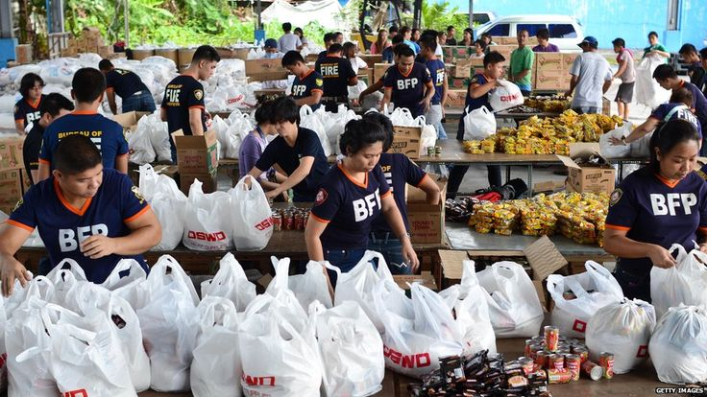
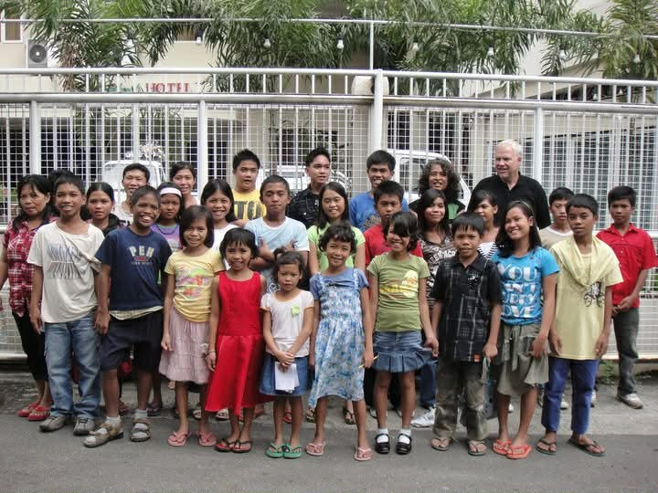

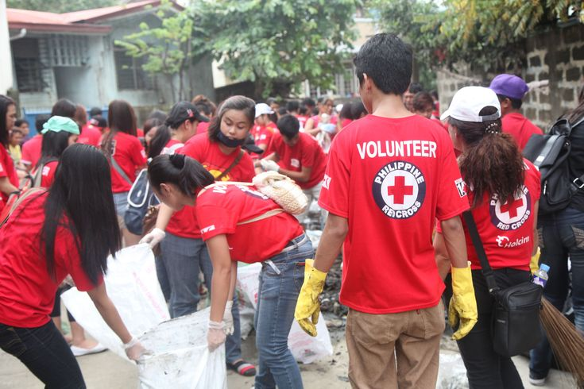
1.5 – SIGNIFICANCE OF THE STUDY
WHY THIS STUDY
MATTERS
This study is significant because it introduces a web-based application that directly improves how communities request and receive essential goods, medicines, and community service volunteers.
DIRECT BENEFICIARIES
INDIRECT BENEFICIARIES
1
Communities
1
Local Communities and Barangays
Gain a structured way to request and receive essential goods and medicines, reducing delays and confusion during emergencies.
Receive structured support during disasters and emergencies, improving resilience and recovery.
2
Community Leaders and Representatives
Donors and Volunteers
2
Benefit from an organized system to post verified requests, track fulfillment, and coordinate with helpers, minimizing duplication of aid and logistical errors.
Benefit from a reliable platform that assures their contributions reach verified recipients, encouraging continued participation in community aid.
3
Helpers and Volunteers
Society at Large
3
Have a reliable platform to identify urgent needs, connect directly with communities, and provide assistance with confidence that their contributions are reaching the intended recipients.
Gains from a culture of solidarity and shared responsibility, where technology bridges the gap between those in need and those willing to help.

Slide 7
1.6 – DEFINITION OF TERMS
KEY TERMS IN CAN
Database
The organized collection of community requests and helper information, searchable by filters such as location, urgency, and type of need.
Donors / Helpers / Volunteers
Individuals or groups willing to provide assistance in the form of essential goods and medicines, not financial support.
Messaging System
A secure communication feature within the app that allows helpers and community representatives to coordinate aid directly.
Request Tracking
A transparency mechanism where communities update the status of posted needs, marking them as fulfilled or ongoing to build trust.
Transparency
The practice of ensuring accountability by showing updates on requests and aid received, fostering confidence between communities and helpers.
Accessibility
In this study, accessibility refers to the ability of users, especially those in remote areas with limited internet or basic smartphones, to effectively use the system without technical barriers.
Aid Distribution
The process of delivering essential goods and medicines from helpers to communities, which the system supports through request tracking and updates.
Barangay Officials / Community Representatives
Verified leaders authorized to post requests for their community’s needs within the platform, ensuring legitimacy and accountability.
Centralized Posting System
A structured feature of the application where all requests for help are submitted in one place, reducing scattered communication and delays.
Community Aid Network (CAN)
The proposed web-based application developed in this study, designed to connect communities in need with helpers and volunteers.

Slide 8
PROJECT NEXUS: SOFTWARE ROOKIES TEAM
PROJECT MANAGEMENT
DESIGN & ARCHITECTURE
Project Manager
UI/UX Lead Designer
Bradecina, Art Lenard B.
Etac, Argie M.
Database Administrator
Technical Writer & UML Architect
Ladrera, Jose Mariano L.
QUALITY & COORDINATION
Bayani, Eunice Gay D.
DEVELOPMENT
UAT Coordinator & Pitch Presenter
Lead Backend Developer
Ladrera, Jose Mariano L.
Canatoy, Ara Jean C.
Lead Fronted Developer
Tuvilla, Anjho M.
Quality Assurance Engineer
Montes, Adrian S.
DevOps & Deployment Specialist
System Analyst
Quiban, Shanti T.
Cu, Lanze Axhel Kenneth D.

