Slide 1
Novibet Casino Insights and Predictions

Slide 2
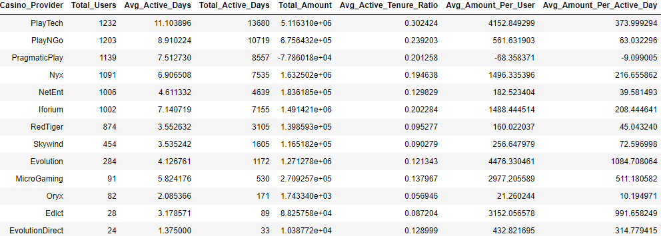
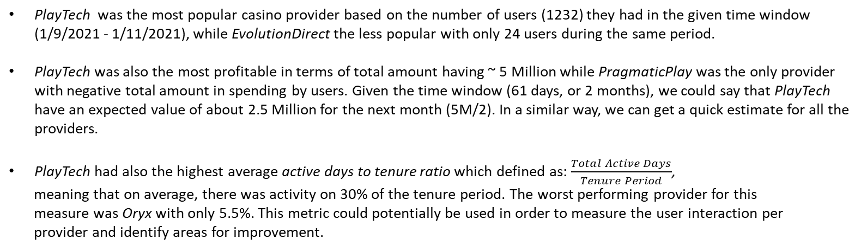
Casino Games Analysis
PlayTech was the most popular casino provider based on the number of users (1232) they had in the given time window (1/9/2021 - 1/11/2021), while EvolutionDirect the less popular with only 24 users during the same period.
PlayTech was also the most profitable in terms of total amount having ~ 5 Million while PragmaticPlay was the only provider with negative total amount in spending by users. Given the time window (61 days, or 2 months), we could say that PlayTech have an expected value of about 2.5 Million for the next month (5M/2). In a similar way, we can get a quick estimate for all the providers.
PlayTech had also the highest average active days to tenure ratio which defined as: $\frac{Total Active Days}{Tenure Period}$,
meaning that on average, there was activity on 30% of the tenure period. The worst performing provider for this
measure was Oryx with only 5.5%. This metric could potentially be used in order to measure the user interaction per
provider and identify areas for improvement.

Slide 3
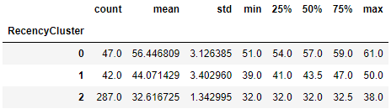
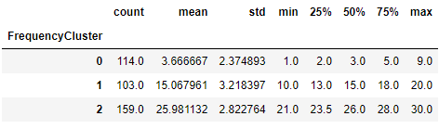
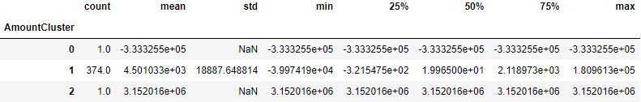
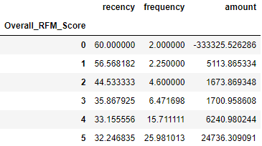
Customer Segmentation – RFM Clustering
Customer Segmentation was performed using K-Means Clustering based on the casino games data
Only users being registered for the whole time period (61 days) were included in this analysis in order to have the same tenure
Recency (R), Frequency (F), Monetary (M) values calculated and 3 clusters were created for each of these metrics:
Cluster 2 is the best with mean recency 32.6, cluster 0 is the worst with mean recency 56.4
Cluster 2 is the best with mean frequency 25.9, cluster 0 is the worst with mean frequency 3.6
Cluster 2 is the best with mean amount 3.15 M, cluster 0 is the worst with mean amount -333K
Then, an overall RFM score calculated by summing the individual cluster numbers (0, 1, 2) together. In this way, the ideal cluster would have a score of 6 (2+2+2) while the worst cluster would have a score 0. Average RFM values per Overall Score are given below:
Customers with overall score 0 can be classified as ‘Low Value’
Customers with 0 < overall score <=3 can be classified as ‘Mid Value’
Customers with overall score > 3 can be classified as ‘High Value’

Slide 4
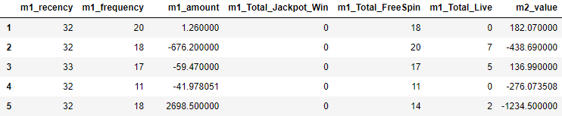
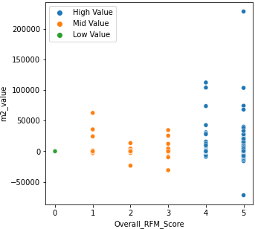
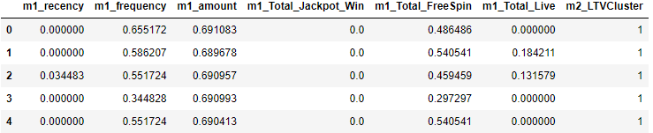
Lifetime Value Prediction
In order to create a predictive model for the customer lifetime value for the next month, we could use as predictors the RFM metrics (and other available data) for the preceding month. In our case, we could therefore, use the RFM metrics for the period 1/9/21 to 30/9/21 and try to predict the amount value for the following period (1/10/21 – 1/11/21).
Cut-off date
1/9/21 30/9/21
1/10/21 1/11/21
RFM Metrics and other data (model features)
Total Value (target variable)
Time
If the target variable is the amount of value, then this is a regression problem and we would want to predict the value
An alternative approach would be to create segments for the m2_value and then target the segment (classification task)
Despite the limited data available, some positive correlation can be seen. High RFM score for previous month means high value for next month.

Slide 5
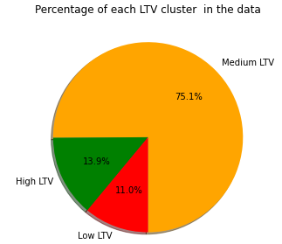
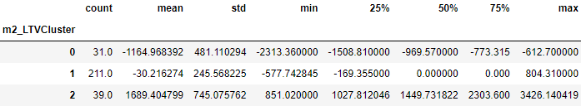
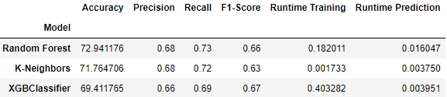
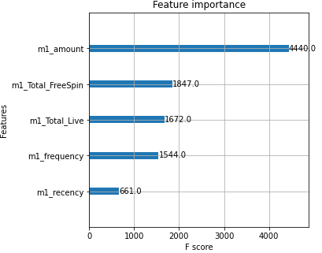
Lifetime Value Prediction (Cont.)
For this case, the second approach was chosen, therefore the target amount was segmented in 3 different clusters (0 - Low, 1 - Medium, 2 - High) and different models created in order to predict the customer cluster for the next month (multiclass classification problem)
After applying K-Means algorithm, we got that 75% of the customers belong to ‘Medium’ class
Low
Medium
3 different machine learning models were used in order to predict the customer class and the comparison results are summarised below:
High
Best class 2, with mean LTV 1689
Although Random Forest had the best Accuracy, Precision and Recall values, XGBoost model had the highest F1-Score which is a weighted average of Precision and Recall and probably the most important metric given the uneven class distribution in the data.
Therefore, using XGBoost, was found that the most important
feature was the total amount of the preceding month (m1_amount), meaning that this variable had the larger effect on the model when trying to predict the LTV class of the next month.

Slide 6
Customer Churn Prediction (some ideas for discussion)
Due to time constraint, a churn prediction model has not been developed/tested but below there are some ideas on how we could approach a problem like that for the given data.
Ideally we would want a churn model to predict the churn in advance (e.g. 2 weeks in advance). This would require the selection of a cut-off date point where
we would use data features only for the period preceding the cut-off date, and then try to predict probability of churn in the next period (after the cut-off date).
In order to do that we can apply a similar methodology as described in slide 4:
Firstly, for each user, we can define as ‘activity’ any deposit (customer wallet dataset) or casino game (casino games dataset) they have.
Then, we could get the maximum activity date which is the max(deposit date, casino game date) and use that along with the ‘StatusSysname’ (casino users data)
in order to identify if the user is churned and therefore to create the target column. In order to do that, we will need to get the active users before the
cut-off date and then check whether they are churned or not in the period after the cut-off date.
Then we could train classification models and get churn probabilities for each customer
week 1 – week 6
week 7 – week 8
Cut-off date
week 8
week 1
week 6
Can use:
RFM Metrics
Activity Metrics (games, provider, amount etc.)
User Features (age, gender etc.)
Binary target column (Churn, No Churn)

Slide 7
Final thoughts
Being able to accurately predict the customer lifetime value and Churn as per the previous analysis and model approaches, is very important since these will allow the casino department to plan and prioritise actions and target individual users/groups.
For example having a list with the users with the highest churn probabilities, the relevant customer department can start engaging with those potential churners by offering some kind of bonus etc.
Similarly, knowing the user CLV and effectively segmenting them, will help the casino to design more efficient strategies and identify in advance which customers will bring more value, and which ones they should focus on first and invest in.
Points for Improvement
Given data was limited, therefore, if there was more data, it would be interesting to look into wider time windows (e.g. years) and include the seasonality factor as feature/element in our analysis/models.
It would probably also worth to include demographic data in the models (these kind of features were not used in the current analysis) to see their effect and importance in the predictions.
Having more data to use, would help us to build and train better models and also to have more robust predictions.
Finally, if there was more time & data, it would be good to apply hyper parameter tuning to our models.

