Slide 1
Statistical Methods for
ESA Agenda-Setting Analysis
Agnes Namyalo

Slide 2
Case Study — Media Attention and Congressional Attention to ESA
Question: Does media coverage of ESA events in month t predict congressional attention in month t+1?
News Articles
Congressional documents
Documents: 300 documents
Documents: 300 documents
Period: 1984 – 2025
Period: 1995 – 2025
Categories: 10 ESA meta-categories
Categories: 10 ESA meta-categories
Variable: news_t = count of listing articles
Variable: cong_t = count of listing documents
What kind of data do I have?
Counts, not measurements, e.g., cong_t can only be 0, 1, 2, 3, 5 — never 0.3 or −0.1
Non-negative by definition, e.g., a month cannot have −1 congressional documents
Heavily zero-inflated, e.g., 359 of 371 months (96.8%) have cong_t = 0

Slide 3
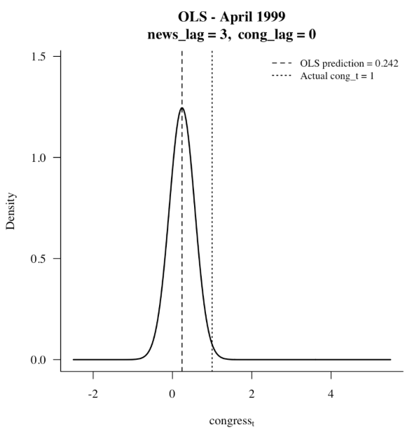
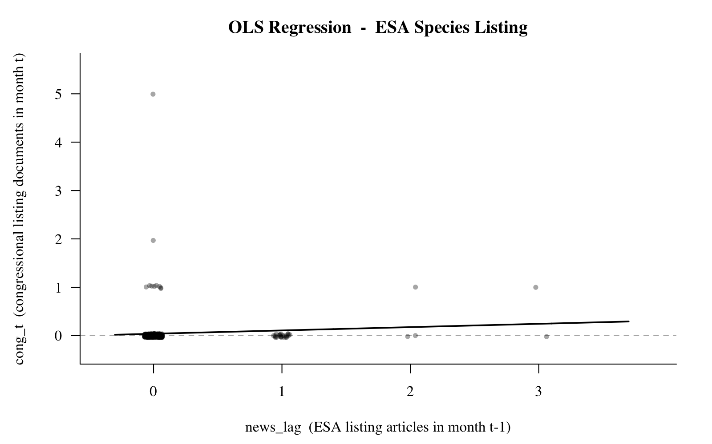
Describing the Response Variable — Congressional Listing Documents (cong_t)
R Summary Output
Data Summary Statistics
Parameter | value
n (months) | 371
Mean | 0.0458
Variance | 0.1030
Var / Mean | 2.2483
Min | 0
Median | 0
Max | 0
Zeros (0) | 359 (96.8%)
Non-zeros (n) | 12 (3.2%)
Skewness | 11.27
Problem:
96.8% structural zeros
Var > Mean
Right-skew (skewness=11.27)
cong_t violates every assumption of OLS. Count regression is required.

Slide 4
Solution: Use of Generalized Linear Models (GLM)
Approaches that allow the dependent variable to follow a different distribution
1
Poisson Regression
log(λ) = α + β₄×news_lag + β₃×cong_lag
λ = exp(α + β₄×news_lag + β₃×cong_lag)
Predictions are always non-negative. exp(β₄)=2.04 means each extra news article doubles the expected count. But Var=Mean assumption still violated (Var/Mean=2.25).
2
Quasi Poisson
log(λ) = α + β₄×news_lag + β₃×cong_lag
Var(cong_t) = φ × Mean(cong_t) where φ = dispersion parameter
Dispersion parameter: φ = Σ[(cong_t − λ̂)² / λ̂] / (n − p) = 2.50
Where:
cong_tᵢ = observed congressional document count in month i
λ̂ᵢ = fitted (expected) Poisson count in month i
n = number of observations (371 months)
p = number of estimated parameters (3: α, β₄, β₃)
n − p = degrees of freedom (368)
Σ = sum over all months i
SE correction: SE_quasi = SE_poisson × √φ = SE_poisson × √2.50 = SE_poisson × 1.581
Poisson model, but allowing the dispersion parameter φ to be ≠ 1
Variance = φ × Mean
φ = 1 → standard Poisson (assumed) φ = 2.50 → variance is 2.5× what Poisson assumes
Every SE inflated by √2.50 = 1.581 → more honest, conservative p-values

Slide 5
Solution: Use of Generalized Linear Models (GLM)
Approaches that allow the dependent variable to follow a different distribution
3
Negative Binomial
congress_t ~ NegBin(μ, θ)
log(μ) = α + β₄×news_lag + β₃×cong_lag → μ = exp(α + β₄×news_lag + β₃×cong_lag)
Variance = μ + μ²/θ (θ = dispersion parameter, estimated by maximum likelihood)
Where:
μ = expected count (same as λ in Poisson) — fitted from the model
θ = dispersion parameter (also written k or r) — estimated by MLE
μ²/θ = extra variance beyond Poisson — grows quadratically with μ
Γ(·) = gamma function — generalisation of factorial used in the PMF
β₄ = news_lag coefficient → exp(0.486) = 1.63× (each article multiplies expected count)
β₃ = cong_lag coefficient → exp(0.625) = 1.87× (each prior doc multiplies expected count)
θ → ∞ : Variance → μ (collapses to Poisson, thin tails) θ → 0 : Variance >> μ (fat tails, extreme counts more likely) Your data: θ = 0.058 → very fat tails
Variance comparison at overall mean (μ = 0.046):
Model
Formula
Predicted Variance
vs Actual (0.103)
Poisson
Var = μ
0.046
Underestimates
Quasi-Poisson
Var = 2.50 × μ
0.115
Slightly overshoots
Negative Binomial
Var = μ + μ²/0.058
0.082
Closest to actual
Negative Binomial adds a dispersion parameter θ allowing Variance > Mean — using a quadratic variance function that better fits data with extreme counts.
Unlike Quasi-Poisson (linear correction applied after Poisson fitting), NB is a full maximum likelihood re-estimation — the coefficients themselves change.
β₄ shifts from 0.714 (Poisson) → 0.486 (NB): NB redistributes weight away from the January 2025 spike (cong_t = 5), which Poisson treats as near-impossible.
Limitation: NB still cannot separate structural zeros (Congress never crosses the threshold) from sampling zeros (probability was low but non-zero) — this is why the Hurdle model is needed on top.

Slide 6
Solution: Use of Generalized Linear Models (GLM)
Approaches that allow the dependent variable to follow a different distribution
4
Hurdle Model
Why needed: 97% of months are zero — but zeros come from two separate processes that no single-part model can separate.
Sampling zero: news & prior activity are low → expected count near 0 → zero drawn by chance from the count process
Structural zero: ESA listing never crosses the congressional attention threshold — silence regardless of news coverage
PART 1 — Binary Hurdle (Logistic Regression): Does Congress cross the attention threshold?
P(cong_t > 0) = logistic(α₀ + β₄₀×news_lag + β₃₀×cong_lag) where logistic(x) = exp(x) / (1 + exp(x))
Where:
α₀ = baseline log-odds of any congressional activity (when both lags = 0)
β₄₀ = how each news article changes the log-odds of Congress crossing the attention threshold
β₃₀ = how prior congressional activity changes the log-odds of any activity this month
logistic(·) = converts log-odds to probability (always between 0 and 1)
PART 2 — Count Component (Negative Binomial): How many documents given Congress IS active?
cong_t | cong_t > 0 ~ NegBin(μ, θ)
log(μ) = α₁ + β₄₁×news_lag + β₃₁×cong_lag (estimated from the 12 active months only — 359 structural zeros excluded)
Where:
α₁ = baseline log expected count when Congress IS active
β₄₁ = how each news article multiplies the expected count given Congress is already active
β₃₁ = persistence — prior activity effect on count intensity
θ = NB dispersion parameter — fat tails for extreme months like January 2025 (cong_t = 5)
Key insight — two coefficients for news_lag:
β₄₀ (Part 1): Does media coverage increase the probability that ESA listing crosses the congressional attention threshold?
β₄₁ (Part 2): Given Congress is already engaged, does more media coverage produce more documents?
No other model in the progression produces two separate coefficients — OLS, Poisson, QP, and NB all give one. The Hurdle model answers both the threshold question and the intensity question simultaneously.

Slide 7
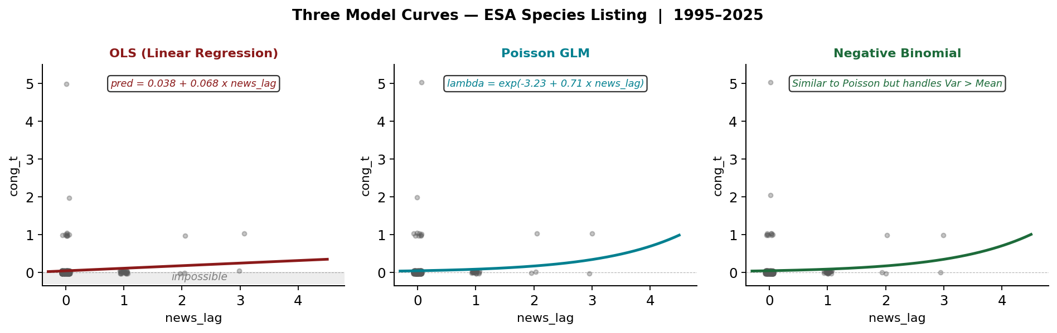
Comparing the Three Model Curves — Why the Curve Shape Matters
Why the lambda shift graph matters
At baseline (news_lag=0): lambda = 0.039 (near zero) At news_lag=3 (April 1999): lambda = 0.336 (7x higher) But zero remains most likely outcome even at news_lag=3. This is episodic agenda-setting — rare, concentrated bursts.

Slide 8
Key Findings and Recommended Path Forward
1
β₄ is positive in both OLS and Poisson
Media coverage last month predicts congressional activity this month — confirmed by both models. Each extra news article roughly doubles the expected count (exp(β₄)=2.04).
2
OLS is misspecified — must be rejected
OLS predicts 0.242 congressional documents — an impossible fraction. The wrong model produces untrustworthy results regardless of what it finds.
3
Overdispersion confirmed (Var/Mean = 2.25)
Poisson assumes Var=Mean. This is violated. Standard Poisson underestimates uncertainty and assigns unrealistically low probability to extreme months.
4
97% structural zeros require hurdle model
Congress is silent in 97% of months. A hurdle model separates structural silence from the count process — the right model for this data structure.
Recommended Model Path:
OLS → Poisson (baseline) → Negative Binomial (overdispersion) → Hurdle Model (structural zeros)
Summer task: understand each model well enough to justify the choice in the proposal defence

