Slide 1

Walmart Sales Analysis
Trends and Insights for Business Optimization
Team Members:
Agraja Gottipati
Spandana Pandi
Kavya Alavala
Varshitha Nalluri

Slide 2
Table of Contents
Main Objectives
Introduction
Tools & Technologies
High level Architecture
Explanation of Architecture
Goals

Slide 3
Main Objectives
Use PySpark to clean and process Walmart sales data.
Perform trend analysis and forecasting to understand sales patterns.
Identify top-performing products and evaluate regional sales performance.
Provide actionable recommendations for inventory optimization

Slide 4
Introduction
The project leverages PySpark for distributed data processing and analysis of Walmart sales data. This enables efficient handling of large datasets for advanced trend analysis and forecasting. Cleaned data is visualized in Excel or Tableau to derive actionable insights for sales optimization. We have React application allows users to upload and visualize sales data dynamically. Users can select specific parameters such as data columns for the X and Y axes, and choose aggregation levels like Monthly, Quarterly, Half-Yearly, or Annual to tailor the analysis. This interactive functionality enables a detailed and flexible exploration of sales trends and insights. Here we are going to demonstrate our project here: http://localhost:3000/

Slide 5

Tools and Technologies
Programming Language: Python (for data preprocessing and analysis) and JavaScript
Frameworks and Libraries: 1.PySpark (for distributed data processing)
2.React.js (for interactive UI development) 3.Chart.js (Visualization library for rendering interactive charts.) 4.React-Chartjs-2: React wrapper for Chart.js. 5.Papaparse: Library for parsing CSV files in JavaScript.
Visualization Tools: Excel (for pivot tables and chart creation)
Dataset Source: Kaggle (for sourcing Walmart sales data)
Development Tools: Visual Studio Code (for coding)
Version Control: Git and GitHub (for collaboration and version tracking)

Slide 6
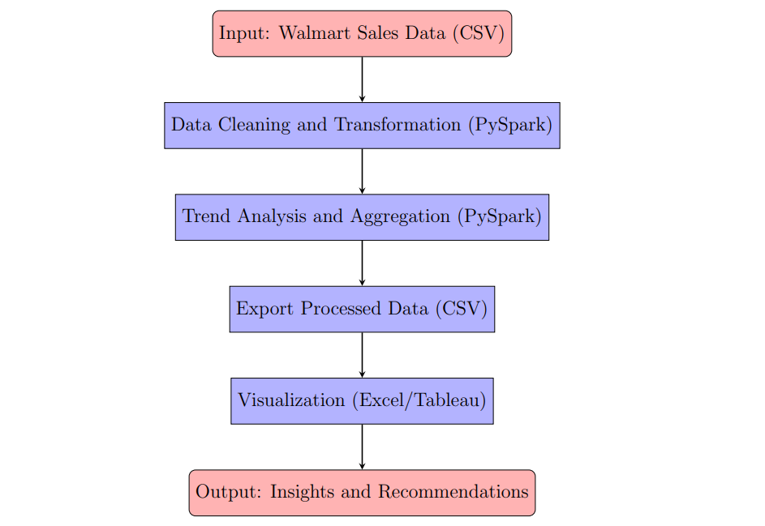
High-Level Architecture

Slide 7
Explanation of the Diagram
Input: Walmart sales data in CSV format, containing store, department, date, and sales amount.
Data Processing:
Clean and process data using PySpark.
Perform transformations (filtering, aggregating, joining).
Trend analysis for monthly and yearly sales patterns.
Export: Processed data exported as a CSV file.
Visualization: Use Excel/Tableau for charts and dashboards.
Output: Insights into sales trends, inventory optimization, and regional performance.

Slide 8
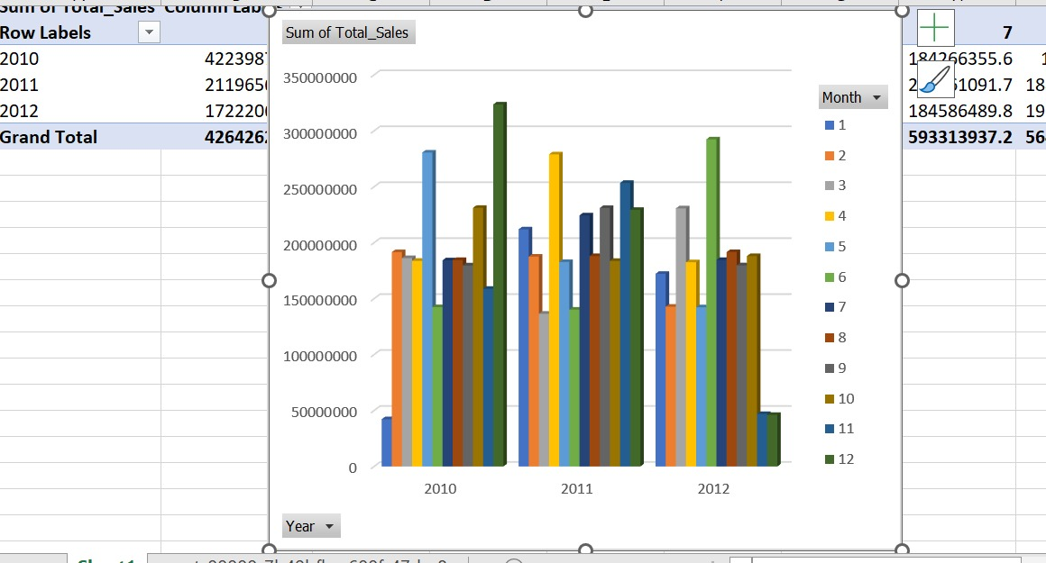
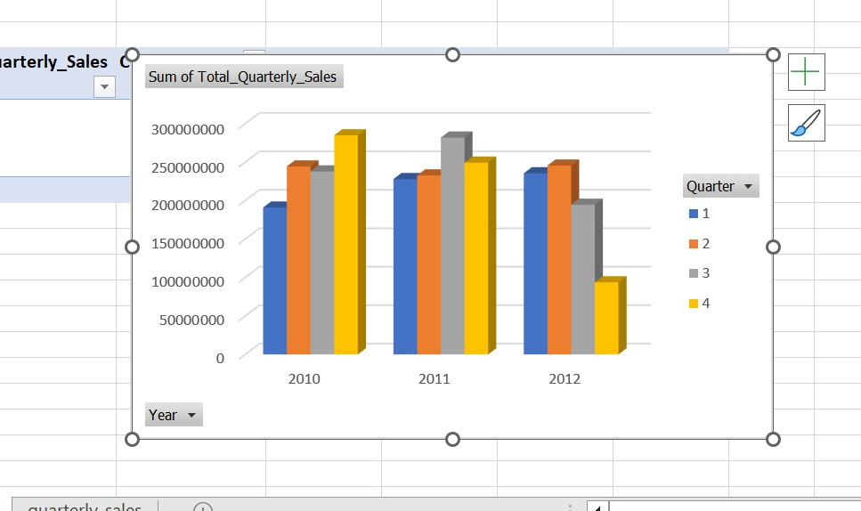
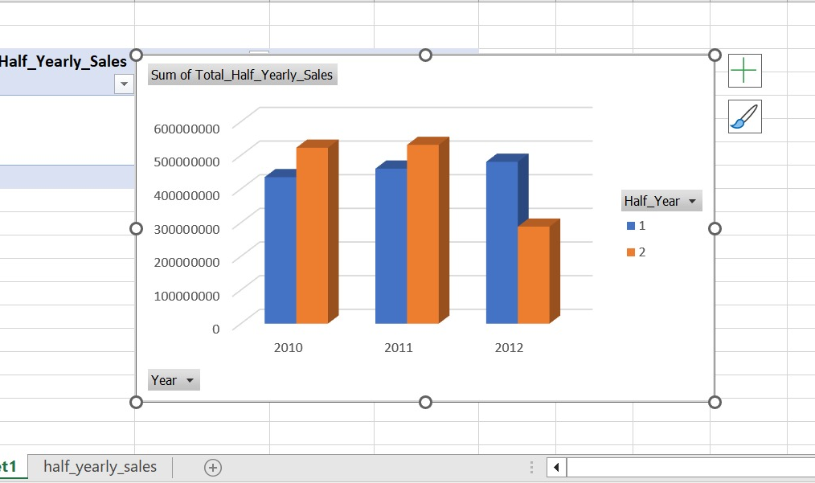
Goals
Walmart sales analysis for 2010, 2011, and 2012 displayed monthly, highlighting total sales for each month.
Walmart sales analysis for 2010, 2011, and 2012 displayed quarterly, comparing total sales for Q1, Q2, Q3, and Q4 of each year.
Walmart sales analysis for 2010, 2011, and 2012 displayed half-yearly, comparing sales for H1 (Jan-Jun) and H2 (Jul-Dec) of each year.

Slide 9
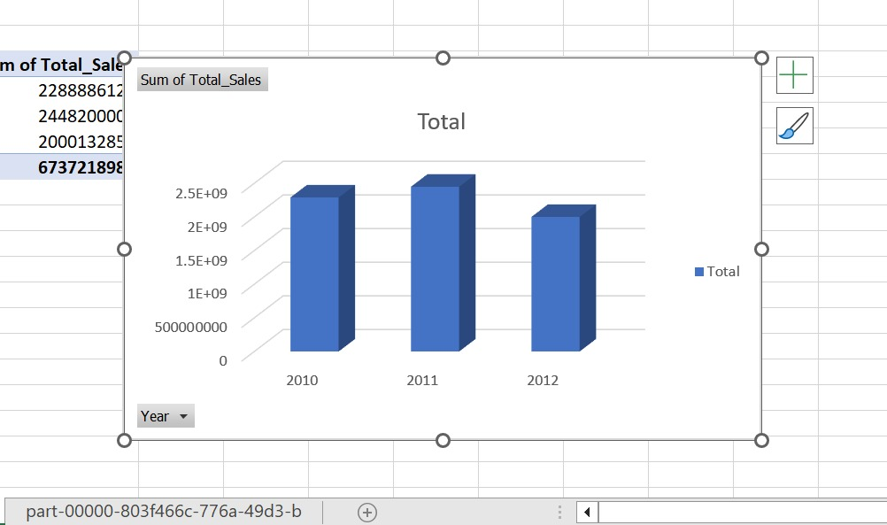
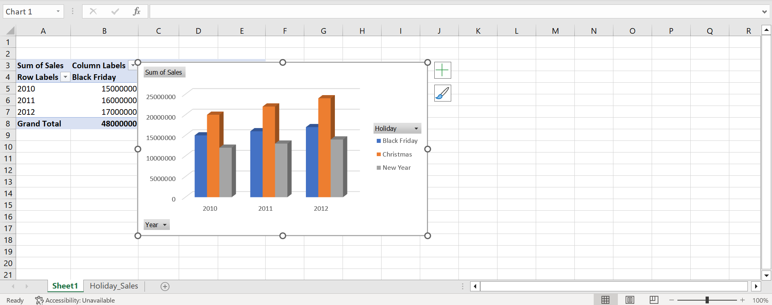
Goals(continued)
Walmart sales analysis for 2010, 2011, and 2012 displayed annually, showcasing total yearly sales.
Walmart holiday sales analysis for 2010, 2011, and 2012 displayed according to the total sales during holiday periods.

Slide 10
Conclusion
Walmart’s sales analysis highlights key trends across various timeframes, enabling the identification of peak sales periods and holiday performance. These insights can guide Walmart in optimizing inventory, enhancing marketing strategies, and maximizing revenue during critical sales periods.

Slide 11

Thank you

