Slide 1
BCUS101 - Installation Tutorial
A Integrated Workflow to Perform BCUS
Bayesian Calibration, Uncertainty Analysis and Sensitivity Analysis
on OpenStudio Models
July. 2016

Slide 2
Overview
This tutorial will lead you through the procedures of installing BCUS - Bayesian Calibration, Uncertainty Analysis and Sensitivity Analysis on OpenStudio models.

Slide 3
Get Started
PREREQUISITE
INSTALLATIONS
Executing BCUS typically requires the following tools and packages:
OpenStudio
EnergyPlus
Microsoft Office(Some functions will be eliminated if using Libre Office in Ubuntu, i.e. drop down list)
R
R packages
SET ENVIRONMENT
Once the prerequisite tools are installed, set up the platform variables to access executables, examples and tests.
TEST INSTALLATION
To make sure BCUS runs correctly:
Test the Ruby-OpenStudio environment
Test installation by running a simple example
SIMPLE
EXAMPLES
Step by step following the tutorial which demonstrate the basic procedure of running BCUS.
Notes:
- To use Ruby from OpenStudio Installation Package: Add path environmental variable: e.g., C:\Program Files\OpenStudio 1.6.0\ruby-install\ruby\bin
Install RubyXL: run cmd.exe as administrator, then gem install rubyXL

Slide 4
Prerequisite Installations
To install and start using the package, make sure you did:
Download and install the latest version of OpenStudio. The download address is: https://www.openstudio.net/downloads
Download and install the latest version of EnergyPlus . The download address is: https://energyplus.net/downloads
Download and install Ruby 2.0.0 (See detailed instructions in the following slides). The download address is:
https://www.ruby-lang.org/en/downloads/
Download and install Microsoft Office Excel 2010 or later version.
Download and install most recent version of R and R packages (ggplot2, triangle, gridExtra, lhs, sensitivity, car) (See detailed instructions in the following slides) The download address of R is:
https://cran.r-project.org/bin/windows/base/
Notes:
- To use Ruby from OpenStudio Installation Package: Add path environmental variable: e.g., C:\Program Files\OpenStudio 1.6.0\ruby-install\ruby\bin
Install RubyXL: run cmd.exe as administrator, then gem install rubyXL

Slide 5
Set up the Environment
Set up Ruby-OpenStudio Environment on Windows
Download and install Ruby.
Download the Ruby 2.0.0 installer. If you have the Windows (x64) version of OpenStudio installed (Help>About>Compiler shows Visual Studio 12 2013 Win64), you'll need the x64 Ruby installer. If you have the Windows (x32) version of OpenStudio installed, you'll need the non-x64 Ruby installer.
Add C:\Ruby200\bin (or wherever you installed Ruby) to the PATH environment variable.
From the desktop, right-click My Computer and click Properties.
In the System Properties window, click on the Advanced tab.
In the Advanced section, click the Environment Variables button.
Finally, in the Environment Variables window (as shown below), highlight the Path variable in the Systems Variable section and click the Edit button. Add C:\Ruby200\bin path lines with the paths you wish the computer to access. Each different directory is separated with a semicolon.
For example: C:\Program Files;C:\Winnt;C:\Winnt\System32; C:\Ruby200\bin

Slide 6
Set up the Environment
Set up Ruby-OpenStudio Environment on Windows – Cont.
Create a text file with the following content:
require 'C:\Program Files\OpenStudio 1.11.0\Ruby\openstudio.rb'
Save the file as openstudio.rb at the following directory:
C:\Ruby200\lib\ruby\site_ruby (next to the 2.3.0 folder).
Install RubyXL
Open cmd – Click Start, in the search box type cmd and press Enter
Type:
gem install rubyXL (note that capitalization is important!)
Note: Here we assume OpenStudio and Ruby are installed in the default directory under the
C: \ drive. Change if you have them installed in other drives.
Need to be consistent with the current OpenStudio version installed on your computer

Slide 7
Set up the Environment
Set up Ruby-OpenStudio Environment on Mac OS X /Linux
Install Ruby Version Manager(RVM)
https://rvm.io/rvm/install
- RVM is a command-line tool which allows you to easily install, manage, and work with multiple ruby environments from interpreters to sets of gems.
# Pre-Install
gpg --keyserver hkp://keys.gnupg.net --recv-keys
409B6B1796C275462A1703113804BB82D39DC0E3
# Install Stable Version with Ruby
\curl -sSL https://get.rvm.io | bash -s stable --ruby
# Add rvm to command line function
source ~/.rvm/scripts/rvm
rvm | head -n 1
# The console should return:
rvm is a function

Slide 8
Set up the Environment
Set up Ruby-OpenStudio Environment on Mac OS X/Linux - Cont.
Install Ruby 2.0.0 with shared library
rvm install 2.0.0 -C --enable-shared
Set Ruby version 2.0.0 as your default Ruby
rvm use 2.0.0 --default
Create openstudio.rb file and save to directed location
For OSX:
Create the openstudio.rb file with the content:
require '/Applications/OpenStudio 1.7.5/Ruby/openstudio.rb'
Save it to:
/Users/user_name/.rvm/rubies/ruby-2.0.0-p643/lib/ruby/site_ruby/
For Linux:
Open a gedit editor and type:
require '/usr/local/lib/openstudio-1.8.0/ruby/2.0/openstudio.rb'
Save it to:
/home/user-name/.rvm/rubies/ruby-2.0.0-p643/lib/ruby/site_ruby
Install Ruby library
gem install rubyXL

Slide 9
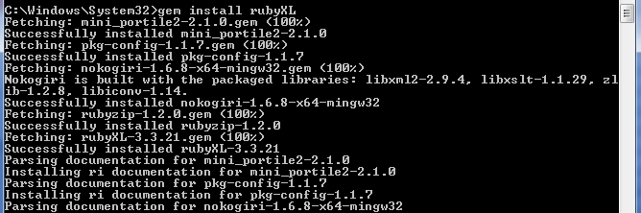
Set up the Environment
Set up Ruby-OpenStudio Environment on Windows
By clicking the install_all.bat file, it will help you install all the required R packages and ruby gems as well as set up the paths.
The following slides explains how to do the installation of the gems and packages step by step. The user could skip to the Test Installation slides directly to test your installation.

Slide 10
Set up the Environment
Set up R Environment on Windows
Download and Install R
Download and Install the R-Windows installer from:
https://cran.r-project.org/bin/windows/.
Follow the instruction to install R on your machine. Installing R in the default directory is recommended.
Install R packages
Open cmd.exe – Click Start, in the search box type cmd and press Enter.
Navigate to RpackagesInstaller directory by typing: cd <your_ RpackagesInstaller_directory> For example, cd/Users/user_name/Documents/BayesianCalibration_OpenStudio_V1.x/Tutorials/RpackagesInstaller/
Type ruby Install_Rpackages.rb in the cmd window and press Enter.
Select mirror location and R packages installation directory ( the default directory is recommended) based on your preference.
Notes:
- To use Ruby from OpenStudio Installation Package: Add path environmental variable: e.g., C:\Program Files\OpenStudio 1.6.0\ruby-install\ruby\bin
Install RubyXL: run cmd.exe as administrator, then gem install rubyXL

Slide 11
Set up the Environment
Set up R Environment on Mac OS X/Linux
Download and Install R.
1. Open the terminal window
For OSX – Press Command + Space and type terminal and press Enter
For Linux – Open the Dash by clicking the Ubuntu icon in the upper-left, type terminal, and select the Terminal application from the results that appear.
2. In the Terminal window, execute: sudo apt-get update
After that: sudo apt-get install r-base
Install R packages.
Open the Terminal.
Navigate to RpackagesInstaller directory by typing: cd <your_ RpackagesInstaller_directory> For example, cd C:/Users/user_name/Documents/BCUS/Install/RpackagesInstaller/
Type ruby Install_Rpackages.rb in the cmd window and press Enter
Select mirror location and R packages installation directory( the default directory is recommended) based on your preference.

Slide 12
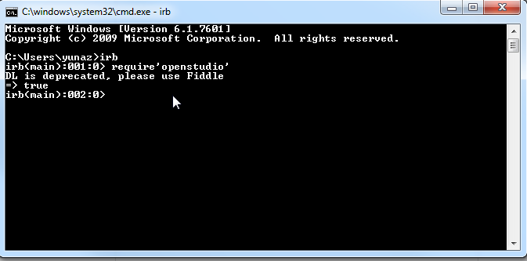
Test Installations
Test Ruby-OpenStudio Environment
Open the terminal window (on Windows OS, cmd.exe):
For OSX – Press Command + Space and type Terminal and press Enter
For Linux – Open the Dash by clicking the Ubuntu icon in the upper-left, type terminal, and
select the Terminal application from the results that appear.
or simply hit the keyboard shortcut Ctrl + Alt + T.
For Windows – Click Start, in the search box type cmd and press Enter
Type irb in the terminal to start the interactive ruby environment
Type require ‘openstudio’
The interface should return => true, which indicates that your Ruby_OpenStudio environment has been successfully set up.

Slide 13
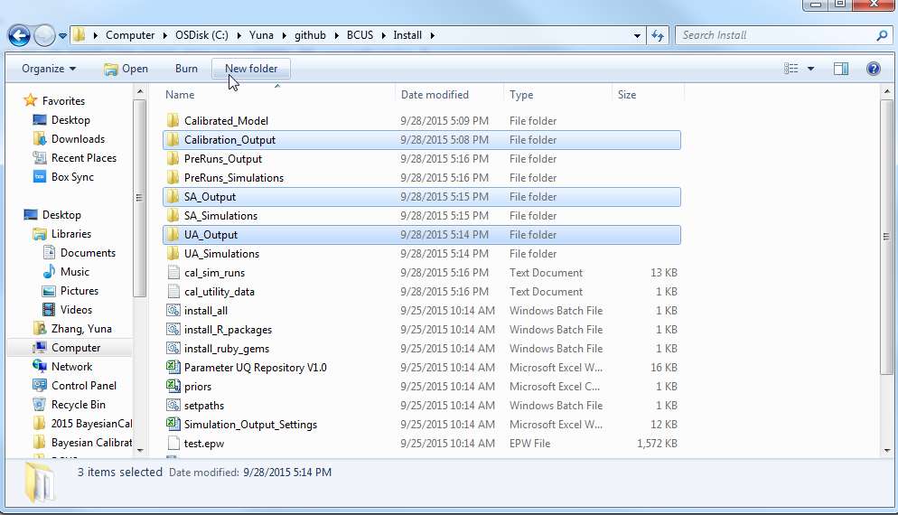
Test Installations
Test Installations
Launch the Terminal of your operating system (See the previous slide for details)
Navigate to InstalltionTest directory by typing:
cd <your_InstallationTest_directory>
For example:
C:/Users/username/Documents/OpenStudio/BCUS/Install
Install required packages and setup the BCUS path by double clicking:
install_all.bat
Execute the simple UA, SA, Bayesian Calibration test run by double clicking:
Testinstall.bat
If no error is reported in the terminal console, your installation is successful. You should be able to access the outputs of the simple test example in output folders inside the install folder.

Slide 14

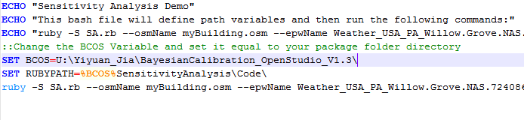
Trouble Shooting
No Such file or directory –SA.rb/UA.rb/*_Calibration.rb (LoadError).
This problem would occur when you don’t have a RUBYPATH variable setting up correctly.
Make sure don’t leave any space when you change the executable bash/batch script.
Make sure no extra space left after your own directory – double check by putting your cursor after the slash.

Slide 15
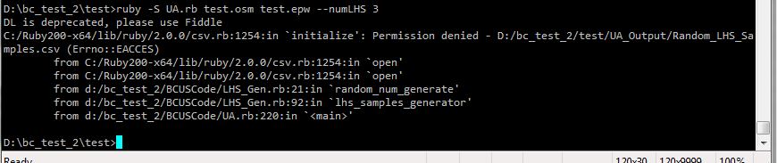
Trouble Shooting
2. ‘initialize’: Permission denied /x/y/UA_Output/Random_LHS_Samples.csv (Errno::EACCES)
This error occurs if you have the Random_LHS_Samples.csv file open in excel when you run the script. The script is unable to write to the file because excel has it open. An example is shown below

Slide 16
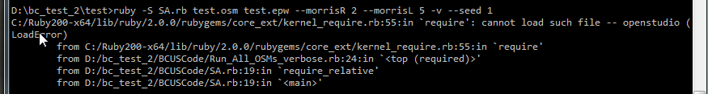
Trouble Shooting
3. ‘require’: cannot load such file openstudio (LoadError)
This error occurs if you have not created an openstudio.rb in the lib/ruby/site_ruby directory of your ruby install. Correct this by copying the openstudio.rb file from the OpenStudio ruby installation in the OpenStudio install directory
ruby-install/ruby/lib/ruby/site_ruby/openstudio.rb

