Slide 1
Glass Furnace Model (GFM) Version 4
Steven A. Lottes

Slide 2
GFM 4.0: A New, Extensively Enhanced Upgrade of GFM 2
GFM 4.0 includes major upgrades to all of the software components of GFM including:
  installation procedure
  user interface
  combustion computation
  radiation computation
  melt computation
  coupling between the components
  automated cycling procedure
  automated soot model calibration procedure
  progress monitoring program & progress data gathering

Slide 3
GFM 4 Incorporates a Large Number of Improvements in the Models, Algorithms, and Features
Code | March 2005 | End June 2006 | Growth
Combustion | 10956 | 21728 | 10772
Melt | 11103 | 16565 | 5462
GUI | 8905 | 17203 | 8298
Installer |  | 608 | 608
RunPlot |  | 303 | 303
Totals | 30964 | 56407 | 25443

Slide 4
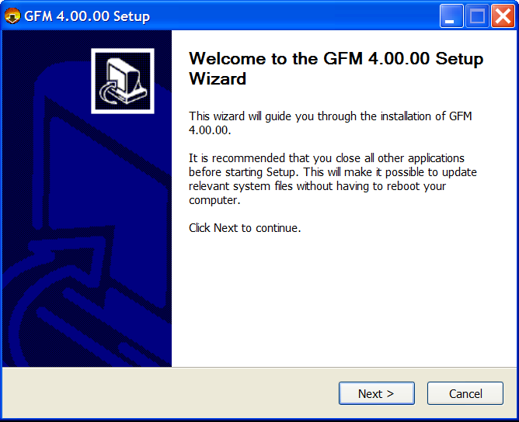
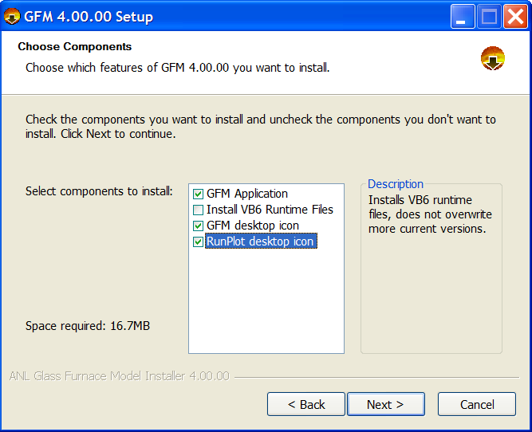

Modern Installer Written for GFM
New install uses a standard installer with option to install VB runtime files.
Provides start menu item, desktop icon, populated directory structure, uninstall program, etc.
Old install procedure was manual and did not provide VB runtime files needed on some systems.

Slide 5
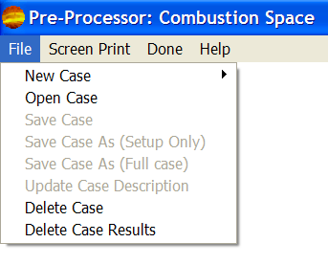
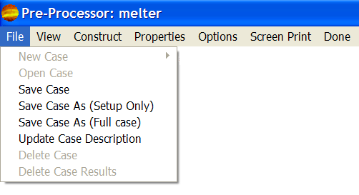
Simplified User Interface with Automated File Handling
Much easier furnace definition, simulation setup, and control
Simulations are now set up as cases, and the user no longer needs any knowledge about file types or file contents for furnace geometry and operating parameter definition.
File menu with case open
File menu with no case open

Slide 6
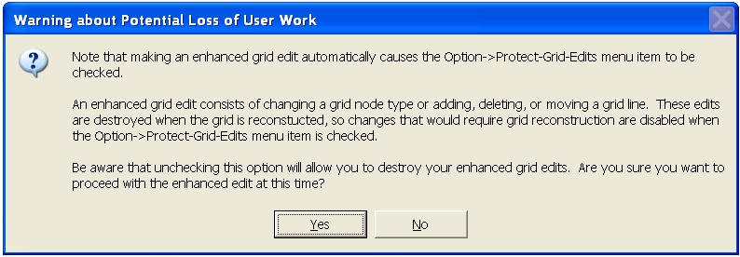
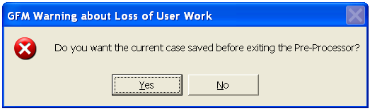
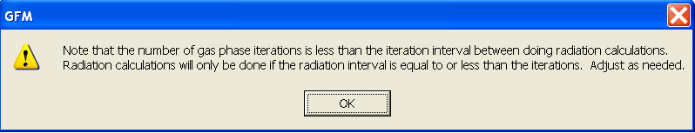
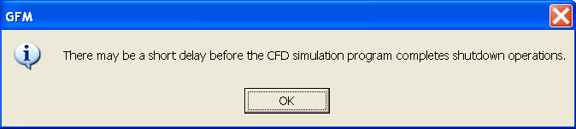
Warning Messages Improve Usability by Helping the User Avoid Mistakes
Well informed users apply software more effectively & avoid problems that cost time.

Slide 7
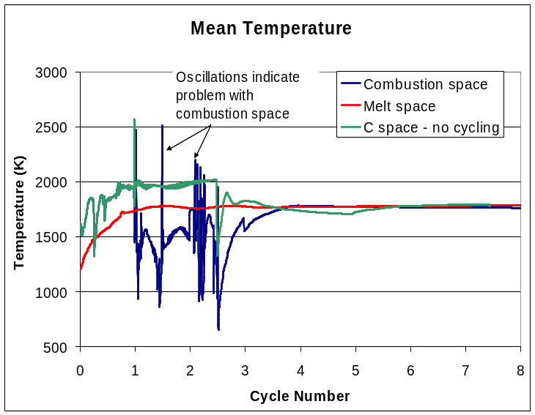
RunPlot: New Status Monitoring Program
Plots convergence measures, average temperatures, and global heat distribution on screen during the course of a simulation
Makes it easy to see how a simulation is progressing and when temperatures and heat transfer rates have stabilized indicating that the simulation is done
Makes it easy to spot problems in a simulation and take steps to correct them
Added legend and right click display options menu

Slide 8

Major New Capability:
Automatic Cycling Between Spaces
  Automatic cycling between combustion and melt spaces for both plain and regenerative furnaces
  20 or more cycles are needed – very difficult to do manually
  Auto cycling reduces time for simulation from ~2 weeks to ~2 days
  Auto cycling tightly couples combustion and melt spaces
    Radiation heat flux is cycled into the melt computation as soon as it is computed
Combustion Space Calculation with Radiation Heat Transfer
Melt Surface
Temperature
1 Cycle ~ ½ to 6 hours
Not 1 to 2 days
Melt Surface
Heat Flux
Melt Space Calculation

Slide 9
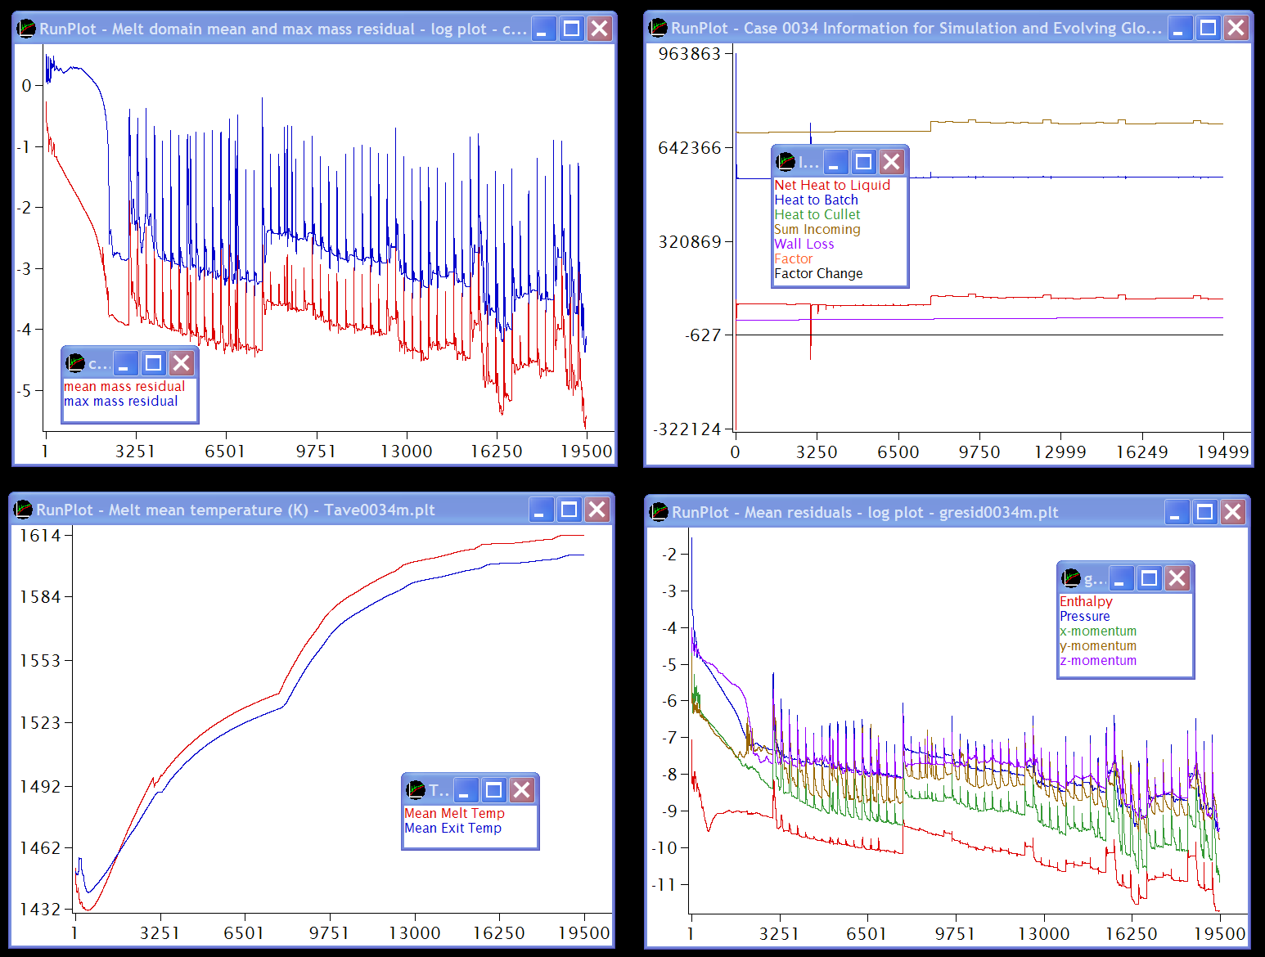
Melt Domain Sample RunPlots

Slide 10
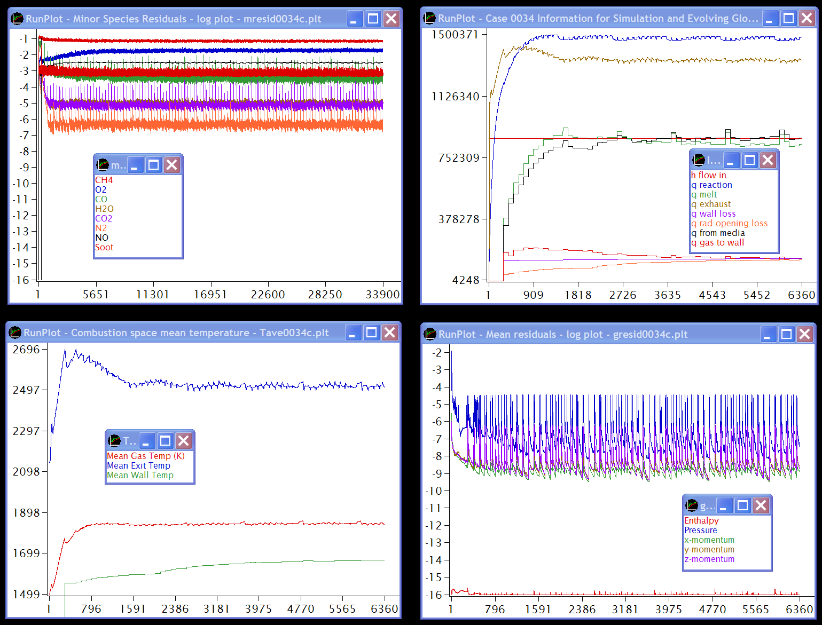
Combustion Domain Sample RunPlots

Slide 11
Melt Surface Boundary Condition Relaxation Scheme
Applied During Cycling
Applied to the coupling conditions between the melt and combustion spaces to damp numerical instabilities in cycling the computation between the combustion and melt

Slide 12
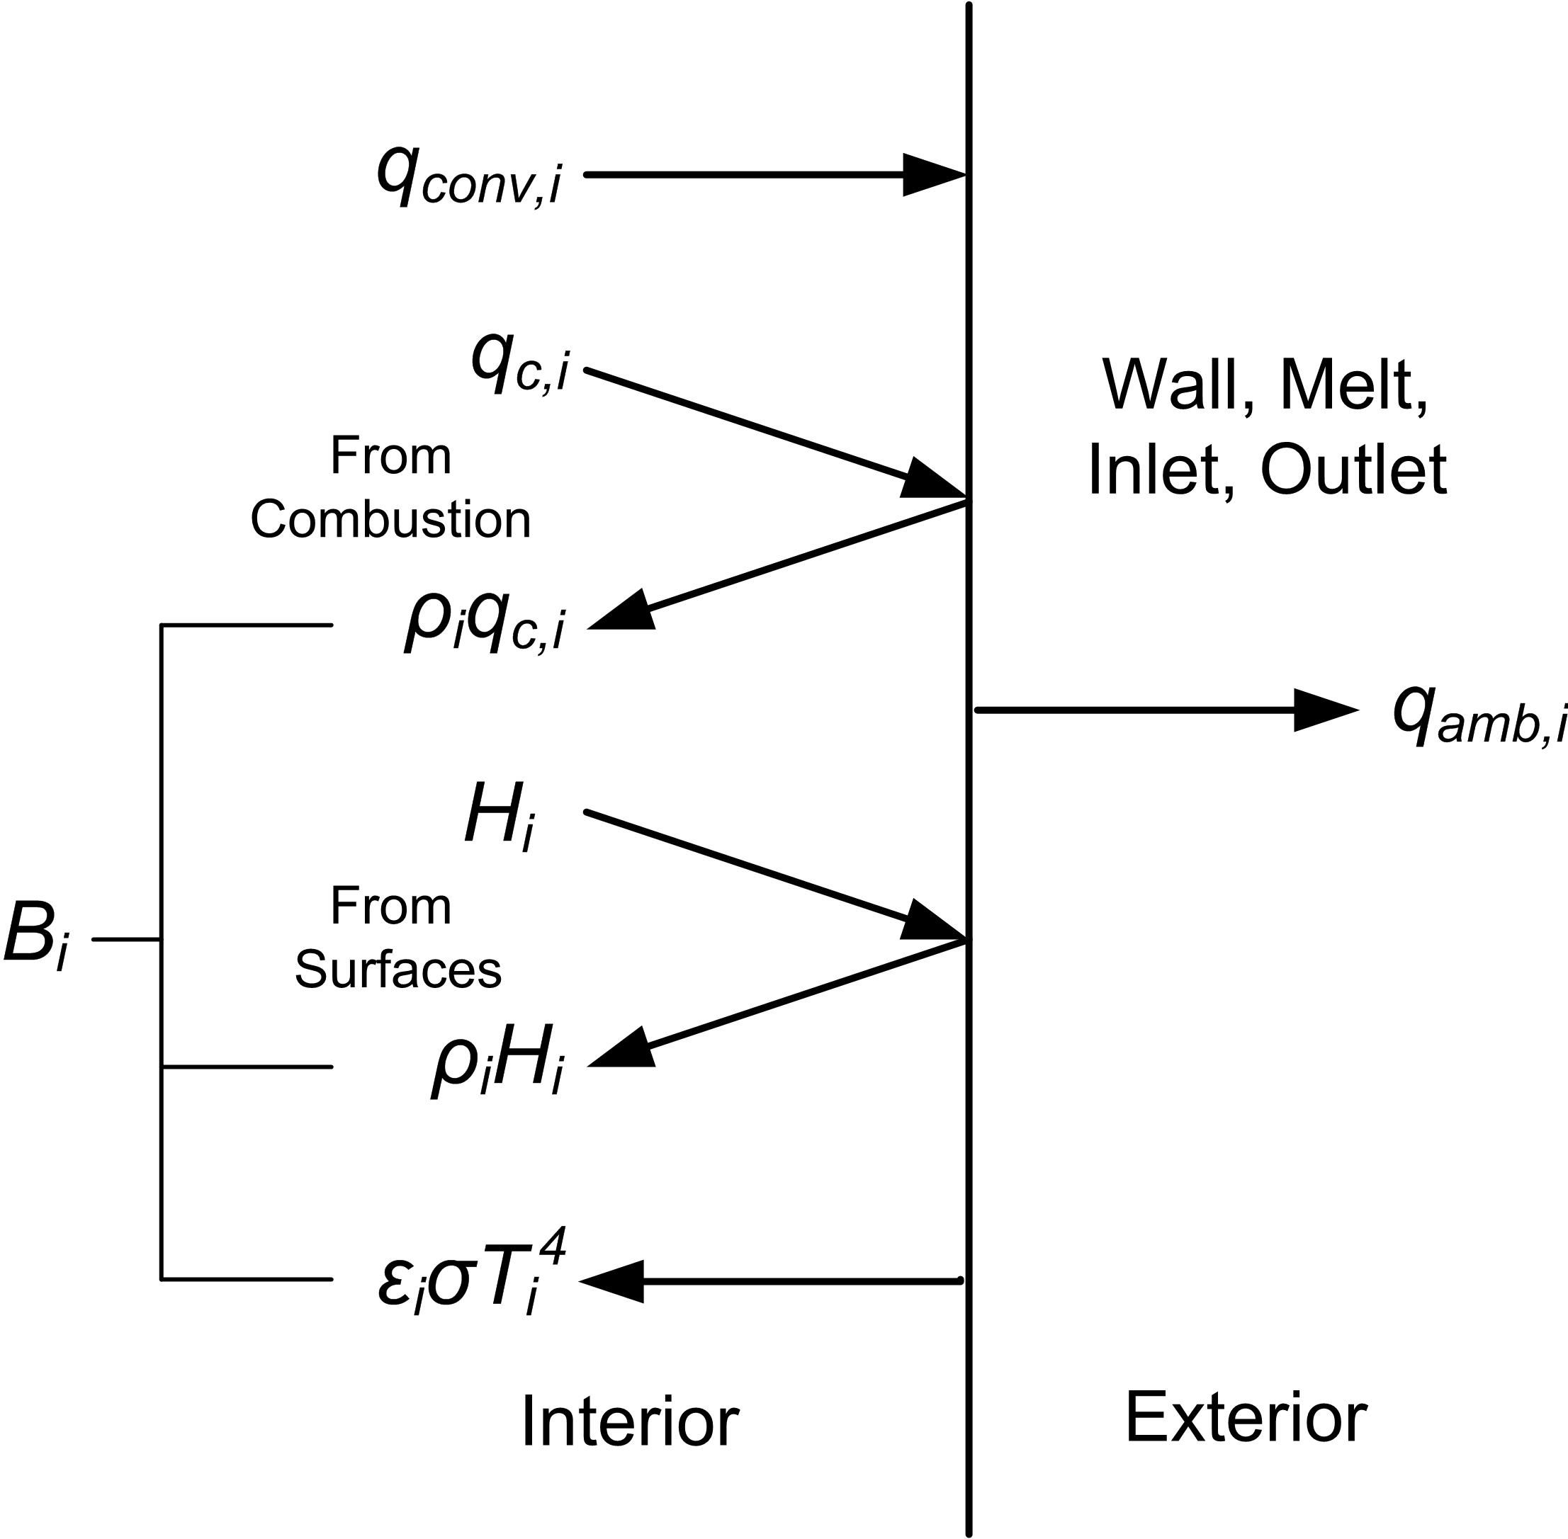
New Hybrid Radiation Computation
Splits into Participating Media Volume Computation and Wall Exchange Computation
New for wall exchange
Greatly improves the accuracy of the wall temperature computation
Works well for furnaces
  Emission >> Absorption
  Solving RTE for walls is very expensive & accumulates discretion error in the volume
  Walls treated as opaque and gray
Volume participating media radiation solve yields:
  incident radiation on walls direct from volume
  local gas energy sink from radiation
Wall exchange solve yields:
  Very fast solve near machine precision
  Radiation to melt surface from walls

Slide 13
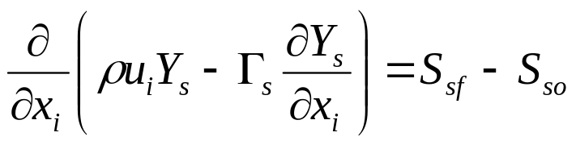
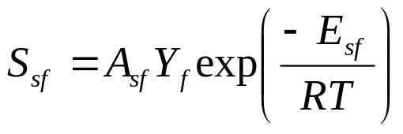
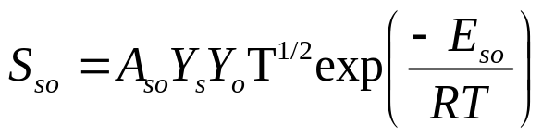
Automated Soot Model Calibration Procedure
In air-fuel furnaces soot is a dominate radiating species
GFM uses a simple soot model
The automated calibration procedure finds the soot formation pre-exponential constant, A_{sf}, that matches a “known” set of furnace operating conditions
  Fuel & air flow
  Batch flow & material properties
  Furnace geometry
Values for other soot kinetic parameters are needed, but heat transfer to the melt is much less sensitive to these
The calibrated soot formation kinetic constant implicitly accounts for other model uncertainties or un-modeled phenomenon
  air infiltration, for example

Slide 14
NIST Thermodynamic Property Relations
GFM 2 used a table lookup with linear interpolation to calculate gas mixture temperature from enthalpy (accurate to 1 to 2 digits)
GFM 4 uses NIST rational functions for the enthalpy and specific heat of gas mixture species in the combustion space
  Mixture temperature is computed using a Newton iteration that converges to machine precision (~15 digits) in 3 to 4 iterations.
  The temperature dependence of specific heat is very accurately represented

Slide 15
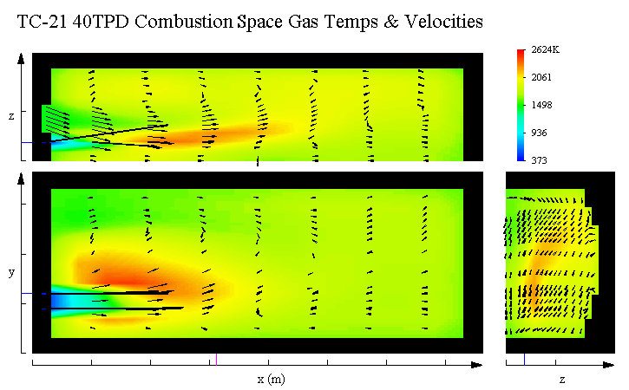
TC21 Problem Test Results – 40 TPD

Slide 16
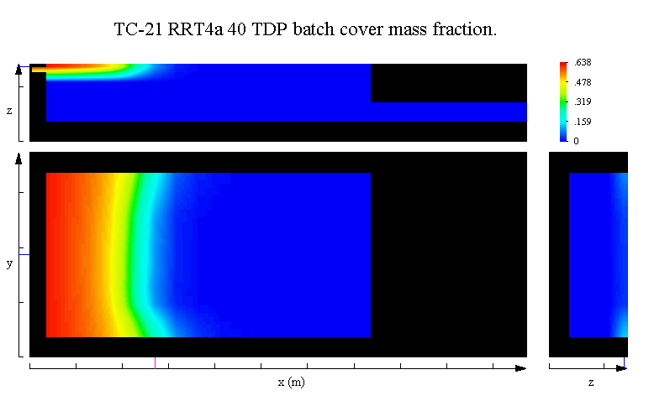
TC-21 Problem Results

Slide 17
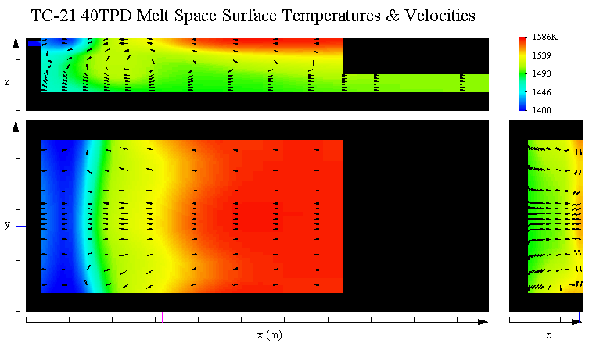
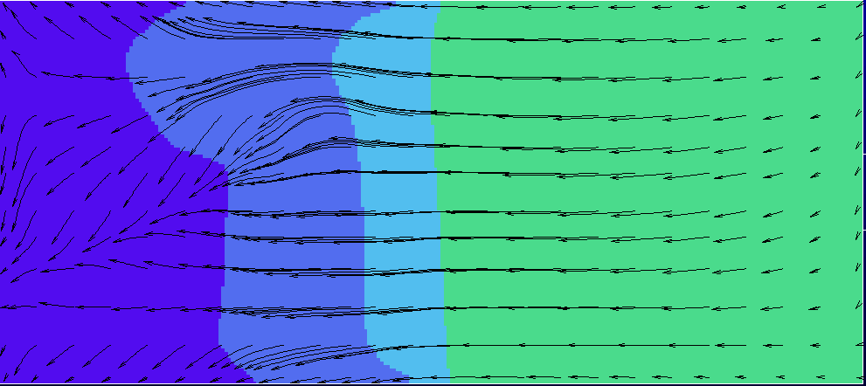
Sisecam 40 TPD Surface T Compared to GFM
GFM averages heat fluxes from both firing patterns
Sisecam result appears to be from one side firing
1448-1498 K
1598-1648 K
3.66 m/ 3.70 m
725 1175 1225 1275 1325 1375 1425 1475 1525 1575 1625 C

Slide 18
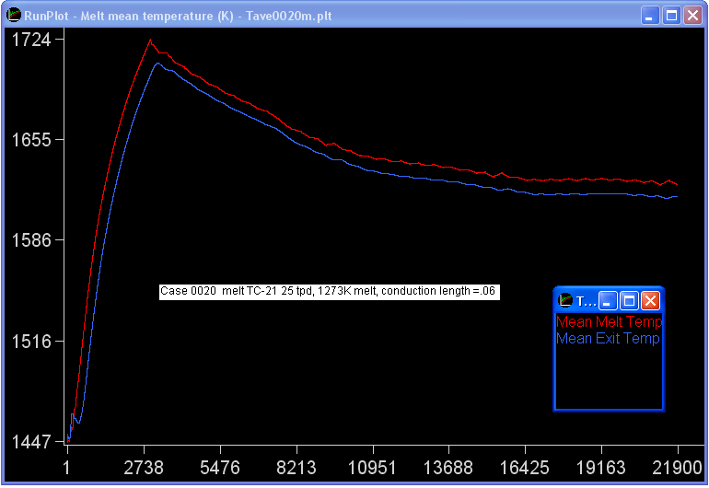
TC21 40 TPD Test Problem Results

Slide 19
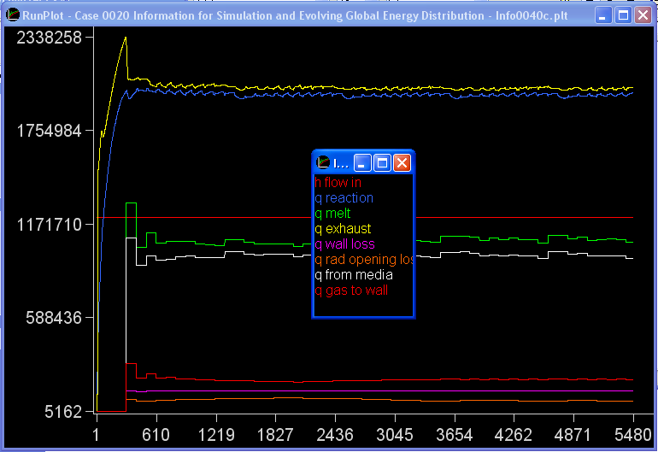
TC21 40 TPD Test Problem Results

Slide 20
Melt Simulation Summary File (end of file)
# Heat Values at Run End:
# Radiation+Conv In: 0.72310070675753E+06 W
# Electric Boost: 0.00000000000000E+00 W
# Total Energy In: 0.72310070675753E+06 W
# Batch heatup need: 0.31557353363728E+06 W
# Batch melt need: 0.21704995672704E+06 W
# Radiation to Batch: 0.40875249975480E+06 W
# Conduction to Batch: 0.13073238958088E+06 W
# Batch q needed: 0.53262349036432E+06 W
# Batch q net: 0.53948488933568E+06 W
# Liquid heatup need: 0.10910377824812E+06 W
# Liquid q net: 0.12491679579722E+06 W
# Adiabatic energy need: 0.64172726861244E+06 W
# Wall heat loss: 0.58699021624631E+05 W
# Net melt input energy need: 0.70042629023707E+06 W
# Actual melt input energy: 0.72310070675753E+06 W
# Energy need divided by input: 0.96864279579793E+00
# Mean glass exit temperature: 0.16043246365875E+04 K
# Batch rate in: 0.28939994230272E+00 kg/s
# Melt rate: 0.28939994841019E+00 kg/s
# Glass rate out: 0.28939289006983E+00 kg/s

Slide 21
Combustion Simulation Summary File (end of file)
# Energy Balance on Exterior Walls # Total energy in: 0.23542154827173E+07 W
# -------------------------------- # Energy in with flow: 0.86689066296079E+06 W
# Energy in via combustion: 0.14873248197565E+07 W
# Total energy leaving furnace: 0.24384136429239E+07 W
# Energy out with flow: 0.13444618452387E+07 W
# Energy out through walls: 0.13476300555161E+06 W
# Net radiation out inlets: 0.68791297934034E+05 W
# Net radiation out outlets: 0.59097976779291E+05 W
# Energy out to melt: 0.83129951742032E+06 W
# from flame: 0.37280814443948E+05 W
# from surfaces: 0.79077172312054E+06 W
# from convection: 0.32469798558295E+04 W
# Gas Energy Balance # Total energy in: 0.23542154827173E+07 W
# -------------------------------- # Energy in with flow: 0.86689066296079E+06 W
# Energy in via combustion: 0.14873248197565E+07 W
# Energy out with or from the gas 0.23743534266882E+07 W
# Energy out with flow 0.13444618452387E+07 W
# Convection to walls 0.14064222849204E+06 W
# Convection to melt surface 0.32469798558295E+04 W
# Radiation from flame to melt: 0.26962612327861E+06 W
# Radiation from flame to walls: 0.59740753496978E+06 W
# Radiation from flame to inlets: 0.91601634251864E+04 W
# Radiation from flame to exits: 0.98085514280762E+04 W
# -------------------------------- # Mass in: 0.56760373880222E+00 kg/s
# Mass out: 0.56765171155295E+00 kg/s
# Fuel mass out: 0.22823902801114E-03 kg/s
# Fuel energy out: 0.11411951400557E+05 W
# Mean temperature: 0.18400522709873E+04 K
# Mean exit temperature: 0.25105402473905E+04 K
# Mean wall temperature: 0.16643211649184E+04 K

Slide 22
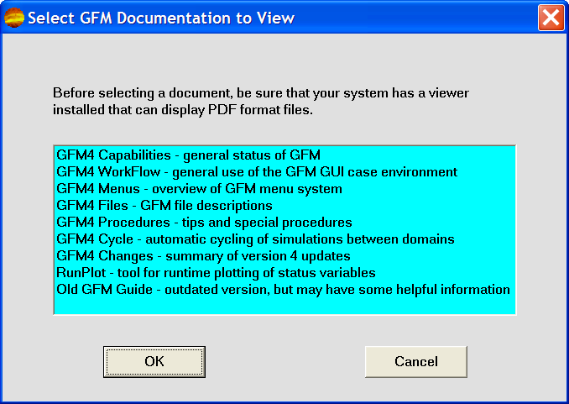
New User Documentation

