Slide 1

Project Title: GuruGraph
Team Name: Team X
Team ID: T28
Team Lead: Samartha Puthraya K
One-line Tagline / Mission: Marks middle-school fraction homework from a phone photo, circles the exact wrong step, and gives the teacher tomorrow's 5‑minute re‑teach.
Name | USN | Email | Contact No.
Samartha Puthraya K | 24SUUBEAML521 | samarthputhraya@gmail.com
Rishabh Arun | 24SUUBEAML493 | arunrishabh33@gmail.com
Risheeth S | 24SUUBEAML494 | risheeth200623@gmail.com
Notes:
0:00-0:15 · Risheeth
"We're Team X. This is GuruGraph: homework comes back already marked, and the teacher knows what to re-teach tomorrow." Move on quickly.

Slide 2

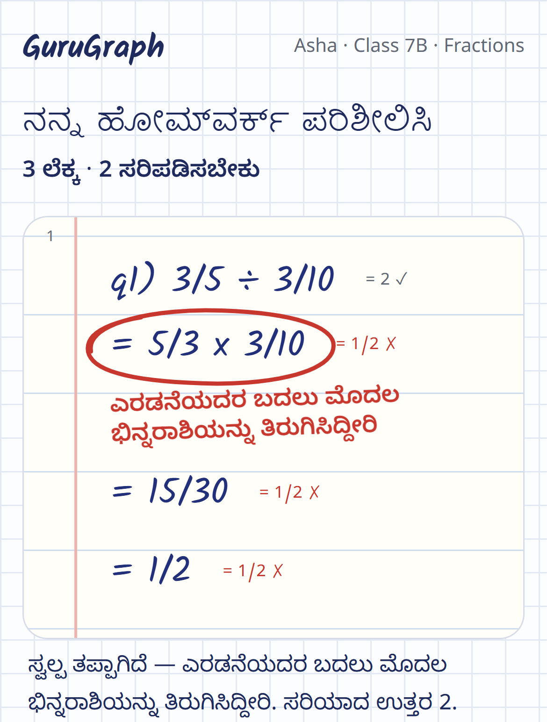
HOW GURUGRAPH WORKS
Teachers don't upload anything.
THE PROBLEM
29%
Snap the page
A child snaps homework at home, or the teacher flips notebooks under a phone.
1
average score on Class 6 fraction questions, their weakest maths skill
NCERT PARAKH Rashtriya Sarvekshan 2024
Find the exact wrong step
AI reads each line. Exact arithmetic finds the first wrong one and names the mistake.
1 in 4
2
teachers say they have too much correction work
Fix it by tomorrow
A short lesson in the child's language, and a 5-minute re-teach plan for the teacher.
TISS SoTTTER 2023 · 3,615 teachers
3
A red cross says wrong. Not why.
A real handwritten page, read live and marked in Kannada
Notes:
0:15-1:00 · Risheeth, then Rishabh
Risheeth: "In India's 2024 national survey, Class 6 scored only 29% on fraction questions, their weakest maths skill. About one in four teachers say they have too much correction work. And a red cross tells a child that it's wrong, not why."
Rishabh: "At the mentor round we were asked: why would a teacher upload notebooks? They don't. A child snaps homework at home, or the teacher flips pages under a phone. GuruGraph finds the exact wrong step, names the mistake, and fixes it by tomorrow."
Then switch to the live demo (1:00-3:00, Samartha): the child's homework in Kannada, Fix this now, gap closed; the dashboard; snap two pages; Plan tomorrow's lesson (the Analyst's veto). Come back to slide 3.

Slide 3
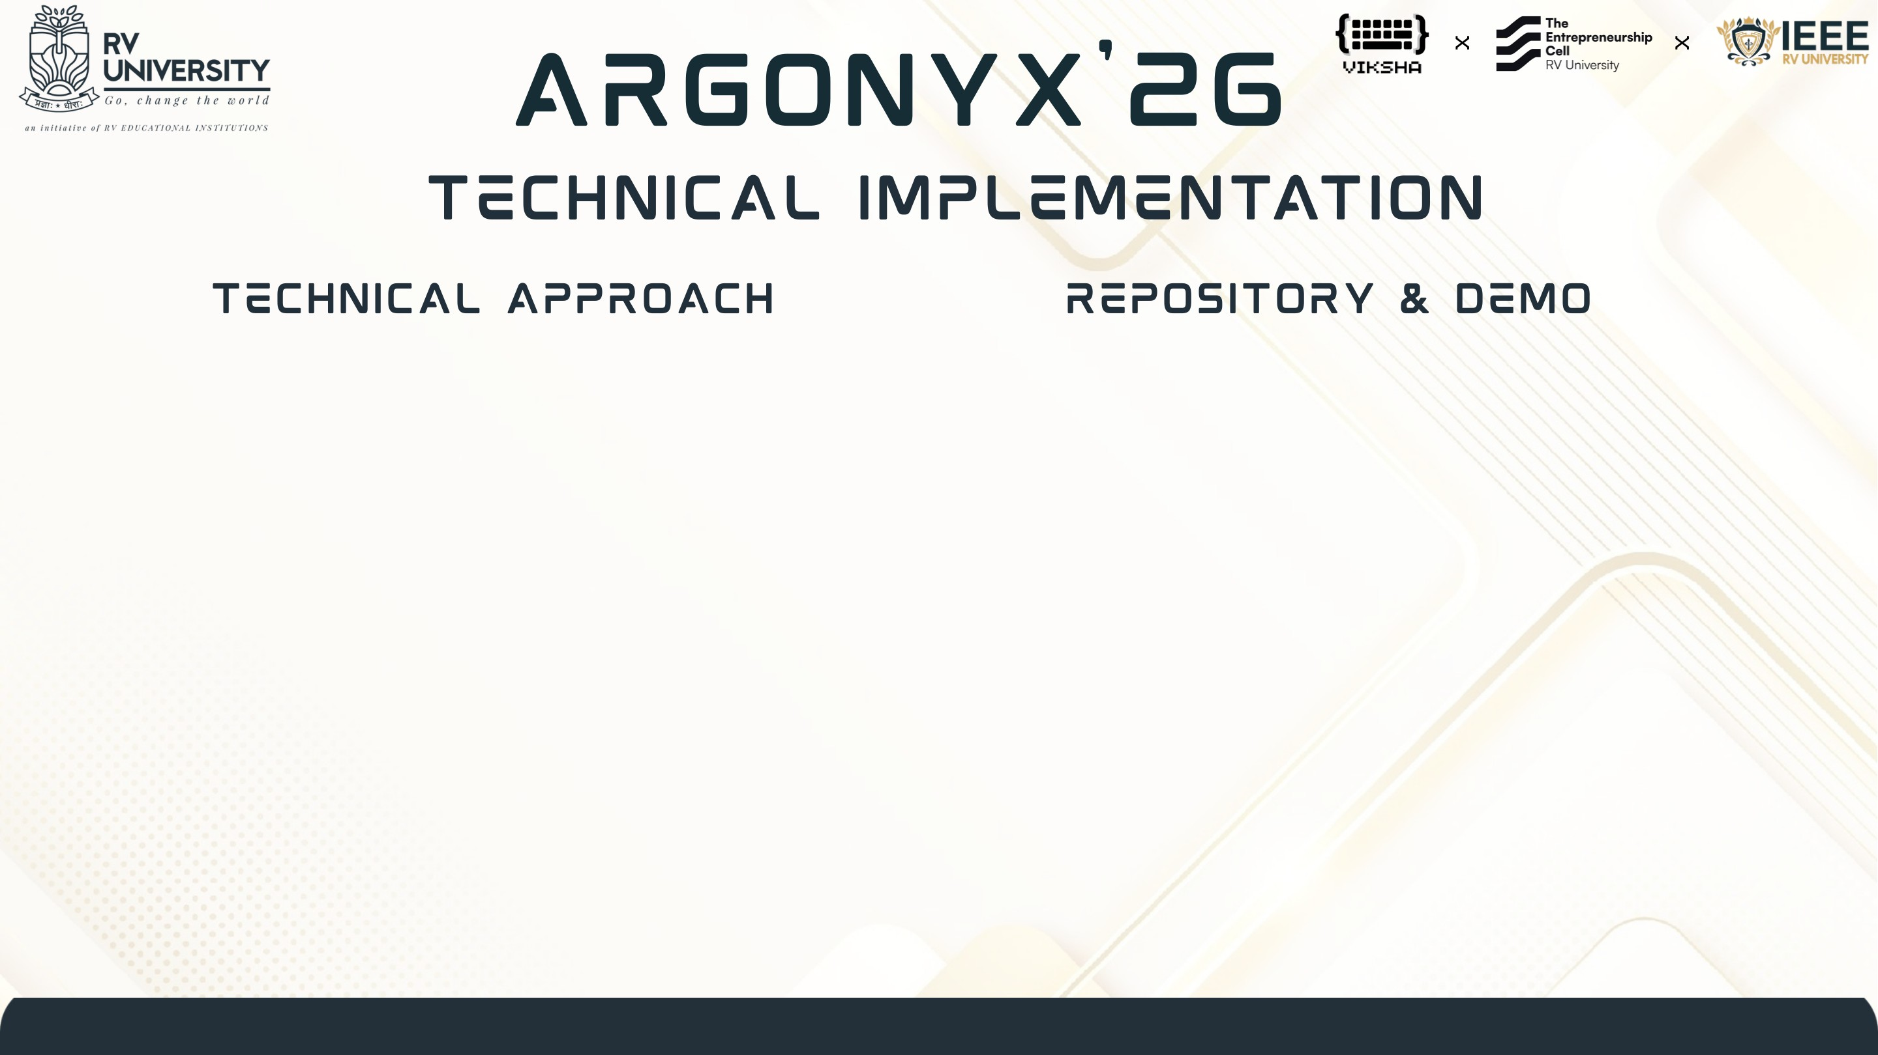


1
Phone photo
Any page, any phone. Photos are never stored.
2
Gemini 3 Flash reads
Every line of working, and where it sits.
3
Exact arithmetic judges
Right or wrong, the first wrong line, the named mistake.
Try it live
class code 7B
Source code
GitHub, public
Agents act, teacher decides
Coach plans, Analyst vetoes, Curator teaches in 3 languages.
▶ Demo video: github.com/Argonyx-26/T28-Team-X/releases
Live: gurugraph-web-215071922486.asia-south1.run.app
Code: github.com/Argonyx-26/T28-Team-X
275 backend tests and 8 browser tests gate every deploy
4
Built with
FastAPI
SQLite
Next.js 16
Google Cloud Run
Gemini on Vertex AI
Chirp 3 HD voice
Notes:
3:00-3:30 · Samartha
"The model only reads. Exact fraction arithmetic decides right or wrong, finds the first wrong line, and a mistake rule recomputes it: that's evidence, not a guess. Agents then act: the Coach plans, the Analyst checks every plan against each child's answers and can veto it, and the teacher has the last word. It's live: scan the QR and try class 7B."

Slide 4

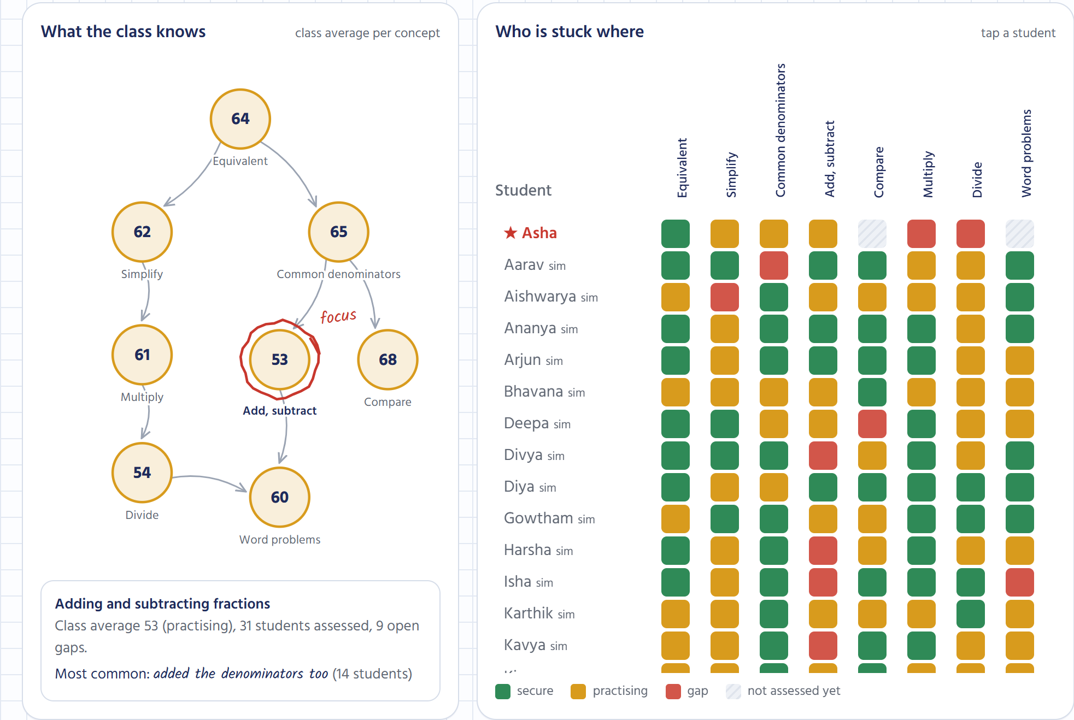
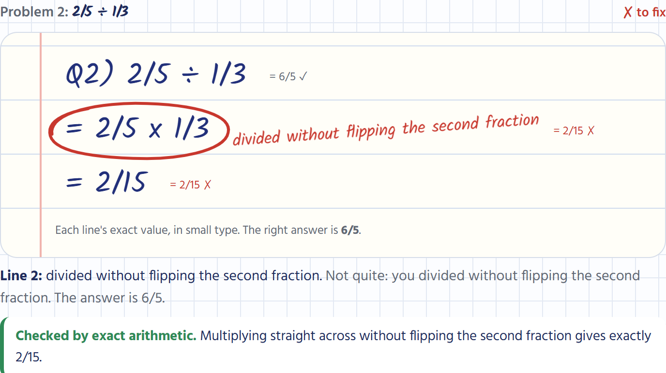
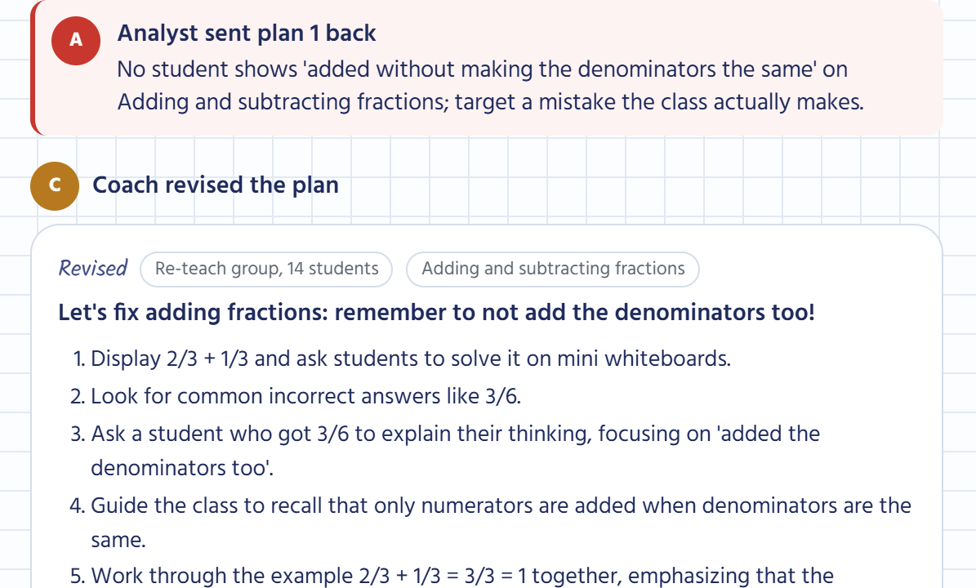
Teacher: who is stuck where
Every wrong line circled and named
Coach plans, Analyst vetoes
MEASURED ON REAL HANDWRITING
18/18
13/13
13/13
3.9 s
₹3.64
problems marked right or wrong correctly
wrong steps found
mistakes named
to read a whole page (median)
AI cost per student per month
Round 2: 6 phone photos of whole notebook pages by 3 writers, 18 problems (5 right, 13 with planted mistakes), labels written before the run. Cost: measured calls × published prices.
Notes:
3:30-4:05 · Rishabh
"Everything here was built in these 24 hours and is live. Every number carries its n and method. On six whole notebook pages by three of us, with 18 problems and planted mistakes labelled before the run: 18 of 18 marked right or wrong, 13 of 13 wrong steps found, 13 of 13 mistakes named, 3.9 seconds a page. AI cost: Rs 3.64 per child per month, measured. What we don't claim: no classroom trial and no users yet. The 30 students in 7B are simulated, and we label them."

Slide 5

CUSTOMER
VALUE
MARKET
Middle-school maths teachers
Marked by morning
19,105 schools
Budget private schools first, then government schools through the state.
The wrong step named on every page, a lesson in the child's language, tomorrow's 5-minute plan.
private unaided schools in Karnataka. Only 8.2% of students there take coaching: the fix has to happen in school.
UDISE+ 2024-25 · MoSPI NSS Education 2025
BUSINESS MODEL
SCALABILITY
Per-student school licence
₹3.64
One class → a district
₹5.1
Free for a teacher's first class; the school pays to roll it out. State and district contracts for government schools.
Same unit everywhere: one child, one problem, one wrong step. Stateless API on Cloud Run; a new topic is a new rule pack.
AI cost per student per month, measured
to serve a student per month at 100,000 students (designed, list prices)
Notes:
4:05-4:35 · Risheeth
"Our customer is the middle-school maths teacher: budget private schools first, then government schools through the state. Karnataka alone has 19,105 private unaided schools, and only 8.2% of students there take coaching, so the fix has to happen in school. A per-student school licence; the AI costs Rs 3.64 per child per month, measured. It scales because the unit never changes: one child, one problem, one wrong step. A school view already rolls it up; a district is the same query."
The Rs 5.1 is designed (Google Cloud list prices), not measured. Say so if asked.

Slide 6

Every wrong answer becomes a named mistake, and a fix by the next morning.
RESEARCH PAPERS
NCERT PARAKH Rashtriya Sarvekshan 2024
Muralidharan & Sundararaman 2010: diagnosis alone didn't raise learning
Siegler & Pyke 2013: how children get fractions wrong
MARKET RESEARCH
UDISE+ 2024-25 · MoSPI NSS Education 2025 · TISS SoTTTER 2023
EXISTING SOLUTIONS STUDIED
Mindspark · Khanmigo · Shiksha Copilot · Gradescope · Photomath
APIS / DOCUMENTATION
Gemini on Vertex AI · Chirp 3 HD voices · GuruGraph API docs
DATASETS
Our 9 handwritten pages, labelled before any model ran
Every evaluation with its n and method: /judges
LIVE TODAY
NEXT
✓ Homework check at home
✓ Scan and snap mode
✓ 3 languages, with voice
✓ Coach vs Analyst plan debate
✓ School view
→ Classroom pilot: measure teacher time saved
→ All middle-school maths topics
→ WhatsApp homework
→ District view for SCERT
No users or trials yet. Class 7B's 30 practice students are simulated, and labelled that way.
Notes:
4:35-5:00 · all three
Risheeth: "Teachers don't upload anything. Homework comes back already marked."
Rishabh: "And when they do check notebooks, flipping pages under a phone is faster than a red pen."
Samartha: "The AI reads. Arithmetic judges. The teacher decides. GuruGraph. Scan the QR and try it."

