Slide 1

battle of races
Alex chica, Yuhen Zhou, Marc Argüelles

Slide 2

index
M02 Local Database
M03 Programming
M04 Web Page
M05 Development Environments
M01 Systems

Slide 3

M01 Systems
User guide
Technical report

Slide 4
M02 local database

Slide 5
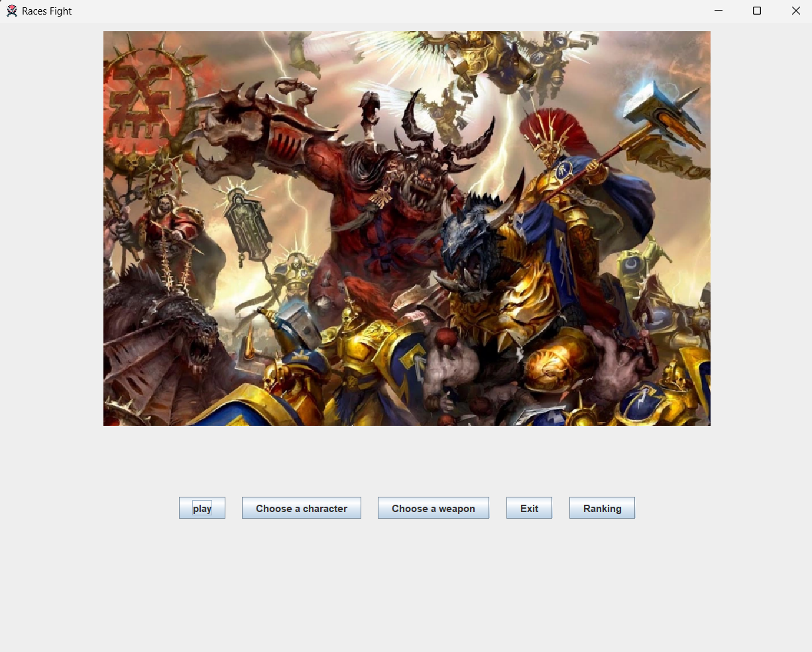
M03 Programming

Slide 6
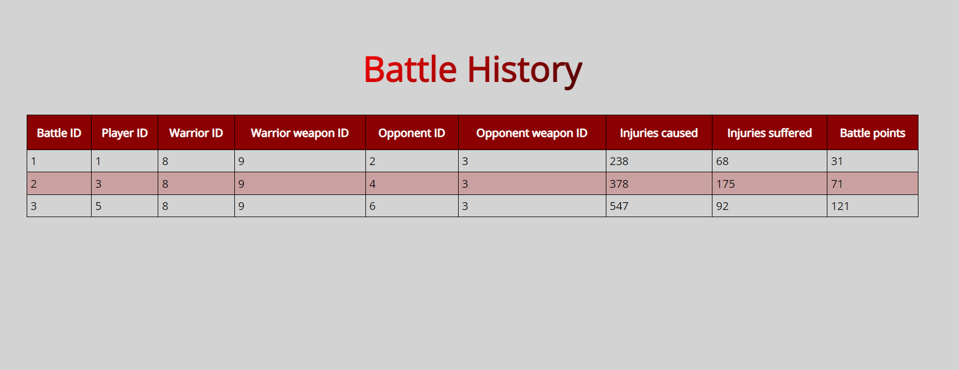
M04 Web page

Slide 7
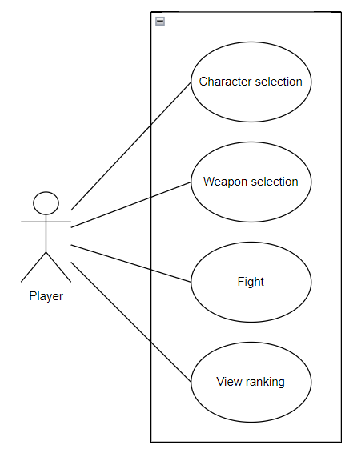
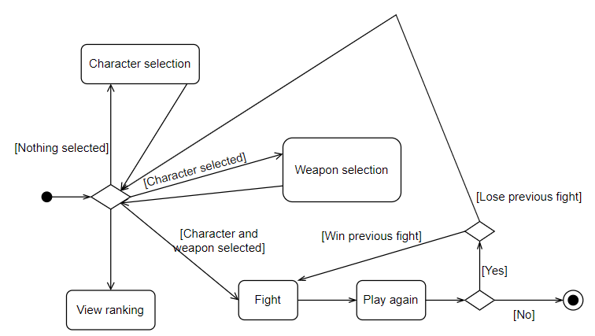
M05 Development enviroments
Github
Diagrams

Slide 8

conclusions

Slide 9

thanks
Alex Chica
Yuhen Zhou
Marc Argüelles

