Slide 1
Snowflake Workshop
Elisabetta Parozzi & Luca Pescatore
Argusa
2025

Slide 2
Getting Started
Why SNOwFLAKE?
Sclability & Performance – Handles large datasets efficiently with automatic scaling and parallel processing.
Separation of Storage and Compute – Enables flexible resource management and cost optimization.
Cloud-Native Platform – Accessible from anywhere, with built-in security, data sharing, and integration features.
SQL-Based & User-Friendly – Leverages standard SQL syntax while supporting advanced analytics and geospatial operations.

Slide 3
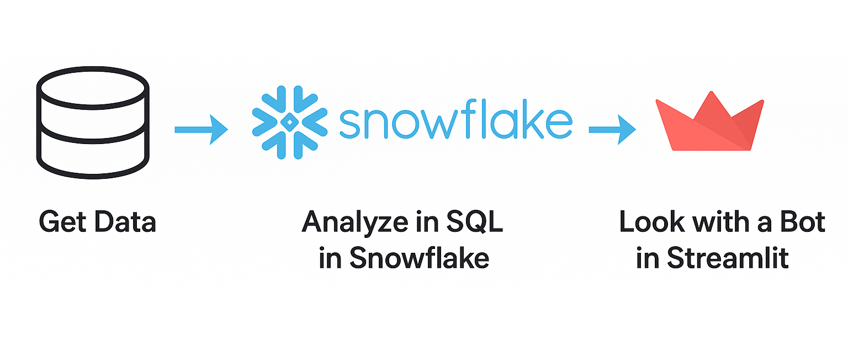
Getting Started
Workshop objective
Learn how to analyze spatial data in Snowflake.
Work with real Swiss data (students and schools).
Understand how to join datasets, compute school distances, and derive insights about school accessibility.
Gain hands-on experience using Snowflake SQL functions for data analysis and transformation.

Slide 4
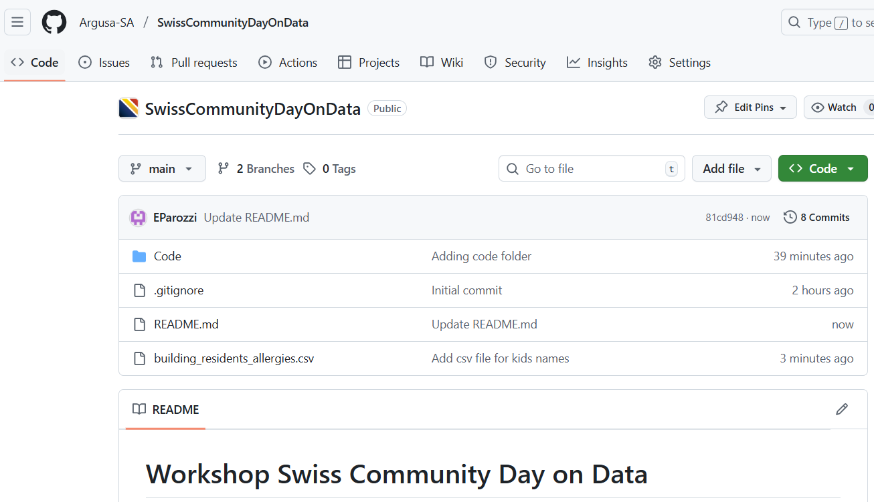
Useful links:
Link where to source the code and the csv file.
https://github.com/Argusa-SA/SwissCommunityDayOnData
Let’s now open a workspace in Snowflake!

Slide 5
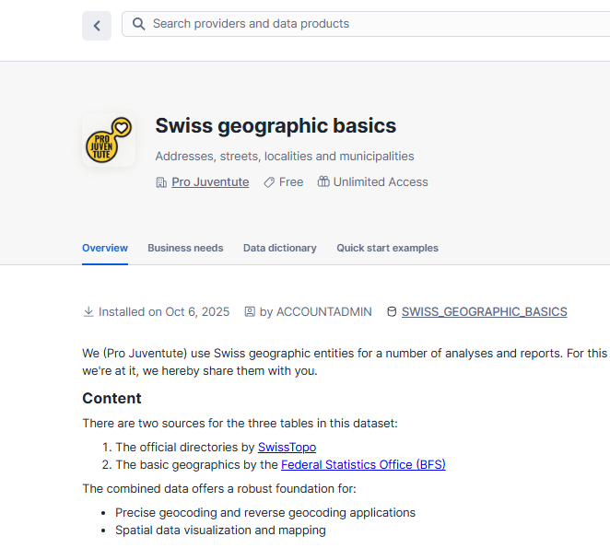
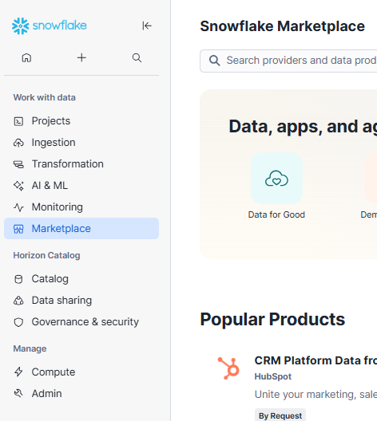
Step 1. Source Database
Go to the marketplace
Download the free database

Slide 6
Step 2. Add CSV file
LOADING an external file to the analysis
1. Upload & Load with the “+” Button
From the Snowflake Web UI, navigate to your database → schema → table.
Click the “+” icon → Load Data.
Select your local CSV file, define the file format (e.g., comma-delimited, header rows, encoding).
Snowflake automatically uploads and loads the data directly into the selected table.
2. Load via Stage and COPY INTO Command:
Create or use an existing internal stage (@mystage) or external stage (e.g., AWS S3).
Upload your CSV file to the stage using “COPY INTO” SQL command.

Slide 7
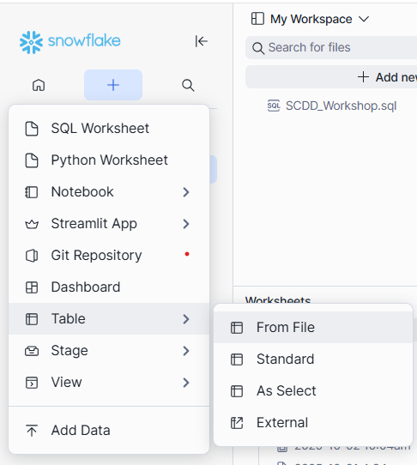
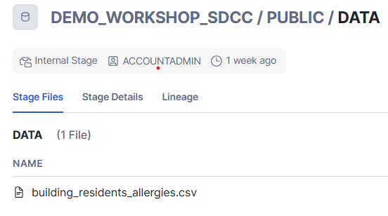
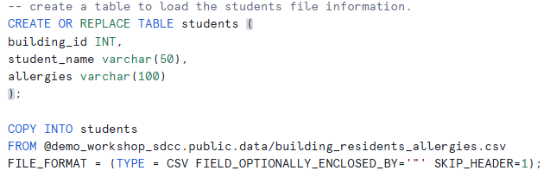
Step 2. Add CSV file
LOADING an external file to the analysis
1.
2.

Slide 8
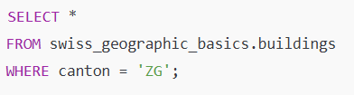

Step 3. Filter and Organize Data
Structure and prepare the raw data for analysis by isolating relevant subsets (e.g., residential buildings, schools, students).
1. Filter the Data by Canton
Extract only the records for Canton Zug (ZG) from the Swiss geographic dataset.
Create working tables such as buildings_zg for further processing.
2. Identify and Separate Key Building Types
Residential buildings → filter by building_category = 'residential’.
Schools → select where building_name ILIKE '%Schul%’.
Store them in new tables:
residences_zg
schools_zg

Slide 9


Step 3. Filter and Organizing Data
3. Enrich Buildings with Municipality Information
Join buildings streets to include geographic context: Municipality
Create a clean, enriched table buildings_with_municipality_zg.
4. Add Student Information
Join residences_zg with the students table imported from the CSV file
Result: buildings_zg_students — a dataset linking each student to their residence and allergies.

Slide 10
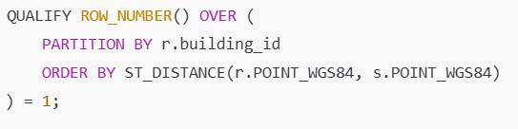
Step 4. What are we looking for?
Determine the distance between each student’s residence and the nearest school in Canton Zug, using Snowflake’s geospatial functions.
1. Compute Geospatial Distances
Use the ST_DISTANCE() function to calculate the distance (in meters) between each residence and nearby schools.
Filter for the closest school using a ranking function:
2. Create the Distance Table
The result is stored in residence_school_mart_zg, containing:
Residence details (address, municipality, student, allergies)
Closest school name and ID
Calculated distance_meters

Slide 11
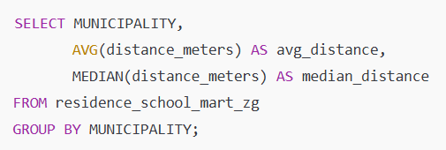
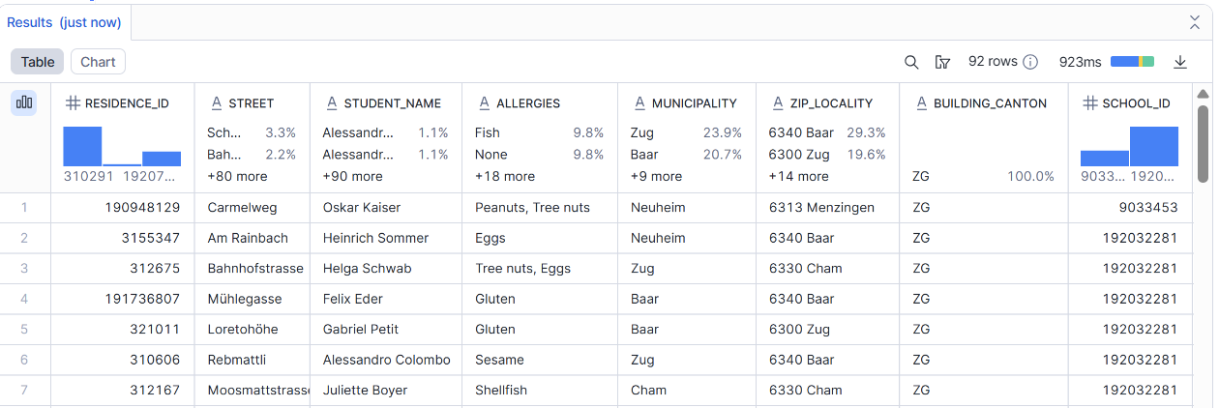
Step 4. What are we looking for?
Results
3. Analyze Accessibility Insights
Aggregate results by municipality.
Identify areas where students live farther from schools → potential insight for urban planning or accessibility studies.

Slide 12

Final Step: Streamlit
Let’s look at the streamlit built chat-bot
Objective:
Build an interactive Streamlit application connected to Snowflake.
Use Cortex Search to query student information and allergy data in natural language.
Key Features:
Conversational Interface: Ask questions such as “Which students in Zug are allergic to peanuts?”
Real-Time Data Access: Retrieves results directly from Snowflake tables.
Multilingual Output: Displays translated allergy information (EN, FR, DE, IT).
User-Friendly Visualization: Explore schools, residences, and allergy data interactively.

Slide 13


THANK YOU!

