Slide 1

GDG Cloud Thessaloniki – Intel OpenVINO
VERDANA
Notes:
Brief introduction

Slide 2

Introduction to AI
at the Edge
What is AI at the Edge?
Local or Near-Local Processing
Neural Network Inference Locally/Semi-Locally
Extension of Internet-Of-Things(IoT)
Notes:
Describe what AI at the Edge is and what it offers to the IoT concept.

Slide 3

A little bit of History
1990 Beginning of Decentralized Computing
(ATMs)
2001 Emergence of Peer-to-Peer Networks
(Torrent Networks, etc.)
2006-2009 Inception of Cloud/Edge Computing
(Cloud Storage, etc.)
2012 Development of Fog Computing
Notes:
https://blog.bosch-si.com/bosch-iot-suite/cloud-and-edge-computing-for-iot-a-short-history/
https://dl.acm.org/doi/10.1145/1013367.1013397

Slide 4

Edge Instead Of Cloud
Why Edge Instead of Cloud?
Lack of spontaneous processing
Need for network availability
Need for real-time decision making
Edge does not imply no cloud whatsoever
Notes:
Describe the differences between the Edge and the Cloud and why Edge is preferred over cloud at certain cases.

Slide 5

Importance of
AI at the Edge
Network availability
Security considerations
(Health, Business, Governmental Data)
Real-time decision-making need
Latency concerns

Slide 6

The OpenVINO Toolkit
Stands for Open Visual Inferencing and Network Optimization
Developed by Intel
Is Open Source
Supports CPUs, GPUs, FPGAs, and Intel’s Neural Compute Stick via usage of a common API
Notes:
Introduce the OpenVINO toolkit and its features

Slide 7
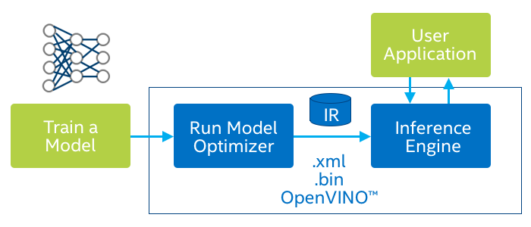
OpenVINO Toolkit
Feed a Pretrained Model to the Model Optimizer
Pass the Intermediate Representation(IR)
to the Inference Engine
Apply inference to the User Application
Notes:
Describe the OpenVINO briefly

Slide 8

Pretrained Models
Models need to be trained beforehand
Preprocess model inputs
Feed the model to the Model Optimizer

Slide 9

Model Optimizer
Accepts all Major Frameworks
Tensorflow, Caffe, Pytorch(via ONNX),etc.
Transforms the Model to an Intermediate Representation
Boosts latency, computational speed, but not inference accuracy

Slide 10
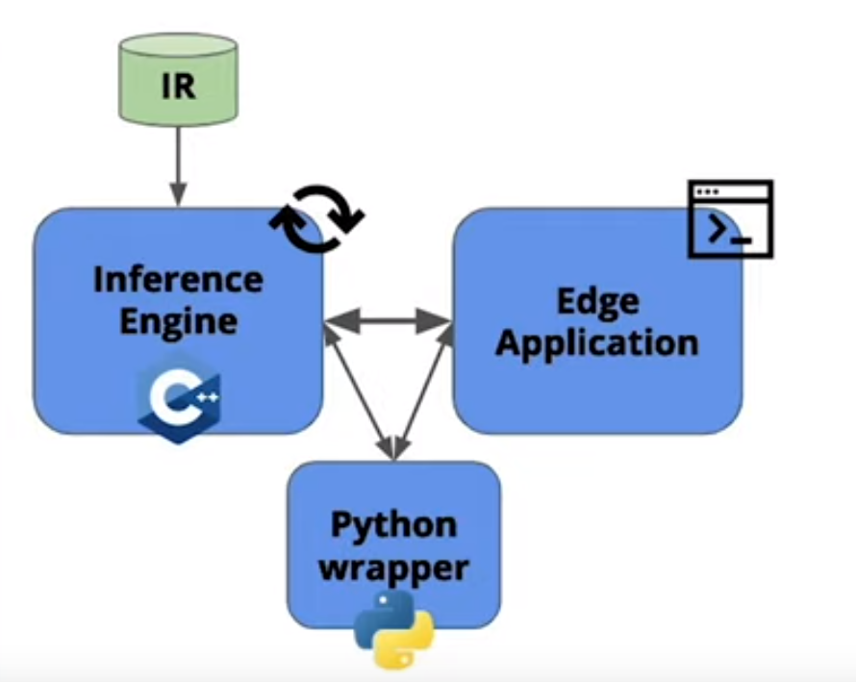

Inference Engine
Runs the actual Inference
Written in C++
Coded with a Python Wrapper
Apps can be developed in both
C++ and Python
Notes:
Describe the graph

Slide 11
Inference Engine
But how does the Inference Engine work?
IECore – A Python Wrapper to work on the IE
IENetwork – A class to hold the network and load it into the IECore
Inference Request – Synchronous/Asynchronous Requests
Notes:
Explanation of the classes that implement the Inference Engine

Slide 12
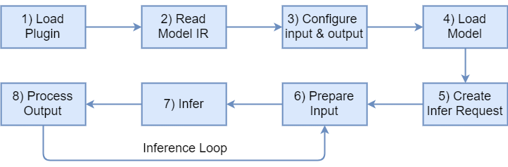

Inference Engine
InferRequest handles inputs, outputs,
and latency as attributes
Notes:
Brief description of the data “journey” within the inference engine

Slide 13

Deploying an Edge App
What do I need to do?
Handle input streams
Process model outputs
Take care of server communications

Slide 14
App Deployment Demo!

Slide 15
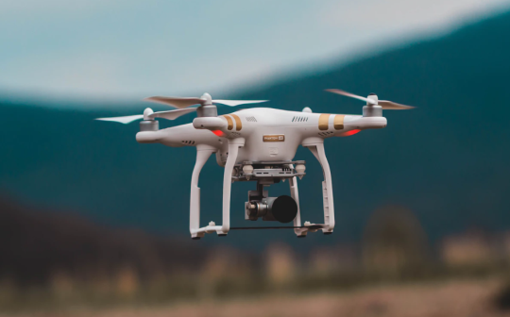
AI At the Edge Applicability
Self-driving cars
Security Cameras
Drones
Robots
Notes:
Delivery drones, assistant robots, etc. etc.

Slide 16

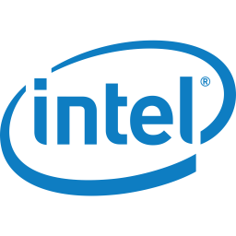


Credits
Elias Papachristos
https://www.linkedin.com/in/elias-papachristos
Argyris Liatsis
https://www.linkedin.com/in/argyris-liatsis/
Icons Designed by studiogstock / Freepik.com
Drone photo by Jared Brashier on Unsplash

