Slide 1
Multi-dimensional Search Trees
Acknowledgement:
Taken slides from Prof. George Bebis, Dept of Computer Science and Engineering, University of Nevada.

Slide 2
Query Types
Exact match query: Asks for the object(s) whose key matches query key exactly.
Range query: Asks for the objects whose key lies in a specified query range (interval).
Nearest-neighbor query: Asks for the objects whose key is “close” to query key.

Slide 3
Exact Match Query
Suppose that we store employee records in a database:
  ID Name Age Salary #Children
Example:
  key=ID: retrieve the record with ID=12345

Slide 4
Range Query
Example:
  key=Age: retrieve all records satisfying
  20 < Age < 50
  key= #Children: retrieve all records satisfying
  1 < #Children < 4
  ID Name Age Salary #Children

Slide 5
Nearest-Neighbor(s) (NN) Query
Example:
  key=Salary: retrieve the employee whose salary is closest to $50,000 (i.e., 1-NN).
  key=Age: retrieve the 5 employees whose age is closest to 40 (i.e., k-NN, k=5).
  ID Name Age Salary #Children

Slide 6
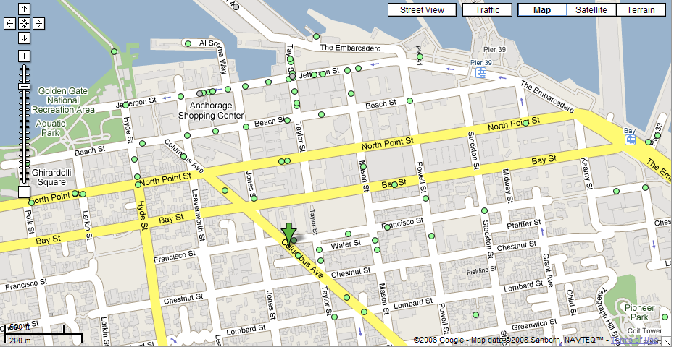
Nearest Neighbor(s) Query
  What is the closest restaurant to my hotel?

Slide 7
Nearest Neighbor(s) Query (cont’d)
  Find the 4 closest restaurants to my hotel

Slide 8
Multi-dimensional Query
In practice, queries might involve multi-dimensional keys.
  key=(Name, Age): retrieve all records with
  Name=“George” and “50 <= Age <= 70”
  ID Name Age Salary #Children

Slide 9
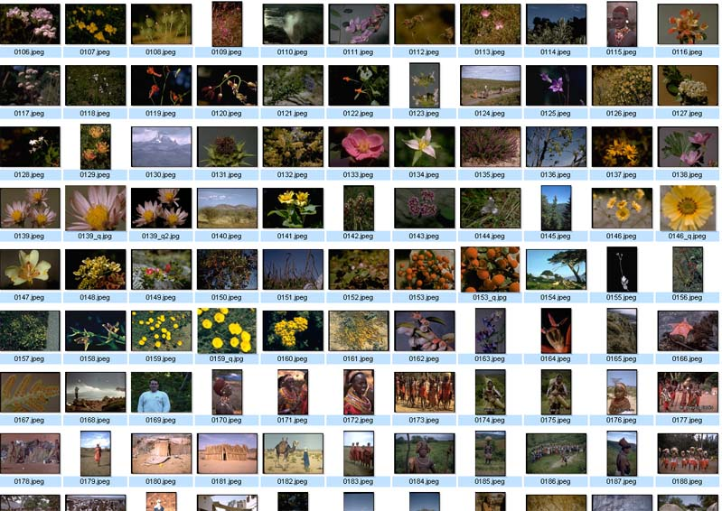
Nearest Neighbor Query in High Dimensions
Very important and practical problem!
  Image retrieval
find N closest
matches (i.e., N
nearest neighbors)
(f₁,f₂, .., f_{k})

Slide 10
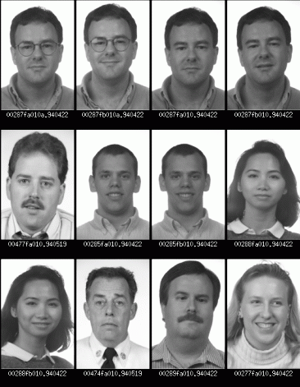
Nearest Neighbor Query in High Dimensions
  Face recognition
find closest match
(i.e., nearest neighbor)

Slide 11
We will discuss …
Range trees
KD-trees
Quadtrees

Slide 12
Interpreting Queries Geometrically
Multi-dimensional keys can be thought as “points” in high dimensional spaces.
Queries about records → Queries about points

Slide 13
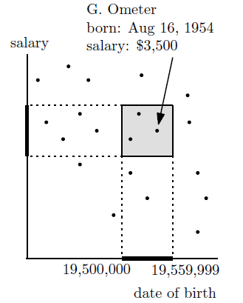
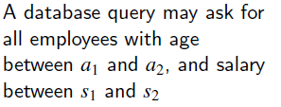
Example 1- Range Search in 2D
age = 10,000 x year + 100 x month + day

Slide 14
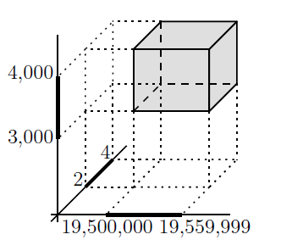
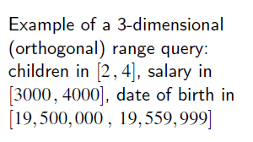
Example 2 – Range Search in 3D

Slide 15
Example 3 – Nearest Neighbors Search
QueryPoint

Slide 16
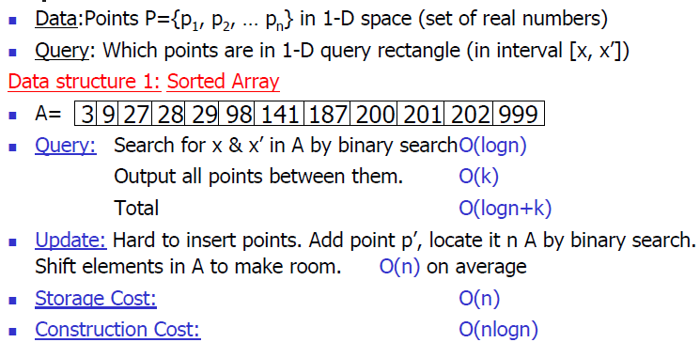
1D Range Search

Slide 17
1D Range Search
Range: [x, x’]
Updates take O(n) time
Does not generalize well to high dimensions.
Example: retrieve all points in [25, 90]

Slide 18
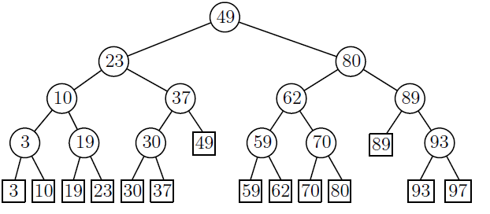


1D Range Search
Data Structure 2: BST
  Search using binary search property.
  Some subtrees are eliminated during search.
Search using:
Range:[l,r]
x
if
if
search
search
Example: retrieve all points in [25, 90]

Slide 19
1D Range Search
Data Structure 3: BST with data stored in leaves
  Internal nodes store splitting values (i.e., not necessarily same as data).
  Data points are stored in the leaf nodes.

Slide 20
BST with data stored in leaves
0
100
25
50
75
50
Data: 10, 39, 55, 120
25
75
10
39
55
120

Slide 21
1D Range Search
Retrieving data in [x, x’]
  Perform binary search twice, once using x and the other using x’
  Suppose binary search ends at leaves l and l’
  The points in [x, x’] are the ones stored between l and l’ plus, possibly, the points stored in l and l’

Slide 22
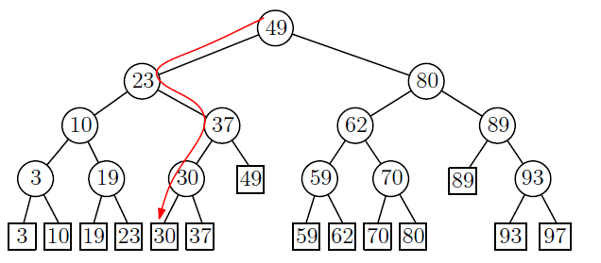
1D Range Search
Example: retrieve all points in [25, 90]
  The search path for 25 is:

Slide 23
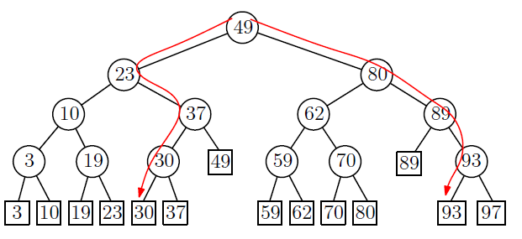
1D Range Search
  The search for 90 is:

Slide 24
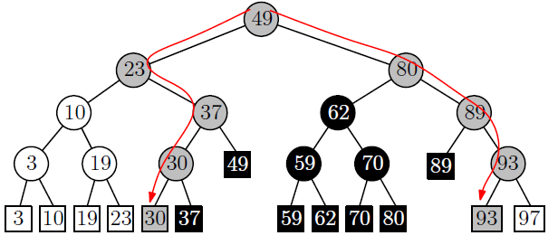
1D Range Search
Examine the leaves in the sub-trees between the two traversing paths from the root.
split node
retrieve all points in [25, 90]

Slide 25
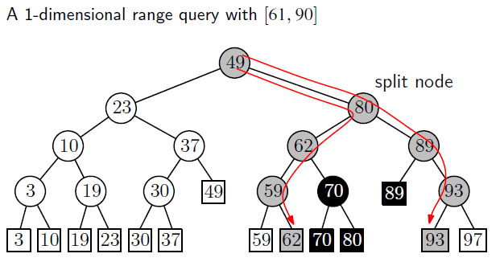
1D Range Search – Another Example

Slide 26
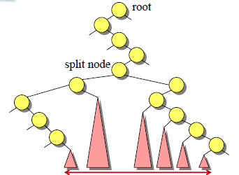
1D Range Search
How do we find the leaves of interest?
Find split node (i.e., node where the
paths to x and x’ split).
Left turn: report leaves in right subtrees
Right turn: report leaves in left substrees
O(logn + k) time where k is the number of items reported.

Slide 27
1D Range Search
Speed-up search by keeping the leaves in sorted order using a linked-list.

Slide 28
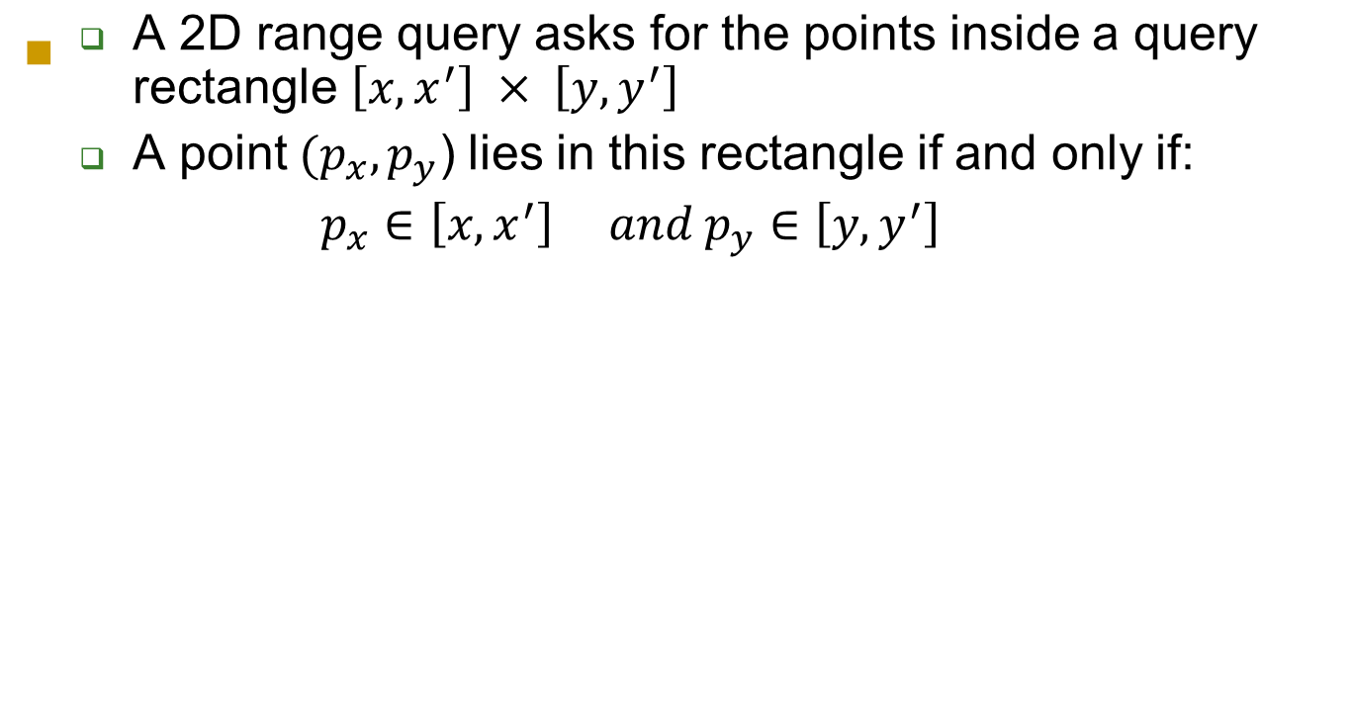


2D Range Search
y’
y

Slide 29
2D Range Search (cont’d)
  A 2D range query can be decomposed in two 1D range queries:
    One on the x-coordinate of the points.
    The other on the y-coordinates of the points.
y’
y

Slide 30
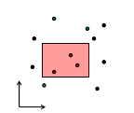
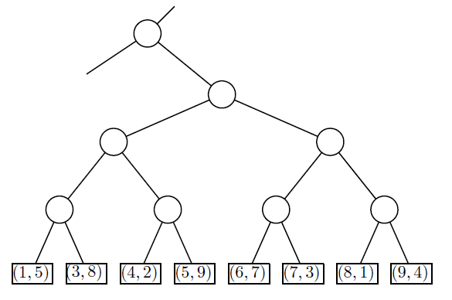
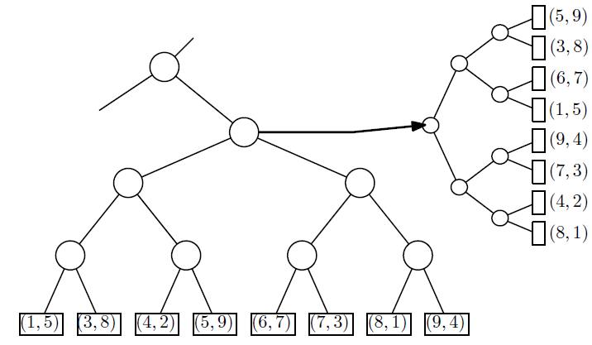
2D Range Search (cont’d)
Store a primary 1D range tree for all the points based on x-coordinate.
For each node, store a secondary 1D range tree based on y-coordinate.

Slide 31
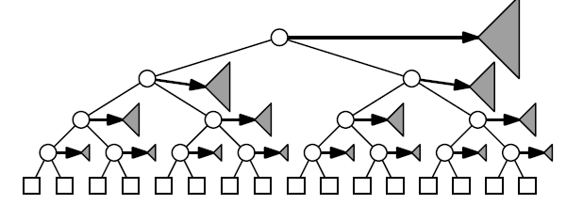
2D Range Search (cont’d)
Range Tree
Space requirements: O(nlogn)

Slide 32
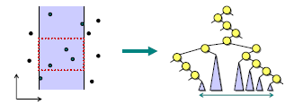
2D Range Search (cont’d)
Search using the x-coordinate only.
How to restrict to points with proper y-coordinate?

Slide 33
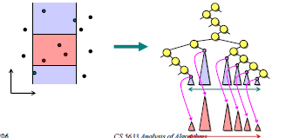
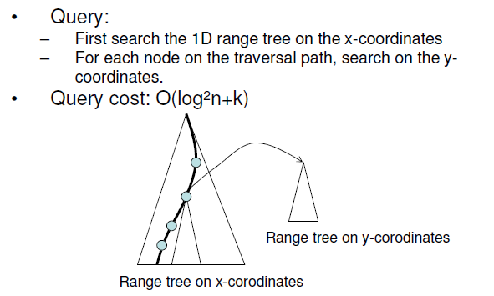
2D Range Search (cont’d)
Recursively search within each subtree using the y-coordinate.

Slide 34
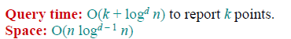
Range Search in d dimensions
1D query time:
O(logn + k)
2D query time:
O(log²n + k)
d dimensions:

Slide 35
KD Tree
A binary search tree where every node is a
k-dimensional point.
Example: k=2
53, 14
27, 28
65, 51
30, 11
31, 85
70, 3
99, 90
29, 16
40, 26
7, 39
32, 29
82, 64
38, 23
55,62
73, 75
15, 61

Slide 36
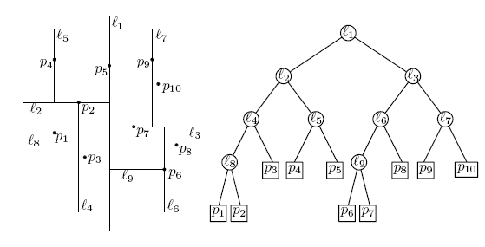
KD Tree (cont’d)
Example: data stored at the leaves

Slide 37
KD Tree (cont’d)
Every node (except leaves) represents a hyperplane that divides the space into two parts.
Points to the left (right) of this hyperplane represent the left (right) sub-tree of that node.
P_{left}
P_{right}

Slide 38
KD Tree (cont’d)
As we move down the tree, we divide the space along alternating (but not always) axis-aligned hyperplanes:
Split by x-coordinate: split by a vertical line that has (ideally) half the points left or on, and half right.
Split by y-coordinate: split by a horizontal line that has (ideally) half the points below or on and half above.

Slide 39
KD Tree - Example
Split by x-coordinate: split by a vertical line that has approximately half the points left or on, and half right.
x

Slide 40
KD Tree - Example
Split by y-coordinate: split by a horizontal line that has half the points below or on and half above.
x
y
y

Slide 41
KD Tree - Example
Split by x-coordinate: split by a vertical line that has half the points left or on, and half right.
x
y
y
x
x
x
x

Slide 42
KD Tree - Example
Split by y-coordinate: split by a horizontal line that has half the points below or on and half above.
x
y
y
x
x
x
x
y
y

Slide 43
Node Structure
A KD-tree node has 5 fields
  Splitting axis
  Splitting value
  Data
  Left pointer
  Right pointer

Slide 44
Splitting Strategies
Divide based on order of point insertion
  Assumes that points are given one at a time.
Divide by finding median
  Assumes all the points are available ahead of time.
Divide perpendicular to the axis with widest spread
  Split axes might not alternate
… and more!

Slide 45
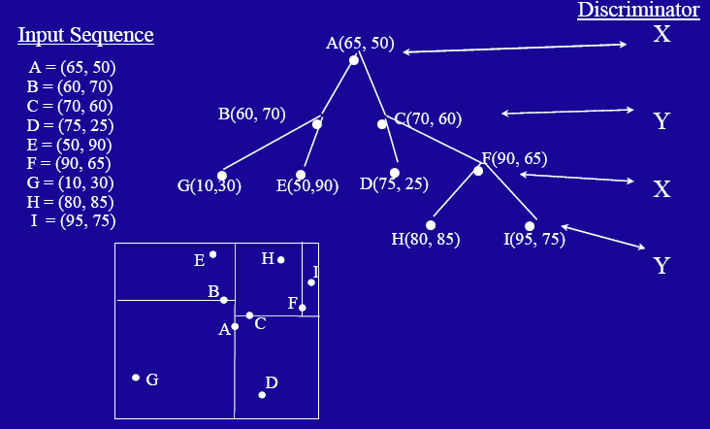
Example – using order of point insertion
(data stored at nodes)

Slide 46
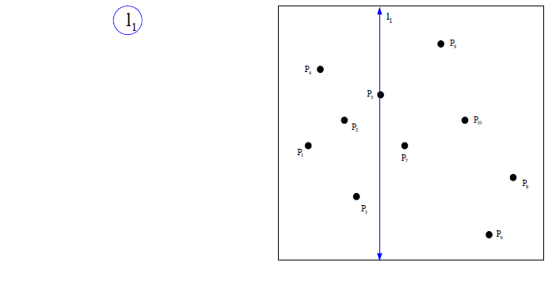
Example – using median
(data stored at the leaves)

Slide 47
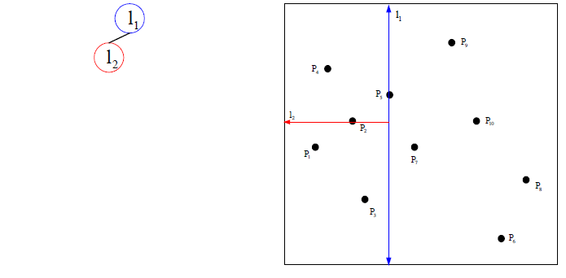
Example – using median
(data stored at the leaves)

Slide 48
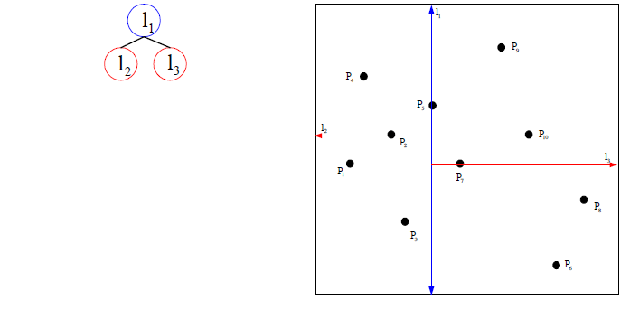
Example – using median
(data stored at the leaves)

Slide 49
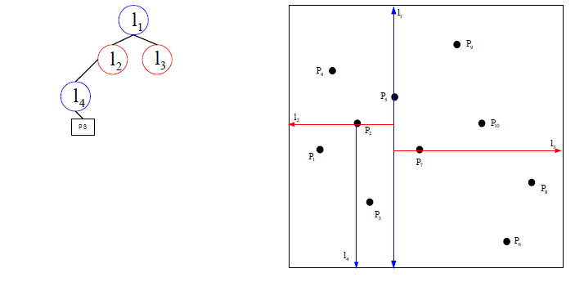
Example – using median
(data stored at the leaves)

Slide 50
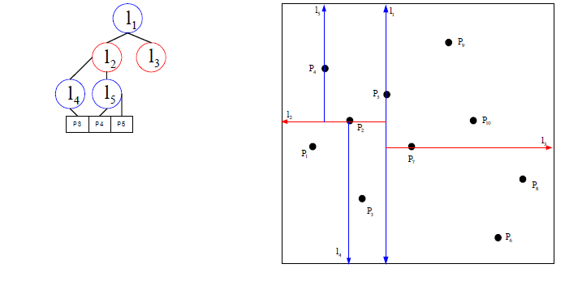
Example – using median
(data stored at the leaves)

Slide 51
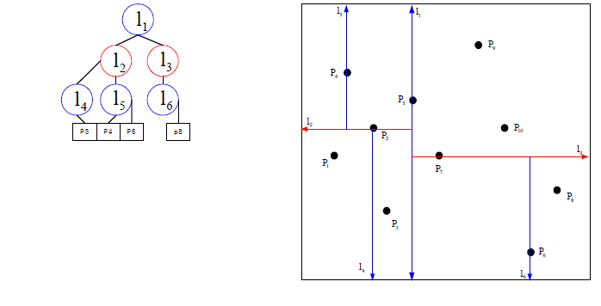
Example – using median
(data stored at the leaves)

Slide 52
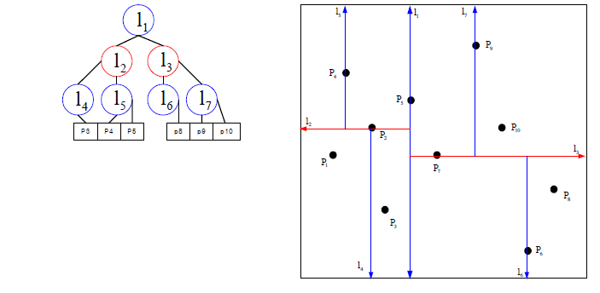
Example – using median
(data stored at the leaves)

Slide 53
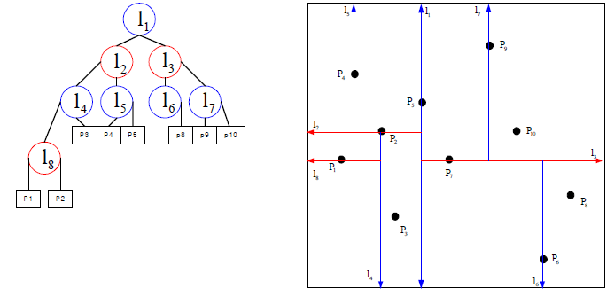
Example – using median
(data stored at the leaves)

Slide 54
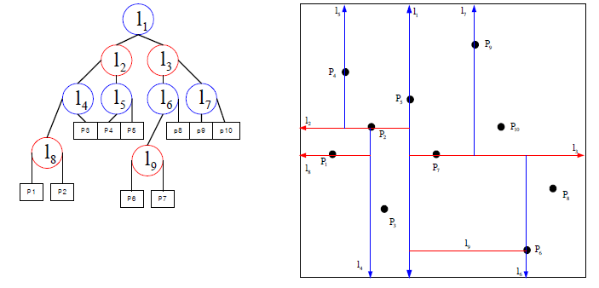
Example – using median
(data stored at the leaves)

Slide 55
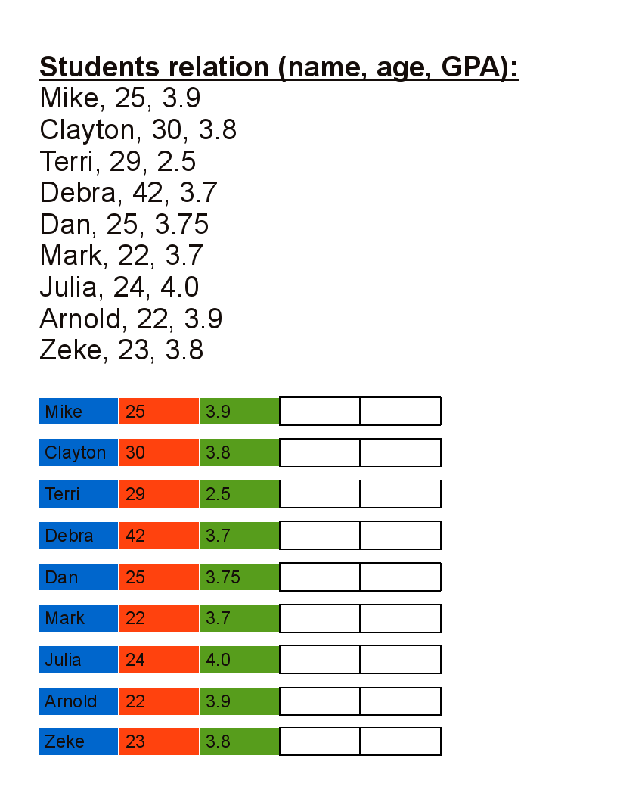
Another Example – using median

Slide 56
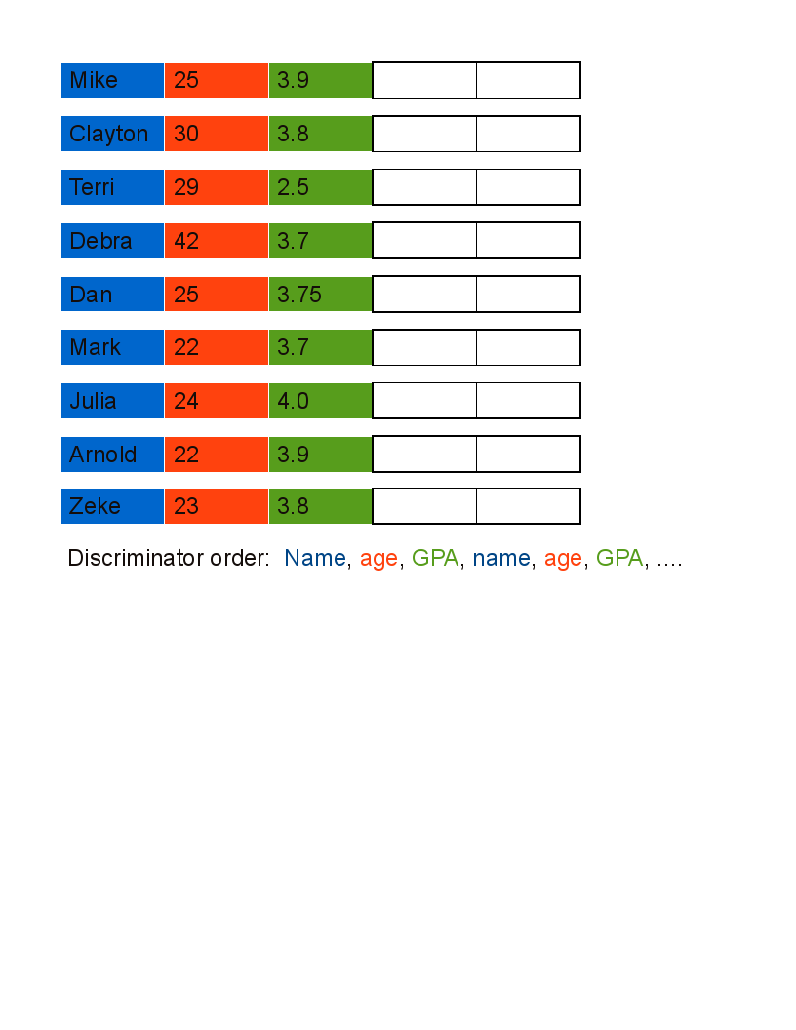
Another Example - using median

Slide 57
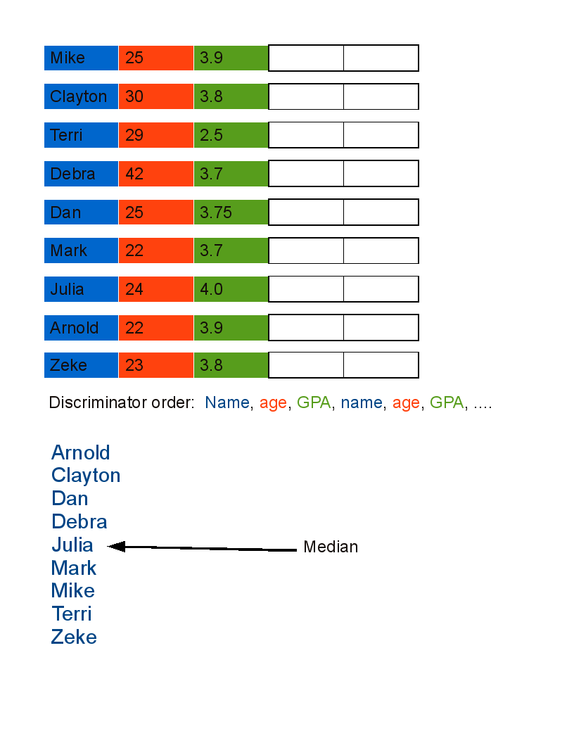
Another Example - using median

Slide 58
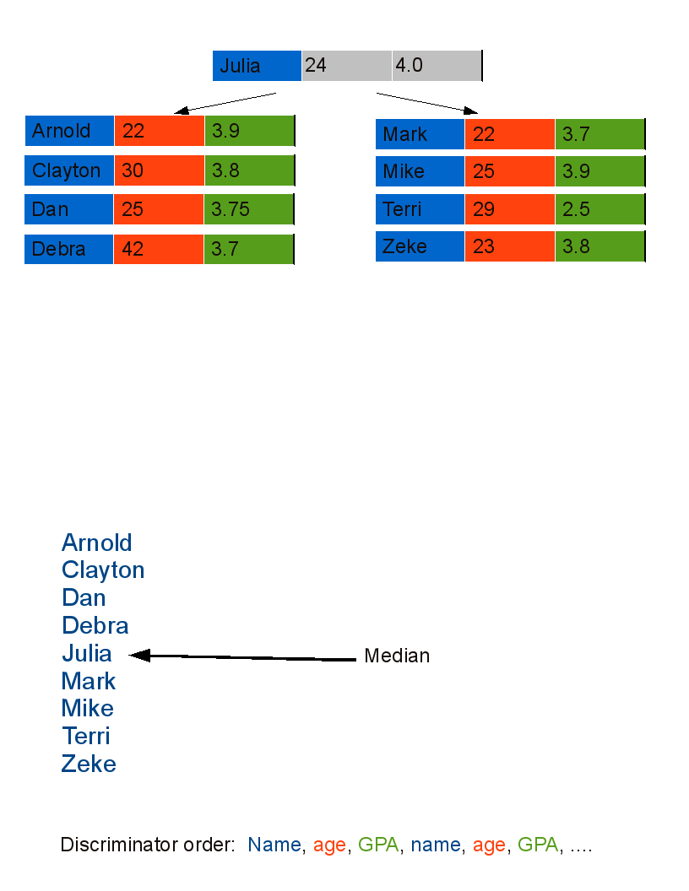
Another Example - using median

Slide 59
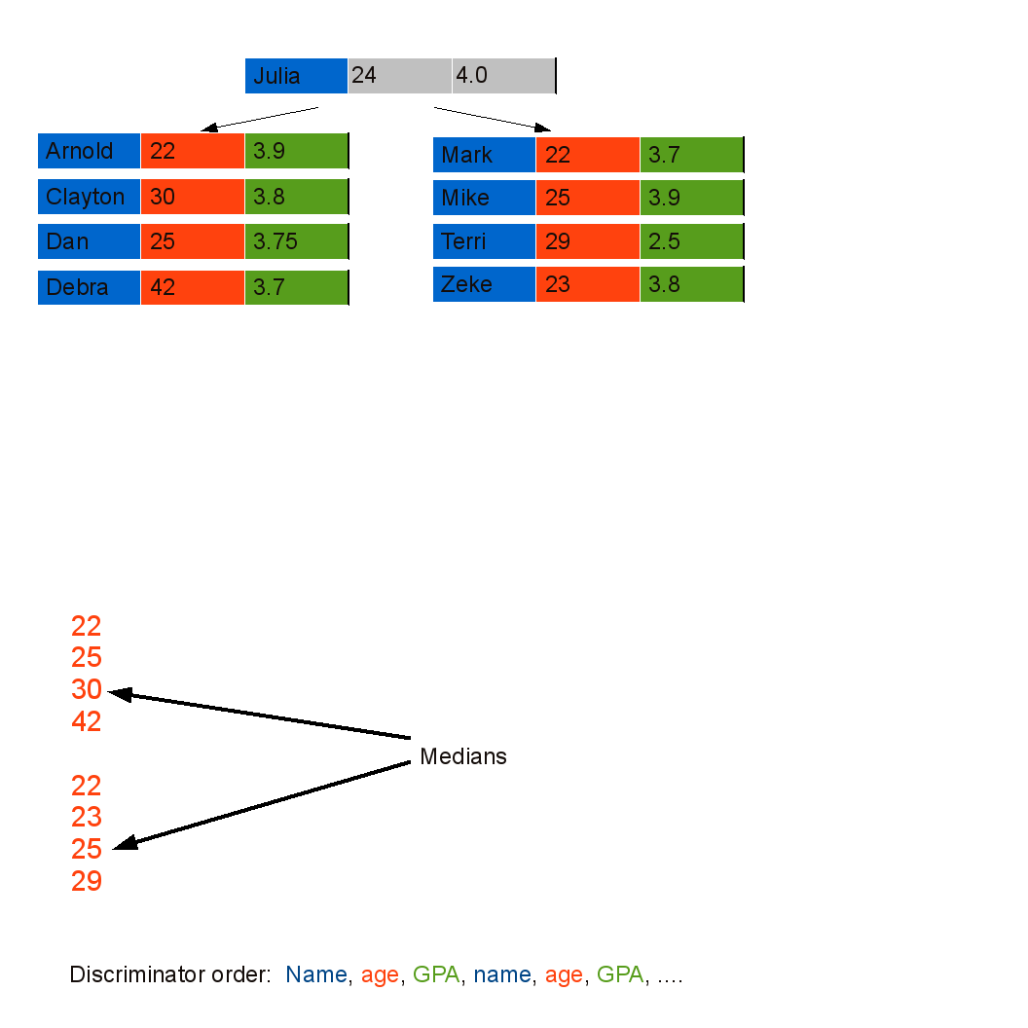
Another Example - using median

Slide 60
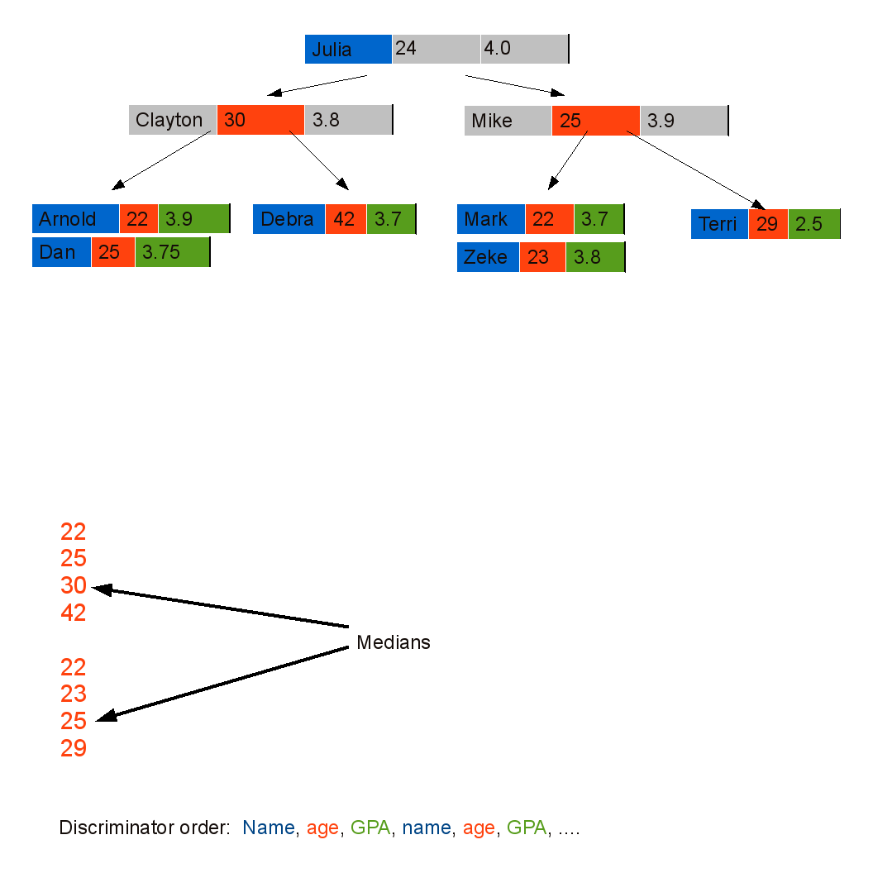
Another Example - using median

Slide 61
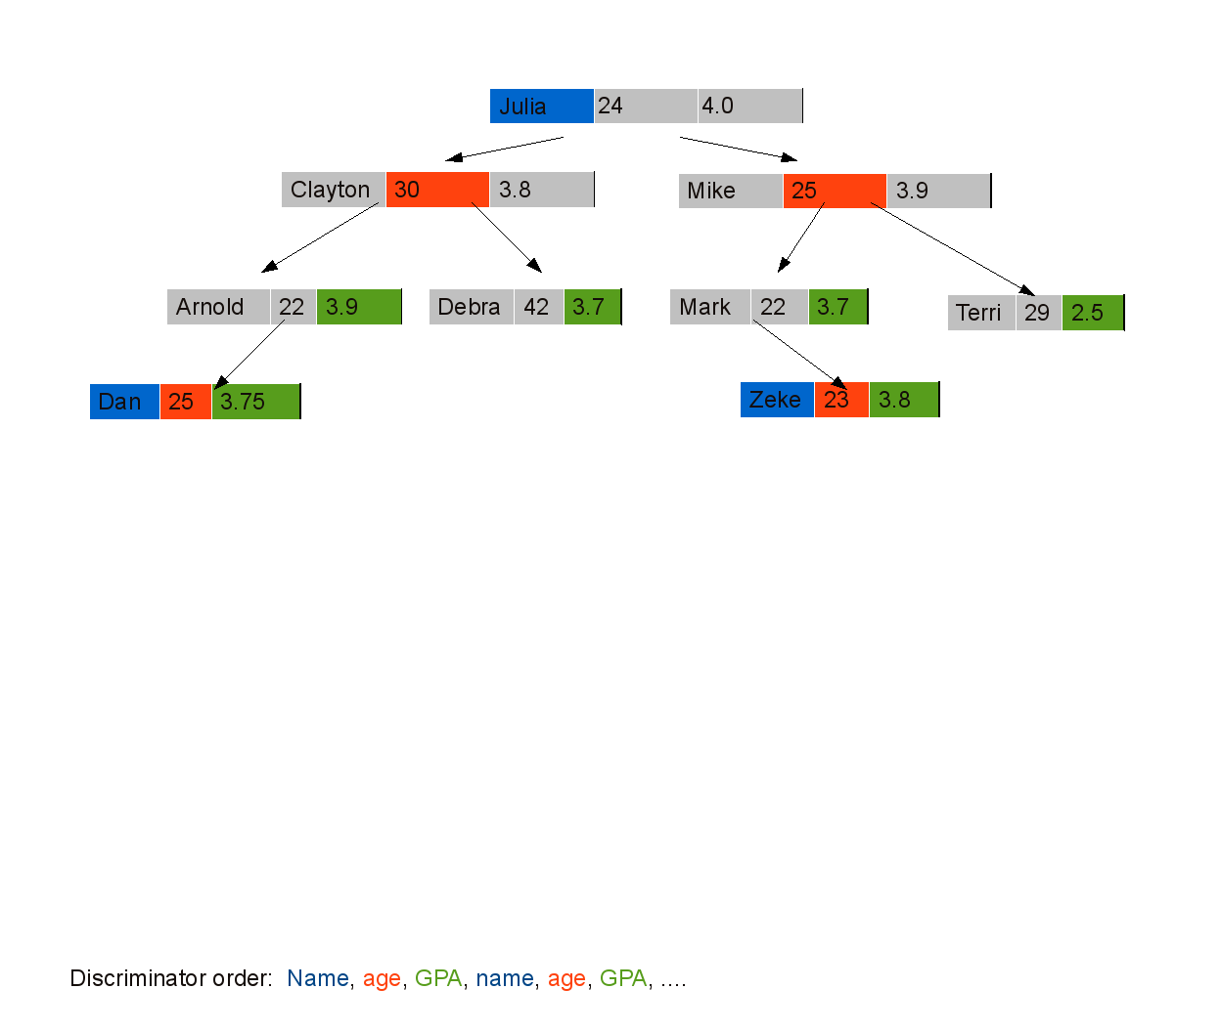
Another Example - using median

Slide 62
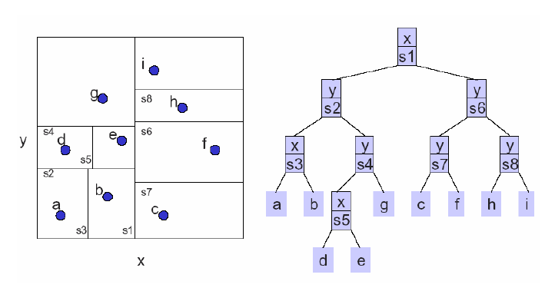
Example – split perpendicular to the axis with widest spread

Slide 63
KD Tree (cont’d)
Let’s discuss
  Insert
  Delete
  Search

Slide 64
Insert (55, 62)
Insert new data
55 > 53, move right
53, 14
x
62 > 51, move right
27, 28
65, 51
y
70, 3
99, 90
x
30, 11
31, 85
55 < 99, move left
29, 16
40, 26
7, 39
32, 29
82, 64
y
38, 23
55,62
73, 75
15, 61
62 < 64, move left
Null pointer, attach

Slide 65
Delete data
Suppose we need to remove p = (a, b)
  Find node t which contains p
  If t is a leaf node, replace it by null
  Otherwise, find a replacement node r = (c, d) – see below!
  Replace (a, b) by (c, d)
  Remove r
Finding the replacement r = (c, d)
  If t has a right child, use the successor*
  Otherwise, use node with minimum value* in the left subtree
*(depending on what axis the node discriminates)

Slide 66
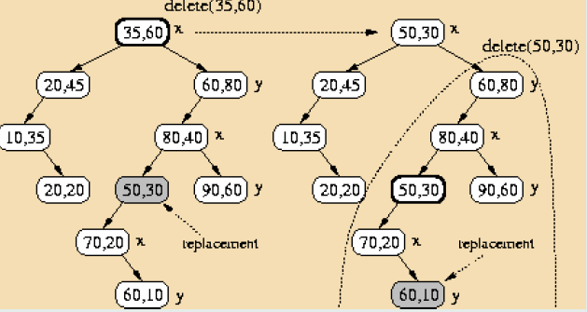
Delete data (cont’d)

Slide 67
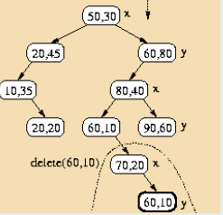
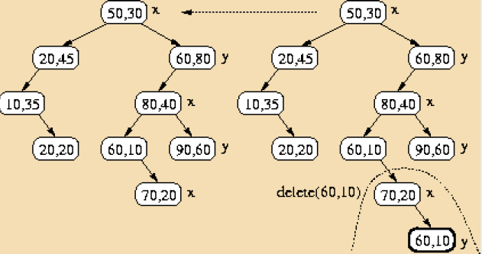
Delete data (cont’d)

Slide 68
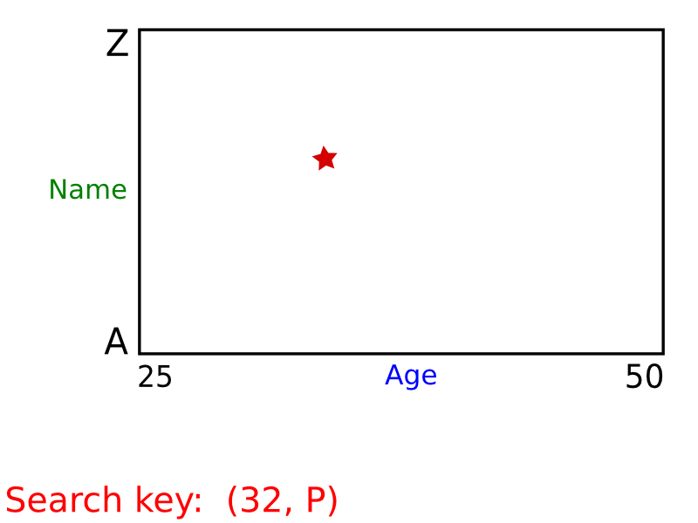
KD Tree – Exact Search

Slide 69
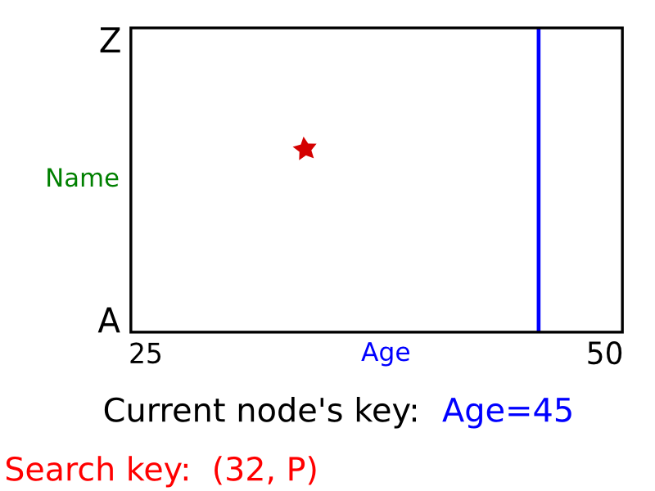
KD Tree – Exact Search

Slide 70
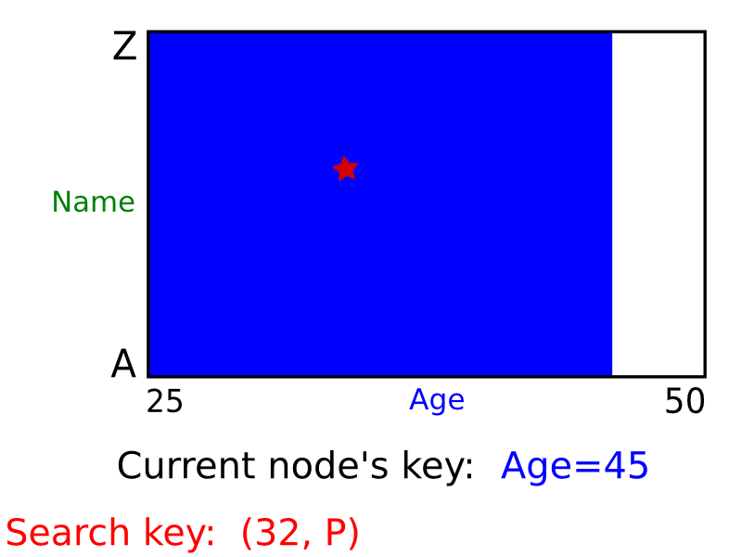
KD Tree – Exact Search

Slide 71
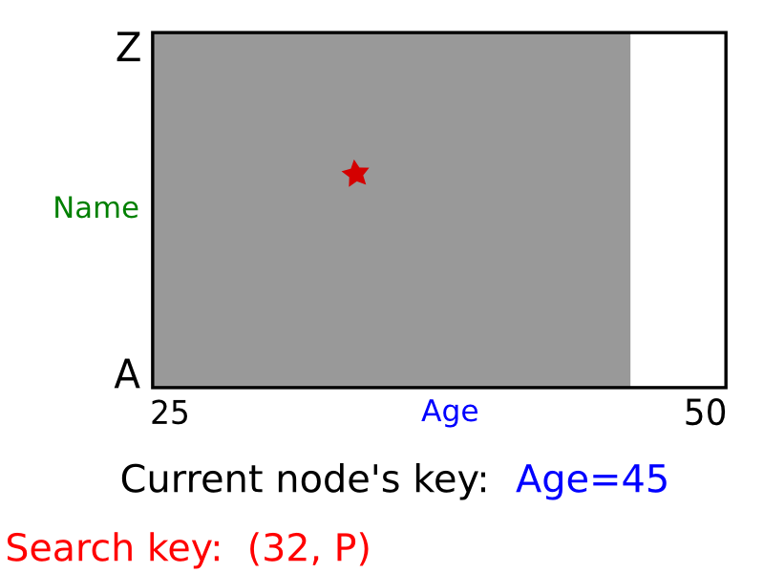
KD Tree – Exact Search

Slide 72
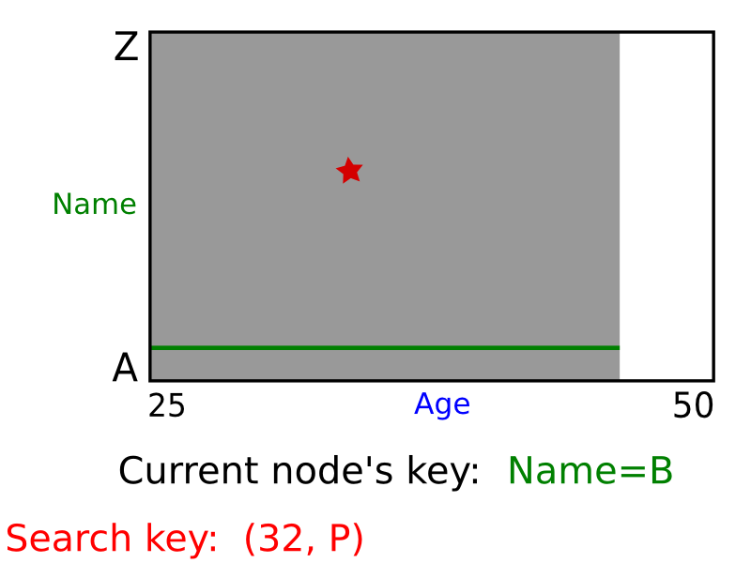
KD Tree – Exact Search

Slide 73

KD Tree – Exact Search

Slide 74

KD Tree – Exact Search

Slide 75

KD Tree – Exact Search

Slide 76

KD Tree – Exact Search

Slide 77

KD Tree – Exact Search

Slide 78

KD Tree – Exact Search

Slide 79
KD Tree - Range Search
Range:[l,r]
x
[35, 40] x [23, 30]
In range? If so, print cell
low[level]<=data[level] → search t.left
high[level] >= data[level] → search t.right
x
53, 14
y
65, 51
27, 28
x
70, 3
99, 90
30, 11
31, 85
y
29, 16
40, 26
7, 39
32, 29
82, 64
x
38, 23
73, 75
15, 61
low[0] = 35, high[0] = 40;
This sub-tree is never searched.
low[1] = 23, high[1] = 30;
Searching is “preorder”. Efficiency is obtained by “pruning” subtrees from the search.

Slide 80
KD Tree - Range Search
Consider a KD Tree where the data is stored at the leaves, how do we perform range search?

Slide 81

KD Tree – Region of a node
The region region(v) corresponding to a node v is a rectangle, which is bounded by splitting lines stored at ancestors of v.

Slide 82
KD Tree - Region of a node (cont’d)
A point is stored in the subtree rooted at node v if and only if it lies in region(v).

Slide 83

KD Trees – Range Search
Need only search nodes whose region intersects query region.
  Report all points in subtrees whose regions are entirely contained in query range.
  If a region is partially contained in the query range check points.
query range

Slide 84

Example – Range Search
Query region: gray rectangle
Gray nodes are the nodes visited in this example.

Slide 85
Example – Range Search
*
Node marked with * corresponds to a region that is entirely inside the query rectangle
Report all leaves in this subtree.

Slide 86
Example – Range Search
All other nodes visited (i.e., gray) correspond to regions
that are only partially inside the query rectangle.
- Report points p₆ and p₁₁ only
- Do not report points p₃, p₁₂ and p₁₃

Slide 87
KD Tree (vs Range tree)
Construction→ O(dnlogn)
  Sort points in each dimension: O(dnlogn)
  Determine splitting line (median finding): O(dn)
Space requirements:
  KD tree: O(n)
  Range tree: O(nlog^{d-1}n)
Query requirements:
  KD tree: O(n^{1-1/d}+k)
  Range tree: O(log^{d}n+k)
O(n+k) as d increases!

Slide 88

Nearest Neighbor (NN) Search
Given: a set P of n points in R^{d}
Goal: find the nearest neighbor p of q in P
p
q
Euclidean distance

Slide 89


Nearest Neighbor Search -Variations
r-search: the distance tolerance is specified.
k-nearest-neighbor-queries: the number of close matches is specified.

Slide 90
Nearest Neighbor (NN) Search
Naïve approach
  Compute the distance from the query point to every other point in the database, keeping track of the "best so far".
  Running time is O(n).
p
q

Slide 91
Array (Grid) Structure
(1) Subdivide the plane into a grid of M x N square cells (same size)
(2) Assign each point to the cell that contains it.
(3) Store as a 2-D (or N-D in general) array:
“each cell contains a link to a list of points stored in that cell”
p₁
p₁,p₂
p₂

Slide 92
Array (Grid) Structure
Algorithm
  * Look up cell holding query point.
  * First examine the cell containing the query,
  then the cells adjacent to the query
  (i.e., there could be points in adjacent
  cells that are closer).
Comments
  * Uniform grid inefficient if points unequally distributed.
  - Too close together: long lists in each grid, serial search.
  - Too far apart: search large number of neighbors.
  * Multiresolution grid can address some of these issues.
p₁
q
p₂

Slide 93


Quadtree
A tree in which each internal node has up to four children.
Every node in the quadtree corresponds to a square.
The children of a node v correspond to the four quadrants of the square of v.
The children of a node are labelled NE, NW, SW, and SE to indicate to which quadrant they correspond.
N
W
E
S
Notes:
Extension to the K-dimensional case

Slide 94
Quadtree Construction
(data stored at leaves)
400
a
Input: point set P
while Some cell C contains more than “k” points do
Split cell C
end
b
c
d
e
Y
g
f
h
l
j
i
k
X 50, Y 200
0
X
100
SW
SE
NW
NE
i h
X 75, Y 100
c e
X 25, Y 300
j k
f
g l
d
a b

Slide 95
Quadtree – Exact Match Query
Partitioning of the plane
The quad tree
D(35,85)
A(50,50)
•
•
B(75,80)
P
SE
NE
•
NW
C(90,65)
SW
B(75,80)
•
NE
A(50,50)
E
D
SE
SW
NW
•
C
E(25,25)
To search for P(55, 75):
Since X_{A}< X_{P} and Y_{A} < Y_{P} → go to NE (i.e., B).
Since X_{B} > X_{P} and Y_{B} > Y_{P} → go to SW, which in this case is null.
Notes:
Multimedia Technologies
7/17/97
Kien A. Hua

Slide 96
Quadtree – Nearest Neighbor Query
X₁,Y₁
SW
SE
NE
NW
X₂,Y₂
Y
X
Notes:
Extension to the K-dimensional case

Slide 97
Quadtree – Nearest Neighbor Query
X₁,Y₁
SW
NE
NW
SE
X₂,Y₂
Y
NW
X
Notes:
Extension to the K-dimensional case

Slide 98
Quadtree– Nearest Neighbor Query
X₁,Y₁
SW
NE
NW
SE
X₂,Y₂
SW
Y
NW
SE
NE
X
Notes:
Extension to the K-dimensional case

Slide 99
Quadtree– Nearest Neighbor Search
Algorithm
Initialize range search with large r
Put the root on a stack
Repeat
  Pop the next node T from the stack
  For each child C of T
    if C intersects with a circle (ball) of radius r around q, add C to the stack
    if C is a leaf, examine point(s) in C and
    update r
q
Whenever a point is found, update r (i.e., current minimum)
Only investigate nodes with respect to current r.

Slide 100
Quadtree (cont’d)
Simple data structure.
Easy to implement.
But, it might not be efficient:
  A quadtree could have a lot of empty cells.
  If the points form sparse clouds, it takes a while to reach nearest neighbors.

Slide 101
Nearest Neighbor with KD Trees
Traverse the tree, looking for the rectangle that contains the query.

Slide 102
Nearest Neighbor with KD Trees
Explore the branch of the tree that is closest to the query point first.

Slide 103
Nearest Neighbor with KD Trees
Explore the branch of the tree that is closest to the query point first.

Slide 104
Nearest Neighbor with KD Trees
When we reach a leaf, compute the distance to each point in the node.

Slide 105
Nearest Neighbor with KD Trees
When we reach a leaf, compute the distance to each point in the node.

Slide 106
Nearest Neighbor with KD Trees
Then, backtrack and try the other branch at each node visited.

Slide 107
Nearest Neighbor with KD Trees
Each time a new closest node is found, we can update the distance bounds.

Slide 108
Nearest Neighbor with KD Trees
Each time a new closest node is found, we can update the distance bounds.

Slide 109
Nearest Neighbor with KD Trees
Using the distance bounds and the bounds of the data below each node, we can prune parts of the tree that could NOT include the nearest neighbor.

Slide 110
Nearest Neighbor with KD Trees
Using the distance bounds and the bounds of the data below each node, we can prune parts of the tree that could NOT include the nearest neighbor.

Slide 111
Nearest Neighbor with KD Trees
Using the distance bounds and the bounds of the data below each node, we can prune parts of the tree that could NOT include the nearest neighbor.

Slide 112
K-Nearest Neighbor Search
Can find the k-nearest neighbors to a query by maintaining the k current bests instead of just one.
Branches are only eliminated when they can't have points closer than any of the k current bests.

Slide 113
NN example using kD trees
d=1 (binary search tree)
5
20
7
8
10
12
13
15
18
7,8,10,12
13,15,18
7,8
10,12
13,15
18
7, 8
10, 12
13, 15
18

Slide 114
NN example using kD trees (cont’d)
d=1 (binary search tree)
5
20
7
8
10
12
13
15
18
query
7,8,10,12
13,15,18
17
7,8
10,12
13,15
18
min dist = 1
7, 8
10, 12
13, 15
18

Slide 115
NN example using kD trees (cont’d)
d=1 (binary search tree)
5
20
7
8
10
12
13
15
18
query
7,8,10,12
13,15,18
16
7,8
10,12
13,15
18
min dist = 2
min dist = 1
7, 8
10, 12
13, 15
18

Slide 116

KD variations - PCP Trees
Splits can be in directions other than x and y.
Divide points perpendicular
to the axis with widest
spread.
Principal Component
Partitioning (PCP)

Slide 117

KD variations - PCP Trees

Slide 118
“Curse” of dimensionality
KD-trees are not suitable for efficiently finding the nearest neighbor in high dimensional spaces.
Approximate Nearest-Neighbor (ANN)
  Examine only the N closest bins of the kD-tree
  Use a heap to identify bins in order by their distance from query.
  Return nearest-neighbors with high probability (e.g., 95%).
Query time: O(n^{1-1/d}+k)
J. Beis and D. Lowe, “Shape Indexing Using Approximate Nearest-Neighbour Search in High-Dimensional Spaces”, IEEE Computer Vision and Pattern Recognition, 1997.

Slide 119

Dimensionality Reduction
Idea: Find a mapping T to reduce the dimensionality of the data.
Drawback: May not be able to find all similar objects (i.e., distance relationships might not be preserved)

