Slide 1
Spatial Indexing I
R-trees

Slide 2
Problem
Given a collection of geometric objects (points, lines, polygons, ...)
organize them on disk, to answer efficiently spatial queries (range, nn, etc)

Slide 3
R-tree
In multidimensional space, there is no unique ordering! Not possible to use B+-trees☹
[Guttman 84] R-tree!
Group objects close in space in the same node
    => guaranteed page utilization
    => easy insertion/split algorithms.
    (only deal with Minimum Bounding Rectangles - MBRs)

Slide 4
R-tree
A multi-way external memory tree
Index nodes and data (leaf) nodes
All leaf nodes appear on the same level
Every node contains between m and M entries
The root node has at least 2 entries (children)

Slide 5
Example
eg., w/ fanout 4: group nearby rectangles to parent MBRs; each group -> disk page
I
A
C
G
F
H
B
J
E
D

Slide 6
Example
F=4
P1
P3
I
A
C
G
F
H
B
J
A
B
C
H
I
J
E
P4
P2
D
D
E
F
G

Slide 7
Example
F=4| m=2, M=4
P5
P6
P6
I
P1
P2
P3
P4
A
C
P1
G
F
P3
H
B
J
A
B
C
H
I
J
E
P4
P2
D
P5
D
E
F
G

Slide 8
R-trees - format of nodes
{(MBR; obj_ptr)} for leaf nodes
P1
P2
P3
P4
x-low; x-high
y-low; y-high
...
obj
ptr
A
B
C
...

Slide 9
R-trees - format of nodes
{(MBR; node_ptr)} for non-leaf nodes
x-low; x-high
y-low; y-high
...
node
ptr
P1
P2
P3
P4
...
A
B
C

Slide 10
R-trees:Search
P5
P6
I
C
P1
P1
P2
P3
P4
A
G
F
P3
H
B
J
E
P4
A
B
C
H
I
J
P2
D
D
E
F
G

Slide 11
R-trees:Search
P5
P6
I
C
P1
P1
P2
P3
P4
A
G
F
P3
H
B
J
E
P4
A
B
C
H
I
J
P2
D
D
E
F
G

Slide 12
R-trees:Search
Main points:
  every parent node completely covers its ‘children’
  nodes in the same level may overlap!
  a child MBR may be covered by more than one parent - it is stored under ONLY ONE of them. (ie., no need for dup. elim.)
  a point query may follow multiple branches.
  everything works for any(?) dimensionality

Slide 13
R-trees:Insertion
Insert X
P1
P3
I
P1
P2
P3
P4
A
C
G
F
H
B
X
J
A
B
C
H
I
J
E
P4
P2
D
D
E
X
F
G

Slide 14
R-trees:Insertion
Insert Y
P1
P3
I
P1
P2
P3
P4
A
C
G
F
H
B
J
A
B
C
H
I
J
Y
E
P4
P2
D
D
E
F
G

Slide 15
R-trees:Insertion
Extend the parent MBR
P1
P3
I
P1
P2
P3
P4
A
C
G
F
H
B
J
A
B
C
H
I
J
Y
E
P4
P2
D
D
E
Y
F
G

Slide 16
R-trees:Insertion
How to find the next node to insert a new object Y?
  Using ChooseLeaf: Find the entry that needs the least enlargement to include Y. Resolve ties using the area (smallest)
Other methods (later)

Slide 17
R-trees:Insertion
If node is full then Split : ex. Insert w
P1
K
P3
I
P1
P2
P3
P4
A
C
G
W
F
H
B
J
A
B
C
K
H
I
J
E
P4
P2
D
D
E
F
G

Slide 18
R-trees:Insertion
If node is full then Split : ex. Insert w
Q1
Q2
P5
P3
I
K
P1
P5
P2
P3
P4
P1
A
C
G
W
F
H
B
A
B
J
H
I
J
E
P4
C
K
W
P2
D
Q2
F
G
Q1
D
E

Slide 19
R-trees:Split
Split node P1: partition the MBRs into two groups.
(A1: plane sweep,
  until 50% of rectangles)
A2: ‘linear’ split
A3: quadratic split
A4: exponential split:
  2^{M-1} choices
P1
K
A
C
W
B

Slide 20
R-trees:Split
pick two rectangles as ‘seeds’for group 1 and group 2;
seed2
R
seed1

Slide 21
R-trees:Split
pick two rectangles as ‘seeds’for group 1 and group 2;
assign each rectangle ‘R’ to the ‘closest’ ‘group’:
‘closest’: the smallest increase in area
seed2
R
seed1

Slide 22
R-trees:Linear Split
How to pick Seeds:
  Find the rects with the highest low and lowest high sides in each dimension
  Normalize the separations by dividing by the width of all the rects in the corresponding dim
  Choose the pair with the greatest normalized separation
PickNext: pick one of the remaining rects and add it to the closest group

Slide 24
R-trees:Insertion
Use the ChooseLeaf to find the leaf node to insert an entry E
If leaf node is full, then Split, otherwise insert there
  Propagate the split upwards, if necessary
Adjust parent nodes

Slide 25
R-Trees:Deletion
Find the leaf node that contains the entry E
Remove E from this node
If underflow:
  Eliminate the node by removing the node entries and the parent entry
  Reinsert the orphaned (other entries) into the tree using Insert
Other method (later)

Slide 26
R-trees: Variations
R+-tree: DO not allow overlapping, so split the objects (similar to z-values)
R*-tree: change the insertion, deletion algorithms (minimize not only area but also perimeter, forced re-insertion )

Slide 27
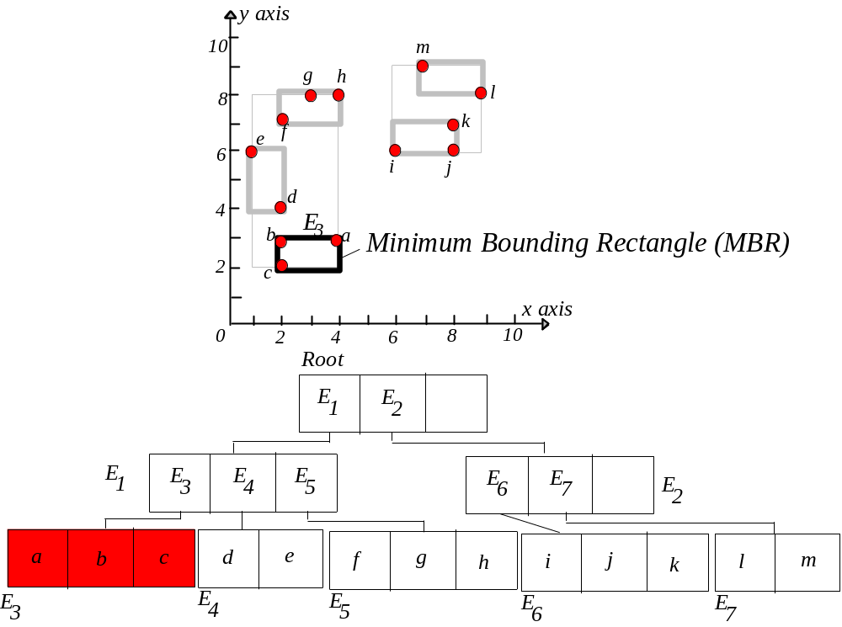
For simplicity node capacity = 3
In practice, in the order of 100

Slide 28
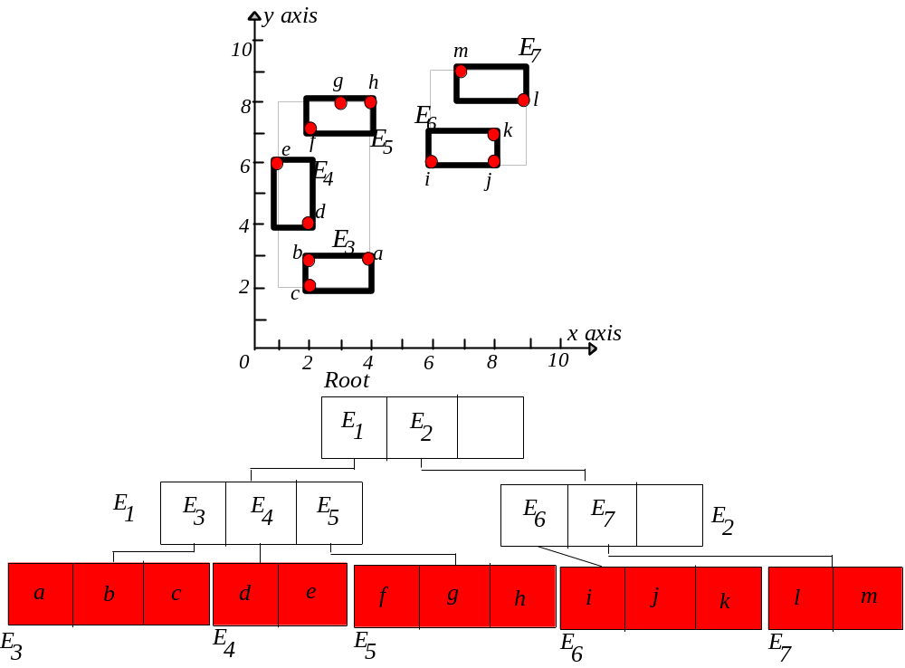
R-Tree, Leaf Nodes

Slide 29
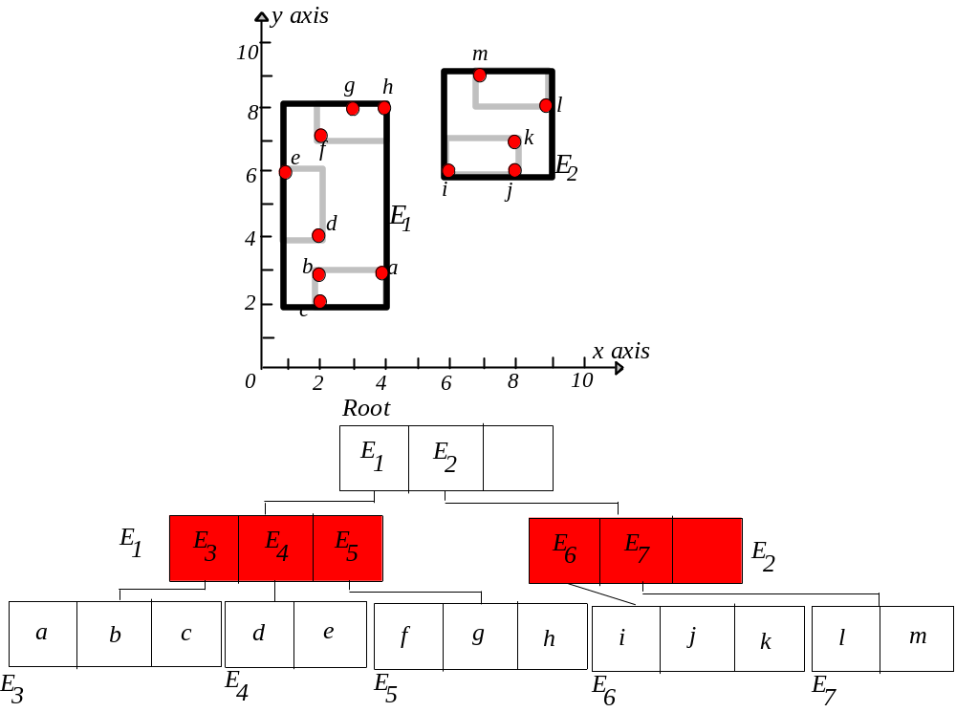
R-Tree – Intermediate Nodes

Slide 30
R-tree, Range Query
y axis
10
m
g
h
8
l
f
k
e
E
2
6
i
j
d
E
1
4
b
a
2
c
x axis
0
2
4
6
8
10
Root
E
1
E
2
E
1
E
3
E
4
E
5
E
E
E
6
7
2
a
b
c
d
e
f
g
h
i
j
k
l
m
E
3
E
4
E
5
E
E
6
7

Slide 31
Range Query
y axis
10
m
g
h
8
l
f
k
e
E
2
6
i
j
d
E
1
4
b
a
2
c
x axis
0
2
4
6
8
10
Root
E
1
E
2
E
1
E
3
E
4
E
5
E
E
E
6
7
2
a
b
c
d
e
f
g
h
i
j
k
l
m
E
3
E
4
E
5
E
E
6
7

Slide 32
R-tree
The original R-tree tries to minimize the area of each enclosing rectangle in the index nodes.
Is there any other property that can be optimized?
R*-tree → Yes!

