Slide 1
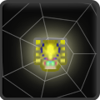
WEBBLE
Free Mode
Touch to Play

Slide 2
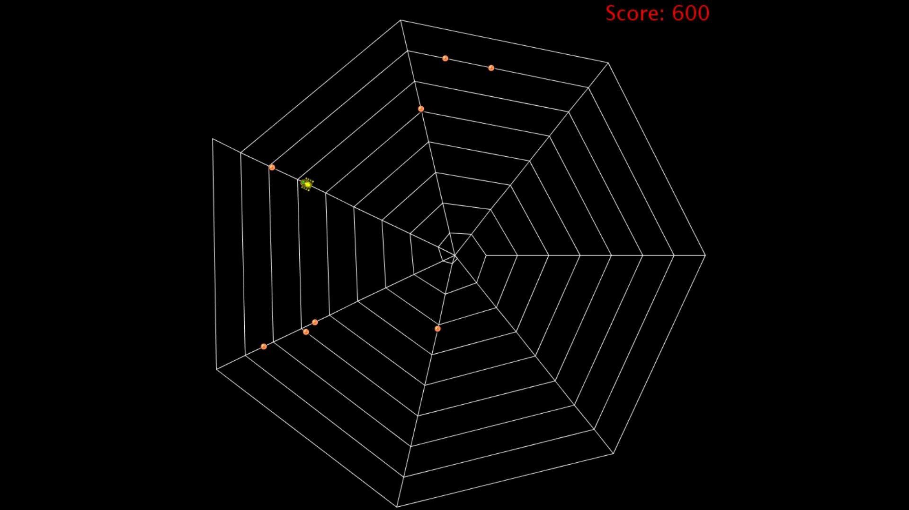
Tap intersections on the web to move to.
Protect this
Catch this

Slide 3
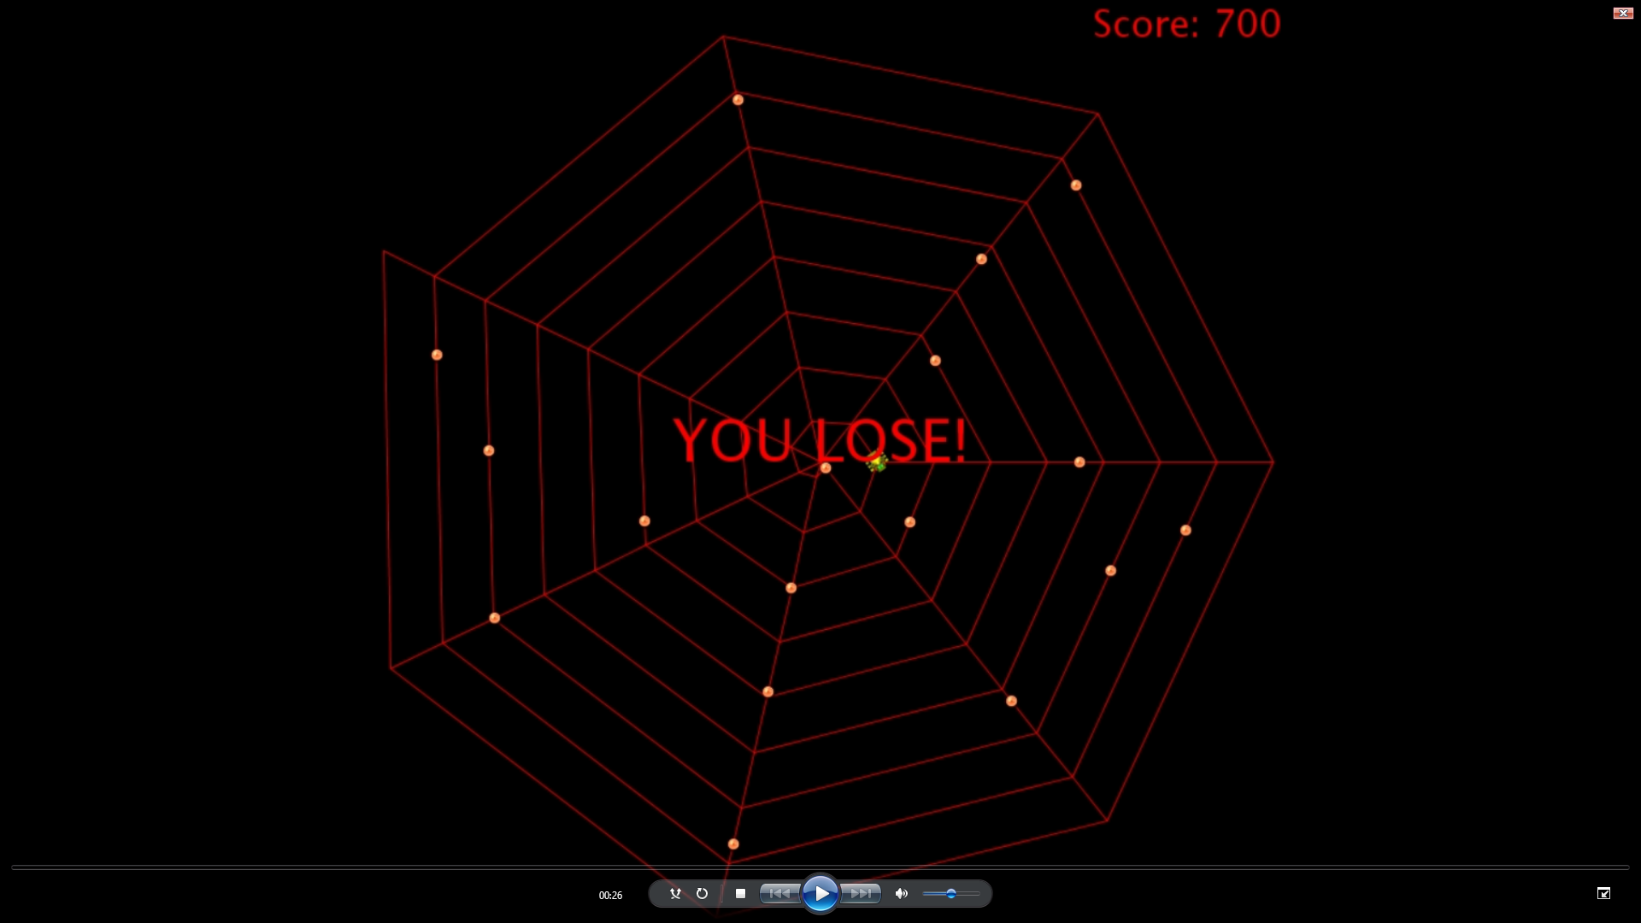
Protect this; If an enemy gets to it, you lose.

