Slide 1
WERM
Weed Emergence Risk Mapping
A log-space multiplicative framework for pre-emergence risk estimation
from field imagery and thermal accumulation
Argument one
Argument two
Emergence is co-limited, so drivers should multiply — not average.
A label-scarce structured model needs an audit protocol, not a score.
Arham Sethi · The Shishukunj International School, Indore, India
IEEE CIBCB 2026 · Athens, Greece
Notes:
OPEN — do not read the title.
"Good morning. A farmer standing at the edge of a field before anything has emerged has to decide where to spray. That decision is spatial, and it is made blind."
Two arguments. First, emergence is co-limited — a seed needs moisture AND exposure AND heat, and missing one is not compensated by having the others. Second: when you build a structured model with almost no labels, the deliverable is not a score, it is a protocol for finding out whether the model is real.
I will walk the pipeline, then show you the six things I did to try to break it.
40 seconds. Do not rush the opening line.

Slide 2
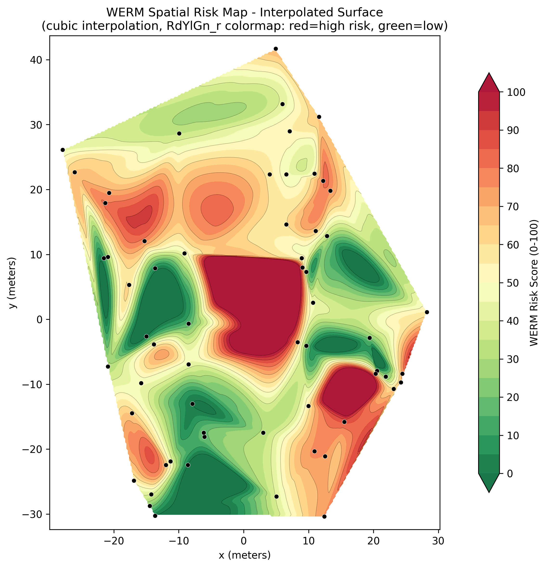
THE PROBLEM
The decision is spatial, and it is made blind
Herbicide is applied uniformly because pre-emergence weed pressure is invisible at decision time.
Seedbank mapping needs coring and germination assays — destructive, slow, and it maps the stock of seed, which changes over seasons.
Emergence models predict WHEN a cohort appears. They do not predict WHERE within a field.
Phalaris minor in the Indo-Gangetic rice–wheat belt now carries resistance across three herbicide modes of action.
THE GAP
No method estimates spatially-resolved pre-emergence risk from surface conditions at the moment the decision is made.
Fig. 21 Interpolated risk surface, 61-point grid. This is the deliverable.
Pre-emergence spatial risk · the decision problem
2
Notes:
Four beats, fast. Each bullet closes off one adjacent literature.
1. Spray is uniform because the information isn't there.
2. Seedbank mapping is destructive and slow, and it maps the STOCK of seed. He needs to know which part of it is about to come up.
3. Emergence models answer WHEN, not WHERE.
4. Resistance makes a blanket spray genuinely costly — three modes of action.
Land on the gap line, then point at Fig 21 once: "That is what I am trying to produce."
65 seconds.

Slide 3
THE IDEA
WERM at a glance
One photograph + GPS coordinate + date
What goes in
One RGB photograph of bare soil, one coordinate, one date. Roughly 36 million pixel values are compressed to four numbers — deliberately.
M
R
T
G
moisture
residue
texture
thermal
T_eff = T × (1 − R) residue damping
What comes out
A relative, spatially-resolved risk ranking for zones within a field, computed before anything is visible above ground.
log risk = Σ wᵢ log xᵢ weighted geometric mean
MAD–tanh → score 0–100 → classes A to E
What is new
Not the drivers individually. Estimating all four from one photograph at decision time, the residue-damped texture correction, and the audit protocol.
Three drivers come from the image. One comes from an API. All four are bounded to [0,1].
THE SECOND HALF
Everything from the pipeline onward in this talk is me trying to break it. Six audits, and I will tell you where two of them came back negative.
Pipeline · inputs · output · what is new
3
Notes:
ORIENTATION SLIDE. Give the room the whole shape before any detail.
Walk the flow top to bottom in one pass, naming each stage in five words: photograph in, four drivers out, residue corrects texture, they multiply, the product becomes a score.
The compression number is worth saying: "a photograph is roughly 36 million numbers. After the driver stage it is four. That destruction is deliberate — it is the whole reason the model is interpretable, and it is also why a supervised end-to-end network would probably beat it if I had labels."
End on the signpost so the audit block is expected rather than a surprise.
60 seconds.

Slide 4
THE INPUTS
Four drivers, and why these four
M
Soil moisture
Water is the proximate requirement for germination. Wet soil is darker: water traps light in internal reflection instead of scattering it back.
R
Residue cover
Straw physically blocks a seedling from reaching the surface. The uncovered fraction (1 − R) is what enters the model.
T
Surface texture
A proxy for tillage. Tillage lifts the seed already there into the germinable zone, breaks crusts, improves seed-to-soil contact.
G
Thermal accumulation
Seeds integrate temperature, not days. Growing degree days measure physiological rather than calendar time.
THE CONSTRAINT THAT SHAPES THIS
Three of the four are read from the photograph. All four are bounded to the unit interval, which is what makes the exponents comparable — and none of them is a measurement. Every one is a proxy.
Biological rationale · unit-interval bounding
4
Notes:
Biology first, machinery next. Do not mention architectures on this slide.
Moisture: proximate requirement. Give the optics — water has refractive index 1.33, so light entering the film is internally reflected and absorbed rather than scattered back. That is why wet soil looks dark and why a camera can see it.
Residue: physical barrier. Note the inversion — the uncovered fraction enters, because all four factors must point the same way for the product to mean anything.
Texture: proxy for tillage. This is the strongest biological argument in the model — recently disturbed soil is emergence-permissive.
Thermal: physiological time. Seeds integrate temperature.
Close on "none of them is a measurement, every one is a proxy." Saying that here means you never have to defend it later.
45 seconds.

Slide 5
ESTIMATION · 1 OF 3
Two drivers are learned
Moisture M
Residue R
ResNet-18, ImageNet initialised, full fine-tune
A single regressor. Backbone pre-adapted on a three-bin soil moisture set, then fine-tuned on INSA (~150-200 usable images)
Sigmoid output, so M lies strictly inside (0,1)
RMSE 0.063 · field validation ρ 0.879, n = 30, 95% CI [0.75, 0.94]
ResNet-18 + sigmoid, full fine-tune, log-cosh loss
Trained on USGS nadir field photographs, point-classified for fractional cover
Direct regression to a single cover fraction
MAE 0.07 — typically within seven percentage points of cover
Why ResNet-18, and why so small
Residual connections compute y = F(x) + x, so a layer only has to learn a correction rather than a whole transformation — that is what makes depth trainable. Eighteen layers rather than fifty because the datasets are small: roughly 23 million trainable parameters across both models, and deeper variants buy accuracy on fine-grained thousand-class problems, which is not this problem.
Transfer learning · ResNet-18 · reported error
5
Notes:
Move quickly. The room does not need a CNN tutorial.
One sentence on residual connections: "the skip connection means a layer only has to learn a correction, not a whole transformation, which is what makes eighteen layers trainable at all."
One sentence on why 18: small datasets, and deeper variants buy accuracy on thousand-class discrimination, which is not the problem here.
The number that matters: 23 million trainable parameters across both learned drivers, and zero across the other two.
IF MOISTURE DOMAIN SHIFT COMES UP — raise it yourself if asked anything adjacent: the INSA set is pale European laboratory soils, deployment is on Madhya Pradesh black vertisols, so absolute calibration is almost certainly biased. That is exactly why every use of M here is ordinal and why the validation is a rank test on the real field soil.
55 seconds.

Slide 6
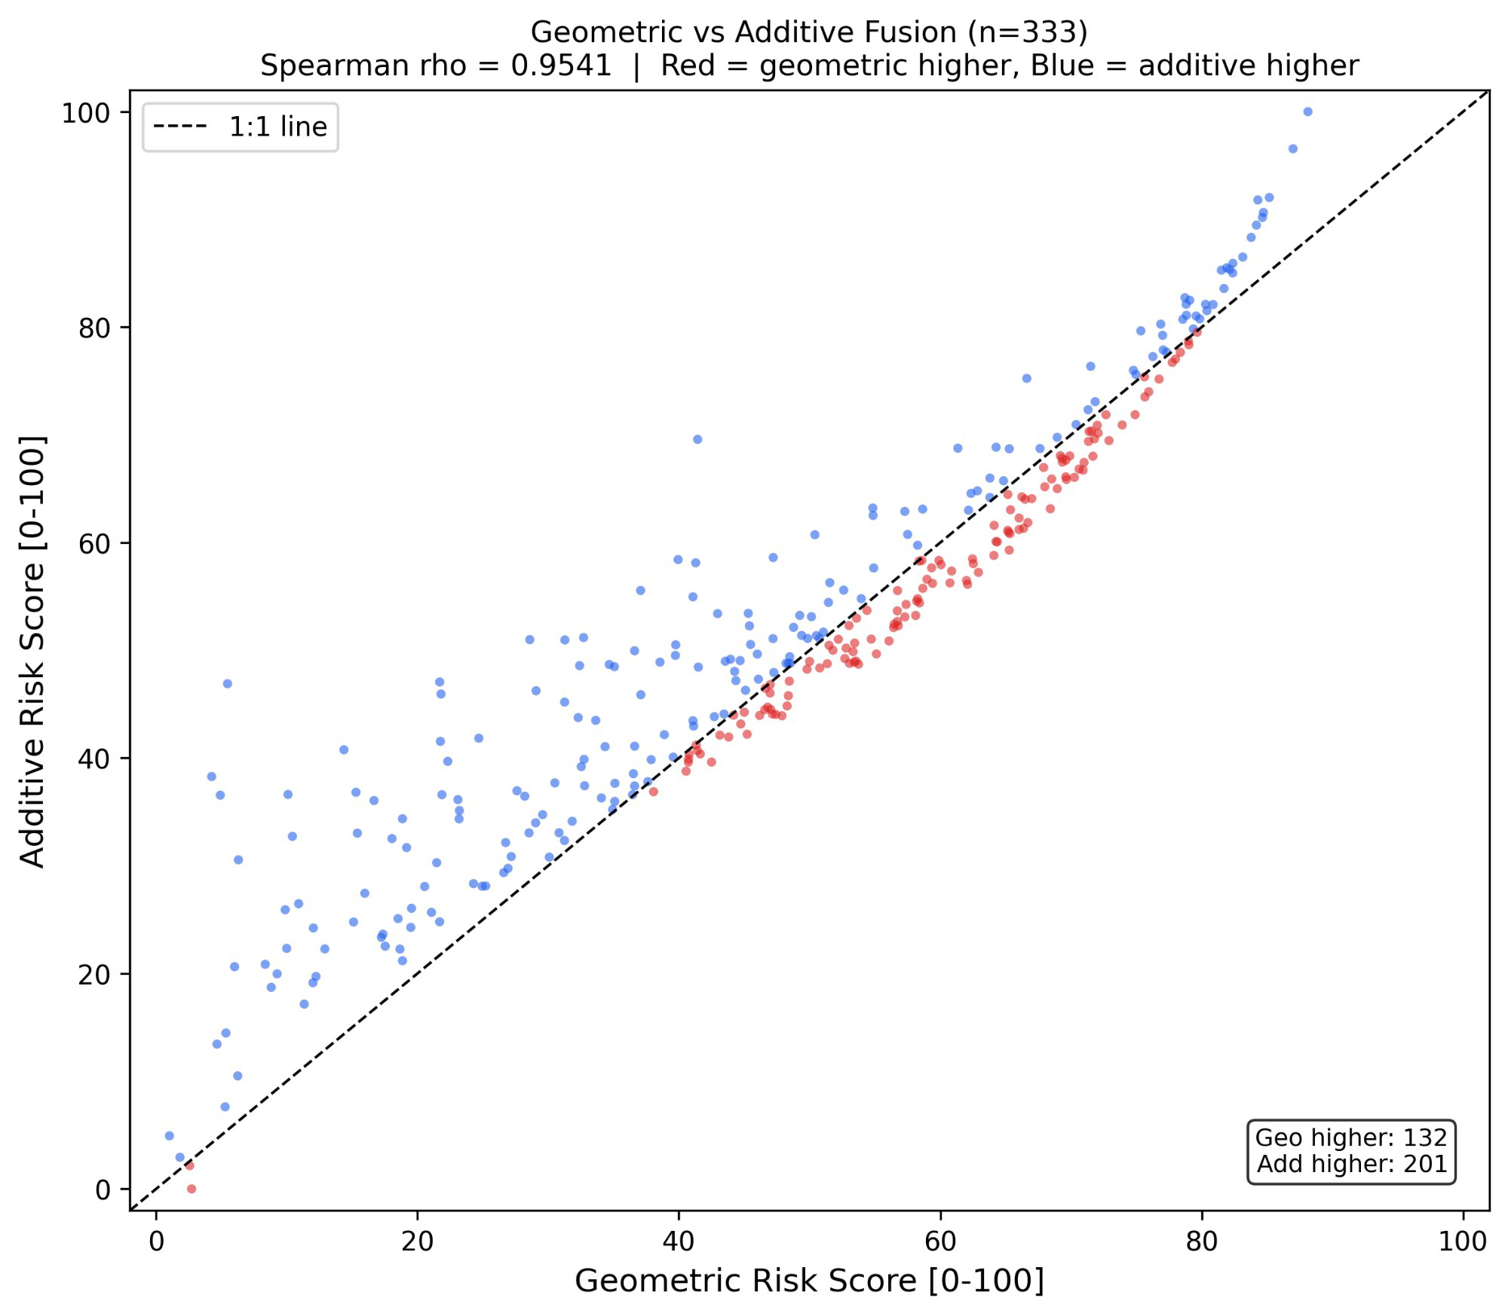
ESTIMATION · 2 OF 3
One driver is closed-form
GLCM contrast = Σᵢ Σⱼ (i − j)² p(i, j)
the mean squared grey-level difference between adjacent pixels
Quantise to 32 grey levels, count how often a pixel of level i sits beside one of level j, normalise to probabilities.
Smooth soil puts all mass on the diagonal. Rough, cloddy soil spreads it off-diagonal.
32 levels gives about 64 pair-counts per matrix cell at 256×256 — at 256 levels the matrix is empty and the estimate is noise.
No fitted parameters. Nothing to overfit.
Normalisation, in order
1
Percentile fit at the 5th and 95th percentiles, then clip to [0,1]
2
Gamma compression at γ = 0.70, which lifts the low end
How the descriptor was chosen
Labelled maximum-tillage and minimum-tillage image sets, three candidate descriptors — Laplacian variance, Canny edge density, GLCM contrast — and an exhaustive search over all 231 convex combinations. The optimum was a corner of the simplex: GLCM contrast alone, zero weight on the other two.
3
Floor at 0.02, so texture never reaches zero
4
Result: T_norm ∈ [0.02, 1.0], comparable within a batch
GLCM contrast · 32 grey levels · percentile normalisation
6
Notes:
The plain-English definition is the whole slide: "GLCM contrast is the mean squared difference in grey level between neighbouring pixels. Smooth soil has neighbours that look alike. Cloddy soil does not."
Say the 32-level argument out loud — it makes an arbitrary-looking choice principled: "at 256 levels the co-occurrence matrix averages about one count per cell, so the probability estimate is noise. At 32 it is about 64."
The 231-configuration search converts "I chose GLCM" into "a systematic search chose GLCM." Use it.
IF ASKED about camera geometry: yes, the fixed 256x256 resize ties measured texture scale to ground-per-pixel, and the offset is single-direction so the descriptor is anisotropic. Consistent capture geometry is a requirement of the method. Angle-averaging is the obvious improvement and it is cheap.
Note the honest point about normalisation: percentile fitting forces texture to span the full range, which is part of why it carries so much variance later.
55 seconds.

Slide 7
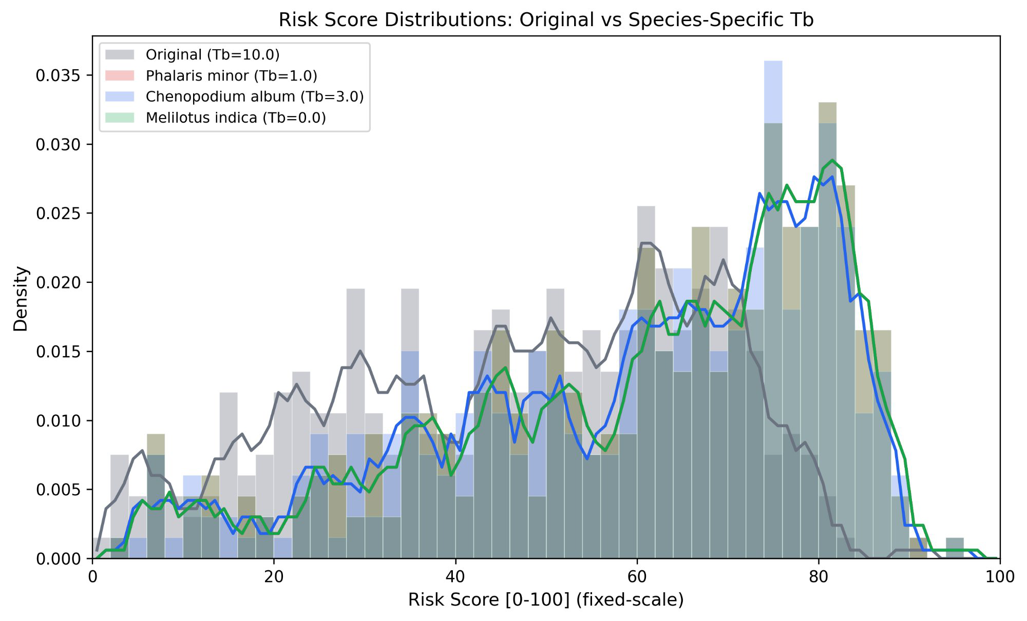
ESTIMATION · 3 OF 3
And one comes from reanalysis data
GDD = Σ max( 0, (T_max + T_min)/2 − T_b )
summed over 7 days, then G = min( GDD / 120, 1 )
T_b is the developmental zero — the temperature below which development effectively stops
max(0, ·) because development does not run backwards on a cold day.
Clipped at 1 because once the thermal requirement is met, more heat does not help.
On this acquisition GDD = 54.0 °Cd and G = 0.450 — identical for every image.
Fig. 17 Score distributions under species-specific base temperatures.
THE RESOLUTION CEILING
NASA POWER resolves at 0.5° × 0.625°, roughly 55 by 65 kilometres. The entire study sits inside one grid cell, so the thermal term can never differentiate within a field — on any date, with this source.
Air temperature genuinely does not vary over seventy metres. This is the correct scale for the variable, and a permanent limit on what it can contribute spatially.
Growing degree days · NASA POWER · spatial ceiling
7
Notes:
Fast slide, but the ceiling point is important and you should be the one to make it.
GDD in one line: "seeds integrate temperature, not days, so I accumulate degree-days above a base temperature over the week before acquisition."
Two design notes: max(0,.) because development does not reverse; clipped at 1 because thermal conditions are either limiting or they are not.
THE CEILING: POWER resolves at roughly 55 kilometres, so the whole field is one grid cell. Say it plainly, then defuse it: "air temperature genuinely does not vary over seventy metres, so this is the right scale for the variable. But it does mean the thermal term can never be a spatial differentiator at field scale with this source — not on this date, not on any date."
That converts a weakness into a demonstrated understanding of your own model's limit. Within-field thermal variation would need soil sensors or a thermal camera.
40 seconds.

Slide 8
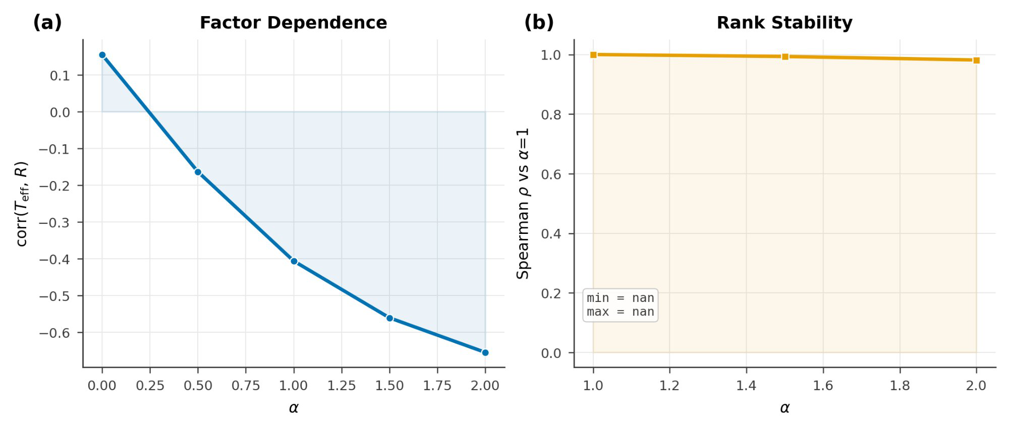
THE CORRECTION
Residue does two things, so it enters twice
Residue physically blocks emergence — the (1−R) term. It also inflates GLCM texture, because straw is bright, linear, high-contrast material. Same pixels, opposite directions.
T_eff = T_norm × (1 − R)^α α = 1
applied before fusion — one exponent, no fitting
+0.155
→
−0.406
ρ 0.993 at α = 1.5
ρ 0.982 at α = 2
r(T_eff, R) at α = 0
at α = 1
Fig. 3 Texture–residue correlation falls monotonically with α.
WHAT THIS ACTUALLY BUYS
α is selected on decoupling, not fitted to an outcome. Substituting T_eff gives residue an effective exponent of 0.20 + 0.30 = 0.50 — so the sweep varies the dominant driver's weight fourfold, and the ranking barely moves.
Damping · decoupling criterion · effective exponent
8
Notes:
Your cleanest original contribution. No prior work appears to decouple residue from texture with an explicit exponent.
The key sentence: "alpha is selected on a decoupling criterion, not fitted to an outcome. A documented insensitivity replaces a free parameter."
THE ALGEBRA, if derived or challenged — agree instantly, it strengthens you:
Substituting T_eff = T_norm(1-R)^alpha gives (1-R) an exponent of w_R + alpha*w_T = 0.20 + 0.30 = 0.50. Residue is therefore the MOST heavily weighted driver. And the alpha sweep from 0 to 2 moves that effective weight from 0.20 to 0.80 — a fourfold change in the dominant driver — while rank correlation holds at 0.982.
Also true: exponents now sum to 1.30, so strict scale-consistency does not hold after damping. The transformation is monotone across all images, so ranking is unaffected.
Why stop at alpha = 1: past 1 you start subtracting genuine tillage signal in high-residue zones.
55 seconds.

Slide 9
FUSION · THE CORE ARGUMENT
Why the four drivers multiply
risk = M⁰·³⁰ × G⁰·²⁰ × (1−R)⁰·²⁰ × T_eff⁰·³⁰
evaluated as log risk = Σ wᵢ log xᵢ · weights sum to 1
Germination is co-limited
But not a hard minimum
And log space is load-bearing
A seed needs water, exposure and heat. Missing one is not repaired by an excess of another. An average says otherwise — it lets a good driver refund a fatal one.
min() has zero gradient on every non-binding driver, so dry-but-perfect scores the same as dry-and-marginal. It is also a single measurement, so it is about 1.7× noisier under 5% perturbation.
A product cannot be decomposed; a sum can. Working in logs is what makes the variance attribution and the elasticity reading possible at all.
What the weights mean
In log space, wᵢ is exactly the elasticity: ∂log risk / ∂log xᵢ = wᵢ. A 1% change in a driver produces a wᵢ% change in risk — a falsifiable claim, not a tuning knob. And ∂risk/∂xᵢ = wᵢ·risk/xᵢ, so the model is most responsive to whichever driver is smallest: it identifies its own binding constraint.
PROVENANCE
Multiplicative co-limitation is standard in habitat-suitability modelling. I am importing a known structure into a new problem, not proposing a new operator.
Co-limitation · log space · elasticity
9
Notes:
CORE SLIDE — never cut. Slowest slide in the first half.
The sentence: "A seed needs water AND exposure AND heat. Missing one is not compensated by having the others."
Middle column is the one people miss. If co-limitation were the whole story you would use min(), and you should not — for a reason about information and a reason about noise. min() has zero gradient on every non-binding driver, so you would get enormous ties. And min() is one measurement, so it inherits that measurement's noise entirely.
Third column plants the phrase you will need on the variance slide.
Elasticity block: this is what makes the weights meaningful rather than arbitrary. And the 1/x_i property is the operational payoff — a worked case in the dataset has moisture at 0.026 with every other driver above 0.6, where the model is more than twenty times more responsive to moisture than to texture. It names the intervention: irrigate, do not till. For a weighted sum the partial derivative is just w_i, constant everywhere — an additive index is structurally incapable of expressing a binding constraint.
Provenance: habitat suitability index modelling, USFWS, since the early 1980s. Say it. Claiming a forty-year-old operator as new would be caught.
75 seconds.

Slide 10
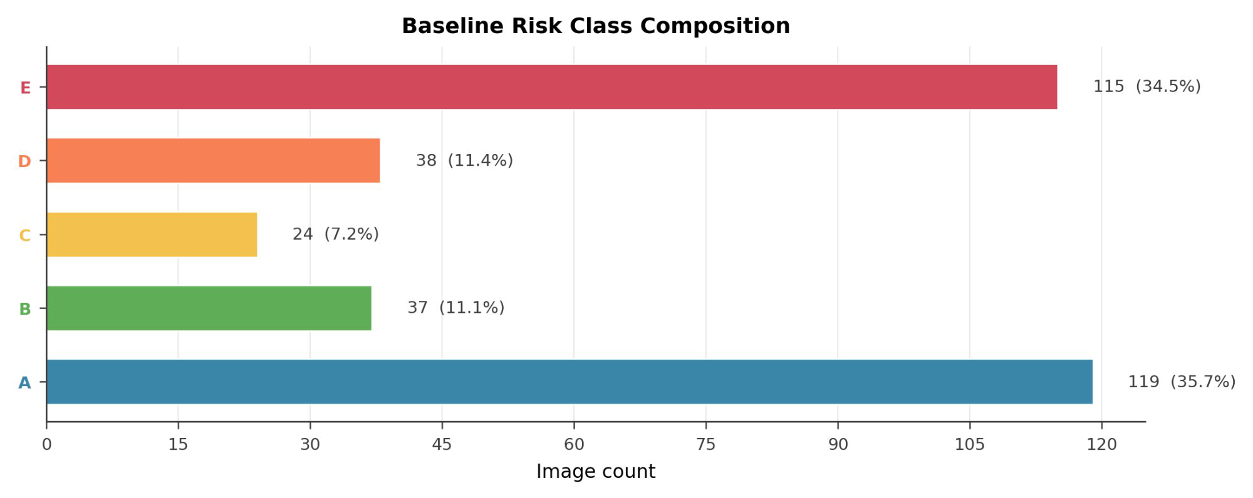
FUSION · SCORING
From a product to a decision
z = ( log risk − median ) / MAD
score = 50 · ( tanh z + 1 )
median and MAD, not mean and standard deviation, so one freak image cannot set the scale
Log first, because the raw risks are products and bunch near zero.
MAD is the median of absolute deviations from the median — the median taken twice, so outliers cannot move it.
tanh squeezes rather than clips: nothing is ever exactly tied, so the ranking is fully preserved.
Min–max scaling gives an identical ranking but collapsed 178 of 333 images into one bin. That is why it was rejected.
Fig. 2 Risk class composition, n = 333.
How to read the classes
A = 119 is the LOW-risk class; E = 115 is HIGH. Median 50.0, IQR [10.2, 87.1]. The bimodality has two causes: products of unit-interval factors pile mass at both ends, and the scaler compresses the middle.
MAD–tanh compression · five operational classes
10
Notes:
Explain WHY the formula looks like this, not just what it is.
Log first: raw risks are products, so they bunch near zero. Logs turn "keeps multiplying" into "keeps adding," which spaces them evenly.
Median not mean, MAD not standard deviation: both choices exist so a single freak image cannot set the scale. MAD is the median of the absolute deviations from the median — the median taken twice.
tanh not clipping: clipping would make everything above a ceiling identical and destroy real information. tanh squeezes, so an image at z = 3 and one at z = 9 are still distinguishable. Ranking is fully preserved.
SAY THE DIRECTION EXPLICITLY: A is low risk, E is high. Most people assume A is the top category.
Min-max is the good comparison: rank-identical, but it dumped 178 of 333 images into a single bin. So the choice is about whether the classes are usable, not about the ordering.
45 seconds.

Slide 11
THE CONTRIBUTION
Six audits, each able to return a negative
A model with four drivers, weights I chose, and almost no labels can look convincing and mean nothing. So the contribution is not the score — it is the protocol that interrogates it.
1
Variance
2
Fusion baseline
3
Perturbation
Is every driver actually doing work?
Does the operator change decisions, not just scores?
Is any of this just noise?
4
Weight priors
5
Reparameterisation
6
Spatial
Did I simply choose the weights I wanted?
Does the result depend on the base temperature I picked?
Is the pattern real, or is it autocorrelation?
A protocol that cannot return a negative is not an audit. Two of these returned one.
Notes:
CORE SLIDE — never cut. This is the hinge of the talk.
"That is the pipeline. Now — WERM has four drivers, four weights I chose, and almost no labels. A model like that can look completely convincing and mean nothing at all. So the thing I actually want to show you is the six things I did to try to break it."
Read the six QUESTIONS, not the six titles. The questions are the content.
Land the last line and pause: "A protocol that cannot return a negative is not an audit. Two of these returned one."
The two you will deliver: Audit 1, thermal contributes exactly zero. Audit 6, the fused map's Moran's I is not significant. Both real, both yours, both on the slides.
40 seconds.

Slide 12
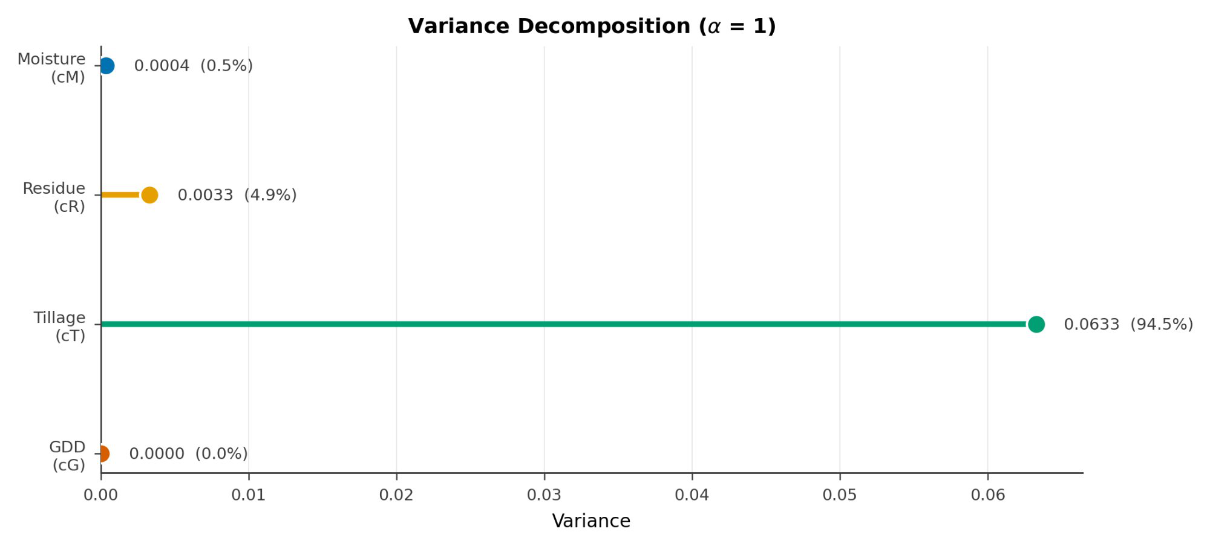
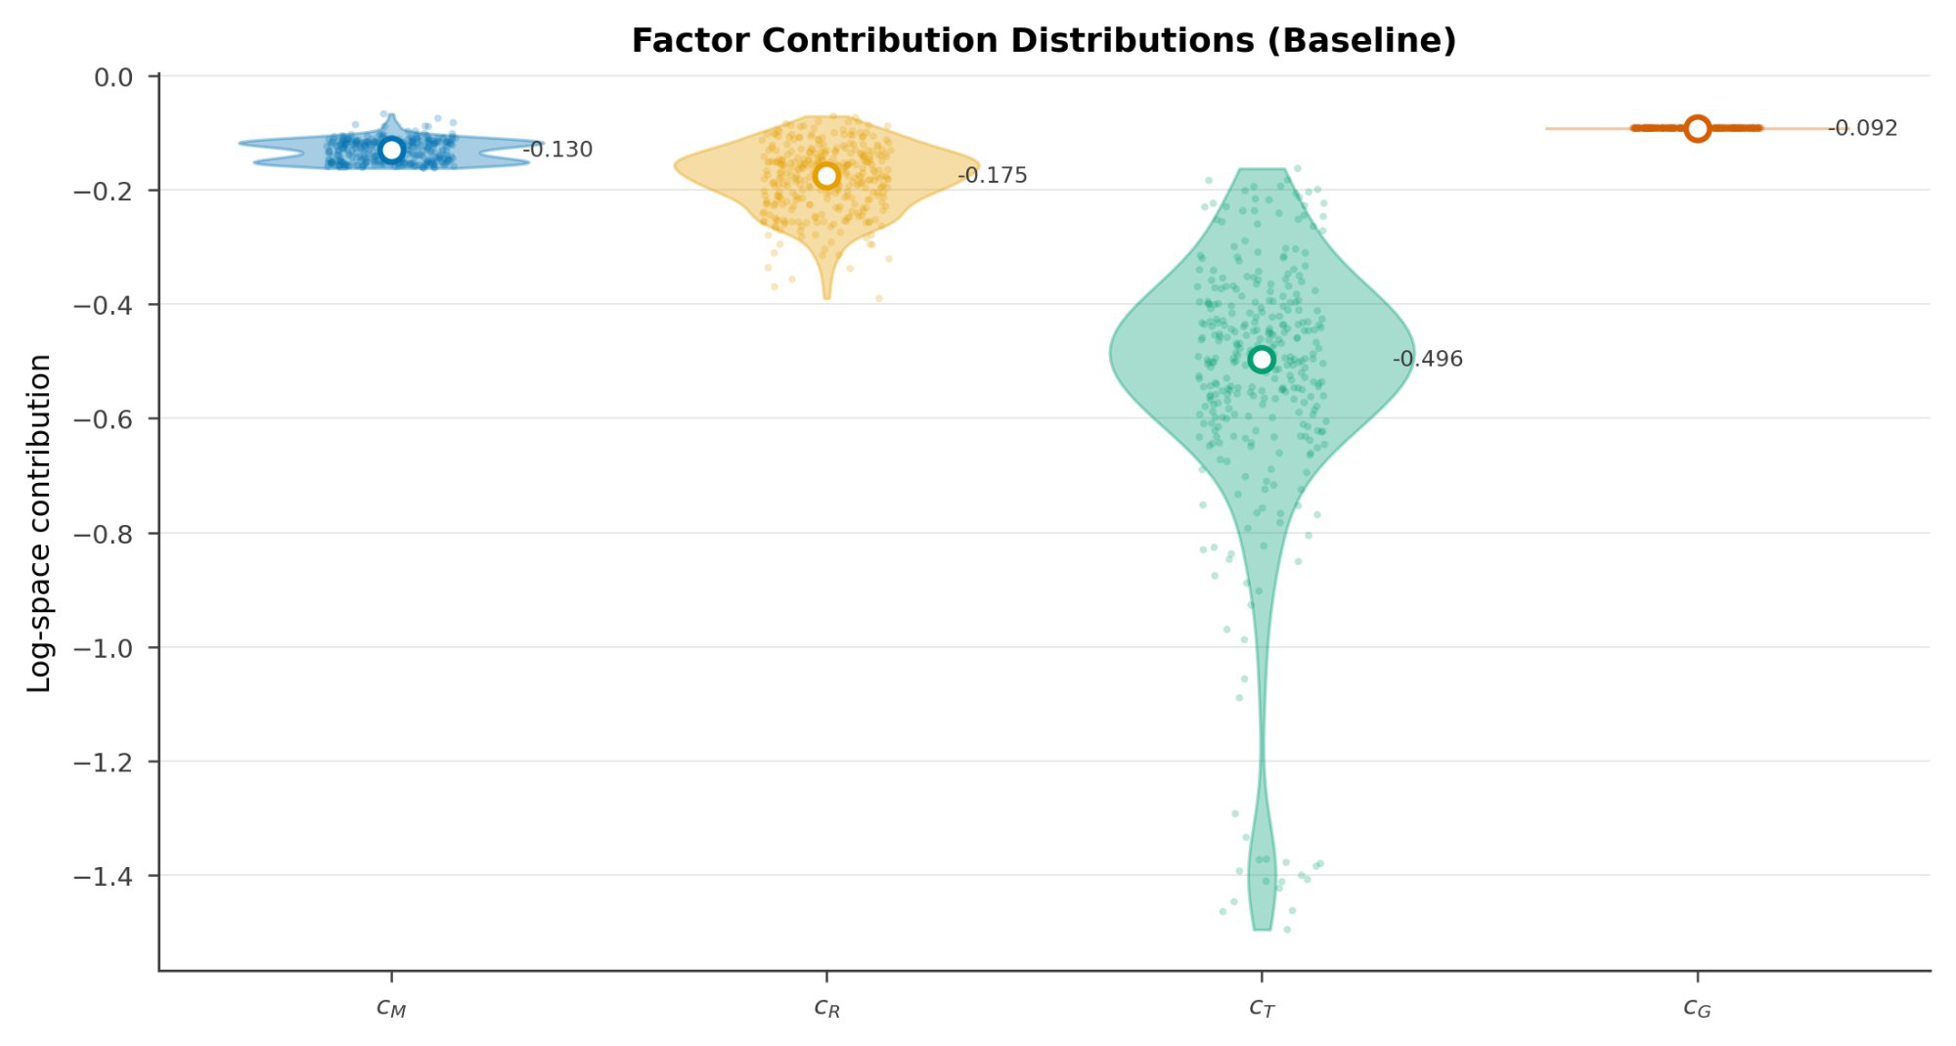
AUDIT 1 · VARIANCE DECOMPOSITION
Is every driver actually doing work?
1
Fig. 4 Log-space variance decomposition, α = 1.
Fig. 5 Factor contribution distributions, 333 images.
THE FIRST NEGATIVE
Texture accounts for 94.5% of the summed component variance. Thermal contributes exactly zero — it is spatially constant by construction. On this acquisition WERM is not a four-driver model, and nothing in the output score would have revealed that.
Precision: 94.5% is texture's share of the summed component variances. Against total variance it is 84.9%, with roughly 10% in a covariance term the decomposition does not attribute.
Variance attribution · the first negative
12
Notes:
FIRST NEGATIVE. Deliver plainly, do not soften.
"Texture is 94.5 percent of the summed component variance. Thermal is exactly zero. On this acquisition, WERM is not a four-driver model — and nothing in the output score would have told me that. I had to take it apart."
Log space earns its keep here: a product cannot be decomposed, a sum can. That is why slide 9 planted the phrase.
IF ASKED why texture dominates: partly biology, partly normalisation. Texture is percentile-normalised, which forces it to span the full range, while the CNN outputs concentrate wherever their training put them. The honest test is to rank-normalise all four and re-run the decomposition. Not done, and first on the list.
Moisture at 0.5% is about THIS field on THIS day — February, post-irrigation, two adjacent fields. Audit 2 shows what that 0.5% is doing.
Transition: "Bulk variance is not the same question as decision-relevant behaviour."
55 seconds.

Slide 13
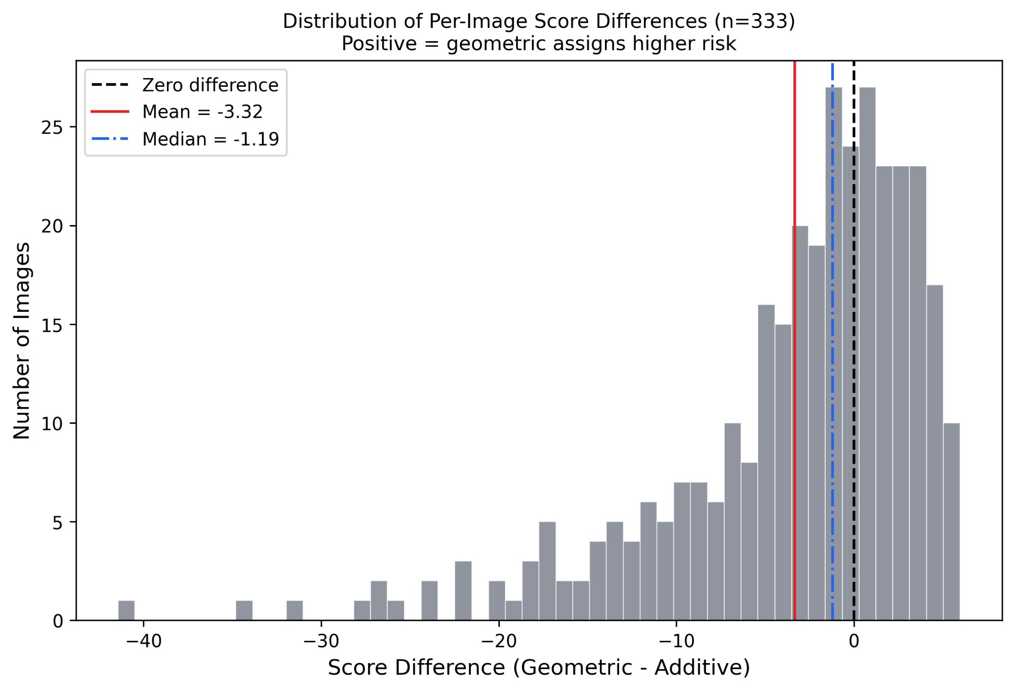
AUDIT 2 · FUSION BASELINE
Does the operator change decisions, or only scores?
2
Aggregate agreement is the wrong statistic
ρ 0.954 · τ 0.839 · top-20% Jaccard 0.881, so 93.7% of the high-risk set is shared. Two models can agree almost everywhere and still differ exactly where the decision is made.
The disagreement has structure
Of the 34 most rank-discrepant images, 17 — exactly half — have one driver below 0.2 while every other exceeds 0.6. One condition badly wrong, everything else fine. The additive model averages that away. The geometric model refuses to.
The dominant suppressor is moisture: the driver worth half a percent of the variance.
Fig. 7 Per-image score difference. The left tail is the finding.
A driver contributing 0.5% of the variance is doing the decisive work in the tail.
Rank agreement · tail structure · the one-low pattern
13
Notes:
CORE SLIDE — never cut. The intellectual centre of the talk. Slowest slide in the deck.
Open by refusing the flattering number: "The two models correlate at 0.954. That is the wrong statistic. Two models can agree almost everywhere and still disagree exactly where the decision gets made."
Then the finding: "Of the 34 images where they disagree most, seventeen — exactly half — have one driver below 0.2 and every other driver above 0.6. One thing badly wrong, everything else fine. The additive model averages that away. The geometric model refuses to."
THE LINE: "A driver contributing half a percent of the variance is doing the decisive work in the tail." PAUSE.
This resolves the apparent contradiction with Audit 1 — moisture is 0.5% of the variance AND decisive. Those answer different questions, bulk versus tail. That is exactly why one audit is not enough.
CAREFUL with the extreme case. Geometric 5.5 versus additive 46.9 is real, but in raw values the ratio is only about 1.9x — the scaler stretches it. If you use it, say "the geometric model puts it in the bottom five percent, additive puts it near the median." Do not say "a 41-point gap."
Say "Jaccard," not "overlap."
70 seconds.

Slide 14
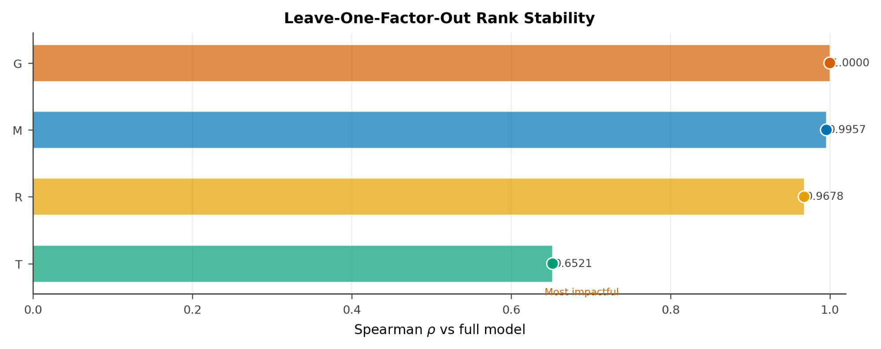
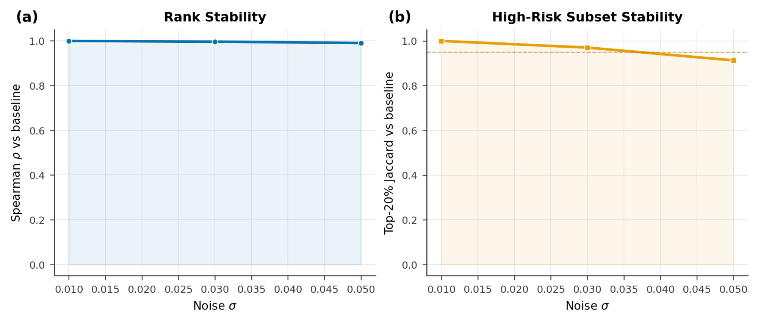
AUDIT 3 · ABLATION AND PERTURBATION
Is any of this just noise?
3
Fig. 10 Leave-one-factor-out rank stability.
Fig. 13 Stability under multiplicative input noise.
Remove texture
Remove residue
Remove moisture
5% input noise
Equal weights, 0.25
ρ 0.652
ρ 0.968
ρ 0.996
ρ 0.990
ρ 0.996
54.5% of set kept
94.0% kept
100% kept
95.5% kept
97.0% kept
LOFO · noise · weight sweeps · set overlap is Jaccard
14
Notes:
Fast and confident. The numbers carry it.
"Only texture is load-bearing. Remove it and rank correlation falls to 0.652. Remove any other single driver and it stays above 0.968. That is consistent with Audit 1 — two independent analyses agreeing is worth more than either alone."
"Under five percent multiplicative noise on every input, ninety-five and a half percent of the high-risk set survives. That is the part a farmer would actually act on."
Three things NOT driving the result: 24 weight configurations, mean rho 0.997, worst 0.984. Equal weights 0.996. Every alternative scaler rank-identical. Epsilon varied 50-fold moves rho by under 0.0001.
Say "Jaccard" for the set column — the percentages shown are the plain shared fraction.
45 seconds.

Slide 15
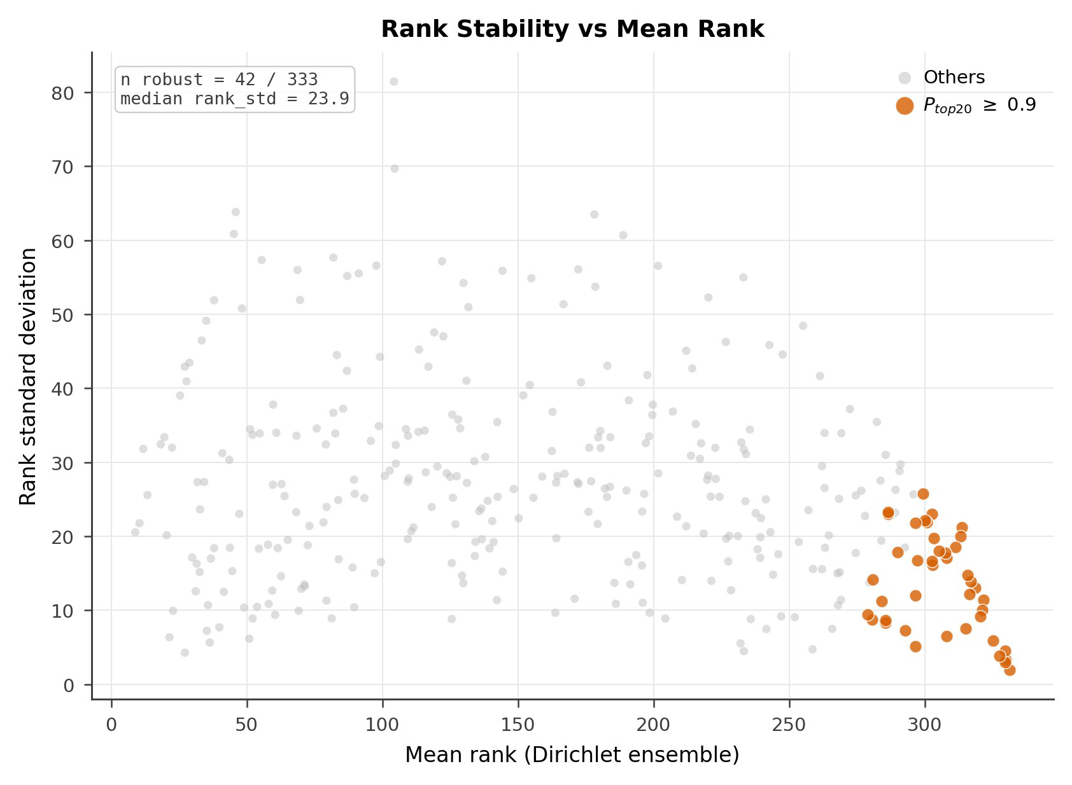
AUDIT 4 · DIRICHLET WEIGHT ENSEMBLE
Did I simply choose the weights I wanted?
4
Rather than defend the weights, I deleted them. Dir(1,1,1,1) is uniform over the entire four-simplex — every weight vector summing to one, equally likely. Not a perturbation around my choice. The whole admissible space.
500
0.945
0.514
weight vectors drawn
mean ρ vs baseline
worst single draw
The deliverable is a set, not a score
42 of 333 zones stay in the high-risk set at probability ≥ 0.90 under any admissible weighting. Those are the locations you would act on. 26 zones are genuinely unstable — and the uncertainty is concentrated there rather than smeared across the field.
PROVENANCE
Standard practice in composite-indicator construction — Saisana, Saltelli and Tarantola; the OECD/JRC handbook.
Fig. 15 Mean rank vs rank SD. Orange: the 42 that hold.
Weight priors · the robust set
15
Notes:
Strong slide. The reframe at the end is the most quotable idea in the talk.
"The obvious objection to any weighted index is that I picked the weights. Rather than defend them, I deleted them."
Dir(1,1,1,1) in one sentence: uniform over every weight vector summing to one. The least informative assumption available. NOT a small wobble around my choice — the entire space.
GIVE THE TAIL HONESTLY: mean 0.945, but fifth percentile 0.775 and worst draw 0.514. Some weightings really do change the map. Saying that is what makes the next sentence believable.
THE REFRAME: "So the deliverable is not a score. It is a set. Forty-two zones out of 333 stay high-risk under any defensible weighting. That is what I would hand a farmer."
Provenance: Saisana, Saltelli, Tarantola; OECD/JRC handbook. Do not let anyone tell you the technique is new.
55 seconds.

Slide 16
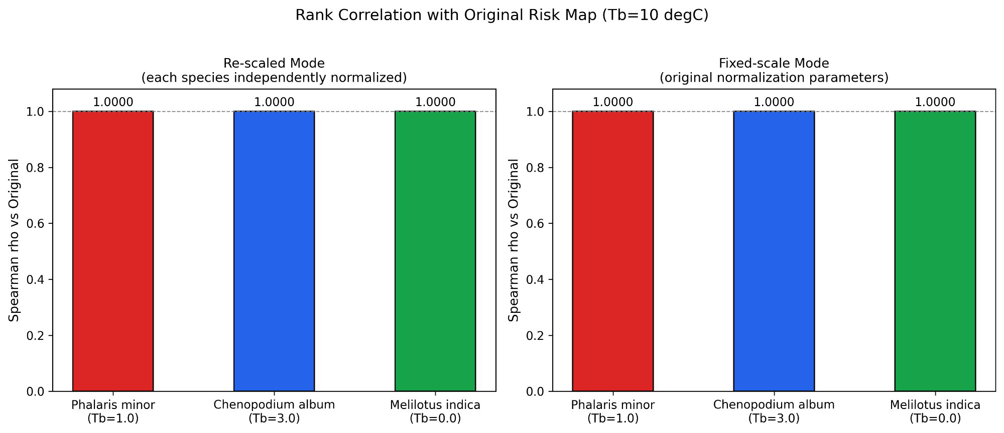
AUDIT 5 · SPECIES REPARAMETERISATION
Does the result depend on the base temperature I chose?
5
PARAMETERISATION
T_B
7-DAY GDD
G_NORM
Δ SCORE
Default
10.0 °C
54.0 °Cd
0.450
—
Phalaris minor
1.0 °C
125.5 °Cd
1.000
+13.8
Chenopodium album
3.0 °C
111.5 °Cd
0.929
+12.6
Melilotus indica
0.0 °C
132.5 °Cd
1.000
+13.8
What this establishes — and what it does not
A generic base temperature underestimates accumulation more than twofold.
All three target species were already thermally saturated at G ≥ 0.929, so heat was not the limiting condition.
Rank correlation is exactly 1.000 — but on a single date G is a scalar, so that is algebra, not evidence.
Fig. 20 Rank correlation with the original map, both scaling modes.
Why ρ = 1.000 is not the finding
Changing T_b multiplies every score by the same constant. Presenting ρ = 1.000 as robustness would be overclaiming — the finding is the calibration error and the saturation.
Base temperature · calibration error · thermal saturation
16
Notes:
THIS SLIDE IS AN HONESTY DEMONSTRATION. The result looks like a perfect robustness score, and you tell the room it is not one.
"I recomputed thermal accumulation using species-specific base temperatures instead of the generic ten degrees. Rank correlation came out at exactly 1.000 — and I want to be precise, because that is algebra, not evidence. On a single date the thermal term is a scalar, so changing the base temperature multiplies every score identically and cannot reorder anything. I could have predicted that without running it."
Then the real findings: "What the analysis does establish is that a generic base temperature underestimates accumulation by more than a factor of two, 54 degree-days against 111 to 133. And all three target species were already thermally saturated, above 0.929. Heat was not the limiting condition in this field."
Delivering this correctly is worth more than the result itself. A room that watches you decline to overclaim a perfect number will believe your other numbers.
If asked why these three species: they are the dominant weeds in Madhya Pradesh wheat, and P. minor is the one carrying multiple resistance.
40 seconds.

Slide 17
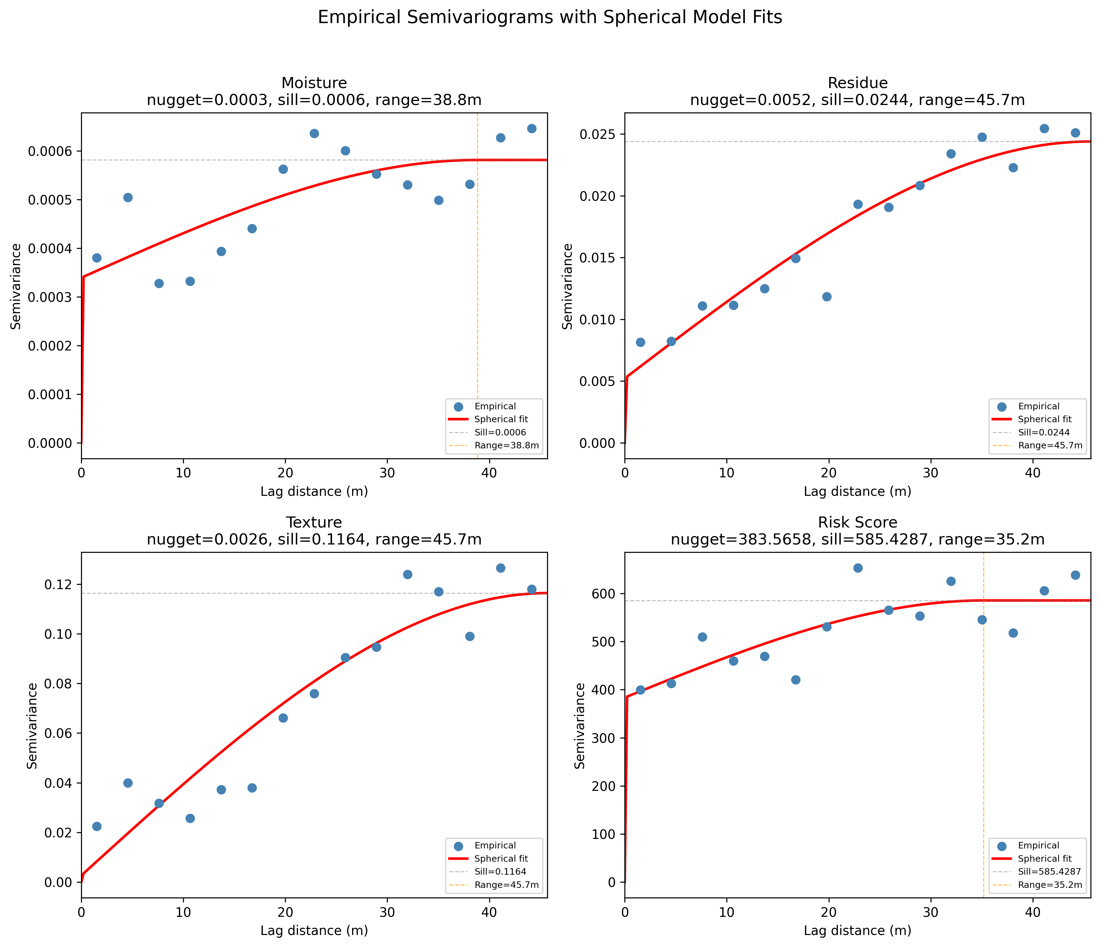
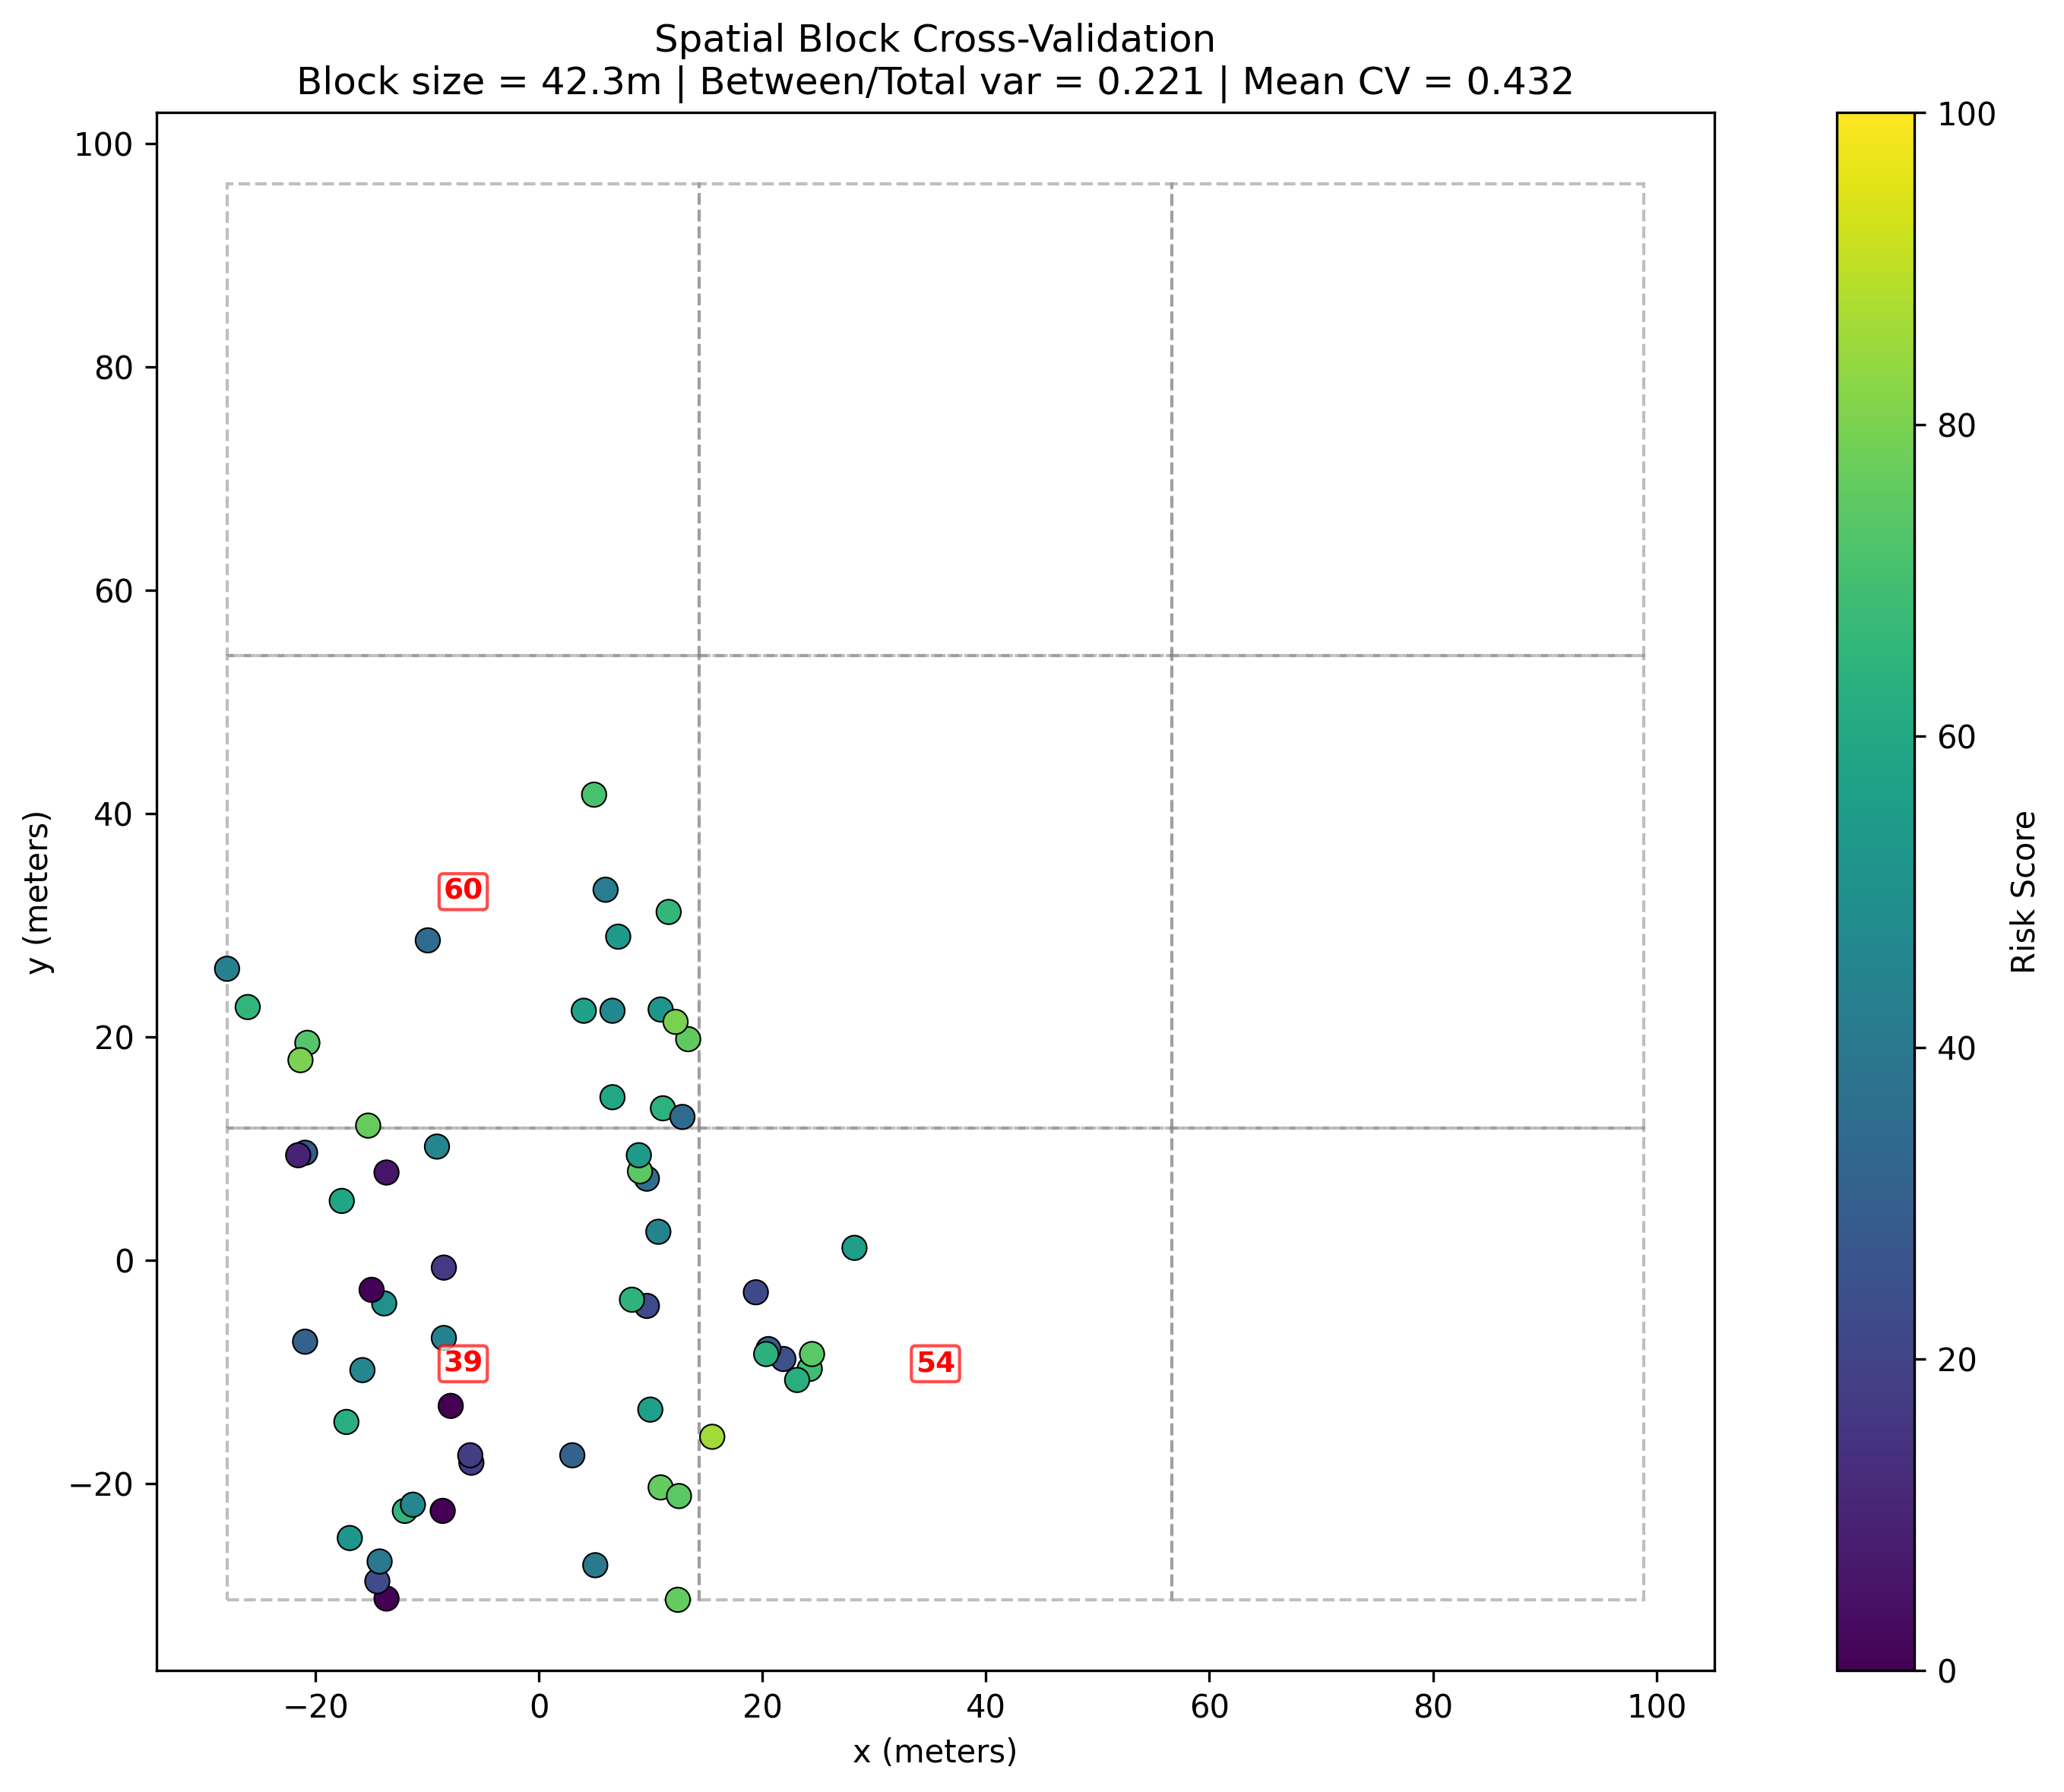
AUDIT 6 · SPATIAL DIAGNOSTICS
Is the spatial pattern real, or is it autocorrelation?
6
Fig. 18 Empirical semivariograms with spherical fits.
Fig. 19 Block cross-validation at 42.3 m.
An external check the model could have failed
The second negative
Fitted ranges of 35–46 m fall inside the 5–50 m weed patchiness scale reported independently in the weed ecology literature. Nothing in my pipeline was tuned to produce that.
The fused risk surface returns Moran's I = 0.011, p = 0.777 — not significant. Two of four semivariogram ranges sit at the maximum measurable lag, so they are ceilings rather than estimates. Only three spatial blocks were available.
Semivariograms · Moran's I · block cross-validation
17
Notes:
SECOND NEGATIVE. Strong half first, then the failure.
Strong: "Fitted ranges of 35 to 46 metres sit inside the 5 to 50 metre patchiness scale that weed ecologists report independently. Nothing in my pipeline was tuned to produce that. It could have come out at 5 metres or 500."
One line on what a semivariogram range is: "the distance beyond which two points tell you nothing about each other."
Then plainly: "The fused surface itself returns a Moran's I that is not significant. p = 0.777."
Why, if asked: constant GDD dilutes per-component autocorrelation through the product; and Moran's I with a single distance band detects hotspot patterns poorly — this surface is hotspots, not a gradient.
Concede unasked: only three valid blocks — but at 42.3 metres on a 56 by 72 metre field, four was the geometric maximum, so three was near-maximum rather than bad luck. And residue and texture both fit at 45.7 metres, which is exactly the half-diagonal and therefore my maximum lag: ceilings, not estimates.
On Ploton if raised: "conservative check, not an accuracy estimate. The Wadoux 2021 critique targets accuracy claims, and I am not making one."
55 seconds.

Slide 18
CONCLUSION
Caveats, and the boundary of the claim
✓
What I claim
✗
What I do not claim
A coherent, internally consistent methodology for pre-emergence spatial risk ranking
A residue-damped texture correction with a stated decoupling criterion
Rank stability under ablation, noise, weight sweeps and a uniform Dirichlet prior
Component spatial ranges consistent with independently reported weed patchiness
A transferable six-audit protocol for label-scarce structured models
Predictive accuracy against emergence counts — nothing in this study counts an emerged weed
Absolute risk magnitude, or calibration of any kind
That the thermal driver contributed anything on this acquisition
That the fused surface shows significant global autocorrelation
Transfer to other soils, seasons, regions or crops
THE ONE SENTENCE
WERM establishes a coherent methodology for pre-emergence risk ranking. It does not yet establish predictive accuracy against emergence counts — and that is the next study: 60 quadrats, counts at day 21 and 35, with a stopping rule fixed in advance.
Claim boundary · next study
18
Notes:
Read the RIGHT column as carefully as the left. Slower, if anything.
The right column is not a weakness. A talk that states its own boundary precisely is more credible than one that does not, and this is the slide that proves the audit framing was sincere. Note that items three and four are your two negatives, restated as claim boundaries — that is deliberate, and it shows the audits changed what you are willing to assert.
The first right-hand item is the important one: nothing here counts an emerged weed. Say it in those words.
Then the one sentence, clean and unhedged, including the next study.
If asked about the validation design: 60 quadrats stratified across the predicted risk range, one WERM score per quadrat at day zero before anything is visible, direct seedling counts at day 21 and 35, pre-specified Spearman test with roughly 79 percent power to detect rho = 0.35. And the stopping rule is fixed now: if rho comes in below 0.2, the multiplicative framing is rejected for this system and I report that.
50 seconds.

Slide 19
The weed result is the demonstration.
The audit is the contribution.
Four drivers from one photograph, combined multiplicatively because germination is co-limited. Then six audits, each able to return a negative — and two of them did. Every claim carries a stated refuting condition, and the study that would falsify the central claim is designed, powered, and has a stopping rule fixed in advance.
That protocol is what transfers. The weeds are where I tested it.
Arham Sethi · arhamsethi09@gmail.com · Thank you
Notes:
Land it. Add nothing after "The weeds are where I tested it."
Then stop, look up, and wait. Two seconds of silence reads as confidence.
Timing check: you should reach this slide between 13:00 and 13:45, leaving buffer before the 15-minute mark.
If running long, cut from Audit 3 and Audit 5 — never from here, and never from slides 9, 11 or 13.

Slide 20
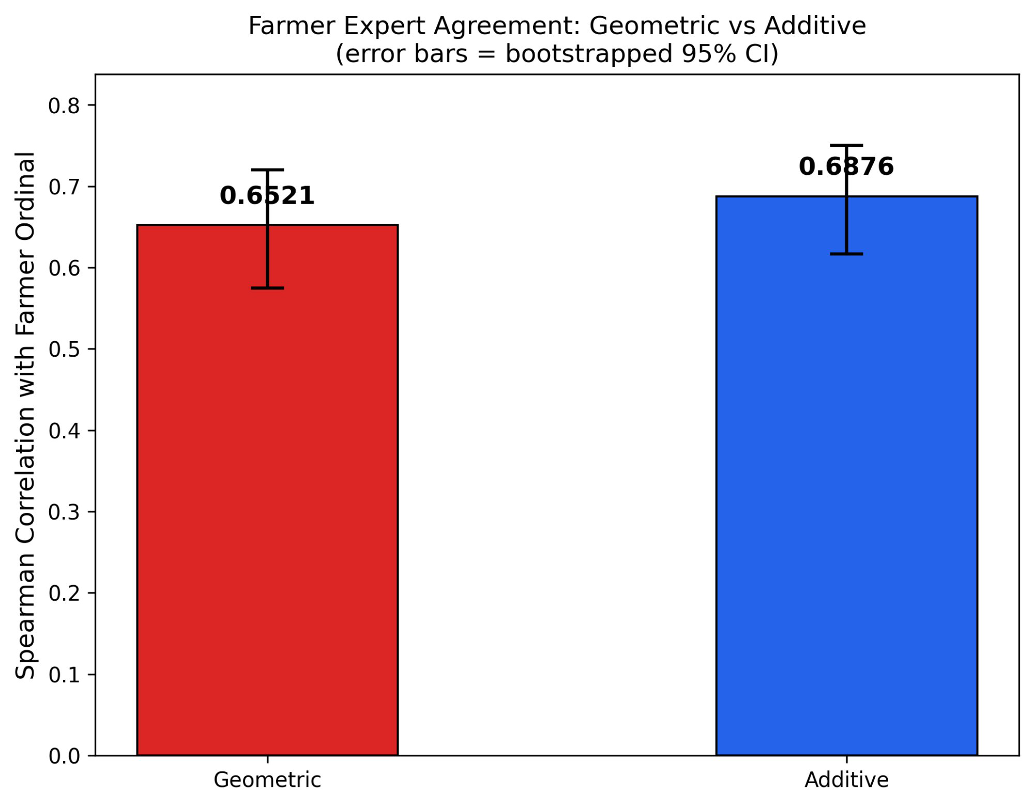
BACKUP
Expert agreement — full numbers
Comparison against independent farmer ranking, with bootstrapped 95% intervals.
Additive baseline
ρ 0.688
95% CI 0.617 – 0.750
Geometric (WERM)
ρ 0.652
95% CI 0.575 – 0.720
The intervals overlap almost entirely — nothing is established either way.
Expert judgement is a second proxy, not emergence ground truth.
Farmers reason compensatorily, which is precisely what a geometric model refuses to do — a gap in that direction is what the hypothesis predicts.
And that defence is untestable with these data. It is indistinguishable from the model simply being worse.
Fig. 8 Expert agreement with bootstrapped 95% CIs.
Notes:
Go here immediately if asked. Hesitation reads as concealment; brevity does not.
Deliver all four bullets in order and do not stop before the fourth. The fourth is what earns credibility.
Also available: the ordinal agreement figures (97.8 / 93.7 / 96.5 percent) compare against labels from the same people who provided them, which is circular. Say so if pressed.

Slide 21
BACKUP
The decision layer
Elasticity, binding constraint, and why an additive index cannot do this.
∂ log risk / ∂ log xᵢ = wᵢ
∂ risk / ∂ xᵢ = wᵢ · risk / xᵢ
constant elasticity — the weight is the meaning
sensitivity scales as 1 / xᵢ
A 1% change in a driver gives a wᵢ% change in risk.
Most responsive to whichever driver is smallest.
Worked case from the dataset
A zone with moisture at 0.026 and every other driver above 0.6. The model is more than twenty times more responsive to a change in moisture than to the same relative change in texture. It names the intervention: irrigate, do not till.
WHY ADDITIVE CANNOT DO THIS
For a weighted sum, ∂R/∂xᵢ = wᵢ — constant everywhere, for every zone. An additive index is structurally incapable of expressing a binding constraint.
These elasticities and per-image partial derivatives are computed in the original fusion pipeline, with an explanatory comment — not added afterwards.
Notes:
Use this if anyone asks what the structure buys operationally, or whether the model can guide intervention rather than just rank.
Provenance line matters if the slide is suspected of being invented for the talk. It was in the pipeline from the start.

Slide 22
BACKUP
Falsifiability register
Every claim, its status, and what would refute it.
CLAIM
STATUS IN THIS STUDY
WHAT WOULD REFUTE IT
Emergence is co-limited
Supported by structure, not by outcome data
Emergence counts uncorrelated with the geometric map but correlated with the additive one
Residue damping decouples texture
Verified: r moves +0.155 → −0.406
Decoupling failing to improve agreement with measured tillage state
Ranking is robust to weights
Verified across 24 sweeps and 500 Dirichlet draws
A defensible weighting that reorders the robust 42
Risk is spatially structured
Partially verified: component ranges match the ecological scale
Fused-surface autocorrelation failing on a larger, better-powered grid
The map predicts emergence
NOT ESTABLISHED
The pre-registered 60-quadrat study
A limitation you cannot test is an excuse. A limitation with a stated falsifier is a research plan.
Notes:
Show this if anyone asks about limitations broadly, or challenges a claim you have already bounded.
Read only the last row aloud, then the closing line.

Slide 23
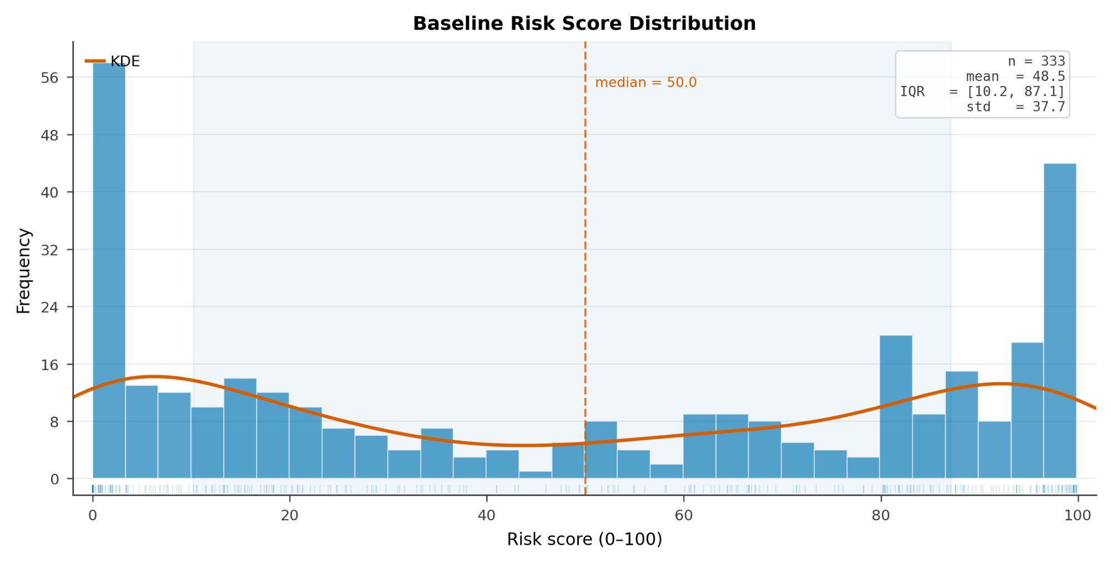
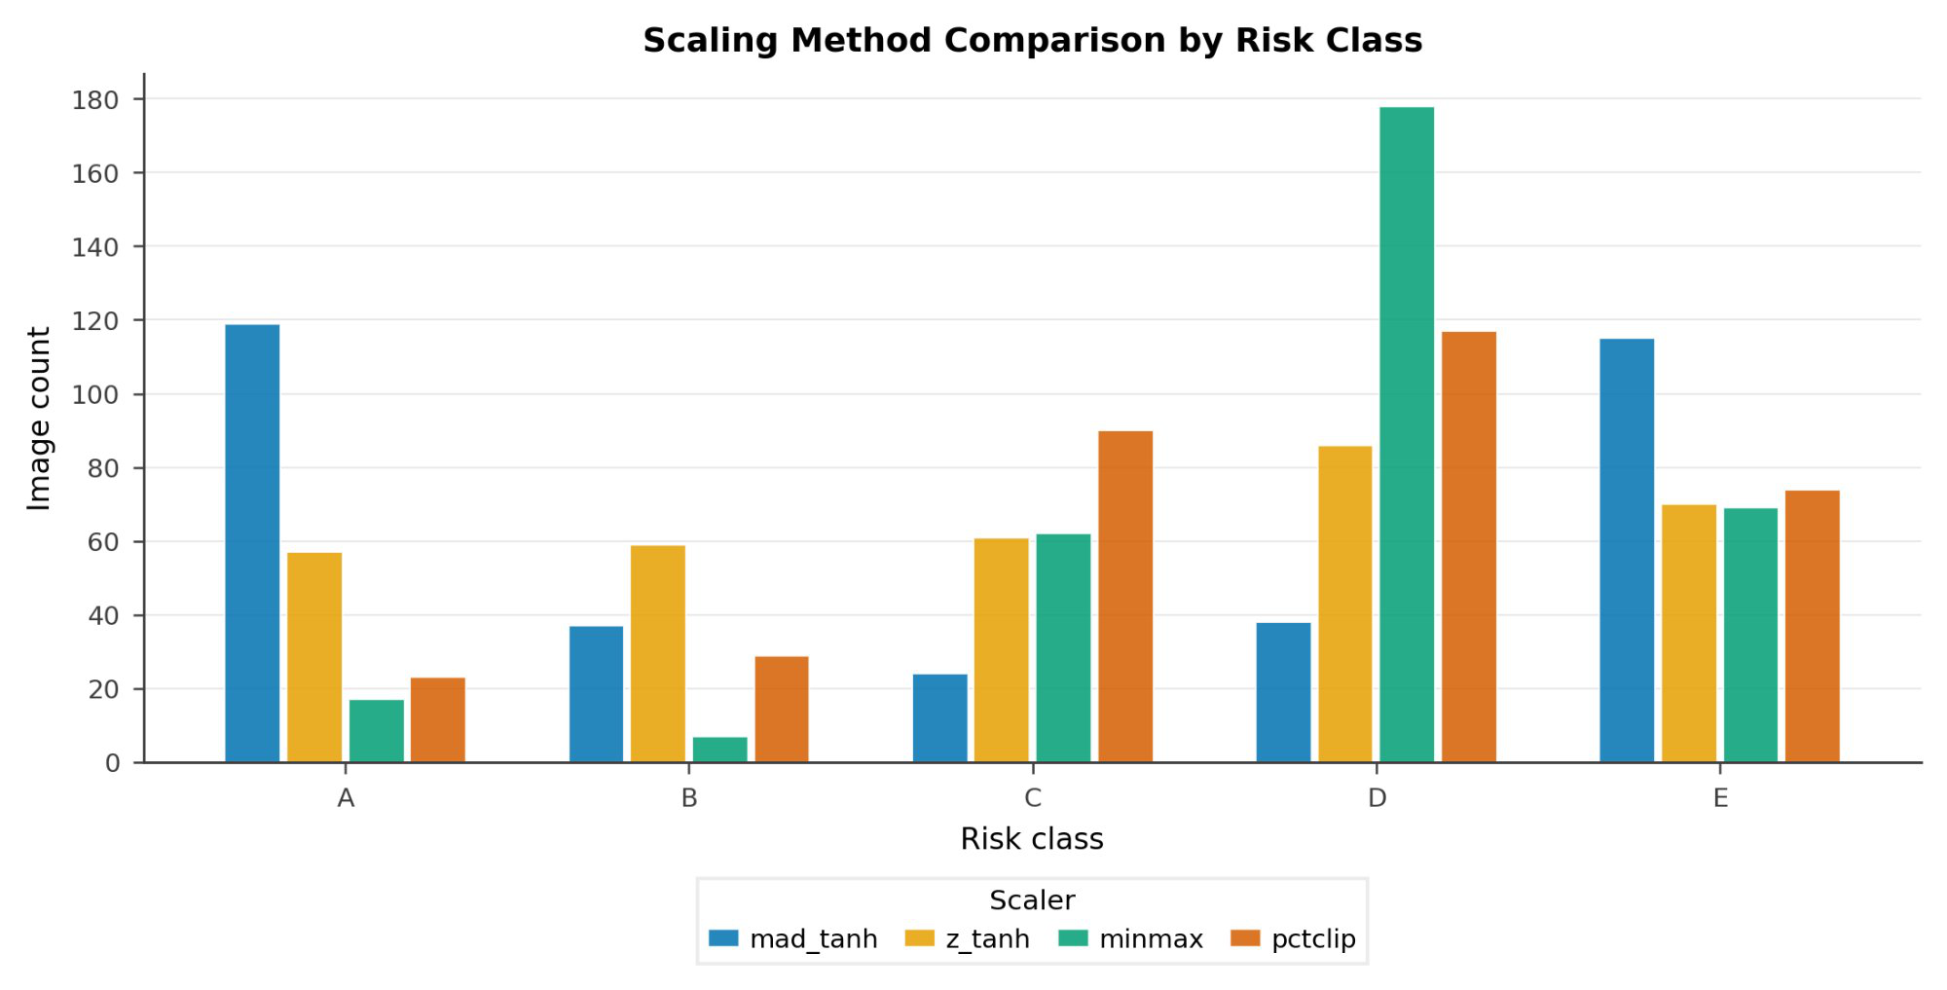
BACKUP
Score distribution and scaling
Where the bimodality comes from.
Fig. 1 Baseline risk score histogram with KDE, n = 333.
Fig. 12 Scaler comparison by risk class.
SUMMARY
A = 119 is LOW risk, E = 115 is HIGH. Mean 48.5, median 50.0, IQR [10.2, 87.1], SD 37.7. All scalers are rank-identical; min–max was rejected because it collapsed 178 of 333 images into one bin.
Notes:
Say the class direction explicitly — A is low, E is high.
Two causes of bimodality: products of unit-interval factors pile mass at both ends, and the MAD-tanh scaler compresses the middle.

Slide 24
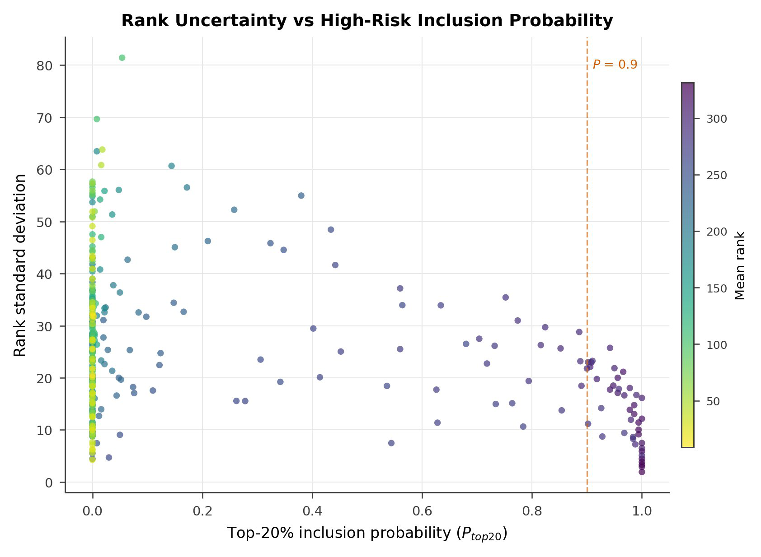
BACKUP
Spatial diagnostics — parameters
Semivariogram fits and Moran's I in full.
Variable
Range
Nugget
Sill
Moran's I
p
Moisture
38.8 m
0.0003
0.0006
0.021
0.331
Residue
45.7 m *
0.0052
0.0244
0.050
0.001
Texture
45.7 m *
0.0026
0.1164
0.084
0.001
Fused risk
35.2 m
383.6
585.4
0.011
0.777
* 45.7 m is exactly the half-diagonal of the field, and therefore the maximum lag. These two are ceilings, not estimates.
BLOCK CROSS-VALIDATION
42.3 m blocks. Between-block variance 22.1%. Block means 38.7 / 54.4 / 59.8. Three valid blocks — four was the geometric maximum here.
Fig. 22 Rank uncertainty vs top-20% inclusion probability.
Notes:
42.3 m is the median of the four ranges: median of 35.2, 38.8, 45.7, 45.7 = 42.25.
On Ploton: conservative check, not an accuracy estimate. Wadoux et al. 2021 dispute whether spatial CV is the right tool for map accuracy — but since no accuracy claim is made, that dispute does not bind.

Slide 25
BACKUP
The damping algebra in full
Why the effective residue exponent is 0.50.
T_eff = T_norm · (1 − R)^α
risk = M^w_M · G^w_G · (1−R)^w_R · [ T_norm · (1−R)^α ]^w_T
= M^w_M · G^w_G · T_norm^w_T · (1−R)^( w_R + α·w_T )
with α = 1: effective residue exponent = 0.20 + 0.30 = 0.50
Residue is therefore the most heavily weighted driver in the model, not the joint-lowest.
Exponents now sum to 1.30, so strict scale-consistency does not hold after damping. The transformation is monotone across all images, so ranking is unaffected.
The α sweep from 0 to 2 moves the effective residue weight from 0.20 to 0.80 — a fourfold change in the dominant driver — while rank correlation holds at 0.982.
The variance term labelled 'texture' contains log(1−R) through T_eff, so Audit 1's 94.5% is texture-and-residue, not texture alone.
Notes:
If someone derives this during the talk, agree immediately and go to the third bullet — the alpha sweep result is stronger than what the paper claims.
Not a correction being extracted from you. A property of the model that strengthens the robustness argument.

Slide 26
BACKUP
Key numbers
Reference figures from across the study.
Design
333 images · 2 wheat fields · 14 Feb 2026 · 22.783°N 75.948°E · 61-point grid
Parameters
w = 0.30 / 0.20 / 0.20 / 0.30 (M, G, R, T) · α = 1 · ε = 1e−6 · γ = 0.70 · tillage floor 0.02
Thermal
GDD 54.0 °Cd · G = 0.450 · constant across all images on this date
Variance
texture 0.0633 (94.5% summed, 84.9% total) · residue 0.0033 · moisture 0.00035 · GDD ≈ 0 · total 0.0746
Geo vs additive
ρ 0.954 · τ 0.839 · Jaccard 0.881 (93.7% shared) · additive higher 201/333 · 17 of 34 one-low-others-high
Ablation
−texture ρ 0.652 · −residue 0.968 · −moisture 0.996 · −GDD 1.000
Noise
1% ρ 0.999 · 3% 0.996 · 5% 0.990 (95.5% of top-20% set retained)
Dirichlet
500 draws · mean ρ 0.945 · 5th pct 0.775 · min 0.514 · 42 of 333 at P ≥ 0.90 · 26 unstable
Species T_b
P. minor 1.0 → 125.5 · C. album 3.0 → 111.5 · M. indica 0.0 → 132.5 · all G ≥ 0.929
Classes
A 119 (LOW) · B 37 · C 24 · D 38 · E 115 (HIGH) · mean 48.5 · median 50.0 · IQR [10.2, 87.1]
Spatial
ranges 38.8 / 45.7 / 45.7 / 35.2 m · block CV 42.3 m · between-block 22.1% · 3 valid blocks
Next study
60 quadrats · counts day 21 and 35 · ~79% power at ρ = 0.35 · stopping rule ρ < 0.2
Notes:
Podium card. Do not show unless a specific number is requested.

