Slide 1


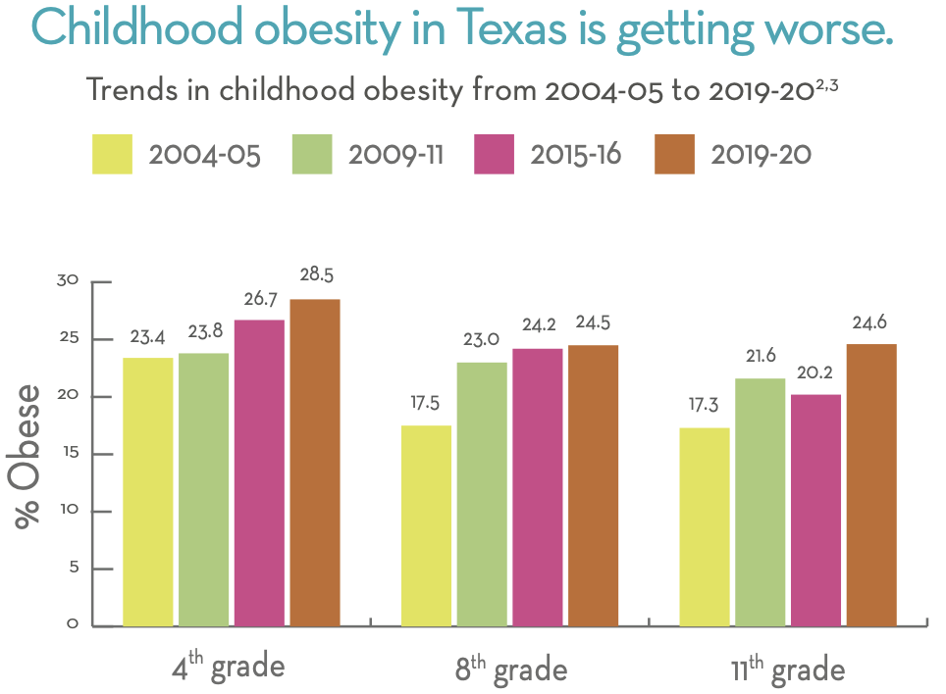
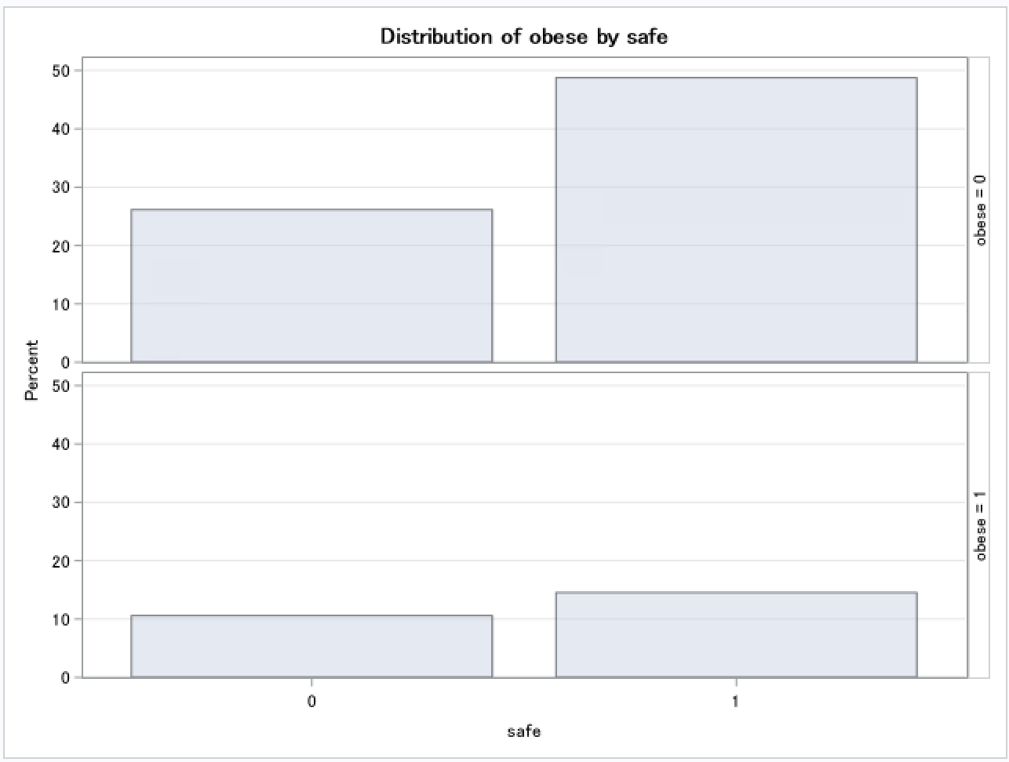
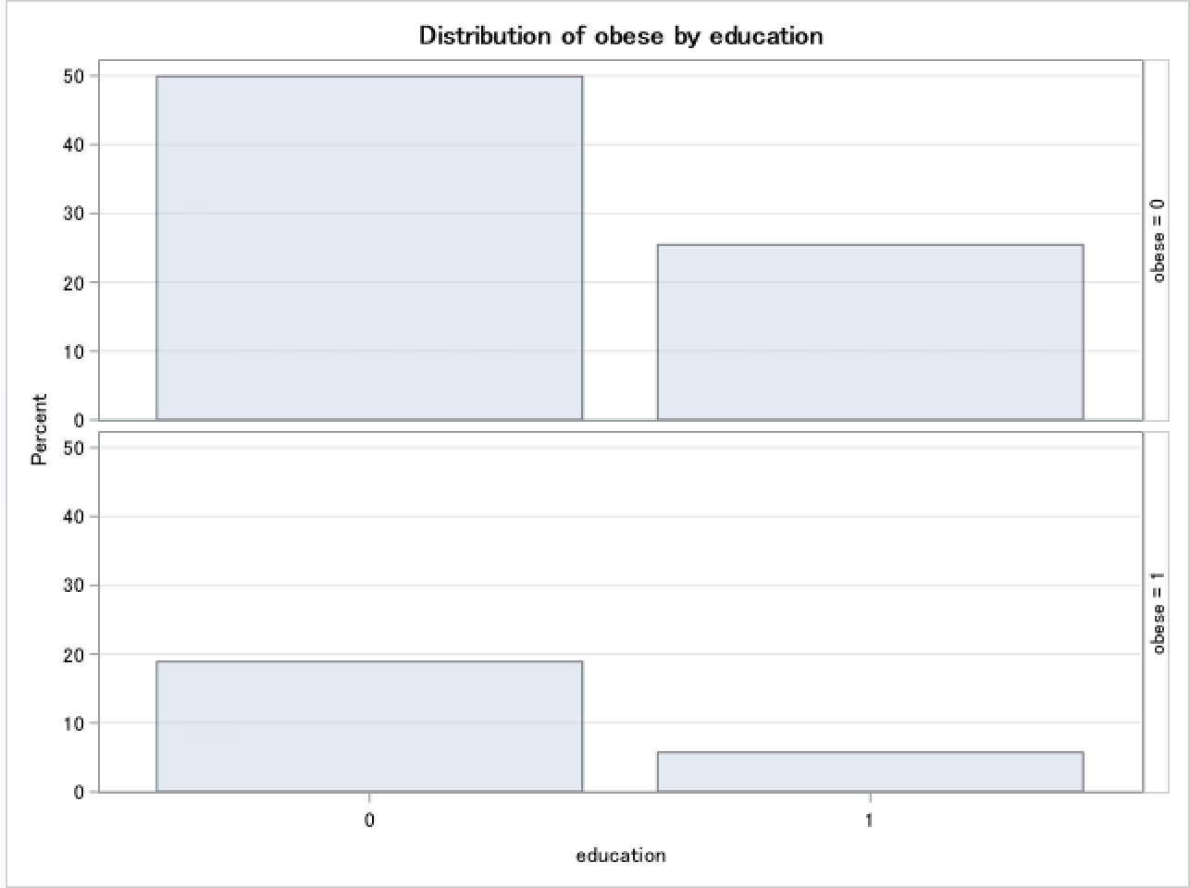
Education-Related Behaviors and their impact on Childhood Obesity in Texas
Arham Salman
University of Texas Health Science Center Houston
Introduction
Results
Discussion
Childhood obesity is a dangerous public health burden that has emerged as a growing pandemic worldwide. The prevalence of childhood obesity has nearly tripled since 1975, with almost 18.5% of children in US experiencing burden with obesity [1]. The World Health Organization (WHO) defines obesity as the deposition of excessive fat in the body. Body mass index (BMI) is the most economic and convenient way to indirectly assess body fat. According to the CDC, for children 2 to 20 years of age, obese class 1 is categorized as the 95th percentile or higher [4]. The Texas School Physical Activity and Nutrition (SPAN) project measures health factors such as nutrition, activity levels, oral health, and other behaviors of school-aged children in Texas. Survey data collected from 2021-2023 contains information for health factors along with demographic information for 2nd grade, 4th grade, and 8th-11th grade children. This poster specifically addresses the research question: What key education related behaviors are associated with obese BMI status of 2nd graders in Texas?
Parameter | Estimate | Standard Error | t value | p value
Intercept | -0.1363 | 0.6662 | -0.20 | 0.8385
Male | -0.0166 | 0.2209 | -0.08 | 0.9404
Hispanic | -0.00538 | 0.2681 | -0.02 | 0.9841
Black | -0.6304 | 0.6109 | -1.03 | 0.3056
Safe | -0.7826 | 0.3874 | -2.02 | 0.0471
Label | -0.3458 | 0.3914 | -0.88 | 0.3800
Sports | -0.4139 | 0.4205 | -0.98 | 0.3283
Cafeteria | 0.6739 | 0.3820 | 1.76 | 0.0820
Mother’s Education | -0.1938 | 0.1180 | -1.64 | 0.1048
Father’s Education | -0.1143 | 0.1285 | -0.89 | 0.3769
Interpretation: Results from Figure 3 show that for parents that feel safe about walking their kids to school, there is a 49% lower odds of obesity than parents who feel unsafe walking their kids to school. For mothers that have at least a college degree, there is a 26% lower odds of their child having obesity compared to mothers that don’t have a college degree. Figure 4 shows a bar graph detailing the trends in childhood obesity from 2004-05 to 2019-20. Critical results show that in 11th graders, obesity jumped from 17.3% to 24.6%.The chi square test results from Figure 5 and Figure 6 indicate that there is a significant relationship between how safe parents feel about walking their kids to school and diabetes and mother’s education level and diabetes. D
Limitations/Future Considerations: One limitation of this study is that it doesn’t consider household income as a factor. Future studies should consider household income as a potential variable related with diabetes in school aged children.
Implications: The results of this study indicate that living safety standards could be directly related with poor health choices. In low-income communities, there is a prevalence of food deserts. This disparity is especially prevalent among high school students.
Figure 1: Preliminary Logistic Regression model of independent variables against outcome variable, class 1 diabetes.
Parameter | Estimate | Standard Error | t value | p value
Intercept | -0.00782 | 0.5304 | 0.01 | 0.9883
Mother’s Education | -0.2971 | 0.1296 | -2.29 | 0.0248
Safe | -0.6761 | 0.3183 | -2.12 | 0.0371
Figure 2: Final Logistic Regression model of how safe parents feel about their kids walking to school and the mother’s level of education against child obesity status
Effect | Point Estimate | 95% Confidence Limits
Mother’s Education | 0.743 | 0.574 | 0.962
Safe | 0.509 | 0.270 | 0.959
Figure 3: Odds Ratio model of how safe parents feel about their kids walking to school and the mother’s level of education against child obesity status
Figure 4: Hosmer and Lemeshow Goodness of Fit results showing how well predictor
data fits model.
Methodology
Data Cleaning - SQL
Logistic Regression Models - SAS
Diagnostic tests
Chi Square Tests
Outcome Variable – Class
Independent Variables – See Figure 1
References/Acknowledgements
Balasundaram P, Krishna S. Obesity Effects on Child Health(Archived). In: StatPearls. Treasure Island (FL): StatPearls Publishing; April 10, 2023.
The 2015-2016 School Physical Activity and Nutrition (SPAN) Survey: Report prepared for the Texas Department of Health Services (2018).
3. School Physical Activity and Nutrition (SPAN) Project 2019-2020. Michael & Susan Dell Center for Healthy Living. SPAN project details available online at go.uth.edu/SPAN.
Obesity and overweight. World Health Organization. Accessed August 29, 2025. https://www.who.int/news-room/fact-sheets/detail/obesity-and-overweight.
This project was supported by the UTHealth GETPHIT program. Collaborators include Raja Malkani, Carolyn Smith, and Pablo Martinez.
Statistic | DF | Value | Prob
Chi-Square | 1 | 4.0950 | 0.0430
Statistic | DF | Value | Prob
Chi-Square | 1 | 18.6718 | <0.0001
Figure 5: Chi-Square test results comparing obesity status with how safe parents feel walking their kids to school
Figure 6: Chi-Square test results comparing obesity status with whether the mother has a college degree education

