Slide 1

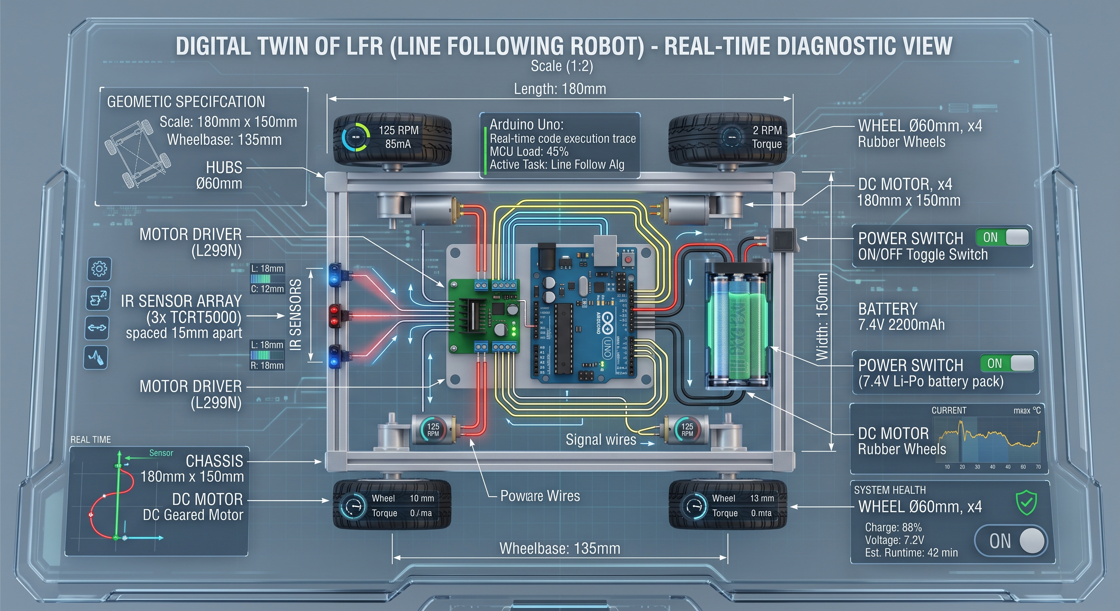
NATIONAL INCUBATION CENTER · KARACHI
OmniTwin
Hands-on digital twin learning kits for Pakistani engineering students — ESP32 hardware + live dashboard, at a fraction of global vendor cost.
PITCH TO 10K
Karachi, Pakistan
Notes:
OmniTwin — hands-on digital twin learning kits for Pakistani engineering students. Pitch to 10K.

Slide 2
02
VISION
Give every Pakistani engineering department affordable, hands-on digital twin hardware — ESP32 kits mirrored into a live dashboard — so students see real physical behavior instead of theory alone.
THEORY, NO HARDWARE ACCESS
Long term: become the default lab infrastructure for Pakistani universities, Urdu-first and load-shedding resilient.

Slide 3
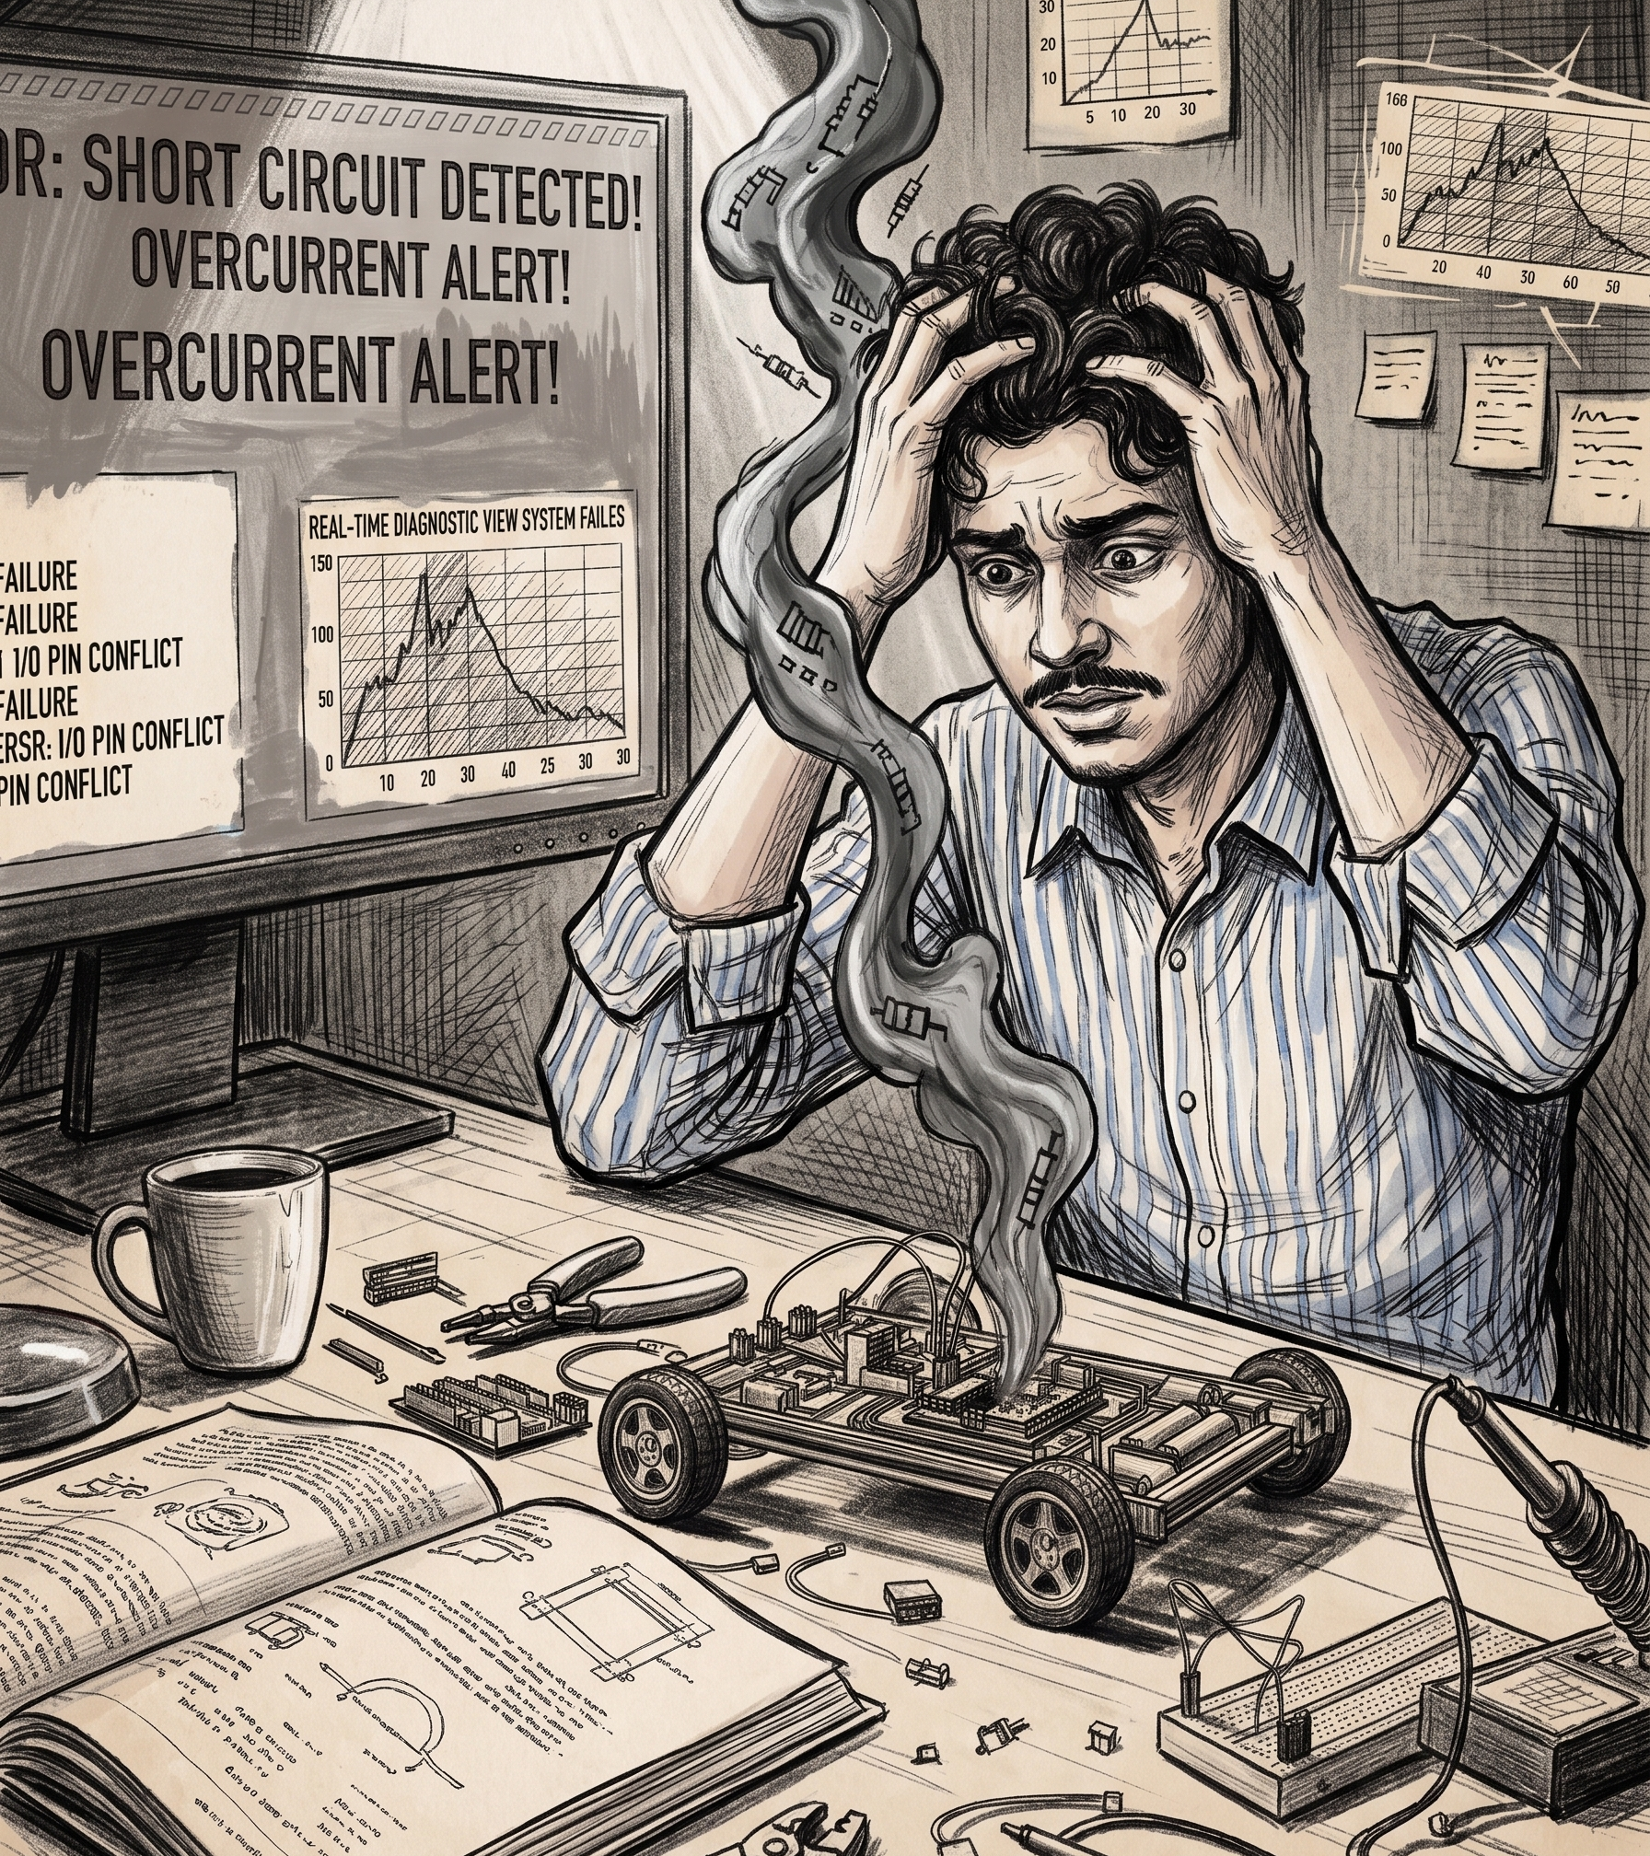
04
PROBLEM
I spent 80% of my time debugging blind — and burned through 2 Arduinos before anything worked.
5th semester
·
MBSD — Microprocessor-Based System Design
Pakistani engineering students learn embedded systems almost entirely through theory. Hardware labs are expensive and rare — so most never build a real system.
// SHORT CIRCUIT — the LFR that wouldn't run
Notes:
This was me. 5th semester MBSD. 80% of my time went to debugging blind, and I burned two Arduinos before anything worked — all for lack of guidance.

Slide 4
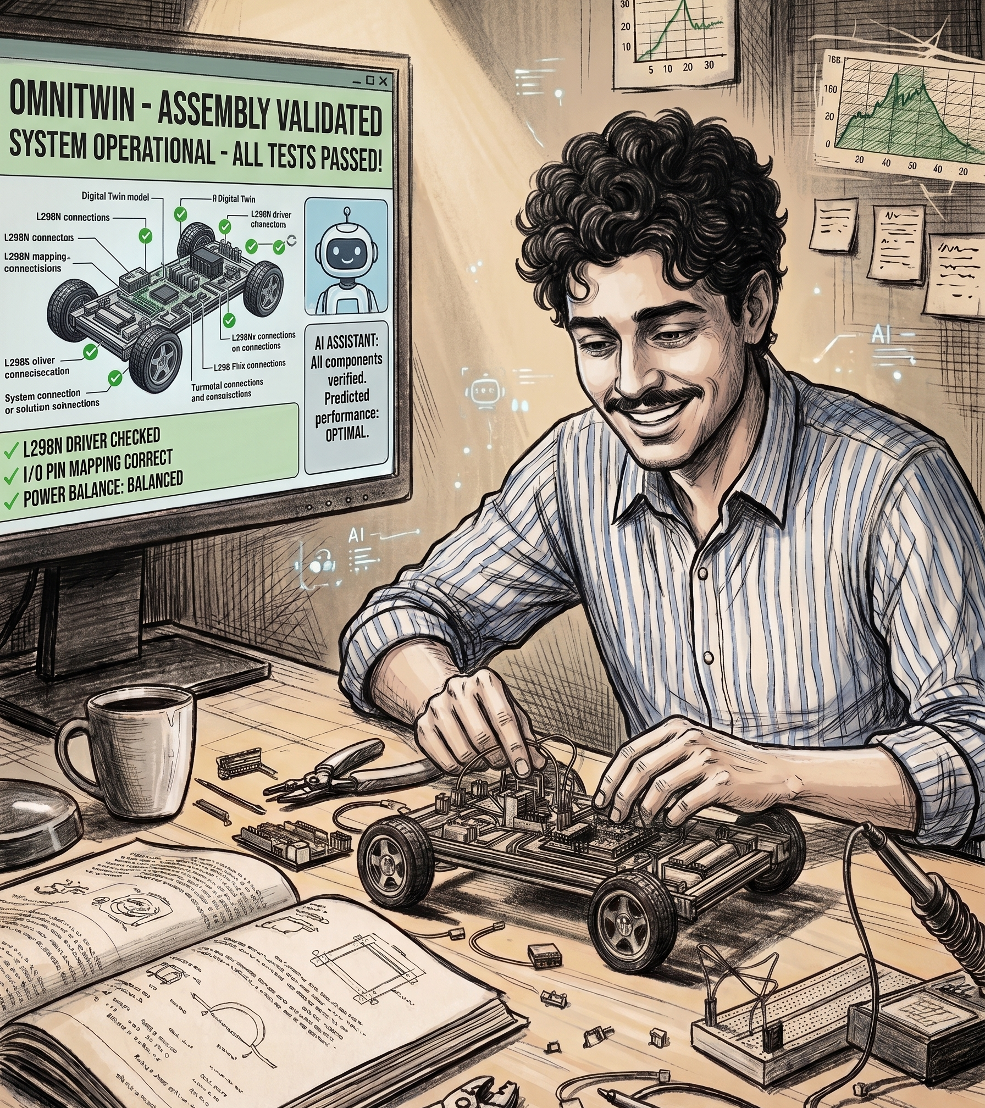
05
SOLUTION
Same robot. This time the twin caught the fault before it fried anything.
01
Connect kit — sensors capture live data
02
Data streams into the digital twin
03
Student runs AI fault detection
An ESP32 + sensor kit mirrors live physical data into an interactive dashboard — the guidance I never had.
// ALL TESTS PASSED — the twin caught the fault first
Notes:
Same robot, same student. This time the digital twin catches the fault before hardware fails. Connect the kit, watch it mirror live, run AI fault detection.

Slide 5
06
DIGITAL TWIN
OMNITWIN · LFR
The LFR, mirrored live — read-time diagnostics a student can actually read.
Real-time Diagnostic View
ALL TESTS PASSED
MOTOR L · RPM
MOTOR R · RPM
MCU LOAD
125
124
45%
HARDWARE
85 mA · nominal
86 mA · nominal
Line-follow alg
ESP32 · L298N driver · 3× TCRT5000 IR
SOFTWARE
IR SENSOR ARRAY · 3× TCRT5000
on line
Live dashboard mirrors every sensor
AI
Fault detection before hardware burns
BATTERY · 7.4V Li-Po
EST. RUNTIME
CHASSIS
88% · 7.2V
42 min
180 × 150 mm
// concept dashboard — clean brand build, not the sketch
Notes:
This is what the student sees. A clean, on-brand diagnostic view of the line-following robot — motor RPM, current draw, IR sensors, battery, and a system-health verdict. Built in the brand, correctly spelled.

Slide 6
08
MARKET SIZING
TAM
53
SAM
HEC engineering universities in Pakistan
~8–10
SOM
engineering-focused Karachi universities (HEC-recognized)
DUET + NED
flagship anchors

Slide 7
10
COMPETITORS
Global alternatives, none Pakistan-priced:
Siemens MindSphere
~$5,000+/mo
PTC ThingWorx
~$4,000+/mo
AWS IoT TwinMaker
Pay-per-resource
Labtech Intl
Enterprise quote
Status quo
Theory-only, no lab
OmniTwin
$20/mo Pro · 5 Lac PKR/yr, 50-seat license

Slide 8
12
REVENUE STREAMS
Freemium → Pro → University License upsell funnel.
PRO SUBSCRIPTION
UNIVERSITY LICENSE
$20/month
5 Lac PKR/year
Fixed, not usage-metered. Individual students — full platform access.
50 seats, unlimited use for license duration + LMS integration + shared AI coaching engine.
Potential future stream: LMS integration fees for deeper university system integration.

Slide 9
13
COST STRUCTURE
CAPEX
OPEX
~50,000 PKR
25–30k PKR/yr
First batch: 5 kits × ~10,000 PKR BOM. Dev cost to date: not yet costed.
Hosting. Team stipends deferred. Support informal for now. Marketing/GTM not yet costed.
Risk: hardware supply chain at scale needs a logistics plan.

Slide 10
17
CORE TEAM
AI / NLP
AI / SOFTWARE
FOUNDER
Tasbiha Naz (Siddiqui)
Asma Aslam
Muhammad Arham Rajput
AI/NLP Developer at HNH Soft Tech Solutions, focused on LLM-powered applications and RAG systems. Brings hands-on experience building automation pipelines, vector-database-backed search, and multi-provider LLM integration.
AI Engineer / Data Engineer at Information Technology Services, and university topper (GPA 3.96) in Computer System Engineering from Dawood UET. Brings full-stack development (React/Next.js, FastAPI) and applied AI/ML experience (TensorFlow, PyTorch, RAG systems) from prior work at 360 Xpert Solutions and the State Bank of Pakistan.
Owns hardware and embedded systems at OmniTwin — ESP32 integration, firmware, and the physical kit build. Leads product and company direction as founder.

