Slide 1

From Python to C
Dr. Charles R. Severance
www.cc4e.com

Slide 2
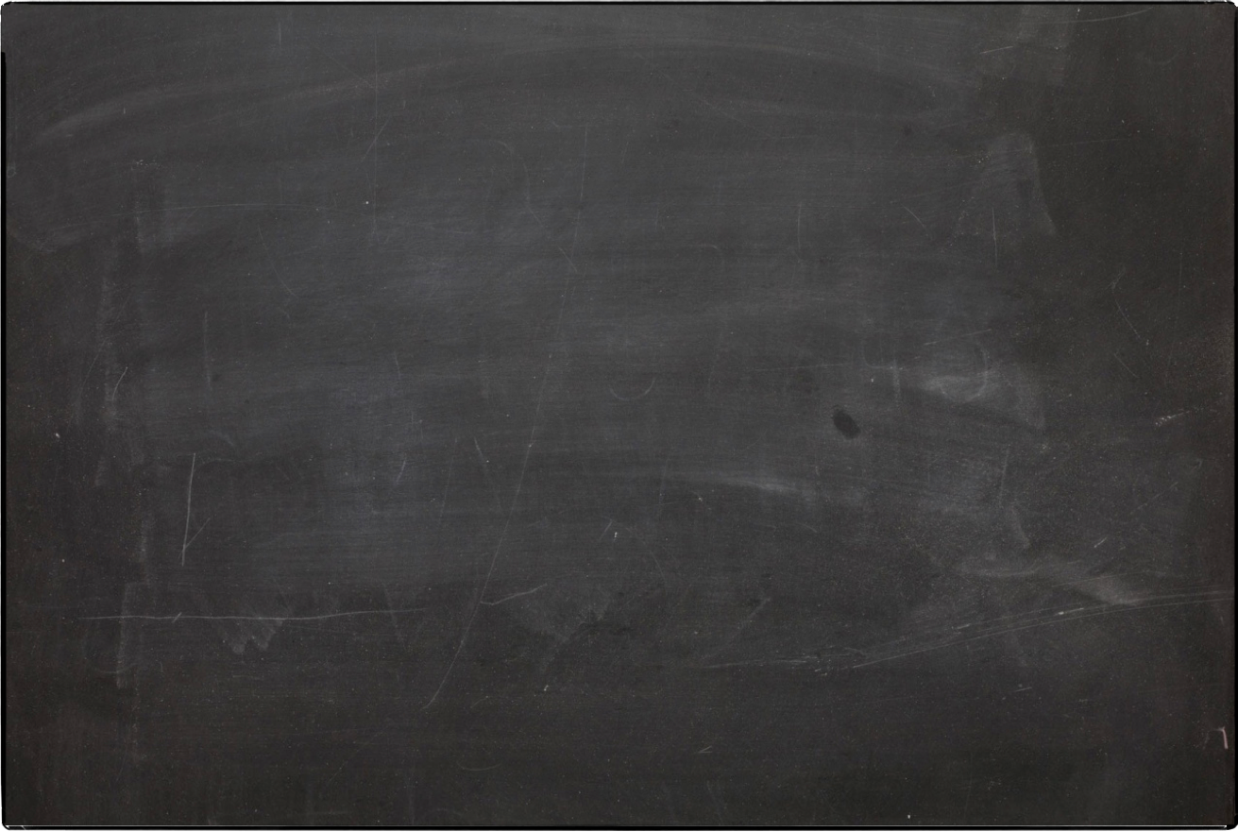
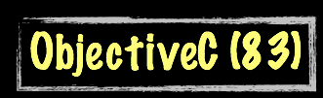
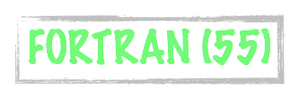


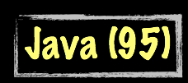




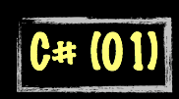

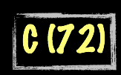
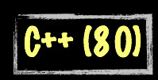

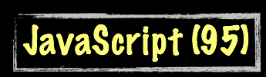



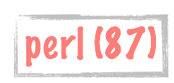


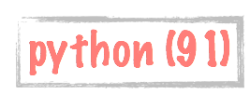
Evolution of Computer Languages
Science Calculations
System
System
bash (79)
C uses curly braces { } for code blocks.
Scripting/
Interpreted
http://en.wikipedia.org/wiki/History_of_programming_languages

Slide 3
Learning Path: online.dr-chuck.com
History – ihts.dr-chuck.com
Python – www.py4e.com
Django (Python, HTML, CSS, SQL, JavaScript) – www.dj4e.com
Web Applications (PHP, HTML, CSS, SQL, JavaScript) – www.wa4e.com
PostgreSQL (SQL) – www.pg4e.com
C Programming – www.cc4e.com ← We are here ☺
Computer Architecture
Java Enterprise Application Development

Slide 4
Python and C
White space is essential
Very object oriented
Convenient data structures
list
dict
Auto memory management
1980's
Whitespace ignored
Not object oriented at all
Fast efficient powerful
struct
Pointers
Manual memory management
1970's
In many ways, Python is a convenience layer built on top of C to make it so users could write code without worrying about the complex details.

Slide 5
Looking at C A Python Lens

Slide 6
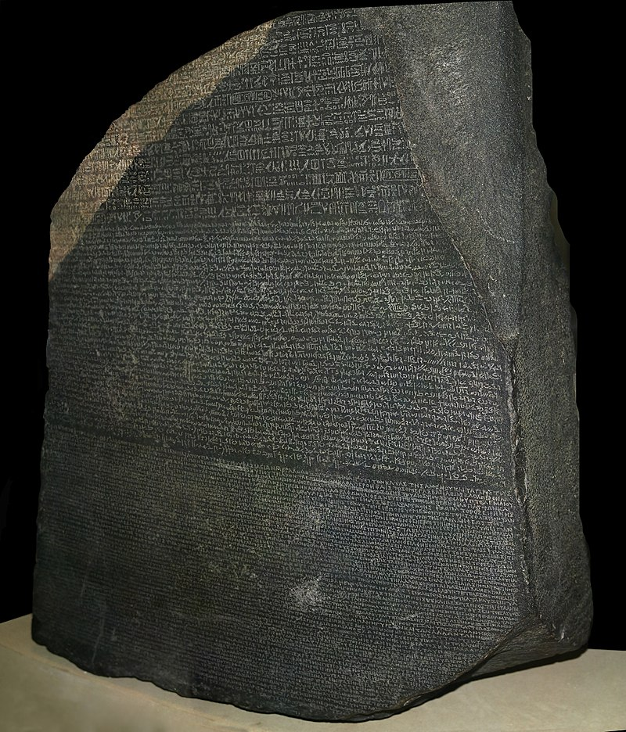
Rosetta Stone
This file is licensed under the Creative Commons Attribution-Share Alike 4.0 International license. Attribution: © Hans Hillewaert
https://en.wikipedia.org/wiki/Rosetta_Stone#/media/File:Rosetta_Stone.JPG

Slide 7
These code examples
Most of these examples are also programming exercises
It is my intention that you watch these lectures and work on the exercises at the same time
These exercises are not trying to assess what you learned
Watching and listening to the lecture and then typing this code in to make it work is the learning objective of this lecture
After this section – you should do the assignments yourself (i.e. don’t search) to gain maximum benefit

Slide 8
Similarities
Arithmetic Operators: + - * / %
Comparison Operators: == != < > <= the same
Variable naming rules – letter/underscore + numbers/letters/underscores – also case matters
While loops – also break and continue in loops
Constants similar except for strings and characters and booleans
Both have int / float, and char / byte
C has no str, list, or dict
Python has no struct or double

Slide 9
Differences
Boolean operators
and / not / or versus && ! ||
C for loops are indeterminant (i.e. no for ... in in C)
C has no pre-defined True or False
None and NULL are similar concepts but quite different
Strings and character arrays are similar concepts but *very* different
C has no list, or dict
Python has no struct - float in Python is a C double

Slide 10
Output
#include <stdio.h>
/* I am a comment */
int main() {
printf("Hello world\n");
printf("Answer %d\n", 42);
printf("Name %s\n", "Sarah");
printf("x %.1f i %d\n", 3.5, 100);
}
# I am a comment
print('Hello world')
print('Answer', 42)
print('Name', 'Sarah')
print('x',3.5,'i',10)
Hello world
Answer 42
Name Sarah
x 3.5 i 100
cc_02_01.c

Slide 11
Number Input
#include <stdio.h>
int main() {
int usf, euf;
printf("Enter US Floor\n");
scanf("%d", &usf);
euf = usf – 1;
printf("EU Floor %d\n", euf);
}
print('Enter US Floor')
usf = int(input())
euf = usf - 1
print('EU Floor', euf)
Enter US Floor
2
EU Floor 1
For those of us who learned Python 2, recall the difference between input() and raw_input(). In Python 3 there is only input() which is the same as Python 2's raw_input(). In C, scanf("%d", ...) is more like Python 2's input().
cc_02_02.c

Slide 12
String Input
#include <stdio.h>
int main() {
char name[100];
printf("Enter name\n");
scanf("%100s", name);
printf("Hello %s\n", name);
}
print('Enter name')
name = input()
print('Hello', name)
Enter name
Sarah
Hello Sarah
cc_02_03.c

Slide 13
Line Input
#include <stdio.h>
int main() {
char line[1000];
printf("Enter line\n");
scanf("%[^\n]1000s", line);
printf("Line: %s\n", line);
}
print('Enter line')
line = input()
print('Line:', line)
Enter line
Hello world - have a nice day
Line: Hello world - have a nice day
cc_02_04.c

Slide 14
Line Input (safe)
#include <stdio.h>
int main() {
char line[1000];
printf("Enter line\n");
fgets(line, 1000, stdin);
printf("Line: %s\n", line);
}
print('Enter line')
line = input()
print('Line:', line)
Enter line
Hello world - have a nice day
Line: Hello world - have a nice day
cc_02_09.c

Slide 15
Read A File
#include <stdio.h>
int main() {
char line[1000];
FILE *hand;
hand = fopen("romeo.txt", "r");
while( fgets(line, 1000, hand) != NULL ) {
printf("%s", line);
}
}
hand = open('romeo.txt')
for line in hand:
print(line.strip())
But soft what light through yonder window breaks
It is the east and Juliet is the sun
Arise fair sun and kill the envious moon
Who is already sick and pale with grief
cc_02_06.c

Slide 16
Counted Loop
#include <stdio.h>
int main() {
int i;
for(i=0; i<5; i++) {
printf("%d\n",i);
}
}
for i in range(5) :
print(i)
0
1
2
3
4
cc_02_07.c

Slide 17
Max / Min
maxval = None
minval = None
while True:
line = input()
line = line.strip()
if line == "done" : break
ival = int(line)
if ( maxval is None or ival > maxval) :
maxval = ival
if ( minval is None or ival < minval) :
minval = ival
print('Maximum', maxval)
print('Minimum', minval)
5
2
9
done
Maximum 9
Minimum 2
cc_02_08.py

Slide 18
Max / Min
#include <stdio.h>
#include <stdlib.h>
#include <string.h>
int main() {
int first = 1;
int val, maxval, minval;
char line[1000];
while(gets(line) != NULL ) {
if ( strcmp(line,"done") == 0 ) break;
val = atoi(line);
if ( first ) {
maxval = val;
minval = val;
first = 0;
} else {
if ( val > maxval ) maxval = val;
if ( val < minval ) minval = val;
}
}
printf("Maximum %d\n", maxval);
printf("Minimum %d\n", minval);
}
warning: this program uses gets(),
which is unsafe.
5
2
9
done
Maximum 9
Minimum 2
cc_02_08.c

Slide 19
Max / Min v2
#include <stdio.h>
int main() {
int first = 1;
int val, maxval, minval;
while(scanf("%d",&val) != EOF ) {
if ( first ) {
maxval = val;
minval = val;
first = 0;
} else {
if ( val > maxval ) maxval = val;
if ( val < minval ) minval = val;
}
}
printf("Maximum %d\n", maxval);
printf("Minimum %d\n", minval);
}
5
2
9
(EOF)
Maximum 9
Minimum 2
5 2 9
(EOF)
Maximum 9
Minimum 2
cc_02_08_b.c

Slide 20
Guessing
#include <stdio.h>
int main() {
int guess;
while(scanf("%d",&guess) != EOF ) {
if ( guess == 42 ) {
printf("Nice work!\n");
break;
}
else if ( guess < 42 )
printf("Too low - guess again\n");
else
printf("Too high - guess again\n");
}
}
while True:
try:
line = input()
except: # If we get EOF
break
line = line.strip()
guess = int(line)
if guess == 42:
print('Nice work!')
break
elif guess < 42 :
print('Too low - guess again')
else :
print('Too high - guess again')
5
Too low - guess again
50
Too high - guess again
42
Nice work!
cc_02_09.c

Slide 21
Functions (call by value)
#include <stdio.h>
int main() {
int mymult();
int retval;
retval = mymult(6,7);
printf("Answer: %d\n",retval);
}
int mymult(a, b)
int a,b;
{
int c = a * b;
return c;
}
def mymult(a,b):
c = a * b
return c
retval = mymult(6, 7)
print('Answer:', retval)
Answer: 42
cc_02_10.c

Slide 22
Shouting
#include <stdio.h>
#include <string.h>
#include <ctype.h>
int main() {
char line[1000];
FILE *hand;
int i;
hand = fopen("romeo.txt", "r");
while( fgets(line, 1000, hand) != NULL )
for(i=0; i<strlen(line); i++)
putchar(toupper(line[i]));
}
hand = open('romeo.txt')
for line in hand:
print(line.strip().upper())
BUT SOFT WHAT LIGHT THROUGH YONDER WINDOW BREAKS
IT IS THE EAST AND JULIET IS THE SUN
ARISE FAIR SUN AND KILL THE ENVIOUS MOON
WHO IS ALREADY SICK AND PALE WITH GRIEF
cc_02_11.c

Slide 23
Concatenation
#include <stdio.h>
#include <string.h>
int main() {
char first[100], second[100], concat[303];
printf("Enter two strings\n");
scanf("%100s", first);
scanf("%100s", second);
strcpy(concat, first);
strcat(concat, " & ");
strcat(concat, second);
printf("%s\n", concat);
}
print('Enter two strings');
first = input()
second = input()
print(first + " & " + second)
Enter two strings
Kernighan
Ritchie
Kernighan & Ritchie
cc_02_12.c

Slide 24
Right Strip
#include <stdio.h>
#include <string.h>
int main() {
char s1[] = " Hello World ";
void py_rstrip();
py_rstrip(s1);
printf("-%s-\n", s1);
}
void py_rstrip(inp)
char inp[];
{
int i, j;
for(i=0, j=0; i<strlen(inp)-1; i++) {
if ( inp[i] == '\n' ||
inp[i] == '\t' || inp[i] == ' ' ) {
/* Whitespace skip */
} else {
j = i; /* the last non-blank */
}
}
if ( j+1 < strlen(inp) ) inp[j+1] = '\0';
}
s1 = " Hello World "
print('-'+s1.rstrip()+'-')
- Hello World-
cc_02_13.c

Slide 25
Left Strip
#include <stdio.h>
#include <string.h>
#include <ctype.h>
int main() {
char s1[] = " Hello World ";
void py_lstrip();
printf("-%s-\n", s1);
py_lstrip(s1);
printf("-%s-\n", s1);
}
void py_lstrip(inp)
char inp[];
{
int i, j;
int found = 0;
for(i=0, j=0; i<strlen(inp)-1; i++) {
if ( ! found && isspace(inp[i]) ) continue;
if ( i == j ) return;
found = 1;
inp[j++] = inp[i];
}
inp[++j] = '\0';
}
s1 = " Hello World "
print('-'+s1.lstrip()+'-')
-Hello World -
cc_02_14.c

Slide 26
Dynamic Memory
#include <stdio.h>
#include <string.h>
#include <stdlib.h>
int main() {
char first[100], second[100], *concat;
int needed;
printf("Enter two strings\n");
scanf("%100s", first);
scanf("%100s", second);
needed = strlen(first)+3+strlen(second)+1;
printf("We need %d characters\n",needed);
concat = (char *) calloc(needed, sizeof(char));
strcpy(concat, first);
strcat(concat, " & ");
strcat(concat, second);
printf("%s\n", concat);
}
print('Enter two strings');
first = input()
second = input()
dest = first + " & " + second
print('We got',len(dest),'characters')
print(dest)
Enter two strings
Kernighan
Ritchie
We got 19 characters
Kernighan & Ritchie
Enter two strings
Kernighan
Ritchie
We need 20 characters
Kernighan & Ritchie
cc_02_15.c

Slide 27
Summary
Input/Output
Looping
Reading a file
Strings
Float
Dynamic memory
Way too complex to implement in C (for now)
Python str()
Python list()
Python dict()
We will revisit these as the end of the course

Slide 28
Acknowledgements / Contributions
These slides are Copyright 2020- Charles R. Severance (online.dr-chuck.com) as part of www.cc4e.com and made available under a Creative Commons Attribution 4.0 License. Please maintain this last slide in all copies of the document to comply with the attribution requirements of the license. If you make a change, feel free to add your name and organization to the list of contributors on this page as you republish the materials.
Initial Development: Charles Severance, University of Michigan School of Information
Insert new Contributors and Translators here including names and dates
Continue new Contributors and Translators here

