Slide 1

C Programming A Historical Perspective
Dr. Charles R. Severance
www.cc4e.com

Slide 2
Learning Path: online.dr-chuck.com
History – ihts.dr-chuck.com
Python – www.py4e.com
Django (Python, HTML, CSS, SQL, JavaScript) – www.dj4e.com
Web Applications (PHP, HTML, CSS, SQL, JavaScript) – www.wa4e.com
PostgreSQL (SQL) – www.pg4e.com
C Programming – www.cc4e.com ← We are here ☺
Computer Architecture
Java Enterprise Application Development

Slide 3
A Brief History of Computers
1940's – Top Secret / Military / WWII (ihts.dr-chuck.com)
Early 1950's – Custom built
Late 1950's – Companies like IBM, DEC, etc. begin selling computers
1960's – More companies, less expensive, wider range of options
Late 1960's – Many kinds of computers old/new/fast/slow
1970's – Searching for "the one" solution for software
1980's – Microprocessors and Personal Computers – performance++
1990's – The network is the computer – performance++
2000's – Amazon AWS founded in 2002 – computing as commodity

Slide 4

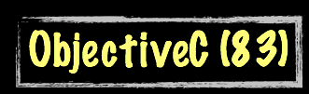



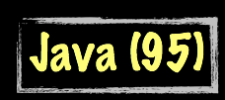




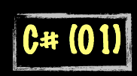

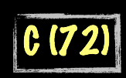
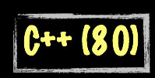

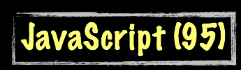






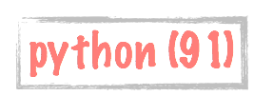
Evolution of Computer Languages
Science Calculations
System
System
bash (79)
C uses curly braces { } for code blocks.
Scripting/
Interpreted
http://en.wikipedia.org/wiki/History_of_programming_languages

Slide 5
Summary
Input/Output
Looping
Reading a file
Strings
Float
Dynamic memory
Way too complex to implement in C (for now)
Python str()
Python list()
Python dict()
We will revisit these as the end of the course

Slide 6
Acknowledgements / Contributions
These slides are Copyright 2020- Charles R. Severance (online.dr-chuck.com) as part of www.cc4e.com and made available under a Creative Commons Attribution 4.0 License. Please maintain this last slide in all copies of the document to comply with the attribution requirements of the license. If you make a change, feel free to add your name and organization to the list of contributors on this page as you republish the materials.
Initial Development: Charles Severance, University of Michigan School of Information
Insert new Contributors and Translators here including names and dates
Continue new Contributors and Translators here

