Slide 1
Tree Maps and Hash Maps
Dr. Charles R. Severance
www.cc4e.com
code.cc4e.com (sample code)
online.dr-chuck.com

Slide 2

“Stopping by Woods on a Snowy Evening”
Whose woods these are I think I know.
His house is in the village though;
He will not see me stopping here
To watch his woods fill up with snow.
My little horse must think it queer
To stop without a farmhouse near
Between the woods and frozen lake
The darkest evening of the year.
He gives his harness bells a shake
To ask if there is some mistake.
The only other sound’s the sweep
Of easy wind and downy flake.
The woods are lovely, dark and deep,
But I have promises to keep,
And miles to go before I sleep,
And miles to go before I sleep.
https://en.wikipedia.org/wiki/Stopping_by_Woods_on_a_Snowy_Evening

Slide 3
Key /Value Implementation Alternatives
We will build an unordered java.util.HashMap / Python 2 dict()
Chapter 6.6
We will build a sorted java.util.TreeMap – plus an iterator
Chapter 6.5 (Simultaneous Linked List + Tree)
It would be named java.util.LinkedTreeMap if Java had such a thing ☺
Python
Python 2 dict - unordered
Python 3.1 - OrderedDict
C++ (capabilities of any map)
Associative
Ordered
Unique Keys
Map (key / simple value)
Java
java.util.HashMap
java.util.TreeMap (*)
java.util.LinkedHashMap
* No iterator

Slide 4
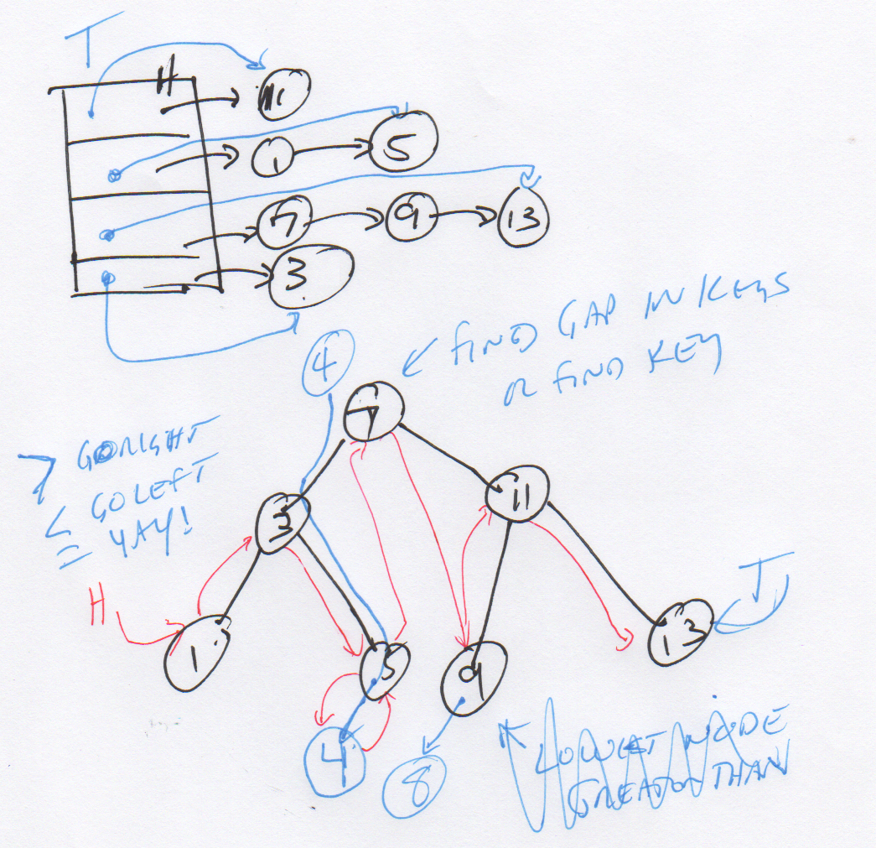
Start with a good picture…

Slide 5
Hash Map
The answer to the most common programming interview question!

Slide 6
HashMap
Weird order (like Python 2 dict and Java HashMap)
Fast insert and lookup (like Python 2 dict and Java HashMap)
Iterable (like Python 2 dict and Java HashMap)
Builds on Linked Lists
Surprisingly easy is you really get Linked Lists
Chapter 6.5.1 and 6.6 in K&R (6.5.2 is harder than 6.6)
Most popular programming interview question ever!

Slide 7
Simplifying our Pictures
head:
tail:
key:
z
struct MapEntry {
char *key; /* public */
int value; /* public */
struct MapEntry *__prev;
struct MapEntry *__next;
};
struct Map {
struct MapEntry *__head;
struct MapEntry *__tail;
...
};
value: 22
prev:
∅
next:
key:
w
value: 42
prev:
next:
head
z=22
w=42
∅
∅

Slide 8
Changing From ListMap to HashMap
struct MapEntry {
char *key; /* public */
int value; /* public */
struct MapEntry *__prev;
struct MapEntry *__next;
};
struct ListMap {
struct MapEntry *__head;
struct MapEntry *__tail;
...
};
struct HashMapEntry {
char *key; /* public */
int value; /* public */
struct HashMapEntry *__prev;
struct HashMapEntry *__next;
};
struct HashMap {
int __buckets;
struct HashMapEntry *__heads[8];
struct HashMapEntry *__tails[8];
...
};

Slide 9
Changing From ListMap to HashMap
head
b=14
d=21
f=19
h=17
j=18
m=90
∅
buckets: 4
f=19
h=17
∅
heads[0]
Hash % 4
heads[1]
d=21
∅
key
heads[2]
b=14
j=18
m=90
∅
heads[3]
∅

Slide 10
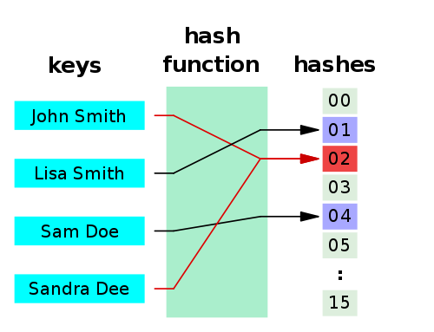
Hashes
A hash function is any algorithm or subroutine that maps large data sets to smaller data sets, called keys. For example, a single integer can serve as an index to an array (cf. associative array). The values returned by a hash function are called hash values, hash codes, hash sums, checksums, or simply hashes.
Hash functions are mostly used to accelerate table lookup or data comparison tasks such as finding items in a database...
http://en.wikipedia.org/wiki/Hash_function

Slide 11
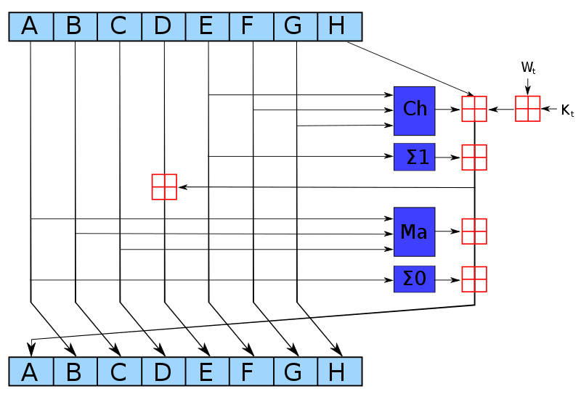
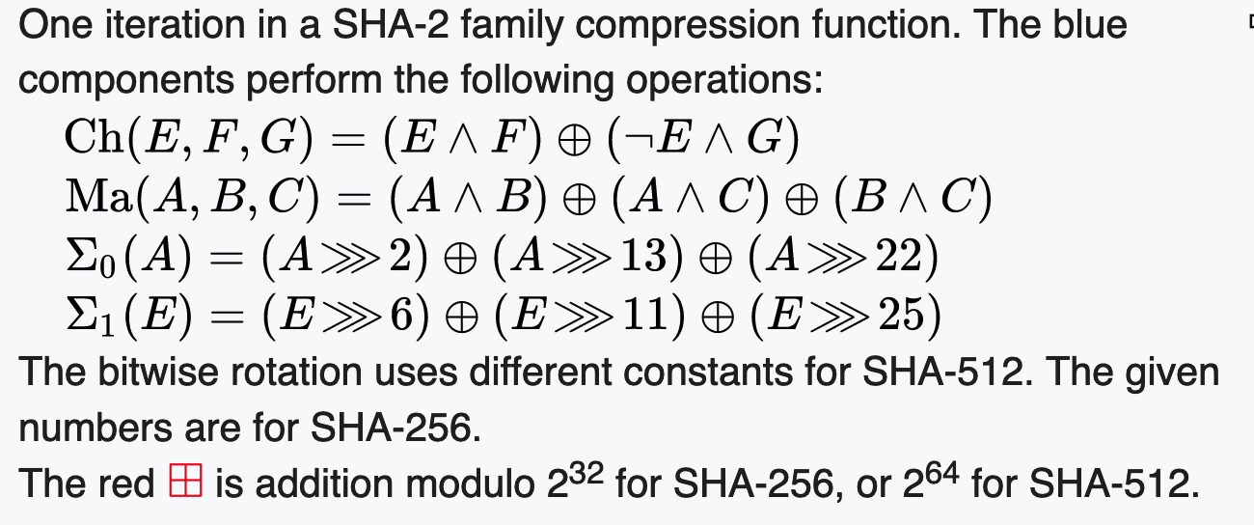
SHA-256 Compression Function
https://en.wikipedia.org/wiki/SHA-2

Slide 12
int getBucket(char *str, int buckets)
{
unsigned int hash = 123456;
printf("\nHashing %s\n", str);
if ( str == NULL ) return 0;
for( ; *str ; str++) {
hash = ( hash << 3 ) ^ *str;
printf("%c 0x%08x %d\n", *str,
hash, hash % buckets);
}
return hash % buckets;
}
int main() {
int h;
h = getBucket("Hi", 8);
h = getBucket("Hello", 8);
h = getBucket("World", 8);
}
Hashing Hi
H 0x000f1248 0
i 0x00789229 1
Hashing Hello
H 0x000f1248 0
e 0x00789225 5
l 0x03c49144 4
l 0x1e248a4c 4
o 0xf124520f 7
Hashing World
W 0x000f1257 7
o 0x007892d7 7
r 0x03c496ca 2
l 0x1e24b63c 4
d 0xf125b184 4
cc_05_01.c

Slide 13
Lets Build our HashMap
First, make a copy of our List Map and change a (very) few things

Slide 14
struct HashMap * HashMap_new() {
struct HashMap *p = malloc(sizeof(*p));
p->__buckets = 8;
for(int i=0; i < p->__buckets; i++ ) {
p->__heads[i] = NULL;
p->__tails[i] = NULL;
}
p->__count = 0;
p->put = &__HashMap_put;
p->get = &__HashMap_get;
p->size = &__HashMap_size;
p->dump = &__HashMap_dump;
p->iter = &__HashMap_iter;
p->del = &__HashMap_del;
return p;
}
struct HashMap {
int __buckets;
struct HashMapEntry *__heads[8];
struct HashMapEntry *__tails[8];
int __count;
...
};

Slide 15
struct HashMapEntry* __HashMap_find(struct HashMap* self, char *key, int bucket)
{
struct HashMapEntry *cur;
if ( self == NULL || key == NULL ) return NULL;
for(cur = self->__heads[bucket]; cur != NULL ; cur = cur->__next ) {
if(strcmp(key, cur->key) == 0 ) return cur;
}
return NULL;
}
int __HashMap_get(struct HashMap* self, char *key, int def)
{
int bucket = getBucket(key, self->__buckets);
struct HashMapEntry *retval = __HashMap_find(self, key, bucket);
if ( retval == NULL ) return def;
return retval->value;
}

Slide 16
void __Map_put(struct Map* self, char *key, int value) {
struct MapEntry *old, *new;
char *new_key;
old = __Map_find(self, key);
if ( old != NULL ) {
old->value = value;
return;
}
/* Not found - time to insert */
new = malloc(sizeof(*new));
new->__next = NULL;
if ( self->__head == NULL ) self->__head = new;
if ( self->__tail != NULL ) self->__tail->__next = new;
new->__prev = self->__tail;
self->__tail = new;
...
}

Slide 17
void __HashMap_put(struct HashMap* self, char *key, int value) {
int bucket;
struct HashMapEntry *old, *new;
char *new_key, *new_value;
bucket = getBucket(key, self->__buckets);
old = __HashMap_find(self, key, bucket);
if ( old != NULL ) {
old->value = value;
return;
}
/* Not found - time to insert */
new = malloc(sizeof(*new));
new->__next = NULL;
if ( self->__heads[bucket] == NULL ) self->__heads[bucket] = new;
if ( self->__tails[bucket] != NULL ) self->__tails[bucket]->__next = new;
new->__prev = self->__tails[bucket];
self->__tails[bucket] = new;
...
}

Slide 18
void __HashMap_dump(struct HashMap* self)
{
int i;
struct HashMapEntry *cur;
printf("Object HashHashMap@%p count=%d buckets=%d\n",
self, self->__count, self->__buckets);
for(i = 0; i < self->__buckets; i++ ) {
for(cur = self->__heads[i]; cur != NULL ; cur = cur->__next ) {
printf(" %s=%d [%d]\n", cur->key, cur->value, i);
}
}
}
Object HashHashMap@0x6000035ac000 count=4 buckets=8
y=2 [1]
a=4 [1]
z=1 [2]
b=3 [2]

Slide 19
LinkedTreeMap

Slide 20
A LinkedTreeMap
Stays ordered (like Python OrderedDict)
Stays sorted (like Java TreeMap)
Can be iterated (like C++ map, and OrderedDict, but not TreeMap)
Fast lookup using secondary binary tree index (6.5.2)
Simultaneously a sorted linked list and binary tree

Slide 21
struct TreeMap {
struct TreeMapEntry *__root;
int __count;
…
}
struct TreeMapEntry {
char *key; /* public */
int value; /* public */
struct TreeMapEntry *__left;
struct TreeMapEntry *__right;
};
root
h=42
d=8
k=9
b=123
f=6
j=12
m=67
∅
∅
∅
∅
∅
∅
∅
∅

Slide 22
struct TreeMap {
struct TreeMapEntry *__root;
int __count;
…
}
struct TreeMapEntry {
char *key; /* public */
int value; /* public */
struct TreeMapEntry *__left;
struct TreeMapEntry *__right;
};
g=25
root
Insert item with a key of g
h=42
d=8
k=9
b=123
f=6
j=12
m=67
∅
∅
∅
∅
∅
∅
∅
∅

Slide 23
struct TreeMap {
struct TreeMapEntry *__root;
int __count;
…
}
struct TreeMapEntry {
char *key; /* public */
int value; /* public */
struct TreeMapEntry *__left;
struct TreeMapEntry *__right;
};
root
Insert item with a key of g
h=42
g=25
d=8
k=9
b=123
f=6
j=12
m=67
∅
∅
∅
∅
∅
∅
∅
∅

Slide 24
struct TreeMap {
struct TreeMapEntry *__root;
int __count;
…
}
struct TreeMapEntry {
char *key; /* public */
int value; /* public */
struct TreeMapEntry *__left;
struct TreeMapEntry *__right;
};
root
Insert item with a key of g
h=42
d=8
k=9
g=25
b=123
f=6
j=12
m=67
∅
∅
∅
∅
∅
∅
∅
∅

Slide 25
struct TreeMap {
struct TreeMapEntry *__root;
int __count;
…
}
struct TreeMapEntry {
char *key; /* public */
int value; /* public */
struct TreeMapEntry *__left;
struct TreeMapEntry *__right;
};
root
Insert item with a key of g
h=42
d=8
k=9
b=123
f=6
j=12
m=67
∅
∅
∅
∅
∅
∅
∅
g=25

Slide 26
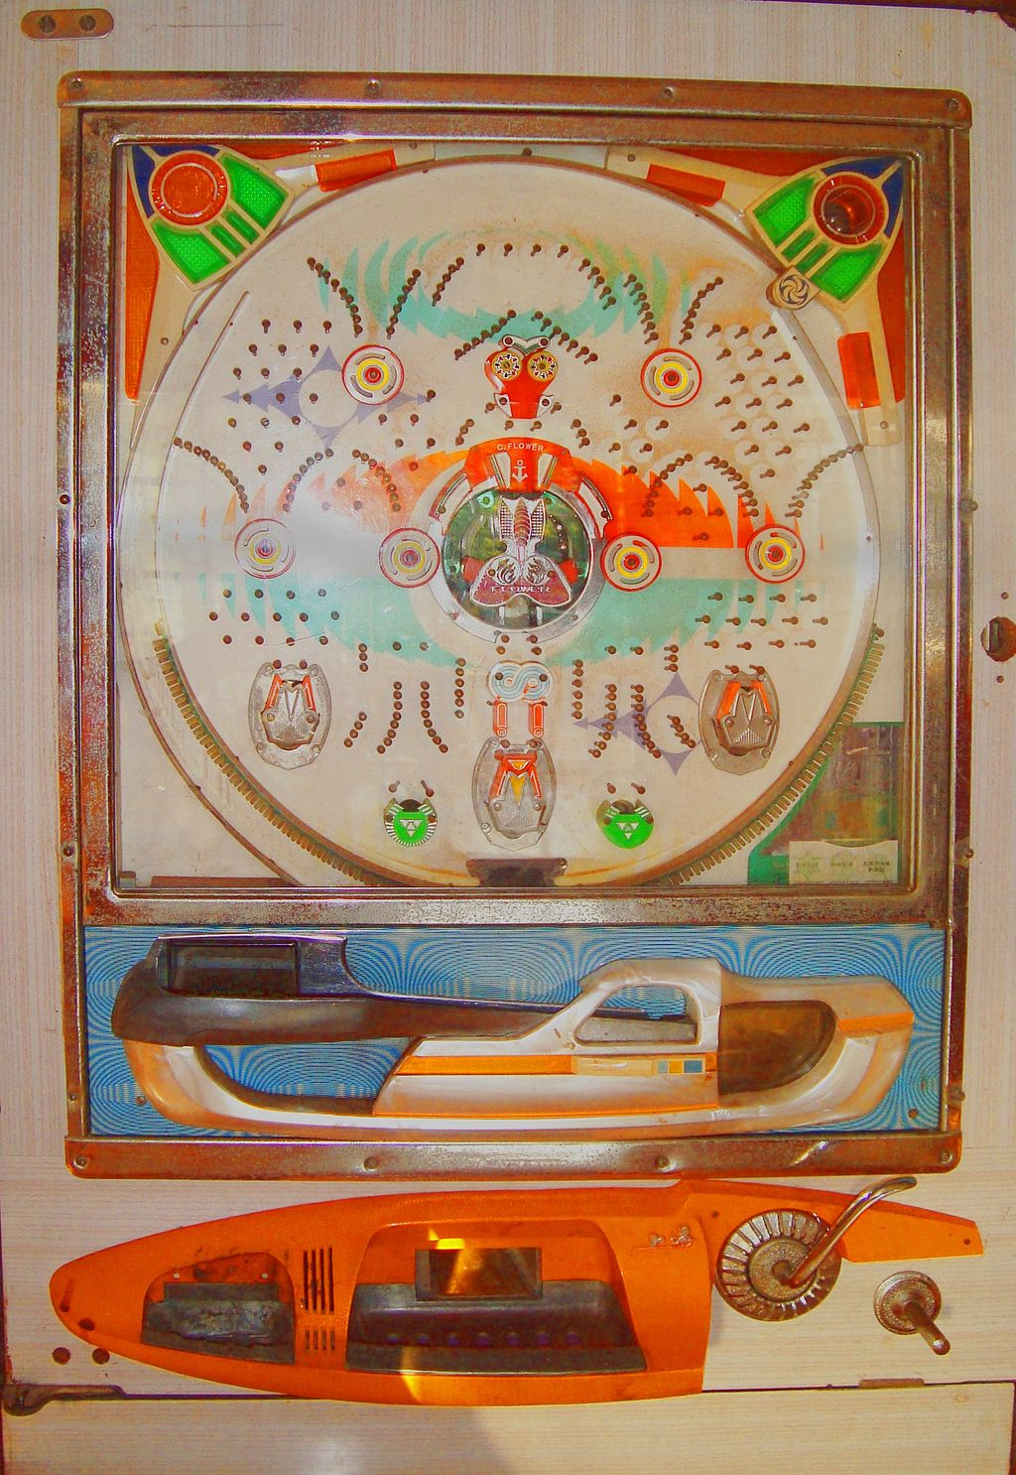
struct TreeMap {
struct TreeMapEntry *__root;
int __count;
…
}
struct TreeMapEntry {
char *key; /* public */
int value; /* public */
struct TreeMapEntry *__left;
struct TreeMapEntry *__right;
};
root
h=42
d=8
k=9
b=123
f=6
j=12
m=67
∅
∅
∅
∅
∅
∅
∅
g=25
https://en.wikipedia.org/wiki/Pachinko

Slide 27
void __TreeMap_put(struct TreeMap* self, char *key, int value) {
struct TreeMapEntry *cur, *left, *right;
int cmp;
cur = self->__root;
left = NULL;
right = NULL;
while(cur != NULL ) {
cmp = strcmp(key, cur->key);
if(cmp == 0 ) {
cur->value = value;
return;
}
if( cmp < 0 ) {
right = cur;
cur = cur->__left;
} else {
left = cur;
cur = cur->__right;
}
}
...
}
g=25
d=8
b=123
f=6
∅
∅
∅
∅
As long as the tree is correctly maintained you will always find either a match, or a place to correctly insert the new record. The tree is not guaranteed to be balanced - that depends on the insert order.

Slide 28
Object TreeMap@0x6000003dcd20 count=4
h=42
| d=8
| | b=123
| | f=6
Object TreeMap@0x6000003dcd20 count=7
h=42
| d=8
| | b=123
| | f=6
| k=9
| | j=12
| | m=67
int main(void)
{
struct TreeMap * map = TreeMap_new();
map->put(map, "h", 42);
map->put(map, "d", 8);
map->put(map, "b", 123);
map->put(map, "f", 6);
map->dump(map);
map->put(map, "k", 9);
map->put(map, "m", 67);
map->put(map, "j", 12);
map->dump(map);
}
d=8
b=123
f=6
∅
∅
∅
∅

Slide 29
void __TreeMap_dump_tree(struct TreeMapEntry *cur, int depth)
{
if ( cur == NULL ) return;
for(int i=0;i<depth;i++) printf("| ");
printf("%s=%d\n", cur->key, cur->value);
if ( cur->__left != NULL ) {
__TreeMap_dump_tree(cur->__left, depth+1);
}
if ( cur->__right != NULL ) {
__TreeMap_dump_tree(cur->__right, depth+1);
}
}
...
// Recursively print the tree view
__TreeMap_dump_tree(self->__root, 0);
h=42
d=8
k=9
b=123
f=6
j=12
m=67
Object TreeMap@0x6000003dcd20 count=4
h=42
| d=8
| | b=123
| | f=6
Object TreeMap@0x6000003dcd20 count=7
h=42
| d=8
| | b=123
| | f=6
| k=9
| | j=12
| | m=67

Slide 30
int __TreeMap_get(struct TreeMap* self, char *key, int def)
{
int cmp;
struct TreeMapEntry *cur;
if ( key == NULL || self->__root == NULL ) return def;
cur = self->__root;
while(cur != NULL ) {
cmp = strcmp(key, cur->key);
if(cmp == 0 ) return cur->value;
else if(cmp < 0 ) cur = cur->__left;
else cur = cur->__right;
}
return def;
}
h=42
d=8
k=9
b=123
f=6
j=12
m=67

Slide 31
Cannot build an Iterator for a Tree
ListMap can support an ordered iterator
HashMap can support an unordered iterator
A TreeMap cannot support an iterator without building a stack within the iterator
printf("\nIterate\n");
iter = map->iter(map);
while(1) {
cur = iter->next(iter);
if ( cur == NULL ) break;
printf(" %s=%d\n", cur->key, cur->value);
}
iter->del(iter);

Slide 32
Tree
root
h=42
d=8
k=9
b=123
f=6
j=12
m=67

Slide 33
Add a LinkedList
root
h=42
d=8
k=9
b=123
f=6
j=12
m=67
head
b=123
d=8
f=6
h=42
j=12
k=9
m=67
∅

Slide 34
LinkedTreeMap
root
h=42
d=8
k=9
head
b=123
f=6
j=12
m=67
∅

Slide 35
struct TreeMap {
struct TreeMapEntry *__head;
struct TreeMapEntry *__root;
…
}
struct TreeMapEntry {
char *key;
int value;
struct TreeMapEntry *__next;
struct TreeMapEntry *__left;
struct TreeMapEntry *__right;
};
root
h=42
d=8
k=9
head
b=123
f=6
j=12
m=67
∅

