Slide 1

K&R Chapter 2
Dr. Charles R. Severance
www.cc4e.com

Slide 2
Chapter 2 – Unique Areas
Section 2.2 – Data types and storage allocation – character, integer, short, long get all the attention. Interestingly float and double are pretty consistent with modern languages
Section 2.7 – Type conversion – integer division and Python 2.0 and 3.0 pain and history
Section 2.9 – Bitwise Logical Operations – Rarely used – In Chapter 6 struct data types are better at extracting but ranges

Slide 3
C and UNIX, Byte-Addressable Computers
In the 1970’s computers were getting smaller, cheaper, and moving away from (8 bit) characters being packed into (32 bit) integer words with masking and shifting and towards direct byte addressing in assembly language
A major reason to move UNIX from the “B” language to the “C” language was to have a language that made efficient use of byte addressing

Slide 4
CDC-6500 Character Support
The CDC-6500 had 60 bit words and 6-bit upper case characters
https://en.wikipedia.org/wiki/CDC_display_code
H
E
L
L
O
W
O
R
L
H
E
L
L
O
W
O
R
L
D
-
-
-
-
-
-
-
-
-
H
E
L
L
W
O
R
L
Bit Mask
O
After Mask
O
Bit Shift

Slide 5
A Quick Tutorial on Number Bases

Slide 6
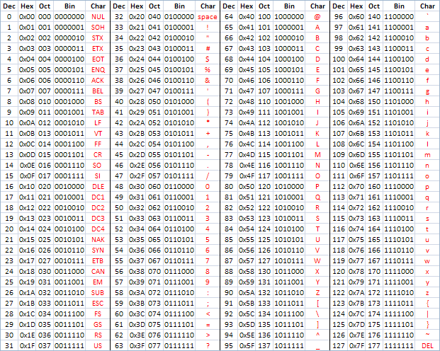
ASCII
American Standard Code for Information Interchange
https://en.wikipedia.org/wiki/ASCII
http://www.catonmat.net/download/ascii-cheat-sheet.png

Slide 7
Characters, words, and bits in C – Oh My!
#include <stdio.h>
#include <string.h>
int main() {
char s[] = "Hello world";
int *si = (int *) &s;
int mask, masked, ch;
printf(" l l e H o W - o 00 d l r\n");
printf("%08x %08x %08x\n", si[0], si[1], si[2]);
mask = 0xff << 8;
masked = si[0] & mask;
ch = masked >> 8;
printf("%08x\n", mask);
printf("%08x\n", masked);
printf("%08x %c\n", ch, ch);
}
$ a.out
l l e H o W - o 00 d l r
6c6c6548 6f77206f 00646c72
0000ff00
00006500
00000065 e
Please don’t try this at home ☺
https://en.wikipedia.org/wiki/Endianness
kr_02_01.c

Slide 8
Summary

Slide 9
Acknowledgements / Contributions
These slides are Copyright 2022- Charles R. Severance (online.dr-chuck.com) as part of www.cc4e.com and made available under a Creative Commons Attribution 4.0 License. Please maintain this last slide in all copies of the document to comply with the attribution requirements of the license. If you make a change, feel free to add your name and organization to the list of contributors on this page as you republish the materials.
Initial Development: Charles Severance, University of Michigan School of Information
Insert new Contributors and Translators here including names and dates
Continue new Contributors and Translators here

