Slide 1
Tree Maps and Hash Maps
Dr. Charles R. Severance
www.cc4e.com
code.cc4e.com (sample code)
online.dr-chuck.com

Slide 2
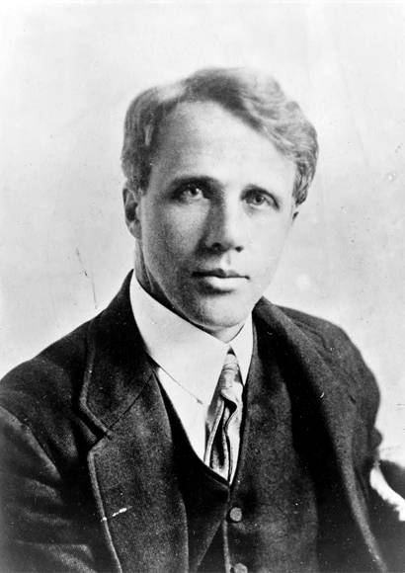
“Stopping by Woods on a Snowy Evening”
Whose woods these are I think I know.
His house is in the village though;
He will not see me stopping here
To watch his woods fill up with snow.
My little horse must think it queer
To stop without a farmhouse near
Between the woods and frozen lake
The darkest evening of the year.
He gives his harness bells a shake
To ask if there is some mistake.
The only other sound’s the sweep
Of easy wind and downy flake.
The woods are lovely, dark and deep,
But I have promises to keep,
And miles to go before I sleep,
And miles to go before I sleep.
https://en.wikipedia.org/wiki/Stopping_by_Woods_on_a_Snowy_Evening

Slide 3
Key /Value Implementation Alternatives
We will build an unordered java.util.HashMap / Python 2 dict()
Chapter 6.6
We will build a sorted java.util.TreeMap – plus an iterator
Chapter 6.5 (Simultaneous Linked List + Tree)
It would be named java.util.LinkedTreeMap if Java had such a thing ☺
Python
Python 2 dict - unordered
Python 3.1 - OrderedDict
C++ (capabilities of any map)
Associative
Ordered
Unique Keys
Map (key / simple value)
Java
java.util.HashMap
java.util.TreeMap (*)
java.util.LinkedHashMap
* No iterator

Slide 4
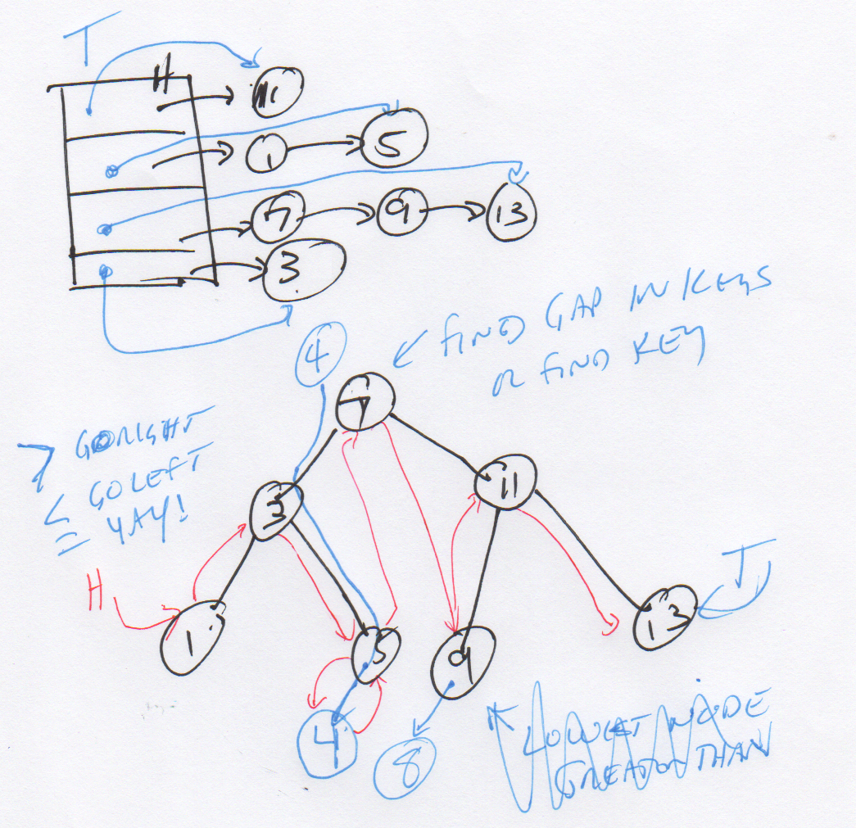
Start with a good picture…

Slide 5
TBD: Hash Map

Slide 6
TBD: Tree

