Slide 1

C Programming A Historical Perspective
Dr. Charles R. Severance
www.cc4e.com

Slide 2
Learning Path: online.dr-chuck.com
History – ihts.dr-chuck.com
Python – www.py4e.com
Django (Python, HTML, CSS, SQL, JavaScript) – www.dj4e.com
Web Applications (PHP, HTML, CSS, SQL, JavaScript) – www.wa4e.com
PostgreSQL (SQL) – www.pg4e.com
C Programming – www.cc4e.com ← We are here ☺
Computer Architecture
Java Enterprise Application Development

Slide 3
A Brief History of Computers
1940's – Top Secret / Military / WWII (ihts.dr-chuck.com)
Early 1950's – Custom built
Late 1950's – Companies like IBM, DEC, etc. begin selling computers
1960's – More companies, less expensive, wider range of options
Late 1960's – Many kinds of computers old/new/fast/slow
1970's – Searching for "the one" solution for software
1980's – Microprocessors and Personal Computers – performance++
1990's – The network is the computer – performance++
2000's – Amazon AWS founded in 2002 – computing as commodity

Slide 4

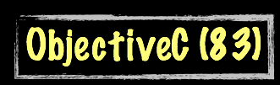



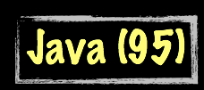




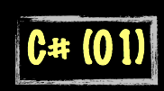

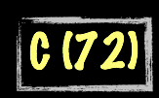
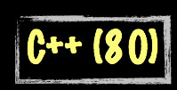

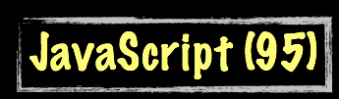







Evolution of Computer Languages
Science Calculations
System
System
bash (79)
C uses curly braces { } for code blocks.
Scripting/
Interpreted
http://en.wikipedia.org/wiki/History_of_programming_languages

Slide 5
A Brief History of Dr. Chuck
1970's – CDC 6500 / SCOPE/Hustler / FORTRAN / Pascal / Assembly
1980's
HP21MX – Assembly
Burroughs B4900 / COBOL
Fortune 32:13 / UNIX / C
IBM PC / DOS / DBase / Turbo Pascal
IBM 360 / Assembly
DEC VAX / VMS / Fortran
AT&T 3B2 / UNIX / C / FORTRAN
1990's – UNIX / Sun / Ardent / Stellar / IBM RS-6000 / Convex C2400 / NeXT – C - Also TCP/IP, HTTP – Windows / MacOS
2000's – Linux / MacOS – Java / PHP / JavaScript
2010's – Linux / MacOS – Python / Java / PHP / JavaScript

Slide 6
History of UNIX
1960s – Multics
1970 – UNIX on a DEC PDP 11/20
1973 – UNIX Rewritten in C – Ran only on the PDP 11
1978 – UNIX ran on the Interdata 8/32 - C Evolved as well to support portability so UNIX could be ported
1978 – Unix version 7 ran on DEC VAX systems
1978 – 1BSD Unix Released
1982 - Sun Microsystems Founded – UNIX Workstation
Late 1980’s Intellectual Property became complex

Slide 7
The post-UNIX world
Late 1980’s UNIX was very popular – AT&T saw an opportunity to commercialize their work. Many variations of UNIX had bits and pieces taken from AT&T UNIX – it got complex quickly
1987 – Minux was developed as a fresh ground-up implementation by Andrew S. Tannenbaum to teach operating system concepts – it was free but modification and redistribution were restricted.
1991 – Linus Torvalds wanted to build a fresh ground up implementation of the “UNIX” kernel that was 100% free – some of the utility code came from the GPL-Licensed GNU project
1992 – Linux adopted the GPL license

Slide 8
History of C
1969 – B Language – Word oriented (i.e. not byte oriented)
1972 – C Multiple types including (byte / character)
1972 – 1978 – C and UNIX co-evolved with a goal of increasingly less assembly language in UNIX
1978 – K&R C
1989 – C89 / ANSI – void type, C++ declarations, character sets, locales
1990 - C90 / ISO C
1999 – C99 – complex type, // comments, Unicode
2011 – C11 – Library improvements
2018 – C17 - Cleanup of C11

Slide 9
Modern C / Future of C / post-C
Challenges to use C as general purpose languages
No dynamic memory support in the core types / libraries
No “safe” string type
C++ is best thought of as a more powerful and flexible C for professional programmers and systems applications
Java / JavaScript / C# / Python – Types are usually objects – not ”close to the metal” – Not as well suited for an operating system Kernel
The likely follow on to C in systems applications is Rust
Stays close to the metal while providing simple and safe core data types
Becoming the second official language in “Linux”

Slide 10
Summary
Input/Output
Looping
Reading a file
Strings
Float
Dynamic memory
Way too complex to implement in C (for now)
Python str()
Python list()
Python dict()
We will revisit these as the end of the course

Slide 11
Acknowledgements / Contributions
These slides are Copyright 2020- Charles R. Severance (online.dr-chuck.com) as part of www.cc4e.com and made available under a Creative Commons Attribution 4.0 License. Please maintain this last slide in all copies of the document to comply with the attribution requirements of the license. If you make a change, feel free to add your name and organization to the list of contributors on this page as you republish the materials.
Initial Development: Charles Severance, University of Michigan School of Information
Insert new Contributors and Translators here including names and dates
Continue new Contributors and Translators here

