Slide 1

K&R Chapter 2 Types, Operators, and Expressions
Dr. Charles R. Severance
www.cc4e.com

Slide 2
Chapter 2 – Unique Areas
Section 2.2 – Data types and storage allocation – character, integer, short, long get all the attention. Interestingly float and double are pretty consistent with modern languages
Section 2.7 – Type conversion – integer division and Python 2.0 and 3.0 pain and history
Section 2.9 – Bitwise Logical Operations – Rarely used – In Chapter 6 struct data types are better at extracting bit ranges

Slide 3
Ah, Division…
Can it be that it was all so simple then?
Or has time rewritten every line?
If we had the chance to do it all again, tell me, would we, could we?
From the film "The Way We Were" (1973)

Slide 4
Python 2 to Python 3
Python 2 was very popular – but under attack from modern languages
Strings were ASCII (Not Unicode)
I/O (print) was part of the language – limited evolution
Converting took from 2008 – 2020
Programmers got a lot of help
An automated code convertor
Back-porting of future library code to support 2.x and 3.x at the same time
Division of two integers
Python 2 – Returns an integer and the division is truncated (3/4 == 0)
Python 3 – Any division converts operands to float and produces a float (3/4 == 0.75)
Python 2 division truncated because C integer division truncated (3/4 == 0)

Slide 5
Integer Division in C
Less of a problem because C is a (pretty) strongly typed language
Python
x = 3 / 4
The type of x is part of x and when x is used many lines later, perhaps in a library routine, it all gets figured out (often badly)
C must declare “x” as float, double, int, etc. So when a C programmer writes a division, they know they need to cast values or use float constants to trigger type conversion in expressions
float x;
x = ((float) 3 / 4);
x = x * 2.5;

Slide 6
A Quick Tutorial on Number Bases

Slide 7
Place Value – Base 10
1
2
3
4
Tens place
One’s place
40
42
1
2
2
4x10¹ + 2x10⁰ = 40 + 2 = 42

Slide 8
Place Value – Base 8
1
2
3
4
5
Eights place
One’s place
40
52
1
2
2
5x8¹ + 2x8⁰ = 40 + 2 = 42

Slide 9
Base 16
1
2
32
0
1
2
3
4
5
6
7
8
9
A
B
C
D
E
F
Sixteens place
One’s place
1
2
3
4
5
6
7
8
9
A
2A
A (10)
2x16¹ + 6x10⁰ = 32 + 10 = 42

Slide 10
num = int(input('Enter a base-10 number: '))
out = ''
val = num
while (val > 0 ) :
digit = val % 8
print(val,'% 8 = ',digit)
out = str(digit) + out;
new = int(val / 8)
print(val,'/ 8 = ',new)
val = new
print(num, 'in base-8 is', out)
digits = '0123456789abcdef'
out = ''
val = num
while (val > 0 ) :
digit = val % 16
print(val,'% 16 = ',digit)
out = digits[digit:digit+1] + out;
new = int(val / 16)
print(val,'/ 16 = ',new)
val = new
print(num, 'in base-16 is', out)
$ python3 kr_02_01.py
Enter a base-10 number: 1234
1234 % 8 = 2
1234 / 8 = 154
154 % 8 = 2
154 / 8 = 19
19 % 8 = 3
19 / 8 = 2
2 % 8 = 2
2 / 8 = 0
1234 in base-8 is 2322
1234 % 16 = 2
1234 / 16 = 77
77 % 16 = 13
77 / 16 = 4
4 % 16 = 4
4 / 16 = 0
1234 in base-16 is 4d2
kr_02_01.py

Slide 11
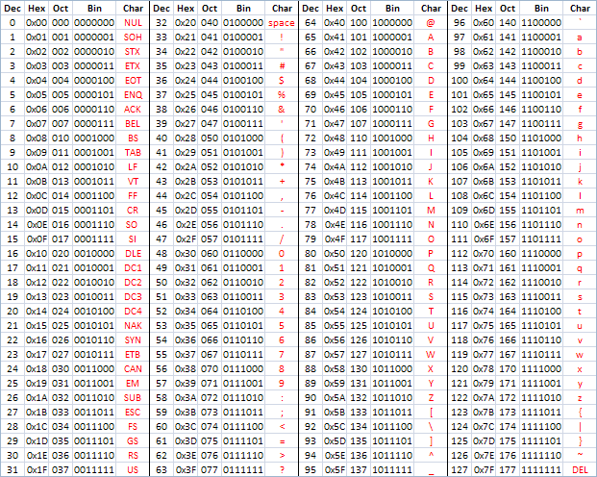
ASCII
American Standard Code for Information Interchange
Upper case H in ASCII is
72 in base 10
0x48 in base-16
00100100 in base-2
https://en.wikipedia.org/wiki/ASCII
http://www.catonmat.net/download/ascii-cheat-sheet.png

Slide 12
C and UNIX, Byte-Addressable Computers
In the 1970’s computers were getting smaller, cheaper, and moving away from (8 bit) characters being packed into (32 bit) integer words with masking and shifting and towards direct byte addressing in assembly language
A major reason to move UNIX from the “B” language to the “C” language was to have a language that made efficient use of byte addressing

Slide 13
CDC-6500 Character Support
The CDC-6500 had 60 bit words and 6-bit upper case characters
https://en.wikipedia.org/wiki/CDC_display_code
H
E
L
L
O
W
O
R
L
H
E
L
L
O
W
O
R
L
D
-
-
-
-
-
-
-
-
-
H
E
L
L
W
O
R
L
Bit Mask
-
-
-
-
O
-
-
-
-
-
After Mask
-
-
-
-
-
-
-
-
-
O
Bit Shift

Slide 14
Thanks Ken, Brian, and Dennis!
Thanks to the pioneering work in the early 1970’s, modern programmers can go through their entire career without masking and shifting
Endianness was just beginning as a problem in the late 1970’s – but Intel microprocessors were little-endian and the rest is history ☹
Dealing with data of different endianness is sometimes termed the NUXI problem. This terminology alludes to the byte order conflicts encountered while adapting UNIX, which ran on the mixed-endian PDP-11, to a big-endian IBM Series/1 computer. Unix was one of the first systems to allow the same code to be compiled for platforms with different internal representations. One of the first programs converted was supposed to print out Unix, but on the Series/1 it printed nUxi instead.
-- https://en.wikipedia.org/wiki/Endianness

Slide 15
Characters, words, and bits in C – Oh My!
#include <stdio.h>
#include <string.h>
int main() {
char s[] = "Hello world";
int *si = (int *) &s;
int mask, masked, ch;
printf(" l l e H o W - o 00 d l r\n");
printf("%08x %08x %08x\n", si[0], si[1], si[2]);
mask = 0xff << 8;
masked = si[0] & mask;
ch = masked >> 8;
printf("%08x\n", mask);
printf("%08x\n", masked);
printf("%08x %c\n", ch, ch);
}
$ a.out
l l e H o W - o 00 d l r
6c6c6548 6f77206f 00646c72
0000ff00
00006500
00000065 e
Please don’t try this at home ☺
https://en.wikipedia.org/wiki/Endianness
kr_02_01.c

Slide 16
Summary
Number Base Conversion (10, 16, 2)
Division and a Python 2 story
Integers
Words / Bytes
Characters

Slide 17
Acknowledgements / Contributions
These slides are Copyright 2022- Charles R. Severance (online.dr-chuck.com) as part of www.cc4e.com and made available under a Creative Commons Attribution 4.0 License. Please maintain this last slide in all copies of the document to comply with the attribution requirements of the license. If you make a change, feel free to add your name and organization to the list of contributors on this page as you republish the materials.
Initial Development: Charles Severance, University of Michigan School of Information
Insert new Contributors and Translators here including names and dates
Continue new Contributors and Translators here

