Slide 1
Tree Maps and Hash Maps
Dr. Charles R. Severance
www.cc4e.com
code.cc4e.com (sample code)
online.dr-chuck.com

Slide 2

“Stopping by Woods on a Snowy Evening”
Whose woods these are I think I know.
His house is in the village though;
He will not see me stopping here
To watch his woods fill up with snow.
My little horse must think it queer
To stop without a farmhouse near
Between the woods and frozen lake
The darkest evening of the year.
He gives his harness bells a shake
To ask if there is some mistake.
The only other sound’s the sweep
Of easy wind and downy flake.
The woods are lovely, dark and deep,
But I have promises to keep,
And miles to go before I sleep,
And miles to go before I sleep.
https://en.wikipedia.org/wiki/Stopping_by_Woods_on_a_Snowy_Evening

Slide 3
name = input('Enter file:')
handle = open(name)
counts = dict()
for line in handle:
words = line.split()
for word in words:
counts[word] = counts.get(word,0) + 1
bigcount = None
bigword = None
for word,count in counts.items():
if bigcount is None or count > bigcount:
bigword = word
bigcount = count
print(bigword, bigcount)
python words.py
Enter file: words.txt
to 16
python words.py
Enter file: clown.txt
the 7

Slide 4
Key/Value Implementation Alternatives
We will build an unordered java.util.HashMap / Python 2 dict()
Chapter 6.6
We will build a sorted java.util.TreeMap – plus an iterator
Chapter 6.5 (Simultaneous Linked List + Tree)
It would be named java.util.LinkedTreeMap if Java had such a thing ☺
Python
Python 2 dict - unordered
Python 3.1 - OrderedDict
C++ (capabilities of any map)
Associative
Ordered
Unique Keys
Map (key / simple value)
Java
java.util.HashMap
java.util.TreeMap (*)
java.util.LinkedHashMap
* No iterator

Slide 5
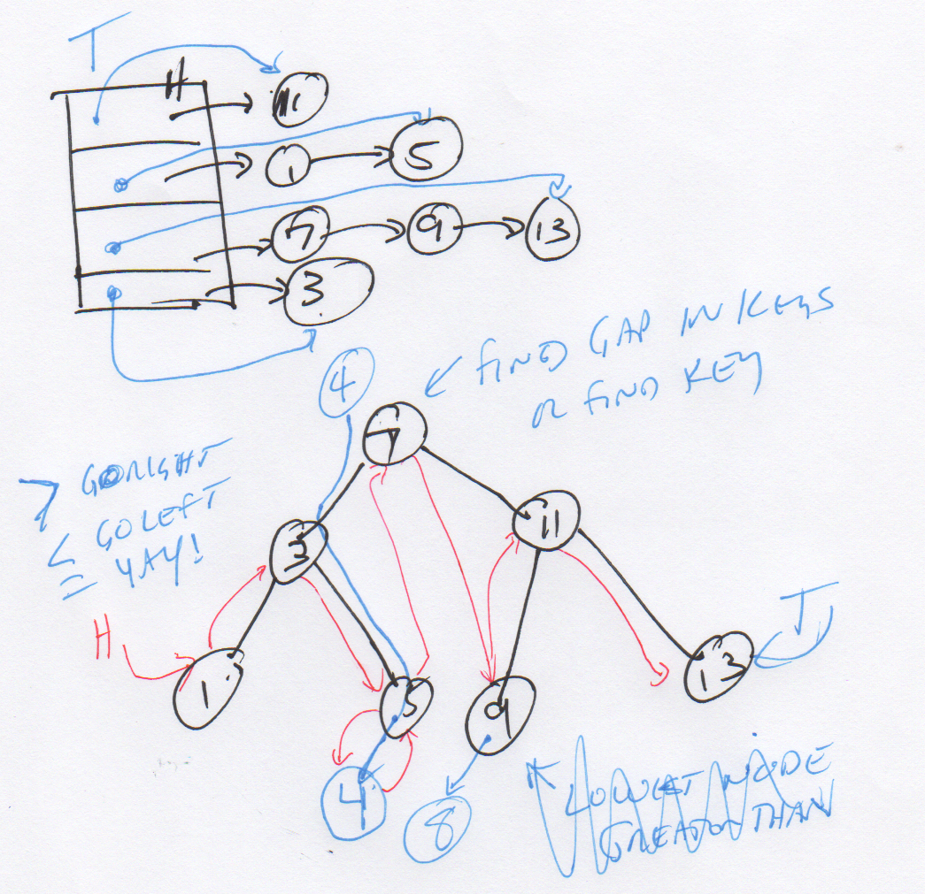
Start with a good picture…

Slide 6
Hash Map
The answer to the most common programming interview question!

Slide 7
HashMap
Weird order (like Python 2 dict and Java HashMap)
Fast insert and lookup (like Python 2 dict and Java HashMap)
Iterable (like Python 2 dict and Java HashMap)
Builds on Linked Lists
Surprisingly easy is you really get Linked Lists
Chapter 6.5.1 and 6.6 in K&R (6.5.2 is harder than 6.6)
Most popular programming interview question ever!

Slide 8
Changing From ListMap to HashMap
struct MapEntry {
char *key; /* public */
int value; /* public */
struct MapEntry *__prev;
struct MapEntry *__next;
};
struct ListMap {
struct MapEntry *__head;
struct MapEntry *__tail;
...
};
struct HashMapEntry {
char *key; /* public */
int value; /* public */
struct HashMapEntry *__prev;
struct HashMapEntry *__next;
};
struct HashMap {
int __buckets;
struct HashMapEntry *__heads[8];
struct HashMapEntry *__tails[8];
...
};

Slide 9
Changing From ListMap to HashMap
head
b=14
d=21
f=19
h=17
j=18
m=90
∅
buckets: 4
f=19
h=17
∅
heads[0]
Hash % 4
heads[1]
d=21
∅
key
heads[2]
b=14
j=18
m=90
∅
heads[3]
∅

Slide 10
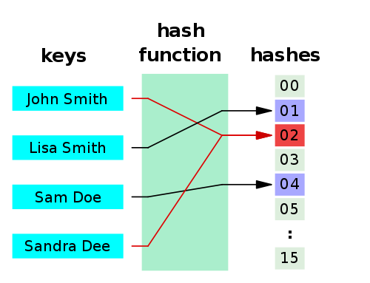
Hashes
A hash function is any algorithm or subroutine that maps large data sets to smaller data sets, called keys. For example, a single integer can serve as an index to an array (cf. associative array). The values returned by a hash function are called hash values, hash codes, hash sums, checksums, or simply hashes.
Hash functions are mostly used to accelerate table lookup or data comparison tasks such as finding items in a database...
http://en.wikipedia.org/wiki/Hash_function

Slide 11
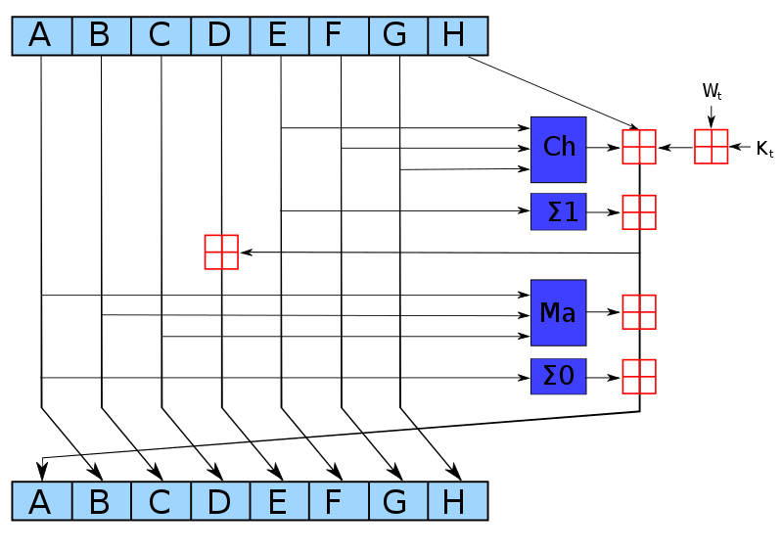
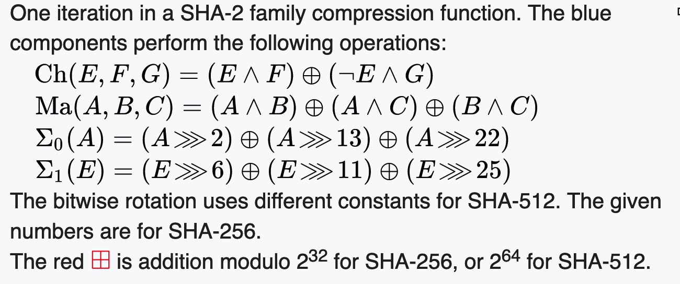
SHA-256 Compression Function
https://en.wikipedia.org/wiki/SHA-2

Slide 12
int getBucket(char *str, int buckets)
{
unsigned int hash = 123456;
printf("\nHashing %s\n", str);
if ( str == NULL ) return 0;
for( ; *str ; str++) {
hash = ( hash << 3 ) ^ *str;
printf("%c 0x%08x %d\n", *str,
hash, hash % buckets);
}
return hash % buckets;
}
int main() {
int h;
h = getBucket("Hi", 8);
h = getBucket("Hello", 8);
h = getBucket("World", 8);
}
Hashing Hi
H 0x000f1248 0
i 0x00789229 1
Hashing Hello
H 0x000f1248 0
e 0x00789225 5
l 0x03c49144 4
l 0x1e248a4c 4
o 0xf124520f 7
Hashing World
W 0x000f1257 7
o 0x007892d7 7
r 0x03c496ca 2
l 0x1e24b63c 4
d 0xf125b184 4
cc_05_01.c

Slide 13
Lets Build our HashMap
First, make a copy of our List Map and change a (very) few things

Slide 14
struct HashMap * HashMap_new() {
struct HashMap *p = malloc(sizeof(*p));
p->__buckets = 8;
for(int i=0; i < p->__buckets; i++ ) {
p->__heads[i] = NULL;
p->__tails[i] = NULL;
}
p->__count = 0;
p->put = &__HashMap_put;
p->get = &__HashMap_get;
p->size = &__HashMap_size;
p->dump = &__HashMap_dump;
p->iter = &__HashMap_iter;
p->del = &__HashMap_del;
return p;
}
struct HashMap {
int __buckets;
struct HashMapEntry *__heads[8];
struct HashMapEntry *__tails[8];
int __count;
...
};

Slide 15
struct HashMapEntry* __HashMap_find(struct HashMap* self, char *key, int bucket)
{
struct HashMapEntry *cur;
if ( self == NULL || key == NULL ) return NULL;
for(cur = self->__heads[bucket]; cur != NULL ; cur = cur->__next ) {
if(strcmp(key, cur->key) == 0 ) return cur;
}
return NULL;
}
int __HashMap_get(struct HashMap* self, char *key, int def)
{
int bucket = getBucket(key, self->__buckets);
struct HashMapEntry *retval = __HashMap_find(self, key, bucket);
if ( retval == NULL ) return def;
return retval->value;
}

Slide 16
void __Map_put(struct Map* self, char *key, int value) {
struct MapEntry *old, *new;
char *new_key;
old = __Map_find(self, key);
if ( old != NULL ) {
old->value = value;
return;
}
/* Not found - time to insert */
new = malloc(sizeof(*new));
new->__next = NULL;
if ( self->__head == NULL ) self->__head = new;
if ( self->__tail != NULL ) self->__tail->__next = new;
new->__prev = self->__tail;
self->__tail = new;
...
}
Notes:
`

Slide 17
void __HashMap_put(struct HashMap* self, char *key, int value) {
int bucket;
struct HashMapEntry *old, *new;
char *new_key, *new_value;
bucket = getBucket(key, self->__buckets);
old = __HashMap_find(self, key, bucket);
if ( old != NULL ) {
old->value = value;
return;
}
/* Not found - time to insert */
new = malloc(sizeof(*new));
new->__next = NULL;
if ( self->__heads[bucket] == NULL ) self->__heads[bucket] = new;
if ( self->__tails[bucket] != NULL ) self->__tails[bucket]->__next = new;
new->__prev = self->__tails[bucket];
self->__tails[bucket] = new;
...
}

Slide 18
void __HashMap_dump(struct HashMap* self)
{
int i;
struct HashMapEntry *cur;
printf("Object HashHashMap@%p count=%d buckets=%d\n",
self, self->__count, self->__buckets);
for(i = 0; i < self->__buckets; i++ ) {
for(cur = self->__heads[i]; cur != NULL ; cur = cur->__next ) {
printf(" %s=%d [%d]\n", cur->key, cur->value, i);
}
}
}
Object HashHashMap@0x6000035ac000 count=4 buckets=8
y=2 [1]
a=4 [1]
z=1 [2]
b=3 [2]

Slide 19
Struct MapIter (review)
The MapIter is a "related class" to it can access "protected" values in MapEntry without violating the abstraction.
/*
* A MapIter contains the current item and whether
* this is a forward or reverse iterator.
*/
struct MapIter {
struct MapEntry *__current;
struct MapEntry* (*next)(struct MapIter* self);
void (*del)(struct MapIter* self);
};
current
head
b=14
d=21
f=19
∅

Slide 20
Using an iterator
printf("\nIterate\n");
iter = map->iter(map);
while(1) {
cur = iter->next(iter);
if ( cur == NULL ) break;
printf(" %s=%d\n", cur->key, cur->value);
}
iter->del(iter);
You create the iterator
Then in a loop, you call next() to get each successive entry in the map, until you exhaust the entries
We could make key and value private in MapEntry – but we just keep them public to reduce code size on slides
cc_04_03.c
x = {'a': 1, 'b': 2, 'c': 3}
it = iter(x)
while True :
item = next(it, False)
if item is False : break
print('item is', item)
cc_04_05.py

Slide 21
Hash Map Iterator Requirements
Must move through all buckets
Must skip empty buckets
struct HashMapIter {
int __bucket;
struct HashMap *__map;
struct HashMapEntry *__current;
struct HashMapEntry* (*next)(struct HashMapIter* self);
void (*del)(struct HashMapIter* self);
};

Slide 22
/**
* map->iter - Create an iterator from the head of the HashMap
*
* self - The pointer to the instance of this class.
*
* returns NULL when there are no entries in the HashMap
*
* This is inspired by the following Python code
* that creates an iterator from a dictionary:
*
* x = {'a': 1, 'b': 2, 'c': 3}
* it = iter(x)
*/
struct HashMapIter* __HashMap_iter(struct HashMap* map)
{
struct HashMapIter *iter = malloc(sizeof(*iter));
iter->__map = map;
iter->__bucket = 0;
iter->__current = map->__heads[iter->__bucket];
iter->next = &__HashMapIter_next;
iter->del = &__HashMapIter_del;
return iter;
}

Slide 23
/**
* HashMapIter_next - Advance the iterator forwards
* This is inspired by the following Python code:
*
* item = next(iterator, None)
*/
struct HashMapEntry* __HashMapIter_next(struct HashMapIter* self)
{
struct HashMapEntry* retval;
/* If we are at the end of a chain and there are still more buckets
* scan for a bucket that is not NULL */
while ( self->__current == NULL) {
self->__bucket++;
if ( self->__bucket >= self->__map->__buckets ) return NULL;
self->__current = self->__map->__heads[self->__bucket];
}
retval = self->__current;
if ( self->__current != NULL ) self->__current = self->__current->__next;
return retval;
}

Slide 24
A HashMap Iterator In Action
retval
current
Just constructed,
in the first
call to next()
bucket: 0
f=19
h=17
∅
heads[0]
heads[1]
∅
heads[2]
b=14
∅
heads[3]
while ( self->__current == NULL) {
self->__bucket++;
if ( self->__bucket >= self->__map->__buckets ) return NULL;
self->__current = self->__map->__heads[self->__bucket];
}
retval = self->__current;
if ( self->__current != NULL ) self->__current = self->__current->__next;
return retval;
d=21
∅

Slide 25
A HashMap Iterator In Action
retval
current
Returned values:
f=19
bucket: 0
f=19
h=17
∅
heads[0]
heads[1]
∅
heads[2]
b=14
∅
heads[3]
while ( self->__current == NULL) {
self->__bucket++;
if ( self->__bucket >= self->__map->__buckets ) return NULL;
self->__current = self->__map->__heads[self->__bucket];
}
retval = self->__current;
if ( self->__current != NULL ) self->__current = self->__current->__next;
return retval;
d=21
∅

Slide 26
A HashMap Iterator In Action
retval
current
Second call
Returned values:
f=19
h=17
buckets: 0
f=19
h=17
∅
heads[0]
heads[1]
∅
heads[2]
b=14
∅
heads[3]
while ( self->__current == NULL) {
self->__bucket++;
if ( self->__bucket >= self->__map->__buckets ) return NULL;
self->__current = self->__map->__heads[self->__bucket];
}
retval = self->__current;
if ( self->__current != NULL ) self->__current = self->__current->__next;
return retval;
d=21
∅

Slide 27
A HashMap Iterator In Action
retval
current
Third call
f=19
h=17
???
buckets: 0
f=19
h=17
∅
heads[0]
heads[1]
∅
heads[2]
b=14
∅
heads[3]
while ( self->__current == NULL) {
self->__bucket++;
if ( self->__bucket >= self->__map->__buckets ) return NULL;
self->__current = self->__map->__heads[self->__bucket];
}
retval = self->__current;
if ( self->__current != NULL ) self->__current = self->__current->__next;
return retval;
d=21
∅

Slide 28
A HashMap Iterator In Action
retval
current
Third call, in
while loop
f=19
h=17
???
bucket: 1
f=19
h=17
∅
heads[0]
heads[1]
∅
heads[2]
b=14
∅
heads[3]
while ( self->__current == NULL) {
self->__bucket++;
if ( self->__bucket >= self->__map->__buckets ) return NULL;
self->__current = self->__map->__heads[self->__bucket];
}
retval = self->__current;
if ( self->__current != NULL ) self->__current = self->__current->__next;
return retval;
d=21
∅

Slide 29
A HashMap Iterator In Action
retval
current
Third call, out
of the while loop
f=19
h=17
???
bucket: 2
f=19
h=17
∅
heads[0]
heads[1]
∅
heads[2]
b=14
∅
heads[3]
while ( self->__current == NULL) {
self->__bucket++;
if ( self->__bucket >= self->__map->__buckets ) return NULL;
self->__current = self->__map->__heads[self->__bucket];
}
retval = self->__current;
if ( self->__current != NULL ) self->__current = self->__current->__next;
return retval;
d=21
∅

Slide 30
A HashMap Iterator In Action
retval
current
Third call,
Returned value:
f=19
h=17
b=14
bucket: 2
f=19
h=17
∅
heads[0]
heads[1]
∅
heads[2]
b=14
∅
heads[3]
while ( self->__current == NULL) {
self->__bucket++;
if ( self->__bucket >= self->__map->__buckets ) return NULL;
self->__current = self->__map->__heads[self->__bucket];
}
retval = self->__current;
if ( self->__current != NULL ) self->__current = self->__current->__next;
return retval;
d=21
∅

Slide 31
A HashMap Iterator In Action
retval
current
Fourth call,
Returned values:
f=19
h=17
b=14
d=21
bucket: 3
f=19
h=17
∅
heads[0]
heads[1]
∅
heads[2]
b=14
∅
heads[3]
while ( self->__current == NULL) {
self->__bucket++;
if ( self->__bucket >= self->__map->__buckets ) return NULL;
self->__current = self->__map->__heads[self->__bucket];
}
retval = self->__current;
if ( self->__current != NULL ) self->__current = self->__current->__next;
return retval;
d=21
∅

Slide 32
A HashMap Iterator In Action
retval
current
Fifth call,
Current is null
f=19
h=17
b=14
d=21
???
bucket: 3
f=19
h=17
∅
heads[0]
heads[1]
∅
heads[2]
b=14
∅
heads[3]
while ( self->__current == NULL) {
self->__bucket++;
if ( self->__bucket >= self->__map->__buckets ) return NULL;
self->__current = self->__map->__heads[self->__bucket];
}
retval = self->__current;
if ( self->__current != NULL ) self->__current = self->__current->__next;
return retval;
d=21
∅

Slide 33
A HashMap Iterator In Action
retval
current
Fifth call returns NULL
f=19
h=17
b=14
d=21
NULL
bucket: 4
f=19
h=17
∅
heads[0]
heads[1]
∅
heads[2]
b=14
∅
heads[3]
while ( self->__current == NULL) {
self->__bucket++;
if ( self->__bucket >= self->__map->__buckets ) return NULL;
self->__current = self->__map->__heads[self->__bucket];
}
retval = self->__current;
if ( self->__current != NULL ) self->__current = self->__current->__next;
return retval;
d=21
∅

Slide 34
We have more to do in our HashMap
At some point if the linked lists from each bucket get too long performance suffers.
When the map reaches a certain load factor, the bucket size is increased (often doubled) and the entries are rehashed and spread across more buckets reducing the average chain length
buckets: 4
f=19
h=17
∅
heads[0]
Hash % 4
heads[1]
d=21
∅
key
heads[2]
b=14
j=18
m=90
∅
heads[3]
∅

Slide 35
HashMap Iterator
It is surprisingly simple
It is very similar to the list iterator
This simple HashMap iterators presents results in a pseudo-random order
We are at a point where we have built the the two foundational types of Python 2.0
Next we will explore a linked list that maintains sorted order and can be iterated in key order

Slide 36
LinkedTreeMap
A modern, flexible key/value store

Slide 37
A LinkedTreeMap
Stays ordered (like Python OrderedDict)
Stays sorted (like Java TreeMap)
Can be iterated (like C++ map, and OrderedDict, but not TreeMap)
Fast lookup using secondary binary tree index (6.5.2)
Simultaneously a sorted linked list (6.5.1) and binary tree (6.5.2)

Slide 38
struct TreeMap {
struct TreeMapEntry *__root;
int __count;
…
}
struct TreeMapEntry {
char *key; /* public */
int value; /* public */
struct TreeMapEntry *__left;
struct TreeMapEntry *__right;
};
root
h=42
d=8
k=9
b=123
f=6
j=12
m=67
∅
∅
∅
∅
∅
∅
∅
∅

Slide 39
struct TreeMap {
struct TreeMapEntry *__root;
int __count;
…
}
struct TreeMapEntry {
char *key; /* public */
int value; /* public */
struct TreeMapEntry *__left;
struct TreeMapEntry *__right;
};
g=25
root
Insert item with a key of g
h=42
d=8
k=9
b=123
f=6
j=12
m=67
∅
∅
∅
∅
∅
∅
∅
∅

Slide 40
struct TreeMap {
struct TreeMapEntry *__root;
int __count;
…
}
struct TreeMapEntry {
char *key; /* public */
int value; /* public */
struct TreeMapEntry *__left;
struct TreeMapEntry *__right;
};
root
Insert item with a key of g
h=42
g=25
d=8
k=9
b=123
f=6
j=12
m=67
∅
∅
∅
∅
∅
∅
∅
∅

Slide 41
struct TreeMap {
struct TreeMapEntry *__root;
int __count;
…
}
struct TreeMapEntry {
char *key; /* public */
int value; /* public */
struct TreeMapEntry *__left;
struct TreeMapEntry *__right;
};
root
Insert item with a key of g
h=42
d=8
k=9
g=25
b=123
f=6
j=12
m=67
∅
∅
∅
∅
∅
∅
∅
∅

Slide 42
struct TreeMap {
struct TreeMapEntry *__root;
int __count;
…
}
struct TreeMapEntry {
char *key; /* public */
int value; /* public */
struct TreeMapEntry *__left;
struct TreeMapEntry *__right;
};
root
Insert item with a key of g
h=42
d=8
k=9
b=123
f=6
j=12
m=67
∅
∅
∅
∅
∅
∅
∅
g=25

Slide 43
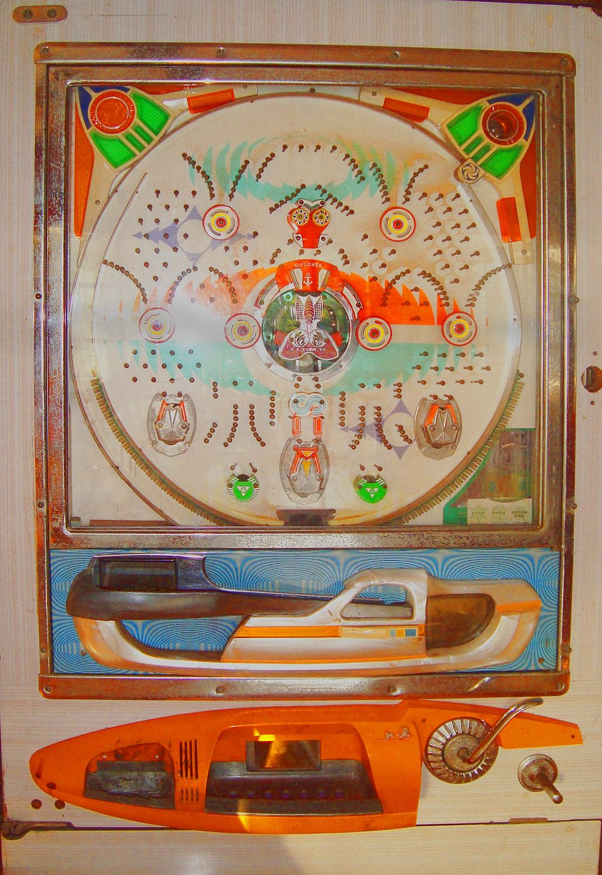
struct TreeMap {
struct TreeMapEntry *__root;
int __count;
…
}
struct TreeMapEntry {
char *key; /* public */
int value; /* public */
struct TreeMapEntry *__left;
struct TreeMapEntry *__right;
};
root
h=42
d=8
k=9
b=123
f=6
j=12
m=67
∅
∅
∅
∅
∅
∅
∅
g=25
https://en.wikipedia.org/wiki/Pachinko

Slide 44
void __TreeMap_put(struct TreeMap* self, char *key, int value) {
struct TreeMapEntry *cur, *left, *right;
int cmp;
cur = self->__root;
while(cur != NULL ) {
cmp = strcmp(key, cur->key);
if(cmp == 0 ) {
cur->value = value;
return;
}
if( cmp < 0 ) {
cur = cur->__left;
} else {
cur = cur->__right;
}
}
...
}
g=25
d=8
b=123
f=6
∅
∅
∅
∅
As long as the tree is correctly maintained you will always find either a match, or a place to correctly insert the new record. The tree is not guaranteed to be balanced - that depends on the insert order.

Slide 45
Object TreeMap@0x6000003dcd20 count=4
h=42
| d=8
| | b=123
| | f=6
Object TreeMap@0x6000003dcd20 count=7
h=42
| d=8
| | b=123
| | f=6
| k=9
| | j=12
| | m=67
int main(void)
{
struct TreeMap * map = TreeMap_new();
map->put(map, "h", 22);
map->put(map, "h", 42); // Replace
map->put(map, "d", 8);
map->put(map, "b", 123);
map->put(map, "f", 6);
map->dump(map);
map->put(map, "k", 9);
map->put(map, "m", 67);
map->put(map, "j", 12);
map->dump(map);
}
d=8
b=123
f=6
∅
∅
∅
∅

Slide 46
void __TreeMap_dump_tree(struct TreeMapEntry *cur, int depth)
{
if ( cur == NULL ) return;
for(int i=0;i<depth;i++) printf("| ");
printf("%s=%d\n", cur->key, cur->value);
if ( cur->__left != NULL ) {
__TreeMap_dump_tree(cur->__left, depth+1);
}
if ( cur->__right != NULL ) {
__TreeMap_dump_tree(cur->__right, depth+1);
}
}
...
// Recursively print the tree view
__TreeMap_dump_tree(self->__root, 0);
h=42
d=8
k=9
b=123
f=6
j=12
m=67
Object TreeMap@0x6000003dcd20 count=4
h=42
| d=8
| | b=123
| | f=6
Object TreeMap@0x6000003dcd20 count=7
h=42
| d=8
| | b=123
| | f=6
| k=9
| | j=12
| | m=67

Slide 47
int __TreeMap_get(struct TreeMap* self, char *key, int def)
{
int cmp;
struct TreeMapEntry *cur;
if ( key == NULL || self->__root == NULL ) return def;
cur = self->__root;
while(cur != NULL ) {
cmp = strcmp(key, cur->key);
if(cmp == 0 ) return cur->value;
else if(cmp < 0 ) cur = cur->__left;
else cur = cur->__right;
}
return def;
}
h=42
d=8
k=9
b=123
f=6
j=12
m=67

Slide 48
Cannot easily build an Iterator for a pure Tree
ListMap can support an ordered iterator
HashMap can support an unordered iterator
A TreeMap cannot support an iterator without building a stack within the iterator
printf("\nIterate\n");
iter = map->iter(map);
while(1) {
cur = iter->next(iter);
if ( cur == NULL ) break;
printf(" %s=%d\n", cur->key, cur->value);
}
iter->del(iter);

Slide 49
Tree
root
h=42
d=8
k=9
b=123
f=6
j=12
m=67

Slide 50
Add a LinkedList
root
h=42
d=8
k=9
b=123
f=6
j=12
m=67
head
b=123
d=8
f=6
h=42
j=12
k=9
m=67
∅

Slide 51
LinkedTreeMap
root
h=42
d=8
k=9
head
b=123
f=6
j=12
m=67
∅

Slide 52
struct TreeMap {
struct TreeMapEntry *__head;
struct TreeMapEntry *__root;
…
}
struct TreeMapEntry {
char *key;
int value;
struct TreeMapEntry *__next;
struct TreeMapEntry *__left;
struct TreeMapEntry *__right;
};
root
h=42
d=8
k=9
head
b=123
f=6
j=12
m=67
∅

Slide 53
Making put() work
Updating two data structures at the same time

Slide 54
Before we start
It likely impossible to write put() using pieces from Google searches or a long conversation with an AI bot
You need to understand it all before you write it
Once you understand it – the code should look clean and simple to you
My put() implementation was broken until it was perfect
I threw it away completely several times

Slide 55
Performance of put()
A binary tree search is O(log N) while a sorted list search is O(N)
Million entry list search average: 500,000
Million entry tree search average: (log₂ 1000000) = 20
We use the Tree to find where to insert or update a key / value pair
root
h=42
d=8
k=9
head
b=123
f=6
j=12
m=67
∅

Slide 56
Use cases for put()
struct TreeMapEntry {
char *key;
int value;
struct TreeMapEntry *__next;
struct TreeMapEntry *__left;
struct TreeMapEntry *__right;
};
Inserting into an empty (easy)
Inserting into a right gap
Inserting into a left gap
Inserting at the beginning
Inserting at the end
Replacing an entry (easy)
struct TreeMap {
struct TreeMapEntry *__head;
struct TreeMapEntry *__root;
…
}
struct TreeMap * TreeMap_new() {
struct TreeMap *p = malloc(sizeof(*p));
p->__head = NULL;
p->__root = NULL;
return p;
}

Slide 57
Empty list
void __TreeMap_put(struct TreeMap* self,
char *key, int value) {
// Scan to see if the entry is in the list
// If the entry is found – update it
// Entry not found – create and fill
new = malloc(sizeof(*new));
...
// If list is empty – just connect it
if ( self->__head == NULL ) {
self->__head = new;
self->__root = new;
return;
}
...
}
...
map->put(map, "h", 22);
root
∅
h=22
??
head
∅

Slide 58
Empty list
void __TreeMap_put(struct TreeMap* self,
char *key, int value) {
// Scan to see if the entry is in the list
// If the entry is found – update it
// Entry not found – create and fill
new = malloc(sizeof(*new));
...
// If list is empty – just connect it
if ( self->__head == NULL ) {
self->__head = new;
self->__root = new;
return;
}
...
}
...
map->put(map, "h", 22);
root
h=22
∅
∅
∅
head

Slide 59
Finding an Item or Gap
void __TreeMap_put(struct TreeMap* self,
char *key, int value) {
cur = self->__root;
right = NULL; /* Our nearest right neighbor */
left = NULL; /* Out nearest left neighbor */
while(cur != NULL ) {
cmp = strcmp(key, cur->key);
if(cmp == 0 ) {
cur->value = value;
return;
}
if( cmp < 0 ) { /* Turn left */
right = cur;
cur = cur->__left;
} else { /* Turn right */
left = cur;
cur = cur->__right;
}
}
...
}
g=29
??
left
root
right
∅
h=42
∅
d=8
k=9
head
b=123
f=6
j=12
m=67
∅

Slide 60
Finding an Item or Gap
void __TreeMap_put(struct TreeMap* self,
char *key, int value) {
cur = self->__root;
right = NULL; /* Our nearest right neighbor */
left = NULL; /* Out nearest left neighbor */
while(cur != NULL ) {
cmp = strcmp(key, cur->key);
if(cmp == 0 ) {
cur->value = value;
return;
}
if( cmp < 0 ) { /* Turn left */
right = cur;
cur = cur->__left;
} else { /* Turn right */
left = cur;
cur = cur->__right;
}
}
...
}
left
root
right
∅
h=42
g=29
d=8
k=9
head
b=123
f=6
j=12
m=67
∅

Slide 61
Finding an Item or Gap
void __TreeMap_put(struct TreeMap* self,
char *key, int value) {
cur = self->__root;
right = NULL; /* Our nearest right neighbor */
left = NULL; /* Out nearest left neighbor */
while(cur != NULL ) {
cmp = strcmp(key, cur->key);
if(cmp == 0 ) {
cur->value = value;
return;
}
if( cmp < 0 ) { /* Turn left */
right = cur;
cur = cur->__left;
} else { /* Turn right */
left = cur;
cur = cur->__right;
}
}
...
}
left
root
right
h=42
d=8
k=9
g=29
head
b=123
f=6
j=12
m=67
∅

Slide 62
Found a gap to the right of a node
void __TreeMap_put(struct TreeMap* self,
char *key, int value) {
cur = self->__root;
right = NULL; /* Our nearest right neighbor */
left = NULL; /* Out nearest left neighbor */
while(cur != NULL ) {
cmp = strcmp(key, cur->key);
if(cmp == 0 ) {
cur->value = value;
return;
}
if( cmp < 0 ) { /* Turn left */
right = cur;
cur = cur->__left;
} else { /* Turn right */
left = cur;
cur = cur->__right;
}
}
...
}
left
root
right
f is between g and h
h=42
d=8
k=9
head
b=123
f=6
j=12
m=67
∅
g=29

Slide 63
Insert into the Linked List
void __TreeMap_put(struct TreeMap* self,
char *key, int value) {
...
// Insert into the sorted linked list
if ( left != NULL ) {
new->__next = right;
left->__next = new;
} else {
new->__next = self->__head;
self->__head = new;
}
...
}
left
root
right
f is between g and h
h=42
d=8
k=9
head
b=123
f=6
j=12
m=67
∅
g=29

Slide 64
Insert into the Tree (right)
void __TreeMap_put(struct TreeMap* self,
char *key, int value) {
...
// Insert into the tree
if ( right != NULL && right->__left == NULL ) {
right->__left = new;
} else if ( left != NULL && left->__right == NULL ) {
left->__right = new;
} else {
printf("FAIL\n");
} ...
}
left
root
right
f is between g and h
h=42
d=8
k=9
head
b=123
f=6
j=12
m=67
∅
g=29

Slide 65
Finding an Item or Left Gap
void __TreeMap_put(struct TreeMap* self,
char *key, int value) {
cur = self->__root;
right = NULL; /* Our nearest right neighbor */
left = NULL; /* Out nearest left neighbor */
while(cur != NULL ) {
cmp = strcmp(key, cur->key);
if(cmp == 0 ) {
cur->value = value;
return;
}
if( cmp < 0 ) { /* Turn left */
right = cur;
cur = cur->__left;
} else { /* Turn right */
left = cur;
cur = cur->__right;
}
}
...
}
left
root
right
i is between h and j
h=42
d=8
k=9
head
b=123
f=6
j=12
m=67
∅
i=77

Slide 66
Insert into the Linked List
void __TreeMap_put(struct TreeMap* self,
char *key, int value) {
...
// Insert into the sorted linked list
if ( left != NULL ) {
new->__next = right;
left->__next = new;
} else {
new->__next = self->__head;
self->__head = new;
}
...
}
left
root
right
i is between h and j
h=42
d=8
k=9
head
b=123
f=6
j=12
m=67
∅
i=77

Slide 67
Insert into the Tree (left gap)
void __TreeMap_put(struct TreeMap* self,
char *key, int value) {
...
// Insert into the tree
if ( right != NULL && right->__left == NULL ) {
right->__left = new;
} else if ( left != NULL && left->__right == NULL ) {
left->__right = new;
} else {
printf("FAIL\n");
} ...
}
left
root
right
i is between h and j
h=42
d=8
k=9
head
b=123
f=6
j=12
m=67
∅
i=77

Slide 68
At the start…
void __TreeMap_put(struct TreeMap* self,
char *key, int value) {
cur = self->__root;
right = NULL; /* Our nearest right neighbor */
left = NULL; /* Out nearest left neighbor */
while(cur != NULL ) {
cmp = strcmp(key, cur->key);
if(cmp == 0 ) {
cur->value = value;
return;
}
if( cmp < 0 ) { /* Turn left */
right = cur;
cur = cur->__left;
} else { /* Turn right */
left = cur;
cur = cur->__right;
}
}
...
}
a=17
left
root
right
∅
h=42
∅
d=8
k=9
head
b=123
f=6
j=12
m=67
∅

Slide 69
To the left…
void __TreeMap_put(struct TreeMap* self,
char *key, int value) {
cur = self->__root;
right = NULL; /* Our nearest right neighbor */
left = NULL; /* Out nearest left neighbor */
while(cur != NULL ) {
cmp = strcmp(key, cur->key);
if(cmp == 0 ) {
cur->value = value;
return;
}
if( cmp < 0 ) { /* Turn left */
right = cur;
cur = cur->__left;
} else { /* Turn right */
left = cur;
cur = cur->__right;
}
}
...
}
left
root
right
∅
h=42
∅
a=17
d=8
k=9
head
b=123
f=6
j=12
m=67
∅

Slide 70
To the left… to the left…
void __TreeMap_put(struct TreeMap* self,
char *key, int value) {
cur = self->__root;
right = NULL; /* Our nearest right neighbor */
left = NULL; /* Out nearest left neighbor */
while(cur != NULL ) {
cmp = strcmp(key, cur->key);
if(cmp == 0 ) {
cur->value = value;
return;
}
if( cmp < 0 ) { /* Turn left */
right = cur;
cur = cur->__left;
} else { /* Turn right */
left = cur;
cur = cur->__right;
}
}
...
}
left
root
right
∅
h=42
∅
d=8
k=9
a=17
head
b=123
f=6
j=12
m=67
∅

Slide 71
To the left…
void __TreeMap_put(struct TreeMap* self,
char *key, int value) {
cur = self->__root;
right = NULL; /* Our nearest right neighbor */
left = NULL; /* Out nearest left neighbor */
while(cur != NULL ) {
cmp = strcmp(key, cur->key);
if(cmp == 0 ) {
cur->value = value;
return;
}
if( cmp < 0 ) { /* Turn left */
right = cur;
cur = cur->__left;
} else { /* Turn right */
left = cur;
cur = cur->__right;
}
}
...
}
left
root
right
∅
h=42
∅
d=8
k=9
head
b=123
f=6
j=12
m=67
∅
a=17

Slide 72
Insert into the linked list
void __TreeMap_put(struct TreeMap* self,
char *key, int value) {
...
// Insert into the sorted linked list
if ( left != NULL ) {
new->__next = right;
left->__next = new;
} else {
new->__next = self->__head;
self->__head = new;
}
...
}
left
root
right
∅
h=42
∅
d=8
k=9
head
b=123
f=6
j=12
m=67
∅
a=17

Slide 73
Insert into the tree
void __TreeMap_put(struct TreeMap* self,
char *key, int value) {
...
// Insert into the tree
if ( right != NULL && right->__left == NULL ) {
right->__left = new;
} else if ( left != NULL && left->__right == NULL ) {
left->__right = new;
} else {
printf("FAIL\n");
}
...
}
left
root
right
∅
h=42
∅
d=8
k=9
head
b=123
f=6
j=12
m=67
∅
a=17

Slide 74
At the end…
void __TreeMap_put(struct TreeMap* self,
char *key, int value) {
cur = self->__root;
right = NULL; /* Our nearest right neighbor */
left = NULL; /* Out nearest left neighbor */
while(cur != NULL ) {
cmp = strcmp(key, cur->key);
if(cmp == 0 ) {
cur->value = value;
return;
}
if( cmp < 0 ) { /* Turn left */
right = cur;
cur = cur->__left;
} else { /* Turn right */
left = cur;
cur = cur->__right;
}
}
...
}
x=71
left
root
right
∅
h=42
∅
d=8
k=9
head
b=123
f=6
j=12
m=67
∅

Slide 75
To the right..
void __TreeMap_put(struct TreeMap* self,
char *key, int value) {
cur = self->__root;
right = NULL; /* Our nearest right neighbor */
left = NULL; /* Out nearest left neighbor */
while(cur != NULL ) {
cmp = strcmp(key, cur->key);
if(cmp == 0 ) {
cur->value = value;
return;
}
if( cmp < 0 ) { /* Turn left */
right = cur;
cur = cur->__left;
} else { /* Turn right */
left = cur;
cur = cur->__right;
}
}
...
}
left
root
right
h=42
∅
x=71
d=8
k=9
head
b=123
f=6
j=12
m=67
∅

Slide 76
To the right.. To the right..
void __TreeMap_put(struct TreeMap* self,
char *key, int value) {
cur = self->__root;
right = NULL; /* Our nearest right neighbor */
left = NULL; /* Out nearest left neighbor */
while(cur != NULL ) {
cmp = strcmp(key, cur->key);
if(cmp == 0 ) {
cur->value = value;
return;
}
if( cmp < 0 ) { /* Turn left */
right = cur;
cur = cur->__left;
} else { /* Turn right */
left = cur;
cur = cur->__right;
}
}
...
}
left
root
right
h=42
∅
d=8
k=9
x=71
head
b=123
f=6
j=12
m=67
∅

Slide 77
To the right.. To the right..
void __TreeMap_put(struct TreeMap* self,
char *key, int value) {
cur = self->__root;
right = NULL; /* Our nearest right neighbor */
left = NULL; /* Out nearest left neighbor */
while(cur != NULL ) {
cmp = strcmp(key, cur->key);
if(cmp == 0 ) {
cur->value = value;
return;
}
if( cmp < 0 ) { /* Turn left */
right = cur;
cur = cur->__left;
} else { /* Turn right */
left = cur;
cur = cur->__right;
}
}
...
}
left
root
right
h=42
∅
d=8
k=9
head
b=123
f=6
j=12
m=67
∅
x=71

Slide 78
Insert into the Linked List
void __TreeMap_put(struct TreeMap* self,
char *key, int value) {
...
// Insert into the sorted linked list
if ( left != NULL ) {
new->__next = right;
left->__next = new;
} else {
new->__next = self->__head;
self->__head = new;
}
...
}
left
root
right
h=42
∅
d=8
k=9
head
b=123
f=6
j=12
m=67
∅
x=71

Slide 79
Insert into the Tree
void __TreeMap_put(struct TreeMap* self,
char *key, int value) {
...
// Insert into the tree
if ( right != NULL && right->__left == NULL ) {
right->__left = new;
} else if ( left != NULL && left->__right == NULL ) {
left->__right = new;
} else {
printf("FAIL\n");
}
...
}
left
root
right
h=42
∅
d=8
k=9
head
b=123
f=6
j=12
m=67
∅
x=71

Slide 80
Replace…
void __TreeMap_put(struct TreeMap* self,
char *key, int value) {
cur = self->__root;
right = NULL; /* Our nearest right neighbor */
left = NULL; /* Out nearest left neighbor */
while(cur != NULL ) {
cmp = strcmp(key, cur->key);
if(cmp == 0 ) {
cur->value = value;
return;
}
if( cmp < 0 ) { /* Turn left */
right = cur;
cur = cur->__left;
} else { /* Turn right */
left = cur;
cur = cur->__right;
}
}
...
}
f=16
left
root
right
∅
h=42
∅
d=8
k=9
head
b=123
f=6
j=12
m=67
∅

Slide 81
Replace…
void __TreeMap_put(struct TreeMap* self,
char *key, int value) {
cur = self->__root;
right = NULL; /* Our nearest right neighbor */
left = NULL; /* Out nearest left neighbor */
while(cur != NULL ) {
cmp = strcmp(key, cur->key);
if(cmp == 0 ) {
cur->value = value;
return;
}
if( cmp < 0 ) { /* Turn left */
right = cur;
cur = cur->__left;
} else { /* Turn right */
left = cur;
cur = cur->__right;
}
}
...
}
left
root
right
∅
h=42
f=16
d=8
k=9
head
b=123
f=6
j=12
m=67
∅

Slide 82
We have a match!!
void __TreeMap_put(struct TreeMap* self,
char *key, int value) {
cur = self->__root;
right = NULL; /* Our nearest right neighbor */
left = NULL; /* Out nearest left neighbor */
while(cur != NULL ) {
cmp = strcmp(key, cur->key);
if(cmp == 0 ) {
cur->value = value;
return;
}
if( cmp < 0 ) { /* Turn left */
right = cur;
cur = cur->__left;
} else { /* Turn right */
left = cur;
cur = cur->__right;
}
}
...
}
left
root
right
∅
h=42
d=8
k=9
f=16
head
b=123
f=6
j=12
m=67
∅

Slide 83
Update Value
void __TreeMap_put(struct TreeMap* self,
char *key, int value) {
cur = self->__root;
right = NULL; /* Our nearest right neighbor */
left = NULL; /* Out nearest left neighbor */
while(cur != NULL ) {
cmp = strcmp(key, cur->key);
if(cmp == 0 ) {
cur->value = value;
return;
}
if( cmp < 0 ) { /* Turn left */
right = cur;
cur = cur->__left;
} else { /* Turn right */
left = cur;
cur = cur->__right;
}
}
...
}
left
root
right
∅
h=42
d=8
k=9
head
b=123
f=16
j=12
m=67
∅

Slide 84
Test cases for put()
Inserting into an empty (easy)
Inserting into a right gap
Inserting into a left gap
Inserting at the beginning
Inserting at the end
Replacing an entry (easy)

Slide 85
Why Program?
Chapter 1
Python for Everybody
www.py4e.com
Notes:
Note from Chuck. If you are using these materials, you can remove the UM logo and replace it with your own, but please retain the CC-BY logo on the first page as well as retain the acknowledgements page(s).

Slide 86
name = input('Enter file:')
handle = open(name)
counts = dict()
for line in handle:
words = line.split()
for word in words:
counts[word] = counts.get(word,0) + 1
bigcount = None
bigword = None
for word,count in counts.items():
if bigcount is None or count > bigcount:
bigword = word
bigcount = count
print(bigword, bigcount)
python words.py
Enter file: words.txt
to 16
python words.py
Enter file: clown.txt
the 7

Slide 87
#include <ctype.h>
#include "map_tree.c"
/**
* The main program to test and exercise the
* TreeMap classes.
*/
int main(void)
{
struct TreeMap * map = TreeMap_new();
struct TreeMapEntry *cur;
struct TreeMapIter *iter;
char name[100]; // Yes, this is dangerous
char word[100]; // Yes, this is dangerous
int i,j;
int count, maxvalue;
char *maxkey;
python words.py
Enter file: words.txt
to 16
gcc words.py
a.out
Enter file: words.txt
to 16

Slide 88
printf("Enter file name: ");
scanf("%s", name);
FILE *fp = fopen(name, "r");
// Loop over each word in the file
while (fscanf(fp, "%s", word) != EOF) {
for (i=0, j=0; word[i] != '\0'; i++) {
if ( ! isalpha(word[i]) ) continue;
word[j++] = tolower(word[i]);
}
word[j] = '\0';
count = map->get(map, word, 0);
map->put(map, word, count+1);
}
fclose(fp);
map->dump(map);
python words.py
Enter file: words.txt
to 16
gcc words.py
a.out
Enter file: words.txt
to 16

Slide 89
maxkey = NULL;
maxvalue = -1;
iter = map->iter(map);
while(1) {
cur = iter->next(iter);
if ( cur == NULL ) break;
if ( maxkey == NULL || cur->value > maxvalue ) {
maxkey = cur->key;
maxvalue = cur->value;
}
}
iter->del(iter);
printf("\n%s %d\n", maxkey, maxvalue);
map->del(map);
}
python words.py
Enter file: words.txt
to 16
gcc words.py
a.out
Enter file: words.txt
to 16

Slide 90
“Stopping by Woods on a Snowy Evening”
Whose woods these are I think I know.
His house is in the village though;
He will not see me stopping here
To watch his woods fill up with snow.
My little horse must think it queer
To stop without a farmhouse near
Between the woods and frozen lake
The darkest evening of the year.
He gives his harness bells a shake
To ask if there is some mistake.
The only other sound’s the sweep
Of easy wind and downy flake.
The woods are lovely, dark and deep,
But I have promises to keep,
And miles to go before I sleep,
And miles to go before I sleep.
https://en.wikipedia.org/wiki/Stopping_by_Woods_on_a_Snowy_Evening

Slide 91

The end is really the beginning…
Data structures are cool
Like a recipe from a cookbook
You combine foundational ingredients to produce something amazing
Think of this course as learning how to cook your first omelette
Your journey can continue with many great "cook" books

Slide 92
Acknowledgements / Contributions
These slides are Copyright 2023- Charles R. Severance (online.dr-chuck.com) as part of www.cc4e.com and made available under a Creative Commons Attribution 4.0 License. Please maintain this last slide in all copies of the document to comply with the attribution requirements of the license. If you make a change, feel free to add your name and organization to the list of contributors on this page as you republish the materials.
Initial Development: Charles Severance, University of Michigan School of Information
Insert new Contributors and Translators here including names and dates
Continue new Contributors and Translators here

