Slide 1

C Programming
Dr. Charles Severance
www.cc4e.com
Notes:
https://www.destroyallsoftware.com/talks/wat

Slide 2

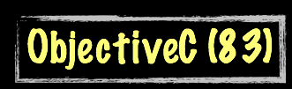
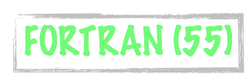


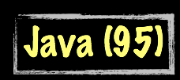




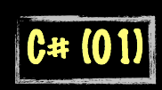

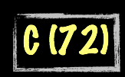
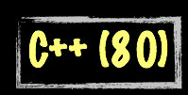

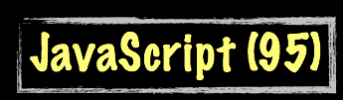



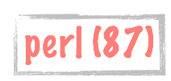
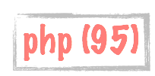

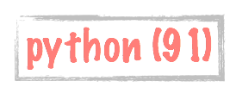
Science Calculations
System
System
bash (79)
C uses curly braces { } for code blocks.
Scripting/
Interpreted
http://en.wikipedia.org/wiki/History_of_programming_languages

Slide 3
Language Syntax (like C/Java)
Whitespace does not matter - spaces and new lines
Begin and end of blocks are curly braces
Statements must end in semicolons
function message()
{
alert("This alert box was called with the onload event");
}

Slide 4
Comments
/* This is a section of
multiline comments that will
not be interpreted */

Slide 5
Statements
White space and newlines do not matter.
Statements end with a semicolon ;

Slide 6
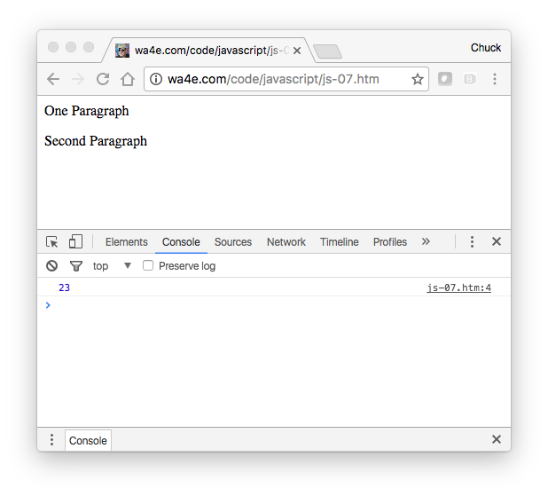
<p>One Paragraph</p>
<script type="text/javascript">
x = 3 +
5 * 4; console.log(
x);
</script>
<p>Second Paragraph</p>
js-07.htm

Slide 7
Variable Names
Valid Characters: a-z, A-Z, 0-9, _ and $
Must not start with a number
Names are case sensitive

Slide 8
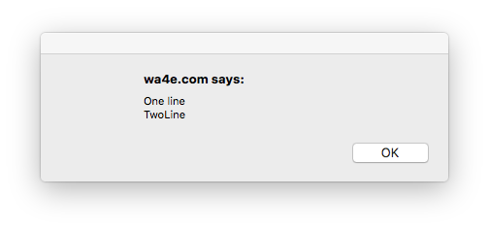
String Constants
js-08.htm
Double Quotes - Single quotes are used typically in JavaScript and we let HTML use double quotes to keep our minds a little sane.
Character Escaping - done using the backslash character
<script type="text/javascript">
alert('One line\nTwoLine');
</script>

Slide 9
Numeric Constants
Constant syntax is like most other languages
Weirdness – One number type (no int or float)
>> x = 5/3;
1.6666666666666667
>> x = Math.trunc(x)
1

Slide 10
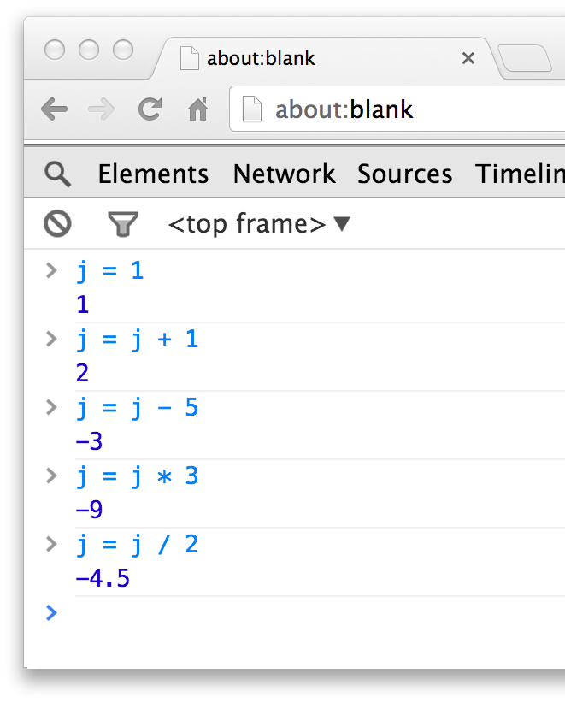
Operators
>> j = 1
1
>> j = j + 1
2
>> j = j - 5
-3
>> j = j * 5
-9
>> j = j / 5
-4.5
>> j = Math.trunc(j)
-4

Slide 11
More Operators
>> j = 45
45
>> k = j % 7
3
>> k++
3
>> k
4
>> --k
3
>> k
3
>> j = 10
10
>> j += 5
15
>> j -= 3
12
>> j *= 2
24
>> j /= 4
6

Slide 12
Comparison Operators
>> j = 10
10
>> j == 10
true
>> j != 17
true
>> j < 43
true
>> j > 42
false
>> j <= 10
true
>> j = false
false
>> j == 0
true
>> j === 0
false
>> j !== false
true
>> j !== true
true

Slide 13
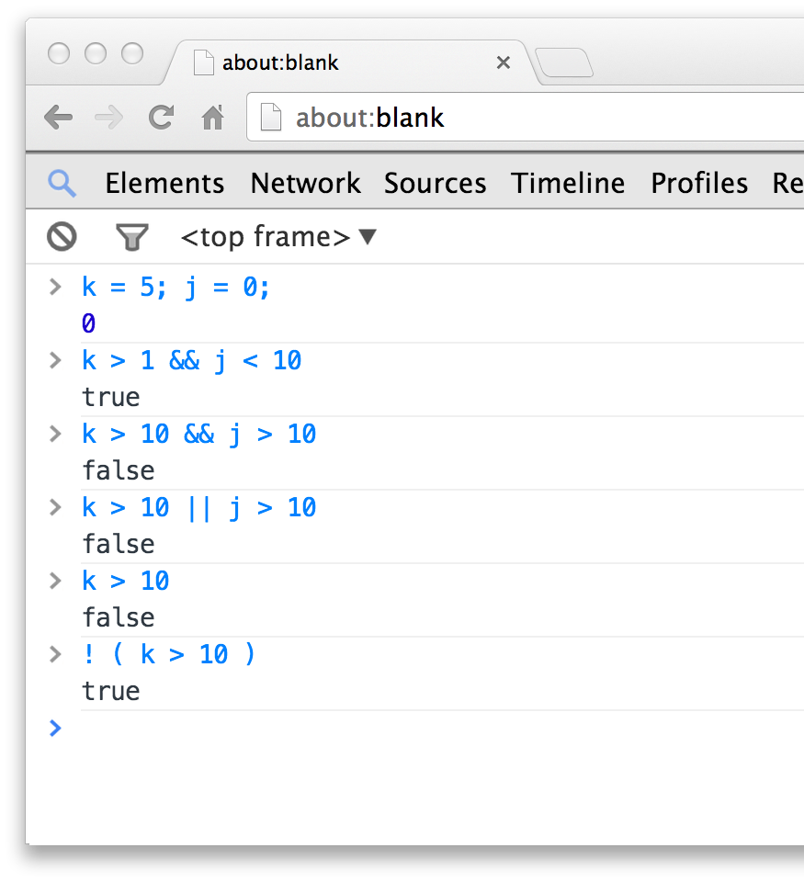
Logical Operators
>> k = 5; j = 0
0
>> k > 1 && j < 10
true
>> k > 10 && j > 10
false
>> k > 10 || j > 10
false
>> k > 10
false
>> ! ( k > 10 )
true

Slide 14
String Concatenation
JavaScript string concatenation is like Python except that it does implicit conversion from integer to string
>> x = 12
12
>> y = 'Hello ' + x + ' people'
"Hello 12 people"

Slide 15
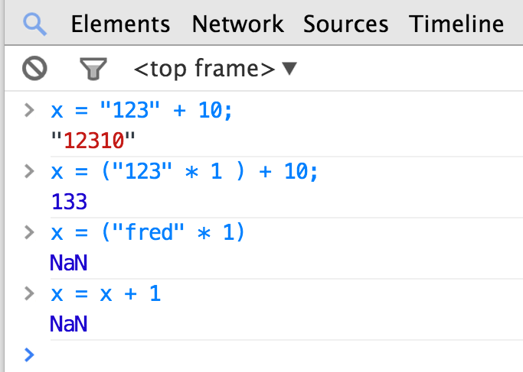
Variable Typing
JavaScript is a loosely typed language and does automatic type conversion when evaluating expressions. It does not trace back when arithmetic is confusing.
>> x = "123" + 10
"12310"
>> x = ("123" * 1) + 10
133
>> x = ("fred" * 1) + 10
NaN
>> x = x + 1
NaN

Slide 16
Variable Conversion
>> x = "fred" + 1
NaN
>> isNaN(x)
true
>> x = x + 1
NaN
>> y = 42 / 0
Infinity
>> isNaN(y)
false
>> isFinite(y)
false
If a string cannot be converted to a number, you end up with “Not a Number” or “NaN”. It is a value, but it is sticky - all operations with NaN as a operand end up with NaN.

Slide 17
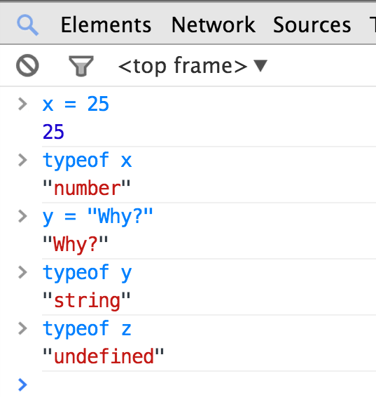
Determining Type
JavaScript provides a unary typeof operator that returns the type of a variable or constant as a string.
>> x = 25
>> typeof x
"number"
>> y = "Why?"
"Why?"
>> typeof y
"string"
>> typeof z
"undefined"

Slide 18
Functions and Arrays

Slide 19
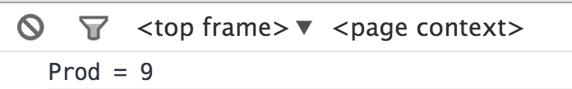
Functions
js-09.htm
Functions use a typical syntax and are indicated using the function keyword.
The return keyword functions as expected.
<script type="text/javascript">
function product(a,b) {
value = a + b;
return value;
}
console.log("Prod = "+product(4,5));
</script>

Slide 20
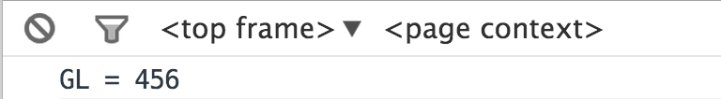
Scope - Global (default)
js-10.htm
Variables defined outside a function that are referenced inside of a function have global scope.
This is a little different than what we expect.
<script type="text/javascript">
gl = 123;
function check() {
gl = 456;
}
check();
console.log("GL = "+gl);
</script>

Slide 21
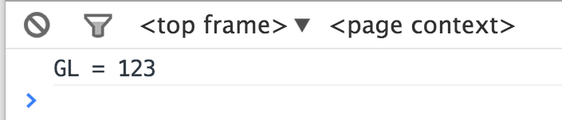
Making a Variable Local
js-11.htm
In a function, the parameters (formal arguments) are local and any variables we mark with the var keyword are local too.
<script type="text/javascript">
gl = 123;
function check() {
var gl = 456;
}
check();
console.log("GL = "+gl);
</script>

Slide 22
Arrays in JavaScript
JavaScript supports both linear arrays and associative structures, but the associative structures are actually objects.
>> a = ["x", "y", "z"]
["x", "y", "z"]
>> b = {"name":"chuck", "class":"dj4e"}
Object {"name":"chuck", "class":"dj4e"}
>> a[0]
"x"
>> b['name']
"chuck"

Slide 23
Linear Arrays
>> arr = Array()
[]
>> arr.push('first')
1
>> arr.push('second')
2
>> arr
["first", "second"]
>> arr = Array()
[]
>> arr[0] = 'first'
"first"
>> arr[1] = 'second'
"second"
>> arr
["first", "second"]

Slide 24
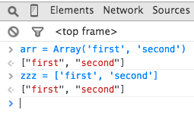
Array Constructor / Constants
>> arr = Array('first', 'second')
["first", "second"]
>> zzz = ["first", "second"]
["first", "second"]
>>

Slide 25
Control Structures

Slide 26
Conditional - if
js-12.htm
Logical operators ( == != < > <= >= && || ! === !==)
Curly braces
<script type="text/javascript">
var ans = 42;
if (ans == 42 ) {
console.log("Hello world!");
} else {
console.log("Wrong answer");
}
</script>
Hello World!

Slide 27
Multi-way Ifs
js-13.htm
var x = 7;
if ( x < 2 ) {
console.log("Small");
} else if ( x < 10 ) {
console.log("Medium");
} else {
console.log("LARGE");
}
console.log("All done");

Slide 28
js-14.htm
var fuel = 10;
while (fuel > 1) {
console.log("Vroom");
}
A while loop is a “zero-trip” loop with the test at the top before the first iteration starts. We hand construct the iteration variable to implement a counted loop.
var fuel = 10;
while (fuel > 1) {
console.log("Vroom");
fuel = fuel - 1;
}

Slide 29
Definite Loops (for)
js-15.htm
balls = {"golf": "Golf balls",
"tennis": "Tennis balls",
"ping": "Ping Pong balls"};
for (ball in balls) {
console.log(ball+' = '+balls[ball]);
}
js-12.htm

Slide 30
js-16.htm
Loop runs while TRUE (top-test)
Run after each iteration.
Before loop starts
for(var count=1; count<=6; count++ ) {
console.log(count, 'times 6 is', count * 6);
}
1 times 6 is 6
2 times 6 is 12
3 times 6 is 18
4 times 6 is 24
5 times 6 is 30
6 times 6 is 36
A for loop is the simplest way to construct a counted loop.

Slide 31
Breaking Out of a Loop
js-17.htm
The break statement ends the current loop and jumps to the statement immediately following the loop.
for(var count=1; count<=600; count++ ) {
if ( count == 5 ) break;
console.log('Count:', count);
}
console.log("Done");
Count: 1
Count: 2
Count: 3
Count: 4
Done

Slide 32
Finishing an Iteration with continue
The continue statement ends the current iteration and jumps to the top of the loop, and starts the next iteration.
Count: 1
Count: 3
Count: 5
Count: 7
Count: 9
Done
for(var count=1; count<=10; count++ ) {
if ( (count % 2) == 0 ) continue;
console.log('Count:', count);
}
console.log("Done");
js-18.htm

Slide 33
Summary
Using JavaScript
Syntax errors
Debugging
Language features
Global and local scope
Arrays
Control structures

Slide 34
Acknowledgements / Contributions
These slides are Copyright 2010- Charles R. Severance (www.dr-chuck.com) as part of www.dj4e.com and made available under a Creative Commons Attribution 4.0 License. Please maintain this last slide in all copies of the document to comply with the attribution requirements of the license. If you make a change, feel free to add your name and organization to the list of contributors on this page as you republish the materials.
Initial Development: Charles Severance, University of Michigan School of Information
Insert new Contributors and Translators here including names and dates
Continue new Contributors and Translators here
Notes:
Note from Chuck. Please retain and maintain this page as you remix and republish these materials. Please add any of your own improvements or contributions.

