Slide 1
A Data Structure
Dr. Charles R. Severance
www.cc4e.com

Slide 2
Our Data Structure – Key / Value Pairs
Inspiration
Java Map<String, Integer>
Python dictionary
PHP Arrays
Start with Doubly Linked List of Key / Value pairs
Put, Get, Delete
Iterator Pattern
Reverse Iterator
Swapping items in a list
Sort Keys / Sort Values

Slide 3
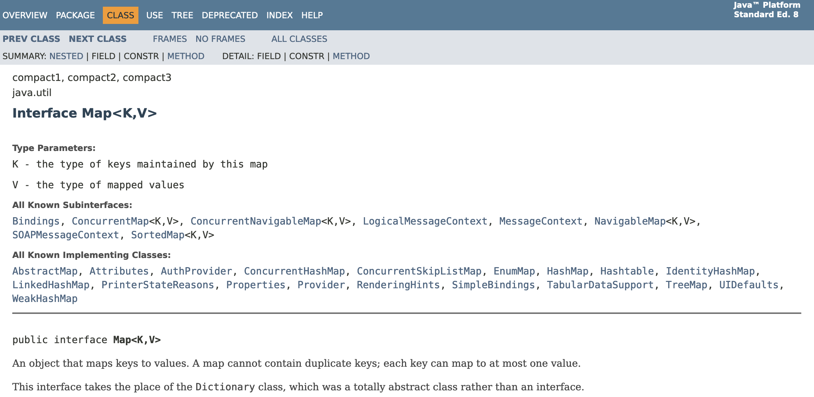
Java Map<Integer, String>
https://docs.oracle.com/javase/8/docs/api/java/util/Map.html

Slide 4
import java.util.Map;
import java.util.TreeMap;
public class cc_04_01 {
public static void main(String[] args)
{
Map<String, Integer> map = new TreeMap<String, Integer> ();
System.out.printf("Testing Map class\n");
map.put("z", 8);
map.put("z", 1);
map.put("y", 2);
map.put("b", 3);
map.put("a", 4);
System.out.println(map);
System.out.println("z="+map.getOrDefault("z", 42));
System.out.println("x="+map.getOrDefault("x", 42));
System.out.printf("\nIterate forwards\n");
for (Map.Entry<String,Integer> entry : map.entrySet()) {
System.out.println("Key = " + entry.getKey() + ",
Value = " + entry.getValue());
}
Integer max = null;
String max_key = null;
for (Map.Entry<String,Integer> entry : map.entrySet()) {
if ( max == null || entry.getValue() > max ) {
max = entry.getValue();
max_key = entry.getKey();
}
}
System.out.printf("The largest value is %s=%d\n", max_key, max);
}
}
Testing Map class
{a=4, b=3, y=2, z=1}
z=1
x=42
Iterate forwards
Key = a, Value = 4
Key = b, Value = 3
Key = y, Value = 2
Key = z, Value = 1
The largest value is a=4
C++ was initially implemented as a pre-processing pass that did textual transformations and then passed the code into the C compiler. There is no concept of "self" or "this".
cc_04_01.java

Slide 5
$a = array();
print("Testing php arrays\n");
$a["z"] = 8;
$a["z"] = 1;
$a["y"] = 9;
$a["b"] = 3;
$a["a"] = 4;
print_r($a);
printf("z=%d\n", $a["z"] ?? 42);
printf("x=%d\n", $a["x"] ?? 42);
printf("\nIterate\n");
foreach( $a as $k => $v ) {
printf(" %s=%d\n", $k, $v);
}
ksort($a);
printf("\nSort by key\n");
print_r($a);
arsort($a);
printf("\nSort by value in reverse\n");
print_r($a);
$k = array_key_first($a);
printf("Largest value %s=%d\n", $k, $a[$k]);
Testing dict class
Array
(
[z] => 1
[y] => 9
[b] => 3
[a] => 4
)
z=1
x=42
Iterate
z=1
y=9
b=3
a=4
Sort by key
Array
(
[a] => 4
[b] => 3
[y] => 9
[z] => 1
)
Sort by value in reverse
Array
(
[y] => 9
[a] => 4
[b] => 3
[z] => 1
)
Largest value y=9
cc_04_01.php

Slide 6
d = dict()
print("Testing dict class\n");
d["z"] = 8
d["z"] = 1
d["y"] = 9
d["b"] = 3
d["a"] = 4
print(d);
print("z=%d" % (d.get("z", 42), ));
print("x=%d" % (d.get("x", 42), ));
items = iter(d.items())
print(type(items));
entry = next(items, False)
while (entry) :
print(entry)
entry = next(items, False)
sd = reversed(sorted(d.items(), key=lambda item: item[1]))
first = next(iter(sd))
print('The largest value', first)
Testing dict class
{'z': 1, 'y': 9, 'b': 3, 'a': 4}
z=1
x=42
<class 'dict_itemiterator'>
('z', 1)
('y', 9)
('b', 3)
('a', 4)
The largest value ('y', 9)
cc_04_01.py

Slide 7
Object Map@0x600001ebc000 count=4
z=1
y=2
b=3
a=4
z=1
x=42
Iterate forwards
z=1
y=2
b=3
a=4
Iterate backwards
a=4
b=3
y=2
z=1
Sorted by key
Object Map@0x600001ebc000 count=4
a=4
b=3
y=2
z=1
Sorted by value
Object Map@0x600001ebc000 count=4
z=1
y=2
b=3
a=4
The smallest value is z=1
The largest value is a=4
int main(void)
{
struct MapEntry *cur;
struct Map * map = Map_new();
printf("Testing Map class\n");
map->put(map, "z", 8);
map->put(map, "z", 1);
map->put(map, "y", 2);
map->put(map, "b", 3);
map->put(map, "a", 4);
map->dump(map);
printf("z=%d\n", map->get(map, "z", 42));
printf("x=%d\n", map->get(map, "x", 42));
printf("\nIterate forwards\n");
for(cur=map->first(map); cur!=NULL; cur=map->next(map) ) {
printf(" %s=%d\n", cur->key, cur->value);
}
printf("\nIterate backwards\n");
for(cur = map->last(map); cur != NULL; cur = map->next(map) ) {
printf(" %s=%d\n", cur->key, cur->value);
}
…
cc_04_01.c

Slide 8
Object Map@0x600001ebc000 count=4
z=1
y=2
b=3
a=4
z=1
x=42
Iterate forwards
z=1
y=2
b=3
a=4
Iterate backwards
a=4
b=3
y=2
z=1
Sorted by key
Object Map@0x600001ebc000 count=4
a=4
b=3
y=2
z=1
Sorted by value
Object Map@0x600001ebc000 count=4
z=1
y=2
b=3
a=4
The smallest value is z=1
The largest value is a=4
…
map->ksort(map);
printf("\nSorted by key\n");
map->dump(map);
printf("\nSorted by value\n");
map->asort(map);
map->dump(map);
cur = map->first(map);
printf("The smallest value is %s=%d\n", cur->key, cur->value);
cur = map->last(map);
printf("The largest value is %s=%d\n", cur->key, cur->value);
Map_del(map);
}
cc_04_01.c

