Slide 1
Map Structures
Dr. Charles R. Severance
www.cc4e.com
code.cc4e.com (sample code)
online.dr-chuck.com

Slide 2
Maps – Key / Value Pairs
Inspiration
Python dictionary
Java Map<String, Integer>
PHP Arrays
Start with Doubly Linked List of Key / Value pairs
Find, Put, Get, Index
Iterator Pattern
Reverse Iterator
Swapping items in a list
Sort Keys / Sort Values

Slide 3
d = dict()
print("Testing dict class\n");
d["z"] = 8
d["z"] = 1
d["y"] = 9
d["b"] = 3
d["a"] = 4
print(d);
print("z=%d" % (d.get("z", 42), ));
print("x=%d" % (d.get("x", 42), ));
items = iter(d.items())
print(type(items));
entry = next(items, False)
while (entry) :
print(entry)
entry = next(items, False)
sd = reversed(sorted(d.items(), key=lambda item: item[1]))
first = next(iter(sd))
print('The largest value', first)
Testing dict class
{'z': 1, 'y': 9, 'b': 3, 'a': 4}
z=1
x=42
<class 'dict_itemiterator'>
('z', 1)
('y', 9)
('b', 3)
('a', 4)
The largest value ('y', 9)
cc_05_01.py

Slide 4
Testing dict class
Array
(
[z] => 1
[y] => 9
[b] => 3
[a] => 4
)
z=1
x=42
Iterate
z=1
y=9
b=3
a=4
Sort by key
Array
(
[a] => 4
[b] => 3
[y] => 9
[z] => 1
)
Sort by value in reverse
Array
(
[y] => 9
[a] => 4
[b] => 3
[z] => 1
)
Largest value y=9
$a = array();
print("Testing php arrays\n");
$a["z"] = 8;
$a["z"] = 1;
$a["y"] = 9;
$a["b"] = 3;
$a["a"] = 4;
print_r($a);
printf("z=%d\n", $a["z"] ?? 42);
printf("x=%d\n", $a["x"] ?? 42);
printf("\nIterate\n");
foreach( $a as $k => $v ) {
printf(" %s=%d\n", $k, $v);
}
ksort($a);
printf("\nSort by key\n");
print_r($a);
arsort($a);
printf("\nSort by value in reverse\n");
print_r($a);
$k = array_key_first($a);
printf("Largest value %s=%d\n", $k, $a[$k]);
cc_05_01.php

Slide 5
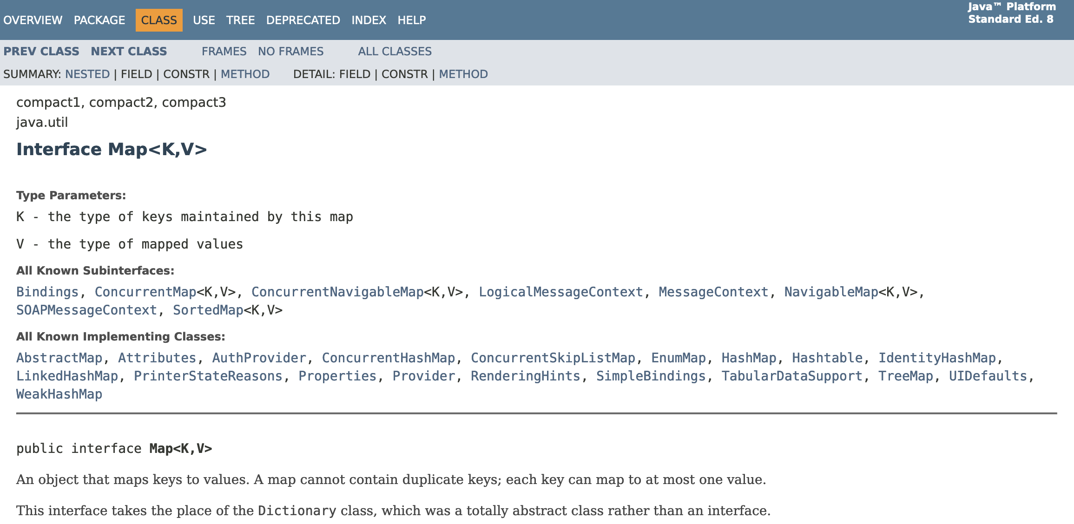
Java Map<String, Integer>
https://docs.oracle.com/javase/8/docs/api/java/util/Map.html

Slide 6
import java.util.Map;
import java.util.TreeMap;
public class cc_05_01 {
public static void main(String[] args)
{
Map<String, Integer> map = new TreeMap<String, Integer> ();
System.out.printf("Testing Map class\n");
map.put("z", 8);
map.put("z", 1);
map.put("y", 2);
map.put("b", 3);
map.put("a", 4);
System.out.println(map);
System.out.println("z="+map.getOrDefault("z", 42));
System.out.println("x="+map.getOrDefault("x", 42));
System.out.printf("\nIterate forwards\n");
for (Map.Entry<String,Integer> entry : map.entrySet()) {
System.out.println("Key = " + entry.getKey() + ",
Value = " + entry.getValue());
}
Integer max = null;
String max_key = null;
for (Map.Entry<String,Integer> entry : map.entrySet()) {
if ( max == null || entry.getValue() > max ) {
max = entry.getValue();
max_key = entry.getKey();
}
}
System.out.printf("The largest value is %s=%d\n", max_key, max);
}
}
Testing Map class
{a=4, b=3, y=2, z=1}
z=1
x=42
Iterate forwards
Key = a, Value = 4
Key = b, Value = 3
Key = y, Value = 2
Key = z, Value = 1
The largest value is a=4
cc_05_01.java

Slide 7
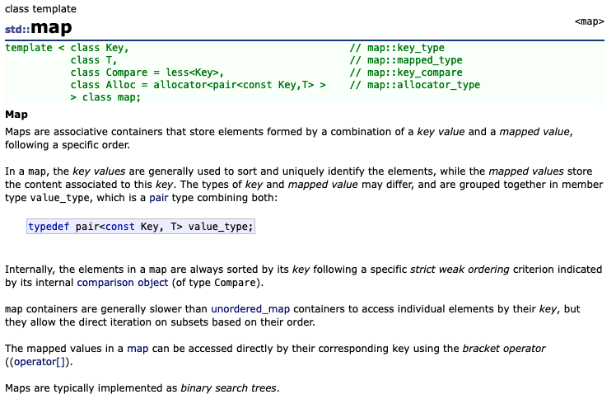
C++
https://cplusplus.com/reference/map/map/

Slide 8
#include <iostream>
#include <map>
using namespace std;
int main() {
map<string, int> mp;
cout << "Testing map class\n";
mp["z"] = 8;
mp["z"] = 1;
mp["y"] = 2;
mp["b"] = 3;
mp["a"] = 4;
for (auto i = mp.begin(); i != mp.end(); ++i) {
cout << i->first << " " << i->second << "\n";
}
cout << "z=" << (mp.count("z") ? mp["z"] : 42) << endl;
cout << "x=" << (mp.count("x") ? mp["x"] : 42) << endl;
cout << "\nIterate forwards\n";
for (auto i = mp.begin(); i != mp.end(); ++i) {
cout << "Key = " << i->first << ", Value = " << i->second << endl;
}
}
Testing map class
a 4
b 3
y 2
z 1
z=1
x=42
Iterate forwards
Key = a, Value = 4
Key = b, Value = 3
Key = y, Value = 2
Key = z, Value = 1
cc_05_01.cpp

Slide 9
d = dict()
print("Testing dict class\n");
d["z"] = 8
d["z"] = 1
d["y"] = 9
d["b"] = 3
d["a"] = 4
print(d);
print("z=%d" % (d.get("z", 42), ));
print("x=%d" % (d.get("x", 42), ));
items = iter(d.items())
print(type(items));
entry = next(items, False)
while (entry) :
print(entry)
entry = next(items, False)
sd = reversed(sorted(d.items(), key=lambda item: item[1]))
first = next(iter(sd))
print('The largest value', first)
Testing dict class
{'z': 1, 'y': 9, 'b': 3, 'a': 4}
z=1
x=42
<class 'dict_itemiterator'>
('z', 1)
('y', 9)
('b', 3)
('a', 4)
The largest value ('y', 9)
cc_05_01.py

Slide 10
int main(void)
{
struct Map * map = Map_new();
struct MapEntry *cur;
struct MapIter *iter;
printf("Testing Map class\n");
map->put(map, "z", 8);
map->put(map, "z", 1);
map->put(map, "y", 2);
map->put(map, "b", 3);
map->put(map, "a", 4);
map->dump(map);
printf("z=%d\n", map->get(map, "z", 42));
printf("x=%d\n", map->get(map, "x", 42));
printf("\nIterate forwards\n");
iter = map->first(map);
while((cur = iter->next(iter)) != NULL ) {
printf(" %s=%d\n", cur->key, cur->value);
}
iter->del(iter);
...
Testing Map class
Object Map@0x600002a3c000 count=4
z=1
y=2
b=3
a=4
z=1
x=42
Iterate forwards
y=2
b=3
a=4
cc_05_01.c

Slide 11
…
printf("\nIterate backwards\n");
iter = map->last(map);
while((cur = iter->next(iter)) != NULL ) {
printf(" %s=%d\n", cur->key, cur->value);
}
iter->del(iter);
map->ksort(map);
printf("\nSorted by key\n");
map->dump(map);
printf("\nSorted by value\n");
map->asort(map);
map->dump(map);
cur = map->index(map, 0);
printf("The smallest value is %s=%d\n", cur->key, cur->value);
int pos = map->size(map) - 1;
cur = map->index(map, pos);
printf("The largest value is %s=%d\n", cur->key, cur->value);
map->del(map);
}
Iterate backwards
b=3
y=2
z=1
Sorted by key
Object Map@0x600002a3c000 count=4
a=4
b=3
y=2
z=1
Sorted by value
Object Map@0x600002a3c000 count=4
z=1
y=2
b=3
a=4
The smallest value is z=1
The largest value is a=4
cc_05_01.c

Slide 12
Looking at Code

Slide 13
MapEntry Structure
This is the structure that will make up the nodes in the list.
The key is a character string – the actual data will be saved in a newly allocated space.
The value is an int and will be allocated right in the node.
/*
* This is our map entry for Map<String,Integer>
*
* The key is a string / character array which is allocated
* using malloc() when a new entry is created.
*/
struct MapEntry {
char *key;
int value;
struct MapEntry *prev;
struct MapEntry *next;
};

Slide 14
Map
struct Map {
/* Attributes */
struct MapEntry *head;
struct MapEntry *tail;
int count;
/* Methods */
void (*put)(struct Map* self,
char *key,int value);
int (*get)(struct Map* self,
char *key, int def);
int (*size)(struct Map* self);
void (*dump)(struct Map* self);
struct MapIter* (*first)(struct Map* self);
struct MapIter* (*last)(struct Map* self);
void (*asort)(struct Map* self);
void (*ksort)(struct Map* self);
struct MapEntry* (*index)(struct Map* self,
int position);
void (*del)(struct Map* self);
};
This contains the attributes and methods
The reverse and current fields will be used to implement the first/next or last/next iterator pattern
We will use the pattern where the pointers to the methods will be in each instance.

Slide 15
Constructor
struct Map * Map_new() {
struct Map *p = malloc(sizeof(*p));
p->head = NULL;
p->tail = NULL;
p->count = 0;
p->put = &Map_put;
p->get = &Map_get;
p->size = &Map_size;
p->dump = &Map_dump;
p->first = &Map_first;
p->last = &Map_last;
p->asort = &Map_asort;
p->ksort = &Map_ksort;
p->index = &Map_index;
p->del = &Map_del;
return p;
}
Allocate the Map and fill it with defaults.

Slide 16
Destructor
/**
* Destructor for the Map Class
*
* Loops through and frees all the keys and
* entries in the map. The values are integers
* and so there is no need to free them.
*/
void Map_del(struct Map* self) {
struct MapEntry *cur, *next;
cur = self->head;
while(cur) {
free(cur->key);
/* value is just part of the struct */
next = cur->next;
free(cur);
cur = next;
}
free((void *)self);
}
Free the allocated key strings, then the MapEntry structure
Note that we take cur->next before we free the node, assuming that cur data might be gone.
At the very end we free the Map structure

Slide 17
Map_dump
Build a simple debug tool right away ☺
/**
* Map_dump - In effect a toString() except we print
* the contents of the Map to stdout
*
* self – The pointer to the instance of this class.
*/
Void Map_dump(struct Map* self)
{
struct MapEntry *cur;
printf("Object Map@%p count=%d\n", self, self->count);
for(cur = self->head; cur != NULL ; cur = cur->next ) {
printf(" %s=%d\n", cur->key, cur->value);
}
}

Slide 18
Map_get
/**
* Map_get - Locate and return the value for the
* corresponding key or a default value
*
* self - The pointer to the instance of this class.
* key - A character pointer to the key value
* def - A default value to return if the key is
* not in the Map
*
* Returns an integer
*
* Sample call:
*
* int ret = map->get(map, "z", 42);
*
* This method takes inspiration from the Python code:
*
* value = map.get("key", 42)
*/
int Map_get(struct Map* self, char *key, int def)
{
struct MapEntry *retval = Map_find(self, key);
if ( retval == NULL ) return def;
return retval->value;
}
Returns the value stored at the key or a default value
Pretty simple when you can use Map_find()

Slide 19
Map_put
/**
* Map_put - Add or update an entry in the Map
*
* self - The pointer to the instance of this class.
* key - A character pointer to the key value
* value - The value to be stored with the associated key
*
* If the key is not in the Map, an entry is added. If there
* is already an entry in the Map for the key, the value
* is updated.
*
* Sample call:
*
* map->put(map, "x", 42);
*
* This method takes inspiration from the Python code:
*
* map["key"] = value
*/
void Map_put(struct Map* self, char *key, int value) {
...
}
This is not used by main() – it is just for in-class use – that is the definition of "private" in OO-speak
Uses Map_find() to check if the key is already in the map to make sure

Slide 20
Map_get()
/**
* Map_get - Locate and return the value for the
* corresponding key or a default value
*
* self - The pointer to the instance of this class.
* key - A character pointer to the key value
* def - A default value to return if the key
* is not in the Map
*
* Returns an integer
*
* This method takes inspiration from the Python code:
*
* value = map.get("key", 42)
*/
int Map_get(struct Map* self, char *key, int def)
{
...
}
This is not used by main() – it is just for in-class use – that is the definition of "private" in OO-speak
Uses Map_find() to check if the key is already in the map to make sure

Slide 21

Iterators

Slide 22
Separation of Concerns
struct Map {
/* Attributes */
struct MapEntry *head;
struct MapEntry *tail;
int count;
/* Methods */
...
};
/* This loop is OK in an object
method – but not in main() */
for (current = map->head;
current != NULL;
current = current->next )
{
}
Following the practice or "Separation of concerns", object builders usually make attributes critical to the functioning of the object "private"
They do not want the calling code to look directly at head or count – and even worse the object will break badly if the main program starts messing with these values
https://en.wikipedia.org/wiki/Separation_of_concerns

Slide 23
About Iterators
x = {'a': 1, 'b': 2, 'c': 3}
print('x is', x)
y = list(x)
print('y is', y)
it = iter(x)
print('it is', it)
while True :
item = next(it, False)
if item is False : break
print('item is', item)
it = iter(reversed(x))
print('it is', it)
while True :
item = next(it, False)
if item is False : break
print('item is', item)
next
To allow code outside the the object to traverse a list, we use iterators
Once we have an iterator, each time we call "next" we get the next item in the list until the end
x is {'a': 1, 'b': 2, 'c': 3}
y is ['a', 'b', 'c']
it is <dict_keyiterator object at 0x100410a40>
item is a
item is b
item is c
it is <dict_reversekeyiterator object at 0x1005888b0>
item is c
item is b
item is a
https://en.wikipedia.org/wiki/Iterator
cc_05_02.py

Slide 24
Struct MapIter
ddsds
/*
* A MapIter contains the current item and whether
* this is a forward or reverse iterator.
*/
struct MapIter {
struct MapEntry *current;
int reverse;
struct MapEntry* (*next)(struct MapIter* self);
void (*del)(struct MapIter* self);
};

Slide 25
Map_first()
/**
* Map_first - Create an iterator from the head of
* the Map and return the first item
*
* self - The pointer to the instance of this class.
*
* returns NULL when there are no entries in the Map
*
* This is inspired by the following Python code
* that creates an iterator from a dictionary:
*
* x = {'a': 1, 'b': 2, 'c': 3}
* it = iter(x)
*/
Struct MapIter* Map_first(struct Map* self)
{
struct MapIter *iter = malloc(sizeof(*iter));
iter->current = self->head;
iter->reverse = 0;
iter->next = &MapIter_next;
iter->del = &MapIter_del;
return iter;
}
ddsds

Slide 26
MapIter_next()
/**
* MapIter_next - Advance the iterator forwards
* or backwards and return the next item
*
* self - The pointer to the instance of this class.
*
* returns NULL when there are no more entries
*
* This is inspired by the following Python code:
*
* item = next(iterator, False)
*/
struct MapEntry* MapIter_next(struct MapIter* self)
{
if ( self->current == NULL) return NULL;
if ( self->reverse == 0 ) {
self->current = self->current->next;
} else {
self->current = self->current->prev;
}
return self->current;
}
This is a method in the Map Iterator

Slide 27
Using an iterator
printf("\nIterate forwards\n");
iter = map->first(map);
while(1) {
cur = iter->next(iter);
if ( cur == NULL ) break;
printf(" %s=%d\n", cur->key, cur->value);
}
iter->del(iter);
You create the iterator
Then in a loop, you call next() to get each successive entry in the map, until you exhaust the entries
x = {'a': 1, 'b': 2, 'c': 3}
it = iter(x)
while True :
item = next(it, False)
if item is False : break
print('item is', item)
cc_05_02.py

Slide 28
Map_last()
/**
* Map_last - Start an iterator at the tail of the
* Map and mark the iterator as "going backwards"
*
* self - The pointer to the instance of this class.
*
* returns NULL when there are no entries in the Map
*
* This is inspired by the following Python code:
*
* x = {'a': 1, 'b': 2, 'c': 3}
* it = iter(reversed(x))
*/
struct MapIter* Map_last(struct Map* self)
{
...
}
Same as Map_first except that we start at tail and indicate we are supposed to go backwards when next() is called..
printf("\nIterate backwards\n");
iter = map->last(map);
while(1) {
cur = iter->next(iter);
if ( cur == NULL ) break;
printf(" %s=%d\n", cur->key, cur->value);
}
iter->del(iter);

