Slide 1

C Programming A Historical Perspective
Dr. Charles Severance
www.cc4e.com
Notes:
https://www.destroyallsoftware.com/talks/wat

Slide 2
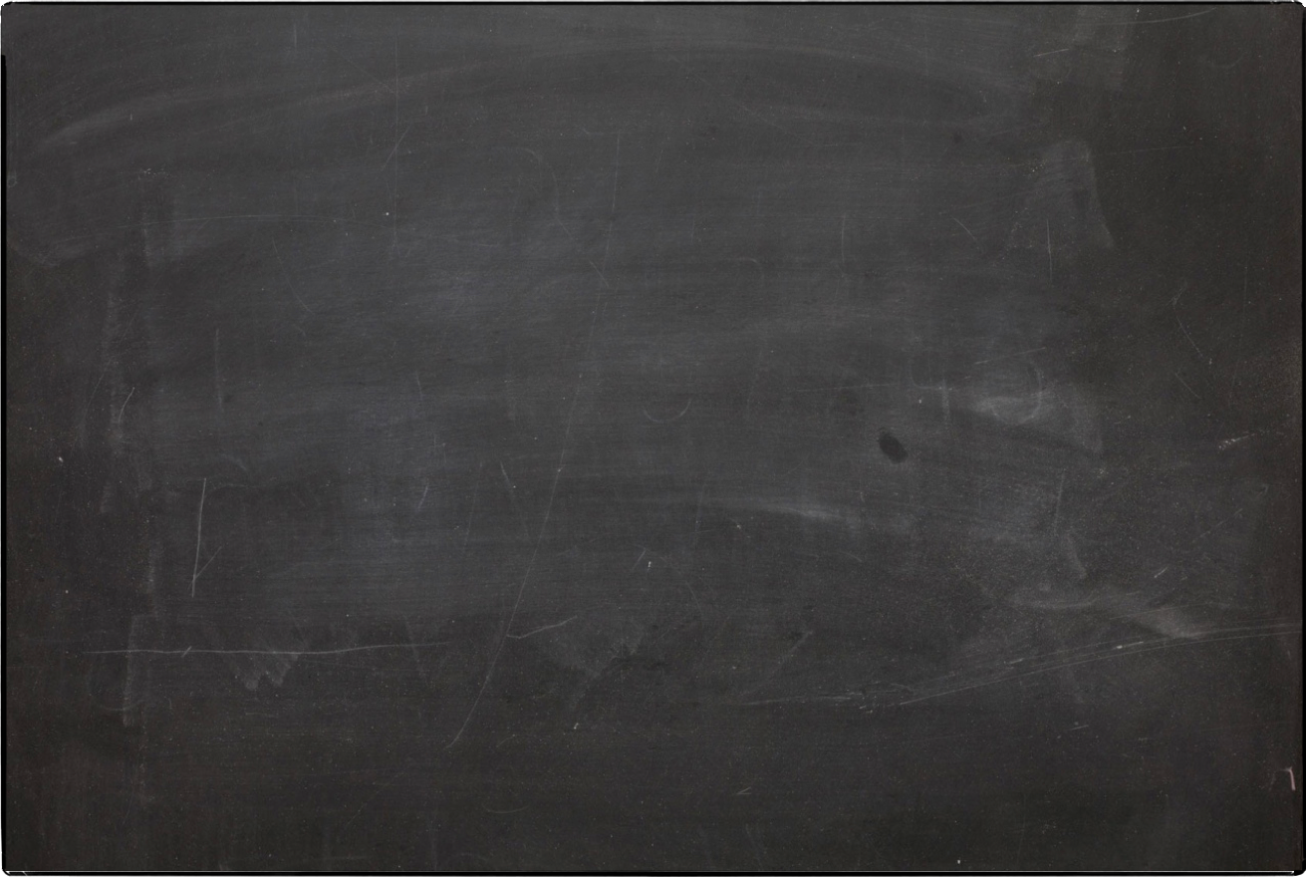
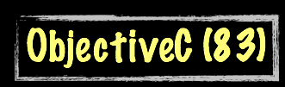
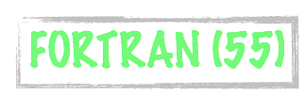


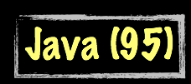




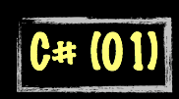
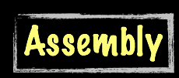
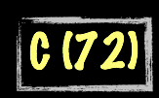
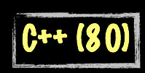

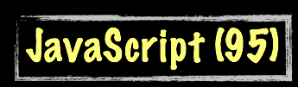



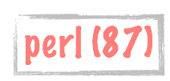
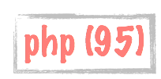

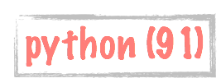
Science Calculations
System
System
bash (79)
C uses curly braces { } for code blocks.
Scripting/
Interpreted
http://en.wikipedia.org/wiki/History_of_programming_languages

Slide 3
Summary
Using JavaScript
Syntax errors
Debugging
Language features
Global and local scope
Arrays
Control structures

Slide 4
Acknowledgements / Contributions
These slides are Copyright 2010- Charles R. Severance (www.dr-chuck.com) as part of www.dj4e.com and made available under a Creative Commons Attribution 4.0 License. Please maintain this last slide in all copies of the document to comply with the attribution requirements of the license. If you make a change, feel free to add your name and organization to the list of contributors on this page as you republish the materials.
Initial Development: Charles Severance, University of Michigan School of Information
Insert new Contributors and Translators here including names and dates
Continue new Contributors and Translators here
Notes:
Note from Chuck. Please retain and maintain this page as you remix and republish these materials. Please add any of your own improvements or contributions.

