Slide 1
Tree Maps and Hash Maps
Dr. Charles R. Severance
www.cc4e.com
code.cc4e.com (sample code)
online.dr-chuck.com

Slide 2

“Stopping by Woods on a Snowy Evening”
Whose woods these are I think I know.
His house is in the village though;
He will not see me stopping here
To watch his woods fill up with snow.
My little horse must think it queer
To stop without a farmhouse near
Between the woods and frozen lake
The darkest evening of the year.
He gives his harness bells a shake
To ask if there is some mistake.
The only other sound’s the sweep
Of easy wind and downy flake.
The woods are lovely, dark and deep,
But I have promises to keep,
And miles to go before I sleep,
And miles to go before I sleep.
https://en.wikipedia.org/wiki/Stopping_by_Woods_on_a_Snowy_Evening

Slide 3
Key /Value Implementation Alternatives
We will build an unordered java.util.HashMap / Python 2 dict()
Chapter 6.6
We will build a sorted java.util.TreeMap – plus an iterator
Chapter 6.5 (Simultaneous Linked List + Tree)
It would be named java.util.LinkedTreeMap if Java had such a thing ☺
Python
Python 2 dict - unordered
Python 3.1 - OrderedDict
C++ (capabilities of any map)
Associative
Ordered
Unique Keys
Map (key / simple value)
Java
java.util.HashMap
java.util.TreeMap (*)
java.util.LinkedHashMap
* No iterator

Slide 4
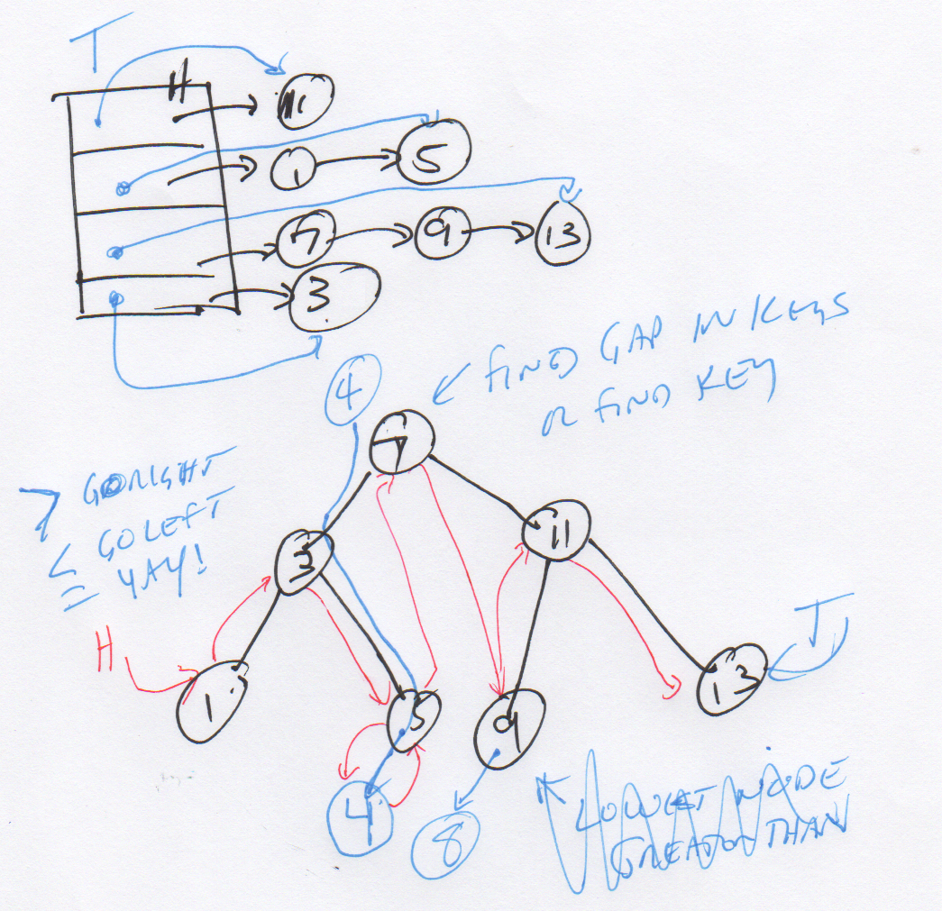
Start with a good picture…

Slide 5
Hash Map
The answer to the most common programming interview question!

Slide 6
HashMap
Weird order (like Python 2 dict and Java HashMap)
Fast insert and lookup (like Python 2 dict and Java HashMap)
Iterable (like Python 2 dict and Java HashMap)
Builds on Linked Lists
Surprisingly easy is you really get Linked Lists
Chapter 6.5.1 and 6.6 in K&R (6.5.2 is harder than 6.6)
Most popular programming interview question ever!

Slide 7
Simplifying our Pictures
head:
tail:
key:
z
struct MapEntry {
char *key; /* public */
int value; /* public */
struct MapEntry *__prev;
struct MapEntry *__next;
};
struct Map {
struct MapEntry *__head;
struct MapEntry *__tail;
...
};
value: 22
prev:
∅
next:
key:
w
value: 42
prev:
next:
head
z=22
w=42
∅
∅

Slide 8
Changing From ListMap to HashMap
struct MapEntry {
char *key; /* public */
int value; /* public */
struct MapEntry *__prev;
struct MapEntry *__next;
};
struct ListMap {
struct MapEntry *__head;
struct MapEntry *__tail;
...
};
struct HashMapEntry {
char *key; /* public */
int value; /* public */
struct HashMapEntry *__prev;
struct HashMapEntry *__next;
};
struct HashMap {
int __buckets;
struct HashMapEntry *__heads[8];
struct HashMapEntry *__tails[8];
...
};

Slide 9
Changing From ListMap to HashMap
head
b=14
d=21
f=19
h=17
j=18
m=90
∅
buckets: 4
f=19
h=17
∅
heads[0]
Hash % 4
heads[1]
d=21
∅
key
heads[2]
b=14
j=18
m=90
∅
heads[3]
∅

Slide 10
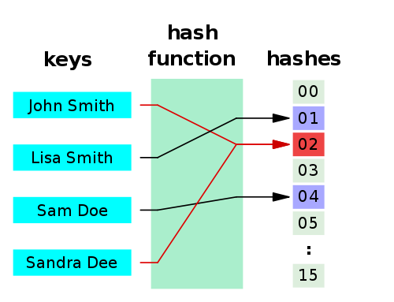
Hashes
A hash function is any algorithm or subroutine that maps large data sets to smaller data sets, called keys. For example, a single integer can serve as an index to an array (cf. associative array). The values returned by a hash function are called hash values, hash codes, hash sums, checksums, or simply hashes.
Hash functions are mostly used to accelerate table lookup or data comparison tasks such as finding items in a database...
http://en.wikipedia.org/wiki/Hash_function

Slide 11
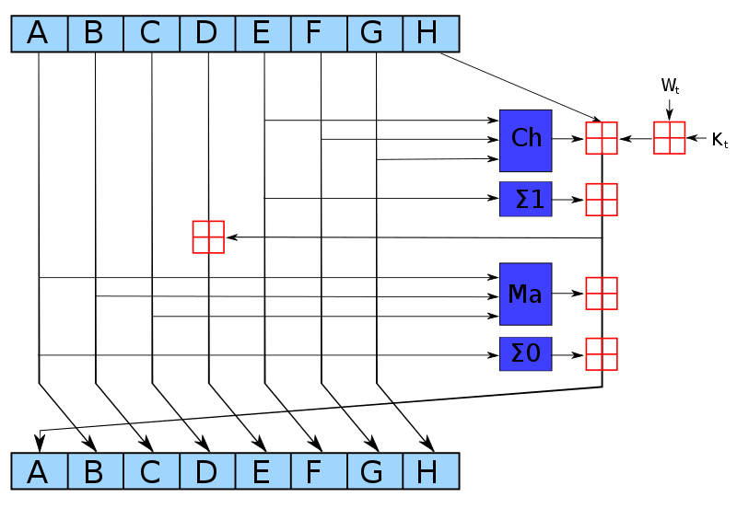
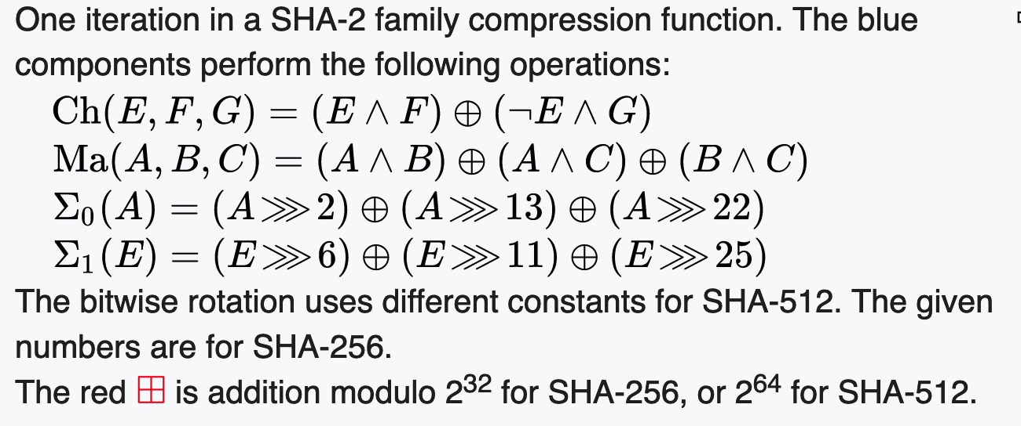
SHA-256 Compression Function
https://en.wikipedia.org/wiki/SHA-2

Slide 12
int getBucket(char *str, int buckets)
{
unsigned int hash = 123456;
printf("\nHashing %s\n", str);
if ( str == NULL ) return 0;
for( ; *str ; str++) {
hash = ( hash << 3 ) ^ *str;
printf("%c 0x%08x %d\n", *str,
hash, hash % buckets);
}
return hash % buckets;
}
int main() {
int h;
h = getBucket("Hi", 8);
h = getBucket("Hello", 8);
h = getBucket("World", 8);
}
Hashing Hi
H 0x000f1248 0
i 0x00789229 1
Hashing Hello
H 0x000f1248 0
e 0x00789225 5
l 0x03c49144 4
l 0x1e248a4c 4
o 0xf124520f 7
Hashing World
W 0x000f1257 7
o 0x007892d7 7
r 0x03c496ca 2
l 0x1e24b63c 4
d 0xf125b184 4
cc_05_01.c

Slide 13
Lets Build our HashMap
First, make a copy of our List Map and change a (very) few things

Slide 14
struct HashMap * HashMap_new() {
struct HashMap *p = malloc(sizeof(*p));
p->__buckets = 8;
for(int i=0; i < p->__buckets; i++ ) {
p->__heads[i] = NULL;
p->__tails[i] = NULL;
}
p->__count = 0;
p->put = &__HashMap_put;
p->get = &__HashMap_get;
p->size = &__HashMap_size;
p->dump = &__HashMap_dump;
p->iter = &__HashMap_iter;
p->del = &__HashMap_del;
return p;
}
struct HashMap {
int __buckets;
struct HashMapEntry *__heads[8];
struct HashMapEntry *__tails[8];
int __count;
...
};

Slide 15
struct HashMapEntry* __HashMap_find(struct HashMap* self, char *key, int bucket)
{
struct HashMapEntry *cur;
if ( self == NULL || key == NULL ) return NULL;
for(cur = self->__heads[bucket]; cur != NULL ; cur = cur->__next ) {
if(strcmp(key, cur->key) == 0 ) return cur;
}
return NULL;
}
int __HashMap_get(struct HashMap* self, char *key, int def)
{
int bucket = getBucket(key, self->__buckets);
struct HashMapEntry *retval = __HashMap_find(self, key, bucket);
if ( retval == NULL ) return def;
return retval->value;
}

Slide 16
void __Map_put(struct Map* self, char *key, int value) {
struct MapEntry *old, *new;
char *new_key;
old = __Map_find(self, key);
if ( old != NULL ) {
old->value = value;
return;
}
/* Not found - time to insert */
new = malloc(sizeof(*new));
new->__next = NULL;
if ( self->__head == NULL ) self->__head = new;
if ( self->__tail != NULL ) self->__tail->__next = new;
new->__prev = self->__tail;
self->__tail = new;
...
}

Slide 17
void __HashMap_put(struct HashMap* self, char *key, int value) {
int bucket;
struct HashMapEntry *old, *new;
char *new_key, *new_value;
bucket = getBucket(key, self->__buckets);
old = __HashMap_find(self, key, bucket);
if ( old != NULL ) {
old->value = value;
return;
}
/* Not found - time to insert */
new = malloc(sizeof(*new));
new->__next = NULL;
if ( self->__heads[bucket] == NULL ) self->__heads[bucket] = new;
if ( self->__tails[bucket] != NULL ) self->__tails[bucket]->__next = new;
new->__prev = self->__tails[bucket];
self->__tails[bucket] = new;
...
}

Slide 18
void __HashMap_dump(struct HashMap* self)
{
int i;
struct HashMapEntry *cur;
printf("Object HashHashMap@%p count=%d buckets=%d\n",
self, self->__count, self->__buckets);
for(i = 0; i < self->__buckets; i++ ) {
for(cur = self->__heads[i]; cur != NULL ; cur = cur->__next ) {
printf(" %s=%d [%d]\n", cur->key, cur->value, i);
}
}
}
Object HashHashMap@0x6000035ac000 count=4 buckets=8
y=2 [1]
a=4 [1]
z=1 [2]
b=3 [2]

Slide 19
Building HashMap Iterator

Slide 20
LinkedTreeMap

Slide 21
A LinkedTreeMap
Stays ordered (like Python OrderedDict)
Stays sorted (like Java TreeMap)
Can be iterated (like C++ map, and OrderedDict, but not TreeMap)
Fast lookup using secondary binary tree index (6.5.2)
Simultaneously a sorted linked list (6.5.1) and binary tree (6.5.2)

Slide 22
struct TreeMap {
struct TreeMapEntry *__root;
int __count;
…
}
struct TreeMapEntry {
char *key; /* public */
int value; /* public */
struct TreeMapEntry *__left;
struct TreeMapEntry *__right;
};
root
h=42
d=8
k=9
b=123
f=6
j=12
m=67
∅
∅
∅
∅
∅
∅
∅
∅

Slide 23
struct TreeMap {
struct TreeMapEntry *__root;
int __count;
…
}
struct TreeMapEntry {
char *key; /* public */
int value; /* public */
struct TreeMapEntry *__left;
struct TreeMapEntry *__right;
};
g=25
root
Insert item with a key of g
h=42
d=8
k=9
b=123
f=6
j=12
m=67
∅
∅
∅
∅
∅
∅
∅
∅

Slide 24
struct TreeMap {
struct TreeMapEntry *__root;
int __count;
…
}
struct TreeMapEntry {
char *key; /* public */
int value; /* public */
struct TreeMapEntry *__left;
struct TreeMapEntry *__right;
};
root
Insert item with a key of g
h=42
g=25
d=8
k=9
b=123
f=6
j=12
m=67
∅
∅
∅
∅
∅
∅
∅
∅

Slide 25
struct TreeMap {
struct TreeMapEntry *__root;
int __count;
…
}
struct TreeMapEntry {
char *key; /* public */
int value; /* public */
struct TreeMapEntry *__left;
struct TreeMapEntry *__right;
};
root
Insert item with a key of g
h=42
d=8
k=9
g=25
b=123
f=6
j=12
m=67
∅
∅
∅
∅
∅
∅
∅
∅

Slide 26
struct TreeMap {
struct TreeMapEntry *__root;
int __count;
…
}
struct TreeMapEntry {
char *key; /* public */
int value; /* public */
struct TreeMapEntry *__left;
struct TreeMapEntry *__right;
};
root
Insert item with a key of g
h=42
d=8
k=9
b=123
f=6
j=12
m=67
∅
∅
∅
∅
∅
∅
∅
g=25

Slide 27
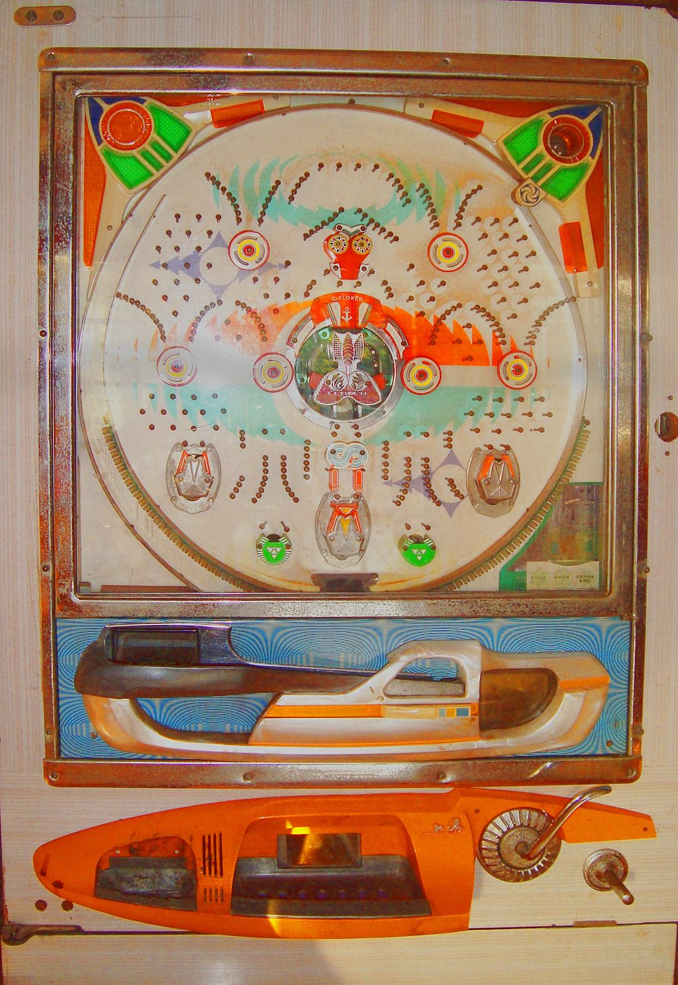
struct TreeMap {
struct TreeMapEntry *__root;
int __count;
…
}
struct TreeMapEntry {
char *key; /* public */
int value; /* public */
struct TreeMapEntry *__left;
struct TreeMapEntry *__right;
};
root
h=42
d=8
k=9
b=123
f=6
j=12
m=67
∅
∅
∅
∅
∅
∅
∅
g=25
https://en.wikipedia.org/wiki/Pachinko

Slide 28
void __TreeMap_put(struct TreeMap* self, char *key, int value) {
struct TreeMapEntry *cur, *left, *right;
int cmp;
cur = self->__root;
while(cur != NULL ) {
cmp = strcmp(key, cur->key);
if(cmp == 0 ) {
cur->value = value;
return;
}
if( cmp < 0 ) {
cur = cur->__left;
} else {
cur = cur->__right;
}
}
...
}
g=25
d=8
b=123
f=6
∅
∅
∅
∅
As long as the tree is correctly maintained you will always find either a match, or a place to correctly insert the new record. The tree is not guaranteed to be balanced - that depends on the insert order.

Slide 29
Object TreeMap@0x6000003dcd20 count=4
h=42
| d=8
| | b=123
| | f=6
Object TreeMap@0x6000003dcd20 count=7
h=42
| d=8
| | b=123
| | f=6
| k=9
| | j=12
| | m=67
int main(void)
{
struct TreeMap * map = TreeMap_new();
map->put(map, "h", 22);
map->put(map, "h", 42); // Replace
map->put(map, "d", 8);
map->put(map, "b", 123);
map->put(map, "f", 6);
map->dump(map);
map->put(map, "k", 9);
map->put(map, "m", 67);
map->put(map, "j", 12);
map->dump(map);
}
d=8
b=123
f=6
∅
∅
∅
∅

Slide 30
void __TreeMap_dump_tree(struct TreeMapEntry *cur, int depth)
{
if ( cur == NULL ) return;
for(int i=0;i<depth;i++) printf("| ");
printf("%s=%d\n", cur->key, cur->value);
if ( cur->__left != NULL ) {
__TreeMap_dump_tree(cur->__left, depth+1);
}
if ( cur->__right != NULL ) {
__TreeMap_dump_tree(cur->__right, depth+1);
}
}
...
// Recursively print the tree view
__TreeMap_dump_tree(self->__root, 0);
h=42
d=8
k=9
b=123
f=6
j=12
m=67
Object TreeMap@0x6000003dcd20 count=4
h=42
| d=8
| | b=123
| | f=6
Object TreeMap@0x6000003dcd20 count=7
h=42
| d=8
| | b=123
| | f=6
| k=9
| | j=12
| | m=67

Slide 31
int __TreeMap_get(struct TreeMap* self, char *key, int def)
{
int cmp;
struct TreeMapEntry *cur;
if ( key == NULL || self->__root == NULL ) return def;
cur = self->__root;
while(cur != NULL ) {
cmp = strcmp(key, cur->key);
if(cmp == 0 ) return cur->value;
else if(cmp < 0 ) cur = cur->__left;
else cur = cur->__right;
}
return def;
}
h=42
d=8
k=9
b=123
f=6
j=12
m=67

Slide 32
Cannot build an Iterator for a Tree
ListMap can support an ordered iterator
HashMap can support an unordered iterator
A TreeMap cannot support an iterator without building a stack within the iterator
printf("\nIterate\n");
iter = map->iter(map);
while(1) {
cur = iter->next(iter);
if ( cur == NULL ) break;
printf(" %s=%d\n", cur->key, cur->value);
}
iter->del(iter);

Slide 33
Tree
root
h=42
d=8
k=9
b=123
f=6
j=12
m=67

Slide 34
Add a LinkedList
root
h=42
d=8
k=9
b=123
f=6
j=12
m=67
head
b=123
d=8
f=6
h=42
j=12
k=9
m=67
∅

Slide 35
LinkedTreeMap
root
h=42
d=8
k=9
head
b=123
f=6
j=12
m=67
∅

Slide 36
struct TreeMap {
struct TreeMapEntry *__head;
struct TreeMapEntry *__root;
…
}
struct TreeMapEntry {
char *key;
int value;
struct TreeMapEntry *__next;
struct TreeMapEntry *__left;
struct TreeMapEntry *__right;
};
root
h=42
d=8
k=9
head
b=123
f=6
j=12
m=67
∅

Slide 37
Making put() work
Updating two data structures at the same time

Slide 38
Before we start
It impossible to write put() using pieces from Google searches or a long conversation with an AI bot
You need to understand it all before you write it
Once you understand it – the code should look clean and simple to you
My put() implementation was broken until it was perfect
I threw it away completely several times

Slide 39
Performance of put()
A binary tree search is O(log N) while a sorted list search is O(N)
Million entry list search average: 500,000
Million entry tree search average: (log₂ 1000000) = 20
We use the Tree to find where to insert or update a key / value pair
root
h=42
d=8
k=9
head
b=123
f=6
j=12
m=67
∅

Slide 40
Use cases for put()
struct TreeMapEntry {
char *key;
int value;
struct TreeMapEntry *__next;
struct TreeMapEntry *__left;
struct TreeMapEntry *__right;
};
Inserting into an empty (easy)
Inserting into a right gap
Inserting into a left gap
Inserting at the beginning
Inserting at the end
Replacing an entry (easy)
struct TreeMap {
struct TreeMapEntry *__head;
struct TreeMapEntry *__root;
…
}
struct TreeMap * TreeMap_new() {
struct TreeMap *p = malloc(sizeof(*p));
p->__head = NULL;
p->__root = NULL;
return p;
}

Slide 41
Empty list
void __TreeMap_put(struct TreeMap* self,
char *key, int value) {
// Scan to see if the entry is in the list
// If the entry is found – update it
// Entry not found – create and fill
new = malloc(sizeof(*new));
...
// If list is empty – just connect it
if ( self->__head == NULL ) {
self->__head = new;
self->__root = new;
return;
}
...
}
...
map->put(map, "h", 22);
root
∅
h=22
??
head
∅

Slide 42
Empty list
void __TreeMap_put(struct TreeMap* self,
char *key, int value) {
// Scan to see if the entry is in the list
// If the entry is found – update it
// Entry not found – create and fill
new = malloc(sizeof(*new));
...
// If list is empty – just connect it
if ( self->__head == NULL ) {
self->__head = new;
self->__root = new;
return;
}
...
}
...
map->put(map, "h", 22);
root
h=22
∅
∅
∅
head

Slide 43
Finding an Item or Gap
void __TreeMap_put(struct TreeMap* self,
char *key, int value) {
cur = self->__root;
right = NULL; /* Our nearest right neighbor */
left = NULL; /* Out nearest left neighbor */
while(cur != NULL ) {
cmp = strcmp(key, cur->key);
if(cmp == 0 ) {
cur->value = value;
return;
}
if( cmp < 0 ) { /* Turn left */
right = cur;
cur = cur->__left;
} else { /* Turn right */
left = cur;
cur = cur->__right;
}
}
...
}
g=29
??
left
root
right
∅
h=42
∅
d=8
k=9
head
b=123
f=6
j=12
m=67
∅

Slide 44
Finding an Item or Gap
void __TreeMap_put(struct TreeMap* self,
char *key, int value) {
cur = self->__root;
right = NULL; /* Our nearest right neighbor */
left = NULL; /* Out nearest left neighbor */
while(cur != NULL ) {
cmp = strcmp(key, cur->key);
if(cmp == 0 ) {
cur->value = value;
return;
}
if( cmp < 0 ) { /* Turn left */
right = cur;
cur = cur->__left;
} else { /* Turn right */
left = cur;
cur = cur->__right;
}
}
...
}
left
root
right
∅
h=42
g=29
d=8
k=9
head
b=123
f=6
j=12
m=67
∅

Slide 45
Finding an Item or Gap
void __TreeMap_put(struct TreeMap* self,
char *key, int value) {
cur = self->__root;
right = NULL; /* Our nearest right neighbor */
left = NULL; /* Out nearest left neighbor */
while(cur != NULL ) {
cmp = strcmp(key, cur->key);
if(cmp == 0 ) {
cur->value = value;
return;
}
if( cmp < 0 ) { /* Turn left */
right = cur;
cur = cur->__left;
} else { /* Turn right */
left = cur;
cur = cur->__right;
}
}
...
}
left
root
right
h=42
d=8
k=9
g=29
head
b=123
f=6
j=12
m=67
∅

Slide 46
Found a gap to the right of a node
void __TreeMap_put(struct TreeMap* self,
char *key, int value) {
cur = self->__root;
right = NULL; /* Our nearest right neighbor */
left = NULL; /* Out nearest left neighbor */
while(cur != NULL ) {
cmp = strcmp(key, cur->key);
if(cmp == 0 ) {
cur->value = value;
return;
}
if( cmp < 0 ) { /* Turn left */
right = cur;
cur = cur->__left;
} else { /* Turn right */
left = cur;
cur = cur->__right;
}
}
...
}
left
root
right
f is between g and h
h=42
d=8
k=9
head
b=123
f=6
j=12
m=67
∅
g=29

Slide 47
Insert into the Linked List
void __TreeMap_put(struct TreeMap* self,
char *key, int value) {
...
// Insert into the sorted linked list
if ( left != NULL ) {
new->__next = right;
left->__next = new;
} else {
new->__next = self->__head;
self->__head = new;
}
...
}
left
root
right
f is between g and h
h=42
d=8
k=9
head
b=123
f=6
j=12
m=67
∅
g=29

Slide 48
Insert into the Tree (right)
void __TreeMap_put(struct TreeMap* self,
char *key, int value) {
...
// Insert into the tree
if ( right != NULL && right->__left == NULL ) {
right->__left = new;
} else if ( left != NULL && left->__right == NULL ) {
left->__right = new;
} else {
printf("FAIL\n");
} ...
}
left
root
right
f is between g and h
h=42
d=8
k=9
head
b=123
f=6
j=12
m=67
∅
g=29

Slide 49
Finding an Item or Left Gap
void __TreeMap_put(struct TreeMap* self,
char *key, int value) {
cur = self->__root;
right = NULL; /* Our nearest right neighbor */
left = NULL; /* Out nearest left neighbor */
while(cur != NULL ) {
cmp = strcmp(key, cur->key);
if(cmp == 0 ) {
cur->value = value;
return;
}
if( cmp < 0 ) { /* Turn left */
right = cur;
cur = cur->__left;
} else { /* Turn right */
left = cur;
cur = cur->__right;
}
}
...
}
left
root
right
i is between h and j
h=42
d=8
k=9
head
b=123
f=6
j=12
m=67
∅
i=77

Slide 50
Insert into the Linked List
void __TreeMap_put(struct TreeMap* self,
char *key, int value) {
...
// Insert into the sorted linked list
if ( left != NULL ) {
new->__next = right;
left->__next = new;
} else {
new->__next = self->__head;
self->__head = new;
}
...
}
left
root
right
i is between h and j
h=42
d=8
k=9
head
b=123
f=6
j=12
m=67
∅
i=77

Slide 51
Insert into the Tree (left gap)
void __TreeMap_put(struct TreeMap* self,
char *key, int value) {
...
// Insert into the tree
if ( right != NULL && right->__left == NULL ) {
right->__left = new;
} else if ( left != NULL && left->__right == NULL ) {
left->__right = new;
} else {
printf("FAIL\n");
} ...
}
left
root
right
i is between h and j
h=42
d=8
k=9
head
b=123
f=6
j=12
m=67
∅
i=77

Slide 52
At the start…
void __TreeMap_put(struct TreeMap* self,
char *key, int value) {
cur = self->__root;
right = NULL; /* Our nearest right neighbor */
left = NULL; /* Out nearest left neighbor */
while(cur != NULL ) {
cmp = strcmp(key, cur->key);
if(cmp == 0 ) {
cur->value = value;
return;
}
if( cmp < 0 ) { /* Turn left */
right = cur;
cur = cur->__left;
} else { /* Turn right */
left = cur;
cur = cur->__right;
}
}
...
}
a=17
left
root
right
∅
h=42
∅
d=8
k=9
head
b=123
f=6
j=12
m=67
∅

Slide 53
To the left…
void __TreeMap_put(struct TreeMap* self,
char *key, int value) {
cur = self->__root;
right = NULL; /* Our nearest right neighbor */
left = NULL; /* Out nearest left neighbor */
while(cur != NULL ) {
cmp = strcmp(key, cur->key);
if(cmp == 0 ) {
cur->value = value;
return;
}
if( cmp < 0 ) { /* Turn left */
right = cur;
cur = cur->__left;
} else { /* Turn right */
left = cur;
cur = cur->__right;
}
}
...
}
left
root
right
∅
h=42
∅
a=17
d=8
k=9
head
b=123
f=6
j=12
m=67
∅

Slide 54
To the left… to the left…
void __TreeMap_put(struct TreeMap* self,
char *key, int value) {
cur = self->__root;
right = NULL; /* Our nearest right neighbor */
left = NULL; /* Out nearest left neighbor */
while(cur != NULL ) {
cmp = strcmp(key, cur->key);
if(cmp == 0 ) {
cur->value = value;
return;
}
if( cmp < 0 ) { /* Turn left */
right = cur;
cur = cur->__left;
} else { /* Turn right */
left = cur;
cur = cur->__right;
}
}
...
}
left
root
right
∅
h=42
∅
d=8
k=9
a=17
head
b=123
f=6
j=12
m=67
∅

Slide 55
To the left…
void __TreeMap_put(struct TreeMap* self,
char *key, int value) {
cur = self->__root;
right = NULL; /* Our nearest right neighbor */
left = NULL; /* Out nearest left neighbor */
while(cur != NULL ) {
cmp = strcmp(key, cur->key);
if(cmp == 0 ) {
cur->value = value;
return;
}
if( cmp < 0 ) { /* Turn left */
right = cur;
cur = cur->__left;
} else { /* Turn right */
left = cur;
cur = cur->__right;
}
}
...
}
left
root
right
∅
h=42
∅
d=8
k=9
head
b=123
f=6
j=12
m=67
∅
a=17

Slide 56
Insert into the linked list
void __TreeMap_put(struct TreeMap* self,
char *key, int value) {
...
// Insert into the sorted linked list
if ( left != NULL ) {
new->__next = right;
left->__next = new;
} else {
new->__next = self->__head;
self->__head = new;
}
...
}
left
root
right
∅
h=42
∅
d=8
k=9
head
b=123
f=6
j=12
m=67
∅
a=17

Slide 57
Insert into the tree
void __TreeMap_put(struct TreeMap* self,
char *key, int value) {
...
// Insert into the tree
if ( right != NULL && right->__left == NULL ) {
right->__left = new;
} else if ( left != NULL && left->__right == NULL ) {
left->__right = new;
} else {
printf("FAIL\n");
}
...
}
left
root
right
∅
h=42
∅
d=8
k=9
head
b=123
f=6
j=12
m=67
∅
a=17

Slide 58
At the end…
void __TreeMap_put(struct TreeMap* self,
char *key, int value) {
cur = self->__root;
right = NULL; /* Our nearest right neighbor */
left = NULL; /* Out nearest left neighbor */
while(cur != NULL ) {
cmp = strcmp(key, cur->key);
if(cmp == 0 ) {
cur->value = value;
return;
}
if( cmp < 0 ) { /* Turn left */
right = cur;
cur = cur->__left;
} else { /* Turn right */
left = cur;
cur = cur->__right;
}
}
...
}
x=71
left
root
right
∅
h=42
∅
d=8
k=9
head
b=123
f=6
j=12
m=67
∅

Slide 59
To the right..
void __TreeMap_put(struct TreeMap* self,
char *key, int value) {
cur = self->__root;
right = NULL; /* Our nearest right neighbor */
left = NULL; /* Out nearest left neighbor */
while(cur != NULL ) {
cmp = strcmp(key, cur->key);
if(cmp == 0 ) {
cur->value = value;
return;
}
if( cmp < 0 ) { /* Turn left */
right = cur;
cur = cur->__left;
} else { /* Turn right */
left = cur;
cur = cur->__right;
}
}
...
}
left
root
right
h=42
∅
x=71
d=8
k=9
head
b=123
f=6
j=12
m=67
∅

Slide 60
To the right.. To the right..
void __TreeMap_put(struct TreeMap* self,
char *key, int value) {
cur = self->__root;
right = NULL; /* Our nearest right neighbor */
left = NULL; /* Out nearest left neighbor */
while(cur != NULL ) {
cmp = strcmp(key, cur->key);
if(cmp == 0 ) {
cur->value = value;
return;
}
if( cmp < 0 ) { /* Turn left */
right = cur;
cur = cur->__left;
} else { /* Turn right */
left = cur;
cur = cur->__right;
}
}
...
}
left
root
right
h=42
∅
d=8
k=9
x=71
head
b=123
f=6
j=12
m=67
∅

Slide 61
To the right.. To the right..
void __TreeMap_put(struct TreeMap* self,
char *key, int value) {
cur = self->__root;
right = NULL; /* Our nearest right neighbor */
left = NULL; /* Out nearest left neighbor */
while(cur != NULL ) {
cmp = strcmp(key, cur->key);
if(cmp == 0 ) {
cur->value = value;
return;
}
if( cmp < 0 ) { /* Turn left */
right = cur;
cur = cur->__left;
} else { /* Turn right */
left = cur;
cur = cur->__right;
}
}
...
}
left
root
right
h=42
∅
d=8
k=9
head
b=123
f=6
j=12
m=67
∅
x=71

Slide 62
Insert into the Linked List
void __TreeMap_put(struct TreeMap* self,
char *key, int value) {
...
// Insert into the sorted linked list
if ( left != NULL ) {
new->__next = right;
left->__next = new;
} else {
new->__next = self->__head;
self->__head = new;
}
...
}
left
root
right
h=42
∅
d=8
k=9
head
b=123
f=6
j=12
m=67
∅
x=71

Slide 63
Insert into the Tree
void __TreeMap_put(struct TreeMap* self,
char *key, int value) {
...
// Insert into the tree
if ( right != NULL && right->__left == NULL ) {
right->__left = new;
} else if ( left != NULL && left->__right == NULL ) {
left->__right = new;
} else {
printf("FAIL\n");
}
...
}
left
root
right
∅
h=42
∅
d=8
k=9
head
b=123
f=6
j=12
m=67
∅
x=71

Slide 64
Replace…
void __TreeMap_put(struct TreeMap* self,
char *key, int value) {
cur = self->__root;
right = NULL; /* Our nearest right neighbor */
left = NULL; /* Out nearest left neighbor */
while(cur != NULL ) {
cmp = strcmp(key, cur->key);
if(cmp == 0 ) {
cur->value = value;
return;
}
if( cmp < 0 ) { /* Turn left */
right = cur;
cur = cur->__left;
} else { /* Turn right */
left = cur;
cur = cur->__right;
}
}
...
}
f=16
left
root
right
∅
h=42
∅
d=8
k=9
head
b=123
f=6
j=12
m=67
∅

Slide 65
Replace…
void __TreeMap_put(struct TreeMap* self,
char *key, int value) {
cur = self->__root;
right = NULL; /* Our nearest right neighbor */
left = NULL; /* Out nearest left neighbor */
while(cur != NULL ) {
cmp = strcmp(key, cur->key);
if(cmp == 0 ) {
cur->value = value;
return;
}
if( cmp < 0 ) { /* Turn left */
right = cur;
cur = cur->__left;
} else { /* Turn right */
left = cur;
cur = cur->__right;
}
}
...
}
left
root
right
∅
h=42
f=16
d=8
k=9
head
b=123
f=6
j=12
m=67
∅

Slide 66
We have a match!!
void __TreeMap_put(struct TreeMap* self,
char *key, int value) {
cur = self->__root;
right = NULL; /* Our nearest right neighbor */
left = NULL; /* Out nearest left neighbor */
while(cur != NULL ) {
cmp = strcmp(key, cur->key);
if(cmp == 0 ) {
cur->value = value;
return;
}
if( cmp < 0 ) { /* Turn left */
right = cur;
cur = cur->__left;
} else { /* Turn right */
left = cur;
cur = cur->__right;
}
}
...
}
left
root
right
∅
h=42
d=8
k=9
f=16
head
b=123
f=6
j=12
m=67
∅

Slide 67
Update Value
void __TreeMap_put(struct TreeMap* self,
char *key, int value) {
cur = self->__root;
right = NULL; /* Our nearest right neighbor */
left = NULL; /* Out nearest left neighbor */
while(cur != NULL ) {
cmp = strcmp(key, cur->key);
if(cmp == 0 ) {
cur->value = value;
return;
}
if( cmp < 0 ) { /* Turn left */
right = cur;
cur = cur->__left;
} else { /* Turn right */
left = cur;
cur = cur->__right;
}
}
...
}
left
root
right
∅
h=42
d=8
k=9
head
b=123
f=16
j=12
m=67
∅

Slide 68
Use cases for put()
Inserting into an empty (easy)
Inserting into a right gap
Inserting into a left gap
Inserting at the beginning
Inserting at the end
Replacing an entry (easy)

Slide 69
Why Program?
Chapter 1
Python for Everybody
www.py4e.com
Notes:
Note from Chuck. If you are using these materials, you can remove the UM logo and replace it with your own, but please retain the CC-BY logo on the first page as well as retain the acknowledgements page(s).

Slide 70
name = input('Enter file:')
handle = open(name)
counts = dict()
for line in handle:
words = line.split()
for word in words:
counts[word] = counts.get(word,0) + 1
bigcount = None
bigword = None
for word,count in counts.items():
if bigcount is None or count > bigcount:
bigword = word
bigcount = count
print(bigword, bigcount)
python words.py
Enter file: words.txt
to 16
python words.py
Enter file: clown.txt
the 7

Slide 71
#include <ctype.h>
#include "map_tree.c"
/**
* The main program to test and exercise the
* TreeMap classes.
*/
int main(void)
{
struct TreeMap * map = TreeMap_new();
struct TreeMapEntry *cur;
struct TreeMapIter *iter;
char name[100]; // Yes, this is dangerous
char word[100]; // Yes, this is dangerous
int i,j;
int count, maxvalue;
char *maxkey;
python words.py
Enter file: words.txt
to 16
gcc words.py
a.out
Enter file: words.txt
to 16

Slide 72
printf("Enter file name: ");
scanf("%s", name);
FILE *fp = fopen(name, "r");
// Loop over each word in the file
while (fscanf(fp, "%s", word) != EOF) {
for (i=0, j=0; word[i] != '\0'; i++) {
if ( ! isalpha(word[i]) ) continue;
word[j++] = tolower(word[i]);
}
word[j] = '\0';
count = map->get(map, word, 0);
map->put(map, word, count+1);
}
fclose(fp);
map->dump(map);
python words.py
Enter file: words.txt
to 16
gcc words.py
a.out
Enter file: words.txt
to 16

Slide 73
maxkey = NULL;
maxvalue = -1;
iter = map->iter(map);
while(1) {
cur = iter->next(iter);
if ( cur == NULL ) break;
if ( maxkey == NULL || cur->value > maxvalue ) {
maxkey = cur->key;
maxvalue = cur->value;
}
}
iter->del(iter);
printf("\n%s %d\n", maxkey, maxvalue);
map->del(map);
}
python words.py
Enter file: words.txt
to 16
gcc words.py
a.out
Enter file: words.txt
to 16

Slide 74
“Stopping by Woods on a Snowy Evening”
Whose woods these are I think I know.
His house is in the village though;
He will not see me stopping here
To watch his woods fill up with snow.
My little horse must think it queer
To stop without a farmhouse near
Between the woods and frozen lake
The darkest evening of the year.
He gives his harness bells a shake
To ask if there is some mistake.
The only other sound’s the sweep
Of easy wind and downy flake.
The woods are lovely, dark and deep,
But I have promises to keep,
And miles to go before I sleep,
And miles to go before I sleep.
https://en.wikipedia.org/wiki/Stopping_by_Woods_on_a_Snowy_Evening

Slide 75

Picture of CLR

Slide 76
Acknowledgements / Contributions
These slides are Copyright 2023- Charles R. Severance (online.dr-chuck.com) as part of www.cc4e.com and made available under a Creative Commons Attribution 4.0 License. Please maintain this last slide in all copies of the document to comply with the attribution requirements of the license. If you make a change, feel free to add your name and organization to the list of contributors on this page as you republish the materials.
Initial Development: Charles Severance, University of Michigan School of Information
Insert new Contributors and Translators here including names and dates
Continue new Contributors and Translators here

