Slide 1
Building a Better Object
Dr. Charles R. Severance
www.cc4e.com
code.cc4e.com (sample code)
online.dr-chuck.com

Slide 2
Object Oriented Principles
Encapsulation – Bundling code and data together
https://en.wikipedia.org/wiki/Encapsulation_(computer_programming)
Abstraction – Separate interface from implementation
https://en.wikipedia.org/wiki/Abstraction_(computer_science)
Inheritance – Creating new classes by extending existing classes (DRY)
https://en.wikipedia.org/wiki/Inheritance_(object-oriented_programming)
Polymorphism - Later ☺
https://en.wikipedia.org/wiki/Polymorphism_(computer_science)

Slide 3
Encapsulation by Naming Convention
So far to keep things simple we associate a method for a class with a simple naming convention
It seems simple enough but is a bad idea in practice.
Python Strings are objects that follow the principle of encapsulation
PHP strings are a type plus an associated / prefixed library
Before I show you the next slide, I need to emphasize that I love many many things about PHP – but there are some annoyances ☺

Slide 4
Encapsulation by Naming Convention (is bad)
# Python
x = "A string with old in it"
print(y.find('with'))
y = x.replace('old', 'new')
print(y)
print(len(y))
# PHP
$x = "A string with old in it";
print(strpos($y,'with')."\n");
$y = str_replace(???, ???, ???);
print($y."\n");
print(???????($y)."\n");

Slide 5
Encapsulation by Naming Convention (is bad)
# Python
x = "A string with old in it"
print(y.find('with'))
y = x.replace('old', 'new')
print(y)
print(len(y))
# PHP
$x = "A string with old in it";
print(strpos($y,'with')."\n");
$y = str_replace('old', 'new', $x);
print($y."\n");
print(strlen($y)."\n");

Slide 6
Moving Methods into the Structure
int main(void)
{
struct pydict * dct = pydict_new();
pydict_put(dct, "z", "Catch phrase");
pydict_put(dct, "z", "W");
printf("Length =%d\n",pydict_len(dct));
printf("z=%s\n", pydict_get(dct, "z"));
pydict_del(dct);
}
int main(void)
{
struct pydict * dct = pydict_new();
dct->put(dct, "z", "Catch phrase");
dct->put(dct, "z", "W");
printf("Length =%d\n",dct->len(dct));
printf("z=%s\n", dct->get(dct, "z"));
dct->del(dct);
}
Because we are emulation OO patterns in C, moving new() into the structure is possible but adds a layer of complexity at compile and run time. Similarly we need to have 'dct' twice in method calls so methods have access to the instance in the methods. Languages like C++ and Python solve this by adjusting their compiler.

Slide 7
"Leaky" Abstractions
When the class is designed such that the calling code needs to look at data attributes *inside* the class – we call this a "leaky abstraction"
The implementation details within the class are "leaking" out into the calling code.
When calling code depends on this internal implementation names and approaches, it means that we cannot change the code in the class without breaking calling code
We need to define a "contract" between the class and its calling code that we agree won't change. We call this contract an "interface".

Slide 8
struct dnode {
char *key;
char *value;
struct dnode *next;
};
struct pydict {
struct dnode *head;
struct dnode *tail;
int count;
};
int main(void)
{
struct pydict * dct = pydict_new();
pydict_put(dct, "z", "Catch phrase");
pydict_print(dct);
pydict_put(dct, "z", "W");
pydict_print(dct);
pydict_put(dct, "y", "B");
pydict_put(dct, "c", "C");
pydict_put(dct, "a", "D");
pydict_print(dct);
printf("Length =%d\n",pydict_len(dct));
printf("z=%s\n", pydict_get(dct, "z"));
printf("x=%s\n", pydict_get(dct, "x"));
printf("\nDump\n");
for(struct dnode * cur = dct->head; cur != NULL ; cur = cur->next ) {
printf("%s=%s\n", cur->key, cur->value);
}
pydict_del(dct);
}
cc_03_04.c

Slide 9
Controlling Access to Object Attributes
As we build a class, we decide which elements are part of our contract with our calling code
In the class definition, we mark attributes and methods with our intended access level
Accessible by the calling code – "public"
Accessible only within the class – "private"
Accessible within the class and other *internal* classes – "protected"

Slide 10
/* protected */ struct dnode {
/* protected */ char *key;
/* protected */ char *value;
/* protected */ struct dnode *next;
};
struct pydict {
/* private */ struct dnode *head;
/* private */ struct dnode *tail;
/* private */ int count;
/* public */ pydict_len();
/* public */ pydict_len();
/* public */ pydict_get();
/* public */ pydict_del();
};
int main(void)
{
struct pydict * dct = pydict_new();
pydict_put(dct, "z", "Catch phrase");
pydict_print(dct);
pydict_put(dct, "z", "W");
pydict_print(dct);
pydict_put(dct, "y", "B");
pydict_put(dct, "c", "C");
pydict_put(dct, "a", "D");
pydict_print(dct);
printf("Length =%d\n",pydict_len(dct));
printf("z=%s\n", pydict_get(dct, "z"));
printf("x=%s\n", pydict_get(dct, "x"));
printf("\nDump\n");
for(struct dnode * cur = dct->head; cur != NULL ; cur = cur->next ) {
printf("%s=%s\n", cur->key, cur->value);
}
pydict_del(dct);
}
Abstraction Boundary
Early C++ access control syntax was implemented by a pre-processor.
cc_03_04.c

Slide 11
Access Control in Java
public class Point {
private double x,y;
Point(double x, double y) {
this.x = x;
this.y = y;
}
public void dump() {
System.out.printf("%s x=%f y=%f\n", this, this.x, this.y);
}
}

Slide 12
Access Control in C++
class Point {
private:
double x, y;
public:
Point(double xc, double yc) {
x = xc;
y = yc;
};
void dump() {
printf("Object point x=%f y=%f\n", x, y);
}
};

Slide 13
Access Control in Python
class Point:
__x = 0.0
__y = 0.0
def __init__(self, x, y):
self.__x = x
self.__y = y
def dump(self):
print('Object point@%x x=%f y=%f' % (id(self),self.__x,self.__y))

Slide 14
Lets Define a Contract / Interface
For dictionary like structures

Slide 15
Problems with our "pydict" class
The previous dict implementation was just a linked list with a key – we need to have multiple implementations for different performance requirements
We need to encapsulate our methods in the struct instead of using prefix-style function naming conventions
We need a better abstraction for looping that does not require "peeking" at the class internal data

Slide 16
Maps – Key / Value Pairs
"Map" captures the abstract notion of key/value collections
Python dictionary
Java Map<String, Integer>
PHP Arrays
C++ map
Iterator Pattern to abstract looping through structures independent
Reverse Iterator (to show off the power of abstraction)
Swapping items in a list
Sort Keys / Sort Values

Slide 17
d = dict()
print("Testing dict class\n");
d["z"] = 8
d["z"] = 1
d["y"] = 9
d["b"] = 3
d["a"] = 4
print(d);
print("z=%d" % (d.get("z", 42), ));
print("x=%d" % (d.get("x", 42), ));
items = iter(d.items())
print(type(items));
entry = next(items, False)
while (entry) :
print(entry)
entry = next(items, False)
sd = reversed(sorted(d.items(), key=lambda item: item[1]))
first = next(iter(sd))
print('The largest value', first)
Testing dict class
{'z': 1, 'y': 9, 'b': 3, 'a': 4}
z=1
x=42
<class 'dict_itemiterator'>
('z', 1)
('y', 9)
('b', 3)
('a', 4)
The largest value ('y', 9)
cc_04_01.py

Slide 18
Testing dict class
Array
(
[z] => 1
[y] => 9
[b] => 3
[a] => 4
)
z=1
x=42
Iterate
z=1
y=9
b=3
a=4
Sort by key
Array
(
[a] => 4
[b] => 3
[y] => 9
[z] => 1
)
Sort by value in reverse
Array
(
[y] => 9
[a] => 4
[b] => 3
[z] => 1
)
Largest value y=9
$a = array();
print("Testing php arrays\n");
$a["z"] = 8;
$a["z"] = 1;
$a["y"] = 9;
$a["b"] = 3;
$a["a"] = 4;
print_r($a);
printf("z=%d\n", $a["z"] ?? 42);
printf("x=%d\n", $a["x"] ?? 42);
printf("\nIterate\n");
foreach( $a as $k => $v ) {
printf(" %s=%d\n", $k, $v);
}
ksort($a);
printf("\nSort by key\n");
print_r($a);
arsort($a);
printf("\nSort by value in reverse\n");
print_r($a);
$k = array_key_first($a);
printf("Largest value %s=%d\n", $k, $a[$k]);
cc_04_01.php

Slide 19
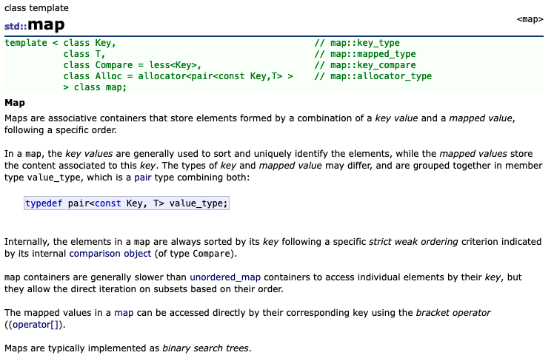
C++
https://cplusplus.com/reference/map/map/

Slide 20
#include <iostream>
#include <map>
using namespace std;
int main() {
map<string, int> mp;
printf("Testing map class\n");
mp["z"] = 8;
mp["z"] = 1;
mp["y"] = 2;
mp["b"] = 3;
mp["a"] = 4;
printf("z=%d\n", (mp.count("z") ? mp["z"] : 42));
printf("x=%d\n", (mp.count("x") ? mp["x"] : 42));
printf("\nIterate forwards\n");
for (auto cur = mp.begin(); cur != mp.end(); ++cur) {
printf(" %s=%d\n", cur->first.c_str(), cur->second);
}
}
Testing map class
z=1
x=42
Iterate forwards
a=4
b=3
y=2
z=1
cc_04_01.cpp

Slide 21
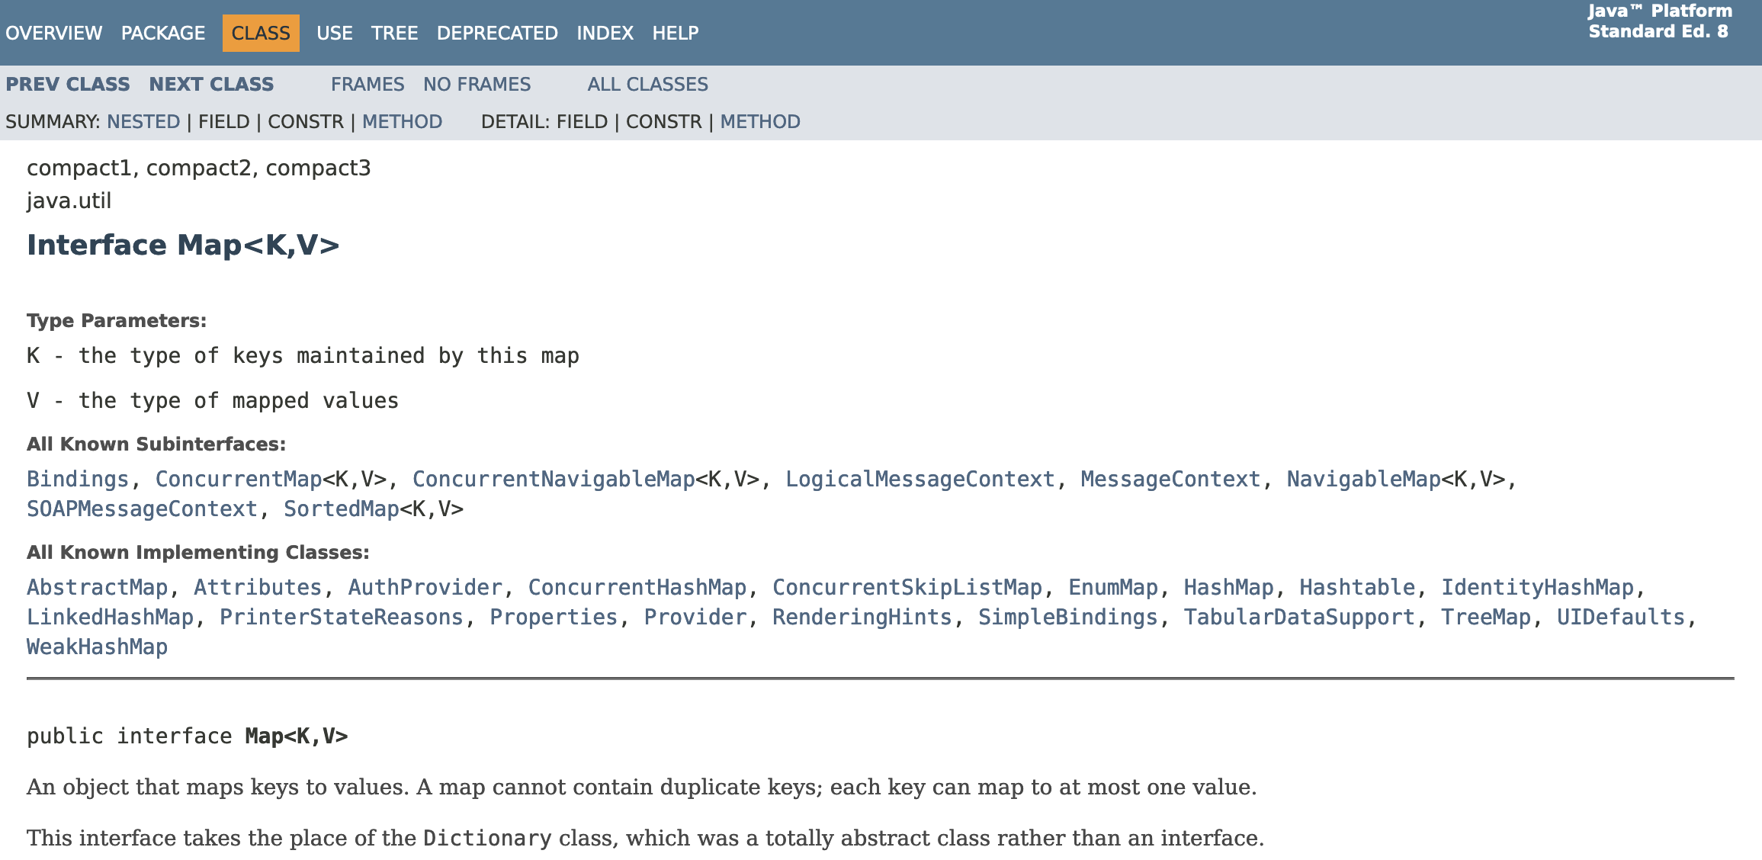
Java Map<String, Integer>
https://docs.oracle.com/javase/8/docs/api/java/util/Map.html

Slide 22
import java.util.Map;
import java.util.TreeMap;
public class cc_05_01 {
public static void main(String[] args)
{
Map<String, Integer> map = new TreeMap<String, Integer> ();
System.out.printf("Testing Map class\n");
map.put("z", 8);
map.put("z", 1);
map.put("y", 2);
map.put("b", 3);
map.put("a", 4);
System.out.println(map);
System.out.println("z="+map.getOrDefault("z", 42));
System.out.println("x="+map.getOrDefault("x", 42));
System.out.printf("\nIterate forwards\n");
for (Map.Entry<String,Integer> entry : map.entrySet()) {
System.out.println("Key = " + entry.getKey() + ",
Value = " + entry.getValue());
}
Integer max = null;
String max_key = null;
for (Map.Entry<String,Integer> entry : map.entrySet()) {
if ( max == null || entry.getValue() > max ) {
max = entry.getValue();
max_key = entry.getKey();
}
}
System.out.printf("The largest value is %s=%d\n", max_key, max);
}
}
Testing Map class
{a=4, b=3, y=2, z=1}
z=1
x=42
Iterate forwards
Key = a, Value = 4
Key = b, Value = 3
Key = y, Value = 2
Key = z, Value = 1
The largest value is a=4
cc_04_01.java

Slide 23
d = dict()
print("Testing dict class\n");
d["z"] = 8
d["z"] = 1
d["y"] = 9
d["b"] = 3
d["a"] = 4
print(d);
print("z=%d" % (d.get("z", 42), ));
print("x=%d" % (d.get("x", 42), ));
items = iter(d.items())
print(type(items));
entry = next(items, False)
while (entry) :
print(entry)
entry = next(items, False)
sd = reversed(sorted(d.items(), key=lambda item: item[1]))
first = next(iter(sd))
print('The largest value', first)
Testing dict class
{'z': 1, 'y': 9, 'b': 3, 'a': 4}
z=1
x=42
<class 'dict_itemiterator'>
('z', 1)
('y', 9)
('b', 3)
('a', 4)
The largest value ('y', 9)
cc_04_01.py

Slide 24
int main(void)
{
struct Map * map = Map_new();
struct MapEntry *cur;
struct MapIter *iter;
printf("Testing Map class\n");
map->put(map, "z", 8);
map->put(map, "z", 1);
map->put(map, "y", 2);
map->put(map, "b", 3);
map->put(map, "a", 4);
map->dump(map);
printf("z=%d\n", map->get(map, "z", 42));
printf("x=%d\n", map->get(map, "x", 42));
printf("\nIterate forwards\n");
iter = map->first(map);
while((cur = iter->next(iter)) != NULL ) {
printf(" %s=%d\n", cur->key, cur->value);
}
iter->del(iter);
...
Testing Map class
Object Map@0x600002a3c000 count=4
z=1
y=2
b=3
a=4
z=1
x=42
Iterate forwards
y=2
b=3
a=4
cc_04_01.c

Slide 25
…
printf("\nIterate backwards\n");
iter = map->last(map);
while((cur = iter->next(iter)) != NULL ) {
printf(" %s=%d\n", cur->key, cur->value);
}
iter->del(iter);
map->ksort(map);
printf("\nSorted by key\n");
map->dump(map);
printf("\nSorted by value\n");
map->asort(map);
map->dump(map);
cur = map->index(map, 0);
printf("The smallest value is %s=%d\n", cur->key, cur->value);
int pos = map->size(map) - 1;
cur = map->index(map, pos);
printf("The largest value is %s=%d\n", cur->key, cur->value);
map->del(map);
}
Iterate backwards
b=3
y=2
z=1
Sorted by key
Object Map@0x600002a3c000 count=4
a=4
b=3
y=2
z=1
Sorted by value
Object Map@0x600002a3c000 count=4
z=1
y=2
b=3
a=4
The smallest value is z=1
The largest value is a=4
cc_04_01.c

Slide 26
Lets build a Map in C

Slide 27
MapEntry Structure
This is the structure that will make up the nodes in the list.
The key is a character string – the actual data will be saved in a newly allocated space.
The value is an int and will be allocated right in the node.
/*
* This is our map entry for Map<String,Integer>
*
* The key is a string / character array which is allocated
* using malloc() when a new entry is created.
*/
struct MapEntry {
char *key;
int value;
struct MapEntry *prev;
struct MapEntry *next;
};

Slide 28
Map
struct Map {
/* Attributes */
struct MapEntry *head;
struct MapEntry *tail;
int count;
/* Methods */
void (*put)(struct Map* self,
char *key,int value);
int (*get)(struct Map* self,
char *key, int def);
int (*size)(struct Map* self);
void (*dump)(struct Map* self);
struct MapIter* (*first)(struct Map* self);
struct MapIter* (*last)(struct Map* self);
void (*asort)(struct Map* self);
void (*ksort)(struct Map* self);
struct MapEntry* (*index)(struct Map* self,
int position);
void (*del)(struct Map* self);
};
This contains the attributes and methods
The reverse and current fields will be used to implement the first/next or last/next iterator pattern
We will use the pattern where the pointers to the methods will be in each instance.

Slide 29
Constructor
struct Map * Map_new() {
struct Map *p = malloc(sizeof(*p));
p->head = NULL;
p->tail = NULL;
p->count = 0;
p->put = &Map_put;
p->get = &Map_get;
p->size = &Map_size;
p->dump = &Map_dump;
p->first = &Map_first;
p->last = &Map_last;
p->asort = &Map_asort;
p->ksort = &Map_ksort;
p->index = &Map_index;
p->del = &Map_del;
return p;
}
Allocate the Map and fill it with defaults.

Slide 30
Destructor
/**
* Destructor for the Map Class
*
* Loops through and frees all the keys and
* entries in the map. The values are integers
* and so there is no need to free them.
*/
void Map_del(struct Map* self) {
struct MapEntry *cur, *next;
cur = self->head;
while(cur) {
free(cur->key);
/* value is just part of the struct */
next = cur->next;
free(cur);
cur = next;
}
free((void *)self);
}
Free the allocated key strings, then the MapEntry structure
Note that we take cur->next before we free the node, assuming that cur data might be gone.
At the very end we free the Map structure

Slide 31
Map_dump
Build a simple debug tool right away ☺
/**
* Map_dump - In effect a toString() except we print
* the contents of the Map to stdout
*
* self – The pointer to the instance of this class.
*/
void Map_dump(struct Map* self)
{
struct MapEntry *cur;
printf("Object Map@%p count=%d\n", self, self->count);
for(cur = self->head; cur != NULL ; cur = cur->next ) {
printf(" %s=%d\n", cur->key, cur->value);
}
}

Slide 32
Map_get
/**
* Map_get - Locate and return the value for the
* corresponding key or a default value
*
* self - The pointer to the instance of this class.
* key - A character pointer to the key value
* def - A default value to return if the key is
* not in the Map
*
* Returns an integer
*
* Sample call:
*
* int ret = map->get(map, "z", 42);
*
* This method takes inspiration from the Python code:
*
* value = map.get("key", 42)
*/
int Map_get(struct Map* self, char *key, int def)
{
struct MapEntry *retval = Map_find(self, key);
if ( retval == NULL ) return def;
return retval->value;
}
Returns the value stored at the key or a default value
Pretty simple when you can use Map_find()

Slide 33
Map_put
/**
* Map_put - Add or update an entry in the Map
*
* self - The pointer to the instance of this class.
* key - A character pointer to the key value
* value - The value to be stored with the associated key
*
* If the key is not in the Map, an entry is added. If there
* is already an entry in the Map for the key, the value
* is updated.
*
* Sample call:
*
* map->put(map, "x", 42);
*
* This method takes inspiration from the Python code:
*
* map["key"] = value
*/
void Map_put(struct Map* self, char *key, int value) {
...
}
This is not used by main() – it is just for in-class use – that is the definition of "private" in OO-speak
Uses Map_find() to check if the key is already in the map to make sure

Slide 34
Map_get()
/**
* Map_get - Locate and return the value for the
* corresponding key or a default value
*
* self - The pointer to the instance of this class.
* key - A character pointer to the key value
* def - A default value to return if the key
* is not in the Map
*
* Returns an integer
*
* This method takes inspiration from the Python code:
*
* value = map.get("key", 42)
*/
int Map_get(struct Map* self, char *key, int def)
{
...
}
This is not used by main() – it is just for in-class use – that is the definition of "private" in OO-speak
Uses Map_find() to check if the key is already in the map to make sure

Slide 35

Iterators

Slide 36
Separation of Concerns
struct Map {
/* Attributes */
struct MapEntry *head;
struct MapEntry *tail;
int count;
/* Methods */
...
};
/* This loop is OK in an object
method – but not in main() */
for (current = map->head;
current != NULL;
current = current->next )
{
}
Following the practice or "Separation of concerns", object builders usually make attributes critical to the functioning of the object "private"
They do not want the calling code to look directly at head or count – and even worse the object will break badly if the main program starts messing with these values
https://en.wikipedia.org/wiki/Separation_of_concerns

Slide 37
About Iterators
x = {'a': 1, 'b': 2, 'c': 3}
print('x is', x)
y = list(x)
print('y is', y)
it = iter(x)
print('it is', it)
while True :
item = next(it, False)
if item is False : break
print('item is', item)
it = iter(reversed(x))
print('it is', it)
while True :
item = next(it, False)
if item is False : break
print('item is', item)
next
To allow code outside the the object to traverse a list, we use iterators
Once we have an iterator, each time we call "next" we get the next item in the list until the end
x is {'a': 1, 'b': 2, 'c': 3}
y is ['a', 'b', 'c']
it is <dict_keyiterator object at 0x100410a40>
item is a
item is b
item is c
it is <dict_reversekeyiterator object at 0x1005888b0>
item is c
item is b
item is a
https://en.wikipedia.org/wiki/Iterator
cc_05_02.py

Slide 38
Struct MapIter
ddsds
/*
* A MapIter contains the current item and whether
* this is a forward or reverse iterator.
*/
struct MapIter {
struct MapEntry *current;
int reverse;
struct MapEntry* (*next)(struct MapIter* self);
void (*del)(struct MapIter* self);
};

Slide 39
Map_first()
/**
* Map_first - Create an iterator from the head of
* the Map and return the first item
*
* self - The pointer to the instance of this class.
*
* returns NULL when there are no entries in the Map
*
* This is inspired by the following Python code
* that creates an iterator from a dictionary:
*
* x = {'a': 1, 'b': 2, 'c': 3}
* it = iter(x)
*/
Struct MapIter* Map_first(struct Map* self)
{
struct MapIter *iter = malloc(sizeof(*iter));
iter->current = self->head;
iter->reverse = 0;
iter->next = &MapIter_next;
iter->del = &MapIter_del;
return iter;
}
ddsds

Slide 40
MapIter_next()
/**
* MapIter_next - Advance the iterator forwards
* or backwards and return the next item
*
* self - The pointer to the instance of this class.
*
* returns NULL when there are no more entries
*
* This is inspired by the following Python code:
*
* item = next(iterator, False)
*/
struct MapEntry* MapIter_next(struct MapIter* self)
{
if ( self->current == NULL) return NULL;
if ( self->reverse == 0 ) {
self->current = self->current->next;
} else {
self->current = self->current->prev;
}
return self->current;
}
This is a method in the Map Iterator

Slide 41
Using an iterator
printf("\nIterate forwards\n");
iter = map->first(map);
while(1) {
cur = iter->next(iter);
if ( cur == NULL ) break;
printf(" %s=%d\n", cur->key, cur->value);
}
iter->del(iter);
You create the iterator
Then in a loop, you call next() to get each successive entry in the map, until you exhaust the entries
x = {'a': 1, 'b': 2, 'c': 3}
it = iter(x)
while True :
item = next(it, False)
if item is False : break
print('item is', item)
cc_04_03.py

Slide 42
Map_last()
/**
* Map_last - Start an iterator at the tail of the
* Map and mark the iterator as "going backwards"
*
* self - The pointer to the instance of this class.
*
* returns NULL when there are no entries in the Map
*
* This is inspired by the following Python code:
*
* x = {'a': 1, 'b': 2, 'c': 3}
* it = iter(reversed(x))
*/
struct MapIter* Map_last(struct Map* self)
{
...
}
Same as Map_first except that we start at tail and indicate we are supposed to go backwards when next() is called..
printf("\nIterate backwards\n");
iter = map->last(map);
while(1) {
cur = iter->next(iter);
if ( cur == NULL ) break;
printf(" %s=%d\n", cur->key, cur->value);
}
iter->del(iter);

Slide 43
Summary
We have altered the interface to our map to allow us to radically change the implementation of the Map without affecting the calling code
Abstraction
Encapsulation

