Slide 1

K&R Chapter 2
Dr. Charles R. Severance
www.cc4e.com

Slide 2
Chapter 2 – Unique Areas
Section 2.2 – Data types and storage allocation – character, integer, short, long get all the attention. Interestingly float and double are pretty consistent with modern languages
Section 2.7 – Type conversion – integer division and Python 2.0 and 3.0 pain and history
Section 2.9 – Bitwise Logical Operations – Rarely used – In Chapter 6 struct data types are better at extracting but ranges

Slide 3
Pre-1970 Computers
Scientific – Needed to do billions of calculations fast
Astronomy simulations / weather simulations / ballistics / rocket science
Control Data / Cray / FORTRAN
Integer / Floating Point focused
Business – Needed to read and write data – calculations were simple
Accounting / banking / census
IBM / Burroughs / COBOL
Character set focused - ASCII / EBCDIC / ???

Slide 4
Minicomputers in the 1970’s
As computer components (i.e. transistors and then chips) became commodities, it was possible to make less expensive computers
Digital Equipment Corporation (DEC) was a leading minicomputer manufacturer
Minicomputers were more about flexibility and ease of use than raw speed – they were equally good at
Character / integer / floating point (albeit slowly in software)
Minicomputers were often used as tools to augment human-to-human communication
Word processing / email / software development

Slide 5
To the present…
1980s – Microprocessors like the Intel 8086 made small, low power, portal “personal” computers. They were good at integer and character computation and did not focus on floating point performance
1990s – Single chips RISC microprocessors led to workstations like the RS/6000 which took a lot of power but had faster floating point than many “refrigerator-sized” computers
2000s – Microprocessors from Intel and AMD got better at floating point and made RISC processors unnecessary (saving a lot of power and heat)
2010s – It is all about power consumption. ARM Processors performance caught up with Intel saving a lot more power and heat

Slide 6
UNIX and C

Slide 7
Character Arrays
We must carefully understand the “size” of the character array and not exceed it – in C nothing is “auto-extended”
#import <stdio.h>
int main() {
char x[10];
int i;
for(i=0; i<1000; i++ ) x[i] = '*';
printf("%s\\n",x);
}
$ a.out
Segmentation fault: 11
x = ""
for i in range(1000) :
x += '*'
print(x)
$ python3 cc_01_01.py
*********…***********
kr_01_01.c

Slide 8
String / Character Constants
Languages like PHP, Python, and JavaScript treat single and double quotes nearly the same. Both create *string* constants.
In C single quotes are a character and double quotes are a character array (neither are a string)
In C, a character is a byte – a short (typically 8-bit) integer
#include <stdio.h>
int main() {
char x[3] = "Hi";
char y[3] = { 'H', 'i' };
printf("x %s\n", x);
printf("y %s\n", y);
printf("%s\n", "Hi");
printf("%c%c\n", 'H', 'i');
}
$ a.out
x Hi
y Hi
Hi
Hi
kr_01_02.c

Slide 9
Character Sets
The C char type is just a number – character representations depend on the character set.
Modern characters including 😊 are represented in multi-byte sequences using Unicode and UTF-8 – but in 1978 we used ASCII and other character sets.
print('A', ord('A'))
print('😊', ord('😊’))
$ python3 kr_01_03.py
A 65
😊 128522
#include <stdio.h>
int main()
{
printf("%c %d\n", 'A', 'A');
}
$ a.out
A 65
kr_01_03.c

Slide 10
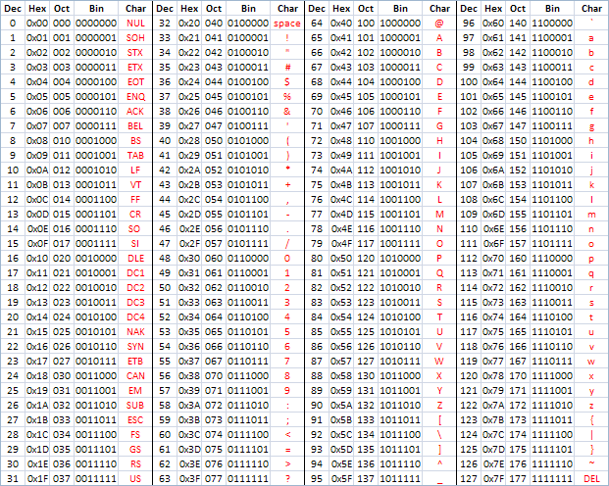
ASCII
American Standard Code for Information Interchange
https://en.wikipedia.org/wiki/ASCII
http://www.catonmat.net/download/ascii-cheat-sheet.png

Slide 11
Terminating a String
#import <stdio.h>
int main() {
char x[6];
x[0] = 'H';
x[1] = 'e';
x[2] = 'l';
x[3] = 'l';
x[4] = 'o';
x[5] = '\0';
printf("%s\n",x);
x[2] = 'L';
printf("%s\n",x);
x[3] = '\0';
printf("%s\n",x);
}
$ a.out
Hello
HeLlo
HeL
The size of a “string” stored in a C array is not the length of the array
C uses a special character ' \0 ' that *marks* the string end by convention
Character arrays need to allocate an extra byte to store the line-end character
kr_01_04.c

Slide 12
String Length
#include <stdio.h>
int main() {
char x[] = "Hello";
int py_len();
printf("%s %d\n",x, py_len(x));
}
int py_len(self)
char self[];
{
int i, len=0;
for(i=0;self[i];i++) len=i;
return i;
}
$ a.out
Hello 5
In C string “length” must be computed in a loop that scans for a zero character
There the strlen() function in string.h computes string length
x = 'Hello'
print(x, len(x))
$ python3 kr_01_05.py
Hello 5
kr_01_05.c

Slide 13
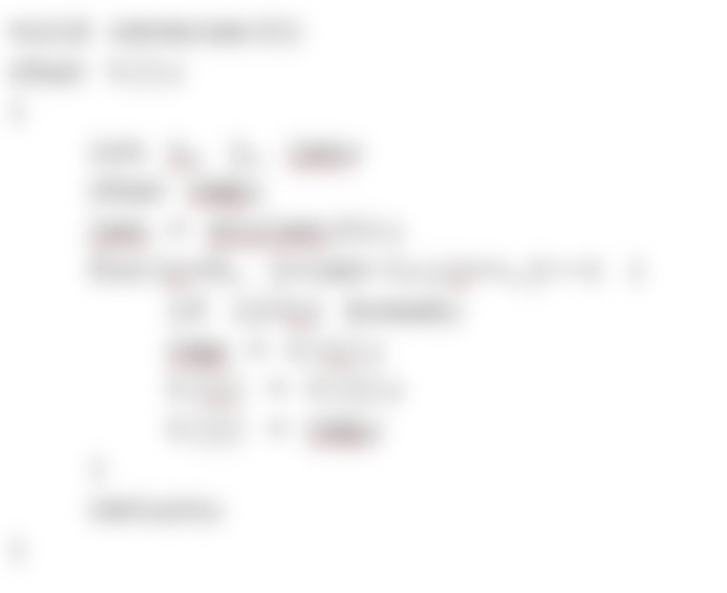
Reverse a String in C
A beloved / terrible coding interview question
Exercise 1-17 in K&R
Do *not* cheat, do not look for the answer (1000’s are out there)
Your struggle is very valuable for you
The reversal must be done in-place
Even length strings, odd length strings, empty strings, single character strings – think about them all

Slide 14
Summary
History of the C Language
History of Computer Hardware
History of the UNIX operating system
History of “the first programming language”

Slide 15
Acknowledgements / Contributions
These slides are Copyright 2022- Charles R. Severance (online.dr-chuck.com) as part of www.cc4e.com and made available under a Creative Commons Attribution 4.0 License. Please maintain this last slide in all copies of the document to comply with the attribution requirements of the license. If you make a change, feel free to add your name and organization to the list of contributors on this page as you republish the materials.
Initial Development: Charles Severance, University of Michigan School of Information
Insert new Contributors and Translators here including names and dates
Continue new Contributors and Translators here

