Slide 1
A Data Structure
Dr. Charles R. Severance
www.cc4e.com

Slide 2
Our Data Structure – Key / Value Pairs
Inspiration
Python dictionary
Java Map<String, Integer>
PHP Arrays
Start with Doubly Linked List of Key / Value pairs
Put, Get, Delete
Iterator Pattern
Reverse Iterator
Swapping items in a list
Sort Keys / Sort Values

Slide 3
d = dict()
print("Testing dict class\n");
d["z"] = 8
d["z"] = 1
d["y"] = 9
d["b"] = 3
d["a"] = 4
print(d);
print("z=%d" % (d.get("z", 42), ));
print("x=%d" % (d.get("x", 42), ));
items = iter(d.items())
print(type(items));
entry = next(items, False)
while (entry) :
print(entry)
entry = next(items, False)
sd = reversed(sorted(d.items(), key=lambda item: item[1]))
first = next(iter(sd))
print('The largest value', first)
Testing dict class
{'z': 1, 'y': 9, 'b': 3, 'a': 4}
z=1
x=42
<class 'dict_itemiterator'>
('z', 1)
('y', 9)
('b', 3)
('a', 4)
The largest value ('y', 9)
cc_04_01.py

Slide 4
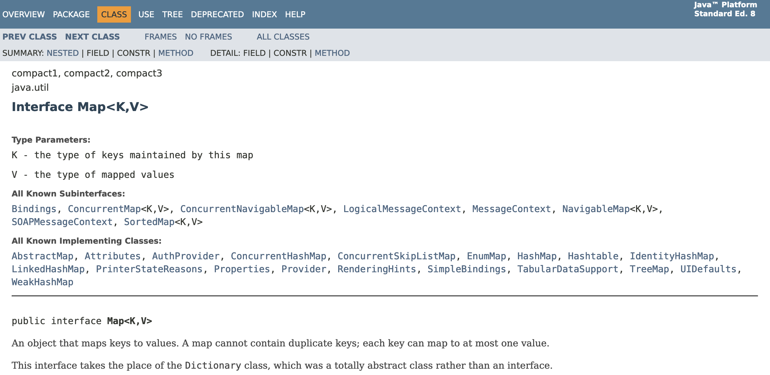
Java Map<Integer, String>
https://docs.oracle.com/javase/8/docs/api/java/util/Map.html

Slide 5
import java.util.Map;
import java.util.TreeMap;
public class cc_04_01 {
public static void main(String[] args)
{
Map<String, Integer> map = new TreeMap<String, Integer> ();
System.out.printf("Testing Map class\n");
map.put("z", 8);
map.put("z", 1);
map.put("y", 2);
map.put("b", 3);
map.put("a", 4);
System.out.println(map);
System.out.println("z="+map.getOrDefault("z", 42));
System.out.println("x="+map.getOrDefault("x", 42));
System.out.printf("\nIterate forwards\n");
for (Map.Entry<String,Integer> entry : map.entrySet()) {
System.out.println("Key = " + entry.getKey() + ",
Value = " + entry.getValue());
}
Integer max = null;
String max_key = null;
for (Map.Entry<String,Integer> entry : map.entrySet()) {
if ( max == null || entry.getValue() > max ) {
max = entry.getValue();
max_key = entry.getKey();
}
}
System.out.printf("The largest value is %s=%d\n", max_key, max);
}
}
Testing Map class
{a=4, b=3, y=2, z=1}
z=1
x=42
Iterate forwards
Key = a, Value = 4
Key = b, Value = 3
Key = y, Value = 2
Key = z, Value = 1
The largest value is a=4
C++ was initially implemented as a pre-processing pass that did textual transformations and then passed the code into the C compiler. There is no concept of "self" or "this".
cc_04_01.java

Slide 6
Testing dict class
Array
(
[z] => 1
[y] => 9
[b] => 3
[a] => 4
)
z=1
x=42
Iterate
z=1
y=9
b=3
a=4
Sort by key
Array
(
[a] => 4
[b] => 3
[y] => 9
[z] => 1
)
Sort by value in reverse
Array
(
[y] => 9
[a] => 4
[b] => 3
[z] => 1
)
Largest value y=9
$a = array();
print("Testing php arrays\n");
$a["z"] = 8;
$a["z"] = 1;
$a["y"] = 9;
$a["b"] = 3;
$a["a"] = 4;
print_r($a);
printf("z=%d\n", $a["z"] ?? 42);
printf("x=%d\n", $a["x"] ?? 42);
printf("\nIterate\n");
foreach( $a as $k => $v ) {
printf(" %s=%d\n", $k, $v);
}
ksort($a);
printf("\nSort by key\n");
print_r($a);
arsort($a);
printf("\nSort by value in reverse\n");
print_r($a);
$k = array_key_first($a);
printf("Largest value %s=%d\n", $k, $a[$k]);
cc_04_01.php

Slide 7
d = dict()
print("Testing dict class\n");
d["z"] = 8
d["z"] = 1
d["y"] = 9
d["b"] = 3
d["a"] = 4
print(d);
print("z=%d" % (d.get("z", 42), ));
print("x=%d" % (d.get("x", 42), ));
items = iter(d.items())
print(type(items));
entry = next(items, False)
while (entry) :
print(entry)
entry = next(items, False)
sd = reversed(sorted(d.items(), key=lambda item: item[1]))
first = next(iter(sd))
print('The largest value', first)
Testing dict class
{'z': 1, 'y': 9, 'b': 3, 'a': 4}
z=1
x=42
<class 'dict_itemiterator'>
('z', 1)
('y', 9)
('b', 3)
('a', 4)
The largest value ('y', 9)
cc_04_01.py

Slide 8
Object Map@0x600001ebc000 count=4
z=1
y=2
b=3
a=4
z=1
x=42
Iterate forwards
z=1
y=2
b=3
a=4
Iterate backwards
a=4
b=3
y=2
z=1
Sorted by key
Object Map@0x600001ebc000 count=4
a=4
b=3
y=2
z=1
Sorted by value
Object Map@0x600001ebc000 count=4
z=1
y=2
b=3
a=4
The smallest value is z=1
The largest value is a=4
int main(void)
{
struct MapEntry *cur;
struct Map * map = Map_new();
printf("Testing Map class\n");
map->put(map, "z", 8);
map->put(map, "z", 1);
map->put(map, "y", 2);
map->put(map, "b", 3);
map->put(map, "a", 4);
map->dump(map);
printf("z=%d\n", map->get(map, "z", 42));
printf("x=%d\n", map->get(map, "x", 42));
printf("\nIterate forwards\n");
for(cur=map->first(map); cur!=NULL; cur=map->next(map) ) {
printf(" %s=%d\n", cur->key, cur->value);
}
printf("\nIterate backwards\n");
for(cur = map->last(map); cur != NULL; cur = map->next(map) ) {
printf(" %s=%d\n", cur->key, cur->value);
}
…
cc_04_01.c

Slide 9
Object Map@0x600001ebc000 count=4
z=1
y=2
b=3
a=4
z=1
x=42
Iterate forwards
z=1
y=2
b=3
a=4
Iterate backwards
a=4
b=3
y=2
z=1
Sorted by key
Object Map@0x600001ebc000 count=4
a=4
b=3
y=2
z=1
Sorted by value
Object Map@0x600001ebc000 count=4
z=1
y=2
b=3
a=4
The smallest value is z=1
The largest value is a=4
…
map->ksort(map);
printf("\nSorted by key\n");
map->dump(map);
printf("\nSorted by value\n");
map->asort(map);
map->dump(map);
cur = map->first(map);
printf("The smallest value is %s=%d\n", cur->key, cur->value);
cur = map->last(map);
printf("The largest value is %s=%d\n", cur->key, cur->value);
Map_del(map);
}
cc_04_01.c

Slide 10
Looking at Code

Slide 11
MapEntry Structure
This is the structure that will make up the nodes in the list.
The key is a character string – the actual data will be saved in a newly allocated space.
The value is an int and will be allocated right in the node.
/*
* This is our map entry for Map<String,Integer>
*
* The key is a string / character array which is allocated
* using malloc() when a new entry is created.
*/
struct MapEntry {
char *key;
int value;
struct MapEntry *prev;
struct MapEntry *next;
};

Slide 12
Map
struct Map {
/* Attributes */
struct MapEntry *head;
struct MapEntry *tail;
struct MapEntry *current;
int count;
int reverse;
/* Methods */
void (*put)(struct Map* self, char *key, int value);
int (*get)(struct Map* self, char *key, int def);
int (*size)(struct Map* self);
void (*dump)(struct Map* self);
struct MapEntry* (*first)(struct Map* self);
struct MapEntry* (*last)(struct Map* self);
struct MapEntry* (*next)(struct Map* self);
void (*asort)(struct Map* self);
void (*ksort)(struct Map* self);
};
This contains the attributes and methods
The reverse and current fields will be used to implement the first/next or last/next iterator pattern
We will use the pattern where the pointers to the methods will be in each instance.

Slide 13
Constructor
struct Map * Map_new() {
struct Map *p = malloc(sizeof(*p));
p->head = NULL;
p->tail = NULL;
p->current = NULL;
p->count = 0;
p->reverse = 0;
p->put = &Map_put;
p->get = &Map_get;
p->size = &Map_size;
p->dump = &Map_dump;
p->first = &Map_first;
p->last = &Map_last;
p->next = &Map_next;
p->asort = &Map_asort;
p->ksort = &Map_ksort;
return p;
}
Allocate the Map and fill it with defaults.

Slide 14
Destructor
/**
* Destructor for the Map Class
*
* Loops through and frees all the keys and
* entries in the map. The values are integers
* and so there is no need to free them.
*/
void Map_del(struct Map* self) {
struct MapEntry *cur, *next;
cur = self->head;
while(cur) {
free(cur->key);
/* value is just part of the struct */
next = cur->next;
free(cur);
cur = next;
}
free((void *)self);
}
Free the allocated key strings, then the MapEntry structure
Note that we take cur->next before we free the node, assuming that cur data might be gone.
At the very end we free the Map structure

Slide 15
Map_dump
Build a simple debug tool right away ☺
/**
* Map_dump - In effect a toString() except we print
* the contents of the Map to stdout
*
* self – The pointer to the instance of this class.
*/
Void Map_dump(struct Map* self)
{
struct MapEntry *cur;
printf("Object Map@%p count=%d\n", self, self->count);
for(cur = self->head; cur != NULL ; cur = cur->next ) {
printf(" %s=%d\n", cur->key, cur->value);
}
}

Slide 16
Map_get
/**
* Map_get - Locate and return the value for the
* corresponding key or a default value
*
* self - The pointer to the instance of this class.
* key - A character pointer to the key value
* def - A default value to return if the key is
* not in the Map
*
* Returns an integer
*
* Sample call:
*
* int ret = map->get(map, "z", 42);
*
* This method takes inspiration from the Python code:
*
* value = map.get("key", def)
*/
int Map_get(struct Map* self, char *key, int def)
{
struct MapEntry *retval = Map_find(self, key);
if ( retval == NULL ) return def;
return retval->value;
}
Returns the value stored at the key or a default value
Pretty simple when you can use Map_find()

Slide 17
Map_put
/**
* Map_put - Add or update an entry in the Map
*
* self - The pointer to the instance of this class.
* key - A character pointer to the key value
* value - The value to be stored with the associated key
*
* If the key is not in the Map, an entry is added. If there
* is already an entry in the Map for the key, the value
* is updated.
*
* Sample call:
*
* map->put(map, "x", 42);
*
* This method takes inspiration from the Python code:
*
* map["key"] = value
*/
void Map_put(struct Map* self, char *key, int value) {
...
}
This is not used by main() – it is just for in-class use – that is the definition of "private" in OO-speak
Uses Map_find() to check if the key is already in the map to make sure

Slide 18
Map_get
/**
* Map_get - Locate and return the value for the
* corresponding key or a default value
*
* self - The pointer to the instance of this class.
* key - A character pointer to the key value
* def - A default value to return if the key is not in the Map
*
* Returns an integer
*
* This method takes inspiration from the Python code:
*
* value = map.get("key", def)
*/
int Map_get(struct Map* self, char *key, int def)
{
This is not used by main() – it is just for in-class use – that is the definition of "private" in OO-speak
Uses Map_find() to check if the key is already in the map to make sure

Slide 19
Iterators

Slide 20
Separation of Concerns
Following the practice or "Separation of concerns", object builders usually make attributes critical to the functioning of the object "private"
They do not want the calling code to look directly at head or count – and even worse the object will break badly if the main program starts changing these values
struct Map {
/* Attributes */
struct MapEntry *head;
struct MapEntry *tail;
struct MapEntry *current;
int count;
int reverse;
...
};
https://en.wikipedia.org/wiki/Separation_of_concerns

Slide 21
About Iterators
struct Map {
/* Attributes */
struct MapEntry *head;
struct MapEntry *tail;
struct MapEntry *current;
int count;
int reverse;
...
struct MapEntry* (*first)(struct Map* self);
struct MapEntry* (*next)(struct Map* self);
};
Following the practice or "Separation of concerns", object builders usually make attributes critical to the functioning of the object "private"
In computer programming, an iterator is an object that enables a programmer to traverse a container, particularly lists
https://en.wikipedia.org/wiki/Separation_of_concerns
https://en.wikipedia.org/wiki/Iterator

