Slide 1

K&R Chapter 6 Structures
Dr. Charles R. Severance
www.cc4e.com

Slide 2
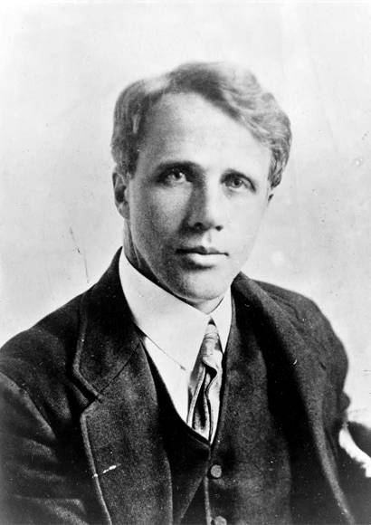

A Bit of Poetry – Robert Frost
Taught at the University of Michigan 1921-1927
Consultant in Poetry to the US Library of Congress 1958-1959
His grandson Bob Frost was a colleague of mine at the University of Michigan for many years
https://en.wikipedia.org/wiki/Robert_Frost

Slide 3
“The Road Not Taken”
Two roads diverged in a yellow wood, And sorry I could not travel both And be one traveler, long I stood And looked down one as far as I could To where it bent in the undergrowth; Then took the other, as just as fair, And having perhaps the better claim, Because it was grassy and wanted wear; Though as for that the passing there Had worn them really about the same, And both that morning equally lay In leaves no step had trodden black. Oh, I kept the first for another day! Yet knowing how way leads on to way, I doubted if I should ever come back. I shall be telling this with a sigh Somewhere ages and ages hence: Two roads diverged in a wood, and I— I took the one less traveled by, And that has made all the difference.
https://en.wikipedia.org/wiki/Wikipedia:Taking_the_road_less_traveled

Slide 4
“Stopping by Woods on a Snowy Evening”
Whose woods these are I think I know.
His house is in the village though;
He will not see me stopping here
To watch his woods fill up with snow.
My little horse must think it queer
To stop without a farmhouse near
Between the woods and frozen lake
The darkest evening of the year.
He gives his harness bells a shake
To ask if there is some mistake.
The only other sound’s the sweep
Of easy wind and downy flake.
The woods are lovely, dark and deep,
But I have promises to keep,
And miles to go before I sleep,
And miles to go before I sleep.
https://en.wikipedia.org/wiki/Wikipedia:Taking_the_road_less_traveled

Slide 5
Two Paths Through Chapter 6
Two ways I could teach Chapter 6
Study for a future programming interview
Continue toward understanding the nature of computers and computing
Chapter 6 Implements a binary tree and a hash map using structures without much background on the uses of these data structures
If your goal is a programming interview, slow way down and read and understand Chapter 6 – find some outside recourses on these data structures
I will take the road (2) less taken….

Slide 6
Chapter 6 – The road less travelled
I will only cover 6.1, part of 6.2, and 6.5.1
There are many sources of material to study for programming exams.
You can read the rest of Chapter 6 as much and often as you like

Slide 7
6.1 Structures
#include <stdio.h>
int main() {
struct point {
double x;
double y;
};
struct point p1, p2;
p1.x = 3.0;
p1.y = 4.0;
p2 = p1;
printf("%f %f\n", p2.x, p2.y);
}
A struct is a user defined type that contains one or more types that can be treated as a unit.
The elements or variables mentioned in a structure are called members.
The dot operator allows us to access the members of the structure
3.000000 4.000000
kr_06_01.c

Slide 8
#include <stdio.h>
struct point {
double x;
double y;
};
void func(pf)
struct point pf;
{
pf.x = 9.0;
pf.y = 8.0;
printf("func %f %f\n", pf.x, pf.y);
}
int main() {
struct point pm;
pm.x = 3.0;
pm.y = 4.0;
printf("main %f %f\n", pm.x, pm.y);
func(pm);
printf("back %f %f\n", pm.x, pm.y);
}
pf
x
9.0
stack
frame
y
8.0
copy
pm
pm
x
3.0
x
3.0
y
4.0
y
4.0
main 3.000000 4.000000
func 9.000000 8.000000
back 3.000000 4.000000
kr_06_02.c

Slide 9
6.2 Structures and Pointers
#include <stdio.h>
int main() {
struct point {
double x;
double y;
};
struct point pt, *pp;
pp = &pt;
pt.x = 3.0;
(*pp).y = 4.0;
printf("%p %f %f\n", pp, (*pp).x, pp->y);
}
0x16d72f1e0 3.000000 4.000000
kr_06_03.c

Slide 10
#include <stdio.h>
struct point {
double x;
double y;
};
void func(pp)
struct point *pp;
{
pp->x = 9.0;
pp->y = 8.0;
printf("func %f %f\n", pp->x, pp->y);
}
int main() {
struct point pm;
pm.x = 3.0;
pm.y = 4.0;
printf("main %f %f\n", pm.x, pm.y);
func(&pm);
printf("back %f %f\n", pm.x, pm.y);
}
pp
stack
frame
point
pm
pm
x
3.0
x
3.0
y
4.0
y
4.0
main 3.000000 4.000000
func 9.000000 8.000000
back 9.000000 8.000000
kr_06_04.c

Slide 11
6.2 Storage Allocation
#include <stdio.h>
int main() {
struct point {
double x;
double y;
};
struct point pt, *pp;
printf("sizeof pt %ld\n",sizeof(pt));
printf("sizeof pp %ld\n",sizeof(pp));
printf("sizeof point %ld\n",sizeof(struct point));
}
sizeof pt 16
sizeof pp 8
sizeof point 16
kr_06_05.c

Slide 12
6.2 Dynamic Memory
#include <stdio.h>
#include <stdlib.h>
int main() {
struct point {
double x;
double y;
};
struct point *pp;
pp = (struct point *) malloc(sizeof(struct point));
pp->x = 3.0;
(*pp).y = 4.0;
printf("%p %f %f\n", pp, (*pp).x, pp->y);
}
0x600002a0c030 3.000000 4.000000
kr_06_06.c

Slide 13
6.5.1 A list of strings
lines = list()
hand = open('romeo.txt')
for line in hand:
lines.append(line.rstrip())
for line in lines:
print(line)
Who is already sick and pale with grief
Arise fair sun and kill the envious moon
It is the east and Juliet is the sun
But soft what light through yonder window breaks
kr_06_07.py

Slide 14
6.5.1 Self Referential Structures
In C we need to create build a list() structure before we can use it
The entries in the list will be stored in dynamically allocated memory
Each list entry contains some data and links to other members of the list using pointers
text
H
e
l
l
o
struct lnode {
char *text;
struct lnode *next;
};
next
kr_06_07.c

Slide 15
Linked List
text
C
struct lnode {
char *text;
struct lnode *next;
};
struct lnode *head;
struct lnode *tail;
next
head
text
i
s
next
tail
text
f
u
n
C
is
fun
next
kr_06_07.c

Slide 16
while(fgets(line, MAXLINE, stdin) != NULL) {
char *save = (char *) malloc(strlen(line)+1);
strcpy(save, line);
struct lnode *new = (struct lnode *)
malloc(sizeof(struct lnode));
if ( tail != NULL ) tail->next = new;
new->text = save;
new->next = NULL;
tail = new;
if ( head == NULL ) head = new;
}
text
C
next
head
text
i
s
tail
next
Lets read a new line and append it to the end of the linked list.
kr_06_07.c

Slide 17
while(fgets(line, MAXLINE, stdin) != NULL) {
char *save = (char *) malloc(strlen(line)+1);
strcpy(save, line);
struct lnode *new = (struct lnode *)
malloc(sizeof(struct lnode));
if ( tail != NULL ) tail->next = new;
new->text = save;
new->next = NULL;
tail = new;
if ( head == NULL ) head = new;
}
text
C
next
head
text
i
s
tail
next
Read the line into an automatic character array variable (max 1000 characters).
line
f
u
n
kr_06_07.c

Slide 18
while(fgets(line, MAXLINE, stdin) != NULL) {
char *save = (char *) malloc(strlen(line)+1);
strcpy(save, line);
struct lnode *new = (struct lnode *)
malloc(sizeof(struct lnode));
if ( tail != NULL ) tail->next = new;
new->text = save;
new->next = NULL;
tail = new;
if ( head == NULL ) head = new;
}
text
C
next
head
text
i
s
tail
next
save
Allocate memory for the new line and copy the contents from line to save.
f
u
n
line
f
u
n
kr_06_07.c

Slide 19
while(fgets(line, MAXLINE, stdin) != NULL) {
char *save = (char *) malloc(strlen(line)+1);
strcpy(save, line);
struct lnode *new = (struct lnode *)
malloc(sizeof(struct lnode));
if ( tail != NULL ) tail->next = new;
new->text = save;
new->next = NULL;
tail = new;
if ( head == NULL ) head = new;
}
text
C
next
head
text
i
s
tail
next
new
save
Allocate memory for a new struct lnode.
text
f
u
n
next
kr_06_07.c

Slide 20
while(fgets(line, MAXLINE, stdin) != NULL) {
char *save = (char *) malloc(strlen(line)+1);
strcpy(save, line);
struct lnode *new = (struct lnode *)
malloc(sizeof(struct lnode));
if ( tail != NULL ) tail->next = new;
new->text = save;
new->next = NULL;
tail = new;
if ( head == NULL ) head = new;
}
text
C
next
head
text
i
s
tail
next
new
save
Append the new node to the end of the linked list.
text
f
u
n
next
kr_06_07.c

Slide 21
while(fgets(line, MAXLINE, stdin) != NULL) {
char *save = (char *) malloc(strlen(line)+1);
strcpy(save, line);
struct lnode *new = (struct lnode *)
malloc(sizeof(struct lnode));
if ( tail != NULL ) tail->next = new;
new->text = save;
new->next = NULL;
tail = new;
if ( head == NULL ) head = new;
}
text
C
next
head
text
i
s
tail
next
new
save
Point the text pointer in the lnode to the recently allocated copy of line.
text
f
u
n
next
kr_06_07.c

Slide 22
while(fgets(line, MAXLINE, stdin) != NULL) {
char *save = (char *) malloc(strlen(line)+1);
strcpy(save, line);
struct lnode *new = (struct lnode *)
malloc(sizeof(struct lnode));
if ( tail != NULL ) tail->next = new;
new->text = save;
new->next = NULL;
tail = new;
if ( head == NULL ) head = new;
}
text
C
next
head
text
i
s
tail
next
new
Mark the newly allocated struct lnode as the last item in the lost using NULL.
text
f
u
n
next
kr_06_07.c

Slide 23
while(fgets(line, MAXLINE, stdin) != NULL) {
char *save = (char *) malloc(strlen(line)+1);
strcpy(save, line);
struct lnode *new = (struct lnode *)
malloc(sizeof(struct lnode));
if ( tail != NULL ) tail->next = new;
new->text = save;
new->next = NULL;
tail = new;
if ( head == NULL ) head = new;
}
text
C
next
head
text
i
s
tail
next
new
Update tail to point to the newly allocated the “last item” in the list.
text
f
u
n
next
kr_06_07.c

Slide 24
while(fgets(line, MAXLINE, stdin) != NULL) {
char *save = (char *) malloc(strlen(line)+1);
strcpy(save, line);
struct lnode *new = (struct lnode *)
malloc(sizeof(struct lnode));
if ( tail != NULL ) tail->next = new;
new->text = save;
new->next = NULL;
tail = new;
if ( head == NULL ) head = new;
}
text
C
next
head
text
i
s
tail
next
Voila! Our list now has three entries with everything properly linked and we can read the next line!
text
f
u
n
next
kr_06_07.c

Slide 25
Walking a linked list
text
C
next
current
To traverse a list, we start at head and walk through the series of next pointers.
head
text
i
s
tail
next
for line in lines:
print(line)
text
f
u
n
for (current = head; current != NULL; current = current->next ) {
printf("%s", current->text);
}
next
kr_06_07.c

Slide 26
Walking a linked list
text
C
next
current
To traverse a list, we start at head and walk through the series of next pointers.
head
text
i
s
tail
next
text
f
u
n
for (current = head; current != NULL; current = current->next ) {
printf("%s", current->text);
}
next
kr_06_07.c

Slide 27
Walking a linked list
text
C
next
current
To traverse a list, we start at head and walk through the series of next pointers.
head
text
i
s
tail
next
text
f
u
n
for (current = head; current != NULL; current = current->next ) {
printf("%s", current->text);
}
next
kr_06_07.c

Slide 28
Walking a linked list
text
C
next
current
To traverse a list, we start at head and walk through the series of next pointers.
head
text
i
s
tail
next
text
f
u
n
for (current = head; current != NULL; current = current->next ) {
printf("%s", current->text);
}
next
kr_06_07.c

Slide 29
Walking a linked list
text
C
next
current
To traverse a list, we start at head and walk through the series of next pointers.
head
text
i
s
tail
next
text
f
u
n
for (current = head; current != NULL; current = current->next ) {
printf("%s", current->text);
}
next
kr_06_07.c

Slide 30
6.5.1 Reverse a List
lines = list()
hand = open('romeo.txt')
for line in hand:
lines.append(line.rstrip())
lines.reverse()
for line in lines:
print(line)
It is simple in Python
Who is already sick and pale with grief
Arise fair sun and kill the envious moon
It is the east and Juliet is the sun
But soft what light through yonder window breaks
kr_06_08.py

Slide 31
6.5.1 Doubly Linked List
To scan a linked list in reverse, we need a “previous” entry in addition to the “next” entry
We call this a “doubly linked list” because it simultaneously maintains forward and backward chains of pointers
struct lnode {
char *text;
struct lnode *prev;
struct lnode *next;
};
text
H
e
l
l
o
prev
next
kr_06_08.c

Slide 32
6.5.1 Doubly Linked List
struct lnode {
char *text;
struct lnode *prev;
struct lnode *next;
};
int main()
{
struct lnode *head = NULL;
struct lnode *tail = NULL;
struct lnode *current;
char line[MAXLINE];
while(fgets(line, MAXLINE, stdin) != NULL) {
char *save = (char *) malloc(strlen(line)+1);
strcpy(save, line);
struct lnode *new = (struct lnode *) malloc(sizeof(struct lnode));
if ( tail != NULL ) tail->next = new;
new->text = save;
new->next = NULL;
new->prev = tail;
tail = new;
if ( head == NULL ) head = new;
}
for (current = tail; current != NULL; current = current->prev ) {
printf("%s", current->text);
}
}
text
H
e
l
l
o
prev
next
kr_06_08.c

Slide 33
Doubly Linked List
text
C
prev
next
struct lnode {
char *text;
struct lnode *prev;
struct lnode *next;
};
struct lnode *head;
struct lnode *tail;
head
text
i
s
prev
next
tail
Section 6.5.1 walks through the doubly linked list example in some detail.
text
c
o
o
l
prev
next
kr_06_08.c

Slide 34
Walking a list backwards
text
C
prev
next
To traverse a list backwards, we start at tail and walk through the series of prev pointers.
head
text
i
s
current
prev
next
tail
for (current = tail; current != NULL; current = current->prev ) {
printf("%s", current->text);
}
text
c
o
o
l
prev
next
kr_06_08.c

Slide 35
Walking a list backwards
text
C
prev
next
To traverse a list backwards, we start at tail and walk through the series of prev pointers.
head
text
i
s
current
prev
next
tail
for (current = tail; current != NULL; current = current->prev ) {
printf("%s", current->text);
}
text
c
o
o
l
prev
next
kr_06_08.c

Slide 36
Walking a list backwards
text
C
prev
next
To traverse a list backwards, we start at tail and walk through the series of prev pointers.
head
text
i
s
current
prev
next
tail
for (current = tail; current != NULL; current = current->prev ) {
printf("%s", current->text);
}
text
c
o
o
l
prev
next
kr_06_08.c

Slide 37
Walking a list backwards
text
C
prev
next
To traverse a list backwards, we start at tail and walk through the series of prev pointers.
head
text
i
s
current
prev
next
tail
for (current = tail; current != NULL; current = current->prev ) {
printf("%s", current->text);
}
text
c
o
o
l
prev
next
kr_06_08.c

Slide 38
Linked List in a Function
#include <stdio.h>
#include <stdlib.h>
#include <string.h>
#define MAXLINE 1000
struct lnode {
char *text;
struct lnode *next;
};
struct list {
struct lnode *head;
struct lnode *tail;
};
void list_add(lst, line)
struct list *lst;
char *line;
{
char *save = (char *) malloc(strlen(line)+1);
strcpy(save, line);
struct lnode *new = (struct lnode *)
malloc(sizeof(struct lnode));
if ( lst->tail != NULL ) lst->tail->next = new;
new->text = save;
new->next = NULL;
lst->tail = new;
if ( lst->head == NULL ) lst->head = new;
}
int main()
{
char line[MAXLINE];
struct list mylist;
struct lnode *current;
mylist.head = NULL;
mylist.tail = NULL;
while(fgets(line, MAXLINE, stdin) != NULL) {
list_add(&mylist, line);
}
for (current = mylist.head; current != NULL; current = current->next ) {
printf("%s", current->text);
}
}
kr_06_09.c

Slide 39
6.8 Unions
#include <stdio.h>
#include <string.h>
int main() {
union sample {
int i;
char ca[4];
float f;
} ;
union sample u;
u.i = 42;
printf("%08x %f %s\n", u.i, u.f, u.ca);
strcpy(u.ca, "Abc");
printf("%08x %f %s\n", u.i, u.f, u.ca);
u.f = 1.0/3.0;
printf("%08x %f %s\n", u.i, u.f, u.ca);
}
A union is like a structure but all of the elements of the union overlap and allow you to view the same are of memory as multiple types
0000002a 0.000000 *
00636241 0.000000 Abc
3eaaaaab 0.333333 ???>@?Hk
kr_06_10.c

Slide 40
6.7 Fields – Getting at the bits ☺
int main() {
union instruction {
char ch;
struct {
unsigned low : 6;
unsigned top : 2;
} parts;
} ;
union instruction inst;
inst.ch = 0xF1;
printf("%s %x %x\n",
ch2b2(inst.ch),
inst.parts.top,
inst.parts.low);
}
Using a struct with small unsigned integers we can allocate, arrange, and pack values as small as a single bit
Big endian – High to low layout
Little endian – Low to high layout
Big Endian Output
11110001 3 31
Little Endian Output
10001111 3 31
kr_06_11.c

Slide 41
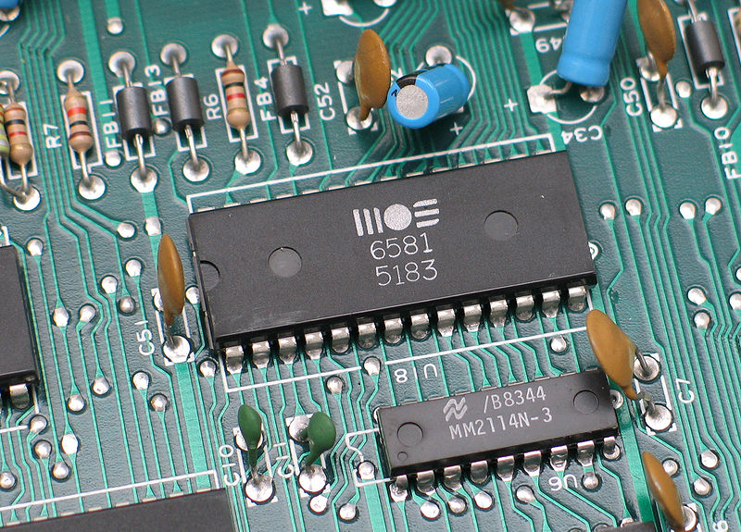
Computer Architecture
Within the computer data is moved using electric wires
Each wire generally has a voltage that is either a "0" or "1"
Wires connect components like the CPU, Memory, or other devices
A sound chip from a 1980's
Commodore 64 connected to the
motherboard
https://en.wikipedia.org/wiki/Printed_circuit_board

Slide 42
Wires transfer data
Central
Processor
Unit (CPU)
Registers
+ - * /
< > == !=
Memory
Instructions
Addresses
Load/Store Data

Slide 43
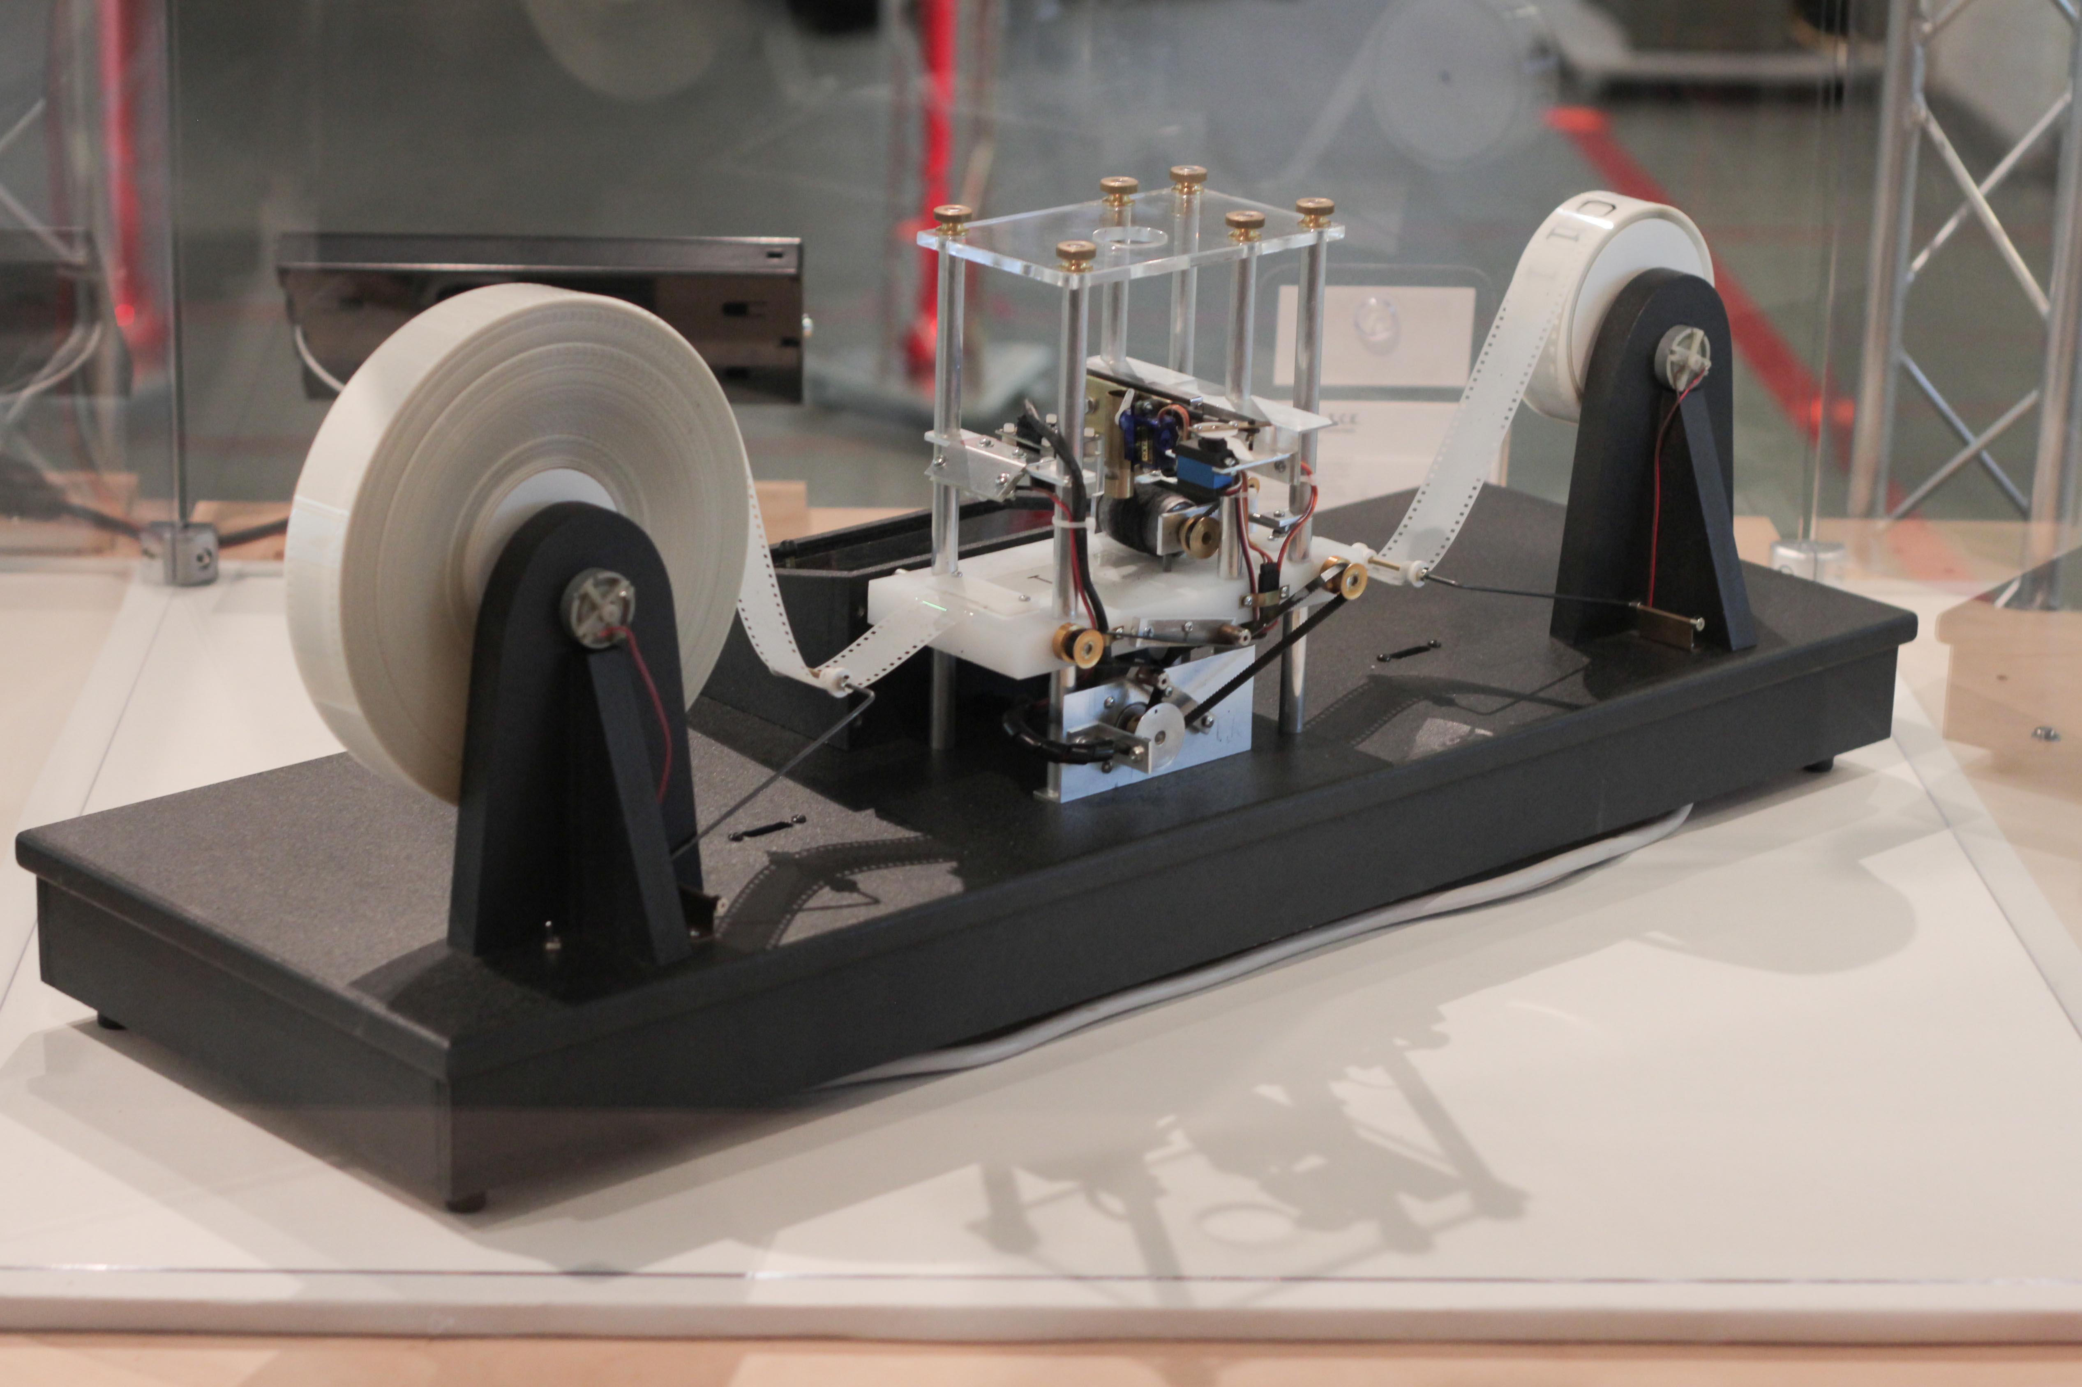
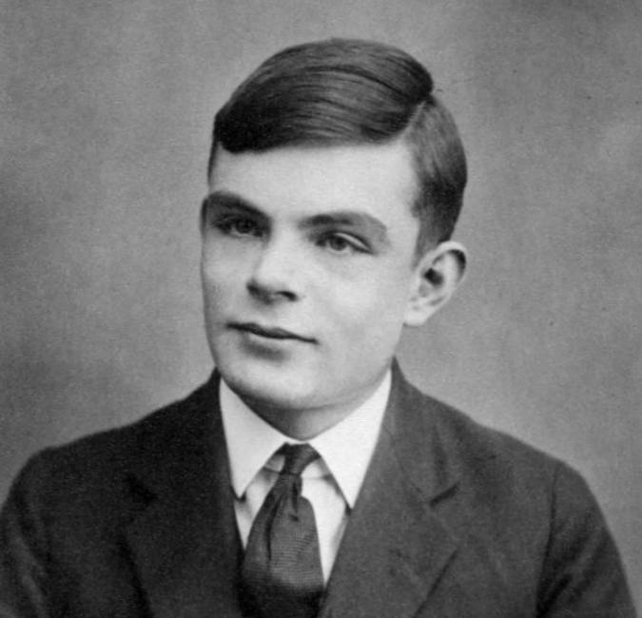
Turing Machine
Homage to the concept of a "Turing Machine"
Alan Turing did theoretical work as to what could be "computed"
Proposed a "Turing Machine" as the definition of foundation of "computability"
https://en.wikipedia.org/wiki/Alan_Turing
https://en.wikipedia.org/wiki/Turing_machine

Slide 44
"Touring Machine"
A highly simplified "Turing Machine" ☺
256 Characters of "tape memory"
Three instructions
Move left <
Move Right >
Store character 42
A Touring Machine Program:
42 > 114 > 105 > 97 > 110 < < < < 66
Output:
Brian

Slide 45
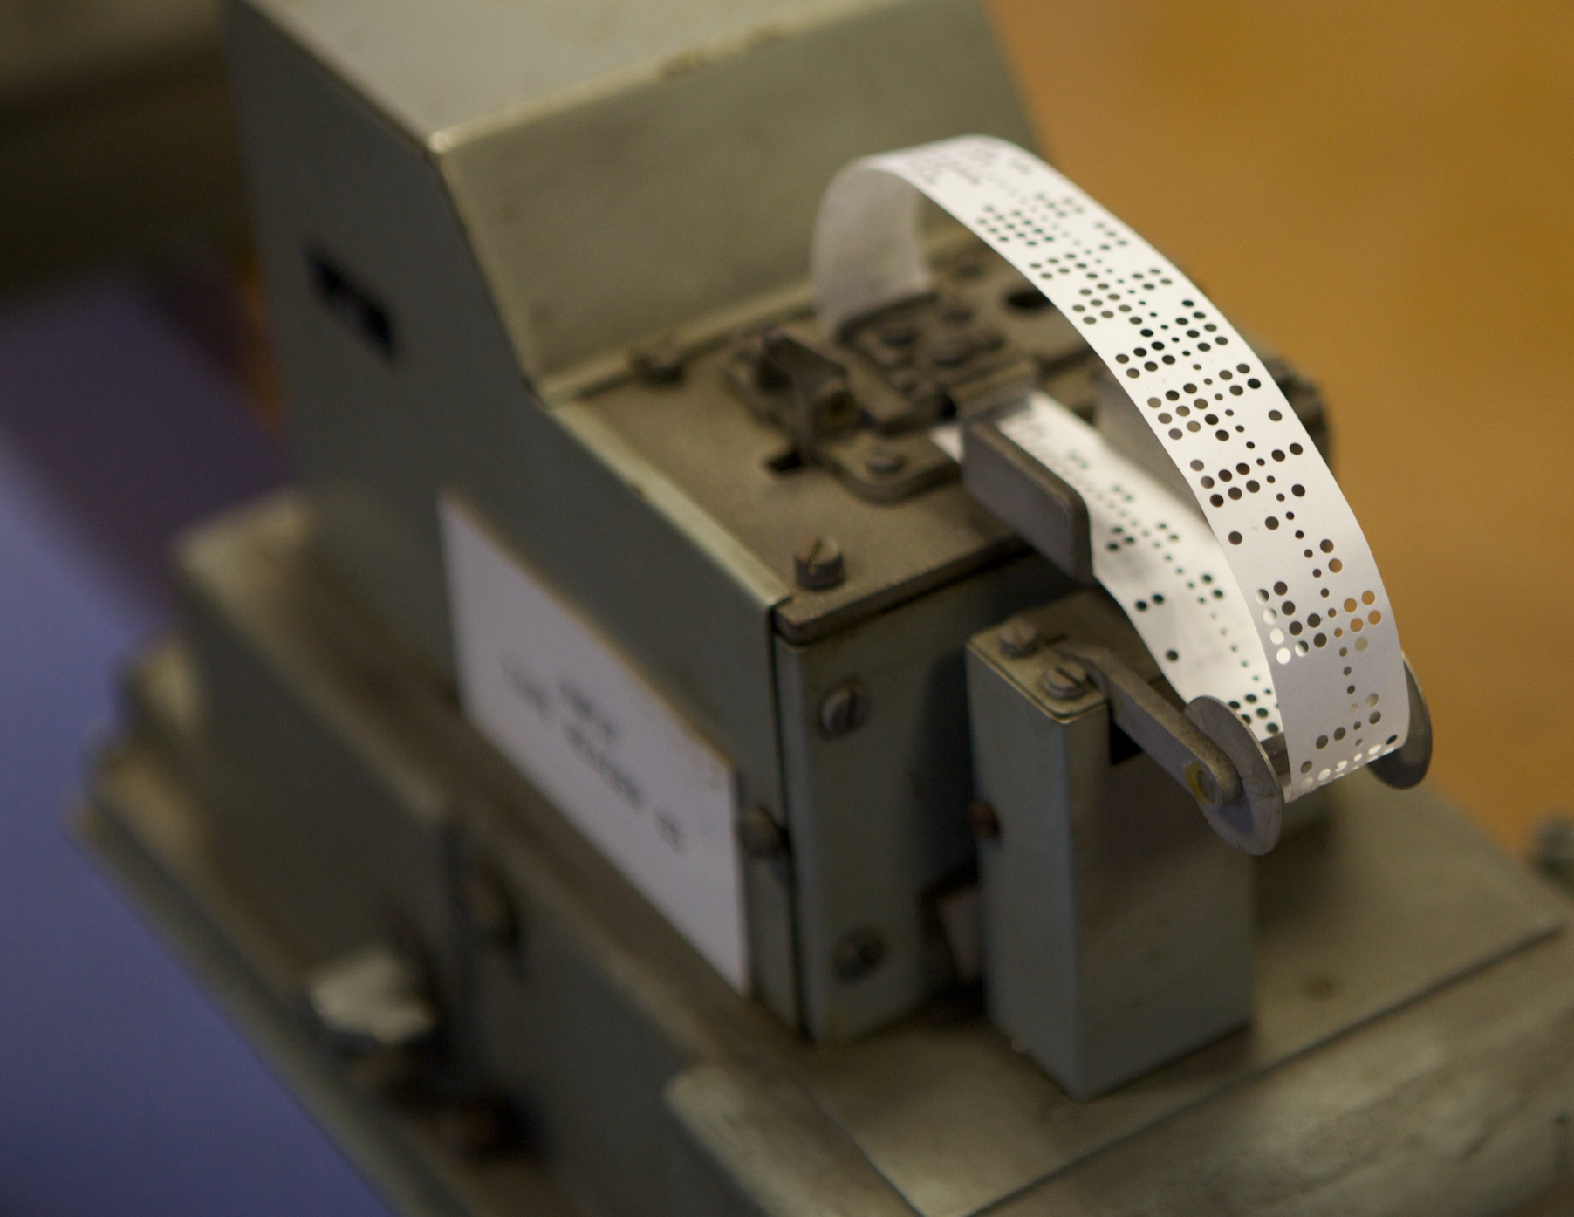

Writing Programs with Bits
In the old days, we encoded programs on paper tape
0
0
1
0
1
1
1
0
Hex: 2E
ASCII Period (.)
https://en.wikipedia.org/wiki/Punched_tape

Slide 46
Binary Touring Machine
char (big endian)
Code
Hex
0
0
0
0
0
0
0
0
42
>
114
>
105
>
97
>
110
<
<
<
<
66
2A
80
72
80
69
80
97
80
6E
C0
C0
C0
C0
66
Op Code
0
0
(0) Store this character
0
1
(1) Store this character
1
0
(2) Move right
1
1
(3) Move Left

Slide 47
Summary
I reduced Chapter 6 to the essential bits I feel we need to go forward
Do not proceed to Chapter 7 until you truly understand it – at least the singly-linked list
I did not teach you how to pass a programming interview test because that is “the road more travelled” and is a long journey through a ”forest dark and deep” and there are many “miles to go before we sleep”
Others can better guide you if you are on that journey…

Slide 48
Acknowledgements / Contributions
These slides are Copyright 2023- Charles R. Severance (online.dr-chuck.com) as part of www.cc4e.com and made available under a Creative Commons Attribution 4.0 License. Please maintain this last slide in all copies of the document to comply with the attribution requirements of the license. If you make a change, feel free to add your name and organization to the list of contributors on this page as you republish the materials.
Initial Development: Charles Severance, University of Michigan School of Information
Insert new Contributors and Translators here including names and dates
Continue new Contributors and Translators here

