Slide 1
Audio Amplifier

Slide 2
Overview
Motivation : How to create Audio Amplifier
Skeleton Model
Modified version (Quality Enhancement)

Slide 3
The Motive
Sound --> Form of Energy
To Make it Louder , We have to Increase it’s Energy.

Slide 4
Characteristics of Sound
Pitch : Pitch refers to Frequency.
Changing Pitch will change our original sound.
2. Quality : Quality is Source-dependent.
3. Loudness : For Amplification, somehow we have to Increase the Loudness.
So, We have to Increase the Loudness of the Sound.

Slide 5
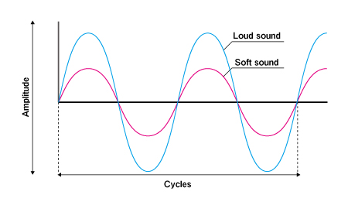
Difference between Loud and Soft sound.
Major Difference : It’s Amplitude.
Louder Sound : Large Amplitude.
Soft Sound : Small Amplitude.

Slide 6
How to Increase Energy?
Two ways: 1) Add Extra Energy while Sound is Being Produced .
Well, It’s has some Limitations.
2)Add Extra Energy After Sound is Produced.
So, We go on this way.

Slide 7
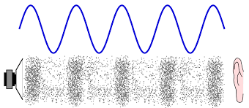
Wave Nature of Sound
Sound is a Longitudinal wave that comprises of Rarefactions and Compressions. Compression : High Particle Density Rarefaction : Low Particle Density

Slide 8
Increasing Energy
Add some element to our original wave, say some abstract element which give “LOUDNESS” to our sound, resulting in a Louder Voice.
But Unfortunately, no such Element exists. :(
CONCLUSION : We can’t increase Energy of the Sound, Keeping it in the Mechanical Form.
2. So, convert Sound energy to some other form.
Say, we opt. For Electrical Energy

Slide 9
IDEA
Say, Using Some Black Box We convert SOUND into electrical energy and give some External Energy to it. Then finally,we will convert that Electrical Energy into SOUND resulting in SOUND with greater Loudness.
Convert PRESSURE VARIATIONS (in Sound) into Electrical Signal and add Ext. Power to Electrical Signal and revert back Electrical Signal to PRESSURE VARIATIONS.

Slide 10


Model
Electrical Energy
(Power low)
Electrical Energy
(Power high)
Black Box 1
Black Box 2
External Power Source
Notes:
Function of Black Boxes 1 and 2.

Slide 11
Quality Enhancement
High sensitivity
Makes sure the softest whispers can be amplified.
Noise filter
Proper insulating material should be selected in order to avoid any kind of disturbances.
Quality sound
High quality transducer should be used.
Bandpass filter

Slide 12
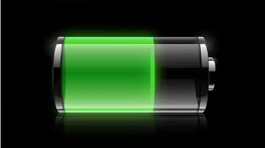
Enhanced Model
Electrical Energy
(Power low)
Electrical Energy
(Power high)
Transducer 1
Transducer 2
Noise filter
Bandpass filter
Battery
Notes:
Function of Black Boxes 1 and 2.

Slide 13
Sound Filter
Two Sound Filters are used :
Noise Filter ( To avoid Ext. Noise)
Band Pass Filter
The range for the Band Pass Filter is 50Hz to 5kHz.
We’ll use an op-amp for the purpose ( As it provide high Gain)

Slide 14
THANKING YOU !!
Animesh Das
Arhant Jain

