Slide 1
Audio Amplifier
Arhant Jain
Animesh Das

Slide 2
Index
Objectives
Introduction
Implementation
Observations
Practical Results
Future Scope

Slide 3
Objective
Our objective in this project is to make a basic audio amplifier which does the following: 1) Taking sound as input and amplifying it. 2) Ensuring there’s no distortion whilst the process. 3) Amplifying the cheese (sound).

Slide 4
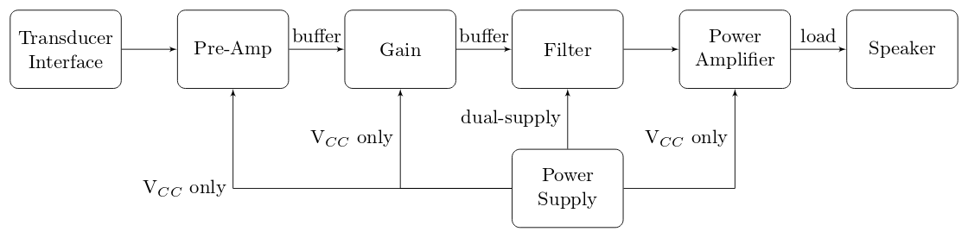
Introduction
The audio power amplifier, which is also known as the audio amplifier, is a kind of electronic amplifiers that amplify low-power audio signals ( the frequencies of the low-power signals are always between 20Hz to 20KHz,which is the range of human hearing) to a level that can be suitable for driving the loudspeakers.

Slide 5
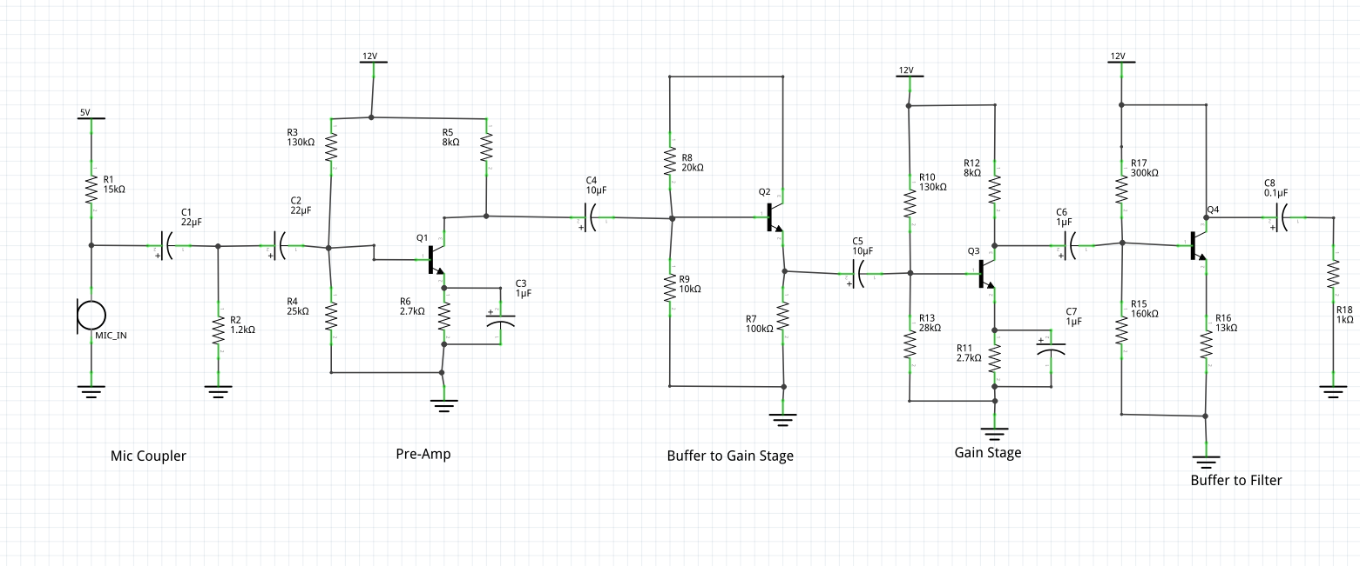
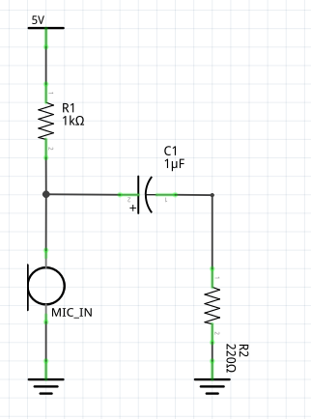
IMPLEMENTATION
Pre-amp and gain stages with buffers, ‘coz why not?
Mic coupler
Note: The buffer to the filter was added when all stages were taken and joined to form the complete design.

Slide 6
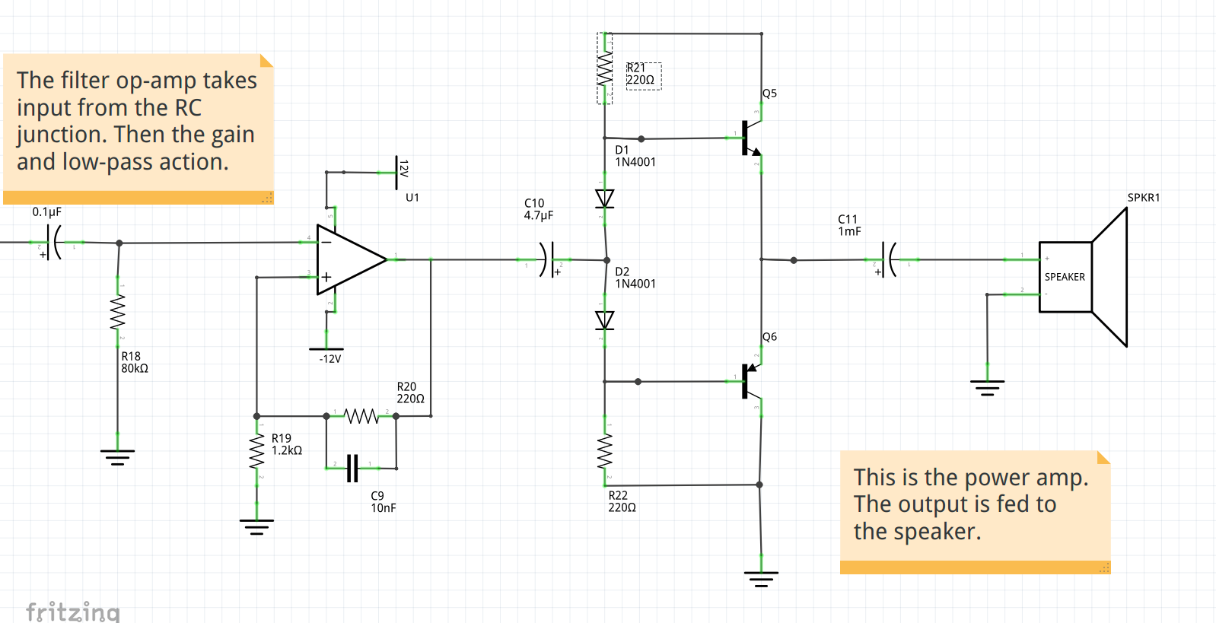
Note: Both R21 and R22 were taken as 400-ohm resistors. The 220-ohm resistors are just placeholders here.

Slide 7
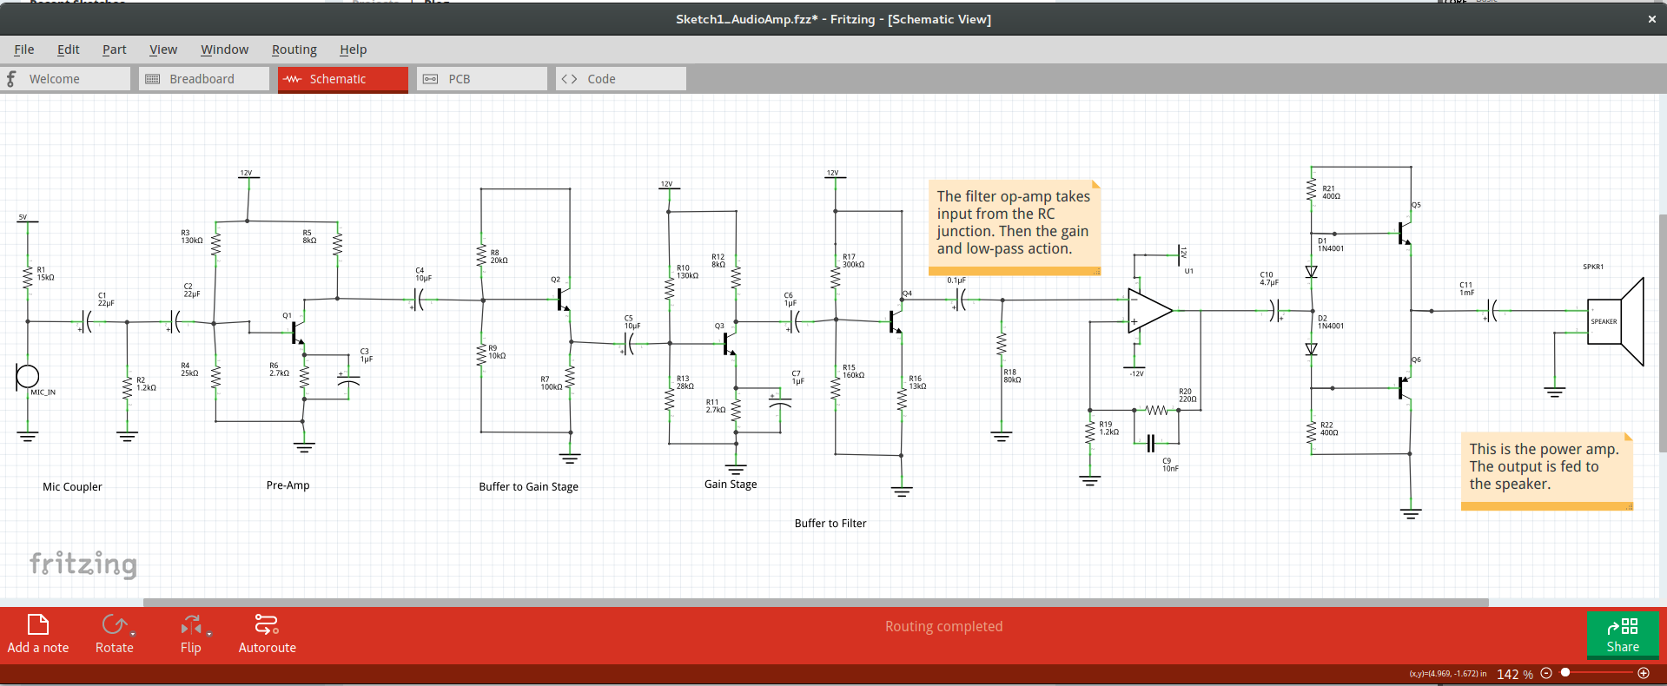

Slide 8
Observations Made:
The pre-amp and gain cell showed some interesting patterns with certain resistors included in their design.
The resistor across the base and ground will handle clipping.
The resistor across emitter and ground will handle the rise and fall of the wave. While we did say “rise and fall”, we mean to refer to the equality between them.
The resistor between the collector and supply terminal handles the gain.
Now, over to the results...

Slide 9
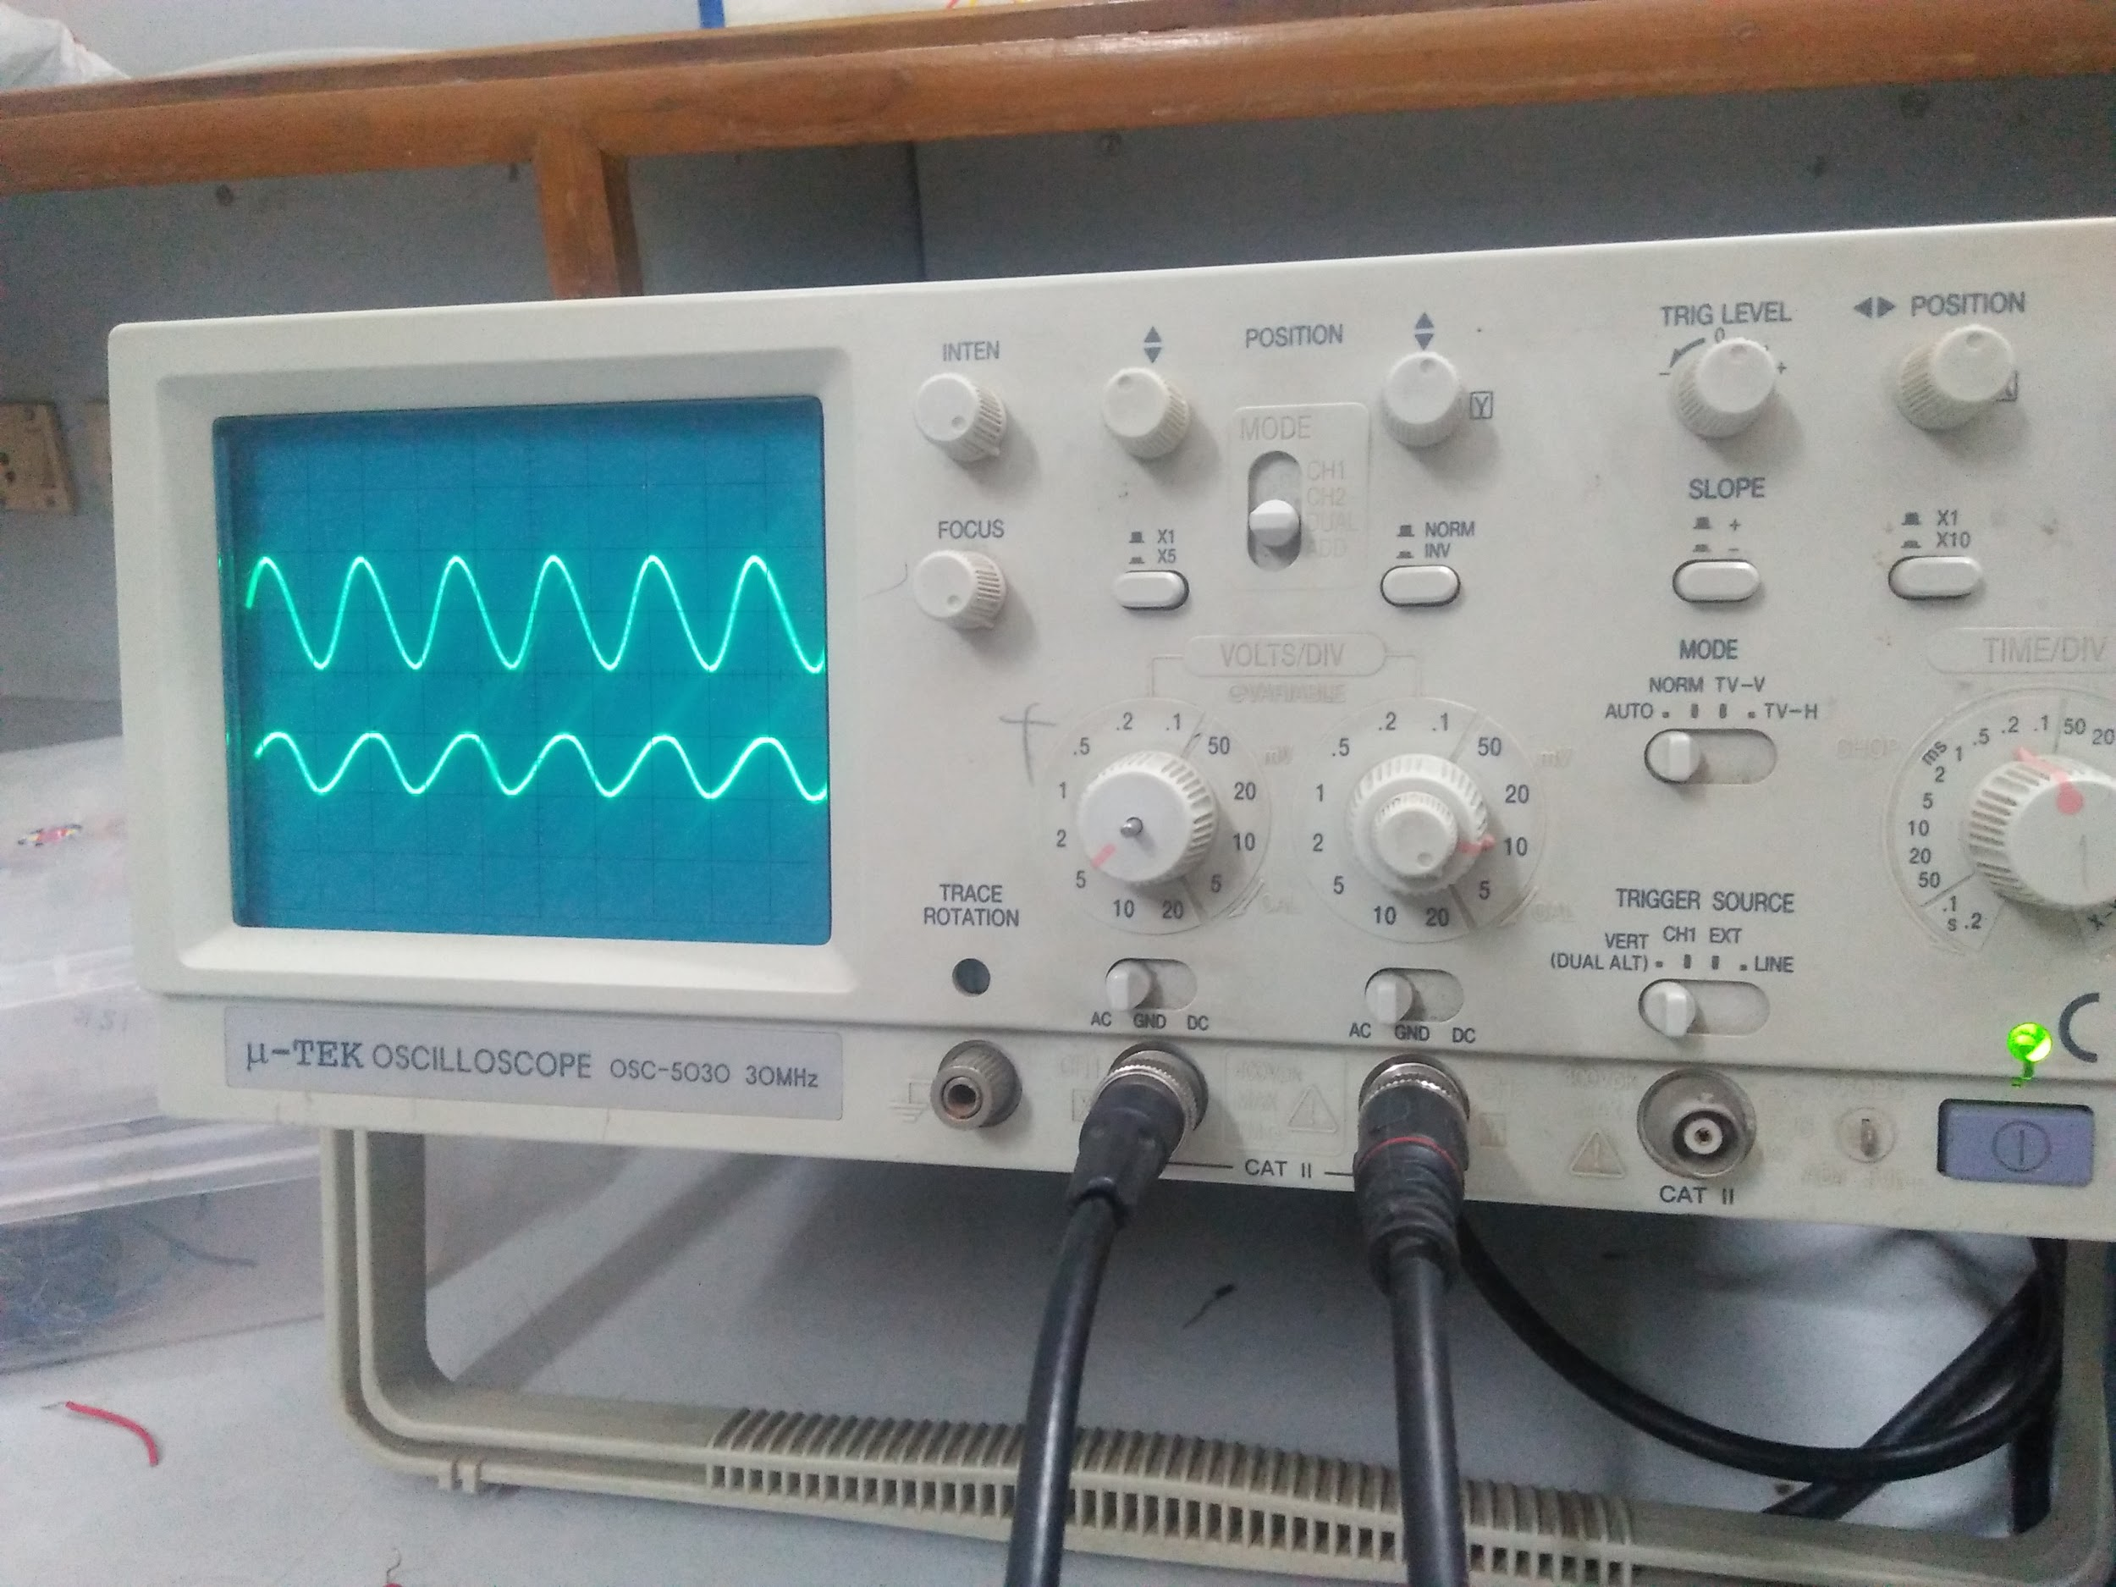
Preamplifier + Gain-Cell
Input Vpp | Output Vpp | Gain (Out/Inp )
20 mV | 5 V | 250
15 mV | 3.7 V | 246.7
10 mV | 2.5 V | 250
5 mV | 1.2 V | 240
Input (CH2)
Output
(CH1)
Gain : ~250

Slide 10
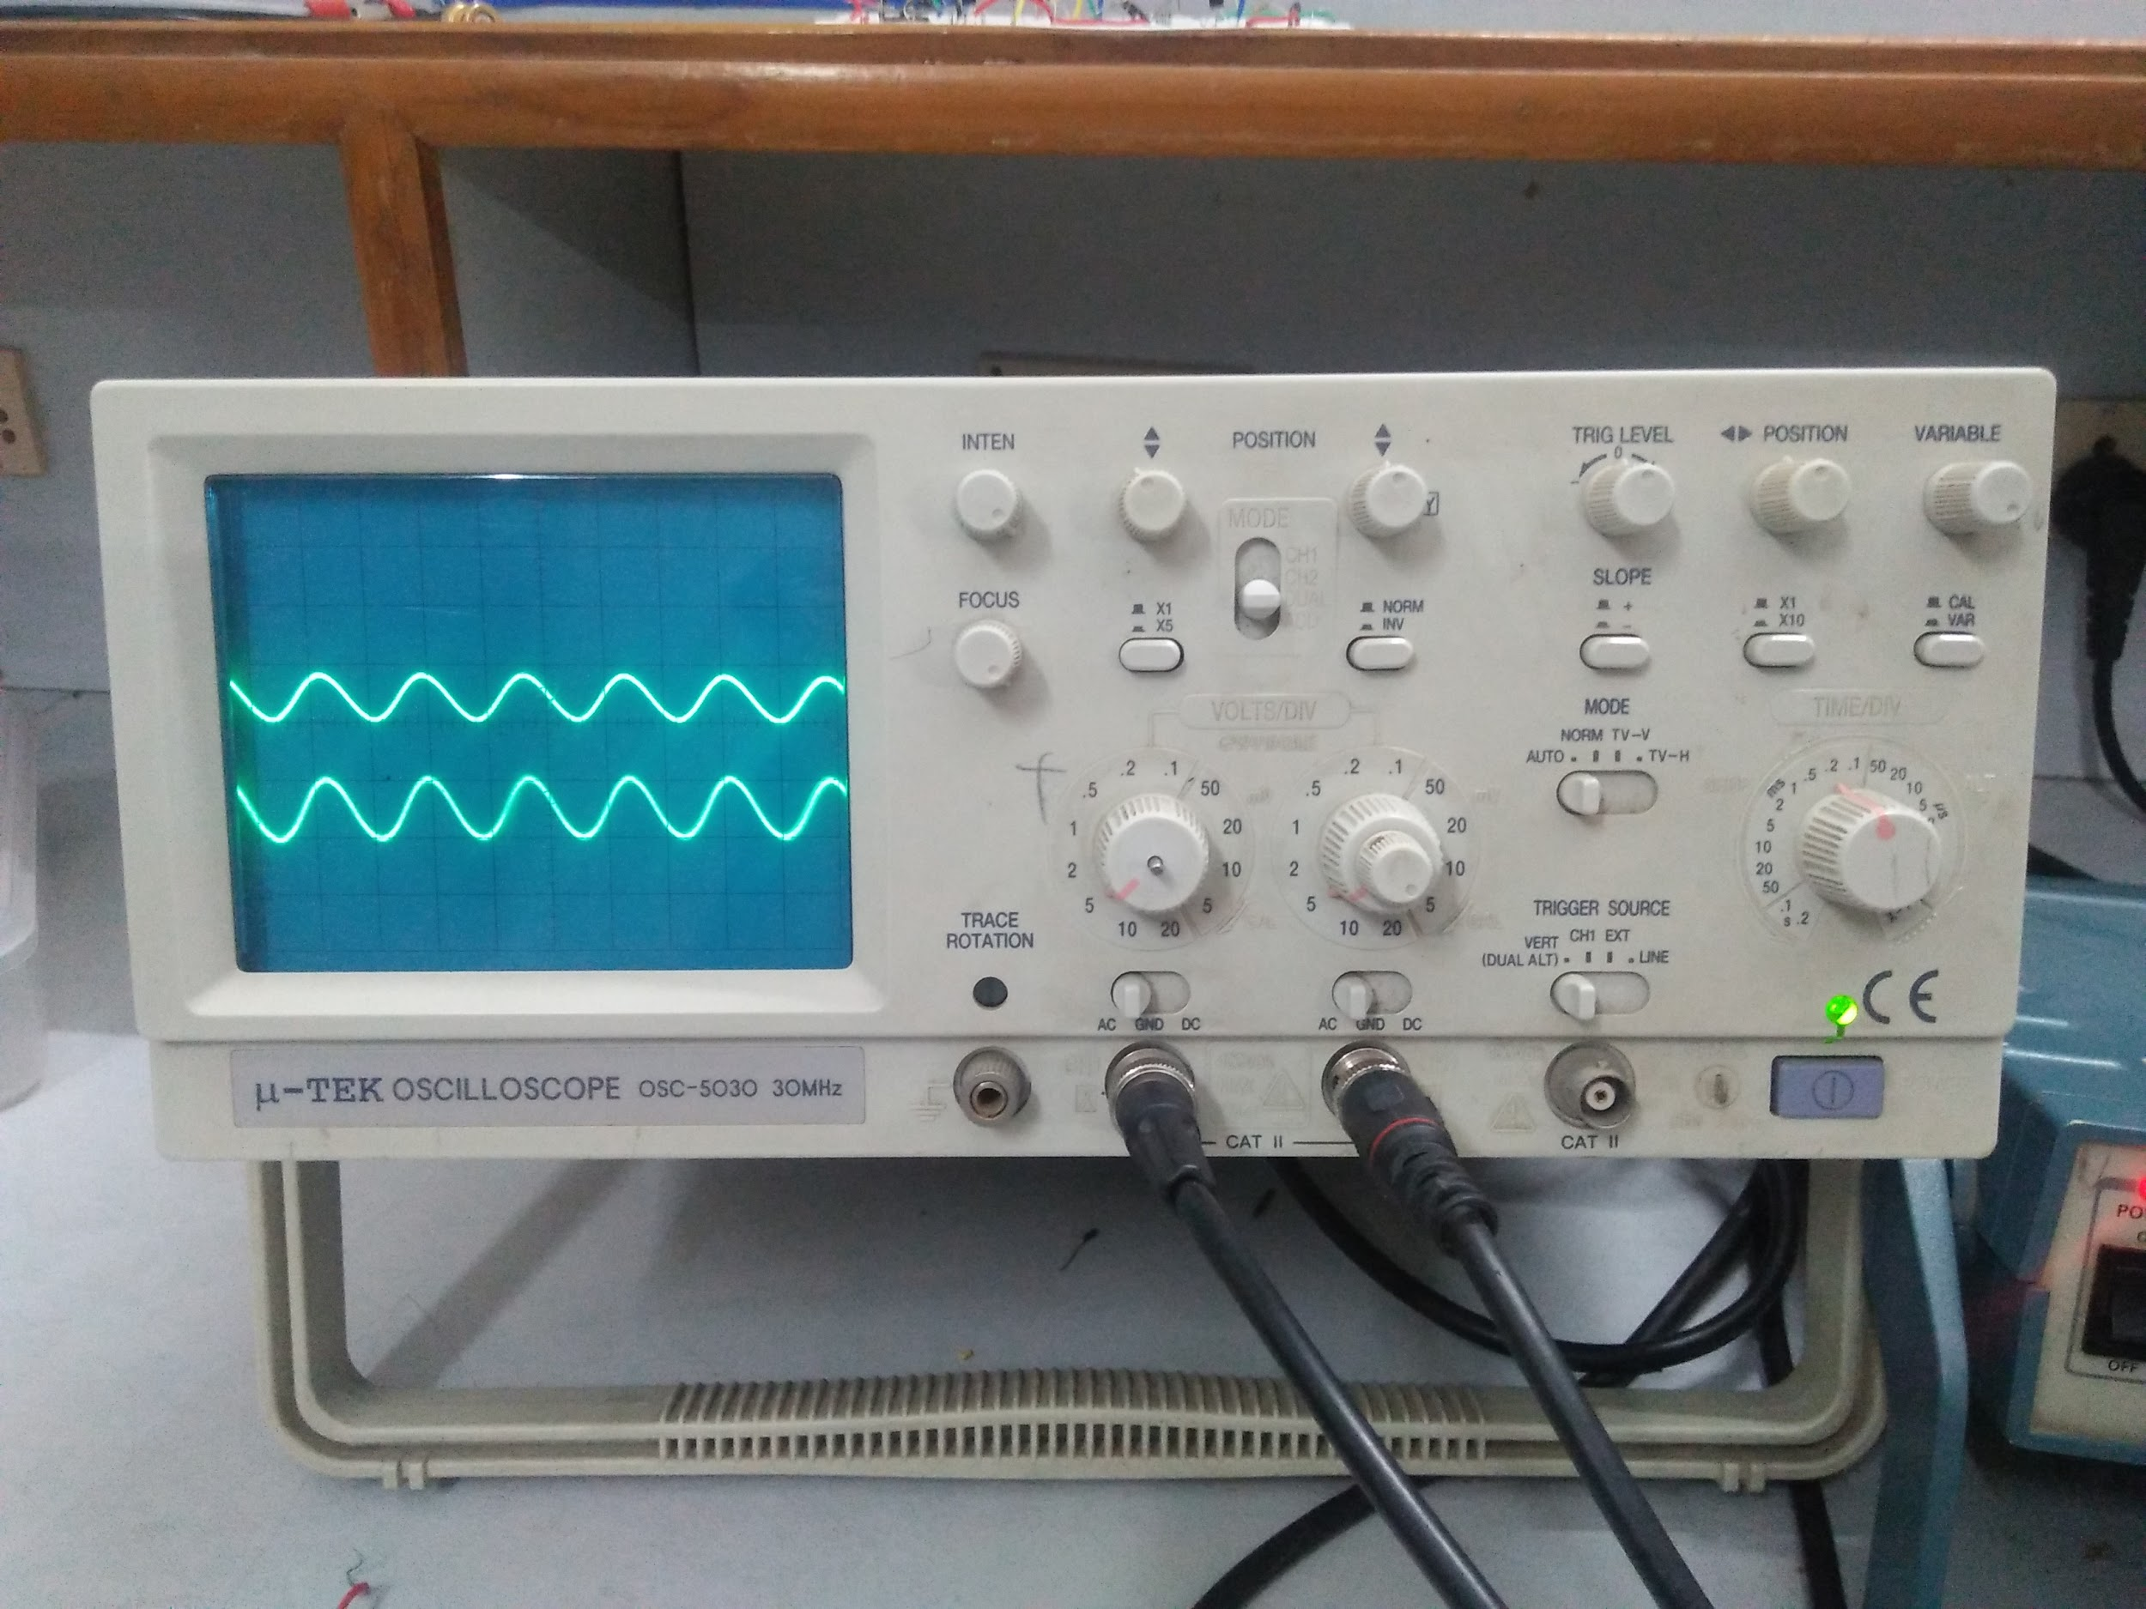
Filter + Power-Amp
Input Vpp | Output Vpp | Maintained/Amp-ed
5 V | 5 V | maintained
4 V | 4.5 V | Amp-ed
3 V | 3.6 V | Amp-ed
Input CH2
Output
(CH1)

