Slide 1

PREDICTION OF LIFE EXPECTANCY THROUGH LINEAR REGRESSION

Slide 2
Introduction
The term “life expectancy” refers to the number of years a person can expect to live. By definition, life expectancy is based on an estimate of the average age that members of a particular population group will be when they die.
The dataset contains 50 observations (one for each US state) and 15 variables (Population, Income, Illiteracy, Life.Exp, Murder, HS.Grad, Frost, Area, state.abb, state.area, x, y, state.division, state.name, and state.region).
Problem statement is to predict life expectancy by state using the state statistics.

Slide 3
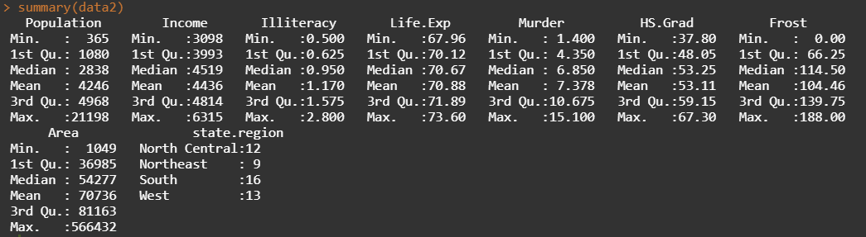
Exploratory Data Analysis (EDA)
The summary statistics of Life.Exp indicates that there is no outlier in the data since the minimum, first quantile, mean, third quantile and maximum value has a similar interval of data points.
The mean and median values are also similar, which indicates that there is no outliers in the dependent variable (life expectancy).

Slide 4
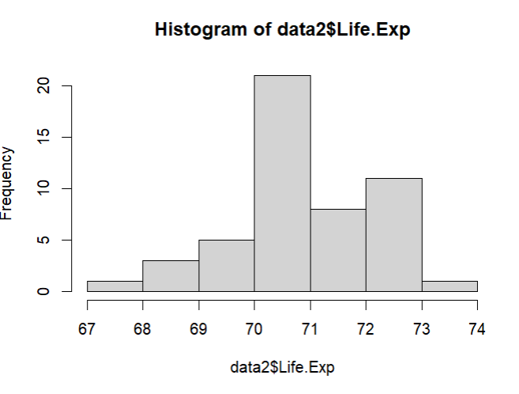
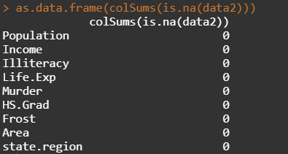
Exploratory Data Analysis (EDA) contd..
The quantile range of Life Expectancy indicates a distributed data range.
Histogram also indicates a normal data curve with no outliers.
Hence, there is no outliers in the dependent variable.
Furthermore, there is no missing value in the dataset also.

Slide 5
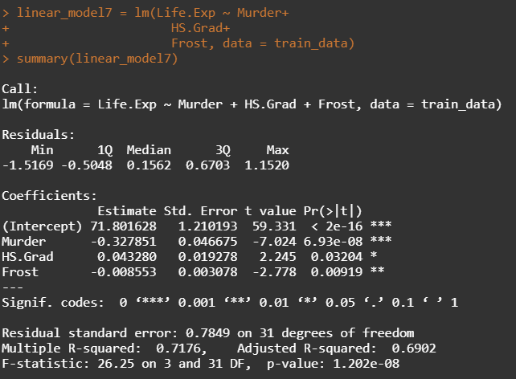
Data Modelling (Training Data)
The dataset is divided in training and test data by a 7:3 ratio.
The training model indicates three variables as significant in 95% confidence level, which are Murder, HS.Grad and Frost.
The adjusted R-square value is 0.69, which indicates that the model is good.

Slide 6
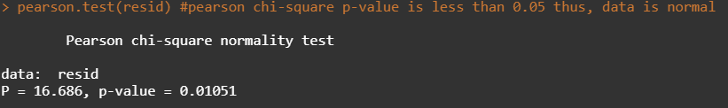
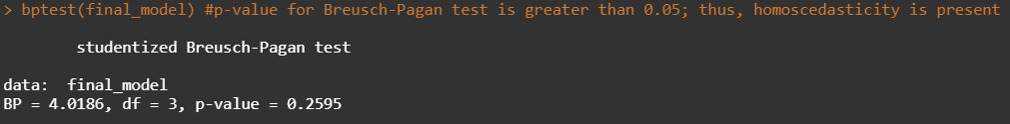
Data Modelling (Training Data) contd..
VIF (Variance Inflation Factor) is less than 1.7; hence, there is no multicollinearity.
Durbin-Watson Statistics is 2.15; hence, negligible negative autocorrelation is present.
Breusch-Pagan Statistics indicate a p-value of 0.26, which is higher than 0.05; hence, homoscedasticity is present.
Pearson Chi-Square normality test indicates a value of 0.01, since this is less than 0.05; hence, the residuals are in normal distribution.
Thus, all the assumptions for the multiple linear regression is met.

Slide 7
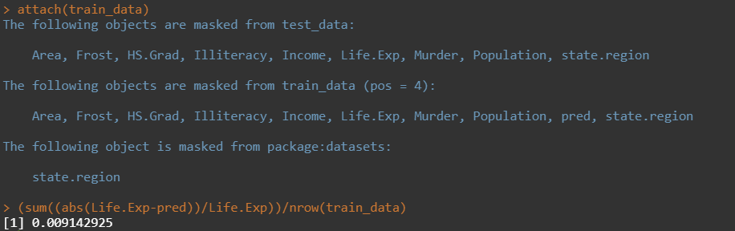
Data Modelling (Training Data) contd..
The MAPE value is 0.9%, which indicates that the predicted data in the training dataset deviates by 0.9% from the actual results.

Slide 8
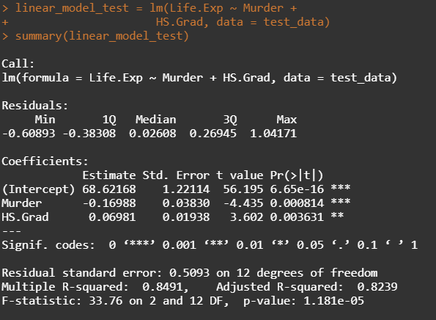
Data Modelling (Test Data)
The test model indicates three variables as significant in 95% confidence level, which are Murder and HS.Grad.
The adjusted R-square value is 0.82, which indicates that the model is good.

Slide 9

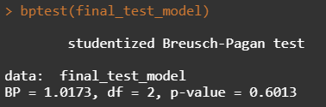
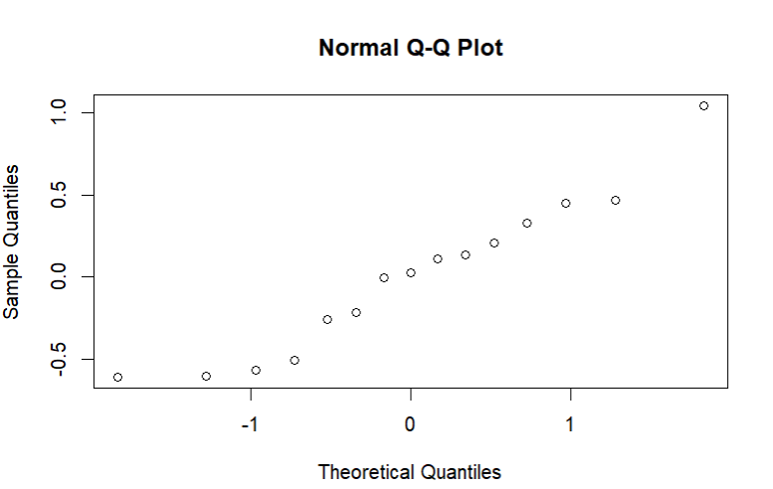
Data Modelling (Test Data) contd..
VIF (Variance Inflation Factor) is less than 1.7; hence, there is no multicollinearity.
Durbin-Watson Statistics is 2.08; hence, negligible negative autocorrelation is present.
Breusch-Pagan Statistics indicate a p-value of 0.6, which is higher than 0.05; hence, homoscedasticity is present.
Normal QQ Plot indicates a 45-degree reference line; hence, the residuals are in normal distribution.
Thus, all the assumptions for the multiple linear regression is met.

Slide 10
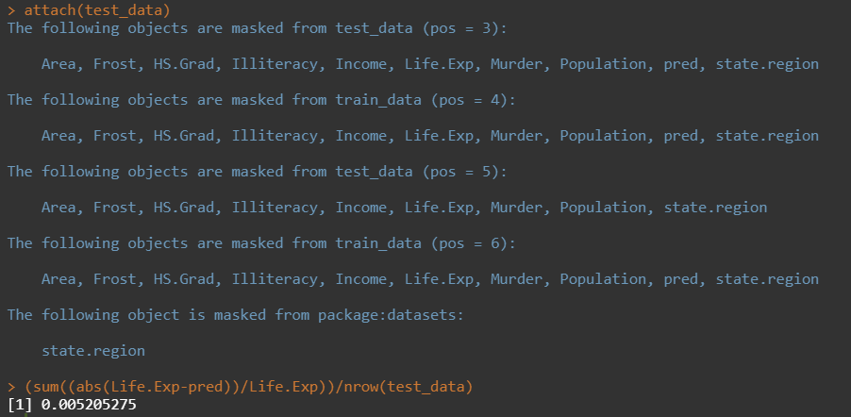
Data Modelling (Test Data) contd..
The MAPE value is 0.5%, which indicates that the predicted data in the training dataset deviates by 0.5% from the actual results.

Slide 11
Conclusion
The statistically significant variable are the murder and non-negligent manslaughter rate per 100,000 population in 1976 (Murder) and percent of high-school graduates in 1970 (HS.Grad).
Thus, the life expectancy depends on the above-mentioned two factors; however, the mean number of days with minimum temperature below freezing from 1931–1960 in the capital or a large city of the state (Frost) can also play a significant role in this life expectancy.

Slide 12
Thank You

