Slide 1
HIERARCHIAL AND K-MEANS CLUSTERING FOR MALL CUSTOMERS

Slide 2
INTRODUCTION
It is basically a type of unsupervised learning method. An unsupervised learning method is a method in which we draw references from datasets consisting of input data without labeled responses.
This dataset contains four variables, which are CustomerID (integer), Gender (character), Age (integer), Annual Income (k$) (integer), and Spending Score (1-100) (integer).
CustomerID will not be needed in the cluster analysis and Gender will be converted into factor variable.
Clustering will be done on the continuous variables.

Slide 3
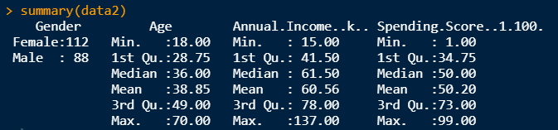
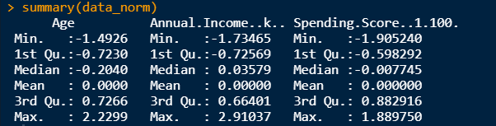
EXPLORATORY DATA ANALYSIS (EDA)
The EDA indicates that there are 112 females and 88 males.
The mean age is 38.85 and median age is 36.00; hence, there is no outlier.
The mean annual income is 60.56 and the median annual income is 61.50; hence, there is no outlier.
The mean spending score is 50.20 and the median spending score is 50.00; hence, there is no outliers.
The summary statistics of normalised data is also presented for better reference.

Slide 4
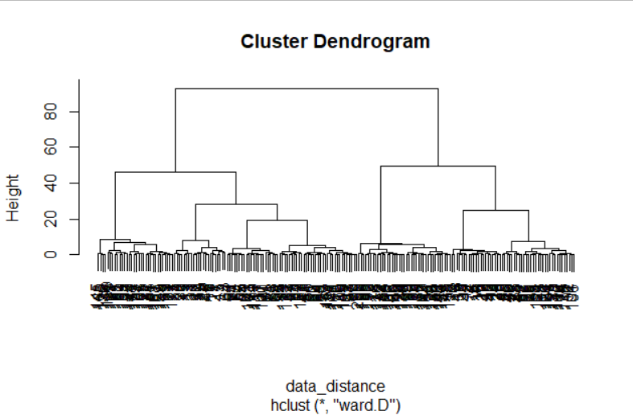
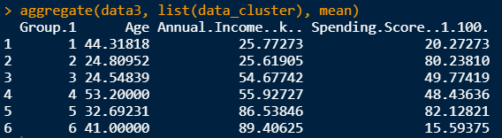
HIERARCHIAL CLUSTERING
The cluster dendogram indicates that six clusters should provide optimal results.
The clusters have 22, 21, 31, 55,39, and 32 datapoints respectively.
The mean of the datapoints indicate that they are homogeneous within themselves and heterogenous amongst each other.

Slide 5
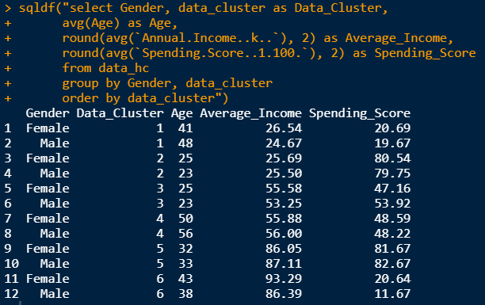
HIERARCHIAL CLUSTERING contd..
The table indicates mean value of each clusters based on individual genders.
In cluster 6, females have an average age of 43, average income of 93.29; however, spending score is 20.64.
In cluster 2, females have an average age of 25, average income of 25.69; however, spending score is 80.54.
In cluster 5, males have an average age of 33, average income of 87.11; however, spending score is 82.67.
In cluster 2, males have an average age of 23, average income of 25.50; however, spending score is 79.75.

Slide 6
HIERARCHIAL CLUSTERING contd..
Cluster 2 indicates high rate of spending despite low income rate; furthermore, they are in relatively lower age group; thus, customers in cluster 2 are vulnerable towards high spending. Nevertheless, further increment in spending is not expected.
Cluster 3 has similar mean age as cluster 2; however, their spending score is moderate and annual income is relatively higher. Hence, there is a potential that they can invest more on spending.

Slide 7
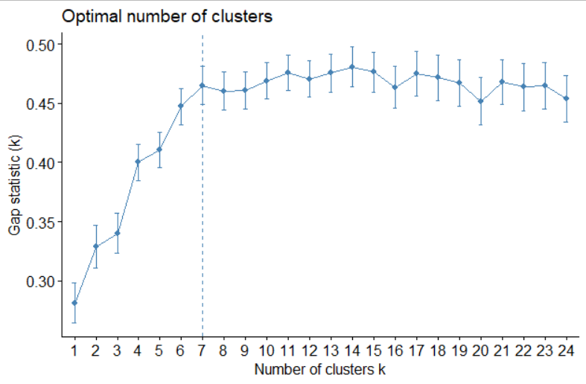
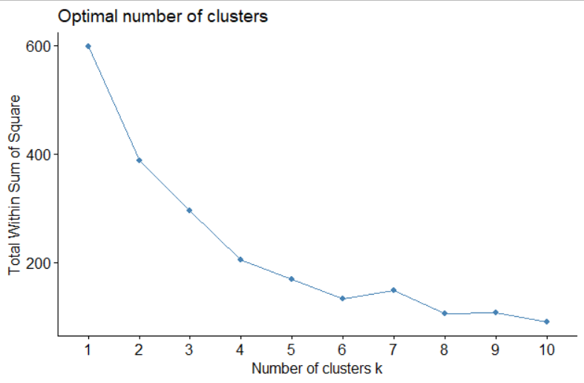
K-MEANS CLUSTERING
The elbow plot and the gap statistics plot indicates that the optimal number of clusters for K-means is 7 since the elbow occurs at 7 and the value of gap reduces after the number of clusters become 7.

Slide 8
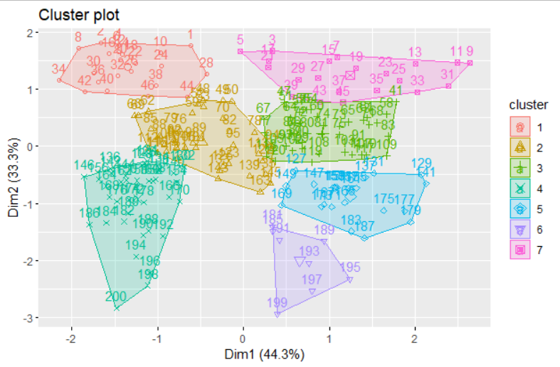
K-MEANS CLUSTERING contd..
The figure indicates the positioning of the 7 clusters and this figure shows that the clusters are different from each other in terms of point distribution.

Slide 9
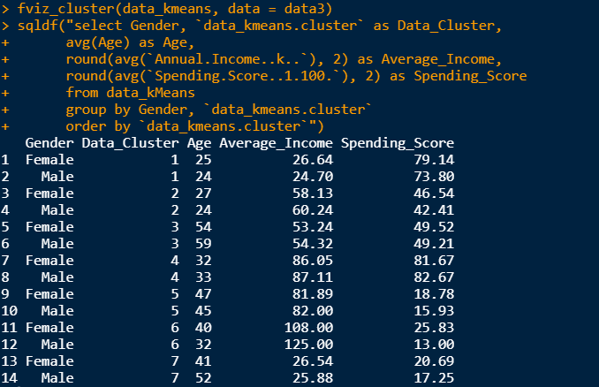
K-MEANS CLUSTERING contd..
The results indicate that cluster 6 has a high average income for both males and females; however, the spending score is very low. Thus, this is a potential area of concern.
For cluster 5, similar observation is evident; thus, proper attention is required for these clusters.
Cluster 1 has reached their potential spending score since they have high spending score with low income.

Slide 10
CONCLUSION
This analysis indicates different clusters of customers that require special attention since they have a high average income with low spending score.
Cluster 5 and 1 of K-means clustering falls under this spectrum of attention.
Cluster 3 of Hierarchical clustering has a spending score that is moderate and annual income is relatively higher. Hence, there is a potential that they can invest more on spending.

Slide 11
THANK YOU

