Slide 1
Genotyping By Sequencing Introduction
GBS
Oregon State University
Center for Genome Research and Biocomputing
May 12, 2015

Slide 2
What is Genotyping-By-Sequencing?
Genotyping -> Single nucleotide polymorphism (SNP) discovery
Sequencing -> “Reduced representation” genome sequencing
ADVANTAGES - High density SNP discovery and genotyping in large populations
Highly multiplexed -> relatively low cost
Easily scalable
- Open-source analysis software

Slide 3
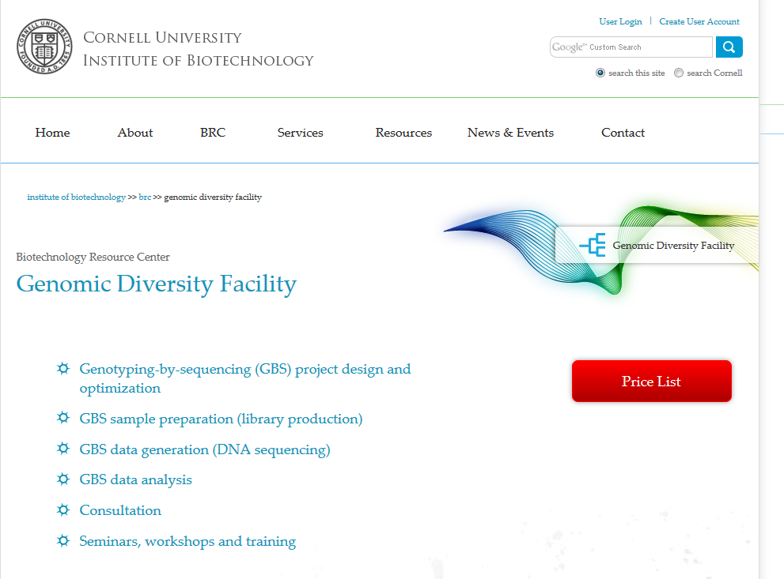
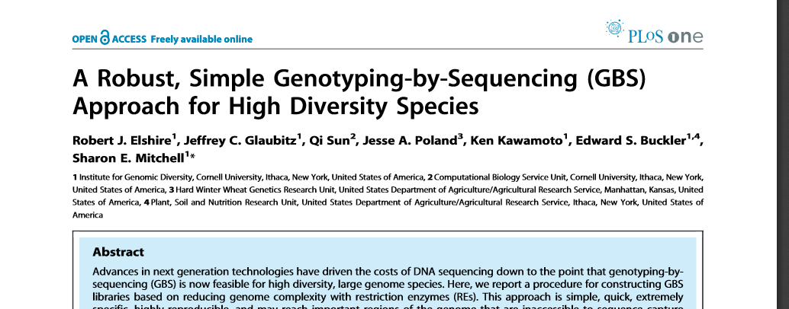
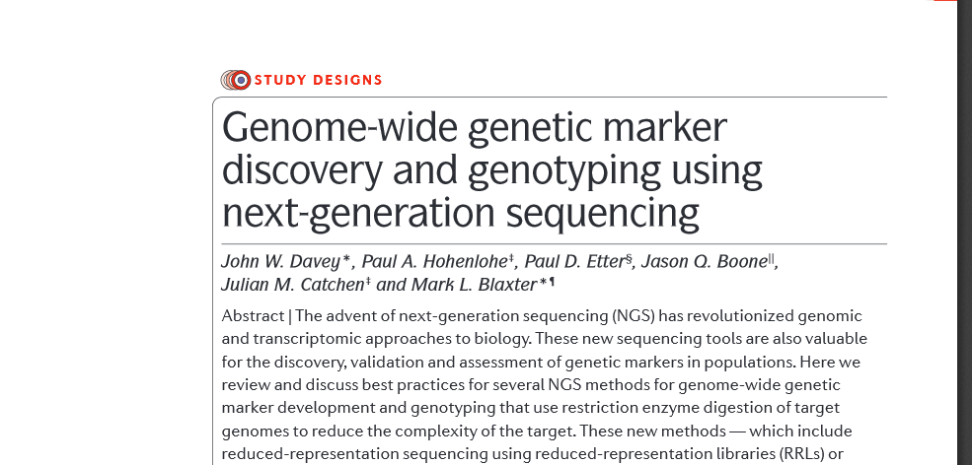
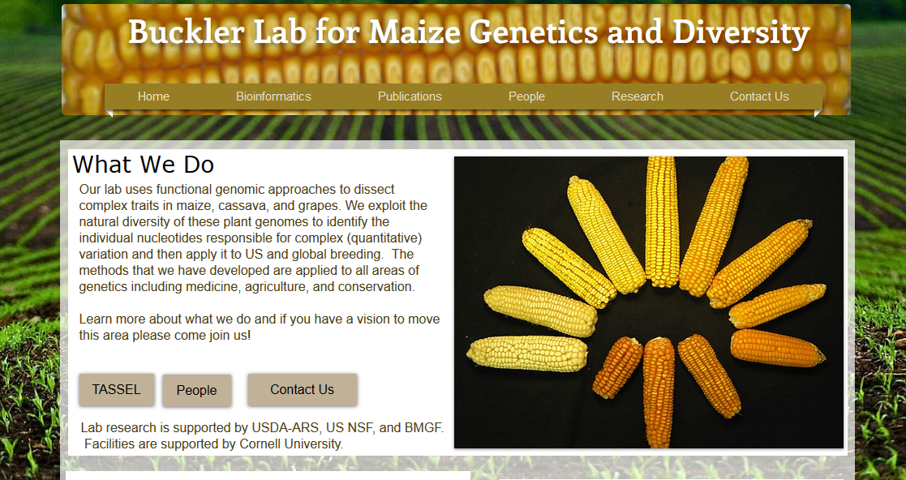
GBS and similar methods developed ~2010-2011

Slide 4
GBS conceptual Overview
Restriction site
Sequence “tag”
SNP
*
*
*
Individual 1
Restriction fragment
Polymorphism = Loss of cut site
*
*
Individual 2
Adapted from http://cbsu.tc.cornell.edu/lab/doc/GBS_Method_Overview1.pdf

Slide 5
GBS restriction enzymes and adapters
ApeKI frequently used because of partial methylation sensitivity
Adapter barcode lengths 4-8 nt
*W=A or T

Slide 6
Barcode sets – design rules
Barcode sets are enzyme-specific -Ligation must not recreate enzyme recognition site -Must have complementary overhangs
Sets must be of variable length
Bases must be well balanced at each position
Must be different enough from each other to avoid confusion if there is a sequencing error -minimum 3 bp difference
Must not nest within other barcodes
No mononucleotide runs of 3+ bases

Slide 7
GBS wet lab workflow

Slide 8
GBS libraries enriched in small fragments
GOOD BIOANALYZER TRACE
NOT SO GOOD…
ADAPTER DIMER PEAK ~150 BP
http://cbsu.tc.cornell.edu/lab/doc/GBS_workshop_intro_June_2013.pdf

Slide 9
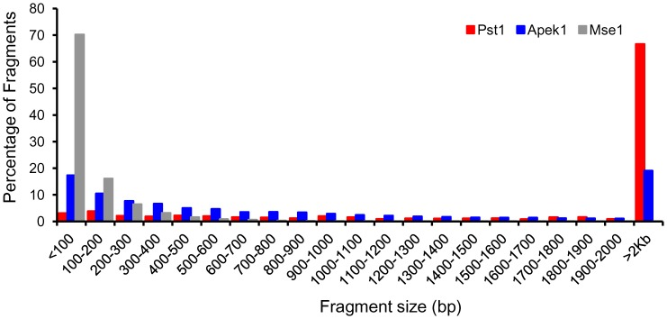

Figure 2. In silico analysis of restriction enzyme sites in the soybean genome.
Fragment size distribution obtained by in silico digestion of soybean chromosome 5 with ApeK1, Pst1 and Mse1 restriction enzymes showing a higher percentage of ApeK1 fragments in a suitable range for genotyping by sequencing.
Sonah H, Bastien M, Iquira E, Tardivel A, et al. (2013) An Improved Genotyping by Sequencing (GBS) Approach Offering Increased Versatility and Efficiency of SNP Discovery and Genotyping. PLoS ONE 8(1): e54603. doi:10.1371/journal.pone.0054603
http://www.plosone.org/article/info:doi/10.1371/journal.pone.0054603

Slide 10
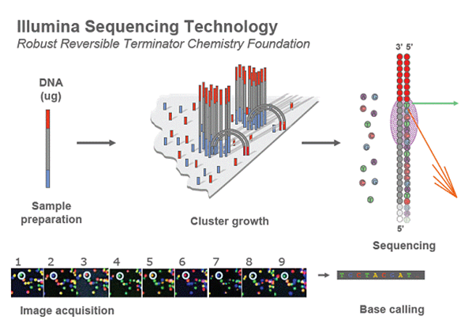
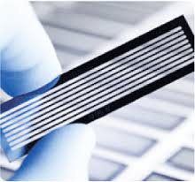
http://openwetware.org/wiki/Image:BMC_IlluminaFlowcell.png

Slide 11
GBS adapters and Illumina sequencing
Barcode adapter
DNA insert
Common adapter
5'-acactctttccctacacgacgctcttccgatctAGGCCWGCNNN…NNNGCWGAGATCGGAAGAGCGGTTCAGCAGGAATGCCGAG-3'
3'-TGTGAGAAAGGGATGTGCTGCGAGAAGGCTAGATCCGGWCGNNN…NNNCGWCTCTAGCCTTCTCGCCAAGTCGTCCTTACGGCTC-5'
Barcode
ApeKI overhang
PCR primer 1
Complement binds to flowcell oligo 1
Binds to 3’ strand of barcode adapter
tctttccctacacgacgctcttccgatct-3'
5'-Aatgatacggcgaccaccgagatctacactctttccctacacgacgctcttccgatct-3'
5'-acacgacgctcttccgatct-3'
Paired-end sequencing primer 1
PCR primer 2
Binds to 3’ strand of common adapter
Complement binds to flowcell oligo 2
3'-TCTAGCCTTCTCGCCAAGTCGTCCTTACGGCTCTGGCtagagcatacggcagaagacgaac-5'
3'-TCTAGCCTTCTCGCCAAGTCGTCCTTACGGCTCTGGC-5'
Paired-end sequencing primer 2
Adapted from: http://cbsu.tc.cornell.edu/lab/doc/GBS_workshop_intro_June_2013.pdf

Slide 12
Variable length barcodes, good design produce even nucleotide distribution
Barcode
Restriction enzyme cut site
Insert DNA

Slide 13
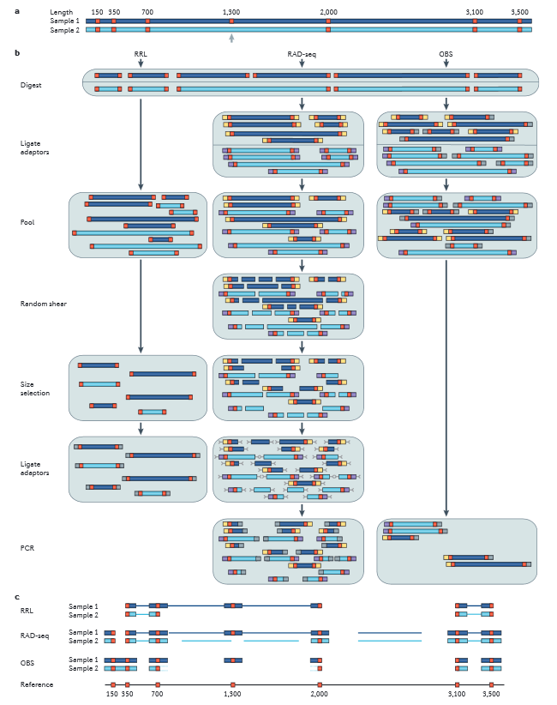
GBS vs RAD-seq
RAD = Restriction site Associated DNA
Both GBS and RAD-tagging are forms of reduced representation sequencing
Davey JW, Hohenlohe PA, Etter PD, Boone JQ, Catchen JM, Blaxter ML. 2011. Genome-wide genetic marker discovery and genotyping using next-generation sequencing. Nature Reviews Genetics 12: 499–510.

Slide 14
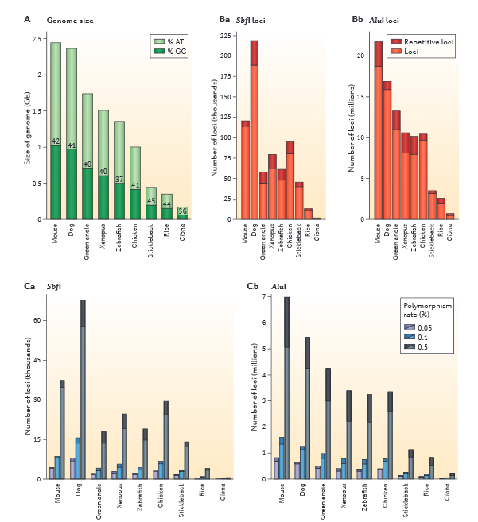
Experimental design considerations
Study objective - Association mapping/QTL discovery - Population studies/phylogeography
Restriction enzyme choice - Genome size, repetitive DNA fraction
Availability of reference genome - in silico digests to estimate fragments/markers from different restriction enzymes
Expected level of polymorphism - Breeding populations - Environmental samples
SbfI -> CCTGCA^GG
AluI -> AG^CT
Davey et al. 2011. Nature Reviews Genetics 12: 499–510.

Slide 15
References
Elshire RJ, Glaubitz JC, Sun Q, Poland JA, Kawamoto K, Buckler ES, Mitchell SE. 2011. A Robust, Simple Genotyping-by-Sequencing (GBS) Approach for High Diversity Species. PLoS ONE 6: e19379.
Davey JW, Hohenlohe PA, Etter PD, Boone JQ, Catchen JM, Blaxter ML. 2011. Genome-wide genetic marker discovery and genotyping using next-generation sequencing. Nature Reviews Genetics 12: 499–510.
Beissinger TM, Hirsch CN, Sekhon RS, Foerster JM, Johnson JM, Muttoni G, Vaillancourt B, Buell CR, Kaeppler SM, Leon N de. 2013. Marker Density and Read Depth for Genotyping Populations Using Genotyping-by-Sequencing. Genetics 193: 1073–1081.

Slide 16
TIME FOR A 15-MINUTE BREAK!
RELAX…REFRESH…REBOOT

Slide 17
GBS services at the CGRB Core Lab http://cgrb.oregonstate.edu/core/genotyping-sequencing

Slide 18
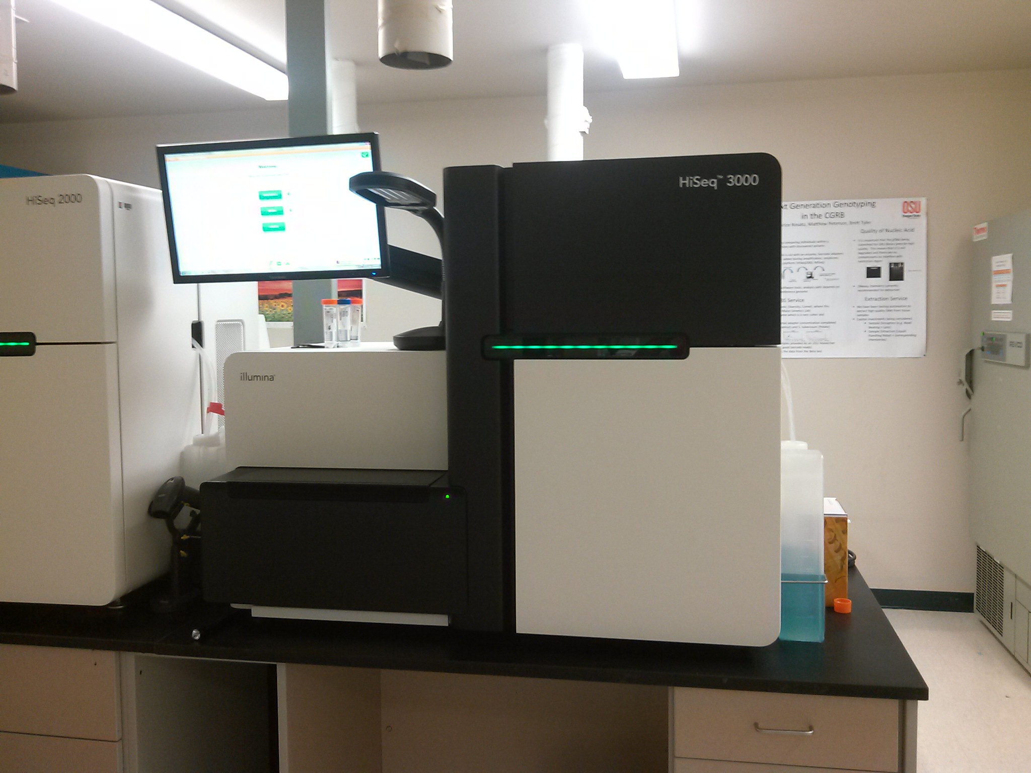
New Illumina HiSeq3000 @ the CGRB!

Slide 19
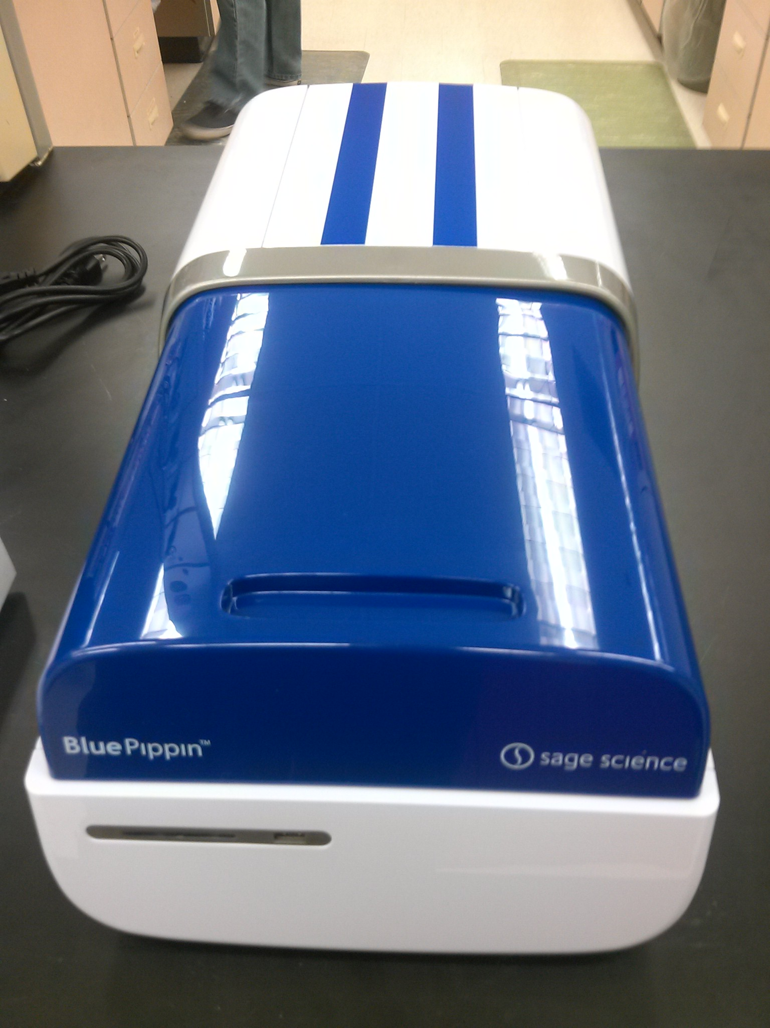
New Pippin Preps @ the CGRB!

Slide 20
GBS services at the CGRB Core Lab http://cgrb.oregonstate.edu/core/genotyping-sequencing
GOOD BIOANALYZER TRACE
Genomic DNA - user-supplied - CGRB high-throughput DNA extraction service
Adapter titration - Necessary to minimize adapter dimers - Done once per experiment with a subset of samples - Two micrograms genomic DNA + 8 adapter concentrations - Assayed on Bioanalyzer HiSensitivity DNA chip
Library preparation - ApeKI -> default restriction enzyme - Enriched in small fragments, 100-300 bp
Illumina sequencing -> HiSeq3000 - read lengths 75-150 bp - single-end ->260-320 million reads per lane - paired-end -> 520-640 million reads per lane
NOT SO GOOD…

Slide 21
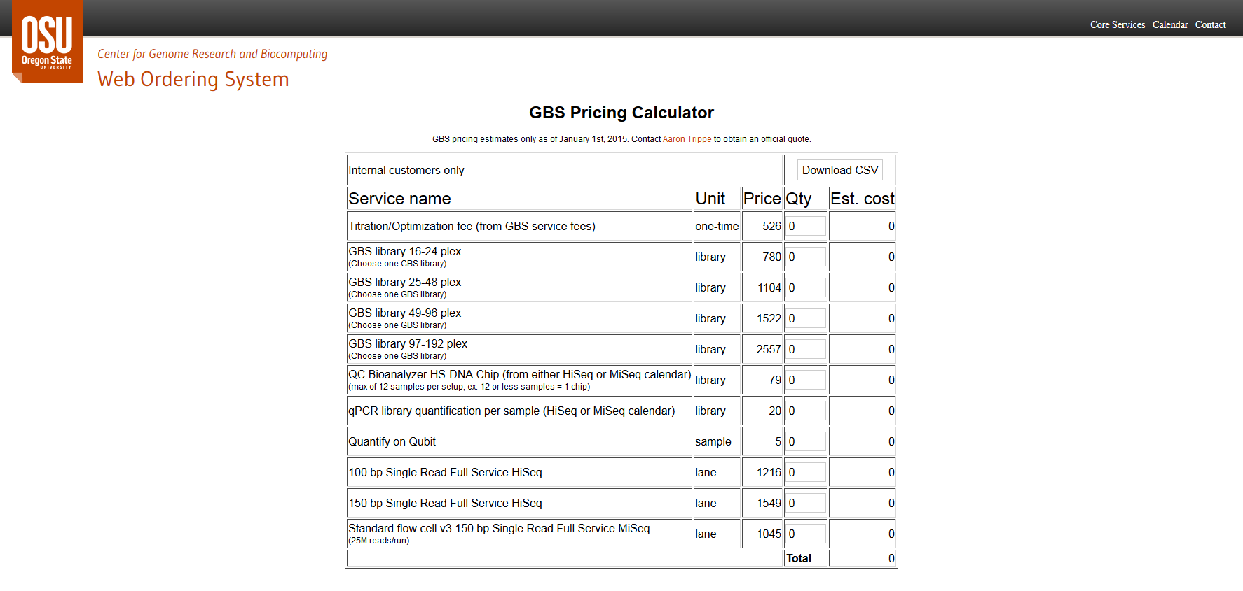
GBS services at the CGRB http://cgrb.oregonstate.edu/core/genotyping-sequencing

